Slide 1
Web Services (SOAP, WSDL, UDDI)
SNU OOPSLA Lab.
October 2005

Slide 2
Contents
Introduction
Web Services
SOAP
WSDL
UDDI
How Web Service Work
Summary
Online Resources

Slide 3
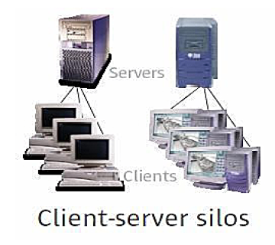
Introduction (1/4)
Distributed Computing Evolution
Client Server Computing
Network protocol and RPC(Remote Procedure Call) were invented
Possible execution across different machine & network

Slide 4
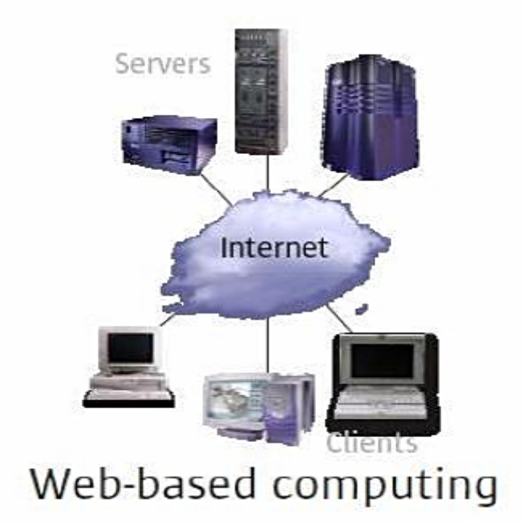
Introduction (2/4)
Distributed Computing Evolution (cont’d)
Web Based Computing
HTTP became standard for sharing data between machines
HTML became standard for data representation
Simplified user-to-program interaction
Did NOT simplify integration of business systems

Slide 5
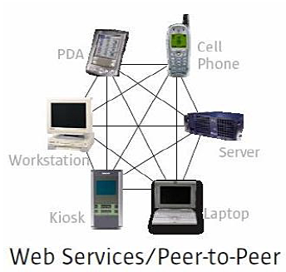
Introduction (3/4)
Distributed Computing Evolution (cont’d)
Web Service Computing
EDI(Electronic Data Interchange) made B2B possible, but were expensive and proprietary
XML was born and quickly became the preferred data representation format
RPC went XML: SOAP
Communication without barrier
: programming language, platform...

Slide 6
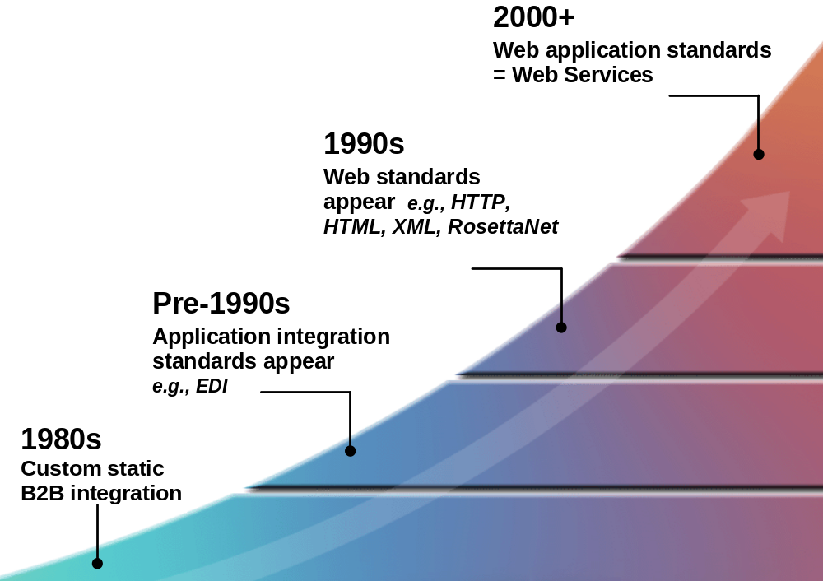
Introduction (4/4)
Evolution of Technology

Slide 7
Web Services (1/2)
What are Web Services?
  Web services perform encapsulated business functions
  Functions can be from simple request-reply to full business process interactions
    stock quotes/stock charting
    credit card verification/payment processing
    integrated travel planning
    RFQ/bid process/auctions
  Can be mixed and matched to create complete process, product
    Enable dynamic integration with decreased human interaction
    Both new & extensions to existing applications

Slide 8
Web Services (2/2)
Web Services Big Picture
The Protocol Stack
  Service Discovery
    UDDI
  Service Description
    WSDL
  XML Messaging
    XML-RPC and SOAP
  Service Transport
    HTTP, SMTP, FTP etc.
Service Discovery
Service Description
XML Messaging
Service Transport

Slide 9
SOAP
SOAP - Simple Object Access Protocol
  Defines a uniform way of passing XML-encoded data
  Message wrapped in an envelope which
  consists of message body and header
  Enables “RPC over the web”
Header
Envelope
Body
SOAP Request Example
<?xml version=“1.0” encoding=“UTF-8”?> <SOAP-ENV:Envelope xmlns:SOAP-ENV=“…” SOAP-ENV:encodingStyle=“…”> <SOAP-ENV:Body> <ns:1getTemperatureRequest xmlns:ns1=“ns”> <zipcode>79098</zipcode> </ns1:getTemperatureRequest> </SOAP-ENV:Body> </SOAP-ENV:Envelope>
SOAP Response Example
<?xml version=“1.0” encoding=“UTF-8”?> <SOAP-ENV:Envelope xmlns:SOAP-ENV=“…” SOAP-ENV:encodingStyle=“…”> <SOAP-ENV:Body> <ns:1getTemperatureRequest xmlns:ns1=“ns”> <zipcode>40.2</zipcode> </ns1:getTemperatureRequest> </SOAP-ENV:Body> </SOAP-ENV:Envelope>

Slide 10
WSDL (1/2)
WSDL - Web Services Description Language
  Specifies the location of the service and the operations (or methods) the service exposes
  Acts as an “instruction manual” guide for interested clients
  Contains information the clients need to use the service:
    The address of machine where the service resides
    The name of the service
    The name of the methods
    The name and types of the service’s arguments

Slide 11
WSDL (2/2)
WSDL Example
<?xml version=“1.0” encoding=“UTF-8”?> <definitions name=“DemoTemperatureService” targetNamespace=“…” xmlns:tns=“…”> <message name=“getTemperatureRequest”> <part name=“zipcode” type=“xsd:string”/> </message> <message name=“getTemperatureResponse”> <part name=“temperature” type=“xsd:float”/> </message> <portType name=“DemoTemperatureServicePortType”> <operation name=“getTemperature”> <input message=“tns:getTemperatureRequest” name=“getTemperatureRequest” /> <output message=“tns:getTemperatureResponse” name=“getTemperatureResponse” /> </operation> </portType> <binding name=“DemoTemperatureServiceBinding” type=“tns:DemoTemperatureServicePortType”> … </binding> <service name=“DemoTemperatureService”> … </service> </definitions>

Slide 12
UDDI (1/2)
UDDI - Universal Description, Discovery and Integration
  Provides a mechanism for clients to dynamically find Web Services
  Using businesses and services classification according to some taxonomies
  Basically, just a phone book
  Services can be found by searching or by unique id
  Servers provide both a browser and a SOAP based web service interface for publishing and finding services
  Registry data
    White pages: general information
    Yellow pages: serviced categorizations
    Green pages: technical information

Slide 13
UDDI (2/2)
SOAP and XML Schema are the basis
UDDI Registry
Node
UDDI
SOAP Request
HTTP
Server
SOAP
Processor
UDDI
SOAP Response
UDDI
Registry Service
Create, View, Update,
and Delete registrations
B2B Directory

Slide 14
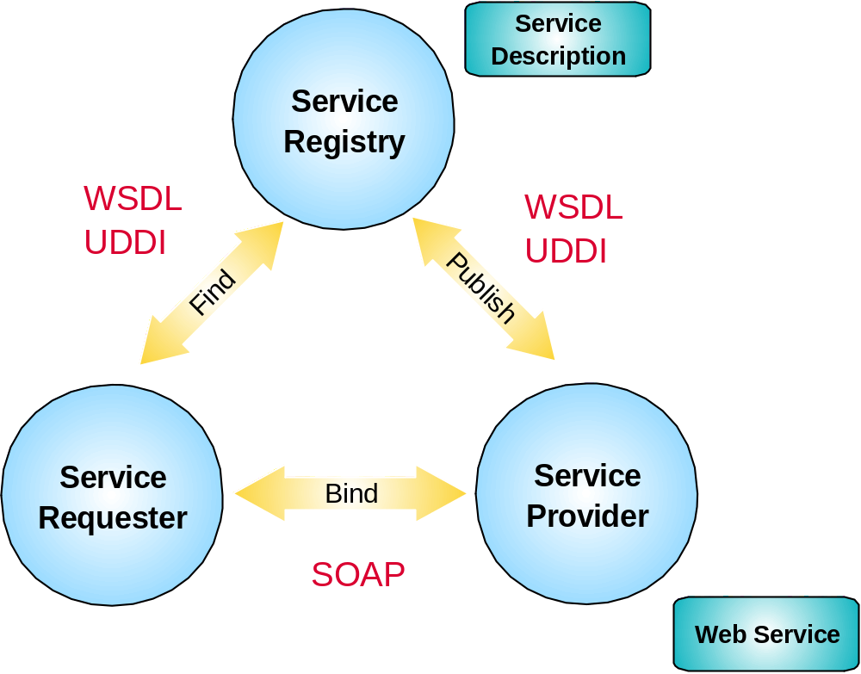
How Web Service Work (1/7)
Web Service Architecture

Slide 15
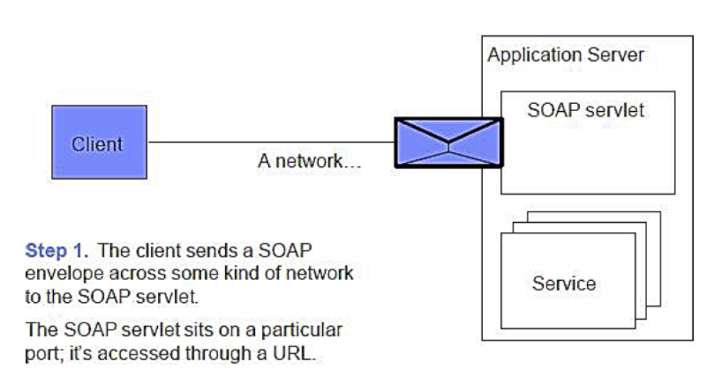
How Web Service Work (2/7)

Slide 16
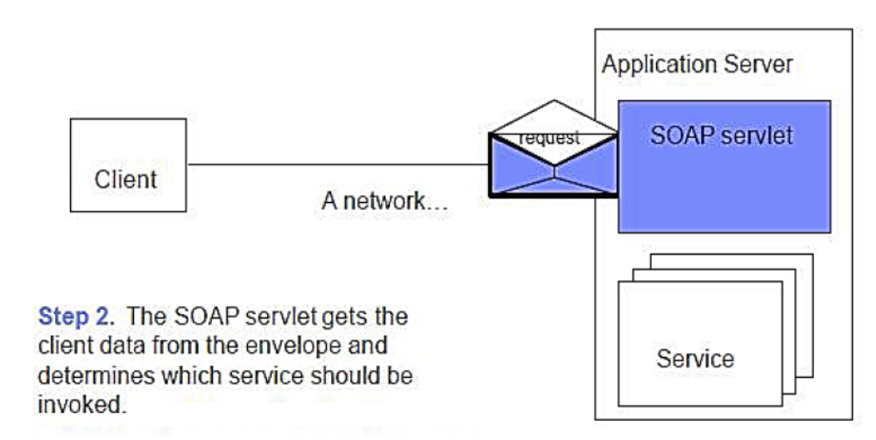
How Web Service Work (3/7)

Slide 17
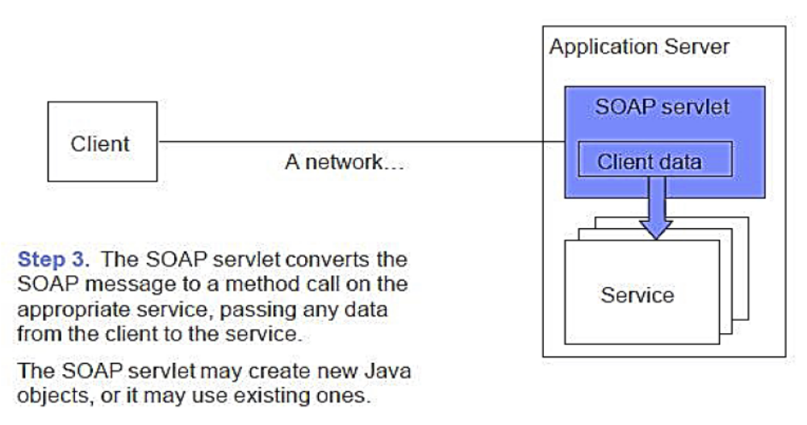
How Web Service Work (4/7)

Slide 18
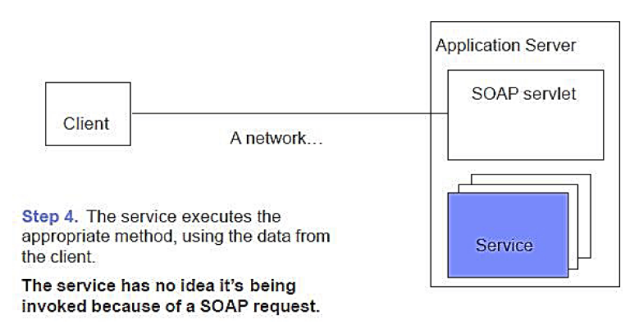
How Web Service Work (5/7)

Slide 19
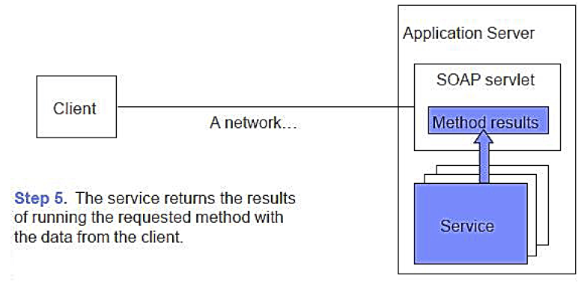
How Web Service Work (6/7)

Slide 20
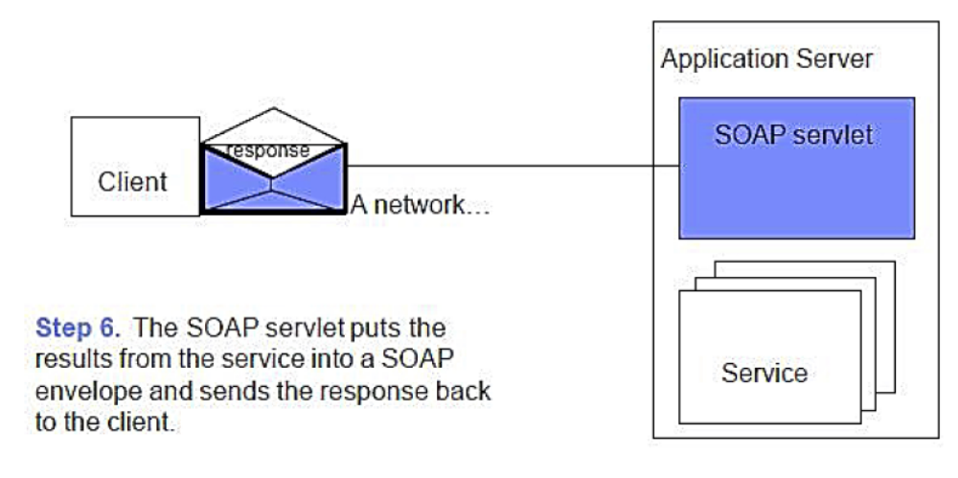
How Web Service Work (7/7)

Slide 21
Benefits (1/2)
For Developers
  Platform, programming language, location, device independence
  Interact between services on any platform, written in any language
  Avoid reinventing the wheel: Ready-to-use components as Web Services
  Accessed over the internet
  Loosely coupled
  No modification of service code necessary

Slide 22
Benefits (2/2)
For Business
  Based on industry standards
  Enables just-in-time integration
  Enables interoperability of legacy application
  Software delivered and paid as fluid streams of services
  More choices due to availability of similar services

Slide 23
Summary
Web Services is a technology that allows applications to communicate with each other in a platform- and programming language-independent manner
SOAP - Simple Object Access Protocol
  Standard for transporting XML based messages
WSDL - Web Services Description Language
  Standard for defining Web Services
UDDI - Universal Description, Discovery and Integration
  Standard for publishing Web Services
SOAP+WSDL+UDDI is useful for an application or data integration strategy

Slide 24
Online Resources
W3C Web Services
http://www.w3.org/2002/ws/
Semantic Web Services
http://www.informatik.uni-freiburg.de/~dbis/lehre/seminar-ws0304/slides/SWSTalk.pdf
Web Services: The Next Horizon for e-business
http://www.idealliance.org/papers/xml2001papers/slides/Gottschalk/XMLConf.ppt
Web Services using UDDI & WSDL
http://sern.ucalgary.ca/courses/CPSC/547/W2002/slides/uddi-wsdl.ppt
Unraveling the web services web: an introduction to SOAP, WSDL, and UDDI
http://www.cc.gatech.edu/classes/AY2003/cs6210_fall/papers/00991449.pdf

