Slide 1
Chapter 14: Query Optimization

Slide 2
Database System Concepts
Chapter 1: Introduction
Part 1: Relational databases
  Chapter 2: Relational Model
  Chapter 3: SQL
  Chapter 4: Advanced SQL
  Chapter 5: Other Relational Languages
Part 2: Database Design
  Chapter 6: Database Design and the E-R Model
  Chapter 7: Relational Database Design
  Chapter 8: Application Design and Development
Part 3: Object-based databases and XML
  Chapter 9: Object-Based Databases
  Chapter 10: XML
Part 4: Data storage and querying
  Chapter 11: Storage and File Structure
  Chapter 12: Indexing and Hashing
  Chapter 13: Query Processing
  Chapter 14: Query Optimization
Part 5: Transaction management
  Chapter 15: Transactions
  Chapter 16: Concurrency control
  Chapter 17: Recovery System
Part 6: Data Mining and Information Retrieval
  Chapter 18: Data Analysis and Mining
  Chapter 19: Information Retreival
Part 7: Database system architecture
  Chapter 20: Database-System Architecture
  Chapter 21: Parallel Databases
  Chapter 22: Distributed Databases
Part 8: Other topics
  Chapter 23: Advanced Application Development
  Chapter 24: Advanced Data Types and New Applications
  Chapter 25: Advanced Transaction Processing
Part 9: Case studies
  Chapter 26: PostgreSQL
  Chapter 27: Oracle
  Chapter 28: IBM DB2
  Chapter 29: Microsoft SQL Server
Online Appendices
  Appendix A: Network Model
  Appendix B: Hierarchical Model
  Appendix C: Advanced Relational Database Model

Slide 3
Part 4: Data storage and querying
(Chapters 11 through 14).
Chapter 11: Storage and File Structure
  deals with disk, file, and file-system structure.
Chapter 12: Indexing and Hashing
  A variety of data-access techniques are presented including hashing and B+ tree indices.
Chapters 13: Query Processing and Chapter 14: Query Optimization
  address query-evaluation algorithms, and query optimization techniques. These chapters provide an understa1nding of the internals of the storage and retrieval components of a database which are necessary for query processing and optimization

Slide 4
Chapter 14: Query Optimization
G
14.1 Introduction
14.2 Transformation of Relational Expressions
  Equivalence rules
  Enumeration of equivalent expressions
14.3 Estimating Statistics of Expression Results
  Statistical information for cost estimation
  Catalog Information for cost estimation
14.4 Choice of Evaluation Plans
  Cost-based optimization
  Heuristic optimization
  Structure of query optimizer
  Optimizing nested subqueries
14.5 Materialized views and view maintenance
14.6 Summary

Slide 5
Introduction
G
Alternative ways of evaluating a given query
  Equivalent expressions
  Different algorithms for each operation (Chapter 13)
Cost difference between a good and a bad way of evaluating a query can be enormous
  Example: performing a r X s followed by a selection r.A = s.B is much slower than performing a join on the same condition
Need to estimate the cost of operations (the number of Disk IOs)
  Depends critically on statistical information about relations which the database must maintain
    E.g. number of tuples, number of distinct values for join attributes, etc.
  Need to estimate statistics for intermediate results to compute cost of complex expressions

Slide 6
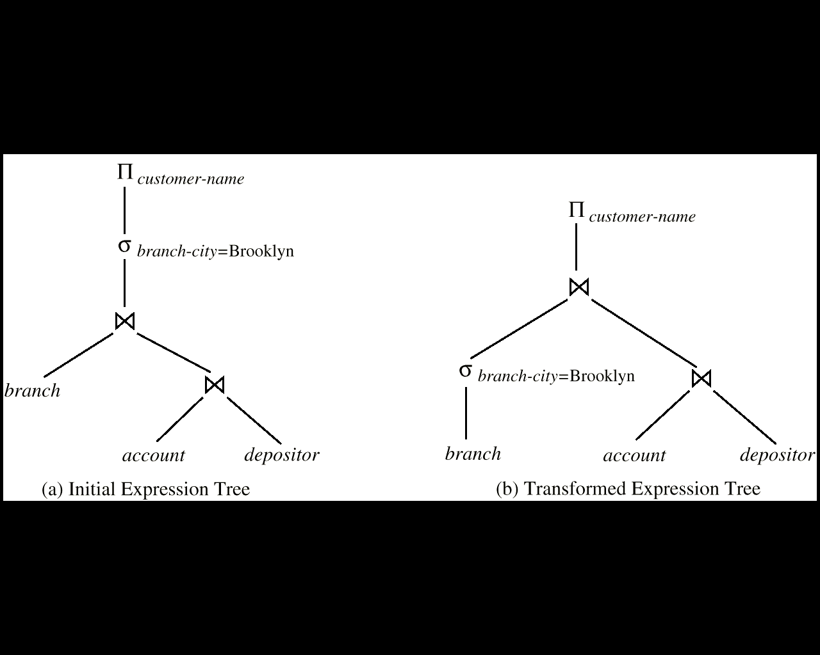
Introduction (Cont.)
G
Relations generated by two equivalent expressions have the same set of attributes and contain the same set of tuples, although their attributes may be ordered differently.

Slide 7
Introduction (Cont.)
G
Generation of query-evaluation plans for an query expression involves several steps:
  Generate logically equivalent expressions
    Use equivalence rules to transform an expression into an equivalent one.
  Annotate resultant expressions to get alternative query plans
  Choose the cheapest plan based on estimated cost
The overall process is called cost based optimization

Slide 8
Chapter 14: Query Optimization
G
14.1 Introduction
14.2 Transformation of Relational Expressions
  Equivalence rules
  Enumeration of equivalent expressions
14.3 Estimating Statistics of Expression Results
  Statistical information for cost estimation
  Catalog Information for cost estimation
14.4 Choice of Evaluation Plans
  Cost-based optimization
  Heuristic optimization
  Structure of query optimizer
  Optimizing nested subqueries
14.5 Materialized views and view maintenance
14.6 Summary

Slide 9
Transformation of Relational Expressions
Two relational algebra expressions are said to be equivalent if on every legal database instance the two expressions generate the same set of tuples
  Note: the order of tuples is irrelevant
In SQL, inputs and outputs are multisets of tuples
  Two expressions in the multiset version of the relational algebra given a SQL query are said to be equivalent if on every legal database instance the two expressions generate the same multiset of tuples
An equivalence rule says that expressions of two forms are equivalent
  Can replace expression of first form by second, or vice versa

Slide 10



Equivalence Rules
1. Conjunctive selection operations can be deconstructed into a sequence of individual selections.
2. Selection operations are commutative.
3. Only the last in a sequence of projection operations is needed, the others can be omitted.
4. Selections can be combined with Cartesian products and theta joins.
  σ_{θ}(E₁ X E₂) = E₁ _{θ} E₂
  σ_{θ1}(E₁ _{θ2} E₂) = E₁ _{θ1∧ θ2} E₂

Slide 11
Equivalence Rules (Cont.)
5. Theta-join operations (and natural joins) are commutative.
E_{1 θ} E₂ = E₂ _{θ} E₁
6. (a) Natural join operations are associative:
(E₁ E₂) E₃ = E₁ (E₂ E₃)
(b) Theta joins are associative in the following manner:
(E_{1 θ1} E₂) _{θ2∧ θ3} E₃ = E_{1 θ1∧ θ3} (E₂ _{θ2} E₃)
where θ₂ involves attributes from only E₂ and E₃.
7. The selection operation distributes over the theta join operation under the following two conditions:
(a) When all the attributes in θ₀ involve only the attributes of one of the expressions (E₁) being joined.
σ_{θ0}(E₁ _{θ} E₂) = (σ_{θ0}(E₁)) _{θ} E₂
(b) When θ ₁ involves only the attributes of E₁ and θ₂ involves only the attributes of E₂.
σ_{θ1}∧_{θ2} (E₁ _{θ} E₂) = (σ_{θ1}(E₁)) _{θ} (σ_{θ2} (E₂))

Slide 12
Equivalence Rule 7-a (1)
보조자료
θ₀의 모든 속성들이 조인되는 expression(E₁) 의 한 쪽의 속성들로만 이루어져 있을 때
  1) σ_{θ0}(E1 _{θ} E2)
branch-city | branch-name | assets | loan-number | amount
Brighton | Perryridge | 7100000 | L-15 | 1500
Brighton | Perryridge | 7100000 | L-16 | 1300
σ_{assets > 2000000}
branch-city | branch-name | assets | loan-number | amount
Bennington | Pownal | 300000 | L-23 | 2000
Horseneck | Mianus | 400000 | L-11 | 900
Brighton | Perryridge | 7100000 | L-15 | 1500
Brighton | Perryridge | 7100000 | L-16 | 1300
branch
loan
branch-name | branch-city | assets
Brighton | Perryridge | 7100000
Downtown | Brooklyn | 9000000
Mianus | Horseneck | 400000
North Town | Rye | 3700000
Perryridge | Horseneck | 1700000
Pownal | Bennington | 300000
Redwood | Palo Alto | 2100000
Round Hill | Horseneck | 8000000
loan-number | branch-name | amount
L-11 | Horseneck | 900
L-14 | Downtown | 1500
L-15 | Perryridge | 1500
L-16 | Perryridge | 1300
L-17 | Downtown | 1000
L-23 | Pownal | 2000
L-93 | Mianus | 500

Slide 13
Equivalence Rule 7-a (2)
보조자료
2) (σ_{θ0}(E₁)) _{θ} E₂
branch-city | branch-name | assets | loan-number | amount
Brighton | Perryridge | 7100000 | L-15 | 1500
Brighton | Perryridge | 7100000 | L-16 | 1300
Result
branch-name | branch-city | assets
Brighton | Perryridge | 7100000
Downtown | Brooklyn | 9000000
North Town | Rye | 3700000
Redwood | Palo Alto | 2100000
Round Hill | Horseneck | 8000000
loan
loan-number | branch-name | amount
L-11 | Horseneck | 900
L-14 | Downtown | 1500
L-15 | Perryridge | 1500
L-16 | Perryridge | 1300
L-17 | Downtown | 1000
L-23 | Pownal | 2000
L-93 | Mianus | 500
σ_{assets > 2000000}
branch
branch-name | branch-city | assets
Brighton | Perryridge | 7100000
Downtown | Brooklyn | 9000000
Mianus | Horseneck | 400000
North Town | Rye | 3700000
Perryridge | Horseneck | 1700000
Pownal | Bennington | 300000
Redwood | Palo Alto | 2100000
Round Hill | Horseneck | 8000000
So, σ_{θ0}(E1 _{θ} E2) = (σ_{θ0}(E1)) _{θ} E2

Slide 14
Equivalence Rule 7-b (1)
보조자료
θ ₁이 E₁ 의 속성들에만 관여되고, θ₂가 E₂의 속성들에만 관여될 때
1) σ_{θ1}∧_{θ2} (E₁ _{θ} E₂)
branch-city | branch-name | assets | loan-number | amount
Brighton | Perryridge | 7100000 | L-15 | 1500
σassets > 2000000 and amount > 1300
branch-city | branch-name | assets | loan-number | amount
Bennington | Pownal | 300000 | L-23 | 2000
Horseneck | Mianus | 400000 | L-11 | 900
Brighton | Perryridge | 7100000 | L-15 | 1500
Brighton | Perryridge | 7100000 | L-16 | 1300
branch
loan
branch-name | branch-city | assets
Brighton | Perryridge | 7100000
Downtown | Brooklyn | 9000000
Mianus | Horseneck | 400000
North Town | Rye | 3700000
Perryridge | Horseneck | 1700000
Pownal | Bennington | 300000
Redwood | Palo Alto | 2100000
Round Hill | Horseneck | 8000000
loan-number | branch-name | amount
L-11 | Horseneck | 900
L-14 | Downtown | 1500
L-15 | Perryridge | 1500
L-16 | Perryridge | 1300
L-17 | Downtown | 1000
L-23 | Pownal | 2000
L-93 | Mianus | 500

Slide 15
Equivalence Rule 7-b (2)
보조자료
2) (σ_{θ1}(E₁)) _{θ} (σ_{θ2} (E₂))
branch-city | branch-name | assets | loan-number | amount
Brighton | Perryridge | 7100000 | L-15 | 1500
Result
branch-name | branch-city | assets
Brighton | Perryridge | 7100000
Downtown | Brooklyn | 9000000
North Town | Rye | 3700000
Redwood | Palo Alto | 2100000
Round Hill | Horseneck | 8000000
loan-number Horseneck | branch-name | amount
L-14 | Downtown | 1500
L-15 | Perryridge | 1500
L-23 | Pownal | 2000
σ_{assets > 2000000}
σ_{amount > 1500}
branch
loan
branch-name | branch-city | assets
Brighton | Perryridge | 7100000
Downtown | Brooklyn | 9000000
Mianus | Horseneck | 400000
North Town | Rye | 3700000
Perryridge | Horseneck | 1700000
Pownal | Bennington | 300000
Redwood | Palo Alto | 2100000
Round Hill | Horseneck | 8000000
loan-number | branch-name | amount
L-11 | Horseneck | 900
L-14 | Downtown | 1500
L-15 | Perryridge | 1500
L-16 | Perryridge | 1300
L-17 | Downtown | 1000
L-23 | Pownal | 2000
L-93 | Mianus | 500
So, σ_{θ1∧θ2} (E1 _{θ} E2) = (σ_{θ1}(E1)) _{θ} (σ_{θ2} (E2))

Slide 16
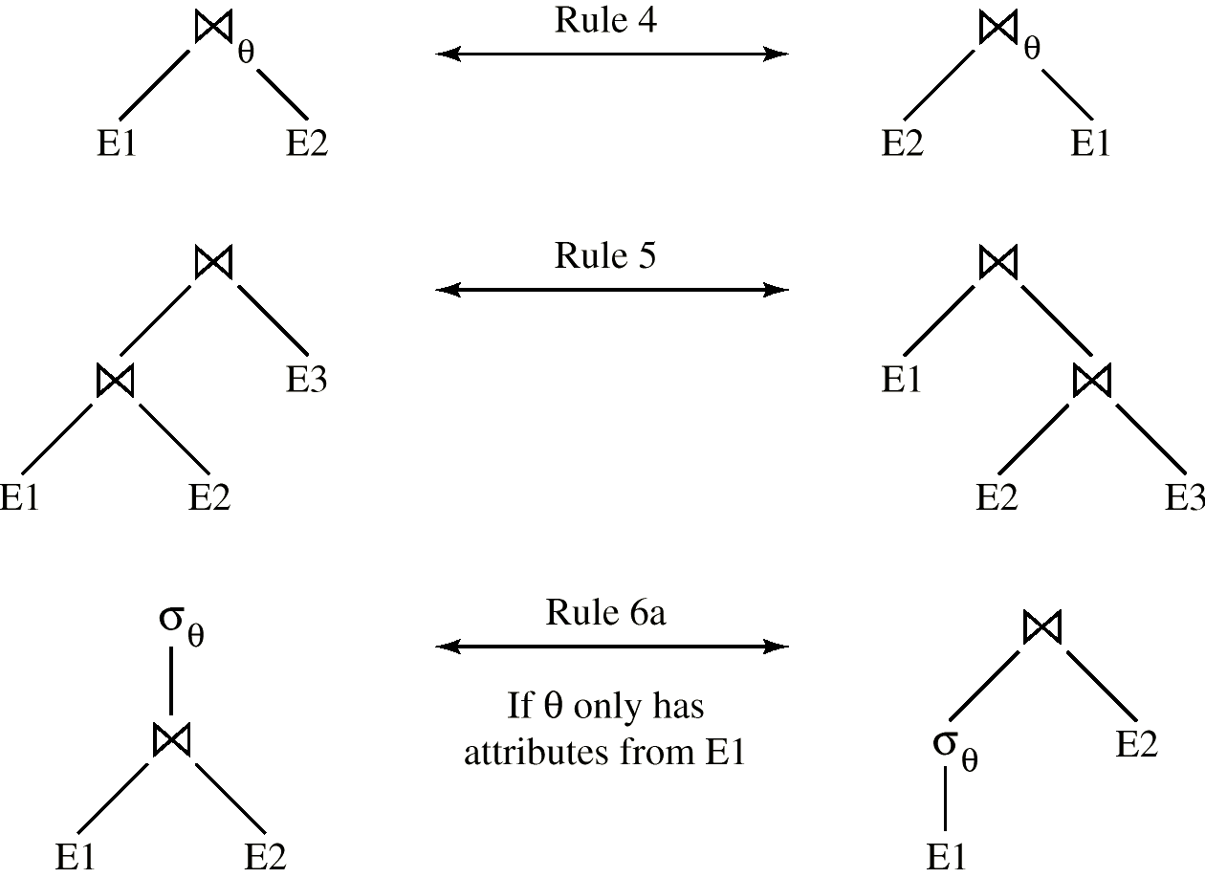
Pictorial Depiction of Equivalence Rules
5
6.a
7.a

Slide 17
Equivalence Rules (Cont.)
8. The projection operation distributes over the theta join operation as follows:
(a) if  involves only attributes from L₁ ∪ L₂:
(b) Consider a join E_{1 θ} E₂.
  Let L₁ and L₂ be sets of attributes from E₁ and E₂, respectively.
  Let L₃ be attributes of E₁ that are involved in join condition θ, but are not in L₁ ∪ L₂, and
  let L₄ be attributes of E₂ that are involved in join condition θ, but are not in L₁ ∪ L₂.

Slide 18




The Equivalence Rule 8-a
보조자료
E1 = loan, E2 = branch
L1 = {loan-number, branch-name}, L2 = {branch-name, assets}
= branch.assets > 75000
In this condition, join condition involves only attributes in

Slide 19


Equivalence Rule 8-a: left-hand side
보조자료
loan-number | branch-name | amount | branch-city | assets
L-11 | Round-Hill | 900 | Horse-neck | 8000000
L-14 | Downtown | 1500 | Brook-lyn | 9000000
L-17 | Downtown | 1000 | Brook-lyn | 9000000
loan-number | branch-name | assets
L-11 | Round-Hill | 8000000
L-14 | Downtown | 9000000
L-17 | Downtown | 9000000

Slide 20
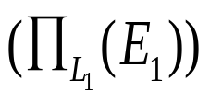


Equivalence Rule 8-a: right-hand side
보조자료
loan-number | branch-name | assets
L-11 | Round-Hill | 8000000
L-14 | Downtown | 9000000
L-17 | Downtown | 9000000

Slide 21
Equivalence Rule 8-b:
보조자료
E1 = loan, E2 = branch
L1 = {branch-name}, L2 = {branch-name}
= loan.amount > 950 and branch.branch-city = ‘Brooklyn’
L3 = {amount}, L4 = {branch-city}

Slide 22
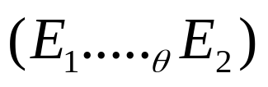
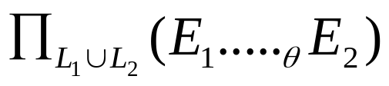
Equivalence Rule 8-b: left-hand side
보조자료
loan-number | branch-name | amount | branch-city | assets
L-14 | Downtown | 1500 | Brook-lyn | 9000000
L-17 | Downtown | 1000 | Brook-lyn | 9000000
branch-name
Downtown

Slide 23




Equivalence Rule 8-b: right-hand side
보조자료
branch-name | amount | branch-city
Downtown | 1500 | Brook-lyn
Downtown | 1000 | Brook-lyn
branch-name
Downtown

Slide 24
Equivalence Rules (Cont.)
9. The set operations union and intersection are commutative
E₁ ∪ E₂ = E₂ ∪ E₁
E₁ ∩ E₂ = E₂ ∩ E₁
  (set difference is not commutative).
10. Set union and intersection are associative.
(E₁ ∪ E₂) ∪ E₃ = E₁ ∪ (E₂ ∪ E₃)
(E₁ ∩ E₂) ∩ E₃ = E₁ ∩ (E₂ ∩ E₃)
11. The selection operation distributes over ∪, ∩ and –.
σ_{θ} (E₁ – E₂) = σ_{θ} (E₁) – σ_{θ}(E₂) and similarly for ∪ and ∩ in place of –
Also: σ_{θ} (E₁ – E₂) = σ_{θ}(E₁) – E₂ and similarly for ∩ in place of –, but not for ∪
12. The projection operation distributes over union
Π_{L}(E₁ ∪ E₂) = (Π_{L}(E₁)) ∪ (Π_{L}(E₂))

Slide 25
Transformation Example
Query: Find the names of all customers who have an account at some branch located in Brooklyn.
Π_{customer-name} ( σ_{branch-city = “Brooklyn”} (branch (account depositor)))
Transformation using rule 7a.
Π_{customer-name} ( ( σ_{branch-city =“Brooklyn”} (branch)) (account depositor))
Performing the selection as early as possible reduces the size of the relation to be joined.

Slide 26
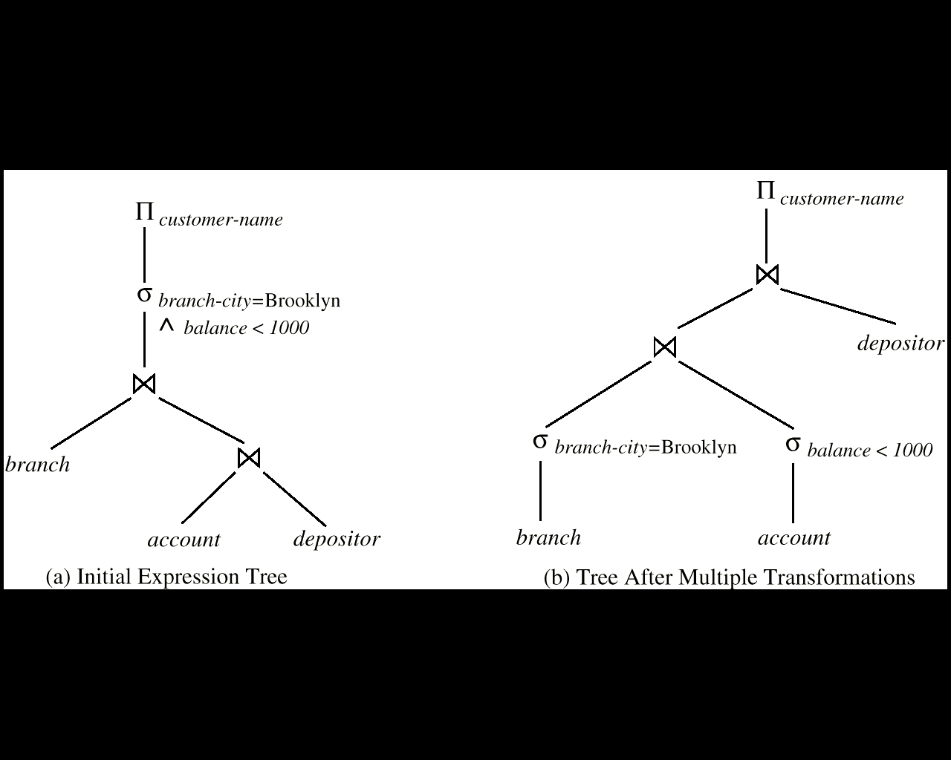
Example with Multiple Transformations
Query: Find the names of all customers with an account at a Brooklyn branch whose account balance is over $1000.
Π_{customer-name(}(σbranch-city = “Brooklyn” ∧ balance > 1000 (branch (account depositor)))
Transformation using join associatively (Rule 6a):
Π_{customer-name}((σbranch-city = “Brooklyn” ∧ balance > 1000 (branch (account)) depositor)
Second form provides an opportunity to apply the “perform selections early” rule, resulting in the subexpression
σ_{branch-city = “Brooklyn”} (branch) σ _{balance > 1000} (account)

Slide 27
Push-down Projection Example
Ex. Π_{customer-name}((σ_{branch-city = “Brooklyn”} (branch) account) depositor)
When we compute
(σ_{branch-city = “Brooklyn”} (branch) account )
we obtain a relation whose schema is:
(branch-name, branch-city, assets, account-number, balance)
Push projections using equivalence rules 8a and 8b & Eliminate unneeded attributes from intermediate results to get:
Π _{customer-name} ((
Π _{account-number} ( (σ_{branch-city = “Brooklyn”} (branch) ) account ) ) depositor)

Slide 28
Join Ordering Example
For all relations r_{1,} r_{2,} and r₃, (r₁ r₂) r₃ = r₁ (r₂ r₃ )
  If r₂ r₃ is quite large and r₁ r₂ is small, we choose (r₁ r₂) r₃
  so that we compute and store a smaller temporary relation.
Consider the expression
Π_{customer-name} ( ( σ_{branch-city = “Brooklyn”} (branch) ) account depositor)
Could compute account depositor first, and then join the result with
σ_{branch-city = “Brooklyn”} (branch)
but account depositor is likely to be a large relation.
Since it is more likely that only a small fraction of the bank’s customers have accounts in branches located in Brooklyn, it is better to first compute
σ_{branch-city = “Brooklyn”} (branch) account

Slide 29
Enumeration of Equivalent Expressions
Query optimizers use equivalence rules to systematically generate expressions equivalent to the given expression
Conceptually, generate all equivalent expressions by repeatedly executing the following step until no more expressions can be found:
  for each expression found so far, use all applicable equivalence rules, and add newly generated expressions to the set of expressions found so far
The above approach is very expensive in space and time
Space requirements reduced by sharing common subexpressions:
  when E1 is generated from E2 by an equivalence rule, usually only the top level of the two are different, subtrees below are the same and can be shared
    E.g. when applying join associativity
Time requirements are reduced by not generating all expressions
  More details shortly

Slide 30
Chapter 14: Query Optimization
G
14.1 Introduction
14.2 Transformation of Relational Expressions
  Equivalence rules
  Enumeration of equivalent expressions
14.3 Estimating Statistics of Expression Results
  Statistical information for cost estimation
  Catalog Information for cost estimation
14.4 Choice of Evaluation Plans
  Cost-based optimization
  Heuristic optimization
  Structure of query optimizer
  Optimizing nested subqueries
14.5 Materialized views and view maintenance
14.6 Summary

Slide 31
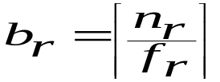
Statistical Information for Cost Estimation
n_{r}: number of tuples in a relation r.
b_{r}: number of blocks containing tuples of r.
s_{r}: size of a tuple of r.
f_{r}: blocking factor of r ( i.e., the number of tuples of r that fit into one block)
If tuples of r are stored together physically in a file, then:
V(A, r): number of distinct values that appear in r for attribute A
  same as the size of ∏_{A}(r).
SC(A, r): selection cardinality of attribute A of relation r
  average number of records that satisfy equality on A.
f_{i}: average fan-out of internal nodes of index i, for B+-trees.
HT_{i}: number of levels in index i ( i.e., the height of i & on attribute A of relation r)
  For a B+-tree HT_{i} = ⎡log_{fi}(V(A,r))⎤
  For a hash index, HT_{i} = 1
LB_{i}: number of lowest-level index blocks in i (i.e, the # of blocks at the leaf level)

Slide 32
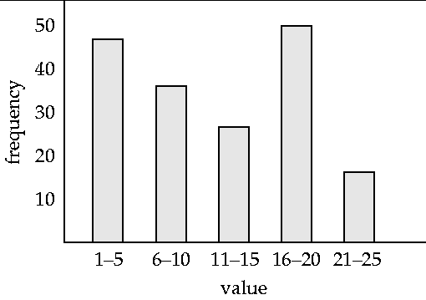
Histograms
Histogram on attribute age of relation person
Equi-width histograms
Equi-depth histograms

Slide 33
Measures of Query Cost
Typically disk access is the predominant cost and is relatively easy to estimate.
So, the number of block transfers from disk is used as a measure of the actual cost of evaluation.
  It is assumed that all transfers of blocks have the same cost.
  Real life optimizers do not make this assumption, and distinguish between sequential and random disk access
We do not include cost to writing output to disk.
We refer to the cost estimate of algorithm A as E_{A}
  The number of disk IOs in performing A algorithm for expression E

Slide 34
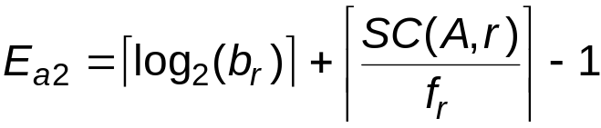
Selection Size Estimation
Equality selection σ_{A=v}(r)
  SC(A, r) : number of records that will satisfy the selection
  ⎡SC(A, r) / f_{r} ⎤ : number of blocks that these records will occupy
  E.g. Binary search (a2 algorithm) cost estimate becomes
  Equality condition on a key attribute: SC(A,r) = 1

Slide 35
Statistical Information for Examples
Relation schema: account (acct-no, branch-name, balance)
f_{account}= 20 (20 tuples of account fit in one block)
V(branch-name, account) = 50 (50 branches)
V(balance, account) = 500 (500 different balance values)
π_{account} = 10000 (account has 10,000 tuples)
Assume the following indices exist on account relation:
  A primary B⁺-tree index for attribute branch-name
  A secondary B⁺-tree index for attribute balance

Slide 36
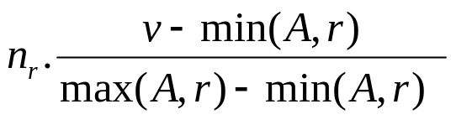
Selections Involving Comparisons
Selections of the form σ_{A≤V}(r) (case of σ_{A ≥ V}(r) is symmetric)
Let c denote the estimated number of tuples satisfying the condition.
  If min(A,r) and max(A,r) are available in catalog
    C = 0 if v < min(A,r)
    C =
  In absence of statistical information c is generally assumed to be n_{r} / 2.

Slide 37
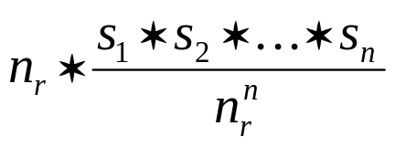
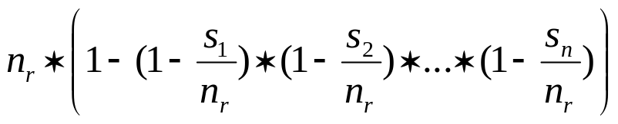
Implementation of Complex Selections
The selectivity of a condition θ_{i} is the probability that a tuple in the relation r satisfies θ_{i} .
If s_{i} is the number of satisfying tuples in r, the selectivity of θ_{i} is given by s_{i} /n_{r}.
Conjunction: σ_{θ1∧ θ2∧. . . ∧ θn} (r).
The estimated number of tuples is:
Disjunction: σ_{θ1∨} _{θ2 ∨. . . ∨} _{θn} (r).
The estimated number of tuples is:
Negation: σ_{¬θ}(r).
The estimated number of tuples is: n_{r} – size(σ_{θ}(r))

Slide 38
Join Operation: Running Example
Running example: depositor customer
depositor (customer-name, account-number)
customer (customer-name, customer-street, customer-city)
Catalog information for join examples:
n_{customer} = 10,000 (10,000 customer records)
f_{customer} = 25, which implies that b_{customer} = 10000/25 = 400.
n_{depositor} = 5000 (5000 depositor records)
f_{depositor} = 50, which implies that b_{depositor} = 5000/50 = 100.
V(customer-name, depositor) = 2500, which implies that, on average, each customer has two accounts.
Also assume that customer-name in depositor is a foreign key on customer.

Slide 39
Estimation of the Size of Joins
The Cartesian product r x s contains n_{r} * n_{s} tuples in the result; each tuple occupies s_{r} + s_{s} bytes.
If R ∩ S = ∅, then r s is the same as r x s.
If R ∩ S is a key for R, then a tuple of s will join with at most one tuple from r
  therefore, the number of tuples in r s is no greater than the number of tuples in s.
If R ∩ S in S is a foreign key in S referencing R, then the number of tuples in r s is exactly the same as the number of tuples in s.
    The case for R ∩ S being a foreign key referencing S is symmetric.
In the example query depositor customer , customer-name in depositor is a foreign key of customer
  hence, the result has exactly n_{depositor} tuples, which is 5000

Slide 40


Estimation of the Size of Joins (Cont.)
If R ∩ S = {A} is not a key for R or S
If we assume that every tuple t in R produces tuples in R S, the number of
tuples in R S is estimated to be:
If the reverse is true, the estimate obtained will be:
The lower of these two estimates is probably the more accurate one.
Let us compute the size estimates for depositor customer without using information about foreign keys:
  V(customer-name, depositor) = 2500, and
  V(customer-name, customer) = 10000
  The two estimates are 5000 * 10000 / 2500 = 20,000 and 5000 * 10000 / 10000 = 5000
  We choose the lower estimate, which in this case, is the same as our earlier computation using foreign keys.

Slide 41
Size Estimation for Other Operations
Projection: estimated size of ∏_{A}(r) = V(A,r)
Aggregation : estimated size of _{A}g_{F}(r) = V(A,r)
Set operations
  For unions/intersections of selections on the same relation: rewrite and use size estimate for selections
    E.g. σ_{θ1} (r) ∪ σ_{θ2} (r) can be rewritten as σ_{θ1} σ_{θ2} (r)
  For operations on different relations:
    estimated size of r ∪ s = size of r + size of s.
    estimated size of r ∩ s = minimum size of r and size of s.
    estimated size of r – s = r.
    All the three estimates may be quite inaccurate, but provide upper bounds on the sizes.
Outer join:
  Estimated size of r s = size of r s + size of r
    Case of right outer join is symmetric
  Estimated size of r s = size of r s + size of r + size of s

Slide 42
** Review **
Catalog Information: derived from given relations
  Nr, Br, Lr, Fr, V(A, r)
Size estimation (various cases)
  Selection
  Join
  Projection, Aggregation, Set operations
Number of distinct values of the intermediate results
  After selection
  After join
  After projection, aggregation, set operations

Slide 43
Estimation of Number of Distinct Values
Selections: σ_{θ} (r)
If θ forces A to take a specified value: V(A,σ_{θ} (r)) = 1.
    e.g., A = 3
If θ forces A to take on one of a specified set of values:
V(A,σ_{θ} (r)) = number of specified values.
    (e.g., (A = 1 V A = 3 V A = 4 )),
If the selection condition θ is of the form “A op r”
estimated V(A,σ_{θ} (r)) = V(A.r) * s
    where s is the selectivity of the selection.
In all the other cases: use approximate estimate of min(V(A,r), n_{σθ (r)} )
  More accurate estimate can be got using probability theory, but this one works fine generally

Slide 44
Estimation of Distinct Values (Cont.)
Joins: r s
If all attributes in A are from r, then
estimated V(A, r s) = min ( V(A,r), n _{r s} )
If A contains attributes A1 from r and A2 from s, then
estimated V(A, r s) = min( V(A1,r) * V(A2 – A1,s), V(A1 – A2,r) * V(A2,s), n _{r s} )
  More accurate estimate can be got using probability theory, but this one works fine generally
Projection: Estimation of distinct values are straightforward
  They are the same in ∏_{A (r)} as in r.
Aggregation: The same holds for grouping attributes of aggregation.
For aggregated values
  For min(A) and max(A), the number of distinct values can be estimated as min(V(A,r), V(G,r)) where G denotes grouping attributes
  For other aggregates, assume all values are distinct, and use V(G,r)

Slide 45
Estimation of Distinct Values in Join (1)
보조자료
A의 모든 속성이 r에 있을때의 estimated V(A, r s) = min (V(A,r), n _{r s})
Example A = (B)
s (case 1)
s (case 2)
r
C | D
C1 | D1
C2 | D1
C3 | D2
C4 | D3
C5 | D4
C | D
C1 | D1
C5 | D2
C12 | D3
C5 | D4
C6 | D5
K | B | C
A1 | B1 | C1
A1 | B2 | C2
A2 | B3 | C1
A2 | B1 | C1
A3 | B5 | C4
r s (case 1)
∏_{B}(r s) (case 1)
K | B | C | D
A1 | B1 | C1 | D1
A2 | B3 | C1 | D1
A2 | B1 | C1 | D1
A1 | B2 | C2 | D1
B
B1
B3
B2
V(A, r s) = V(A,r)
r s (case 2)
∏_{B}(r s) (case 2)
K | B | C | D
A1 | B1 | C1 | D1
A2 | B3 | C1 | D1
B
B1
B3
V(A, r s) = n _{r s}

Slide 46
Estimation of Distinct Values in Join (2)
보조자료
A의 속성 A1은 r에, A2는 s에 있을때의 estimated V(A, r s) =
  min(V(A1,r) * V(A2 – A1,s), V(A1 – A2,r) * V(A2,s), n_{r s})
Example A = (B, D), 처음 두 개의 경우는 대칭적이므로 처음과 세번째 경우만 고려
r
s (case 1)
s (case 3)
K | B | C
A1 | B1 | C1
A1 | B2 | C2
A2 | B2 | C1
A2 | B1 | C1
A3 | B2 | C4
C | D
C1 | D1
C1 | D1
C2 | D2
C2 | D1
C | D
C2 | D1
C5 | D2
C12 | D3
C5 | D4
C6 | D5
r s (case 1)
∏_{A}(r s) (case 1)
K | B | C | D
A1 | B1 | C1 | D1
…
A2 | B1 | C1 | D1
A1 | B2 | C2 | D1
V(A, r s) =
V(A1,r) * V(A2-A1,s)
(4 = 2 X 2)
(Join의 결과가 큰 경우)
B | D
B1 | D1
B1 | D2
B2 | D1
B2 | D2
r s (case 3)
∏_{A}(r s) (case 3)
K | B | C | D
A1 | B2 | C2 | D1
B | D
B2 | D1
V(A, r s) = n _{r s}
(1 = 1)

Slide 47
Chapter 14: Query Optimization
G
14.1 Introduction
14.2 Transformation of Relational Expressions
  Equivalence rules
  Enumeration of equivalent expressions
14.3 Estimating Statistics of Expression Results
  Statistical information for cost estimation
  Catalog Information for cost estimation
14.4 Choice of Evaluation Plans
  Cost-based optimization
  Heuristic optimization
  Structure of query optimizer
  Optimizing nested subqueries
14.5 Materialized views and view maintenance
14.6 Summary

Slide 48
Choice of Evaluation Plans
Must consider the interaction of evaluation techniques when choosing evaluation plans
Choosing the cheapest algorithm for each operation independently may not yield best overall algorithm.
  merge-join may be costlier than hash-join, but may provide a sorted output which reduces the cost for “later” outer level aggregation.
  nested-loop join may provide opportunity for pipelining
Practical query optimizers incorporate elements of the following two broad approaches:
  1. Search all the plans and choose the best plan in a cost-based fashion
  2. Uses heuristics to choose a plan

Slide 49
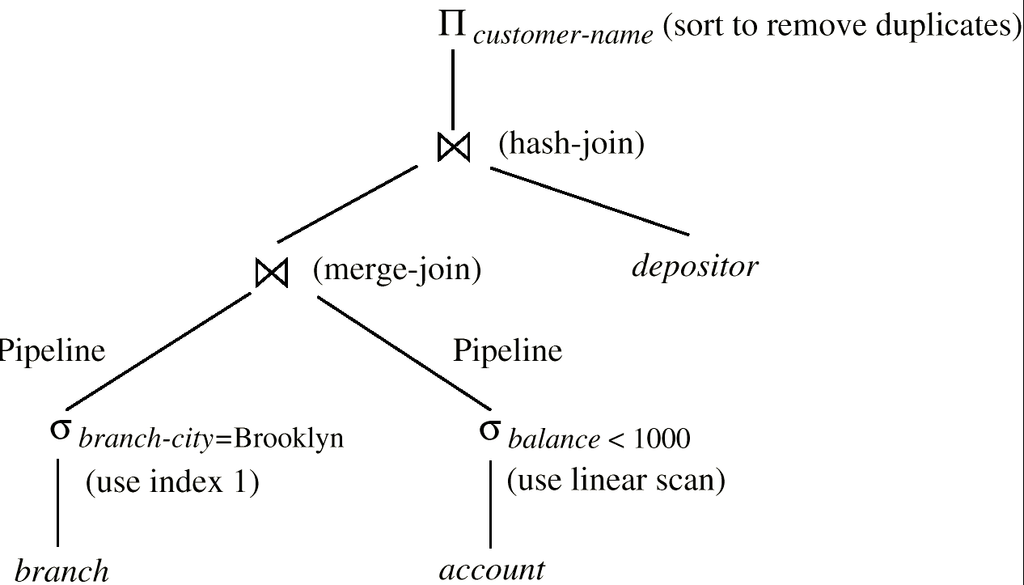
Evaluation Plan (adding annotation)
An evaluation plan defines exactly what algorithm is used for each operation, and how the execution of the operations is coordinated.

Slide 50
Cost-Based Optimization
skip
Consider finding the best join-order for r₁ r₂ . . . r_{n}.
There are (2(n – 1))!/(n – 1)! different join orders for above expression.
  With n = 7, the number is 665280, with n = 10, the number is over 176 billion!
  The number of complete binary trees with n leaf nodes ( n-1 internal nodes)
    1/n X 2(n-1) C (n-1) ➔ (2(n-1))! / ( n! * (n-1)!)
  Multiply this by n! (permutations of n leaves)
No need to generate all the join orders.
Using dynamic programming, the least-cost join order for any subset of
{r₁, r₂, . . . r_{n}} is computed only once and stored for future use.

Slide 51
Dynamic Programming in Optimization
skip
To find best join tree for a set of n relations:
  To find best plan for a set S of n relations, consider all possible plans of the form: S₁ (S – S₁) where S₁ is any non-empty subset of S.
  Recursively compute costs for joining subsets of S to find the cost of each plan. The number of subsets of n relations is 2^{n}.
    nC1 + nC2 + …. nCn = 2^{n}
    Choose the cheapest of the 2^{n} – 1 alternatives.
    Space overhead for storing 2^{n} cost ➔ O(2^{n})
  When plan for any subset is computed, store it and reuse it when it is required again, instead of recomputing it
    Dynamic programming O(3^{n})
    O(3^{n}) by solving the recurrence relation of the next slide

Slide 52
Join Order Optimization Algorithm
skip
procedure findbestplan(S)
if (bestplan[S].cost ≠ ∞)
return bestplan[S]
// else bestplan[S] has not been computed earlier,
compute it now
for each non-empty subset S1 of S such that S1 ≠ S
P1= findbestplan(S1)
P2= findbestplan(S - S1)
A = best algorithm for joining results of P1 and P2
cost = P1.cost + P2.cost + cost of A
if cost < bestplan[S].cost
bestplan[S].cost = cost
bestplan[S].plan = “execute P1.plan; execute P2.plan;
join results of P1 and P2 using A”
return bestplan[S]

Slide 53
Interesting Orders in Cost-Based Optimization
skip
Consider the expression (r₁ r₂ r₃) r₄ r₅
An interesting sort order is a particular sort order of tuples that could be useful for a later operation.
  Generating the result of r₁ r₂ r₃ sorted on the attributes common with r₄ or r₅ may be useful, but generating it sorted on the attributes common only r₁ and r₂ is not useful.
  Using merge-join to compute r₁ r₂ r₃ may be costlier, but may provide an output sorted in an interesting order.
Not sufficient to find the best join order for each subset of the set of n given relations; must find the best join order for each subset, for each interesting sort order
  Simple extension of earlier dynamic programming algorithms O(3^{n}).
  Usually, number of interesting orders is quite small and doesn’t affect time/space complexity significantly

Slide 54
Structure of Query Optimizers**
skip
The System R/Starburst optimizer considers only left-deep join orders.
  This reduces optimization complexity and generates plans amenable to pipelined evaluation.
  System R/Starburst also uses heuristics to push selections and projections down the query tree.
Heuristic optimization used in some versions of Oracle:
  Repeatedly pick the “best” relation to join next
    Starting from each of n starting points. Pick best among these.
For scans using secondary indices, some optimizers take into account the probability that the page containing the tuple is in the buffer.
Intricacies of SQL complicate query optimization
  E.g. nested subqueries

Slide 55
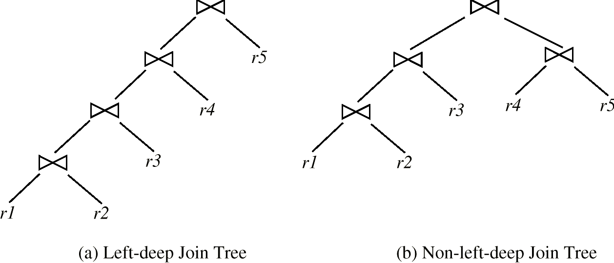
Left Deep Join Trees
skip
In left-deep join trees, the right-hand-side input for each join is a relation, not the result of an intermediate join.
Left-deep join orders are convenient for pipelined evaluation: the right operand is a stored relation and only one input to each join is pipelined
Figure (a) would enjoy pipelining while pipelining may not be possible in Figure (b)
All left-deep join orders is O(n!) while all join orders is O(3^{n}).

Slide 56
Cost of Optimization
skip
With dynamic programming the time complexity of optimization with bushy trees is O(3^{n}).
  With n = 10, this number is 59000 instead of 17.6 billion (i.e., (2(n – 1))!/(n – 1) ) !!
  Space complexity is O(2^{n})
To find best left-deep join tree for a set of n relations:
  Consider n alternatives with one relation as right-hand side input and the other relations as left-hand side input.
  Using (recursively computed and stored) least-cost join order for each alternative on left-hand-side, choose the cheapest of the n alternatives.
If only left-deep trees are considered in the System R optimizer with the dynamic programming technique, time complexity of finding best join order is O(n 2^{n})
  Space complexity remains at O(2^{n})
Cost-based optimization is expensive, but worthwhile for queries on large datasets (typical queries have small n, generally < 10)

Slide 57
Note on Join Orders
skip
All possible join orders ➔ (2(n – 1))!/(n – 1)!
Join orders by dynamic programming ➔ O(3^{n}).
All left-deep join orders ➔ O(n!)
System R ➔ O(n 2^{n})

Slide 58
Structure of Query Optimizers (Cont.)
skip
Some query optimizers integrate heuristic selection and the generation of alternative access plans.
  System R and Starburst use a hierarchical procedure based on the nested-block concept of SQL: heuristic rewriting followed by cost-based join-order optimization.
Even with the use of heuristics, cost-based query optimization imposes a substantial overhead.
This expense is usually more than offset by savings at query-execution time, particularly by reducing the number of slow disk accesses.
But, optimization process is once and the optimized query could be used for each run!

Slide 59
Heuristic Optimization
Cost-based optimization is expensive, even with dynamic programming.
Systems may use heuristics to reduce the number of choices that must be made in a cost-based fashion.
Heuristic optimization transforms the query-tree by using a set of rules that typically (but not in all cases) improve execution performance:
  Perform selection early (reduces the number of tuples)
  Perform projection early (reduces the number of attributes)
  Perform most restrictive selection and join operations before other similar operations.
  Some systems use only heuristics, others combine heuristics with partial cost-based optimization.
Direction in heuristics ➔ reduce the size of intermediate results!

Slide 60
Steps in Typical Heuristic Optimization
1. Deconstruct conjunctive selections into a sequence of single selection operations (Equiv. rule 1.).
2. Move selection operations down the query tree for the earliest possible execution (Equiv. rules 2, 7a, 7b, 11).
3. Execute first those selection and join operations that will produce the smallest relations (Equiv. rule 6).
4. Replace Cartesian product operations that are followed by a selection condition by join operations (Equiv. rule 4a).
5. Deconstruct and move as far down the tree as possible lists of projection attributes, creating new projections where needed (Equiv. rules 3, 8a, 8b, 12).
6. Identify those subtrees whose operations can be pipelined, and execute them using pipelining.

Slide 61
Optimizing Nested Subqueries**
SQL conceptually treats nested subqueries in the where clause as functions that take parameters and return a single value or set of values
  Parameters are variables from outer level query that are used in the nested subquery; such variables are called correlation variables
E.g.
select customer-name
from borrower
where exists (select *
from depositor
where depositor.customer-name =borrower.customer-name)
Conceptually, nested subquery is executed once for each tuple in the cross-product generated by the outer level from clause
  Such evaluation is called correlated evaluation
  Note: other conditions in where clause may be used to compute a join (instead of a cross-product) before executing the nested subquery

Slide 62
Optimizing Nested Subqueries (Cont.)
Correlated evaluation may be quite inefficient since
  a large number of calls may be made to the nested query
  there may be unnecessary random I/O as a result
SQL optimizers attempt to transform nested subqueries to joins where possible, enabling use of efficient join techniques
E.g.: earlier nested query can be rewritten as
select customer-name
from borrower, depositor
where depositor.customer-name = borrower.customer-name
  Note: above query doesn’t correctly deal with duplicates, can be modified to do so as we will see
In general, it is not possible/straightforward to move the entire nested subquery from clause into the outer level query from clause
  A temporary relation is created instead, and used in body of outer level query

Slide 63
Optimizing Nested Subqueries (Cont.)
In general, SQL queries of the form below can be rewritten as shown
Rewrite: select …
from L₁
where P₁ and exists (select *
from L₂
where P₂)
To: create table t₁ as
select distinct V
from L₂
where P₂¹
select …
from L₁, t₁
where P₁ and P₂²
  P₂¹ contains predicates in P₂ that do not involve any correlation variables
  P₂² reintroduces predicates involving correlation variables, with relations renamed appropriately
  V contains all attributes used in predicates with correlation variables

Slide 64
Optimizing Nested Subqueries (Cont.)
In our example, the original nested query would be transformed to
create table t₁ as
select distinct customer-name
from depositor
select customer-name
from borrower, t₁
where t₁.customer-name = borrower.customer-name
The process of replacing a nested query by a query with a join (possibly with a temporary relation) is called decorrelation.
Decorrelation is more complicated when
  the nested subquery uses aggregation, or
  when the result of the nested subquery is used to test for equality, or
  when the condition linking the nested subquery to the other query is not exists,
  and so on.

Slide 65
Chapter 14: Query Optimization
G
14.1 Introduction
14.2 Transformation of Relational Expressions
  Equivalence rules
  Enumeration of equivalent expressions
14.3 Estimating Statistics of Expression Results
  Statistical information for cost estimation
  Catalog Information for cost estimation
14.4 Choice of Evaluation Plans
  Cost-based optimization
  Heuristic optimization
  Structure of query optimizer
  Optimizing nested subqueries
14.5 Materialized views and view maintenance
14.6 Summary

Slide 66
Materialized Views**
A materialized view is a view whose contents are computed and stored.
Consider the view
create view branch-total-loan (branch-name, total-loan) as
select branch-name, sum(amount)
from loan
groupby branch-name
Materializing the above view would be very useful if the total loan amount is required frequently
  Saves the effort of finding multiple tuples and adding up their amounts

Slide 67
Query Optimization and Materialized Views
Rewriting queries to use materialized views:
  A materialized view v = r s is available
  A user submits a query r s t
  We can rewrite the query as v t
    Whether to do so depends on cost estimates for the two alternative
Replacing a use of a materialized view by the view definition:
  A materialized view v = r s is available, but without any index on v
  Suppose a user submits a query σ_{A=10}(v).
  Suppose also that s has an index on the common attribute B, and r has an index on attribute A.
  Then the best plan for this query may be to replace v by r s, which can lead to the query plan σ_{A=10}(r) s
Query optimizer should be extended to consider all above alternatives and choose the best overall plan

Slide 68
Materialized View Maintenance
The task of keeping a materialized view up-to-date with the underlying data is an issue (known as materialized view maintenance)
Materialized views can be maintained by recomputation on every update
A better option is to use incremental view maintenance
  Modify only the affected parts of materialized view
  Changes to database relations are used to compute changes to materialized view, which is then updated
View maintenance can be done by
  Manually defining triggers on insert, delete, and update of each relation in the view definition
  Manually written code to update the view whenever database relations are updated
  Supported directly by the database

Slide 69
Incremental View Maintenance
The changes (inserts and deletes) to a relation or expressions are referred to as its differential
  Set of tuples inserted to and deleted from r are denoted i_{r} and d_{r}
To simplify our description, we only consider inserts and deletes
  We replace updates to a tuple by deletion of the tuple followed by insertion of the update tuple
We describe how to compute the change to the result of each relational operation, given changes to its inputs
We then outline how to handle relational algebra expressions

Slide 70
Incremental View Maintenance: Join Operation
Consider the materialized view v = r s and an update to r
Let r^{old} and r^{new} denote the old and new states of relation r
Consider the case of an insert to r:
  We can write r^{new} s as (r^{old} ∪ i_{r}) s
  And rewrite the above to (r^{old} s) ∪ (i_{r} s)
  But (r^{old} s) is simply the old value of the materialized view, so the incremental change to the view is just i_{r} s
Thus, for inserts v^{new} = v^{old} ∪ (i_{r} s)
Similarly for deletes v^{new} = v^{old} – (d_{r} s)

Slide 71
Incremental View Maintenance
보조자료
r = loan, s = branch
The materialized view v = r s
loan-number | branch-name | amount | branch-city | assets
L-11 | Round-Hill | 900 | Horseneck | 8000000
L-14 | Downtown | 1500 | Brooklyn | 9000000
L-15 | Perryridge | 1500 | Horseneck | 1700000
L-16 | Perryridge | 1300 | Horseneck | 1700000
L-17 | Downtown | 1000 | Brooklyn | 9000000
L-23 | Redwood | 2000 | Palo Alto | 2100000
L-93 | Mianus | 500 | Horseneck | 400000

Slide 72
Incremental Deletion
보조자료
dr = (L-11, Round Hill, 900)
dr s
vnew = vold – (dr s)
loan-number | branch-name | amount | branch-city | assets
L-11 | Round-Hill | 900 | Horseneck | 8000000
loan-number | branch-name | amount | branch-city | assets
L-14 | Downtown | 1500 | Brooklyn | 9000000
L-15 | Perryridge | 1500 | Horseneck | 1700000
L-16 | Perryridge | 1300 | Horseneck | 1700000
L-17 | Downtown | 1000 | Brooklyn | 9000000
L-23 | Redwood | 2000 | Palo Alto | 2100000
L-93 | Mianus | 500 | Horseneck | 400000

Slide 73
Incremental Insertion
보조자료
ir = (L-11, Round Hill, 900)
ir s
vnew = vold ∪ (ir s)
loan-number | branch-name | amount | branch-city | assets
L-11 | Round-Hill | 900 | Horseneck | 8000000
loan-number | branch-name | amount | branch-city | assets
L-11 | Round-Hill | 900 | Horseneck | 8000000
L-14 | Downtown | 1500 | Brooklyn | 9000000
L-15 | Perryridge | 1500 | Horseneck | 1700000
L-16 | Perryridge | 1300 | Horseneck | 1700000
L-17 | Downtown | 1000 | Brooklyn | 9000000
L-23 | Redwood | 2000 | Palo Alto | 2100000
L-93 | Mianus | 500 | Horseneck | 400000

Slide 74
Incremental View Maintenance:
Selection and Projection Operations
Selection: Consider a view v = σ_{θ}(r).
  v^{new} = v^{old} ∪σ_{θ}(i_{r})
  v^{new} = v^{old} - σ_{θ}(d_{r})
Projection is a more difficult operation
  R = (A,B), and r(R) = { (a,2), (a,3)}
  ∏_{A}(r) has a single tuple (a).
  If we delete the tuple (a,2) from r, we should not delete the tuple (a) from ∏_{A}(r), but if we then delete (a,3) as well, we should delete the tuple
For each tuple in a projection ∏_{A}(r) , we will keep a count of how many times it was derived
  On insert of a tuple to r, if the resultant tuple is already in ∏_{A}(r) we increment its count, else we add a new tuple with count = 1
  On delete of a tuple from r, we decrement the count of the corresponding tuple in ∏_{A}(r)
    if the count becomes 0, we delete the tuple from ∏_{A}(r)

Slide 75
Incremental View Maintenance:
Aggregation Operations
count : v = _{A}g_{count(B)}^{(r)}.
  When a set of tuples i_{r} is inserted
    For each tuple r in i_{r}, if the corresponding group is already present in v, we increment its count, else we add a new tuple with count = 1
  When a set of tuples d_{r} is deleted
    for each tuple t in i_{r.}we look for the group t.A in v, and subtract 1 from the count for the group.
      If the count becomes 0, we delete from v the tuple for the group t.A
sum: v = _{A}g_{sum (B)}^{(r)}
  We maintain the sum in a manner similar to count, except we add/subtract the B value instead of adding/subtracting 1 for the count
  Additionally we maintain the count in order to detect groups with no tuples. Such groups are deleted from v
    Cannot simply test for sum = 0 (why?)
To handle the case of avg, we maintain the sum and count aggregate values separately, and divide at the end

Slide 76
Incremental View Maintenance
보조자료
Count
  v = _{branch-name}g_{count(loan-number)} ^{(loan)}
Sum
  v = _{branch-name}g_{sum(amount)} ^{(loan)}
Avg
  v = _{branch-name}g_{avg(amount)} ^{(loan)}

Slide 77
Incremental View Maintenance
보조자료
Materialized View (Count) Materialized View (Sum)
Materialized View (Avg)
branch-name | count
Round Hill | 1
Downtown | 2
Perryridge | 2
Red Wood | 1
Mianus | 1
branch-name | sum
Round Hill | 900
Downtown | 2500
Perryridge | 2800
Red Wood | 2000
Mianus | 500
branch-name | avg
Round Hill | 900
Downtown | 1250
Perryridge | 1400
Red Wood | 2000
Mianus | 500

Slide 78
Insertion to Base Relation
보조자료
Base relation loan에 tuple (L-30, Round Hill, 1300) 이 삽입된 경우
  Count: Materialized View Count 에 Round Hill 이 있는가? ➔ Yes
      Update the tuple (Round Hill, 1) ➔ (Round Hill, 2)
  Sum: Materialized View Sum 에 RoundHill 이 있는가? ➔ Yes
      Update the tuple (RoundHill, 900) ➔ (RoundHill, 2200) // 900+1300
  Avg: Materialized View Sum 에 RoundHill 이 있는가? ➔ Yes
      -- Update the tuple (RoundHill, 900) ➔ (RoundHill, 1100) // (900 + 1300) / 2
Base relation loan에 tuple (L-70, Seoul, 1000) 이 삽입된 경우
  Count: Materialized View Count 에 Seoul 이 있는가? ➔ No
      -- Insert a new tuple (Seoul, 1) to Count
  Sum: Materialized View Sum 에 Seoul 이 있는가? ➔ No
      -- Insert a new tuple (Seoul, 1000) to Sum
  Avg: Materialized View Sum 에 Seoul 이 있는가? ➔ No
      -- Insert a new tuple (Seoul, 1000) to Sum

Slide 79
Delete from Base Relation
보조자료
Base relation loan에 tuple (L-11, Round Hill, 900)이 삭제된 경우
  Count: Attribute ‘count’ value를 1감소. 0인가?
  If so, Tuple (Round Hill, 1)을 Count에서 삭제
  Sum: 구릅별 count 에서 1감소. 0인가?
  If so, Tuple (Round Hill, 900)을 Sum에서 삭제
  Avg: 구릅별 count 에서 1감소. 0인가?
  If so, Tuple (Round Hill, 900)을 Avg에서 삭제
Base relation loan에 tuple (L-15, Downtown, 1500) 삭제된 경우
  Count: Attribute ‘count’ value를 1감소. 0인가?
  If not, update (Downtown, 2) ➔ (Downtown, 1)
  Sum: . Group별 count에서 1감소. 0인가?
  If not, update Tuple (Downtown, 2500) ➔ (Downtown, 1000) // 2500 - 1500
  Avg: Group별 count에서 1감소. 0인가?
  If not, update Tuple (Downtown, 2500) ➔ (Downtown, 1000) // (2500 – 1500)/ (2 -1)

Slide 80
Incremental View Maintenance:
Aggregate Operations (Cont.)
min, max: v = _{A}g_{min (B)} (r).
  Handling insertions on r is straightforward.
  Maintaining the aggregate values min and max on deletions may be more expensive.
    We have to look at the other tuples of r that are in the same group to find the new minimum

Slide 81
Incremental View Maintenance:
Other Operations
Set intersection: v = r ∩ s
  when a tuple is inserted in r we check if it is present in s, and if so we add it to v.
  If the tuple is deleted from r, we delete it from the intersection if it is present.
  Updates to s are symmetric
  The other set operations, union and set difference are handled in a similar fashion.
Outer joins are handled in much the same way as joins but with some extra work
  we leave details to you.

Slide 82
Incremental View Update with Expressions
To handle an entire expression, we derive expressions for computing the incremental change to the result of each sub-expressions, starting from the smallest sub-expressions.
E.g. consider E₁ E₂ where each of E₁ and E₂ may be a complex expression
  Suppose the set of tuples to be inserted into E₁ is given by D₁
    Computed earlier, since smaller sub-expressions are handled first
  Then the set of tuples to be inserted into E₁ E₂ is given by D₁ E₂
    This is just the usual way of maintaining joins

Slide 83
Materialized View Selection
Materialized view selection: “What is the best set of views to materialize?”.
  This decision must be made on the basis of the system workload
Indices are just like materialized views, problem of index selection is closely related, to that of materialized view selection, although it is simpler.
Some database systems, provide tools to help the database administrator with index and materialized view selection.

Slide 84
Chapter 14: Query Optimization
G
14.1 Introduction
14.2 Transformation of Relational Expressions
  Equivalence rules
  Enumeration of equivalent expressions
14.3 Estimating Statistics of Expression Results
  Statistical information for cost estimation
  Catalog Information for cost estimation
14.4 Choice of Evaluation Plans
  Cost-based optimization
  Heuristic optimization
  Structure of query optimizer
  Optimizing nested subqueries
14.5 Materialized views and view maintenance
14.6 Summary

Slide 85
Ch 14: Summary (1)
Given a query, there are generally a variety of methods for computing the answer.
  It is the responsibility of the system to transform the query as entered by the user into an equivalent query that can be computed more efficiently.
  The process of finding a good strategy for processing a query, is called query optimization.
The evaluation of complex queries involves many accesses to disk.
  Since the transfer of data from disk is slow relative to the speed of main memory and the CPU of the computer system, it is worthwhile to allocate a considerable amount of processing to choose a method that minimizes disk accesses.

Slide 86
Ch 14: Summary (2)
The strategy that the database system chooses for evaluating an operation depends on the size of each relation and on the distribution of values within columns.
  So that they can base the strategy choice on reliable information, database systems may store statistics for each relation r.
These statistics include
  The number of tuples in the relation r
  The size of a record(tuple) of relation r in bytes
  The number of distinct values that appear in the relation r for a particular attribute
These statistics allow us to estimate the sizes of the results of various operations, as well as the cost of executing the operations.
  Statistical information about relations is particularly useful when several indices are available to assist in the processing of a query.
  The presence of these structures has a significant influence on the choice of a query-processing strategy.

Slide 87
Ch 14: Summary (3)
Each relational-algebra expression represents a particular sequence of operations.
  The first step in selecting a query-processing strategy is to find a relational-algebra expression that is equivalent to the given expression and is estimated to cost less to execute.
There are a number of equivalence rules that we can use to transform an expression into an equivalent one.
  We use these rules to generate systematically all expressions equivalent to the given query.
Alternative evaluation plans for each expression can be generated by similar rules, and the cheapest plan across all expressions can be chose.
  Several optimization techniques are available to reduce the number of alternative expressions and plans that need to be generated.

Slide 88
Ch 14: Summary (4)
We use heuristics to reduce the number of plans considered, and thereby to reduce the cost of optimization.
  Heuristic rules for transforming relational-algebra queries include “Perform selection operations as early as possible,” “Perform projections early,” and “Avoid Cartesian products.”
Materialized views can be used to speed up query processing.
  Incremental view maintenance is needed to efficiently update materialized views when the underlying relations are modified.
  The differential of and operation can be computed by means of algebraic expressions involving differentials of the inputs of the operation.
  Other issues related to materialized views include how to optimize queries by making use of available materialized views, and how to select views to be materialized.

Slide 89
Ch 14: Bibliographical Notes (1)
The seminal work of Selinger et al. [1979] describes access-path selection in the System R optimizer, which was one of the earliest relational-query optimizers.
Graefe and McKenna [1993] describe Volcano, and equivalence-rule based query optimizer.
Query processing in Starburst is described in Haas et al. [1989].
Query optimization in Oracle is briefly outlined in Oracle [1997].
Estimation of statistics of query results, such as result size, is addressed by Ioannidis and Poosala [1995], Poosala et al. [1996], and Ganguly et al. [1996], among others.
Nonuniform distributions of values causes problems for estimation of query size and cost.
Cost-estimation techniques that use histograms of value distributions have been proposed to tackle the problem.
Ioannidis and Christodoulakis [1993], Ioannidis and Poosala [1995], and Poosala et al. [1996] present results in this area.

Slide 90
Ch 14: Bibliographical Notes (2)
Exhaustive searching of all query plans is impractical for optimization of joins involving many relations, and techniques based on randomized searching, which do not examine all alternatives, have been proposed. Ioannidis and Wong [1987],
Swami and Gupta [1988], and Ioannidis and Kang [1990] present results in this area.
Parametric query-optimization techniques have been proposed by Ioannidis et al. [1992] and Ganguly [1998], to handle query processing when the selectivity of query parameters is not known at optimization time.
A set of plans-one for each of several different query selectivities-is computed, and is stored by the optimizer, at compile time.
One of these plans is chosen at run time, on the basis of the actual selectivities, avoiding the cost of full optimization at run time.
Klug [1982] was an early work on optimization of relational-algebra expressions with aggregate functions.
Optimization of queries containing outer joins is described in Rosenthal and Reiner [1984], Galindo-Legaria and Rosenthal [1992], and Galindo-Legaria [1994].

Slide 91
Ch 14: Bibliographical Notes (3)
The SQL language poses several challenges for query optimization, including the presence of duplicates and nulls, and the semantics of nested subqueries.
Extension of relational algebra to duplicates is described in Dayal et al. [1982].
Optimization of nested subqueries is discussed in Kim [1982], Ganski and Wong [1987], Dayal [1987], and more recently, in Seshadri et al. [1996].
When queries are generated through views, more relations often are joined than is necessary for computation of the query.
A collection of techniques for join minimization has been grouped under the name tableau optimization.
The notion of a tableau was introduced by Aho et al. [1979b] and Aho et al. [1979a], and was further extended by Sagiv and Yannakakis [1981].
Ullman [1988] and Maier [1983] provide a textbook coverage of tableaux.
Sellis [1988] and Roy et al. [2000] describe multiquery optimization, which is the problem of optimizing the execution of several queries as a group. If an entire group of queries is considered, it is possible to discover common subexpressions that can be evaluated once for the entire group.

Slide 92
Ch 14: Bibliographical Notes (4)
Finkelstein [1982] and Hall [1976] consider optimization of a group of queries and the use of common subexpressions.
Dalvi et al. [2001] discuss optimization issues in pipelining with limited buffer space combined with sharing of common subexpressions.
Query optimization can make use of semantic information, such as functional dependencies and other integrity constraints.
Semantic query-optimization in relational databases is covered by King [1981], Chakravarthy et al. [1990], and in the context of aggregation, by Sudarshan and Ramakrishnan [1991].
Query-processing and optimization techniques for Datalog, in particular techniques to handle queries on recursive views, are described in Banchilhon and Ramakrishnan [1986], Beeri and Ramakrishnan [1991], Ramakrishnan et al. [1992c], Srivastava et al. [1995] and Mumick et al. [1996].
Query processing and optimization techniques for object-oriented databases are discussed in Maier and Stein [1986], Beech [1988], Bertino and Kim [1989], and Blakeley et al. [1993].

Slide 93
Ch 14: Bibliographical Notes (5)
Blakeley et al. [1986], Blakeley et al. [1989], and Griffin and Libkin [1995] describe techniques for maintenance of materialized views.
Gupta and Mumick [1995] provides a survey of materialized view maintenance. Optimization of materialized view maintenance plans is described by Vista [1998] and Mistry et al. [2001].
Query optimization in the presence of materialized views is addressed by Larson and Yang [1985], Chaudhuri et al. [1995], Dar et al. [1996], and Roy et al. [2000].
Index selection and materialized view selection are addressed by Ross et al. [1996], Labio et al. [1997], Gupta [1997], Chaudhuri and Narasayya [1997], and Roy et al. [2000].

Slide 94
Chapter 14: Query Optimization
G
14.1 Introduction
14.2 Transformation of Relational Expressions
  Equivalence rules
  Enumeration of equivalent expressions
14.3 Estimating Statistics of Expression Results
  Statistical information for cost estimation
  Catalog Information for cost estimation
14.4 Choice of Evaluation Plans
  Cost-based optimization
  Heuristic optimization
  Structure of query optimizer
  Optimizing nested subqueries
14.5 Materialized views and view maintenance
14.6 Summary

Slide 95
End of Chapter
(Extra slides with details of selection cost estimation follow)

Slide 96
Selection Cost Estimate Example
σ_{branch-name = “Perryridge”}(account)
Number of blocks is b_{account} = 500: 10,000 tuples in the relation; each block holds 20 tuples.
Assume account is sorted on branch-name.
  V(branch-name,account) is 50
  10000/50 = 200 tuples of the account relation pertain to Perryridge branch
  200/20 = 10 blocks for these tuples
  A binary search to find the first record would take
  ⎡log₂(500)⎤ = 9 block accesses
Total cost of binary search is 9 + 10 -1 = 18 block accesses (versus 500 for linear scan)

Slide 97
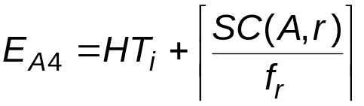
Selections Using Indices
Index scan – search algorithms that use an index; condition is on search-key of index.
A3 (primary index on candidate key, equality). Retrieve a single record that satisfies the corresponding equality condition E_{A3} = HT_{i} + 1
A4 (primary index on nonkey, equality) Retrieve multiple records. Let the search-key attribute be A.
A5 (equality on search-key of secondary index).
  Retrieve a single record if the search-key is a candidate key
  E_{A5} = HT_{i} + 1
  Retrieve multiple records (each may be on a different block) if the search-key is not a candidate key. E_{A3} = HT_{i} + SC(A,r)

Slide 98
Cost Estimate Example (Indices)
Consider the query is σ_{branch-name = “Perryridge”}(account), with the primary index on branch-name.
Since V(branch-name, account) = 50, we expect that 10000/50 = 200 tuples of the account relation pertain to the Perryridge branch.
Since the index is a clustering index, 200/20 = 10 block reads are required to read the account tuples.
Several index blocks must also be read. If B⁺-tree index stores 20 pointers per node, then the B⁺-tree index must have between 3 and 5 leaf nodes and the entire tree has a depth of 2. Therefore, 2 index blocks must be read.
This strategy requires 12 total block reads.

Slide 99
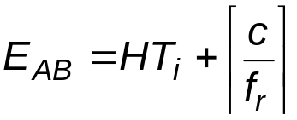
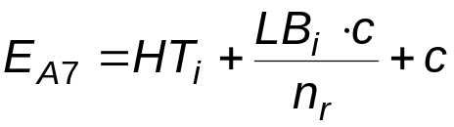
Selections Involving Comparisons
selections of the form σ_{A≤V}(r) or σ_{A ≥ V}(r) by using a linear file scan or binary search, or by using indices in the following ways:
A6 (primary index, comparison). The cost estimate is:
where c is the estimated number of tuples satisfying the condition. In absence of statistical information c is assumed to be n_{r}/2.
A7 (secondary index, comparison). The cost estimate:
where c is defined as before. (Linear file scan may be cheaper if c is large!).

Slide 100
Example of Cost Estimate for Complex Selection
Consider a selection on account with the following condition: where branch-name = “Perryridge” and balance = 1200
Consider using algorithm A8:
  The branch-name index is clustering, and if we use it the cost estimate is 12 block reads (as we saw before).
  The balance index is non-clustering, and
  V(balance, account = 500, so the selection would retrieve 10,000/500 = 20 accounts. Adding the index block reads, gives a cost estimate of 22 block reads.
  Thus using branch-name index is preferable, even though its condition is less selective.
  If both indices were non-clustering, it would be preferable to use the balance index.

Slide 101
Example (Cont.)
Consider using algorithm A10:
  Use the index on balance to retrieve set S₁ of pointers to records with balance = 1200.
  Use index on branch-name to retrieve-set S₂ of pointers to records with branch-name = Perryridge”.
  S₁ ∩ S₂ = set of pointers to records with branch-name = “Perryridge” and balance = 1200.
  The number of pointers retrieved (20 and 200), fit into a single leaf page; we read four index blocks to retrieve the two sets of pointers and compute their intersection.
  Estimate that one tuple in 50 * 500 meets both conditions. Since n_{account} = 10000, conservatively overestimate that
  S₁ ∩ S₂ contains one pointer.
  The total estimated cost of this strategy is five block reads.

