Slide 1
Comparing Twitter Summarization Algorithms for Multiple Post Summaries
David Inouye and Jugal K. Kalita
SocialCom 2011
2013 May 10
Hyewon Lim

Slide 2
Outline
Introduction
Related Work
Problem Definition
Selected Approaches for Twitter Summaries
Experimental Setup
Results and Analysis
Conclusion

Slide 3
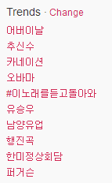
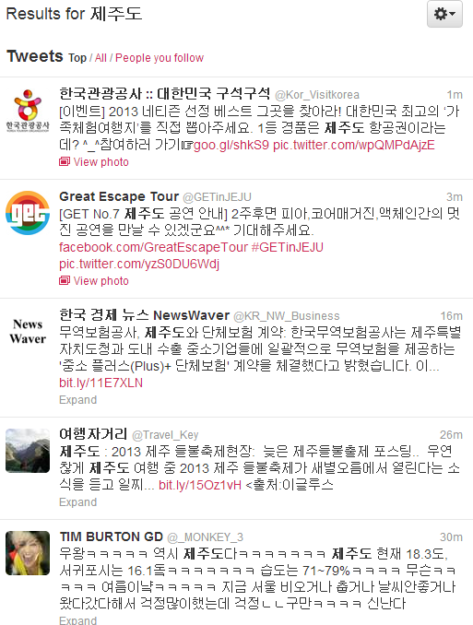
Introduction
Motivation of the summarizer

Slide 4
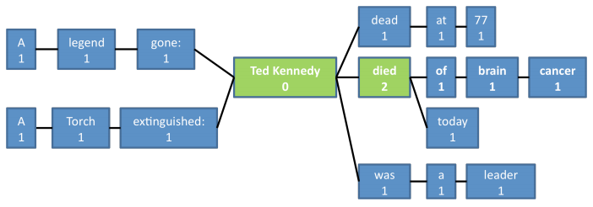
Introduction
Prior work
“A torch extinguished: Ted Kennedy dead at 77.” “A legend gone: Ted Kennedy died of brain cancer.” “Ted Kennedy was a leader.” “Ted Kennedy died today.”
B. Sharifi et al., “Automatic Summarization of Twitter Topics”

Slide 5

Introduction
Prior work (cont.)
“A torch extinguished: Ted Kennedy dead at 77.” “A legend gone: Ted Kennedy died of brain cancer.” “Ted Kennedy was a leader.” “Ted Kennedy died today.”
Best final summary: Ted Kennedy died
B. Sharifi et al., “Automatic Summarization of Twitter Topics”

Slide 6
Introduction
We create summaries that contain multiple posts
Several sub-topics or themes in a specified topic

Slide 7
Outline
Introduction
Related Work
Problem Definition
Selected Approaches for Twitter Summaries
Experimental Setup
Results and Analysis
Conclusion

Slide 8
Related Work
Text summarization
Reduce the amount of content to read
Reduce the number of features required for classifying or clustering
Multi-document summarization
Potential redundancy
Algorithms
SumBasic, Centroid, LexRank, TextRank, MEAD, …

Slide 9
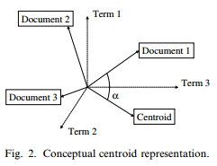

Related Work
SumBasic
Centroid
“A torch extinguished: Ted Kennedy dead at 77.” “A legend gone: Ted Kennedy died of brain cancer.” “Ted Kennedy was a leader.” “Ted Kennedy died today.”
Ted Kennedy died
(D. R. Radev et al., “Centroid-based summarization of multiple documents”)

Slide 10
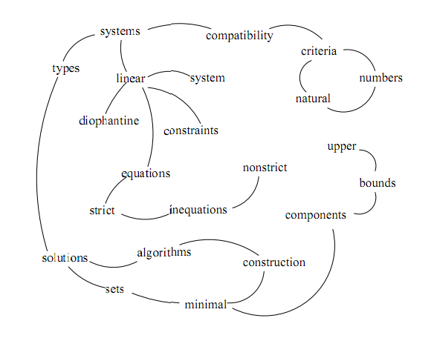
Related Work
LexRank
Adjacency matrix for computing the relative importance of sentences
TextRank
Find the most highly ranked sentences using the PageRank
Compatibility of systems of linear constraints over the set of natural numbers. Criteria of compatibility of a system of linear Diophantine equations, strict inequations, and nonstrict inequations are considered. Upper bounds for components of a minimal set of solutions and algorithms of construction of minimal generating sets of solutions for all types of systems are given. These criteria and the corresponding algorithms for constructing a minimal supporting set of solutions can be used in solving all the considered types systems and systems of mixed types.

Slide 11
Outline
Introduction
Related Work
Problem Definition
Selected Approaches for Twitter Summaries
Experimental Setup
Results and Analysis
Conclusion

Slide 12
Problem Definition
Given
A topic keyword or phrase T
Length k for the summary
Output
A set of representative posts S with a cardinality of k such that 1) ∀s ∈ S, T is in the text of s 2) ∀s_{i}, ∀s_{j} ∈ S, s_{i} ≁ s_{j}

Slide 13
Selected Approaches for Twitter Summaries
TF-IDF
(Term frequency) * (Inverse document frequency)
A microblog post is not a traditional document
Define a single document that encompass all the posts => IDF↓
Define each post as a document => TF↓
A
A
A…….A………
……………A…
…......................
…………………
…….A…………
…………………
A

Slide 14
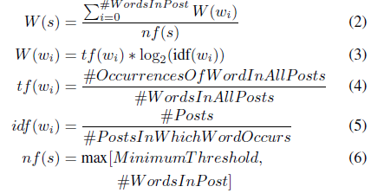

Selected Approaches for Twitter Summaries
Hybrid TF-IDF
Define a document as a single post
Computing the term frequencies
Assume the document is the entire collection of posts
Select the top k most weighted posts
Cosine similarity for avoiding redundancy

Slide 15

Selected Approaches for Twitter Summaries
Cluster summarizer
Cluster the tweets into k clusters based on a similarity measure
Summarize each cluster by picking the most weighted post
Bisecting k-means++ algorithm
Bisecting k-means
k-means++
Chooses the next centroid c_{i}, selecting c_{i} = v’ ∈ V with probability

Slide 16



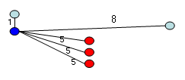
Selected Approaches for Twitter Summaries
k-means++
Outlier problem
k-means
k-means++
http://blog.sragent.pe.kr/
Notes:
노드마다 확률을 준다. 그 후 랜덤으로 centroid를 pick 하는 방식.
확률은 현재 알려진 center 중 가장 가까운 거리에 대한 것으로 멀수록 확률이 높아짐.

Slide 17
Selected Approaches for Twitter Summaries
Algorithms to compare results
Baseline
Random summarizer
Most recent summarizer
SumBasic
Depends only on the frequency of words
MEAD
Comparison between the more structured document domain and Twitter
Graph-based method
LexRank
TextRank

Slide 18
Outline
Introduction
Related Work
Problem Definition
Selected Approaches for Twitter Summaries
Experimental Setup
Results and Analysis
Conclusion

Slide 19

Experimental Setup
Data collection
5 consecutive days
Top ten currently trending topics every day
Approximately 1500 tweets for each topic
ROUGE
Automated summary vs. manual summaries
Choice of k
Notes:
ROUGE:
a suite of metrics that automatically measures the similarity between an automated summary and a set of manual summaries

Slide 20
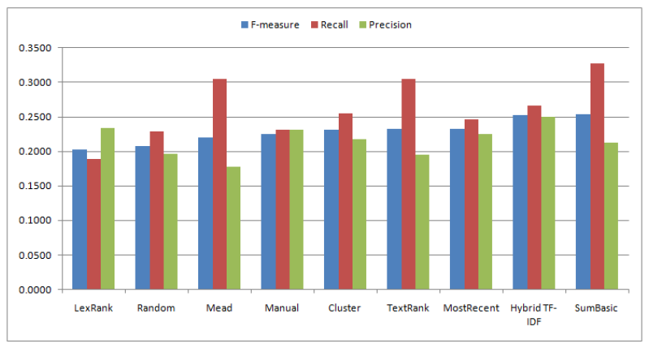
Results and Analysis
Average F-measure, precision and recall

Slide 21
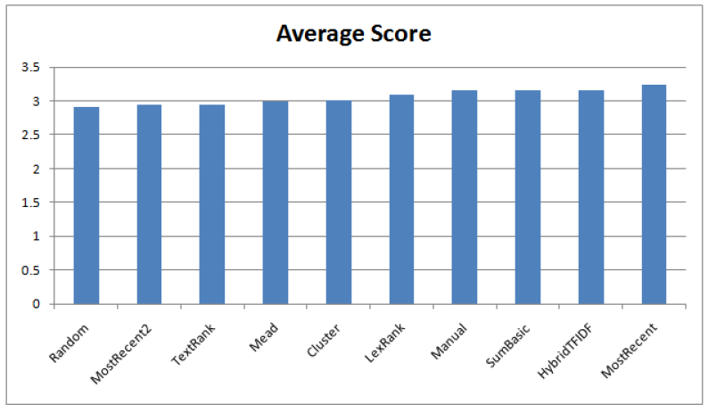
Results and Analysis
Average score for human evaluation
Notes:
즉 트위터는 구조도 없고 post간에 연관성도 별로 없고 주제가 있는 애들도 많지 않아서
복잡한 관계모델이 좋은 성능을 내기 힘들다.

Slide 22
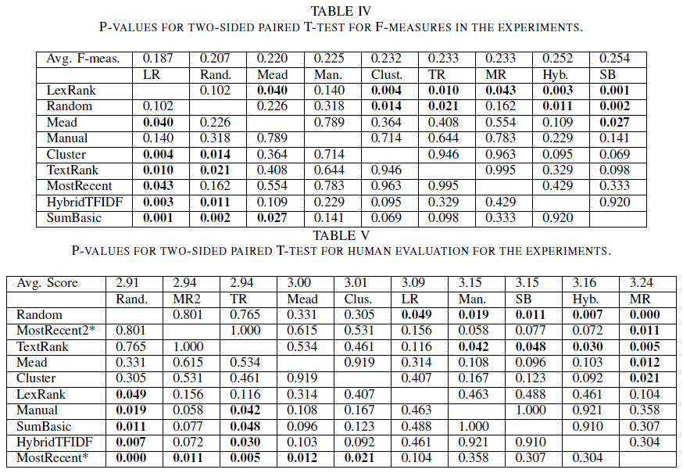
Results and Analysis
Paired two-sided T-test
Notes:
앞의 두 그래프만 봐서는 ROUGE랑 human evaluation에 큰 차이가 없어보여서 paired t-test를 수행
Random의 average score이 비교적 높게 나왔다
microblog 같은데서는 어떤 토픽에 대해 비슷한 단어를 사용하는 경향, 토씨하나 안틀리고 옮기는 RT 영향, 그리고 noise를 제거한 전처리 영향 때문
2-1 Most Recent의 경우, Random과 비교했을 때 F-measure는 괜찮은 값이 나왔는데, human score에서는 random이 더 낫다고 나옴. → 아마 실험과정에서 bias가 일어난 것으로 보임 2-2 또한 MR의 avg human score 값이 상당히 높게 나옴 (f-measure에서는 hybrid나 sumbasic보다 낮았는데) → skewed 되었다고 생각하여 다른 실험 set을 만들어서 재실험 : MostRecent2 → 이번엔 제대로 나온거 같음. 둘 간의 avg score를 평균 내면 3.09로 manual 기법보다도 낮은 것을 알 수 있음.
** 결론적으로 MR이 random보다 딱히 나아보이진 않음. 즉, 랜덤으로 뽑은 post들에 비해 MR post들이 더 연관있어 보이지 않는다는 얘기. 이 이유는 tweet 자체가 어떤 순서나 주제에 맞춰 게재되는게 아니라 막 올리는 경향이 있어서 그런 듯.
3. Cluster based (MEAD, Cluster): 성능이 썩 좋진 않음.
f-measure에서는 random보다는 월등히 좋은 거 같은데 human score에서 보면 random이랑 비슷한 수준.
Twitter에는 cluster같은 고전적인 summarizing 기법이 잘 안맞는다는 결론
4. Frequency-based (SumBasic & Hybrid TF-IDF): 제일 성능이 좋게 나옴
앞선 그래프에서 precision과 recall 값을 보면 hybrid는 대충 balance가 맞는데, SumBasic는 recall이 상당히 높게 나오는 걸 볼 수 있음. 이건 SumBasic이 tweet의 길이에 영향을 받는다는 것을 보여주는데, 이 avg score를 보면 그게 성능에 큰 영향을 주진 않는 거 같음.
또 하나 주목할 것은 이 frequency-based 기법에서는 비슷한 post들을 제거하기 위한 “중복제거방법(redundancy reduction method)”을 도입했다는 것이다.
** 이 결과로 미루어 보아 단순한 word frequency 계산과 중복 제거가 twitter topic summarizing에 중요한 요소라고 볼 수 있다.
5. Graph based (LexRank & TextRank): 매우 흥미로운 결과
F-measure에서는 LexRank가 random보다 안좋은데 TextRank는 월등히 좋음. Human score에서는 반대로 TextRank가 random과 비슷하고 LexRank는 월등히 좋음.
앞 precision recall 그래프를 보면 LexRank는 precision이 더 높고, TextRank는 recall이 더 높음을 알 수 있는데, 이를 통해, LexRank는 짧고 간결한 글에, TextRank는 긴 글을 줄이는 데 효과적이라고 볼 수 있다.
** 어쨌든 frequency 기반이 graph 기반보다 나은 것으로 봐서, tweet간의 관계를 반영한 복잡한 그래프 기법은 별 소용이 없단걸….=_=

Slide 23
Outline
Introduction
Related Work
Problem Definition
Selected Approaches for Twitter Summaries
Experimental Setup
Results and Analysis
Conclusion

Slide 24
Conclusion
The best techniques for summarizing Twitter topics
Simple word frequency
Redundancy reduction
Simple algorithms seem to perform well
Not clear that added complexity will improve the quality of the summaries
Extension
Extrinsic evaluations (e.g., user survey)
Dynamically discovering a good value for k for k-means
Detect named entities and events in the documents

