Slide 1
Fast Data in the Era of Big Data: Twitter’s Real-Time Related Query Suggestion Architecture
Gilad Mishne, Jeff Dalton, Zhenghua Li, Aneesh Sharma, Jimmy Lin
SIGMOD 2013
23 August 2013
SNU IDB Lab.
Namyoon Kim

Slide 2
Outline
Introduction
Background
Real-time Query Suggestion
Challenges
Statistics
Algorithm – Overview, Components
#1: The Hadoop Solution
Bottleneck: Hadoop
#2: The Deployed Solution
Twitter Search – Architecture, Assistance Engine
Data Flow
Scalability
Pieces of the Solution
Conclusion

Slide 3
Introduction
Three aspects of data: volume, velocity, and variety
Big data vs. fast data
- academia and industry focus on volume aspect of data
- Is there anything for dealing with fast data?

Slide 4
Background
Related query suggestion
e.g. query “obama”, and you’ll likely get “white house”
Spelling correction
e.g. “wierd” vs. “weird”
Queries, clickthrough, logs – with the advent of the web, relevance feedback has become much easier

Slide 5
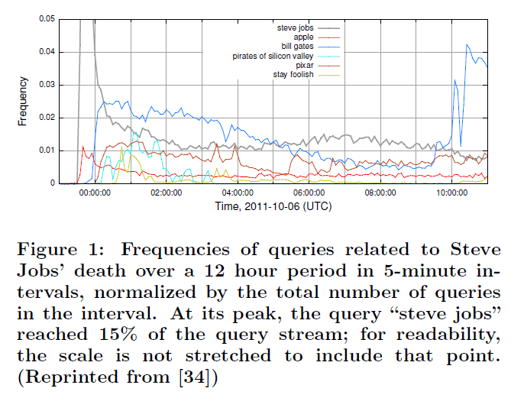
Real-Time Query Suggestion
Twitter: provides up-to-the-second updates on major events
Query suggestion must be real-time

Slide 6
Challenges
Relevance: how “good” is the result?
- ambiguous, and atemporal
Time frame and impact
- certain terms are only important for a short time
Slower signals
- e.g. “#bigdata” for “hadoop”

Slide 7
Statistics
Churn: process by which terms and queries become prevalent and then “drop out of the limelight”
~17% of the top 1000 query terms from one hour are no longer in the top 1000 in the next hour
~13% of the top 1000 queries drop on a daily basis
~33% of the top 1000 queries are new on an hourly basis; 31% are new on a daily basis
Time window granularity: 5 minutes

Slide 8
Algorithm Overview
“If query A and B are seen in the same context,
there’s evidence that they are related”
In many cases, A precedes B in time
If A and B are similar by edit distance, B is likely a spell-corrected version of A

Slide 9
Algorithm - components
Context
Ex) user issues query A; browses results, notices something
interesting that leads to query B
Quantitative measurement
How often do A and B appear together in the same context?
Temporal weighting
Decay observed counts over time

Slide 10
#1: The Hadoop Solution
Uses Pig, a high-level dataflow language that compiles into physical plans, executed on Hadoop
Oink
Scripting wrapper for MapReduce, schedules hundreds of Pig scripts
Scribe: Developed and open sourced by Facebook
System for aggregating high volumes of streaming log data

Slide 11
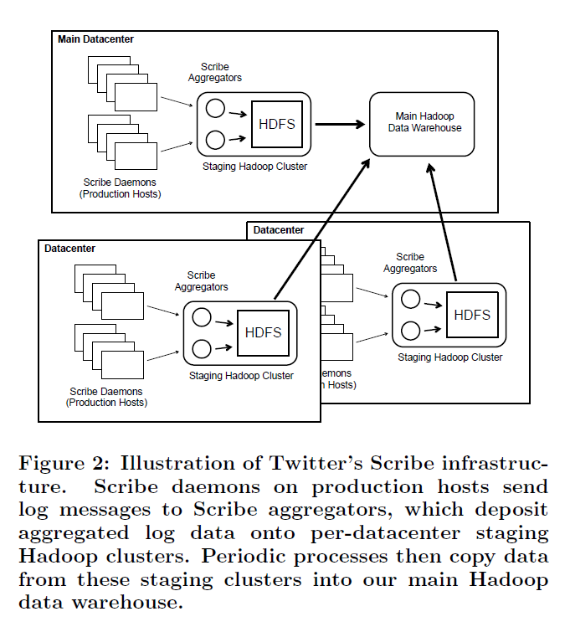
The Hadoop Solution - Figure

Slide 12
Bottleneck: Hadoop
Resource contention: Ad hoc nature in environment
Growth: cluster usage > physical cluster resources
Speed of MapReduce – not latency sensitive
Job completion times of stragglers: max run time is much larger than average run time
Best case: 10 minutes
Advantages
Logs: Searches, tweet activities, impressions, clicks
Requires no additional infrastructures

Slide 13
Twitter Search
Blender
brokers all requests from web client to search services (searching for tweets/accounts/search assistance, etc.)
Has a complete record of users’ search sessions; No need for client event Scribe logs
EarlyBird
Custom inverted indexing engine
Ingests tweets from firehose (tweet streaming API)

Slide 14
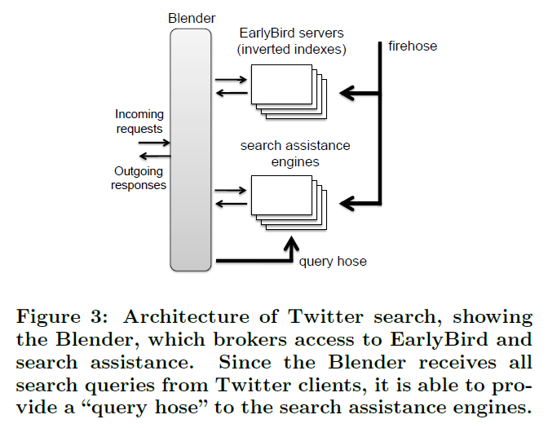
Search Architecture

Slide 15
Search assistance engine
Inputs: Tweet firehose and Blender query hose
In-memory caches (frontend nodes)
periodically reads fresh results from HDFS
Using Thrift, an Interface Definition Language, caches form a scalable service endpoint
Backend nodes: actual computation
HDFS: receives results every 5 minutes, performs leader election
In memory stores
sessions store
query statistics store
query co-occurrence statistics store: data about pairs of co-occurring queries

Slide 16
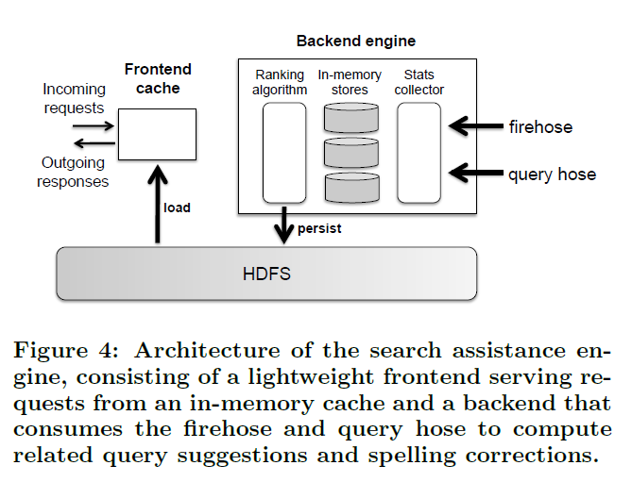
#2: The Deployed Solution

Slide 17
Data flow
The Query Path
Query statistics are updated in the query statistics store
Query is added to sessions store
For each previous query, a cooccurence is formed with the new query, and its respective statistics updated
Additional Checks
The tweet path: Tweet’s n-grams are processed to see if it’s a query
Decay/Prune cycles: All weights decay over time
Ranking cycles: Generates suggestions based on accumulated data

Slide 18
Scalability
Bottlenecks
Data streams are not partitioned, so a single server must keep up with the incoming data
Event space for cooccurring queries is large, and requires lots of memory
Temporal Coverage optimization
Same backend search assistance is run with long term data, and with different parameters
Pairwise edit distance variant calculation (spellchecking)

Slide 19
Pieces of the Solution
The Problem
Need a general and unified data processing framework for fast data
Relevant Work
Kafka: Handles more than 10 billion messages per day, with a sustained peak of 172,000 messages per sec.
Facebook: ptail (variant of UNIX “tail” program) and Puma (memory aggregation engine)
Google Percolator: update processor for Bigtable

Slide 20
Conclusion
Contributions
introduced the real-time related query suggestion problem
described the initial Hadoop-based implementation and the deployed in-memory processing engine
highlight gap between architectures for big data and fast data
Future Directions
Temporal granularity needs more variance
A more generic platform

