Slide 1
XML TOPIC MAP
JUNG J. W.

Slide 2
contents
What’s XTM?
Why XTM?
Element of XTM
XTM Conceptual Model
DTD
Introduction to XTM Syntax

Slide 3
What’s XTM?
Topic maps superimpose an external layer that describes the nature of the knowledge represented in the information resources.
The purpose of the extensible Markup language topic maps (XTM) initiative is to apply the topic maps paradigm in the context of the World Wide Web.

Slide 4
Formalism
The XTM interchange syntax like, the ISO 13250 interchange syntax, is expressed as a document type definition (DTD)
It could also be expressed as an
  XML schema
  Relax
  Schematron
  TREX

Slide 5
Why XTM?
XTM allow us to model and represent knowledge in an interchangeable form.
XTM provide a unifying frame work for knowledge and information management.
XTM promise to revolutionize the ways in which we search for and navigate information.

Slide 6
Element of XTM(1)
TAO
  Topic
  Associations
  Occurrences

Slide 7
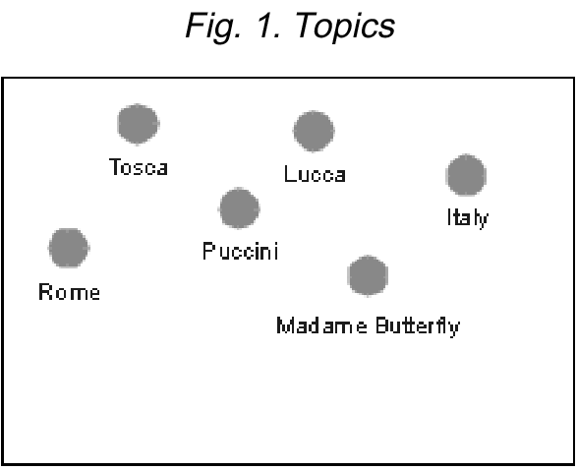
Element of XTM(2)

Slide 8
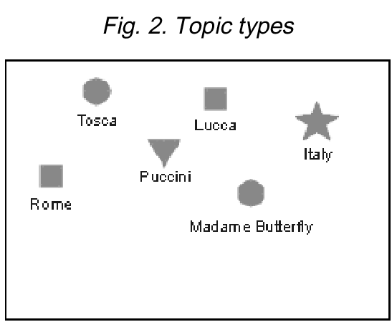
Element of XTM(3)

Slide 9
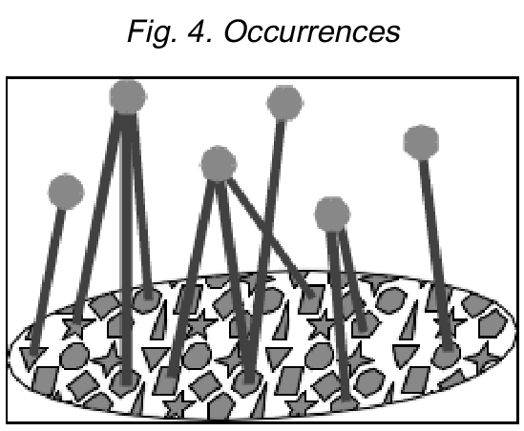
Element of XTM(4)

Slide 10
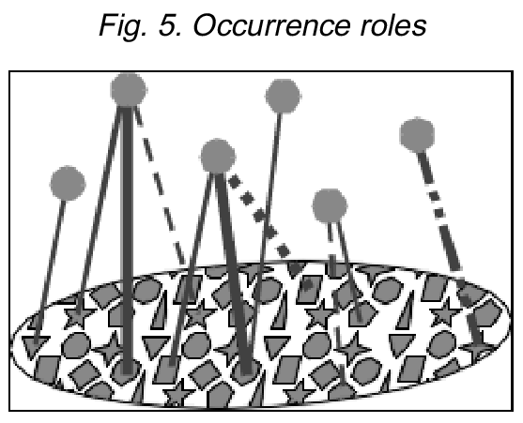
Element of XTM(5)

Slide 11
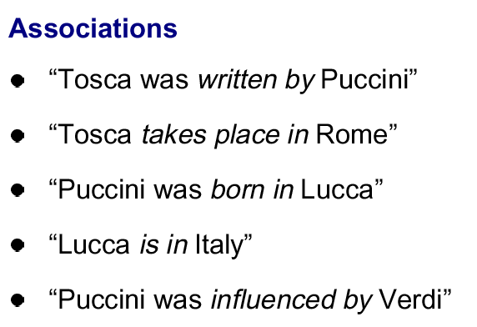
Element of XTM(6)

Slide 12
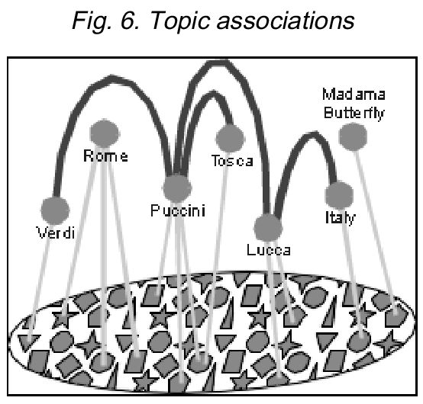
Element of XTM(7)

Slide 13
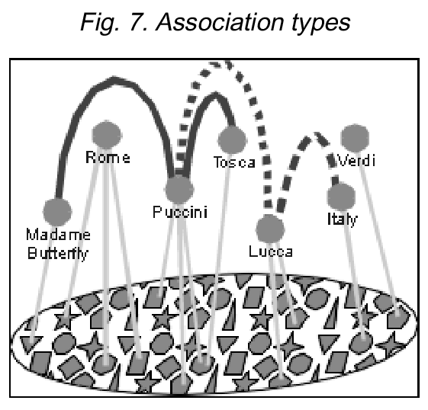
Element of XTM(8)

Slide 14
XTM Conceptual Model(1)
An Explanation of the Notation used in the Conceptual Model
  Line ending in hollow triangle: from subtype to type
  Line optionally ending in line arrowhead: named relationship
  Line ending in black diamond: strict dependency, commonly called ownership
  Line ending in open diamond: a set

Slide 15
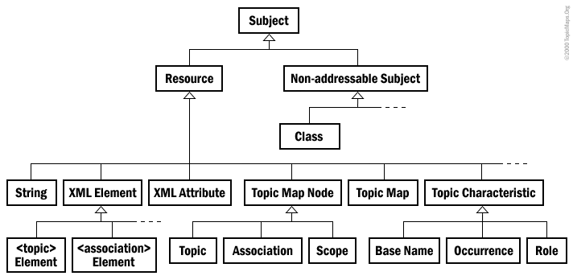
XTM Conceptual Model(2)
Class Hierarchy

Slide 16

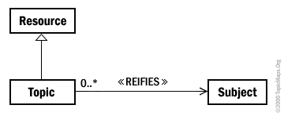
XTM Conceptual Model(3)
Class-Instance Relationship
Topic Reifies a Subject

Slide 17
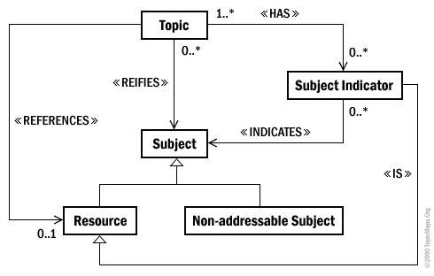
XTM Conceptual Model(4)
Referencing the Subject

Slide 18
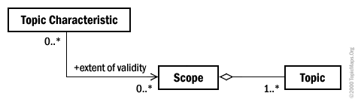
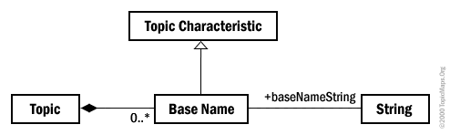
XTM Conceptual Model(5)
Topic Characteristics Are Assigned Within Scopes
Base Name Within Scope

Slide 19
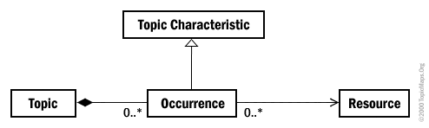
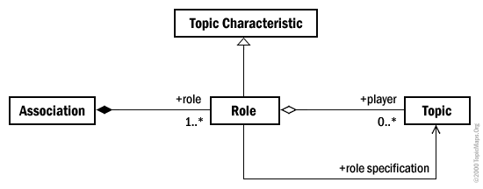
XTM Conceptual Model(6)
Occurrence
Association Between Topics

Slide 20
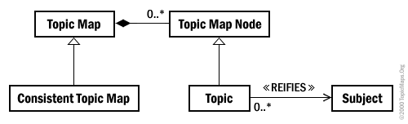
XTM Conceptual Model(7)
Topic Map

Slide 21
DTD(1)
<!-- XLink Support .............................................. -->
<!-- Used to identify the XLink namespace. Will hardwire this
value following XLink reaching W3C Recommendation status.
-->
<!ENTITY % XLINK.xmlns "http://www.w3.org/1999/xlink" >
<!-- ................................................... -->
<!-- topicmap: Topic Map document element .............. -->
<!ELEMENT topicmap
( topic | assoc | mergemap )*
>
<!ATTLIST topicmap
id ID #IMPLIED
commonThemes CDATA #IMPLIED
xmlns CDATA #FIXED 'http://www.topicmaps.org/xtm/DTD_VER'
xmlns:xlink CDATA #FIXED '%XLINK.xmlns;'
>

Slide 22
DTD(2)
<!-- topic: Topic element .............................. -->
<!-- if 'identity' is a link, then should it be an XLink,
and if so, then it can't be contained in the same
element as <topic>, since it must contain the xlink:type
of 'extended'
-->
<!-- FIXME remove 'scope' on <topic>?
-->
<!ELEMENT topic
( topname | occurs )*
>
<!ATTLIST topic
id ID #REQUIRED
instanceOf CDATA #IMPLIED
scope CDATA #IMPLIED
identity CDATA #IMPLIED
xlink:type NMTOKEN #FIXED 'extended'
>

Slide 23
DTD(3)
<!-- Topic Names ...................................... -->
<!-- topic name container -->
<!ELEMENT topname ( basename, dispname* , sortname* ) >
<!ATTLIST topname
id ID #IMPLIED
scope CDATA #IMPLIED
>
<!-- topic base name (required) -->
<!ELEMENT basename ( #PCDATA ) >
<!ATTLIST basename
id ID #IMPLIED
>
<!-- topic display name (optional) -->
<!ELEMENT dispname ( #PCDATA ) >
<!ATTLIST dispname
id ID #IMPLIED
scope CDATA #IMPLIED
xlink:type NMTOKEN #FIXED 'simple'
xlink:href %URI.datatype; #IMPLIED
>
<!-- topic sort name (optional) -->
<!ELEMENT sortname ( #PCDATA ) >
<!ATTLIST sortname
scope CDATA #IMPLIED
>

Slide 24
DTD(4)
<!-- occurs: Topic Occurrences ........................ -->
<!-- instanceOf or role? I thought we'd agreed instanceOf.
If instanceOf is XLink, can't be in same start tag.-->
<!ELEMENT occurs EMPTY >
<!ATTLIST occurs
instanceOf %URI.datatype; #IMPLIED
scope CDATA #IMPLIED
xlink:type NMTOKEN #FIXED 'locator'
xlink:href %URI.datatype; #REQUIRED
>
<!-- ................................................... -->
<!-- assoc: Topic Associations ........................ -->
<!-- remove 'types' attribute or not?
-->
<!ELEMENT assoc ( assocrl )+ >
<!ATTLIST assoc
id ID #IMPLIED
types CDATA #IMPLIED
instanceOf %URI.datatype; #IMPLIED
scope CDATA #IMPLIED
xlink:type NMTOKEN #FIXED 'extended'
>

Slide 25
DTD(5)
<!-- assocrl: Topic Association Roles ................. -->
<!ELEMENT assocrl EMPTY >
<!ATTLIST assocrl
id ID #IMPLIED
xlink:type NMTOKEN #FIXED 'locator'
xlink:href %URI.datatype; #REQUIRED
xlink:role %URI.datatype; #IMPLIED
>
<!-- ................................................... -->
<!-- mergemap: Explicit Merge ......................... -->
<!ELEMENT mergemap EMPTY >
<!ATTLIST mergemap
id ID #IMPLIED
tmdoc ENTITY #REQUIRED
theme CDATA #IMPLIED
>
<?doc type="doctype" role="title" { XTM DTD_VER }?>
<!-- end of XML Topic Map (XTM) DTD_VER DTD -->

Slide 26
Introduction to XTM Syntax(1)
<topicRef>: Reference to a Topic element
<subjectIndicatorRef>: Reference to a Subject Indicator
<scope>: Reference to Topic(s) that comprise the Scope
<instanceOf>: Points to a Topic representing a class
<topicMap>: Topic Map document element
<topic>: Topic element
<subjectIdentity>: Subject reified by Topic

Slide 27
Introduction to XTM Syntax(2)
<baseName>: Base Name of a Topic
<baseNameString>: Base Name String container
<variant>: Alternate forms of Base Name
<variantName>: Container for Variant Name
<parameters>: Processing context for Variant
<association>: Topic Association
<member>: Member in Topic Association

Slide 28
Introduction to XTM Syntax(3)
<roleSpec>: Points to a Topic serving as an Association Role
<occurrence>: Resources regarded as an Occurrence
<resourceRef>: Reference to a Resource
<resourceData>: Container for Resource data
<mergeMap>: Merge with another Topic Map

Slide 29
Introduction to XTM Syntax(4)
Example
- Content Model –
<!ELEMENT topic ( instanceOf*, subjectIdentity?, ( baseName | occurrence )* ) >
- Attributes –
<!ATTLIST topic id ID #REQUIRED >

Slide 30
Introduction to XTM Syntax(5)
The topic whose ID is “hamlet” is an instance of the topic type whose ID is “play”:
<topic id="hamlet">
<instanceOf>
<topicRef xlink:href="#play"/> </instanceOf>
<!-- base names and occurrences go here -->
</topic>

