Slide 1
Workload-Aware Aggregate Maintenance in Columnar In-Memory Databases
Stephan Müller, Lars Butzmann, Stefan Klauck, Hasso Plattner
2013 IEEE International Conference on Big Data
01 May 2014
SNU IDB Lab.
Namyoon Kim

Slide 2
Outline
Introduction
Related Work
Workloads
Aggregate Maintenance Strategies
Switching Between Aggregate Maintenance Strategies
Benchmarks
Conclusion

Slide 3
Introduction
OLTP/OLAP
Transactional and analytical queries have traditionally been associated with separate applications
However, this is no longer the case
ATP (available-to-promise)
OLTP: product stock movements
OLAP: aggregate over product movements to determine delivery dates for customers
Financial Accounting
OLTP: document creation
OLAP: profit and loss statements

Slide 4
Execution Speedup
Materialized View
Database view whose tuples are persisted in the database
Materialized Aggregate
Materialized view whose creation query contains aggregations
Columnar in-memory Database
IMDBs such as SAP HANA, Hyrise or Hyper are separated into a read-optimized main storage and a write-optimized delta storage
All data changes of a table are propagated to the delta storage
Periodically, the main is combined with the delta (merge operation)

Slide 5
Merge Update
Merge update
Novel view maintenance strategy for IMDBs with a main-delta architecture
Materialized aggregate table only contains data from main storage
Query results are produced by aggregating delta on the fly and combining with the materialized aggregate table
Outperforms other view maintenance strategies for workloads with high insert ratios
However, not the ideal choice for the full range of insert ratios
Goals
Propose and evaluate an adaptive, workload-aware materialized aggregate en-gine

Slide 6
Related Work
Overview and related issues of materialized views [1]
Database vendors on problem of materialized view maintenance [2],[3]
Materialized view research in data warehousing environments [4],[5],[6],[7]
Different from this scenario; maintenance downtimes are acceptable
Importance of automated physical database design [8]
Index and materialized view selection based on changing workloads
Extended definition of workload [9]
Not only ratios of query types in a workload, but also their sequence

Slide 7


Workloads
Workload
A DB’s workload is characterized by its queries
Queries
Single inserts changing the base table
Selects querying single aggregate values
Workload can be described by insert ratio and select ratio
Insert Ratio: number of insert queries in relation to the total number of queries
Select Ratio: 1 – insert ratio

Slide 8
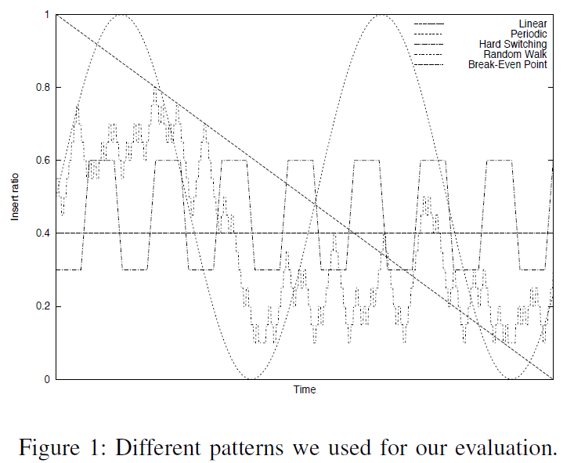
Evaluation Patterns

Slide 9
Aggregate Maintenance Strategies
Cost functions
Required time to access the aggregate
Required time to maintain the aggregate

Slide 10
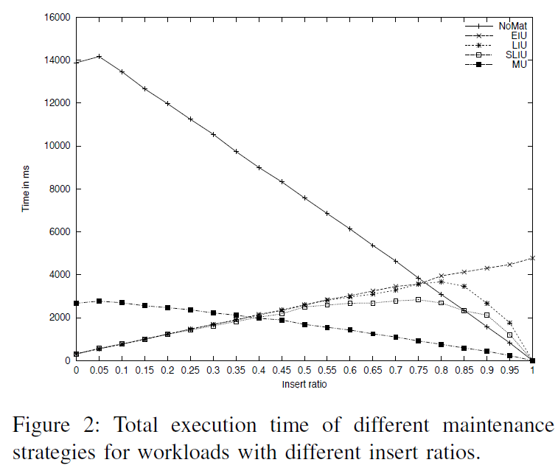
Break Even Point
Smart lazy incremental
update (SLIU) and
Merge update (MU)
We call the workload
characteristic where
the best performing
strategy changes the
break even point

Slide 11
Smart Lazy Incremental Update
For read intensive workloads
Maintenance is done when reading the materialized aggregate
After processing a select, the requested aggregate is up to date
Aggregate maintenance
Dictionary structure stores changes caused by inserts since the last maintenance point
Multiple changes for the same aggregated value are combined into one value to increase performance

Slide 12
SLIU Cost (1)
T_{select}: average time for a single read of an aggregate
Multiplied by select ratio (R_{select}) to weight costs, since they are not required for inserts
T_{dict} + T_{maintenance}: cost of a single maintenance activity
Increases with an increasing insert ratio (R_{insert}) since each insert requires a maintenance activity with corresponding aggregate request
Optimization
Maintenance cost can be optimized, in two scenarios
1. When R_{insert} ≤ 0.5, R_{insert} × (T_{dict} + T_{maintenance}) is linear
2. When R_{insert} > 0.5, R_{insert} × (T_{dict} + T_{maintenance}) is smaller because:
Possibility of combining multiple values in the dictionary structure with the same grouping attributes
Bulk maintenance where all relevant values from the dictionary structure are processed together

Slide 13

SLIU Cost (2)
Cost for a single query
Optimization function

Slide 14
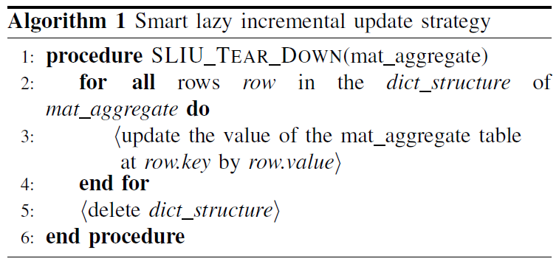
Algorithm (SLIU)
Setup
A dictionary structure is required to store the inserts that occur between two select queries
Tear down
The values from the dictionary structure have to be included into the materialized aggregate

Slide 15
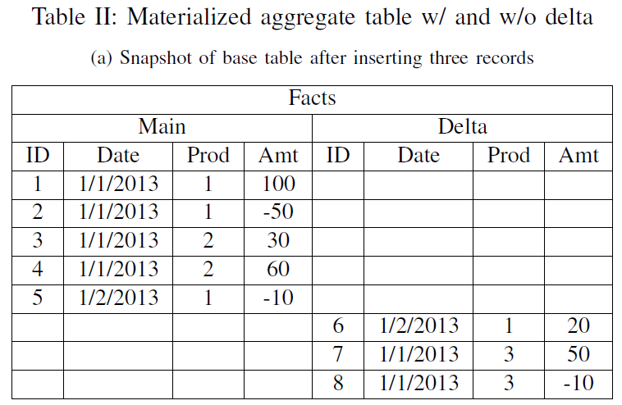
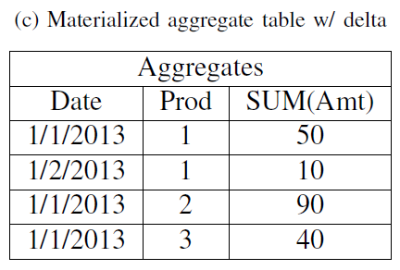
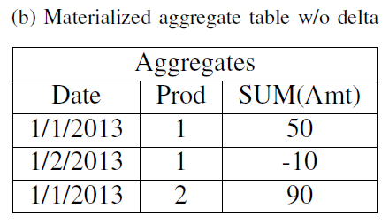
Merge Update in Action

Slide 16

Merge Update Cost
MU only creates costs when requesting an aggregate
Cost is higher than that of SLIU because of delta storage access
T_{delta}: cost for aggregating on delta
T_{union}: cost to combine T_{select} and T_{delta}

Slide 17
MU Setup and Tear Down
Setup
After switching, materialized aggregate table contains both the records of main and delta
Values from delta have to be subtracted from the materialized aggregate so that it only contains main storage records
Alternatively, can merge to transfer delta into main storage
Tear down
Values from delta have to be included into the materialized aggregate
The delta values are aggregated and the result is used to update the materialized main aggregate

Slide 18
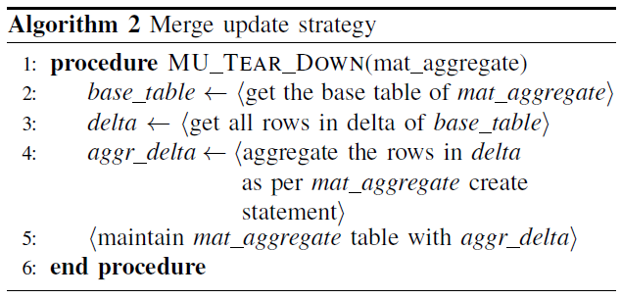
Algorithm (MU)

Slide 19
Swtiching Strategies
Main influence factor is R_{insert}
How to determine current insert ratio?
Track the last n queries
Size of the delta storage
No switching
Does not switch between different view maintenance strategies; baseline for benchmark
Switching
Each time system determines the current insert ratio, it chooses the optimal strategy ASAP

Slide 20
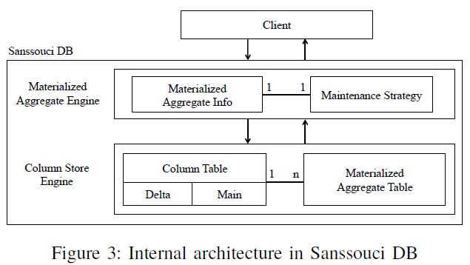
Test Setup - Architecture
Uses SanssouciDB

Slide 21
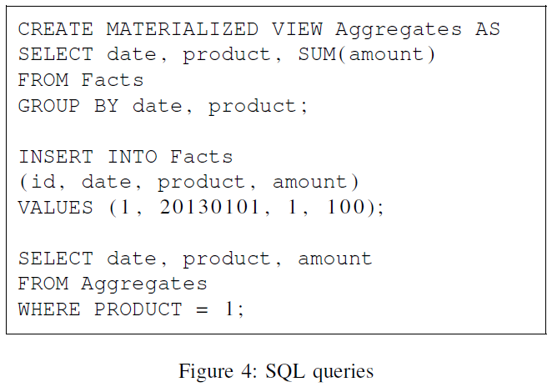
Test Setup - Data
1M record base table
Incrementally maintain aggregates
4,000 record materialized aggregate (i.e. date-product combinations)
Selects querying aggregates filtered by product
Inserts with about 1,000 different date-product combinations

Slide 22
Test Setup – Workload and Hardware
20k queries
200 phases of constant insert ratios
Between consecutive phases, insert ratios can stay constant or increase/decrease by 10%
Hardware
8 × Intel Xeon E5450 3GHz 12MB cache
64GB main memory
Benchmark
Every benchmark is run at least three times
Result is the median of the three
Switching vs. no switching
No switching is run twice; once using MU, once using SLIU

Slide 23
Evaluation Patterns Revisited

Slide 24
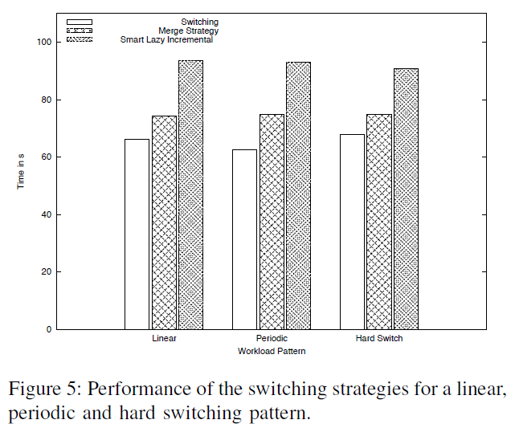
Basic Workload Patterns

Slide 25
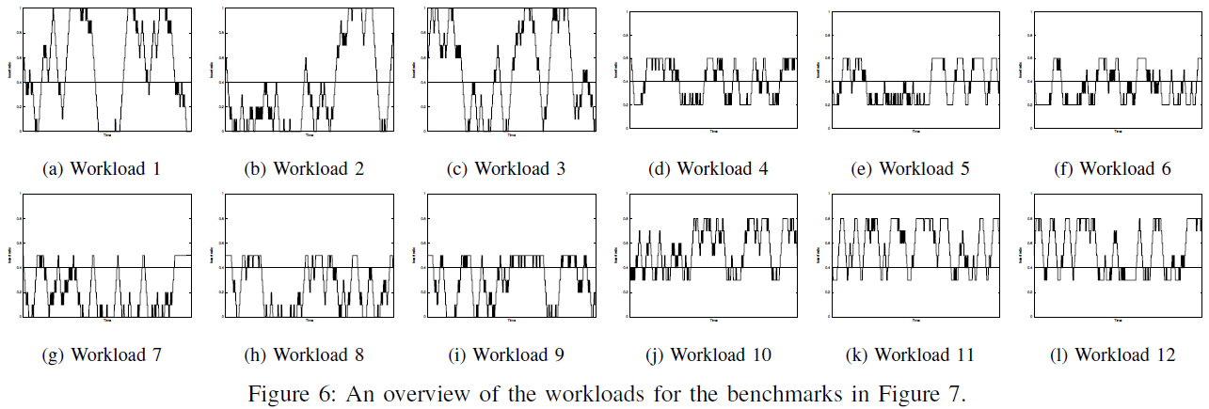
Random Workloads - Ranges
[0,1] (a – c): covers the largest possible interval
Switching improvement should be greatest
[0.2,0.6] (d – f): covers near the break even point
Switching improvement should be lower
[0,0.5] (g – i): interval beneficial for SLIU
[0.3,0.8] (j – l): interval beneficial for MU

Slide 26
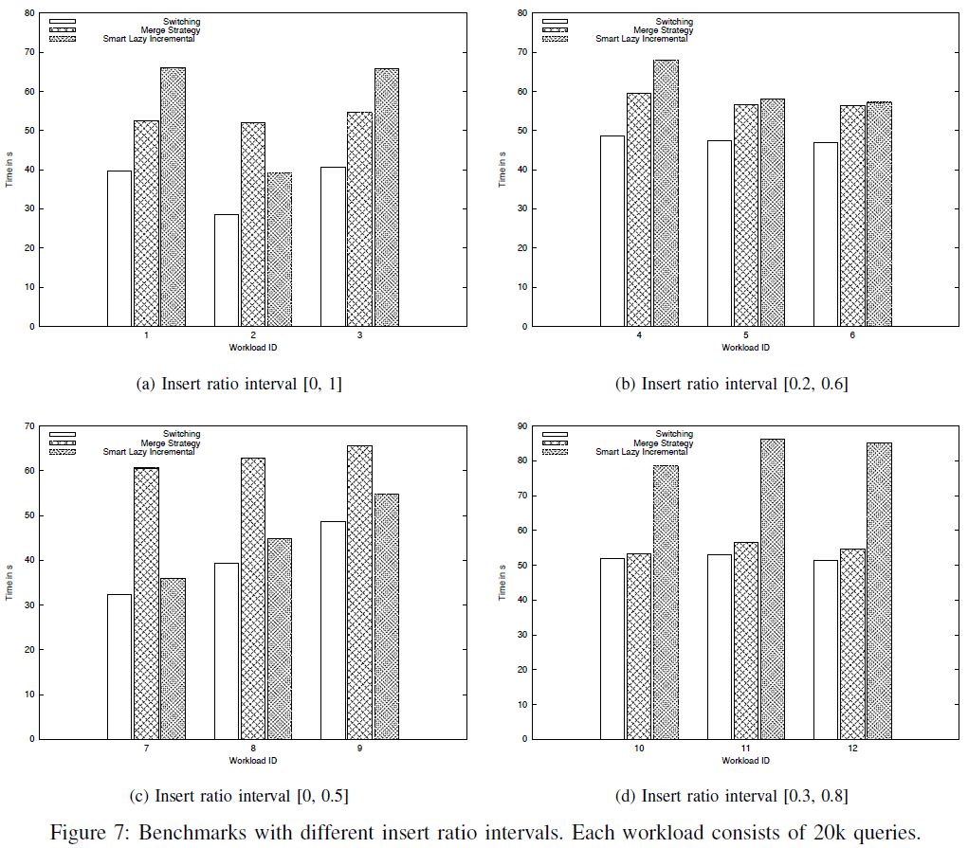
Random Workloads - Results

Slide 27
Conclusion
Contributions
Motivated the importance of materialized view maintenance in columnar IMDBs with mixed database workloads
Proposed an algorithm to select optimal view maintenance strategy
Based on ratio between reads of the materialized view and inserts to the base table affecting the view
Future Work
Extend simple switching algorithm to evaluate workload history and switch cost
Implement machine learning to predict future workload changes

Slide 28
References
[1] A. Gupta and I. S. Mumick. Maintenance of materialized views: Problems, techniques, and applications. IEEE Data Eng. Bull. 1995.
[2] R. G. Bello, K. Dias, A. Downing, J. J. F. Jr., J. L. Finnerty, W. D. Norcott, H. Sun, A. Witkowski, and M. Ziauddin. Materialized views in oracle. In VLDB, pages 659–664, 1998.
[3] J. Zhou, P.-A. Larson, and H. G. Elmongui. Lazy maintenance of materialized views. In VLDB, pages 231–242, 2007.
[4] Y. Zhuge, H. Garc´ıa-Molina, J. Hammer, and J. Widom. View maintenance in a warehousing environment. In SIGMOD, pages 316–327, 1995.
[5] D. Agrawal, A. El Abbadi, A. Singh, and T. Yurek. Efficient view maintenance at data warehouses. In SIGMOD, 1997.
[6] H. Jain and A. Gosain. A comprehensive study of view maintenance approaches in data warehousing evolution. SIGSOFT Softw. Eng. Notes 2012.
[7] I. S. Mumick, D. Quass, and B. S. Mumick. Maintenance of data cubes and summary tables in a warehouse. In SIGMOD, 1997.
[8] S. Chaudhuri and V. Narasayya. Self-tuning database systems: a decade of progress. In VLDB, 2007.
[9] S. Agrawal, E. Chu, and V. Narasayya. Automatic physical design tuning: Workload as a Sequence. In SIGMOD, 2006.

