Slide 1
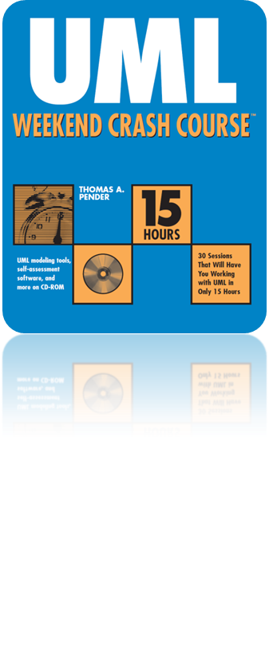
Session17
Applying the Sequence Diagram to the Case Study
Written by Thomas A. Pender
Published by Wiley Publishing, Inc.
October 20, 2011
Presented by So-min Kim

Slide 2
Contents
Building a Sequence Diagram from a Scenario

Slide 3
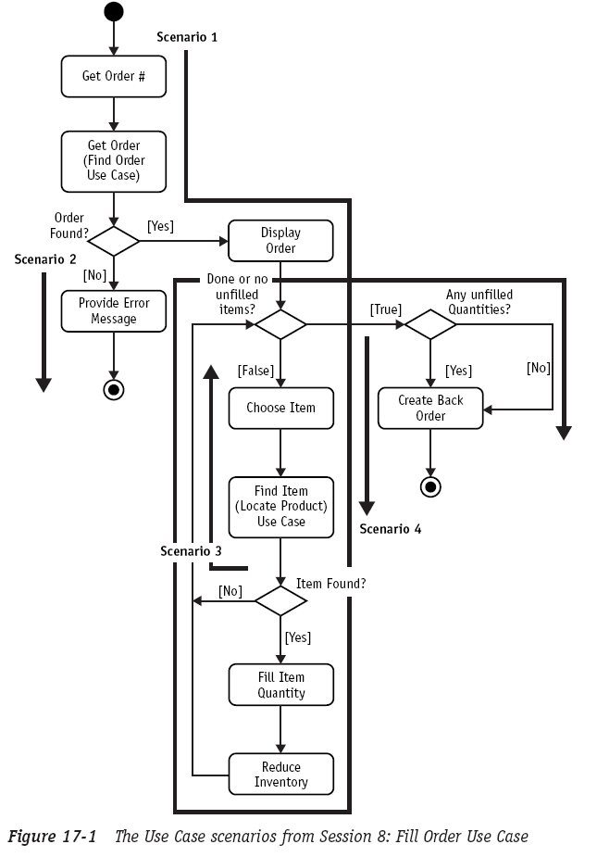
Building a Sequence Diagram from a Scenario (1/10)

Slide 4
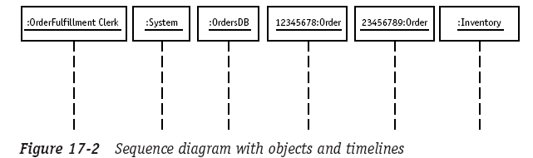
Building a Sequence Diagram from a Scenario (2/10)
Scenario 1
  Each object is placed at the top of the diagram

Slide 5
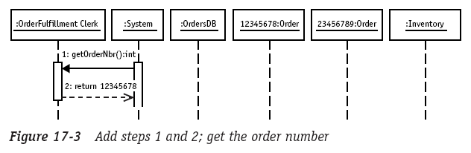
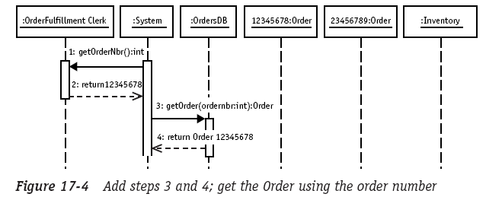
Building a Sequence Diagram from a Scenario (3/10)
Scenario 1 (cont.)

Slide 6
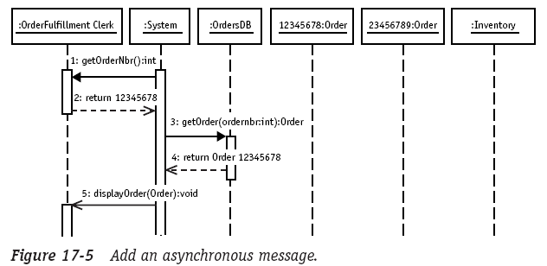
Building a Sequence Diagram from a Scenario (4/10)
Scenario 1 (cont.)

Slide 7
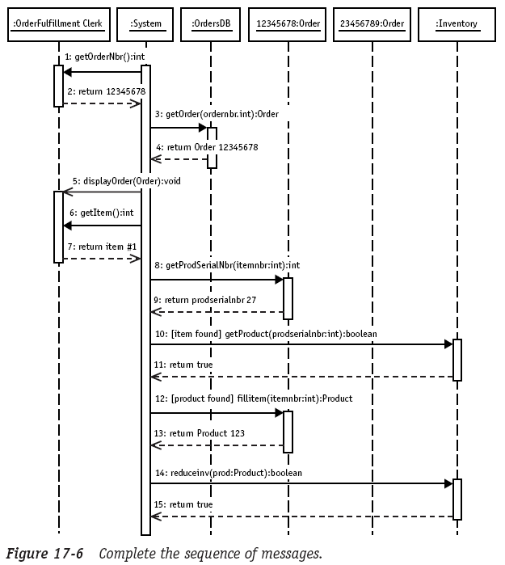
Building a Sequence Diagram from a Scenario (5/10)
Scenario 1 (cont.)

Slide 8
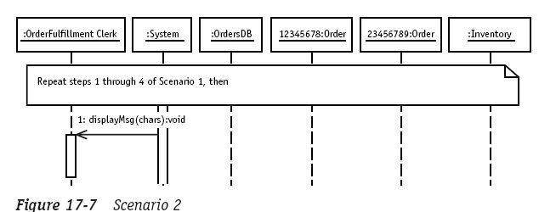
Building a Sequence Diagram from a Scenario (6/10)
Scenario 2
  The comment referring to steps 1 through 4 of Scenario 1 helps you avoid having to repeat all the steps you’ve already documented in the previous Sequence diagram

Slide 9
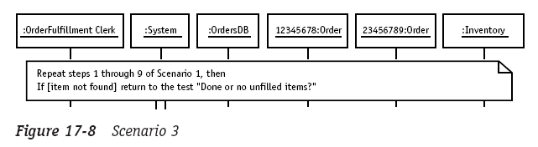
Building a Sequence Diagram from a Scenario (7/10)
Scenario 3

Slide 10
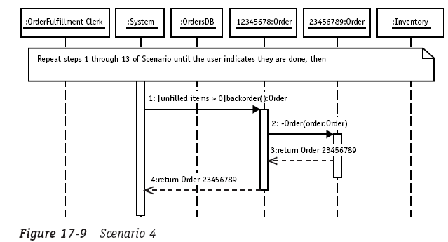
Building a Sequence Diagram from a Scenario (8/10)
Scenario 4

Slide 11
Building a Sequence Diagram from a Scenario (9/10)
To construct the Sequence diagram
  Identify the participating objects
  Line them up across the top of the diagram
  Draw a vertical dashes line below each object, representing a timeline
  Each message in the sequence becomes at least one horizontal arrow from the sending object’s timeline to the receiving object’s timeline
    The type of arrow depends on the type of message.
  For a synchronous message or procedure call that requires a reply, draw a solid line with a solid arrowhead
  For the reply, place a second horizontal arrow below the first
    Use a dashed line-style arrow for replies.
  Continue to represent each message as a horizontal arrow, placing each new message below the previous one, until all the messages have been translated onto the Sequence diagram

Slide 12
Building a Sequence Diagram from a Scenario (10/10)
The goal of Sequence diagram
  It models interactions between objects
    To discover the interfaces required for each object and to validate that each interface is actually used
    Much better understanding of the design of the objects and the performance impact on the application as you visualize the volume and complexity of the communication

Slide 13
The End

