Slide 1
Detecting Friendship within Dynamic Online Interaction Networks
Sears Merritt, Abigail Z. Jacobs, Winter Mason, and Aaron Clauset
ICWSM 2013
26 Dec 2013
Hyewon Lim

Slide 2
Outline
Introduction
Data and Survey
Inferring Friendship
Conclusion

Slide 3

Introduction
Which users are “friends”?
Word-of-mouth advertising
Product recommendations
Detecting hidden social relationships
…

Slide 4
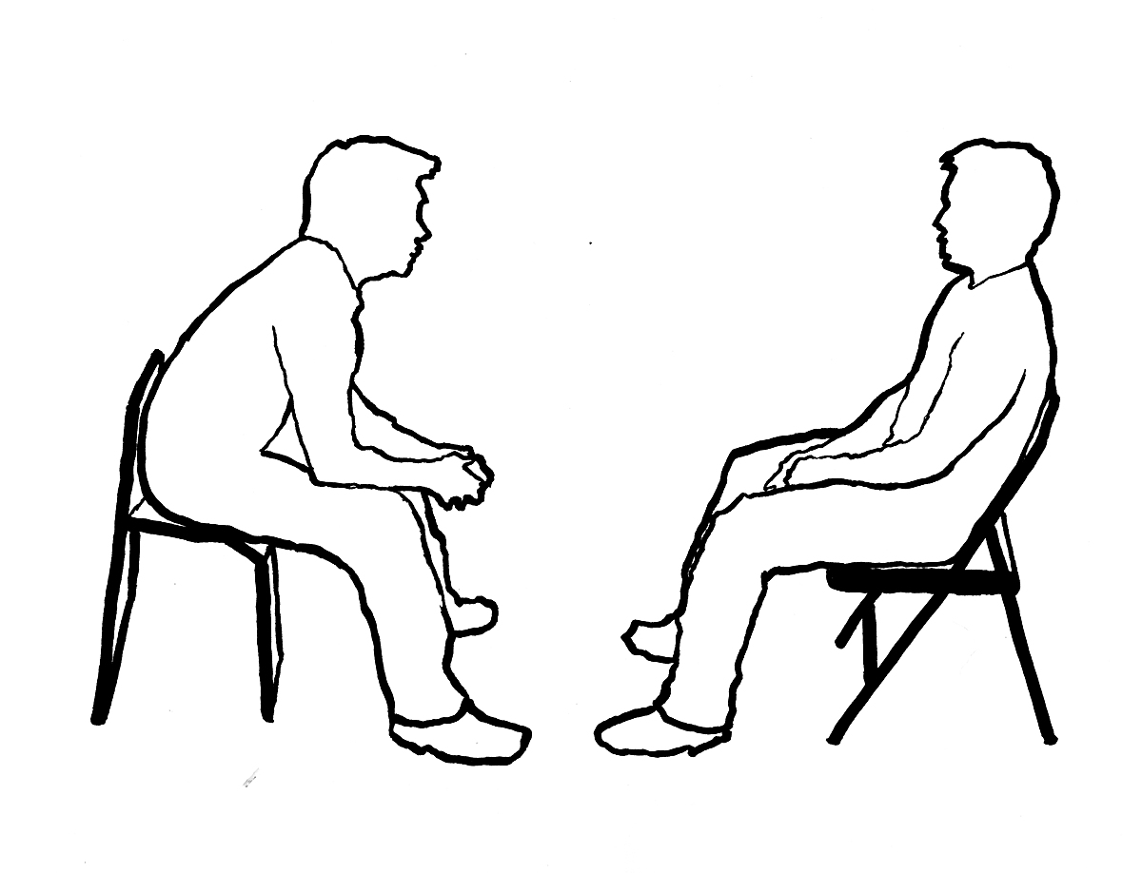
Introduction
Whether hidden or latent friendship ties can be inferred from interaction data alone
Citations between scientists
Appearances together in photos
Exchanges of tweets
Phone calls
Playing games together
…

Slide 5
Outline
Introduction
Data and Survey
Inferring Friendship
Conclusion

Slide 6

Data and Survey
Halo: Reach
A popular online first person shooter game
Matchmaking algorithm based on the “TrueSkill”
Data
700M game instances
Roughly 305 days of activity by 17M individuals
Each game file includes a timestamp, game type label, and a list of gamertags
Gamertag
Associate with a particular team and a set of attributes indicating specific cooperative behavior actions
No information about which interactions are produced by friendships versus non-friendships

Slide 7

Data and Survey
The participant identified which individuals were friends
Of the 965 participants, 847 individuals appear in the data
14,045 latent friendship ties and 7,159,989 non-friendship ties
Mostly disconnected egocentric subgraphs

Slide 8
Data and Survey
Interaction network
Two vertices are connected
They appear in a game instance together at time t (10 min intervals)
Complete game sample
17,286,270 vertices / 18,305,874,864 temporal edges (305 days)
Survey participants
2,531,479 vertices / 665,401,283 temporal edges (305 days)
A
B
Same team or not
Game type
# games played together at time t

Slide 9
Outline
Introduction
Data and Survey
Inferring Friendship
Conclusion

Slide 10
Inferring Friendship
Supervised learning approach
Classification trees
Logistic regression classifier
For predicting latent ties
Temporal class
Cooperative class
Notes:
Temporal보다 Cooperative에서 얻을 수 있는 신호가 더 많은 것 같다는 예상

Slide 11


Inferring Friendship Temporal Features
Pair autocorrelation
“Interaction periodicity”
Friends play many more consecutive games than non-friends
Continuous interaction over a significant span of time is likely an indication of a latent tie
Autocorrelation
→ If x and y are friends, we expect n_{x,y}(t) to exhibit stronger periodicity
→ If n_{x,y}(t) is generated by a friend pair, we expect AC_{x,y} to be large
Notes:
Autocorrelation: 시각 t₁일 때의 값 x(t₁)과 시각 t₂일 때의 값 x(t₂) 사이에 존재하는 상관
이전 연구에 보면, 친구는 2시간 동안 평균 12게임정도, 친구 아니면 1.25게임 정도를 연속으로 함.

Slide 12

Inferring Friendship Temporal Features
Pair frequency
Captures the share of x’s interactions that involve y
Individual entropy
Schedule entropy H_{t}(x)
Spatial entropy H_{s}(x)
All pairs of schedule and spatial locations H_{t,s}(x)
For predicting friendships
Take the sum of the individuals’ entropies, i.e., H_{t}(x) + H_{t}(y)
Notes:
2.
앞에 autocorrelation은 time interval을 따지는거고, 얘는 fixed time period에서 재는 것.
3.
Sum 한 값이 작으면 entropy가 낮다는 거니까 굉장히 typical한 생활을 하고 있다는 증거

Slide 13



Inferring Friendship Cooperative Features
Betrayals
Occasionally friends are placed on opposing teams
Increased betrayal rate → friends on one team turn against their teammates
Direct assistance
Indirect assistance
Notes:
Temporal feature → explicitly ignore the character of the interactions

Slide 14
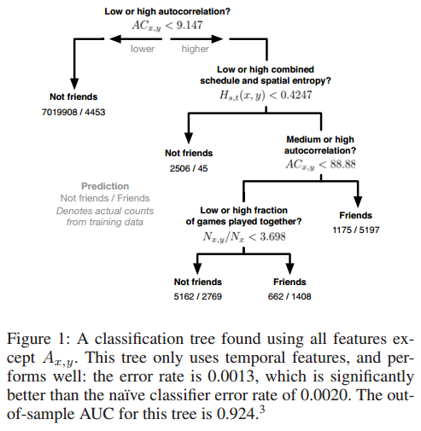
Inferring Friendship Predicting Latent Friendships
Classification trees
Which features or combinations are likely to be predictive
Compared to random forests
Notes:
이 트리는 temporal feature만 가지고 만든 것.
모든 feature를 다 쓰거나, assist를 제외한 feature로 만들어도 비슷한 결과가 나옴. (AUC가 0.83정도)

Slide 15
Inferring Friendship Predicting Latent Friendships
Classification trees
Temporal features are most useful for correctly predicting friendship
Highly periodic interactions are strongly indicative of friendship
Fitting the model with just the cooperative features
Yields classification probabilities nearly as high (AUC = 0.789)
Direct assistance → direct assistance → indirect assistance
Entropy features
Not particularly useful by themselves
Become predictive for high values of autocorrelation
Allow to identify non-friends who have autocorrelated schedules

Slide 16
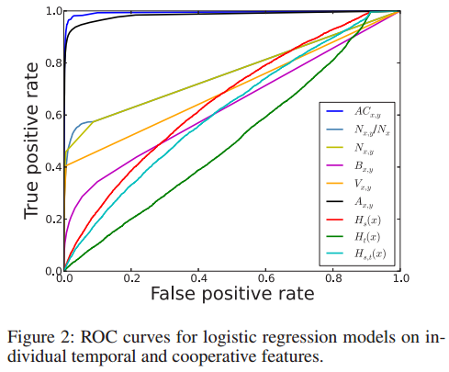
Inferring Friendship Lightweight Predictors of Friendship
Individual features alone may perform well
Using logistic regression to build single-feature latent tie classifier
Measure their performance using AUC
Autocorrelation
Normalized pair frequency
Pair frequency
Betrayals
Indirect assists
Direct assists
Loc. entropy
Sched. entropy
Sched.+Loc. entropy
Notes:
Indirect assistance (V_{x,y}) → uncommon event
Entropy를 physical location으로 연구할땐 좋게 나오는데, 여기서 낮은 이유는 location이 많지 않아서(맵이 얼마 안된다는 뜻인듯).
Betrayal feature also correlate with latent friendship: avg betrayal total <B_{x,y}>=6.27 for friend pairs but only 0.5 for non-friend pairs.

Slide 17
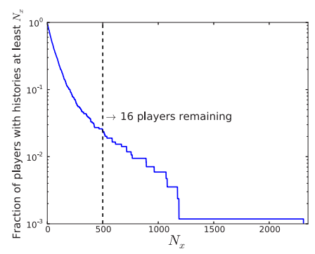
Inferring Friendship Predicting Friendships for Casual Users
How robust features are to the amount of available information
Study the performance of each individual feature as a function of N_{x}, the length of an individual’s history
Notes:
N_{x} : the number of games played
Y축은 CCDF로 나타낸 것. CCDF = 1 – CDF(: 누적분포함수)

Slide 18
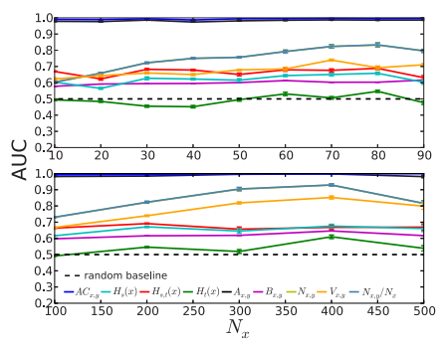
Inferring Friendship Predicting Friendships for Casual Users
How robust features are to the amount of available information
Study the performance of each individual feature as a function of N_{x}, the length of an individual’s history
Notes:
N_{x} : the number of games played
Game 수가 10 이하여도 autocorrelation과 direct assistance의 AUC가 굉장히 높음.

Slide 19
Outline
Introduction
Data and Survey
Inferring Friendship
Conclusion

Slide 20
Conclusion
Motivating question
Whether latent social ties like friendships can be accurately recovered from interaction data alone
→ This paper shown that they can, with remarkable accuracy!
Robust indicators of friendship
Periodicity between interactions
Specific prosocial behaviors across these interactions
“friendship-aware matchmaking algorithm”
The result could be applied in an unsupervised manner

