Slide 1
Jena Property Table Implementation
Kevin Wilkinson
Second International Workshop on Scalable Semantic Web Knowledge Base Systems, 2006
Jan 16, 2014
Kyung-Bin Lim

Slide 2
Outline
Introduction
Property Tables
Discussion
Conclusion

Slide 3
RDF
RDF (Resource Description Framework)
Designed by W3C
The most prominent standards by W3C
Unit: Triple Structure (Subject – Predicate – Object)
Predicate
Subject
Object

Slide 4
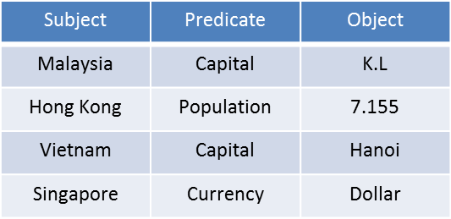
Triple Store
A common approach to store RDF in RDB
Store in a three-column table
Each table row represents one RDF statement

Slide 5
Limitations
Many RDF datasets have a significant amount of regularity
Frequently occurring patterns of statements
i.e. an employee dataset might include for each employee, an employee number, a name, location, phone, etc.
Need to leverage this regularity

Slide 6
Property Tables
Take advantage of regularity in RDF datasets
Stores a number of related properties together in a table
Reduced storage requirements and faster access times
Each table row represents one OR more RDF statement

Slide 7
Outline
Introduction
Property Tables
Discussion
Conclusion

Slide 8
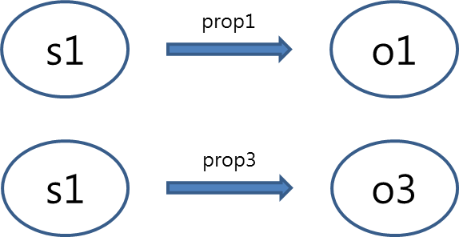
Single-valued Property Table
Store values for one or more properties that have cardinality of one
Subject column serves as the table key
Each property column stores an object value or be null
Each row represents as many RDF statements as it has non-null values
subj | prop1 | prop2 | prop3 | prop4
s1 | o1 | null | o3 | null
s2 | ∙∙∙ | ∙∙∙ | ∙∙∙ | ∙∙∙
∙∙∙ | ∙∙∙ | ∙∙∙ | ∙∙∙ | ∙∙∙

Slide 9
Multi-valued Property Table
Store a single property that has a maximum cardinality greater than one
Subject and object value serve as the table key (compound key)
Each row represents a single RDF statement
Property column value may not be null
<prop2>
s1
prop2
o2
subj | obj
s1 | o2
s1 | o4
s2 | o3
∙∙∙ | ∙∙∙
s1
prop2
o4
s2
prop2
o3

Slide 10
Property-class Table
Stores all members of a class together
<BookType>
subj | title | author | copyright | type
ID1 | “XYZ” | Fox, Joe | 2001
ID3 | “MNP” | null | null
ID6 | null | null | 2004
∙∙∙ | ∙∙∙ | ∙∙∙ | ∙∙∙ | ∙∙∙

Slide 11
Outline
Introduction
Property Tables
Discussion
Conclusion

Slide 12
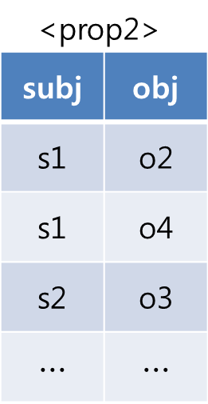
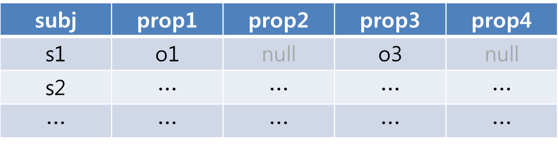
Add Statement
Multi-valued property table
Creates a new row
Single-valued property or Property-class table
If the subject does not exist
Create a new row
If the subject already exist
Update the row with property value
Optimization of Single-valued property table
When inserting series of statement (assume ordered)

Slide 13
Delete Statement
Multi-valued property table
Removes the row
Single-valued property or Property-class table
Changes the column value to null
If all property columns are null as a result, remove the row
Optimization of Single-valued property table
When deleting series of statement (assume ordered)

Slide 14
Advantages
Generate better plans over property tables than over a triple store
For efficient query plan: choose the most selective predicate (Age or IQ)
Query optimizer looks at the property tables
SELECT ?s
WHERE { ?s ex:hasAge 50.
?s ex:hasIQ 150 }
<hasAge>
subj | age
s1 | 50
s2 | ∙∙∙
∙∙∙ | 50
∙∙∙ | ∙∙∙
<hasIQ>
subj | IQ
s4 | 150
s6 | ∙∙∙

Slide 15
Advantages
Joins can be eliminated (assume predicates are single-valued)
In triple store, this query requires a join
In single-valued property table, store both ex:p1 and ex:p2 as columns in the same table
We can process the query as a selection over the table
SELECT ?s
WHERE { ?s ex:p1 10.
?s ex:p2 25}
subj | ex:p1 | ex:p2 | ∙∙∙ | ∙∙∙
s1 | 10 | 3 | ∙∙∙ | ∙∙∙
s2 | 4 | 25 | ∙∙∙ | ∙∙∙
s3 | 10 | 25 | ∙∙∙ | ∙∙∙

Slide 16
Outline
Introduction
Property Tables
Discussion
Conclusion

Slide 17
Conclusion
Efficient storage for frequently occurring pattern
Space efficient
Better query plan
Makes a good use of query optimizer
Eliminate possible joins

