Slide 1
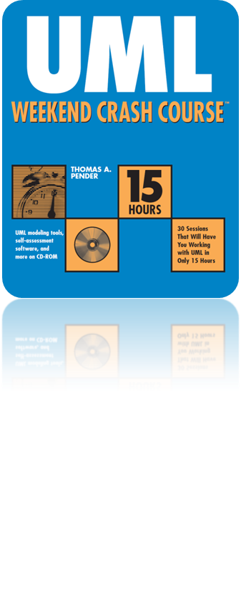
Session 11
The Class Diagram:
Aggregation and Generalization
Written by Thomas A. Pender
Published by Wiley Publishing, Inc.
October 12, 2011
Presented by Hyewon Lim

Slide 2
Contents
Modeling Aggregation and Composition
Modeling Generalization

Slide 3
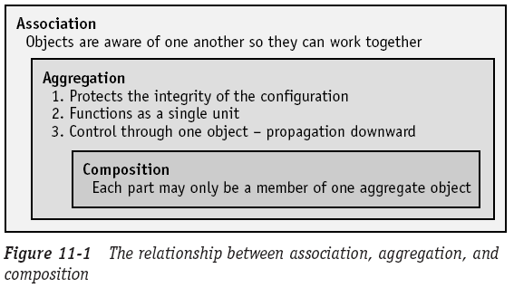
Modeling Aggregation and Composition (1/6)
Every aggregation relationship is a type of association
  All the properties of an association relationship + some rules of its own
Every composition relationship is a form of aggregation
  All the properties of an aggregation + some rules of its own

Slide 4
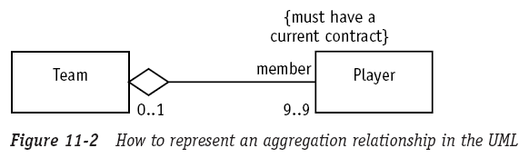
Modeling Aggregation and Composition (2/6)
Aggregation
  A special type of association
  Used to indicate that the participating objects are not just independent objects that know about each other
  They are assembled or configured together to create a new,
  more complex object
Model aggregation on a Class diagram
Notes:
To model on a Class diagram:
Aggregation으로 나타내어야 할 class 사이에 association (a line)을 그림.
Figure 11-2에서는 Team class와 Player class 사이에 라인을 그렸음.
Association 양 쪽 중에서 Aggregation class인 쪽에다가 다이아몬드를 그림.
Figure 11-2에서는 Team이 player들의 group임을 나타냄.
Association 양 끝에다가 적절한 multiplicities를 할당하고, 관계의 rule을 정의하기 위한 role이나 constraint들을 추가함.
Figure 11-2에서는 member가 1개보다 많은 팀에 속하면 안되고, 모든 member가 Team에 속하는 건 아님(0..1로 표현).
Team은 항상 9명의 player로 구성되어야 함(9..9 or 9로 표현).
Player는 Team의 “member”라고 표현(role을 “member”라고 지정했음).
모든 Player는 Team의 member가 되기 위해서 “must have a current contract” 라는 제약조건을 갖는다.

Slide 5
Modeling Aggregation and Composition (3/6)
Aggregation describes a group of objects in a way that changes how you interact with them
The concept is aimed at protecting the integrity of a configuration of objects in two specific ways
  Aggregation defines a single point of control in the object that represents the assembly
  When an instruction is given that might effect the entire collection of objects, the control object dictates how the members will respond
Notes:
Aggregation은 객체들을 그룹화하여 그룹 내부의 객체와 그룹 외부의 객체가 상호 작용하는 방법의 변화를 기술한다.
이 개념은 두 가지 측면에서 객체 구성의 무결성을 보장한다.
Aggregation은 집합체를 대표하는 객체에서 단일 제어 지점(single point of control)을 정의한다. 이것을 제어 객체(Control object)라고 하며, 외부의 어떤 객체가 집합체의 멤버와 통신하는 행위를 허용할 것인지 최종 결정한다.
Control object는 집합체 전체에 영향을 주는 명령을 받은 경우 member들이 응답해야 하는 방법을 기술한다. 따라서 집합체는 주어진 명령에 대해 마치 하나의 객체처럼 기능을 수행한다.

Slide 6
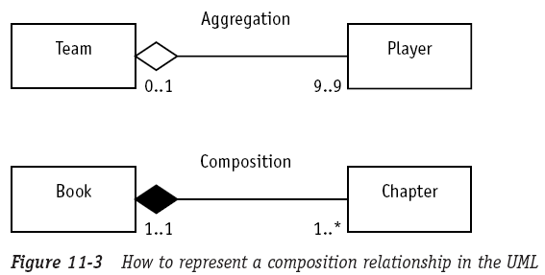
Modeling Aggregation and Composition (4/6)
Composition
  Used for aggregations where the life span of the part depends on the life span of the aggregate
  The aggregate has control over the creation and destruction of the part
    The member object cannot exist apart from the aggregation
Notes:
Aggregation과 composition은 multiplicity로도 구분할 수 있다.
Team은 (0..1)로 player가 team에 속할 수도, 속하지 않을 수도 있지만,
Book은 (1..1)로써, chapter가 반드시 book에 속해야 함을 나타낸다.

Slide 7
Modeling Aggregation and Composition (5/6)
Creating aggregation and composition relationships
Our company maintains a group of race cars. Our cars use some of our
new 8-cylinder engines and new transmissions. Once the engines are
assembled, the pistons, carburetor, and plugs cannot be swapped between
engines due to changes caused by the high temperatures.
We want to keep records of the performance achieved by each engine in
each car and each transmission in combination with each engine.
Our drivers evaluate each car to give us their assessment of the handling.
We need a system to track the configurations and the drivers’ assessments.
Notes:
문제:
우리 회사는 경주용 자동차를 만든다. 경주용 자동차는 8-실린더 엔진과 신모델 트랜스미션을 장착한다. 엔진이 한번 만들어지면 피스톤, 캬뷰레터와 플러그는 고온에서 변형되므로 서로 다른 엔진들 사이에 바꾸어 장착할 수 없다.
우리는 자동차에 장착된 각각의 엔진에 대해서, 엔진과 결합된 각각의 트랜스미션의 성능을 평가한 자료를 관리하고 싶다. 시험 운전자들은 자동차를 평가하여 평가서를 제출한다. 우리는 엔진과 트랜스미션의 결합과 평가 자료를 관리하는 시스템이 필요하다.

Slide 8
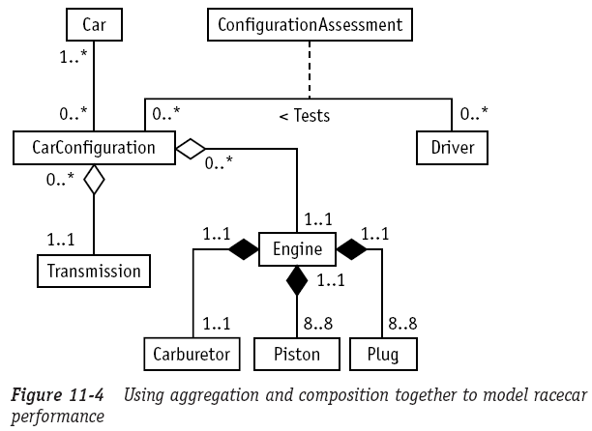
Modeling Aggregation and Composition (6/6)
Creating aggregation and composition relationships

Slide 9
Contents
Modeling Aggregation and Composition
Modeling Generalization

Slide 10
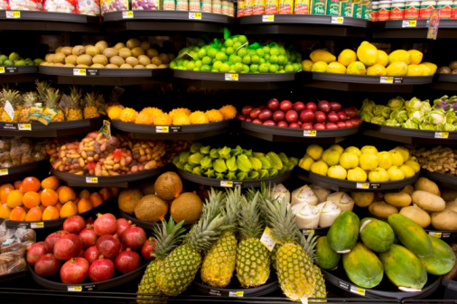
Modeling Generalization (1/11)
Generalization
  The process of organizing the properties of a set of objects that share the same purpose
  Use this process routinely to organize large amounts of information
  “kind of” or “type of”

Slide 11
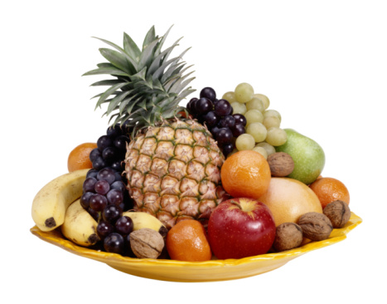
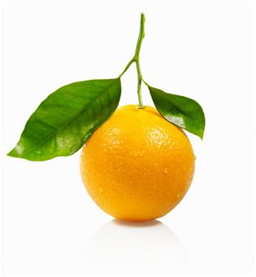



Modeling Generalization (2/11)
Generalization and inheritance
Generalization
Inherits all the
properties of fruit
Specialization:
Adds some unique properties
that only apply to applies

Slide 12
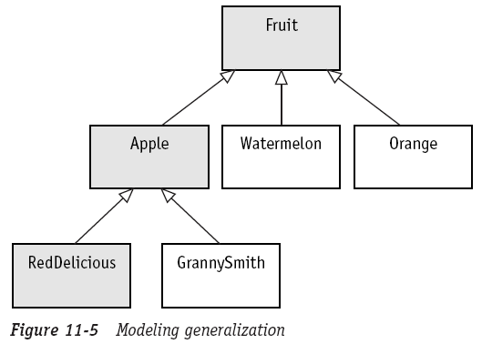
Modeling Generalization (3/11)
A generalization is not an association
  Association define the rules for how objects may relate to one another
  Generalization relates classes together where each class contains a subset of the elements needed to define a type of object
  No need for multiplicity, roles, and constraints
Notes:
Red Delicious Apple을 만들고 싶다면, RedDelicious class와 Apple class, Fruit class를 합쳐서 모든 attribute들과 operation들을 갖도록 해야 한다. 이렇게 합쳐진 class를 통해, RedDelicious (apple) 타입의 object를 만들어낼 수 있다.
“Red Delicious”는 apple 타입이며, apple은 fruit 타입이다. 이런 이유로 generalization을 “is a” relationship이라고도 한다.

Slide 13

Modeling Generalization (4/11)
Protected visibility
  Allows only objects of the same class or subclasses to see the element

Slide 14
Modeling Generalization (5/11)
To draw a generalization relationship
  Superclass
    Contains the traits that are common to every object in the set
  Subclass
    Contains a unique set of properties for only certain objects within the set
    A class my be both a superclass and a subclass
  Abstract class
    A class that cannot create objects (cannot be instantiated)
    Abstract
      Any superclass that defines at least one operation that does not have a method
    Only a superclass can be abstract

Slide 15
Modeling Generalization (6/11)
To draw a generalization relationship
  Concrete class
    A class that has a method for every operation, so it can create objects
    The methods may be defined in the class or inherited from a superclass
    All classes at the bottom of a generalization hierarchy must be concrete
    Any superclass may be concrete
  Discriminator
    An attribute or rule that describes how I choose to identify the set of subclasses for a superclass
    The discriminator I choose depends on the problem I am trying to solve

Slide 16

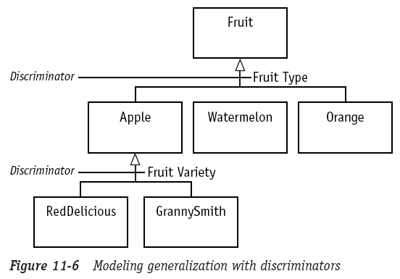
Modeling Generalization (7/11)
Superclass
Subclass
Concrete class

Slide 17
Modeling Generalization (8/11)
Two ways to draw a generalization
  In either form, draw a triangle at the superclass end of the generalization line (pointing to the superclass)
How to model generalization
  Specialization (the most general class → the most specialized classes)
  Generalization (the most specialized classes → the most generalized class)

Slide 18
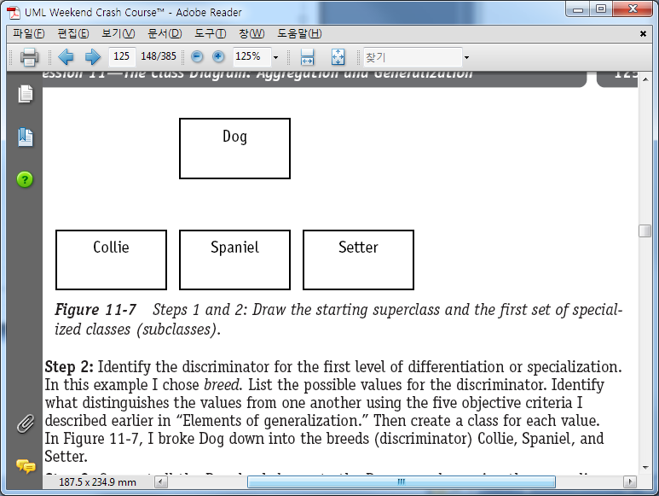
Modeling Generalization (9/11)
Example: specialization
  Step 1: Draw the starting superclass
  Step 2: Identify the discriminator (“breed”) for the first level of differentiation or specilazation, then create a class for each value

Slide 19
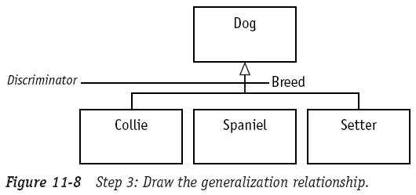
Modeling Generalization (10/11)
Example: specialization
  Step 3: Connect all the Breed subclasses to the Dog superclass using the generalization relationship & place the discriminator label on the line

Slide 20
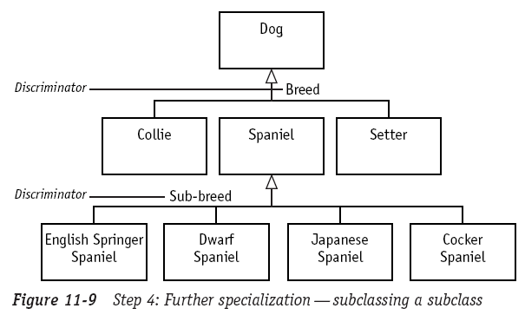
Modeling Generalization (11/11)
Example: specialization
  Step 4: The process continues by repeating the steps for each new subclass I create

Slide 21
The End

