Slide 1
Chapter 7 – Classification and Regression Trees
Data Mining for Business Intelligence
Shmueli, Patel & Bruce
© Galit Shmueli and Peter Bruce 2008

Slide 2
Trees and Rules
Goal: Classify or predict an outcome based on a set of predictors
The output is a set of rules
Example:
Goal: classify a record as “will accept credit card offer” or “will not accept”
Rule might be “IF (Income > 92.5) AND (Education < 1.5) AND (Family <= 2.5) THEN Class = 0 (nonacceptor)
Also called CART, Decision Trees, or just Trees
Rules are represented by tree diagrams

Slide 3
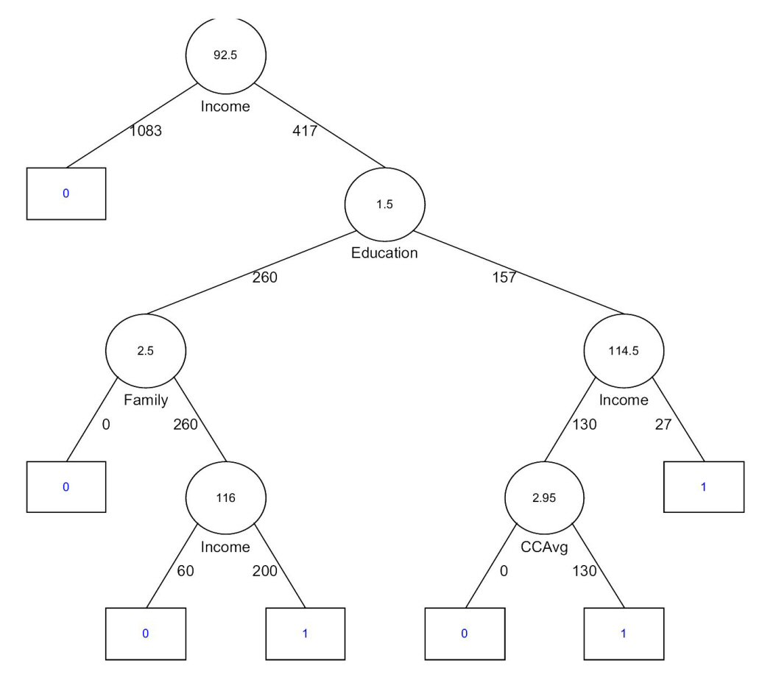

Slide 4
Key Ideas
Recursive partitioning: Repeatedly split the records into two parts so as to achieve maximum homogeneity within the new parts
Pruning the tree: Simplify the tree by pruning peripheral branches to avoid overfitting

Slide 5
Recursive Partitioning

Slide 6
Recursive Partitioning Steps
Pick one of the predictor variables, x_{i}
Pick a value of x_{i,} say s_{i}, that divides the training data into two (not necessarily equal) portions
Measure how “pure” or homogeneous each of the resulting portions are
  “Pure” = containing records of mostly one class
Idea is to pick x_{i,} and s_{i} to maximize purity
Repeat the process

Slide 7
Example: Riding Mowers
Data: 24 households classified as owning or not owning riding mowers
Predictors = Income, Lot Size

Slide 8
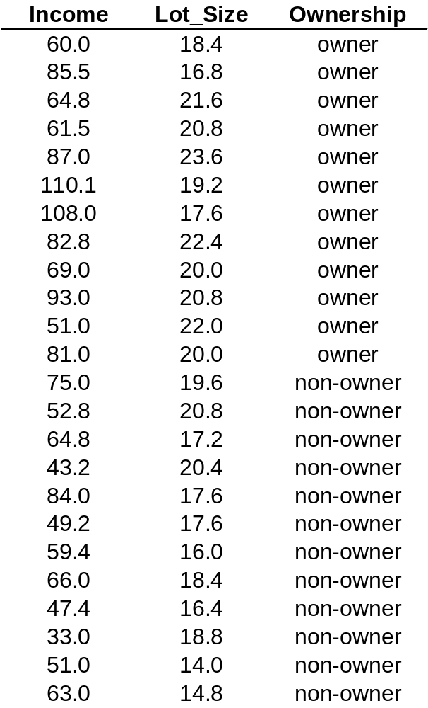

Slide 9
How to split
Order records according to one variable, say lot size
Find midpoints between successive values
E.g., first midpoint is 14.4 (halfway between 14.0 and 14.8)
Divide records into those with lot size > 14.4 and those < 14.4
After evaluating that split, try the next one, which is 15.4 (halfway between 14.8 and 16.0)

Slide 10
Note: Categorical Variables
Examine all possible ways in which the categories can be split.
E.g. categories A, B, C can be split 3 ways
  {A} and {B, C}
  {B} and {A, C}
  {C} and {A, B}
With many categories, # of splits becomes huge
XLMiner supports only binary categorical variables

Slide 11
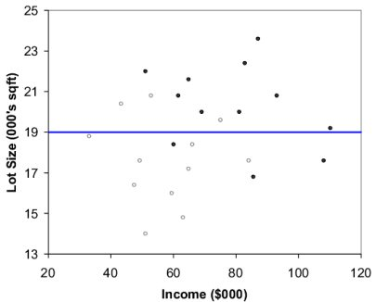
The first split: Lot Size = 19,000

Slide 12
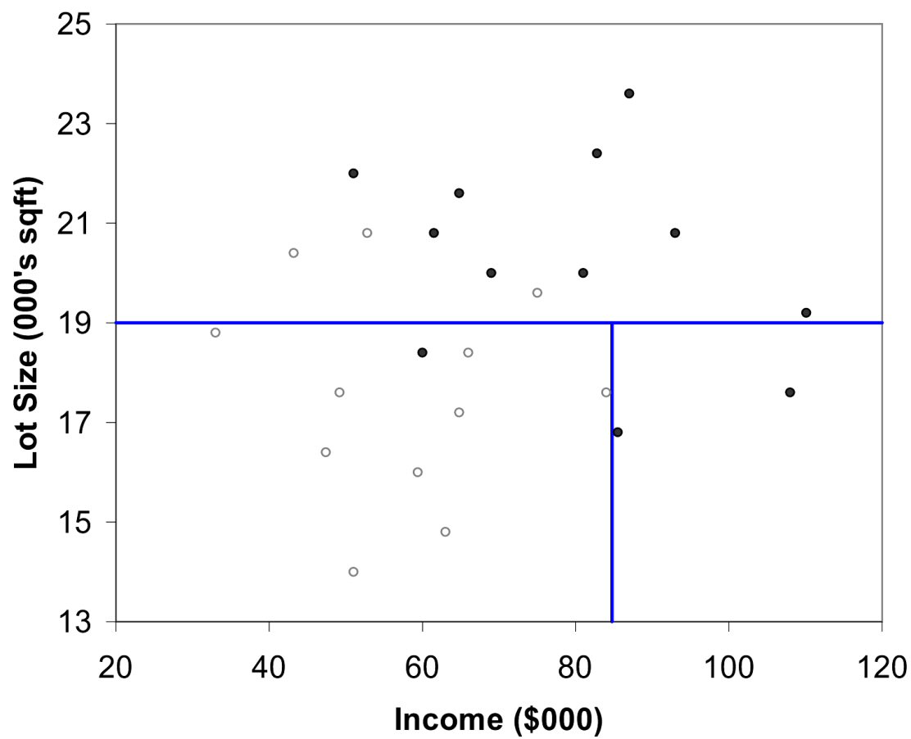
Second Split: Income = $84,000

Slide 13
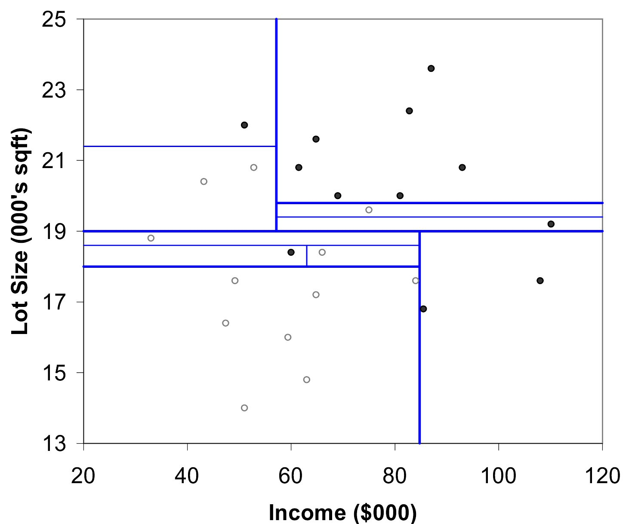
After All Splits

Slide 14
Measuring Impurity

Slide 15
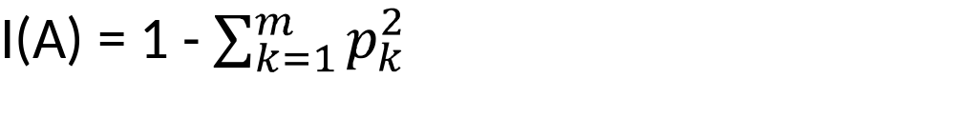
Gini Index
Gini Index for rectangle A containing m records
p = proportion of cases in rectangle A that belong to class k
I(A) = 0 when all cases belong to same class
At a max when all classes are equally represented (= 0.50 in binary case)
Note: XLMiner uses a variant called “delta splitting rule”

Slide 16
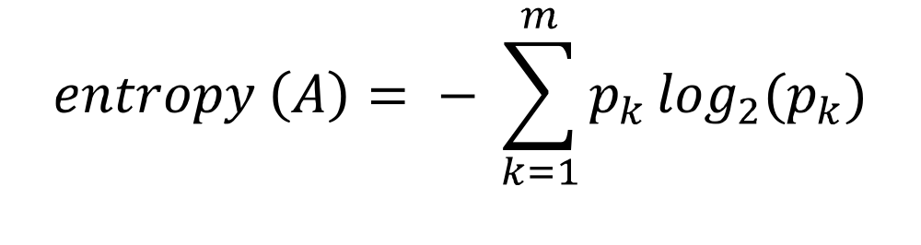
Entropy
p = proportion of cases (out of m) in rectangle A that belong to class k
Entropy ranges between 0 (most pure) and log₂(m) (equal representation of classes)

Slide 17
Recursive Partitioning
Obtain overall impurity measure (weighted avg. of individual rectangles)
At each successive stage, compare this measure across all possible splits in all variables
Choose the split that reduces impurity the most
Chosen split points become nodes on the tree

Slide 18
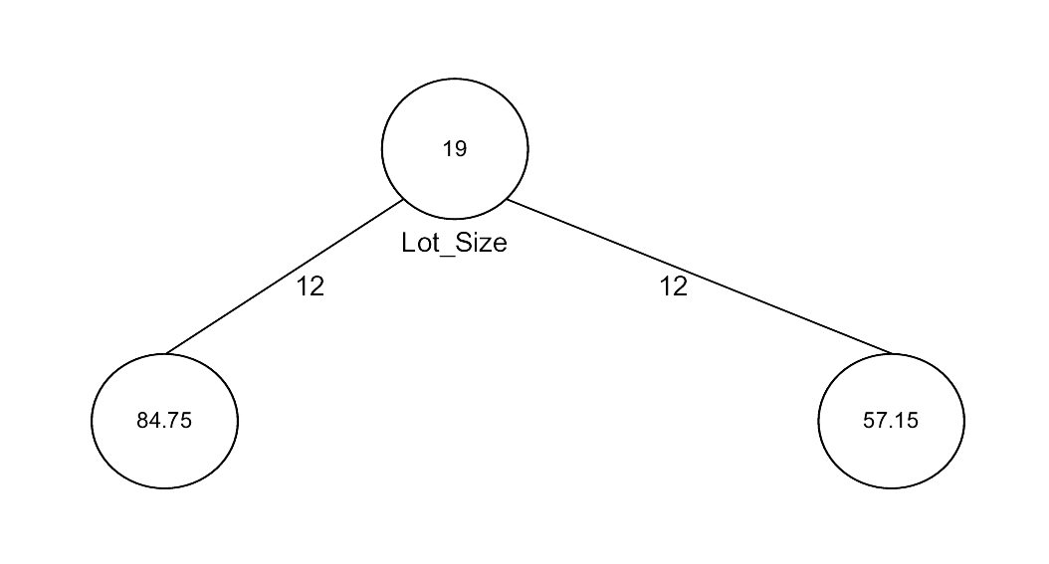
First Split – The Tree

Slide 19
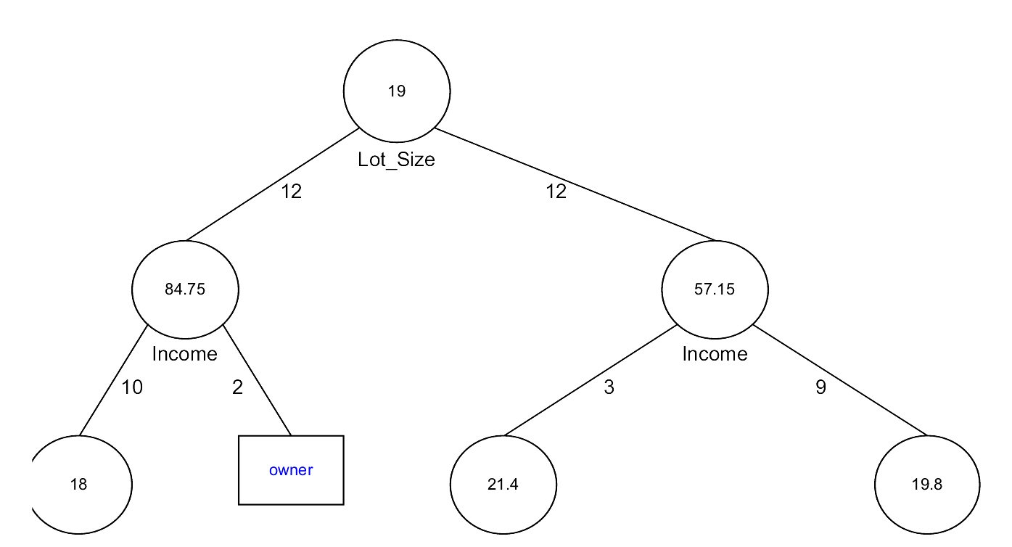
Tree after second split

Slide 20
Tree Structure
Split points become nodes on tree (circles with split value in center)
Rectangles represent “leaves” (terminal points, no further splits, classification value noted)
Numbers on lines between nodes indicate # cases
Read down tree to derive rule, e.g.
  If lot size < 19, and if income > 84.75, then class = “owner”

Slide 21
Determining Leaf Node Label
Each leaf node label is determined by “voting” of the records within it, and by the cutoff value
Records within each leaf node are from the training data
Default cutoff=0.5 means that the leaf node’s label is the majority class.
Cutoff = 0.75: requires majority of 75% or more “1” records in the leaf to label it a “1” node

Slide 22
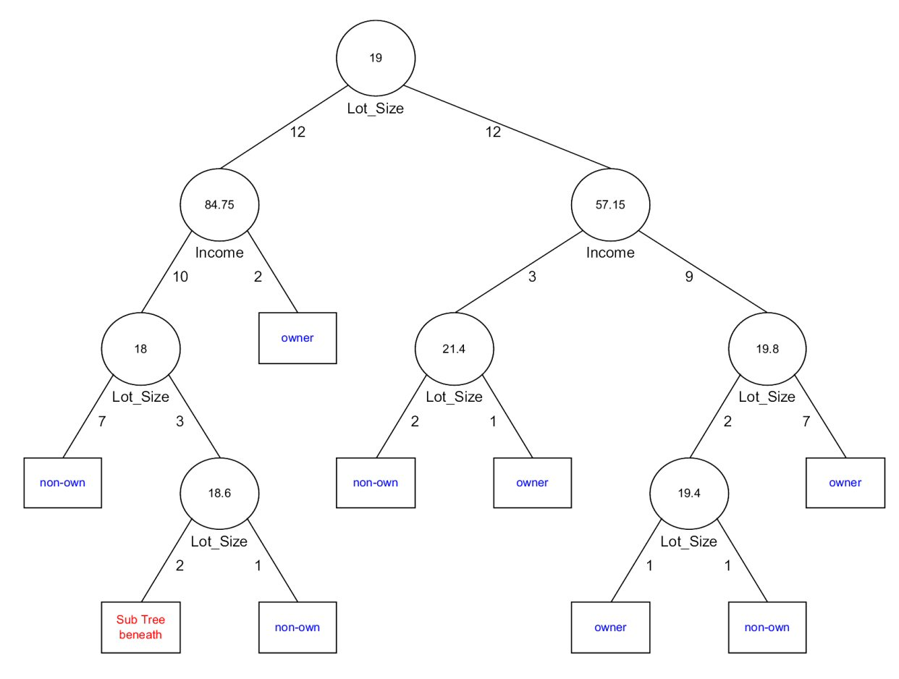
Tree after all splits

Slide 23
The Overfitting Problem

Slide 24
“Small is better” (Occam’s Razor)
Natural end of process is 100% purity in each leaf
This overfits the data, which end up fitting noise in the data
Overfitting leads to low predictive accuracy of new data
Past a certain point, the error rate for the validation data starts to increase

Slide 25
How to avoid overfitting
Be cautious when splitting
  Eg: CHAID
Build a full grown tree and then prune
  Based on Validation error: Early stopping
  Based on Cost Complexity: Pruning

Slide 26
CHAID
CHAID, older than CART, uses chi-square statistical test to limit tree growth
Splitting stops when purity improvement is not statistically significant

Slide 27
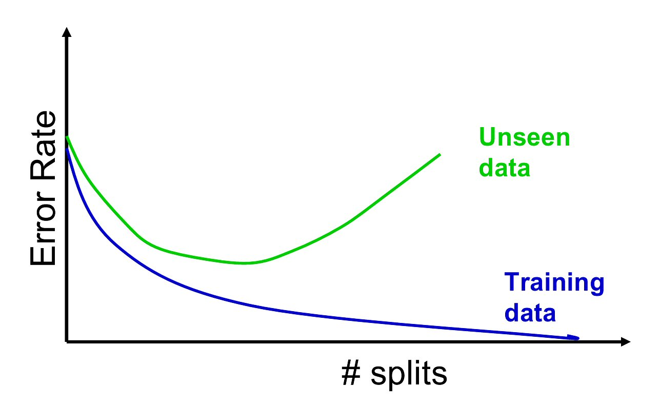
Full Tree Error Rate

Slide 28
Early Stopping: “min error tree”
Monitor validation error while growing tree
In the early stage, both training error and validation error decrease as tree grows
But, after a certain point, training error decreases while validation error starts increasing
Stop growing tree at that point
The “early stopped”, not fully grown tree becomes your final tree
“min error tree”

Slide 29
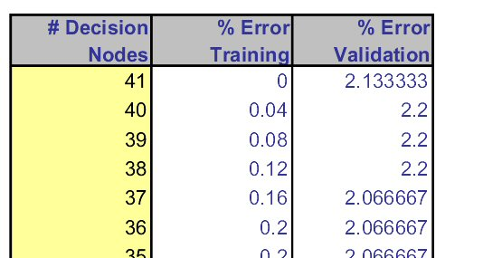
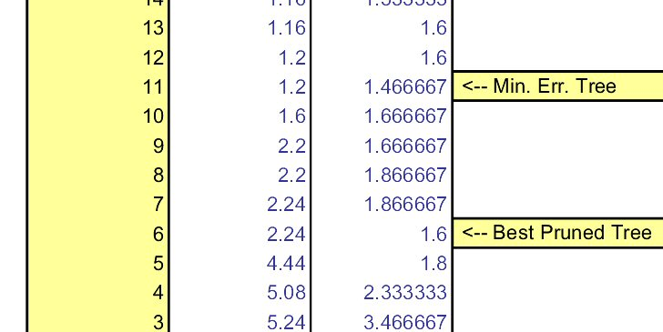
Error rates on pruned trees

Slide 30
Cost Complexity
CC(T) = Err(T) + α L(T)
CC(T) = cost complexity
Err(T) = proportion of misclassified training records
L(T) = cost complexity (# of leaf nodes) of a tree
α = penalty factor attached to tree size (set by user)
A larger tree tends to have smaller Err and larger L
A smaller tree tends to have larger Err and smaller L

Slide 31
Pruning
CART lets tree grow to full extent, then prunes it back
Generate successively smaller trees by pruning leaves
The question is which leaf to remove? In other words, at each pruning stage, multiple trees are possible
Use cost complexity to choose the best tree at that stage

Slide 32
Pruning Results
This process yields a set of trees of different sizes and associated error rates
Two trees of interest:
Minimum error tree
  Has lowest error rate on validation data
Best pruned tree
  Smallest tree within one std. error of min. error
  This adds a bonus for simplicity/parsimony

Slide 33
Regression Trees

Slide 34
Regression Trees for Prediction
Used with continuous outcome variable
Procedure similar to classification tree
Many splits attempted, choose the one that minimizes impurity

Slide 35
Differences from CT
Prediction is computed as the average of numerical target variable in the rectangle (in CT it is majority vote)
Impurity measured by sum of squared deviations from leaf mean
Performance measured by RMSE (root mean squared error)

Slide 36
Advantages of trees
Easy to use, understand
Produce rules that are easy to interpret & implement
Variable selection & reduction is automatic
Do not require the assumptions of statistical models
Can work without extensive handling of missing data

Slide 37
Disadvantages
May not perform well where there is structure in the data that is not well captured by horizontal or vertical splits
Since the process deals with one variable at a time, no way to capture interactions between variables

Slide 38
Summary
Classification and Regression Trees are an easily understandable and transparent method for predicting or classifying new records
A tree is a graphical representation of a set of rules
Trees must be pruned to avoid over-fitting of the training data
As trees do not make any assumptions about the statistical structure, they usually require large samples

