Slide 1
Chapter 1: Introduction

Slide 2
Database System Concepts
Chapter 1: Introduction
Part 1: Relational databases
  Chapter 2: Relational Model
  Chapter 3: SQL
  Chapter 4: Advanced SQL
  Chapter 5: Other Relational Languages
Part 2: Database Design
  Chapter 6: Database Design and the E-R Model
  Chapter 7: Relational Database Design
  Chapter 8: Application Design and Development
Part 3: Object-based databases and XML
  Chapter 9: Object-Based Databases
  Chapter 10: XML
Part 4: Data storage and querying
  Chapter 11: Storage and File Structure
  Chapter 12: Indexing and Hashing
  Chapter 13: Query Processing
  Chapter 14: Query Optimization
Part 5: Transaction management
  Chapter 15: Transactions
  Chapter 16: Concurrency control
  Chapter 17: Recovery System
Part 6: Data Mining and Information Retrieval
  Chapter 18: Data Analysis and Mining
  Chapter 19: Information Retreival
Part 7: Database system architecture
  Chapter 20: Database-System Architecture
  Chapter 21: Parallel Databases
  Chapter 22: Distributed Databases
Part 8: Other topics
  Chapter 23: Advanced Application Development
  Chapter 24: Advanced Data Types and New Applications
  Chapter 25: Advanced Transaction Processing
Part 9: Case studies
  Chapter 26: PostgreSQL
  Chapter 27: Oracle
  Chapter 28: IBM DB2
  Chapter 29: Microsoft SQL Server
Online Appendices
  Appendix A: Network Model
  Appendix B: Hierarchical Model
  Appendix C: Advanced Relational Database Model

Slide 3
Overview (Chapter 1).
Chapter 1: Introduction
  provides a general overview of the nature and purpose of database systems.
We explain
  how the concept of a database system has developed,
  what the common features of database systems are,
  what a database system does for the user,
  and how a database system interfaces with operating systems.
We also introduce an example database application: a banking enterprise consisting of multiple bank branches.
This example is used as a running example throughout the book. This chapter is motivational, historical, and explanatory in nature.

Slide 4
Chapter 1: Introduction
1.1 Database-System Applications
1.2 Purpose of Database Systems
1.3 View of Data
1.4 Database Languages
1.5 Relational Databases
1.6 Database Design
1.7 Object-based and Semistructured databases
1.8 Data Storage and Querying
1.9 Transaction Management
1.10 Data Mining and Analysis
1.11 Database Architecture
1.12 Database Users and Administrators
1.13 History of Database Systems

Slide 5
1.1 Database System Applications
DBMS contains information about a particular enterprise
  Collection of interrelated data
  Set of programs to access the data
  An environment that is both convenient and efficient to use
Database Applications:
  Banking: all transactions
  Airlines: reservations, schedules
  Universities: registration, grades
  Sales: customers, products, purchases
  Online retailers: order tracking, customized recommendations
  Manufacturing: production, inventory, orders, supply chain
  Human resources: employee records, salaries, tax deductions
Databases touch all aspects of our lives

Slide 6
1.2 Purpose of Database Systems
In the early days, database applications were built directly on top of file systems
Drawbacks of using file systems to store data:
  Data redundancy and inconsistency
    Multiple file formats, duplication of information in different files
  Difficulty in accessing data
    Need to write a new program to carry out each new task
  Data isolation — multiple files and formats
  Integrity problems
    Integrity constraints (e.g. account balance > 0) become “buried” in program code rather than being stated explicitly
    Hard to add new constraints or change existing ones

Slide 7
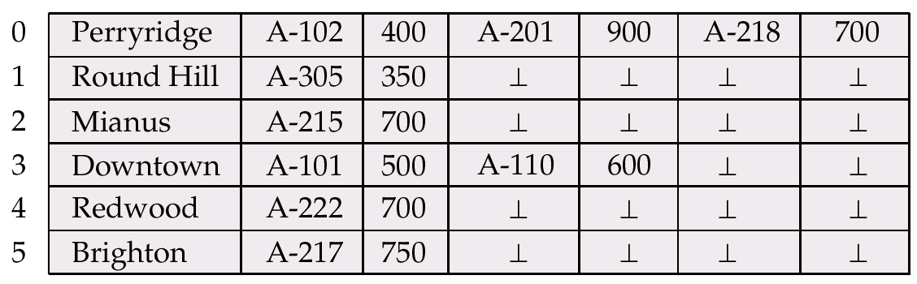

Files supported by OS
Branch name
account
account
account
customer
account number

Slide 8
Purpose of Database Systems (Cont.)
Drawbacks of using file systems (cont.)
  Atomicity of updates
    Failures may leave database in an inconsistent state with partial updates carried out
    Example: Transfer of funds from one account to another should either complete or not happen at all
  Concurrent access by multiple users
    Concurrent accessed needed for performance
    Uncontrolled concurrent accesses can lead to inconsistencies
      Example: Two people reading a balance and updating it at the same time
  Security problems
    Hard to provide user access to some, but not all, data
Database systems offer solutions to all the above problems!!

Slide 9
1.3 View of Data
Physical level: describes how a record (e.g., customer) is stored.
Logical level: describes data stored in database, and the relationships among the data.
  type customer = record
  customer_id : string;
  customer_name : string;
  customer_street : string;
  customer_city : integer;
        end;
View level: application programs hide details of data types. Views can also hide information (such as an employee’s salary) for security purposes.

Slide 10
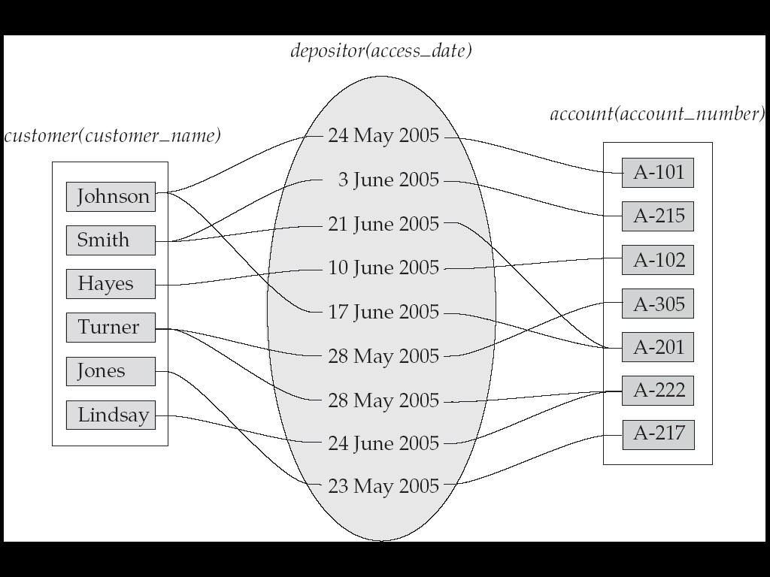
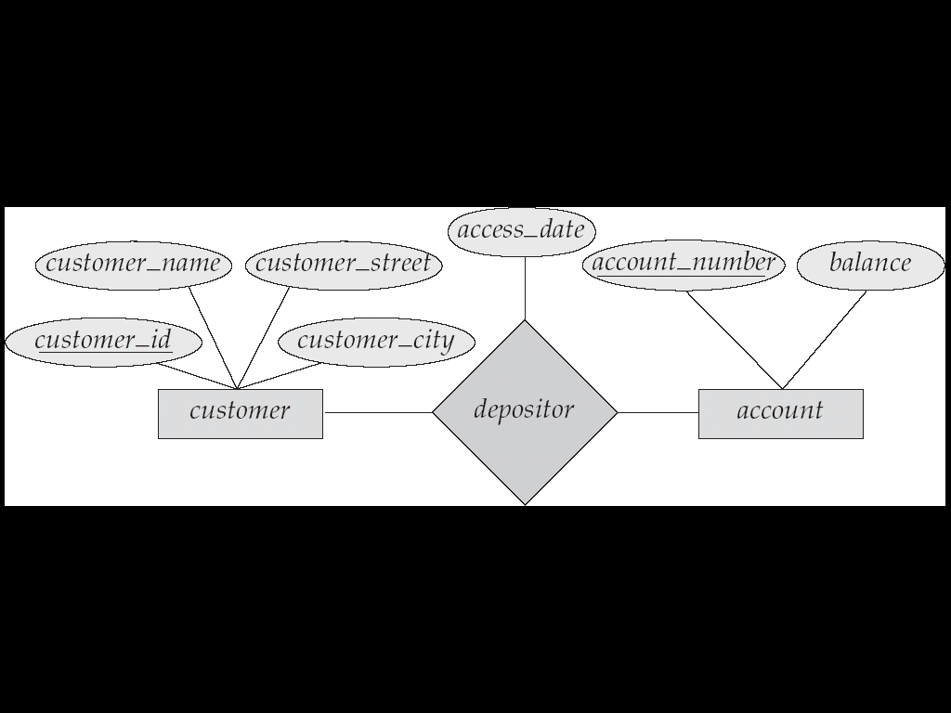
Data Levels

Slide 11

Level of Abstraction
An architecture for a database system

Slide 12
Instances and Schemas
Similar to types and variables in programming languages
Schema – the logical structure of the database
  Example: The database consists of information about a set of customers and accounts and the relationship between them)
  Analogous to type information of a variable in a program
  Physical schema: database design at the physical level
  Logical schema: database design at the logical level
Instance – the actual content of the database at a particular point in time
  Analogous to the value of a variable
Physical Data Independence – the ability to modify the physical schema without changing the logical schema
  Applications depend on the logical schema
  In general, the interfaces between the various levels and components should be well defined so that changes in some parts do not seriously influence others.

Slide 13
Data Models
A collection of tools for describing
  Data
  Data relationships
  Data semantics
  Data constraints
Relational model
Entity-Relationship data model (mainly for database design)
Object-based data models (Object-oriented and Object-relational)
Semistructured data model (XML)
Other older models:
  Network model
  Hierarchical model

Slide 14

Relational Data Model

Slide 15
E-R Data Model

Slide 16
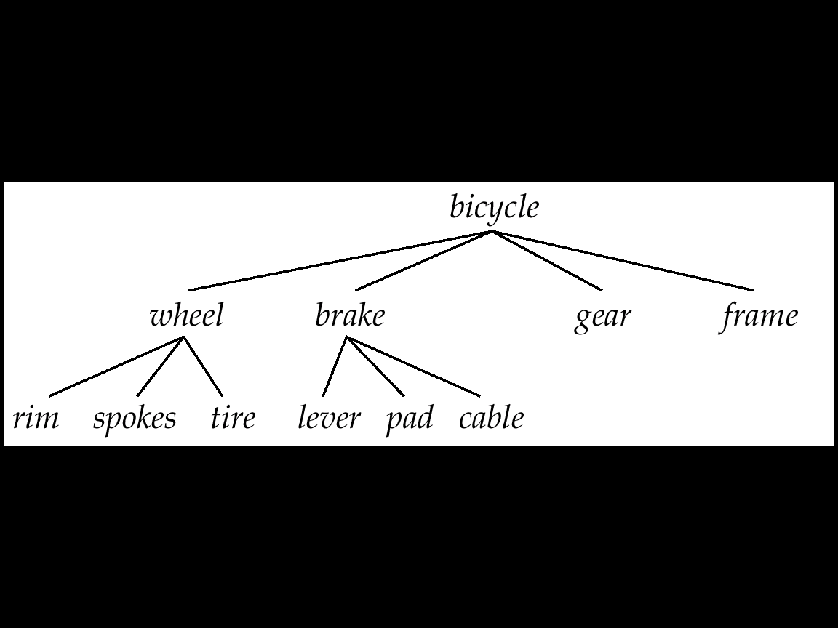
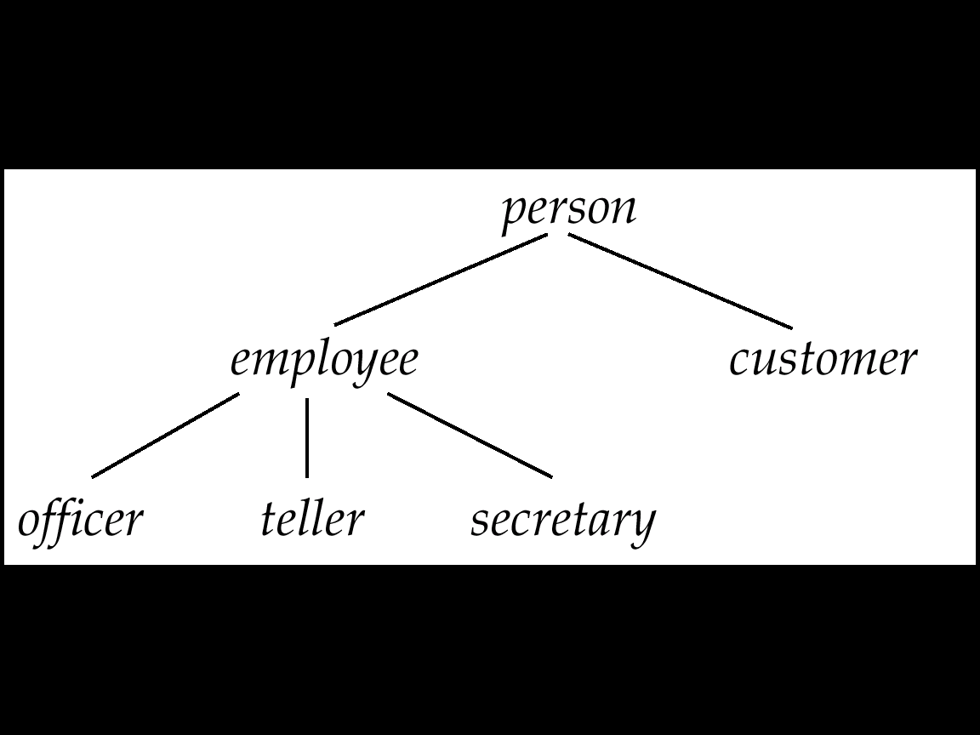
Object-Oriented Data Model
name | street | city | amount
Lowerly | Maple | Queens | 900
Shiver | North | Bronx | 556
Shiver | North | Bronx | 647
Hodges | SideHill | Brooklyn | 801
Hodges | SideHill | Brooklyn | 647
Is-part-of relationship
ISA relationship

Slide 17
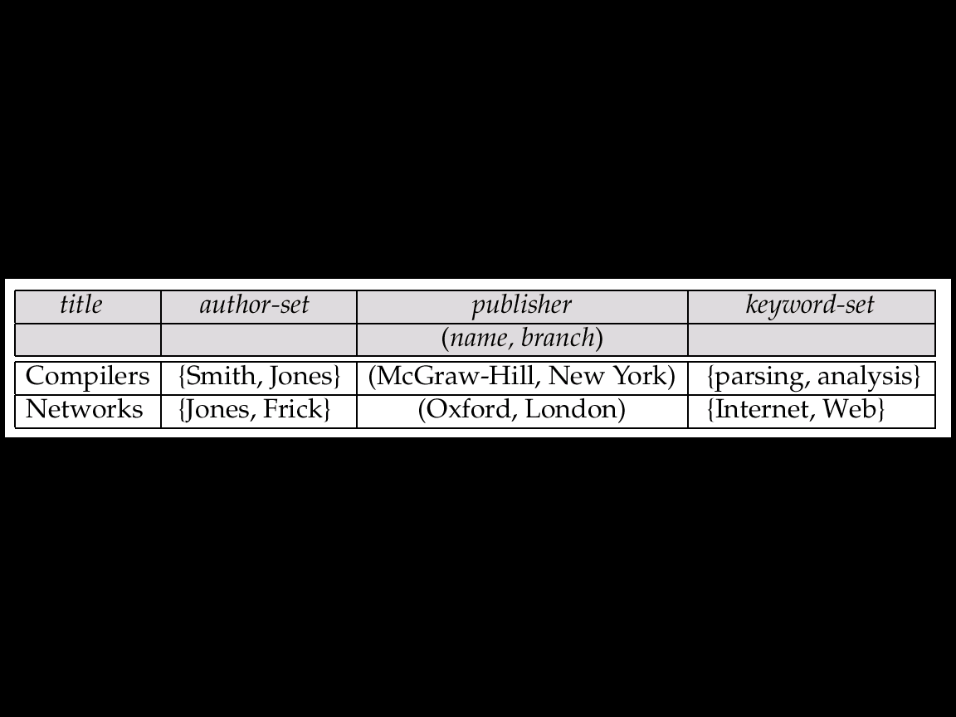

OR Data Model
name | street | city | amount
Lowerly | Maple | Queens | 900
Shiver | North | Bronx | 556
Shiver | North | Bronx | 647
Hodges | SideHill | Brooklyn | 801
Hodges | SideHill | Brooklyn | 647
http://www.oopsla.snu.ac.kr
SNU OOPSLA Lab.

Slide 18
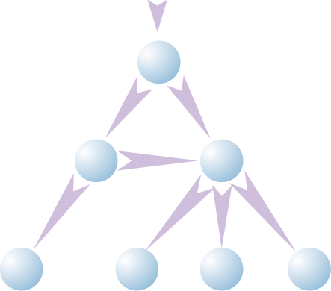
XML Data Model
Bib
<Bib>
<paper id=“o2” references=“o3”>
<author>Abiteboul </author>
</paper>
<book id=“o3”>
<author> Hull </author>
<title> Foundations of Data
Bases </title>
<publisher> Addison Wesley
</publisher>
</book>
</Bib>
1
paper
book
reference
2
3
author
publisher
author
title
4
5
6
7
Abiteboul
Hull
Foundations
Of DataBases
Addison
Wesley
XML data
OEM Model

Slide 19
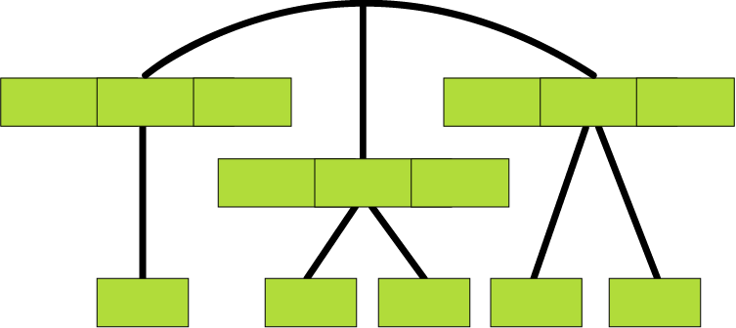
Network Data Model
Root Record
Customer records
Lowery
Maple
Queens
Hodges
SideHill
Brooklyn
Shiver
North
Bronx
Amount records
900
556
647
647
801

Slide 20
1.4 Database Language
Data Manipulation Language (DML)
Language for accessing and manipulating the data organized by the appropriate data model
  DML also known as query language
Two classes of languages
  Procedural – user specifies what data is required and how to get those data
  Declarative (nonprocedural) – user specifies what data is required without specifying how to get those data
SQL is the most widely used query language

Slide 21
1.4 Database Language
Data Definition Language (DDL)
Specification notation for defining the database schema
  Example: create table account (
  account-number char(10),
  balance integer)
DDL compiler generates a set of tables stored in a data dictionary
Data dictionary contains metadata (i.e., data about data)
  Database schema
  Data storage and definition language
    Specifies the storage structure and access methods used
  Integrity constraints
    Domain constraints
    Referential integrity (references constraint in SQL)
    Assertions
  Authorization

Slide 22
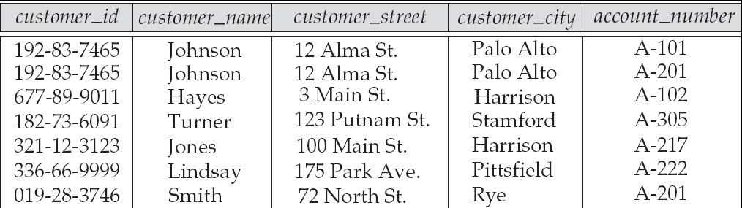
1.5 Relational Databases
Relational Model
Attributes
Example of tabular data in the relational model

Slide 23

A Sample Relational Database

Slide 24
SQL
SQL: widely used non-procedural language
  Example: Find the name of the customer with customer-id 192-83-7465
  select customer.customer_name
  from customer
  where customer.customer_id = ‘192-83-7465’
  Example: Find the balances of all accounts held by the customer with customer-id 192-83-7465
  select account.balance
  from depositor, account
  where depositor.customer_id = ‘192-83-7465’ and
  depositor.account_number = account.account_number
Application programs generally access databases through one of
  Language extensions to allow embedded SQL
  Application program interface (e.g., ODBC/JDBC) which allow SQL queries to be sent to a database

Slide 25
1.6 Database Design
The process of designing the general structure of the database:
Logical Design – Deciding on the database schema. Database design requires that we find a “good” collection of relation schemas.
  Business decision – What attributes should we record in the database?
  Computer Science decision – What relation schemas should we have and how should the attributes be distributed among the various relation schemas?
Physical Design – Deciding on the physical layout of the database

Slide 26

The Entity-Relationship Model
Models an enterprise as a collection of entities and relationships
  Entity: a “thing” or “object” in the enterprise that is distinguishable from other objects
    Described by a set of attributes
  Relationship: an association among several entities
Represented diagrammatically by an entity-relationship diagram:

Slide 27
1.7 Object-Based and Semistructured Databases
Object-Relational Data Models
Extend the relational data model by including object orientation and constructs to deal with added data types.
Allow attributes of tuples to have complex types, including non-atomic values such as nested relations.
Preserve relational foundations, in particular the declarative access to data, while extending modeling power.
Provide upward compatibility with existing relational languages.

Slide 28
1.7 Object-Based and Semistructured Databases
XML: Extensible Markup Language
Defined by the WWW Consortium (W3C)
Originally intended as a document markup language not a database language
The ability to specify new tags, and to create nested tag structures made XML a great way to exchange data, not just documents
XML has become the basis for all new generation data interchange formats.
A wide variety of tools is available for parsing, browsing and querying XML documents/data

Slide 29
1.8 Data Storage and Querying
Storage Management
Storage manager is a program module that provides the interface between the low-level data stored in the database and the application programs and queries submitted to the system.
The storage manager is responsible to the following tasks:
  Interaction with the file manager
  Efficient storing, retrieving and updating of data
Issues:
  Storage access
  File organization
  Indexing and hashing

Slide 30

1.8 Data Storage and Querying
Query Processing
Query Processor
1. Parsing and translation
2. Optimization
3. Evaluation

Slide 31
Query Processing (Cont.)
Alternative ways of evaluating a given query
  Equivalent expressions
  Different algorithms for each operation
Cost difference between a good and a bad way of evaluating a query can be enormous
Need to estimate the cost of operations
  Depends critically on statistical information about relations which the database must maintain
  Need to estimate statistics for intermediate results to compute cost of complex expressions

Slide 32
1.9 Transaction Management
A transaction is a collection of operations that performs a single logical function in a database application
Transaction-management component ensures that the database remains in a consistent (correct) state despite system failures (e.g., power failures and operating system crashes) and transaction failures.
Concurrency-control manager controls the interaction among the concurrent transactions, to ensure the consistency of the database.

Slide 33
Example of Transactions and Concurrent Access
Transaction to transfer $50 from account A to account B:
  1. read(A)
  2. A := A – 50
  3. write(A)
  4. read(B)
  5. B := B + 50
  write(B)
Two people P1 and P2 are using two company debit cards for business
  There is $1000 in the company account
  P1 is trying to retrieve $500
  P2 is trying to retrieve $300

Slide 34
1.10 Data Mining and Analysis
The process of semiautomatically analyzing large databases to find useful patterns and rules
Similar to Knowledge Discovery in AI (also called Machine Learning), but dealing with very large database
Decision Support System for Business
  Data-Warehouse (DW)
  On-Line Analytical Processsing (OLAP)
Information Retrieval from unstructured textual data

Slide 35
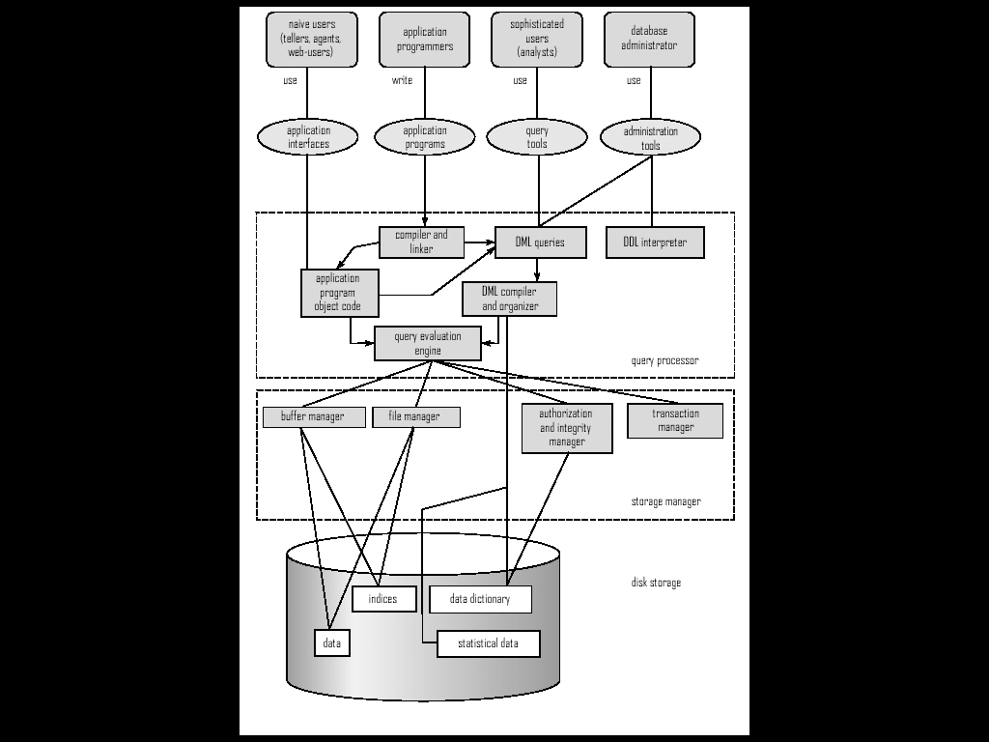
1.11 Database Architecture
Overall System Structure

Slide 36
1.11 Database Architecture
The architecture of a database systems is greatly influenced by
the underlying computer system on which the database is running:
Centralized
Client-server
Parallel (multi-processor)
Distributed

Slide 37
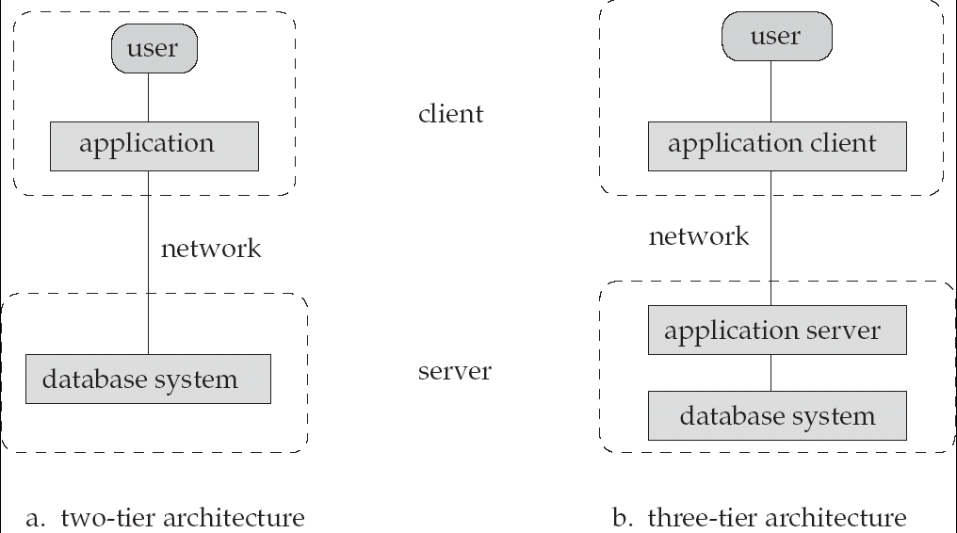
Figure 1.7

Slide 38
1.12 Database Users and Administrators
Database Users
Users are differentiated by the way they expect to interact with the system
Application programmers – interact with system through DML calls
Sophisticated users – form requests in a database query language
Specialized users – write specialized database applications that do not fit into the traditional data processing framework
Naïve users – invoke one of the permanent application programs that have been written previously
  Examples, people accessing database over the web, bank tellers, clerical staff

Slide 39
1.12 Database users and Database Administrator
Database Administrator
Coordinates all the activities of the database system; the database administrator has a good understanding of the enterprise’s information resources and needs.
Database administrator's duties include:
  Schema definition
  Storage structure and access method definition
  Schema and physical organization modification
  Granting user authority to access the database
  Specifying integrity constraints
  Acting as liaison with users
  Monitoring performance and responding to changes in requirements

Slide 40
1.13 History of Database Systems
1950s and early 1960s:
  Data processing using magnetic tapes for storage
    Tapes provide only sequential access
  Punched cards for input
Late 1960s and 1970s:
  Hard disks allow direct access to data
  Network and hierarchical data models in widespread use
  Ted Codd defines the relational data model
    Would win the ACM Turing Award for this work
    IBM Research begins System R prototype
    UC Berkeley begins Ingres prototype
  High-performance (for the era) transaction processing

Slide 41
History (cont.)
1980s:
  Research relational prototypes evolve into commercial systems
    SQL becomes industrial standard
  Parallel and distributed database systems
  Object-oriented database systems
1990s:
  Large decision support and data-mining applications
  Large multi-terabyte data warehouses
  Emergence of Web commerce
2000s:
  XML and XQuery standards
  Automated database administration

Slide 42
Ch 1: Summary (1)
A database-management system(DBMS) consists of a collection of interrelated data and a collection of programs to access that data. The data describe one particular enterprise.
The primary goal of a DBMS is to environment that is both convenient and efficient for people to use in retrieving and storing information.
Database systems are ubiquitous today, and most people interact, either directly or indirectly, with databases many tiles every day.
Database systems are designed to store large bodies of information. The management of data involves both the definition of structures for the storage of information and provision of mechanisms for the manipulation of information.
In addition, the database system must provide for the safety of the information stored, in the face of system crashes or attempts at unauthorized access.
If data are to be shared among several users, the system must avoid possible anomalous results.

Slide 43
Ch 1: Summary (2)
A major purpose of a database system is to provide users with an abstract view of the data.
That is, the system hides certain details of how the data are stored and maintained.
Underlying the structure of a database is the data model: a collection of conceptual tools for describing data, data relationships, data semantics, and data constraints.
A data-manipulation language(DML) is a language that enables users to access or manipulate data
The overall design of the database is called the database schema. A database schema is specified by a set of definitions that are expressed using data definition language(DDL).

Slide 44
Ch 1: Summary (3)
The relational data model is widely used to store data in databases. Other data models are the object-oriented model, the object-relational model, and semistructured data models..
The entity-relationship(E-R) data model is a widely used data model, and it provides a convenient graphical representation to view data, relationships,and constraints.
A database system has several subsystems.
  The storage manager subsystem provides the interface between the low level data stored in the database and the application programs and queries submitted to the system.
  The query processor subsystem compiles and executes DDL and DML statements.
  The transaction manager subsystem is responsible for ensuring that the database remains in a consistent(correct) state despite system failures.
  The transaction manager also ensures that concurrent transaction executions proceed without conflicting.

Slide 45
Ch 1: Summary (4)
Database applications are typically broken up into front-end part that runs at client machines and a part that runs at the back-end.
In two-tier architectures, the front-end directly communicates with a database running at the back-end.
In three -tier architectures, the back end part is itself broken up into an application server and a database server.
Database users can be categorized into several classes, and each class of users usually uses different type of interface to the database.

Slide 46
Ch 1: Bibliographical Notes (1)
We list below general purpose books, research paper collections, and Web sites on databases. Subsequent chapters provide references to material on each topic outlined in this chapter.
Codd[1970] is the landmark paper that introduced the relational model.
Textbooks covering database system include Abiteboul et al.[1995]. Date[2003], Elmasri and Navathe[2000], O’Neil and O’Neil[2000], Ramakrishnan and Gehrke[2000], Garcia-Molinar et al. [2001] and Ullman[1998].
Textbook coverage of transaction processing is provided by Bernstein and Newcomer[1997] and Reuter[1993].
Several books contain collections of research papers on database management. Among these are Bancilhon and Buneman[1990], Date[1986], Date[1990], Kim[1995], Zaniolo et al.[1997], and Hellerstein and Stonebreaker[2005].

Slide 47
Ch 1: Bibliographical Notes (2)
A review of accomplishments in database management and an assessment of future research challenges appears in Silberschatz et al.[1990], Silberschatz et al.[1996], Bernstein et al.[1990] and Abiteboul et al [2003].
The home page of the ACM Special Interest Group on Management of Data (see www.acm.org/sigmod) provides a wealth of information about database research.
Database vendor Web sites(see the tools section below) provide details about their respective products.

Slide 48
Ch1: Tools
There are a large number of commercial database system in use today.
The major ones include : IBM DB2(www.ibm.com/software/data), Oracle(www.oracle.com), Microsoft SQL server(www.microsoft.com/sql), Informix(www.informix.com), and Sybase(www.sybase.com).
Some of these systems are available free for personal or noncommercial use, or for development, but are not free for actual development.
There are also a number of free/public domain database systems;
widely used ones include MySQL(www.mysql.com) and PostgresSQL(www.postgressql.org).
A more complete list of links to vendor Web sites and other information is available from the home page of this book, at www.db-book.com

Slide 49
End of Chapter 1

