Slide 1
PLSA (Probabilistic Latent Semantic Analysis)
Thomas Hofmann, Probabilistic Latent Semantic Indexing, Proceedings of the Twenty-Second Annual International SIGIR Conference on Research and Development in Information Retrieval (SIGIR-99), pp. 50-57, 1999.
A. Singh, Survey on pLSA based scene classification techniques, Confluence The Next Generation Information Technology Summit (Confluence), 2014 5th International Conference, pp. 555-560, 2014.
Jan 16, 2015
Hee-Gook Jun

Slide 2
Outline
Disadvantages of LSA
PLSA: Topic Model Based on Aspect Model
EM Algorithm for PLSA
Conclusion

Slide 3
Disadvantages of LSA
Statistical foundation is missing
SVD (Singular Value Decomposition)
Assumes normally distributed data
But, term occurrence is not normally distributed
(Reason why it still works well)
Matrix entries are weighted (e.g. tf-idf)
Those weighted entries may be normally distributed
A
U
∑
V^{T}

Slide 4
Probabilistic topic model
Each document
Probability distribution over topics
Distribution over topics
Represents the essence, the body, or the gist of a given document
Each topic
Probability distribution over words
e.g.) "Education": school, students, education, university,…

Slide 5
LSA vs. PLSA
Same concept to LSA
Dimensionality reduction
Construction of a latent space
Different features
Well defined probabilities
Explicable results
Values in all matrices are normalized and non-negative
LSA: Batch learning (SVD) vs. PLSA: Incremental learning (EM)

Slide 6
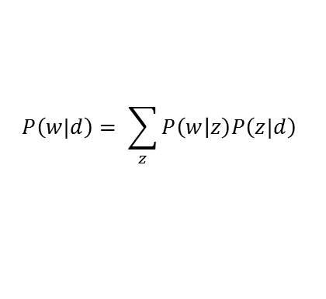
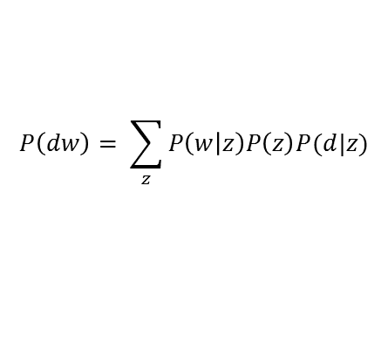



LSA vs. PLSA: Matrix Decomposition Technique
LSA
$$P\left(dw\right)= \sum_{z}{P\left(w | z\right)P\left(z\right)P(d|z)}$$
n
r
r
n
m
A
m
U
r
∑
r
V^{T}
PLSA
$$P\left(w|d\right)= \sum_{z}{P\left(w | z\right)P\left(z|d\right)}$$
doc n
r
n
word m
m
r
$$P\left(w|d\right)$$
$$P\left(w | z\right)$$
$$P\left(z|d\right)$$
Observed word
distributions
Word distributions
per topic
Topic distributions
per document

Slide 7

Aspect Model
PLSA
Generative model based on the aspect model
Select a document $d_{j}$ with $P(d_{j})$
For each word $w_{i},i∈\{1,…,M\}$ in the document $d_{j}$
Select a topic $z_{k}$ on the given document with $P(z_{k}|d_{j})$
Select a word $w_{i}$ on the previous chosen topic with$P(w_{i}|z_{k})$
d
z
w
N (number of documents)
M (number of words)

Slide 8

Parameter inference [1/3]
Topics
$z_{k}∈Z=\{z_{1}\text{, }z_{2}\text{, }z_{3}\text{, …., }z_{k}\}$
Corpus
Document ‘d’ and Word ‘w’ pairs
Y = {${d_{j},w}_{i}$} , $d_{j}∈\{d_{1},…,d_{N}\}\text{, }w_{i}∈\{w_{1},…,w_{M}\}$
Estimator
$θ=\{P(w_{i}|z_{k}),P(z_{k}|d_{j})\}$
Log Likelihood
$\ln{P\left(Y | θ\right)}$
Maximum Likelihood
$ML: \hat{θ}=\begin{matrix}argmax \ln{P\left(Y | θ\right)} \\ θ \end{matrix}$
Notes:
𝜃 를 찾는 건데 likelihood 계산위해서 𝜃를 알아야해
그런데 우리가 알고 있는 것은 Y 정보 뿐
그러므로 EM 알고리즘으로 Y 이용해 반복적 절차를 거쳐 𝜃를 계산해낸다.

Slide 9

Parameter inference [2/3]
Number of occurrences of $w_{i}$ in $d_{j}$
$n(w_{i},d_{j})$
Observing $n(w_{i},d_{j})$ occurrences of $w_{i}$ in $d_{j}$
${P(w_{i},d_{j}) }^{n(w_{i},d_{j}) }$
$$L=P\left(X | θ\right)=\prod_{i=1}^{M}{\prod_{j=1}^{N}{{P(w_{i},d_{j}) }^{n(w_{i},d_{j}) }}}$$
$$ℒ=\ln{P\left(X | θ\right)}=\sum_{i=1}^{M}{\sum_{j=1}^{N}{n(w_{i},d_{j})\ln{P(w_{i},d_{j})}}}$$
d1
red .. red .. red
n(red, d1) = 3

Slide 10

Parameter inference [3/3]
$$P\left(w,d\right)=P\left(w | d\right)P\left(d\right)=P\left(d\right)\sum_{z}{P\left(wz | d\right)}=P\left(d\right)\sum_{z}{P\left(w | zd\right)}P(z|d)$$
$$=P\left(d\right)\sum_{z}{P\left(w | z\right)}P(z|d)=\sum_{z}{P\left(w | z\right)}P\left(z | d\right)P(d)$$
$$=\sum_{z}{P\left(w | z\right)}P\left(d | z\right)P(z)$$
$$ℒ=\prod_{i=1}^{M}{\prod_{j=1}^{N}{{n(w_{i},d_{j})\ln{P(w_{i},d_{j})}}^{ }=\prod_{i=1}^{M}{\prod_{j=1}^{N}{{n(w_{i},d_{j})\ln\left(\sum_{z}{P\left(w | z\right)}P\left(d | z\right)P(z)\right)}^{ } }}}}$$
d and w is conditionally independent
P(z|d) P(d) = P(d|z)P(z) = P(zd)
→ Compute ML using EM algorithm

Slide 11
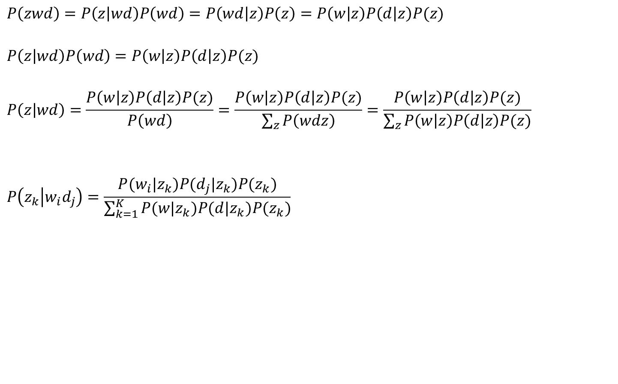
E-step (Expectation)
$$P\left(zwd\right)=P\left(z | wd\right)P\left(wd\right)=P\left(wd | z\right)P\left(z\right)=P\left(w | z\right)P\left(d | z\right)P(z)$$
$$P\left(z | wd\right)P\left(wd\right)=P\left(w | z\right)P\left(d | z\right)P(z)$$
$$P\left(z | wd\right)=\frac{P\left(w | z\right)P\left(d | z\right)P(z)}{P\left(wd\right)}=\frac{P\left(w | z\right)P\left(d | z\right)P(z)}{\sum_{z}{P\left(wdz\right)}}=\frac{P\left(w | z\right)P\left(d | z\right)P(z)}{\sum_{z}{P\left(w | z\right)P\left(d | z\right)P(z)}}$$
$$P\left(z_{k} | w_{i}d_{j}\right)=\frac{P(w_{i}|z_{k})P(d_{j}|z_{k})P(z_{k})}{\sum_{k=1}^{K}{P(w|z_{k})P(d|z_{k})P(z_{k})}}$$

Slide 12
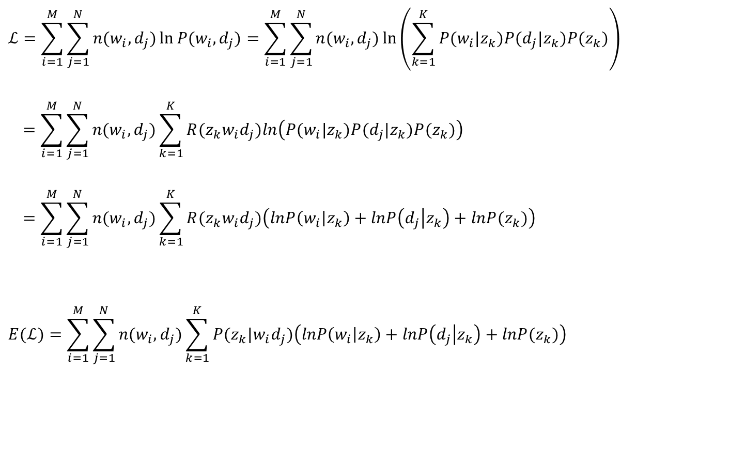
M-step (Maximization) [1/8]
$$ℒ=\sum_{i=1}^{M}{\sum_{j=1}^{N}{n(w_{i},d_{j})\ln{P(w_{i},d_{j})}}}=\sum_{i=1}^{M}{\sum_{j=1}^{N}{n(w_{i},d_{j})\ln\left(\sum_{k=1}^{K}{P(w_{i}|z_{k})P(d_{j}|z_{k})P(z_{k})}\right)}}$$
$$=\sum_{i=1}^{M}{\sum_{j=1}^{N}{n(w_{i},d_{j})\sum_{k=1}^{K}{R(z_{k}w_{i}d_{j})ln\left(P(w_{i}|z_{k})P(d_{j}|z_{k})P(z_{k})\right)}}}$$
$$=\sum_{i=1}^{M}{\sum_{j=1}^{N}{n(w_{i},d_{j})\sum_{k=1}^{K}{R(z_{k}w_{i}d_{j})\left(lnP\left(w_{i} | z_{k}\right)+lnP\left(d_{j} | z_{k}\right)+lnP(z_{k})\right)}}}$$
$$E(ℒ)=\sum_{i=1}^{M}{\sum_{j=1}^{N}{n(w_{i},d_{j})\sum_{k=1}^{K}{P(z_{k}|w_{i}d_{j})\left(lnP\left(w_{i} | z_{k}\right)+lnP\left(d_{j} | z_{k}\right)+lnP(z_{k})\right)}}}$$
If $n(w_{i},d_{j})≠0$ then $R\left(z_{k}w_{i}d_{j}\right)=1$ otherwise $R\left(z_{k}w_{i}d_{j}\right)=0$

Slide 13
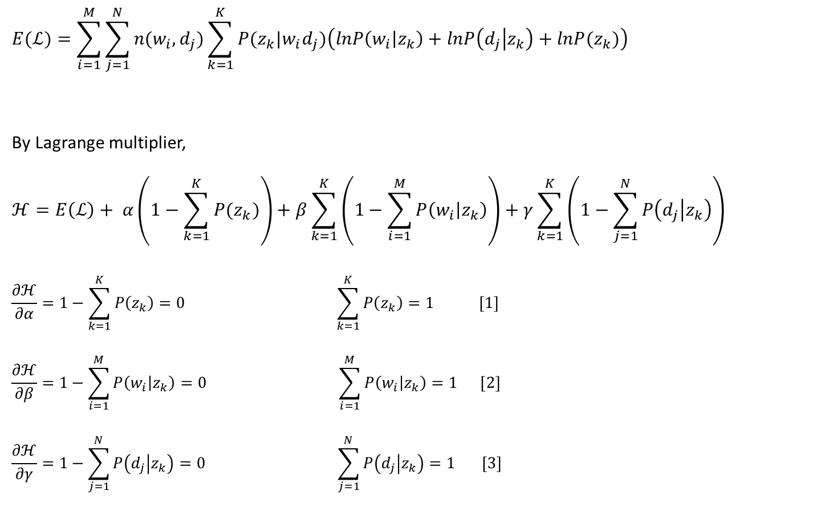
M-step (Maximization) [2/8]
$$E(ℒ)=\sum_{i=1}^{M}{\sum_{j=1}^{N}{n(w_{i},d_{j})\sum_{k=1}^{K}{P(z_{k}|w_{i}d_{j})\left(lnP\left(w_{i} | z_{k}\right)+lnP\left(d_{j} | z_{k}\right)+lnP(z_{k})\right)}}}$$
By Lagrange multiplier,
$$ℋ=E\left(ℒ\right)+ α\left(1−\sum_{k=1}^{K}{P(z_{k})}\right)+β\sum_{k=1}^{K}{\left(1−\sum_{i=1}^{M}{P\left(w_{i} | z_{k}\right)}\right)}+γ\sum_{k=1}^{K}{\left(1−\sum_{j=1}^{N}{P\left(d_{j} | z_{k}\right)}\right)}$$
$$\frac{∂ℋ}{∂α}=1−\sum_{k=1}^{K}{P\left(z_{k}\right)}=0 \sum_{k=1}^{K}{P\left(z_{k}\right)}=1 [1]$$
$$\frac{∂ℋ}{∂β}=1−\sum_{i=1}^{M}{P\left(w_{i} | z_{k}\right)}=0 \sum_{i=1}^{M}{P\left(w_{i} | z_{k}\right)}=1 [2]$$
$$\frac{∂ℋ}{∂γ}=1−\sum_{j=1}^{N}{P\left(d_{j} | z_{k}\right)}=0 \sum_{j=1}^{N}{P\left(d_{j} | z_{k}\right)}=1 [3]$$

Slide 14

M-step (Maximization) [3/8]: Compute P(z)
$$\frac{∂ℋ}{∂P(z_{k})}=\frac{∂E\left(ℒ\right)}{∂P(z_{k})}−α$$
$$=\frac{∂\sum_{i=1}^{M}{\sum_{j=1}^{N}{n(w_{i},d_{j})\sum_{k=1}^{K}{P(z_{k}|w_{i}d_{j})\left(lnP\left(w_{i} | z_{k}\right)+lnP\left(d_{j} | z_{k}\right)+lnP(z_{k})\right)}}}}{∂P(z_{k})}−α$$
$$=\frac{\sum_{i=1}^{M}{\sum_{j=1}^{N}{n(w_{i},d_{j})P(z_{k}|w_{i}d_{j})}}}{P(z_{k})}−α=0$$
$$P\left(z_{k}\right)=\frac{\sum_{i=1}^{M}{\sum_{j=1}^{N}{n(w_{i},d_{j})P(z_{k}|w_{i}d_{j})}}}{α} [A]$$

Slide 15

M-step (Maximization) [4/8]: Compute P(z)
$$\sum_{k=1}^{K}{P\left(z_{k}\right)}=1 \left[1\right] P\left(z_{k}\right)=\frac{\sum_{i=1}^{M}{\sum_{j=1}^{N}{n(w_{i},d_{j})P(z_{k}|w_{i}d_{j})}}}{α} [A]$$
$$By \left[1\right]and \left[A\right],$$
$$\sum_{k=1}^{K}{\frac{\sum_{i=1}^{M}{\sum_{j=1}^{N}{n(w_{i},d_{j})P(z_{k}|w_{i}d_{j})}}}{α}}=1$$
$$α=\sum_{k=1}^{K}{\sum_{i=1}^{M}{\sum_{j=1}^{N}{n(w_{i},d_{j})P(z_{k}|w_{i}d_{j})}}}=\sum_{i=1}^{M}{\sum_{j=1}^{N}{n(w_{i},d_{j})\sum_{k=1}^{K}{P(z_{k}|w_{i}d_{j})} }}=\sum_{i=1}^{M}{\sum_{j=1}^{N}{n(w_{i},d_{j}) }}$$
$$Thus,$$
$$P\left(z_{k}\right)=\frac{\sum_{i=1}^{M}{\sum_{j=1}^{N}{n(w_{i},d_{j})P(z_{k}|w_{i}d_{j})}}}{\sum_{i=1}^{M}{\sum_{j=1}^{N}{n(w_{i},d_{j}) }}}$$
=1

Slide 16

M-step (Maximization) [5/8]: Compute P(w|z)
$$\frac{∂ℋ}{∂P\left(w_{i} | z_{k}\right)}=\frac{∂E\left(ℒ\right)}{∂P\left(w_{i} | z_{k}\right)}−β$$
$$=\frac{∂\sum_{i=1}^{M}{\sum_{j=1}^{N}{n(w_{i},d_{j})\sum_{k=1}^{K}{P(z_{k}|w_{i}d_{j})\left(lnP\left(w_{i} | z_{k}\right)+lnP\left(d_{j} | z_{k}\right)+lnP(z_{k})\right)}}}}{∂P\left(w_{i} | z_{k}\right)}−β$$
$$=\frac{\sum_{j=1}^{N}{n(w_{i},d_{j})P(z_{k}|w_{i}d_{j})}}{P\left(w_{i} | z_{k}\right)}−β=0$$
$$P\left(w_{i} | z_{k}\right)=\frac{\sum_{j=1}^{N}{n(w_{i},d_{j})P(z_{k}|w_{i}d_{j})}}{β} [B]$$

Slide 17

M-step (Maximization) [6/8]: Compute P(w|z)
$$\sum_{i=1}^{M}{P\left(w_{i} | z_{k}\right)}=1 \left[2\right] P\left(w_{i} | z_{k}\right)=\frac{\sum_{j=1}^{N}{n(w_{i},d_{j})P(z_{k}|w_{i}d_{j})}}{β} [B]$$
$$By \left[2\right]and \left[B\right],$$
$$\sum_{i=1}^{M}{\frac{\sum_{j=1}^{N}{n(w_{i},d_{j})P(z_{k}|w_{i}d_{j})}}{β}}=1$$
$$β=\sum_{i=1}^{M}{\sum_{j=1}^{N}{n(w_{i},d_{j})P(z_{k}|w_{i}d_{j})}}$$
$$Thus,$$
$$P\left(w_{i} | z_{k}\right)=\frac{\sum_{j=1}^{N}{n(w_{i},d_{j})P(z_{k}|w_{i}d_{j})}}{\sum_{i=1}^{M}{\sum_{j=1}^{N}{n(w_{i},d_{j})P(z_{k}|w_{i}d_{j})}}}$$

Slide 18

M-step (Maximization) [7/8]: Compute P(d|z)
$$\frac{∂ℋ}{∂P\left(d_{j} | z_{k}\right)}=\frac{∂E\left(ℒ\right)}{∂P\left(d_{j} | z_{k}\right)}−γ$$
$$=\frac{∂\sum_{i=1}^{M}{\sum_{j=1}^{N}{n(w_{i},d_{j})\sum_{k=1}^{K}{P(z_{k}|w_{i}d_{j})\left(lnP\left(w_{i} | z_{k}\right)+lnP\left(d_{j} | z_{k}\right)+lnP(z_{k})\right)}}}}{∂P\left(d_{j} | z_{k}\right)}−γ$$
$$=\frac{\sum_{i=1}^{M}{n(w_{i},d_{j})P(z_{k}|w_{i}d_{j})}}{P\left(d_{j} | z_{k}\right)}−γ=0$$
$$P\left(d_{j} | z_{k}\right)=\frac{\sum_{i=1}^{M}{n(w_{i},d_{j})P(z_{k}|w_{i}d_{j})}}{γ} [C]$$

Slide 19

M-step (Maximization) [8/8]: Compute P(d|z)
$$\sum_{j=1}^{N}{P\left(d_{j} | z_{k}\right)}=1 \left[3\right] P\left(d_{j} | z_{k}\right)=\frac{\sum_{i=1}^{M}{n(w_{i},d_{j})P(z_{k}|w_{i}d_{j})}}{γ} [C]$$
$$By \left[3\right]and \left[C\right],$$
$$\sum_{j=1}^{N}{\frac{\sum_{i=1}^{M}{n(w_{i},d_{j})P(z_{k}|w_{i}d_{j})}}{γ}}=1$$
$$γ=\sum_{j=1}^{N}{\sum_{i=1}^{M}{n(w_{i},d_{j})P(z_{k}|w_{i}d_{j})}}$$
$$Thus,$$
$$P\left(d_{j} | z_{k}\right)=\frac{\sum_{i=1}^{M}{n(w_{i},d_{j})P(z_{k}|w_{i}d_{j})}}{\sum_{j=1}^{N}{\sum_{i=1}^{M}{n(w_{i},d_{j})P(z_{k}|w_{i}d_{j})}}}$$

Slide 20

EM Algorithm
Expectation
$P\left(z_{k} | w_{i}d_{j}\right)=\frac{P(w_{i}|z_{k})P(d_{j}|z_{k})P(z_{k})}{\sum_{k=1}^{K}{P(w|z_{k})P(d|z_{k})P(z_{k})}}$
Maximization
$P\left(z_{k}\right)=\frac{\sum_{i=1}^{M}{\sum_{j=1}^{N}{n(w_{i},d_{j})P(z_{k}|w_{i}d_{j})}}}{\sum_{i=1}^{M}{\sum_{j=1}^{N}{n(w_{i},d_{j}) }}}$
$P\left(w_{i} | z_{k}\right)=\frac{\sum_{j=1}^{N}{n(w_{i},d_{j})P(z_{k}|w_{i}d_{j})}}{\sum_{i=1}^{M}{\sum_{j=1}^{N}{n(w_{i},d_{j})P(z_{k}|w_{i}d_{j})}}}$
$P\left(d_{j} | z_{k}\right)=\frac{\sum_{i=1}^{M}{n(w_{i},d_{j})P(z_{k}|w_{i}d_{j})}}{\sum_{j=1}^{N}{\sum_{i=1}^{M}{n(w_{i},d_{j})P(z_{k}|w_{i}d_{j})}}}$
Repeat until converge

Slide 21
PLSA Example
doc 1 " modem the steering linux. modem, linux the modem. steering the modem. linux "
doc 2 " linux; the linux. the linux modem linux. the modem, clutch the modem. petrol "
doc 3 " petrol! clutch the steering, steering, linux. the steering clutch petrol. clutch the petrol; the clutch "
doc 4 " the the the. clutch clutch clutch! steering petrol; steering petrol petrol; steering petrol "

Slide 22

PLSA Example: Term Frequency Matrix
$$n(w_{i},d_{j})$$
 | d1 | d2 | d3 | d4
linux | 3 | 4 | 1 | 0
modem | 4 | 3 | 0 | 1
the | 3 | 4 | 4 | 3
clutch | 0 | 1 | 4 | 3
steering | 2 | 0 | 3 | 3
petrol | 0 | 1 | 3 | 4

Slide 23



PLSA Example: Result
doc 1
"modem the steering linux. modem,
linux the modem. steering the modem. linux "
doc 2
"linux; the linux. the linux modem linux.
the modem, clutch the modem. petrol "
doc 3
"petrol! clutch the steering, steering, linux. the
steering clutch petrol. clutch the petrol; the clutch "
doc 4
"the the the. clutch clutch clutch! steering petrol;
steering petrol petrol; steering petrol "
 | dim1
t1 | 0.35
t2 | 0.65
$$P\left(z_{k}\right)$$
 | d1 | d2 | d3 | d4
t1 | 0.00 | 0.09 | 0.47 | 0.44
t2 | 0.46 | 0.40 | 0.07 | 0.06
$$P\left(d_{j} | z_{k}\right)$$
 | w1 (linux) | w2 (modem) | w3 (the) | w4 (clutch) | w5 (steering) | w6 (petrol)
t1 | 0.00 | 0.00 | 0.23 | 0.28 | 0.19 | 0.28
t2 | 0.31 | 0.31 | 0.29 | 0.00 | 0.09 | 0.00
$$P\left(w_{i} | z_{k}\right)$$

Slide 24
Conclusion
There is no syntactic relation or word-ordering
But co-occurences still provide useful semantic insights about topics
PLSA
Generative model based on aspect model
Extract topics from a collection of documents
Work for automated document indexing
Significantly outperforms LSA
Limitation
Overfitting problem
Notes:
It is reported that the aspect model used in the probabilistic latent semantic analysis has severe overfitting problems
Blei, David M.; Andrew Y. Ng; Michael I. Jordan (2003). "Latent Dirichlet Allocation". Journal of Machine Learning Research 3: 993?1022. doi:10.1162/jmlr.2003.3.4-5.993.

