Slide 1
Head First Python Chapter 4 Persistence: Saving Data to Files
SNU IDB Lab.

Slide 2
Outline
Programs produce data
From the previous class…
Open your file in write mode
Example - write mode
Files are left open after an exception!
Extend try with 'finally'
Knowing the type of error is not enough
Example - Error types
Use 'with' to work with files
Example - with
Pickle your data
Example - pickle

Slide 3
Programs produce data
Typically, programs:
save processed data
print output on screen
transfer data over network
This chapter will focus on storing and retrieving file data

Slide 4
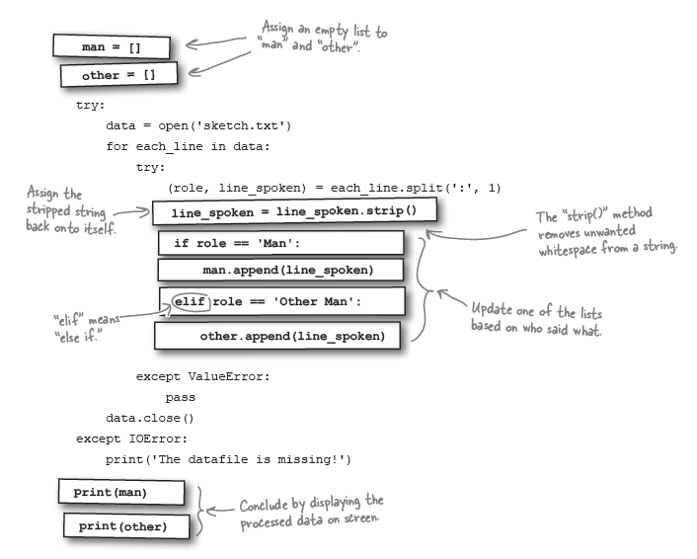
From the previous class…

Slide 5
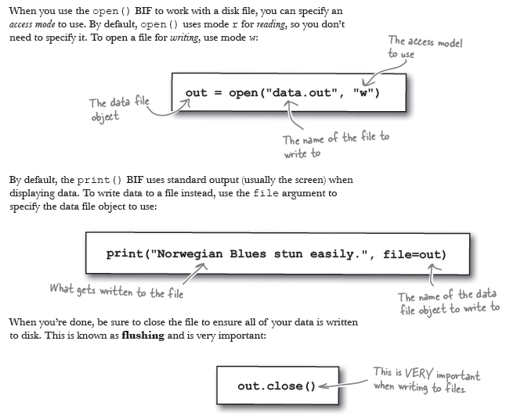
Open your file in write mode

Slide 6
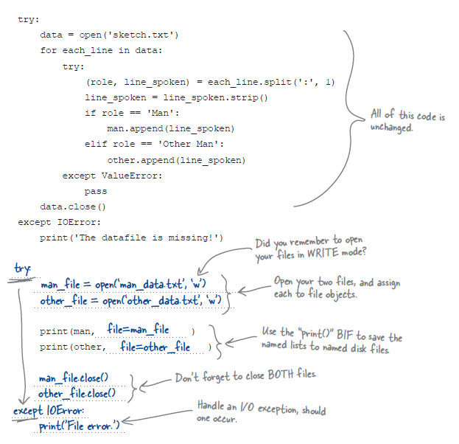
Example – write mode (1)

Slide 7
Example – write mode (2)
Before the program runs, there are no data files in your folder,
just your code
After your program runs, two text files are created in your folder,
man_data.txt and other_data.txt

Slide 8
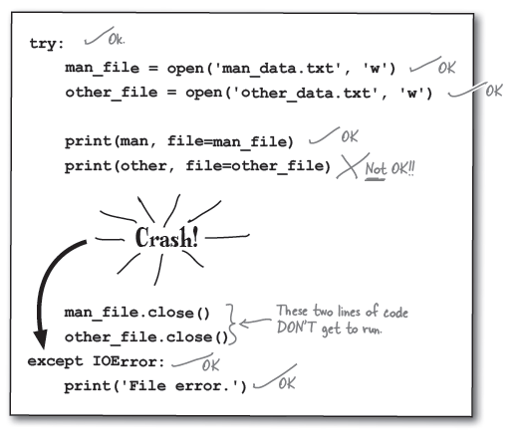
Files are left open after an exception!
If IOError is handled before a file is closed, written data might
Become corrupted
We still need to close files no matter what

Slide 9
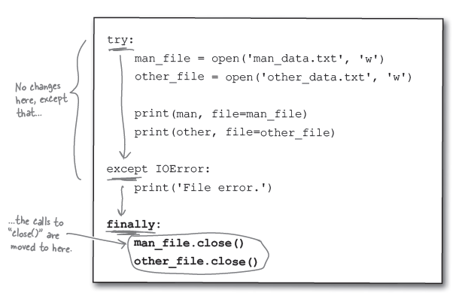
Extend try with finally
No matter what, the finally suite always runs.

Slide 10
Knowing the type of error is not enough
I/O Error is displayed as a generic “File Error”
What really happened?
When an error occurs at runtime, Python raises an exception of the
specific type (IOError, ValueError, etc.)
Python creates an exception object that is passed as an argument to
your except suite

Slide 11
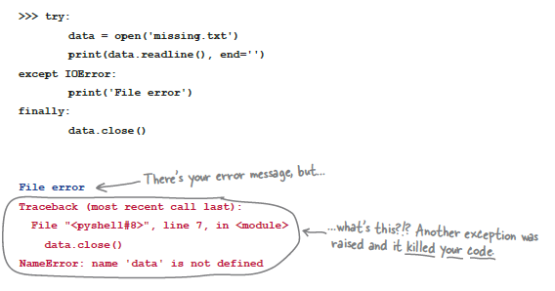
Example – Error types (1)
The file doesn’t exist, so its object was not created
Impossible to call close(), so the program ends up with NameError

Slide 12
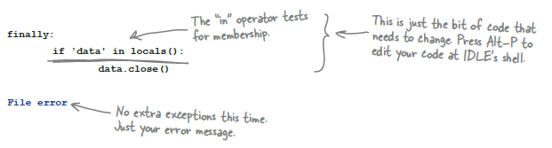

Example – Error types (2)
Quick fix: add a check to see if the file object exists
Still, we are none the wiser as to what the error is. So, we add

Slide 13
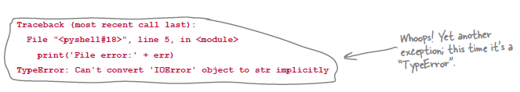

Example – Error types (3)
Another error! This time it’s a TypeError. Strings and objects are not
compatible.
Use str()
…and get the correct output,

Slide 14
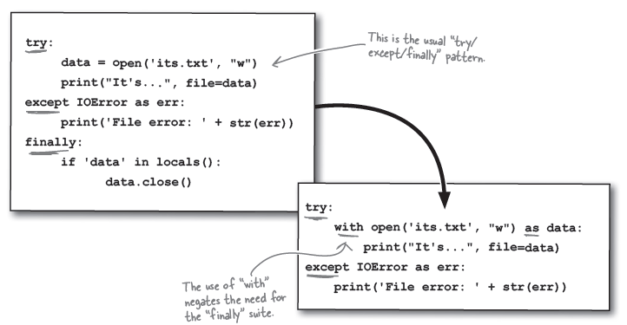
Use with to work with files
Instead of the try/except/finally pattern, Python offers the with
statement, which can shorten code
with automatically closes opened files

Slide 15
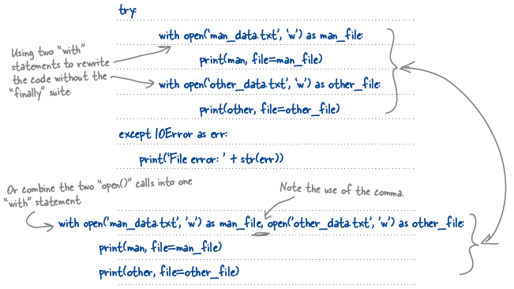
Example - with

Slide 16
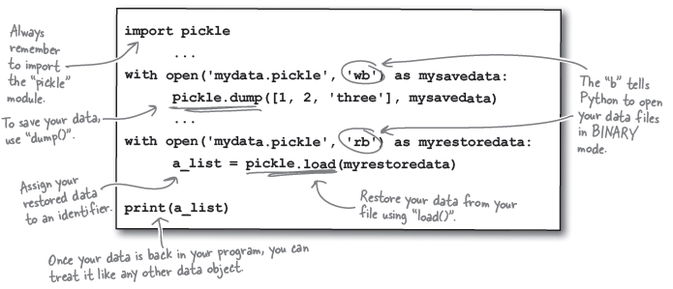
Pickle your data
Python offers a standard library called pickle, which can save/load
almost any Python data object, including lists
Once pickled, the data is persistent and ready to be read into
another program at a later time

Slide 17
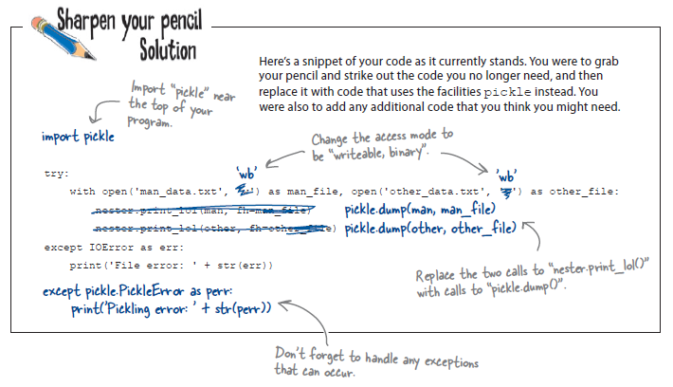
Example – pickle (1)

Slide 18
Example – pickle (2)
new_man = []
try:
with open(‘man_data.txt’, ‘rb’) as man_file: rb stands for “readable, binary”.
new_man = pickle.load(man_file)
except IOError as err:
print(‘File error: ‘ + str(err))
except pickle.PickleError as perr:
print(‘Pickling error: ‘ + str(perr))
print(new_man)

