Slide 1
Chapter 18: Data Analysis and Mining

Slide 2
Database System Concepts
Chapter 1: Introduction
Part 1: Relational databases
  Chapter 2: Relational Model
  Chapter 3: SQL
  Chapter 4: Advanced SQL
  Chapter 5: Other Relational Languages
Part 2: Database Design
  Chapter 6: Database Design and the E-R Model
  Chapter 7: Relational Database Design
  Chapter 8: Application Design and Development
Part 3: Object-based databases and XML
  Chapter 9: Object-Based Databases
  Chapter 10: XML
Part 4: Data storage and querying
  Chapter 11: Storage and File Structure
  Chapter 12: Indexing and Hashing
  Chapter 13: Query Processing
  Chapter 14: Query Optimization
Part 5: Transaction management
  Chapter 15: Transactions
  Chapter 16: Concurrency control
  Chapter 17: Recovery System
Part 6: Data Mining and Information Retrieval
  Chapter 18: Data Analysis and Mining
  Chapter 19: Information Retrieval
Part 7: Database system architecture
  Chapter 20: Database-System Architecture
  Chapter 21: Parallel Databases
  Chapter 22: Distributed Databases
Part 8: Other topics
  Chapter 23: Advanced Application Development
  Chapter 24: Advanced Data Types and New Applications
  Chapter 25: Advanced Transaction Processing
Part 9: Case studies
  Chapter 26: PostgreSQL
  Chapter 27: Oracle
  Chapter 28: IBM DB2
  Chapter 29: Microsoft SQL Server
Online Appendices
  Appendix A: Network Model
  Appendix B: Hierarchical Model
  Appendix C: Advanced Relational Database Model

Slide 3
Part 6: Data Mining and Information Retrieval (Chapters 18 and 19).
Chapter 18: Data Analysis and Mining
  introduces the concept of a data warehouse and explains data mining and online analytical processing (OLAP), including SQL support for OLAP and data warehousing.
Chapter 19: Information Retrieval
  describes information retrieval techniques for querying textual data, including hyperlink-based techniques used in Web search engines.

Slide 4
Chapter 18: Data Analysis and Mining
18.1 Decision Support Systems
18.2 Data Analysis and OLAP
18.3 Data Warehousing
18.4 Data Mining
18.5 Summary

Slide 5
Decision Support Systems
Decision-support systems are used to make business decisions, often based on data collected by on-line transaction-processing systems. (OLTP)
  Examples of business decisions:
    What items to stock? or To whom to send advertisements?
  Examples of input data used for making decisions
    Retail sales transaction details or Customer profiles (income, age, etc.)
Components of DSS
Data analysis tasks are simplified by specialized tools and SQL extensions
  The area called, Online Analytical Processing (OLAP)
  For each product category and each region, what were the total sales in the last quarter and how do they compare with the same quarter last year
Statistical analysis packages (e.g., : SAS, S++) can be interfaced with databases
Data warehouse archives information gathered from multiple sources, and stores it under a unified schema, at a single site.
Data mining seeks to discover knowledge automatically in the form of statistical rules and patterns from large databases.

Slide 6
Chapter 18: Data Analysis and Mining
18.1 Decision Support Systems
18.2 Data Analysis and OLAP
18.3 Data Warehousing
18.4 Data Mining
18.5 Summary

Slide 7
Data Analysis and OLAP
Online Analytical Processing (OLAP)
  Interactive analysis of data, allowing data to be summarized and viewed in different ways in an online fashion (with negligible delay)
Statistical analysis often requires grouping on multiple attributes
Data that can be modeled as dimension attributes and measure attributes are called multidimensional data.
  Measure attributes
    measure some value
    can be aggregated upon
    e.g. the attribute number of the sales relation
  Dimension attributes
    define the dimensions on which measure attributes (or aggregates thereof) are viewed
    e.g. the attributes item_name, color, and size of the sales relation

Slide 8
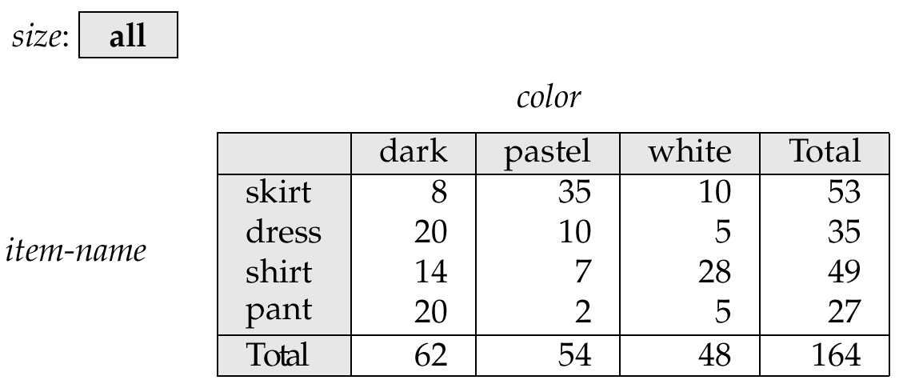
Cross Tabulation of sales by item-name and color
Figure 18.1
The table above is an example of a cross-tabulation (cross-tab), also referred to as a pivot-table.
  Values for one of the dimension attributes form the row headers
  Values for another dimension attribute form the column headers
  Other dimension attributes are listed on top
  Values in individual cells are (aggregates of) the values of the dimension attributes that specify the cell.

Slide 9
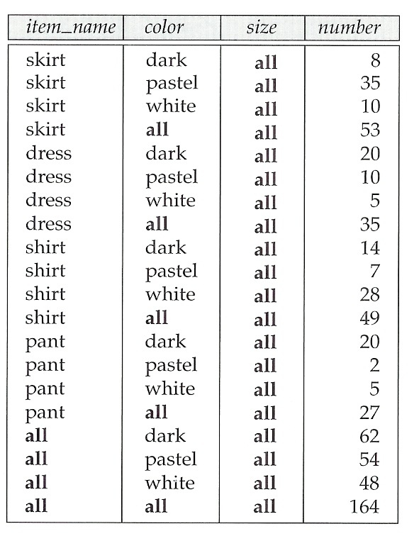
Relational Representation of Cross-tabs
Figure 18.2
Cross-tabs can be represented as relations
  We use the value all is used to represent aggregates
  The SQL:1999 standard actually uses null values in place of all despite confusion with regular null values

Slide 10
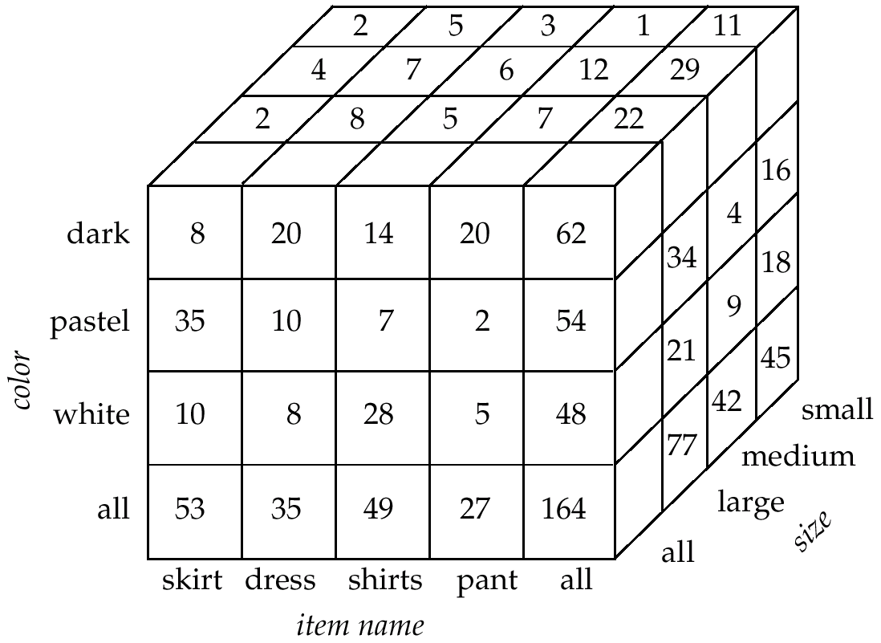
Data Cube
A data cube is a multidimensional generalization of a cross-tab
Can have n dimensions; we show 3 dimensional data cube below
Cross-tabs can be used as views on a data cube
Figure 18.3

Slide 11
OnLine Analytical Processing Operations
Pivoting: changing the dimensions used in a cross-tab is called
Slicing: creating a cross-tab for fixed values only
  Sometimes called dicing, particularly when values for multiple dimensions are fixed.
Rollup: moving from finer-granularity data to a coarser-granularity
Drill down: the opposite operation of Rollup - that of moving from coarser-granularity data to finer-granularity data

Slide 12
OLAP operations 그림예제추가

Slide 13

Hierarchies on Dimensions
Hierarchy on dimension attributes lets dimensions to be viewed at different levels of detail
  E.g. the dimension DateTime can be used to aggregate by hour of day, date, day of week, month, quarter or year

Slide 14
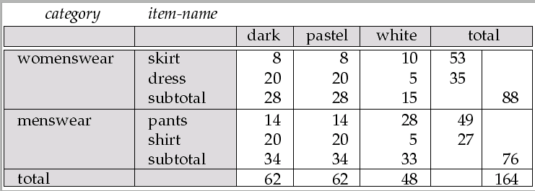
Cross Tabulation with Hierarchy
Cross-tabs can be easily extended to deal with hierarchies
  Multi levels of hierarchy can be displayed in the cross-tab
  Can drill down or roll up on a hierarchy
Figure 18.5
Figure 18.1
⬅ Cross tab without hierarchy

Slide 15
OLAP Implementation
Multidimensional OLAP (MOLAP) systems
  The earliest OLAP systems used multidimensional arrays in memory to store data cubes (ie, Programming Language’s Array Data Type)
  So called, MOLAP Data Cubes
Relational OLAP (ROLAP) systems
  OLAP implementations using only relational database features
  SQL aggregation functions & Many scans on relations
  The old versions of SQL are limited
Hybrid OLAP (HOLAP) systems.
  Hybrid systems, which store some summaries in memory and store the base data and other summaries in a relational database

Slide 16
OLAP Implementation (Cont.)
Early OLAP systems precomputed all possible aggregates in order to provide online response
  Space and time requirements for doing so can be very high
    2^{n} combinations of group by
Instead, precompute and store some aggregates, and compute others on demand from one of the precomputed aggregates
  Can compute aggregate on (item-name, color) from an aggregate on (item-name, color, size)
    For all but a few “non-decomposable” aggregates such as median
    is cheaper than computing it from scratch
Several optimizations available for computing multiple aggregates
  Can compute aggregates on (item-name, color, size),
  (item-name, color) and (item-name) using a single sorting of the base data

Slide 17
Extended Aggregation in SQL:1999
Statistical functions
  Standard deviation: stddev
  Variance: variance
  Binary aggregate functions
    correlations
    covariances
    regression curves
Generalization of Group-By
  Cube and Rollup
Ranking
Windowing

Slide 18
Extended Aggregation in SQL:1999
The cube operation computes union of group by’s on every subset of the specified attributes
select item-name, color, size, sum(number)
from sales
group by cube(item-name, color, size)
This computes the union of eight different groupings of the sales relation:
{ (item-name, color, size), (item-name, color), (item-name, size), (color, size),
(item-name), (color), (size), ( ) } where ( ) denotes an empty group by list.
  For each grouping, the result contains the null value for attributes not present in the grouping.
(item-name, color, size) 로 group-by
(item-name, color)로 group-by
(item-name, size)로 group-by
(color, size)로 group-by
(item-name)로 group-by
(color)로 group-by
(size)로 group-by
()로 group-by
Sales relation
Item-name | color | size | number
skirt | dark | large | 2
skirt | dark | medium | 4
skirt | dark | small | 2
skirt | pastel | large | 8
skirt | pastel | medium | 7
… | … | …. | ….
pant | white | small | 18

Slide 19
8 different groupings

Slide 20
Extended Aggregation in SQL1999 (Cont.)
Relational representation of cross-tab that we saw earlier, but with null in place of all, can be computed by
select item-name, color, sum(number)
from sales
group by cube(item-name, color)
Sales relation
Item-name | color | size | number
skirt | dark | large | 2
skirt | dark | medium | 4
skirt | dark | small | 2
skirt | pastel | large | 8
skirt | pastel | medium | 7
… | … | …. | ….
pant | white | small | 18
Null
Null
Null
Null
Null
Null
Null
Null
Null

Slide 21
Extended Aggregation in SQL1999 (Cont.)
The rollup construct generates union on every prefix of specified list of attributes
  E.g.
select item-name, color, size, sum(number)
from sales
group by rollup(item-name, color, size)
  Generates the union of four groupings:
{ (item-name, color, size), (item-name, color), (item-name), ( ) }
Rollup can be used to generate aggregates at multiple levels of a hierarchy.
  E.g., suppose table itemcategory(item-name, category) gives the category of each item. Then
select category, item-name, sum(number)
from sales, itemcategory
where sales.item-name = itemcategory.item-name
group by rollup(category, item-name)
would give a hierarchical summary by item-name and by category.

Slide 22
4 different groupings by roll-up

Slide 23
Extended Aggregation in SQL1999 (Cont.)
Multiple rollups and cubes can be used in a single group by clause
  Each generates set of group by lists, cross product of sets gives overall set of group by lists
E.g.,
select item-name, color, size, sum(number)
from sales
group by rollup(item-name) , rollup(color, size)
generates the groupings
{item-name, ()} X {(color, size), (color), ()}
= { (item-name, color, size), (item-name, color), (item-name),
(color, size), (color), ( ) }

Slide 24
Ranking in SQL1999
Ranking is done in conjunction with an order by specification.
Given a relation student-marks(student-id, marks) find the rank of each student.
select student-id, rank( ) over (order by marks desc) as s-rank
from student-marks
An extra order by clause is needed to get them in sorted order
select student-id, rank ( ) over (order by marks desc) as s-rank
from student-marks
order by s-rank
Ranking may leave gaps
  e.g. if 2 students have the same top mark, both have rank 1, and the next rank is 3
  dense_rank does not leave gaps, so next dense rank would be 2
Student-marks(stu-id, marks)
S-id | marks
S-10 | 90
S-7 | 80
S-13 | 95
S-id | marks | rank
S-10 | 90 | 2
S-7 | 80 | 3
S-13 | 95 | 1
S-id | marks | rank
S-13 | 95 | 1
S-10 | 90 | 2
S-7 | 80 | 3

Slide 25
Ranking in SQL1999 (Cont.)
Ranking can be done within partition of the data.
student-marks(student-id, marks), student-section(student-id, section)
  “Find the rank of students within each section.”
select student-id, section,
rank ( ) over (partition by section order by marks desc) as sec-rank
from student-marks, student-section
where student-marks.student-id = student-section.student-id
order by section, sec-rank
Multiple rank clauses can occur in a single select clause
Ranking is done after applying group by clause/aggregation
Other ranking functions:
  percent_rank (within partition, if partitioning is done)
  cume_dist (cumulative distribution)
    fraction of tuples with preceding values
  row_number (non-deterministic in presence of duplicates)

Slide 26
다양한 Ranking function 그림예제 추가

Slide 27
Ranking in SQL1999 (Cont.)
For a given constant n, the ranking the function ntile(n)
  takes the tuples in each partition in the specified order,
  and divides them into n buckets with equal numbers of tuples.
E.g.:
select threetile, sum(salary)
from (
select salary, ntile(3) over (order by salary) as threetile
from employee
) as s
group by threetile
SQL:1999 permits the user to specify nulls first or nulls last
select student-id,
rank ( ) over (order by marks desc nulls last) as s-rank
from student-marks

Slide 28
Ntile Ranking 그림예제 추가

Slide 29
Windowing in SQL1999
Used to smooth out random variations.
E.g.: moving average: “Given sales values for each date, calculate for each date the average of the sales on that day, the previous day, and the next day”
Window specification in SQL:
  Given a relation sales(date, value)
select date, sum(value) over
(order by date between rows 1 preceding and 1 following)
from sales
Examples of other window specifications:
  between rows unbounded preceding and current
  rows unbounded preceding
  range between 10 preceding and current row
    All rows with values between current row value –10 to current value
  range interval 10 day preceding
    Not including current row
date | value
Oct 2 | 90
Oct 3 | 80
Oct 4 | 60
Oct 5 | 95

Slide 30
Windowing in SQL1999 (Cont.)
Can do windowing within partitions
E.g. Given a relation transaction (account-number, date-time, value), where value is positive for a deposit and negative for a withdrawal
  “Find total balance of each account after each transaction on the account”
  select account-number, date-time,
  sum (value ) over
  ( partition by account-number
  order by date-time
  rows unbounded preceding)
  as balance
  from transaction
  order by account-number, date-time

Slide 31
Windowing 그림예제 추가

Slide 32
Chapter 18: Data Analysis and Mining
18.1 Decision Support Systems
18.2 Data Analysis and OLAP
18.3 Data Warehousing
18.4 Data Mining
18.5 Summary

Slide 33
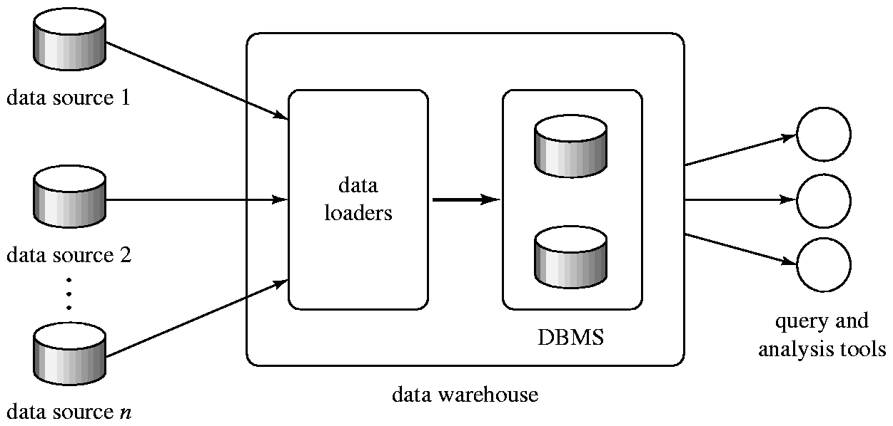
Data Warehousing
Data sources often store only current data, not historical data
Corporate decision making requires a unified view of all organizational data, including historical data
A data warehouse is a repository (archive) of information gathered from multiple sources, stored under a unified schema, at a single site
  Greatly simplifies querying, permits study of historical trends
  Shifts decision support query load away from transaction processing systems

Slide 34
Data Warehouse Design Issues
When and how to gather data!
  Source driven architecture: data sources transmit new information to warehouse, either continuously or periodically (e.g. at night)
  Destination driven architecture: warehouse periodically requests new information from data sources
  Keeping warehouse exactly synchronized with data sources (e.g. using two-phase commit) is too expensive
    Usually OK to have slightly out-of-date data at warehouse
    Data/updates are periodically downloaded from online transaction processing (OLTP) systems.
What schema to use!
  Schema integration

Slide 35
Data Warehouse Design Issues (con’d)
Data cleansing
  E.g. correct mistakes in addresses (misspellings, zip code errors)
  Merge address lists from different sources and purge duplicates
How to propagate updates!
  Warehouse schema may be a (materialized) view of schema from data sources
What data to summarize!
  Raw data may be too large to store on-line
  Aggregate values (totals/subtotals) often suffice
  Queries on raw data can often be transformed by query optimizer to use aggregate values

Slide 36
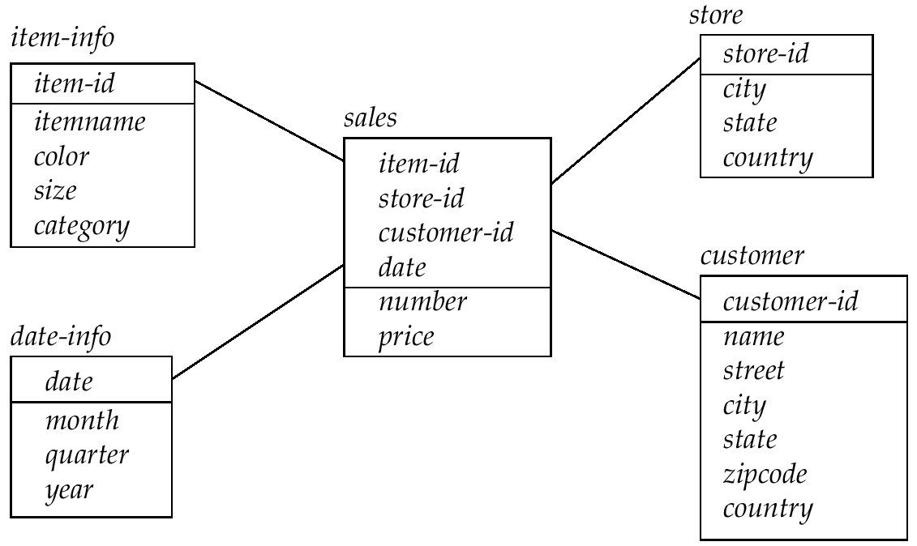
Warehouse Schemas
Dimension values are usually encoded using small integers and mapped to full values via dimension tables
Resultant schema is called a star schema
  More complicated schema structures
    Snowflake schema: multiple levels of dimension tables
    Constellation: multiple fact tables
Star Schema

Slide 37
Snow flake schema and Constellation 그림추가

Slide 38
Chapter 18: Data Analysis and Mining
18.1 Decision Support Systems
18.2 Data Analysis and OLAP
18.3 Data Warehousing
18.4 Data Mining
18.5 Summary

Slide 39
Data Mining
Data mining is the process of semi-automatically analyzing large databases to find useful patterns
Prediction based on past history
  Predict if a credit card applicant poses a good credit risk, based on some attributes (income, job type, age, ..) and past history
  Predict if a pattern of phone-calling card usage is likely to be fraudulent
Some examples of prediction mechanisms:
  Classification
    Given a new item whose class is unknown, predict to which class it belongs
  Regression formulae
    Given a set of mappings for an unknown function, predict the function result for a new parameter value with regression formulae

Slide 40
Data Mining (Cont.)
Prediction by Descriptive Patterns
  Associations
    Associations may be used as a first step in detecting causation
      E.g. association between exposure to chemical X and cancer,
    Ex: Recommendation system using association
      Find books that are often bought by “similar” customers.
      If a new such customer buys one such book, suggest the others too.
  Clusters
    A cluster of something has a some special reason
    E.g. typhoid cases were clustered in an area with a contaminated well
    Detection of clusters of diseases remains important in detecting epidemics

Slide 41
Classification Rules
Classification rules help assign new objects to classes.
  E.g., given a new automobile insurance applicant, should he or she be classified as low risk, medium risk or high risk?
Classification rules for above example could use a variety of data, such as educational level, salary, age, etc.
  ∀ person P, P.degree = masters and P.income > 75,000
    ➔ P.credit = excellent
  ∀ person P, P.degree = bachelors and
  (P.income ≥ 25,000 and P.income ≤ 75,000)
  ➔ P.credit = good
Rules are not necessarily exact: there may be some misclassifications
Classification rules can be shown compactly as a decision tree.

Slide 42
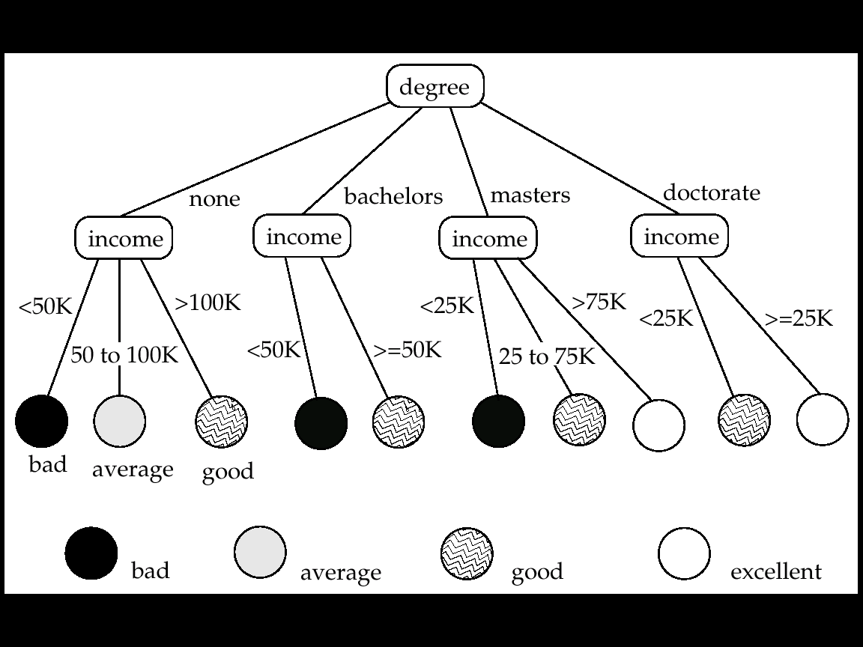
Classification - “Decision Trees”
Training set: a data sample in which the classification is already known.
Greedy top down generation of decision trees.
  Each internal node of the tree partitions the data into groups based on a partitioning attribute, and a partitioning condition for the node
  Leaf node:
    all (or most) of the items at the node belong to the same class, or
    all attributes have been considered, and no further partitioning is possible.

Slide 43
Best Splits of Decision Trees
skip
Way for choosing best attributes and conditions on which to partition
The purity of a set S of training instances can be measured quantitatively in several ways.
  Notation:
    number of classes = k
    number of instances = |S|
    fraction of instances in class i = p_{i}
The Gini measure of purity is defined as
Gini (S) = 1 - ∑
  When all instances are in a single class, the Gini value is 0
  It reaches its maximum (of 1 – 1/k) if each class the same number of instances.
k
p²_{i}
i =1

Slide 44
Best Splits of Decision Trees (Cont.)
skip
Another measure of purity is the entropy measure, which is defined as
entropy (S) = – ∑
  The entropy value is 0 if all instances are in a single class
  It reaches its maximum when each class has the same number of instances
When a set S is split into multiple sets Si, i = 1, 2, …, r, we can measure the purity of the resultant set of sets as:
purity(S₁, S₂, ….., S_{r}) = ∑
Either Gini or Entropy can be used as purity function
k
p_{i}log₂ p_{i}
i = 1
r
|S_{i}|
|S|
purity (S_{i})
i= 1

Slide 45
Best Splits of Decision Trees (Cont.)
skip
The information gain due to particular split of S into S_{i}, i = 1, 2, …., r
Information-gain (S, {S₁, S₂, …., S_{r} }) = purity(S ) – purity (S₁, S₂, … S_{r})
Measure of “cost” of a split:
Information-content (S, {S₁, S₂, ….., S_{r} } ) = – ∑
Now define Information-gain ratio
Information-gain ratio = Information-gain (S, {S₁, S₂, ……, S_{r}})
Information-content (S, {S₁, S₂, ….., S_{r}})
The best split is the one that gives the maximum information gain ratio
r
|S_{i}|
|S|
|S_{i}|
|S|
log₂
i = 1

Slide 46
Finding Best Splits of Decision Trees
skip
Categorical attributes (with no meaningful order):
  Multi-way split: one child for each value
  Binary split: try all possible breakup of values into two sets, and pick the best
Continuous-valued attributes (can be sorted in a meaningful order)
  Binary split:
    Sort values, try each as a split point
      E.g. if values are 1, 10, 15, 25, split at ≤1, ≤ 10, ≤ 15
    Pick the value that gives best split
  Multi-way split:
    A series of binary splits on the same attribute has roughly equivalent effect

Slide 47
Decision-Tree Construction Algorithm
skip
  Procedure GrowTree (S )
  Partition (S );
  Procedure Partition (S) {
  if ( purity (S ) > δ_{p} or |S| < δ_{s} ) then return;
  for each attribute A
  evaluate splits on attribute A;
  Use the best split found (across all attributes) to
  partition S into S₁, S₂, …., S_{r};
  for i = 1, 2, ….., r
  Partition (S_{i} );
  }

Slide 48
Best Split 그림예제 추가
skip

Slide 49
Other Classifiers
Neural net classifiers are studied in artificial intelligence and are not covered here
Bayesian classifiers use Bayes theorem, which says
p (c_{j} | d ) = p (d | c_{j} ) p (c_{j} )
p ( d )
where
p (c_{j} | d ) = probability of instance d being in class c_{j},
p (d | c_{j} ) = probability of generating instance d given class c_{j},
p (c_{j} ) = probability of occurrence of class c_{j}, and
p (d ) = probability of instance d occurring
The class with the maximum probability becomes the predicated class of instance d
Bayesian classifiers require
  computation of p (d | c_{j} )
  precomputation of p (c_{j} )
  p (d ) can be ignored since it is the same for all classes

Slide 50
Naïve Bayesian Classifiers
To simplify the task, naïve Bayesian classifiers assume attributes have independent distributions, and thereby estimate
p (d | c_{j}) = p (d₁ | c_{j} ) * p (d₂ | c_{j} ) * ….* (p (d_{n} | c_{j} )
  Each of the p (d_{i} | c_{j} ) can be estimated from a histogram on d_{i} values for each class c_{j}
    the histogram is computed from the training instances
  Histograms on multiple attributes are more expensive to compute and store
Divide the range of values of attribute i into equal intervals and store the fraction of instances of class c_{j} that fall in each interval
Given a value d_{i} for attribute i, the value of p (d_{i} | c_{j}) is simply the fraction belonging to class c_{j} that fall in the interval to which d_{i} belongs
Class C1: Attribute A ( 10--20: 0.3, 20--30: 0.7), Attribute B (a--c: 0.2, d--f: 0.8)
Class C2: Attribute A ( 10--20: 0.6, 20--30: 0.4), Attribute B (a--c: 0.7, d--f: 0.3)
instance d (25, e) ➔ compute p(d, C1) and p(d, C2)

Slide 51
Bayesian Classifier 의 그림예제추가

Slide 52
Regression
Regression deals with the prediction of a value, rather than a class.
  Given values for a set of variables, X₁, X₂, …, X_{n}, we wish to predict the value of a variable Y.
One way is to infer coefficients a₀, a₁, a₁, …, a_{n} such that
Y = a₀ + a₁ * X₁ + a₂ * X₂ + … + a_{n} * X_{n}
Finding such a linear polynomial is called linear regression
  In general, the process of finding a curve that fits the data is also called curve fitting.
The fit may only be approximate
  because of noise in the data, or
  because the relationship is not exactly a polynomial
Regression aims to find coefficients that give the best possible fit
  Standard techniques in statistics

Slide 53
Descriptive Patterns: Association Rules
Retail shops are often interested in associations between different items that people buy.
  Someone who buys bread is quite likely also to buy milk
  A person who bought the book Database System Concepts is quite likely also to buy the book Operating System Concepts.
Associations information can be used in several ways.
  E.g. when a customer buys a particular book, an online shop may suggest associated books.
Association rules:
Buying bread ⇒ Buying milk
Buying DB-Concepts book ⇒ Buying OS-Concepts book
  Left hand side: antecedent, right hand side: consequent
  An association rule must have an associated population
    the population consists of a set of instances
    E.g. each transaction (sale) at a shop is an instance, and the set of all transactions is the population

Slide 54
Descriptive Patterns: Association Rules (Cont.)
Rules have an associated support, as well as an associated confidence.
Support is a measure of what fraction of the population satisfies both the antecedent and the consequent of the rule.
  E.g. Suppose only 0.001 percent of all purchases include milk and screwdrivers.
    The support for the rule is Buying milk ⇒ Buying screwdrivers is low.
Confidence is a measure of how often the consequent is true when the antecedent is true.
  E.g. the rule Buying bread ⇒ Buying milk has a confidence of 80 percent if 80 percent of the purchases that include bread also include milk.
If A ⇒ B
    Support (A) = count(A) / population
    Support of rule = count (A union B) / population
    Confidence of rule = support (B ) / support (A)

Slide 55
Descriptive Patterns: Association Rules (Con’d)
We are generally only interested in association rules with reasonably high support (e.g. support of 2% or greater)
Naïve algorithm for discover association rules
  Consider all possible sets of relevant items.
  For each set, find its support (i.e. count how many transactions purchase all items in the set).
    Large itemsets: sets with sufficiently high support
  Use large itemsets to generate association rules.
    From large itemset A, generate the rule A - {b } ⇒ b for each b ∈ A
    if the rule has sufficient confidence
      Support of rule = support (A)
      Confidence of rule = support (A ) / support (A - {b })

Slide 56
Finding Support of Association Rules
Determine support of itemsets via a single pass on set of transactions
  Large itemsets: sets with a high count at the end of the pass
If memory not enough to hold all counts for all itemsets, use multiple passes, considering only some itemsets in each pass.
Optimization: Once an itemset is eliminated because its count (support) is too small, none of its supersets needs to be considered.
Given a, b, c: counts would be incremented for {a}, {b}, {c}, {a,b}, {b,c},{a,c}, {a,b,c}
The a priori technique to find large itemsets:
  Pass 1:
    Count support of all sets with just 1 item
    Eliminate those items with low support
  Pass i: candidates: every set of i items such that all its i-1 item subsets are large
    Count support of all candidates
    Stop if there are no candidates

Slide 57
Descriptive Patterns:
Other Types of Associations
Basic association rules have several limitations
Deviations from the expected probability are more interesting
  E.g. if many people purchase bread and many people purchase cereal, quite a few would be expected to purchase both
  We are interested in positive as well as negative correlations between sets of items
    Positive correlation: co-occurrence is higher than predicted
    Negative correlation: co-occurrence is lower than predicted
Sequence associations (or sequence correlations)
  Sequence data = Time series data
  E.g. whenever bonds go up, stock prices go down in 2 days
Deviations from temporal patterns (or sequential patterns)
  Deviation from a steady growth
  E.g. sales of winter wear go down in summer
    Not surprising, part of a known pattern.
    Look for deviation from value predicted using past patterns

Slide 58
Descriptive Patterns: Clustering
Clustering: Intuitively, finding clusters of points in the given data such that similar points lie in the same cluster
  Can be formalized using distance metrics in several ways
Grouping points into k sets (for a given k)
  (A) Minimize the average distance of points from the centroid of their cluster
    Centroid: point defined by taking average of coordinates in each dimension.
  (B) Minimize the average distance between every pair of points in a cluster
Known as K-means clustering algorithm
Has been studied extensively in statistics, but on small data sets
  Data mining systems aim at clustering techniques that can handle very large data sets
  E.g. the Birch clustering algorithm (more shortly)

Slide 59
Descriptive Patterns: Various Clustering
Hierarchical clustering (Example from biological classification)
  does not attempt to predict, rather attempt to cluster related items
  chordata
  mammalia reptilia
  leopards humans snakes crocodiles
  Other examples: Internet directory systems (e.g. Yahoo, more on this later)
Agglomerative clustering algorithms
  Build small clusters, then cluster small clusters into bigger clusters, and so on
Divisive clustering algorithms
  Start with all items in a single cluster, repeatedly refine (break) clusters into smaller ones

Slide 60
Various Clustering algorithms 동작그림예제

Slide 61
Descriptive Patterns: Clustering Algorithms
Clustering algorithms have been designed to handle very large datasets
E.g. the Birch clustering algorithm
  Main idea: use an in-memory R-tree to store points that are being clustered
  Insert points one at a time into the R-tree, merging a new point with an existing cluster if is less than some δ distance away
  If there are more leaf nodes than fit in memory, merge existing clusters that are close to each other
  At the end of first pass we get a large number of clusters at the leaves of the R-tree
    Merge clusters to reduce the number of clusters

Slide 62
Birch algorithm의 직관적예제추가

Slide 63
Descriptive Pattern:
Clustering by Collaborative Filtering
Goal: predict what movies/books/… a person may be interested in, on the basis of
  Past preferences of the person
  Other people with similar past preferences
  The preferences of such people for a new movie/book/…
One approach based on repeated clustering
  Cluster people on the basis of preferences for movies
  Then cluster movies on the basis of being liked by the same clusters of people
  Again cluster people based on their preferences for (the newly created clusters of) movies
  Repeat above till equilibrium
  Suppose 4 persons & 5 movies
    P1(m1,m2, m5), P2(m2, m4), P3(m1, m5), P4(m2)
Above problem is an instance of collaborative filtering, where users collaborate in the task of filtering information to find information of interest

Slide 64
Collaborative filtering 그림예제추가

Slide 65
Other Types of Data Mining
Text mining: application of data mining to textual documents
  cluster Web pages to find related pages
  cluster pages a user has visited to organize their visit history
  classify Web pages automatically into a Web directory
Data visualization systems help users examine large volumes of data and detect patterns visually
  Can visually encode large amounts of information on a single screen
  Humans are very good a detecting visual patterns

Slide 66
Chapter 18: Data Analysis and Mining
18.1 Decision Support Systems
18.2 Data Analysis and OLAP
18.3 Data Warehousing
18.4 Data Mining
18.5 Summary

Slide 67
Ch 18: Summary (1)
Decision-support systems analyze on-line data collected by transaction processing systems, to help people make business decisions.
  Since most organizations are extensively computerized today, a vary large body of information is available for decision support.
  Decision-support systems come in various forms, including OLAP systems and data-mining systems.
Online analytical processing(OLAP) tools help analysts view data summarized in different ways, so that they can gain insight into the functioning of an organization.
  OLAP tools work on multidimensional data, characterized by dimension attributes and measure attributes.
  The Data cube contains of multidimensional data summarized in different ways. Precomputing the data cube helps speed up queries on summaries of data.
  Cross-tab displays permit users to view two dimensions of multidimensional data at a time, along with summaries of the data.
  Drill down, rollup, slicing, and dicing are among the operations that users perform with OLAP tools.

Slide 68
Ch 18: Summary (2)
The OLAP component of the SQL:1999 standard provides a variety of new functionality for data analysis, including new aggregate functions, cube and rollup operations; ranking functions; windowing functions, which support summarization on moving windows; and partitioning, with windowing and ranking applied inside each partition.
Data warehouses help gather and archive important operational data.
  Warehouses are used for decision support and analysis on historical data, for instance, to predict trends.
  Data cleansing from input data sources is often a major task in data warehousing.
  Warehouse schemas tend to be multidimensional, involving one or a few vary large fact tables and several much smaller dimension tables.
Data mining is the process of semiautomatically analyzing large databases to find useful patterns.
  There are a number of applications of data mining, such as prediction of values based on past examples, finding of associations between purchases, and automatic clustering of people and movies

Slide 69
Ch 18: Summary (3)
Classification deals with predicting the class of test instances, by using attributes of the test instances, based on attributes of training instances, and the actual class of training instances.
  Classification can be used, for instance, to predict credit-worthiness levels of new applicants or to predict the performance of applicants to a university.
  Decision-tree classifiers, which perform classification by constructing a tree based on training instances with leaves having class labels.
    The tree is traversed for each test instance to find a leaf, and the class of the leaf is the predicted class.
    Several techniques are available to construct decision trees, most of them based on greedy heuristics.
  Bayesian classifiers are simpler to construct than decision-tree classifiers, and work better in the case of missing/null attribute values.
Association rules identify items that co-occur frequently, for instance, items that tend to be bought by the same customer.
  Correlations look for deviations from expected levels of association.
Other types of data mining include clustering, text mining, and data visualization.

Slide 70
Ch 18: Bibliographical Notes (1)
Gray et al.[1995] and Gray et al.[1997] describe the data-cube operator.
Efficient algorithms for computing data cubes are described by Agarwal et al.[1996], Harinarayan et al.[1996], and Ross and Srivastava [1997].
Descriptions of extended aggregation support SQL:1999 can be found in the product manuals of database systems such as Oracle and IBM DB2.
Definitions of statistical functions can be found in standard statistics textbooks such as Bulmer[1979] and Ross[1999].
Poe[1995] and Mattison[1996] provide textbook coverage of data-warehousing environment.
Chaudhuri et al.[2003] describes a system for deduplication using active learning techniques.
Witten and Frank[1999] and Han and Kamber[2000] provide textbook coverage of data mining.
Mitchell[1997] is a classic textbook on machine learning, and covers classification techniques in detail

Slide 71
Ch 18: Bibliographical Notes (2)
Fayyad et al.[1995] present an extensive collection of articles on knowledge discovery and data mining.
Kohavi and Provost[2001] present a collection of articles on applications of data mining to electronic commerce.
Agrawal et al.[1993b] provide an early overview of data mining in databases.
Algorithms for computing classifiers with large training sets are described by Agrawal et al.[1992] and Shafer et al.[1996]; the decision-tree construction algorithm described in this chapter is based on the SPRINT algorithm of Shafer et al.[1996].
Agrawal et al.[1993a] introduced the notion of association rules, while Agrawal and Srikant[1994] present an efficient algorithm for associations rule mining.
Algorithms for mining of different forms of association rules are described by Srikant and Agrawal[1996a] and Srikant and Agrawal[1996b].
Chakrabarti et al.[1998] describe techniques for mining surprising temporal patterns.

Slide 72
Ch 18: Bibliographical Notes (3)
Techniques for integrating data cubes with data mining are described by Sarawagi[2000].
Clustering has long been studied in the area of statistics, and Jain and Dubes[1998] provide textbook coverage of clustering.
Ng and Han [1994] describe spatial clustering techniques for large datasets are described by Zhang et al.[1996]
Breese et al.[1998] provide an empirical analysis of different algorithms for collaborative filtering.
Techniques for collaborative filtering of news articles are described by Konstan et al.[1997].
Chakrabarti[2002] provides a text book description of information retrieval, including extensive coverage of data mining-tasks related to textual and hypertext data, such as classification and clustering.
Chakrabarti[2000] provides a survey of hypertext mining techniques such as hypertext classification and clustering.

Slide 73
Ch 18: Tools (1)
A variety of tools are available for each of the applications we have studied in this chapter.
Most database vendors provide OLAP tools as part of their database system, or as add-on applications.
  These include OLAP tools from Microsoft Corp., Oracle Express, and Informix Metacube.
  The Arbor Essbase OLAP tools is from an independent software vendor.
  The site www.databeacon.com provides an on-line demo of the Databeacon OLAP tools for specific applications, such as customer relationship management.
Major database vendors also offer data warehousing products coupled with their database systems. These provide support functionality for data modeling, cleansing, loading, and querying. The web site www.dwinfocenter.org provides information on data-warehousing products.

Slide 74
Ch 18: Tools (2)
There is also a wide variety of general-purpose data-mining tools, including mining tools from the SAS Institute, IBM Intelligent Miner, and SGI Mineset.
A good deal of expertise is required to apply general-purpose mining tools for specific applications. As a result, a large number of mining tools have been developed to address specialized applications.
The Web site www.kdnuggets.com provides an extensive directory of mining software, solutions, publications, and so on.

Slide 75
Chapter 18: Data Analysis and Mining
18.1 Decision Support Systems
18.2 Data Analysis and OLAP
18.3 Data Warehousing
18.4 Data Mining
18.5 Summary

Slide 76
End of chapter 18

