Slide 1
Practical RDF Ch.2
Junwon Jung
SNU OOPSLA Lab.
Shelley Powers, O’Reilly
August 5, 2004

Slide 2
Table of contents
The search for knowledge
The RDF triple
The Basic RDF data model and the RDF graph
URIs
RDF Serialization
  N3
  N-triples
Lingo and vocabulary

Slide 3
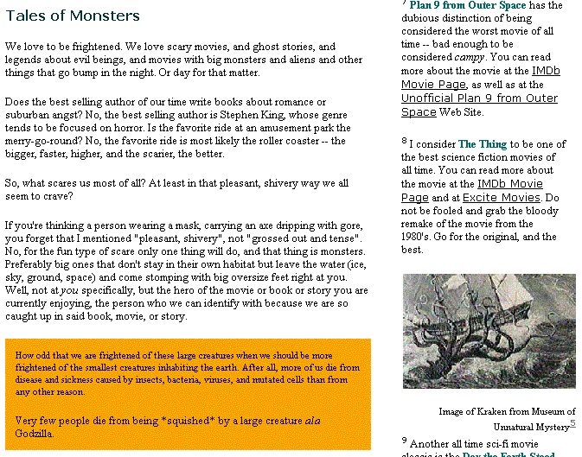
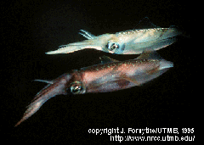


The search for knowledge(1/2)
Previous method
x
Links
.
.
.
(giant squid)

Slide 4
The search for knowledge(2/2)
The reason we get so many links
  Most search engine use keyword based search
  Need for context based search
    Attach information about the context of the resource
  Ex) The article’s title is “Architeuthis Dux”
  The article’s author is Shelly Powers
  The article’s is part of a series
  The related article is …
  The article is about the giant squid and its place in the legends
    RDF records data in a machine understandable format
    RDF is based on a domain-neutral model

Slide 5
The RDF triple(1/3)
Three pieces of information are all that’s needed in order to fully define a single bit of knowledge
RDF specification, an RDF triple documents knowledge
  RDF triple
    Subject : something to describe
    Property(predicate) : attributes, relationships
    value(object) : the value associated with the property
    Ex)
    I(subject) have a name(property), which is Shelley Powers(property value)
    I(subject) have a height(property), which is five feet eleven inches(property value)

Slide 6
The RDF triple(2/3)
The title of the article is “Architeuthis Dux”
(predicate) (subject) (object)
In RDF terms, a resource identified by URI
  The title of the article at http://burningbird.net/articles/monsters1.htm is “Architeuthis Dux”
  Providing URI is equivalent to giving a person a unique identifier within a personal system
Each of the three components specifically broken out into the following format
  <subject> has <predicate> <object>
  Ex) http://burningbird.net/articles/monsters1.htm has a title of “Architeuthis Dux”

Slide 7
The RDF triple(3/3)
One shorthand technique
  { subject, predicate, object }
  { http://burningbird.net/articles/monsters1.htm , title , “Architeuthis
  Dux” }
Regardless of the manner, four facts are immutable
  Each RDF triple is made up of subject, predicate, and object
  Each RDF triple is a complete and unique fact
  An triple is a 3-tuple, which is made up of a subject, predicate, and object which are respectively a uriref or bnode; a uriref; and a uriref, bnode or literal
  Each RDF triple can be joined other RDF triples, but it still retains its own unique meaning

Slide 8
The Basic RDF data model and the RDF graph (1/)
RDF graph
  RDF core working group decided
  A directed labeled graph
  Graphs are extremely easy to read
  RDF data model can be represented in RDF graphs
  The graph consists of a set of nodes connected by arcs
    Node – Arc – Node

Slide 9
The Basic RDF data model and the RDF graph (2/)
Node of RDF graph
  uriref node : Uniform Resource Identifier(URI) that provides a specific identifier unique to the node
  Blank node : nodes that don’t have a URI
  literal : literal values represent RDF objects
The arcs are directional and labeled with the predicate
  predicate is given a uriref equal to the schema for RDF vocabulary elements
http://burningbird.net/postcon/elements/1.0/title
http://burningbird.net/articles/monsters1.htm
Architeuthis Dux

Slide 10
The Basic RDF data model and the RDF graph (3/)
http://www.w3.org/1999/02/22-rdf-syntax-ns#Subject
http://www.webreference.com/dhtml/hiemenus
http://www.w3.org/1999/02/22-rdf-syntax-ns#predicate
http://burningbird.net/schema/Contains
http://www.w3.org/1999/02/22-rdf-syntax-ns#object
genid:158
Tutorials and source code about creating
hierarchical menus in DHTML
http://www.w3.org/1999/02/22-rdf-syntax-ns#type
http://burningbird.net/schema/Contains
http://burningbird.net/schema/recommendedBy
Shelley Powers

Slide 11
URIs(Uniform Resource Identifier)
The identifiers contained within a uriref
Used to identify specific predicates
URIs provide a common syntax for naming a resource regardless of the protocol used to access the resource
Absolute or Partial URIs
  http://burningbird.net/articles/monsters1.htm
  monsters1.htm
URI include fragment identifier (#)
  http://burningbird.net/articles/monsters1.htm#introduction
URL(Uniform Resource Locators)
URN(Uniform Resource Name)

Slide 12
RDF Serialization(1/4)
A brief Look at N3(N3 or Notation3)
  The basic structure of an N3 tuple
    subject predicate object .
    Ex) <http://webblog.burningbird.net/fires/000805.htm> <http://purl.org/dc/elements/1.1/creatir> Shelley.
    QNames can be used instead of the full namespace
    Ex) <bbd:000805.htm> dc:creator Shelley.

Slide 13
RDF Serialization(2/4)
N-Triples
  N-triples is a subset of N3
  It supports the same format for RDF triples
    Subject predicate object .
  N-triples can contain comments
    #comment
  The sunject can consist of either a uriref or a blank node identifier
    _:name
  The predicate is always a uriref

Slide 14
RDF Serialization(3/4)
N-Triples
<http://burningbird.net/articles/monsters2.htm> <http://burningbird.net/postcon/elements/1.0/title>
“Shelly Powers” .
<http://burningbird.net/articles/monsters2.htm> <http://burningbird.net/postcon/elements/1.0/author>
“Architeuthis Dux” .
http://burningbird.net/postcon/elements/1.0/title
http://burningbird.net/articles/monsters2.htm
Architeuthis Dux
Shelley Powers
http://burningbird.net/postcon/elements/1.0/author

Slide 15
RDF Serialization(4/4)
Ex) N-triples output with generated blank node identifier
_:j0 <http://www.w3.org/1999/02/22-rdf-syntax-ns#Subject> <http://www.webreference.com/dhtml/hiemenus> .
_:j0 http://www.w3.org/1999/02/22-rdf-syntax-ns#predicate http://burningbird.net/schema/Contains .
_:j0 http://www.w3.org/1999/02/22-rdf-syntax-ns#object “Tutorials and source code about creating hierarchical menus in DHTML” .
_:j0 http://www.w3.org/1999/02/22-rdf-syntax-ns#type http://www.w3.org/1999/02/22-rdf-syntax-ns#Staement .
_:j0 http://burningbird.net/schema/recommendedBy “Shelley Powers” .

Slide 16
Lingo and vocabulary(1/2)
Graph and subgraphs
  Subgraph is a subset of the triples contained in the graph
Merge of the graphs
  Union of two or more RDF graphs
  Blank nodes are never merged in a graph
    There is no way of determining whether two nodes are same
Ground and not graph
  An RDF graph is considered grounded if there are no blank nodes
Entailment
  Within RDF semantics document, entailment describes two graphs, which are equal in all aspects

Slide 17
Lingo and vocabulary(2/2)
http://www.w3.org/1999/02/22-rdf-syntax-ns#Subject
http://www.webreference.com/dhtml/hiemenus
http://www.w3.org/1999/02/22-rdf-syntax-ns#predicate
http://burningbird.net/schema/Contains
http://www.w3.org/1999/02/22-rdf-syntax-ns#object
genid:158
Tutorials and source code about creating
hierarchical menus in DHTML
http://www.w3.org/1999/02/22-rdf-syntax-ns#type
http://burningbird.net/schema/Contains
http://burningbird.net/schema/recommendedBy
Shelley Powers
http://burningbird.net/articles/monsters1.htm
Architeuthis Dux
http://burningbird.net/postcon/elements/1.0/title

