Slide 1
Finding and Evaluating Community Structure in Networks
M.E.J. Newman and M. Girvan
Physical Review E 69, 026113 (2004)
11 July 2014
SNU IDB Lab.
Namyoon Kim

Slide 2
Outline
Introduction
Hierarchical Clustering
Edge Betweenness
The Algorithm
Implementation
Weighting
Edge betweenness contribution
Community strength
Modularity
Tests
Conclusion

Slide 3
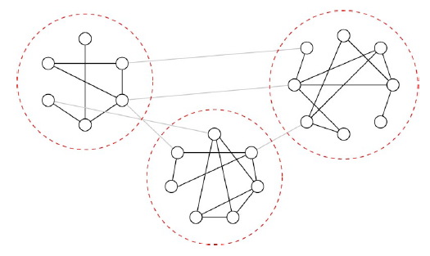
Introduction
Networks
Interest in theoretical modelling of networks in recent years
Covers a wide variety of topics such as statistical physics, applied mathematics, computational biology and social networking
Community Structure
Within network connections: dense
Between network connections: sparse

Slide 4
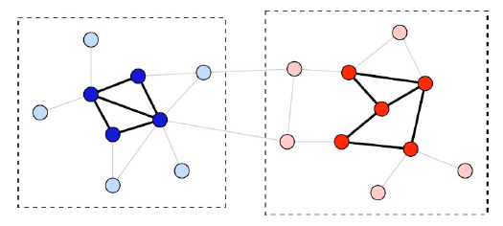
Hierarchical Clustering: Agglomerative
Agglomerative
Edges added to an initially empty network
Tends to find only the core of communities
Peripheral nodes are important in finding the true size of a network

Slide 5
Hierarchical Clustering: Divisive
Divisive
Start with a non-empty network, find the least similar pairs of vertices and re-move their in-between edges
Newman’s approach
Look for edges that are between networks

Slide 6
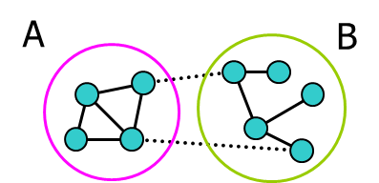
Edge Betweenness
Betweenness
All paths from community A to community B (and vice versa) must pass through either edges 1 or 2
Edges 1 and 2 have high betweenness
source: www.cs.kent.edu/~jin/DM07/PPT/muad.ppt
1
2

Slide 7
The Algorithm
Shortest path betweenness
Find shortest paths for all pairs of vertices and count how many run along each edge
Recalculation step
Remove edge with highest count
Recalcuate shortest path betweenness for all edges
Steps
Calculate betweenness scores for all edges in the network
Find the edge with the highest score and remove it from the network
Recalculate betweenness for all remaining edges
Repeat from step 2

Slide 8
Implementation – weighting (i)
Weighting
i. Initial vertex s is given distance 0 and weight 1
(d_{s} = 0, w_{s} = 1)
S

Slide 9
Weighting (ii)
Weighting
ii. Every vertex i adjacent to s is given distance d_{i} = d_{s} + 1 = 1
and weight w_{i} = w_{s} = 1
(0, 1)
S
(d_{i} = 1, w_{i} = 1)
(d_{i} = 1, w_{i} = 1)
i
i

Slide 10
Weighting (iii)
Weighting
iii. For each vertex j adjacent to i, do:
a) w_{j} = w_{i}, and d_{j} = d_{i} + 1,
ONLY when d_{j} is not assigned
yet
b) Add weights of other
incoming vertices (i) ONLY if
d_{j} is assigned AND d_{j} ≥ d_{i} + 1
(0, 1)
S
(1, 1)
(1, 1)
i
i
(d_{i} = 2, w_{i} = 2)
(d_{i} = 2, w_{i} = 1)
j
j

Slide 11
Weighting (iv)
Weighting
iv. Repeat from iii until no vertices remain that have assigned distances but whose neighbours do not have assigned distances
Time complexity: O(E)
(0, 1)
S
(1, 1)
(1, 1)
(2, 2)
(2, 1)
(3, 1)
(3, 3)

Slide 12
Implementation – edge betweenness contribution (i)
Edge betweenness contribution
i. Find every “leaf” vertex t that no paths from s to other vertices go through
(1)
S
(1)
(1)
(2)
(1)
(3)
t
t
(1)

Slide 13


Edge betweenness contribution (ii)
Edge betweenness contribution
ii. From each vertex i neighbouring t, assign a score for the t-i edge of w_{i}/w_{t}
(1)
S
(1)
(1)
(2)
(1)
i
i
$$\frac{2}{3}$$
$$\frac{1}{3}$$
1
(3)
t
t
(1)

Slide 14



Edge betweenness contribution (iii)
Edge betweenness contribution
iii. Work upwards to s. From node j to i (j farther from s than i), assign the edge a score of w_{i}/w_{j}×(1 + sum of all scores of edges immediately below j)
(1)
S
(1)
(1)
i
i
$$\frac{1}{2}×\left(1+\frac{2}{3}\right)= \frac{5}{6}$$
$$\frac{5}{6}$$
$$\frac{1}{1}×\left(1+1+ \frac{1}{3}\right)= \frac{7}{3}$$
(2)
(1)
j
j
$$\frac{2}{3}$$
$$\frac{1}{3}$$
1
(3)
(1)

Slide 15



Edge betweenness contribution (iv)
Edge betweenness contribution
iv. Repeat from iii until s is reached
Time complexity: O(E)
(1)
S
$$\frac{1}{1}×\left(1+\frac{5}{6}\right)= \frac{11}{6}$$
$$\frac{1}{1}×\left(1+\frac{5}{6}+ \frac{7}{3}\right)= \frac{25}{6}$$
(1)
(1)
$$\frac{5}{6}$$
$$\frac{5}{6}$$
$$\frac{7}{3}$$
(2)
(1)
$$\frac{2}{3}$$
$$\frac{1}{3}$$
1
(3)
(1)

Slide 16


Algorithm complexity
Edge betweenness contribution
Repeat weighting and edge betweenness contribution calculations for all V source vertices s, E times (every time an edge is removed)
Time complexity:
(O(E) + O(E)) × V × E = O(E²V)
= O(n³)
(1)
$$\frac{11}{6}$$
S
$$\frac{25}{6}$$
(1)
(1)
$$\frac{5}{6}$$
$$\frac{5}{6}$$
$$\frac{7}{3}$$
(2)
(1)
$$\frac{2}{3}$$
$$\frac{1}{3}$$
1
(3)
(1)

Slide 17
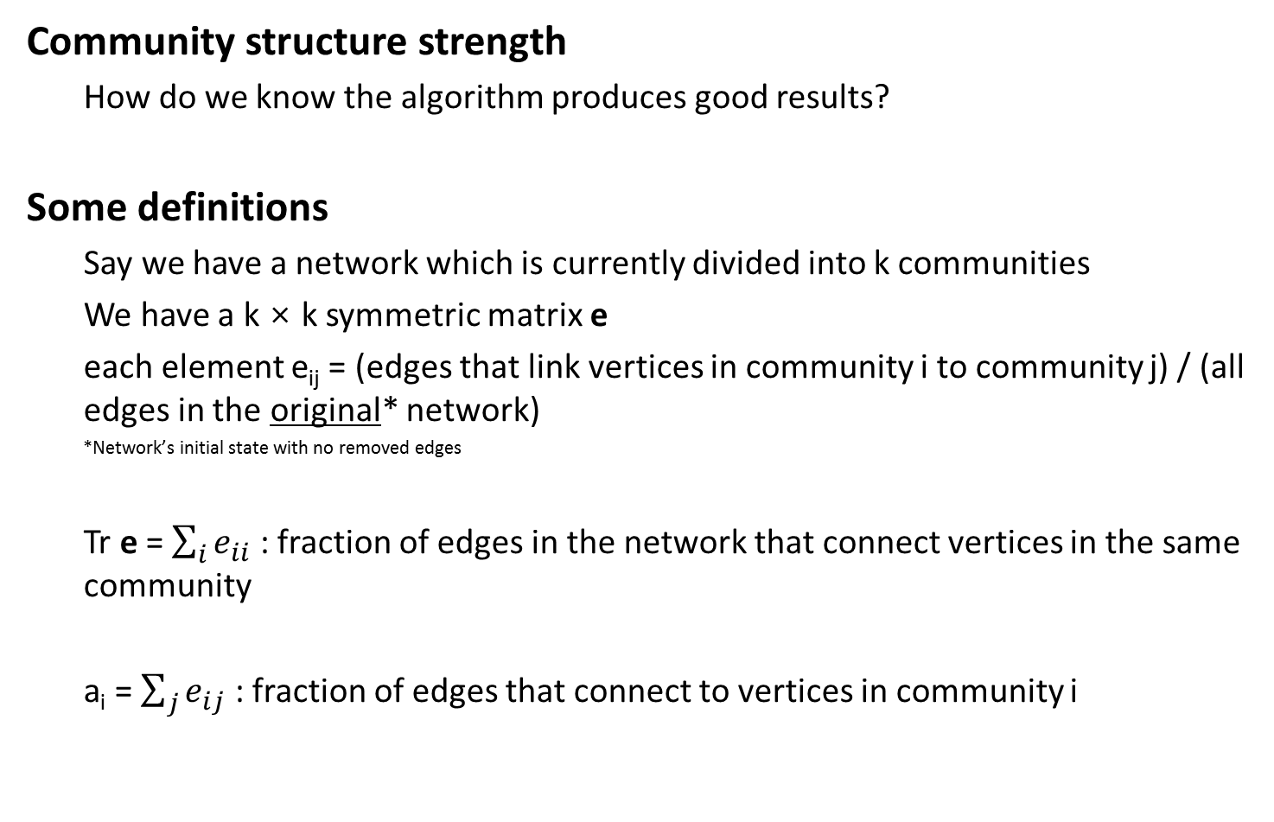
Community strength
Community structure strength
How do we know the algorithm produces good results?
Some definitions
Say we have a network which is currently divided into k communities
We have a k × k symmetric matrix e
each element e_{ij} = (edges that link vertices in community i to community j) / (all edges in the original* network)
*Network’s initial state with no removed edges
Tr e = $\sum_{i}{e_{ii}}$ : fraction of edges in the network that connect vertices in the same community
a_{i} = $\sum_{j}{e_{ij}}$ : fraction of edges that connect to vertices in community i

Slide 18

Modularity
Modularity
Q = $\sum_{i}{(e_{ij} −a_{i}^{2})}=(Tr e) − \left\|e^{2}\right\|$
Q = 0 means the split is no better than random partitioning
Q = 1 means network has strong community structure
Generally, networks with reasonably well split communities have Q of 0.3 – 0.7

Slide 19
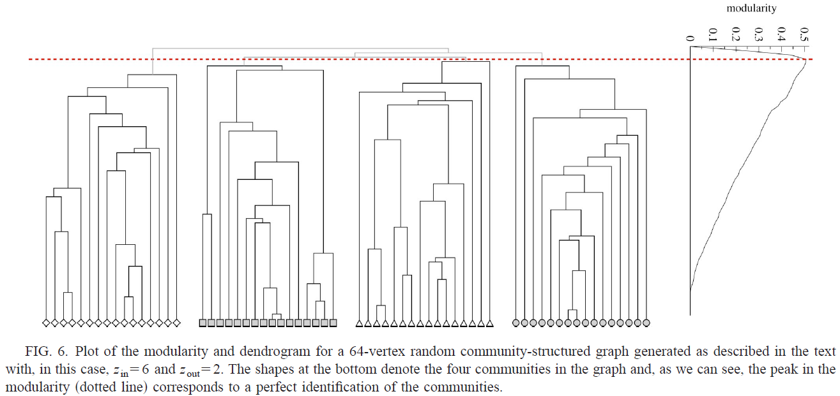
Tests – shortest-paths
z_{in} = mean no. of edges from a vertex to another vertex in same community
z_{out} = mean no. of edges from a vertex to another vertex in different community

Slide 20
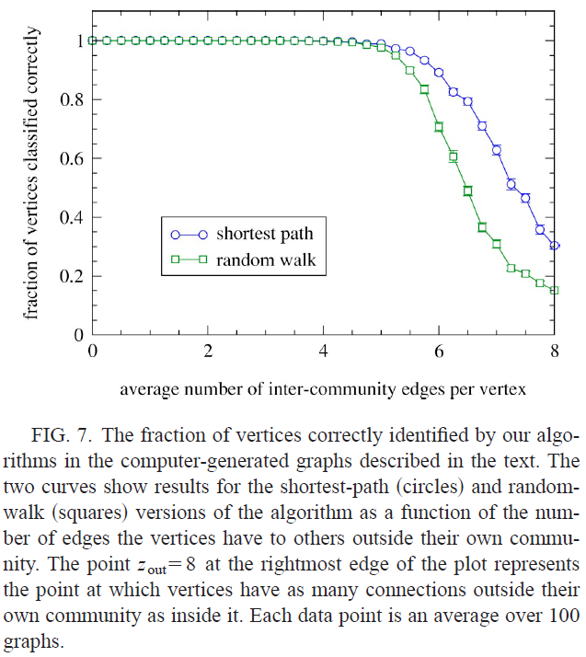
Tests - correctness

Slide 21
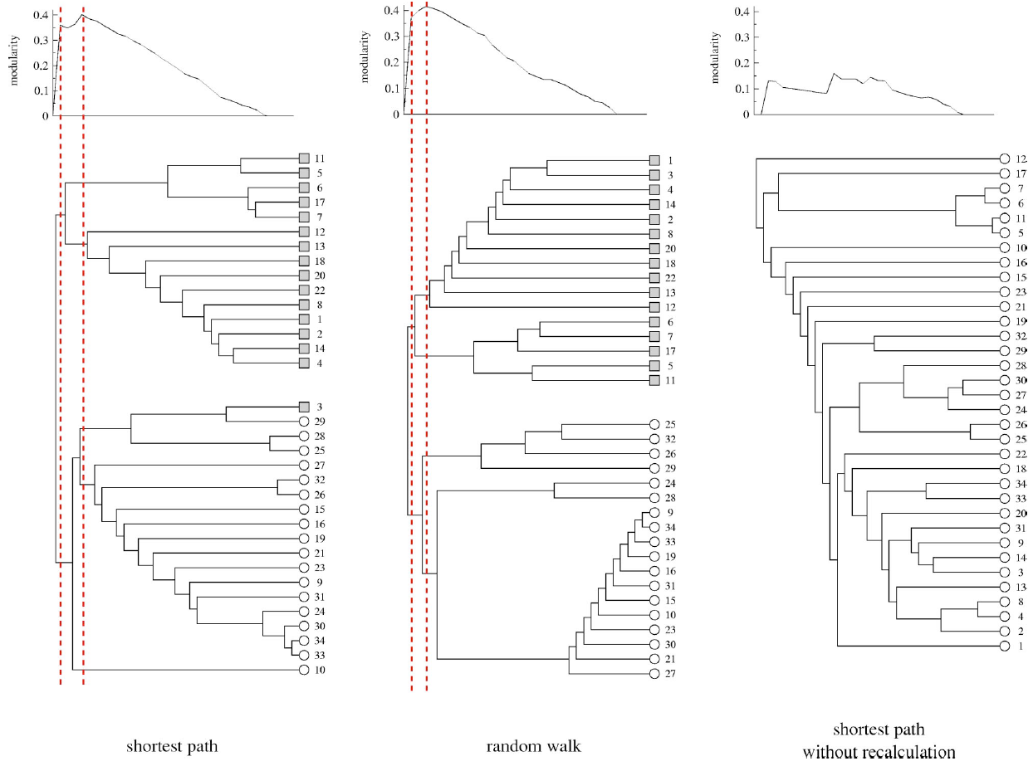
Tests – random walk and recalculation

Slide 22
Conclusion
Contributions
A new class of algorithms for performing network clustering
Described the task of extracting the natural community structure from networks of vertices and edges
Future Work
Reduce time complexity

Slide 23
References
[1] M.E.J. Newman and M. Girvan. Finding and Evaluating Community Structure in Networks. Phys. Rev. E 69 (2):026113, 2004.
[2] M.E.J. Newman, Fast Algorithm for Detecting Community Structure in Networks. Phys. Rev. E 69, 066133, 2004. Presentation by Muad Abu-Ata, www.cs.kent.edu/~jin/DM07/PPT/muad.ppt

