Slide 1
Weighted Graphs and Disconnected Components Patterns and a Generator
IDB Lab.
2014. 8. 1.
현근수
In KDD 08.
Mary McGlohon, Leman Akoglu, Christos Faloutsos

Slide 2
Outline
Introduction
Related Work
Data
Observation
Generative model
Conclusion

Slide 3
“Disconnected” components
In graphs a largest connected component emerges.
What about the smaller-size components?
How do they emerge, and join with the large one?

Slide 4
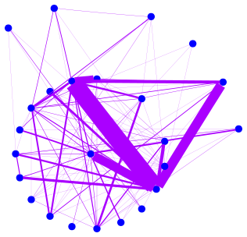
Weighted edges
Graphs have heavy-tailed degree distribution.
What can we also say about these edges?
How are they repeated, or otherwise weighted?

Slide 5
Goals
Observe “Next-largest connected components(NLCCs)”
Q1. How does the GCC emerge?
Q2. How do NLCC’s emerge and join with the GCC?
Find properties that govern edge weights
Q3: How does the total weight of the graph relate to the number of edges?
Q4: How do the weights of nodes relate to degree?
Q5: Does this relation change with the graph?
Q6: Can we produce an emergent, generative model

Slide 6
Properties of networks
Small diameter (“small world” phenomenon)
[Milgram 67] [Leskovec, Horovitz 07]
Heavy-tailed degree distribution
[Barabasi, Albert 99] [Faloutsos, Faloutsos, Faloutsos 99]
Densification
[Leskovec, Kleinberg, Faloutsos 05]
“Middle region” components as well as GCC and singletons
[Kumar, Novak, Tomkins 06]
Notes:
Note that nlcc’s = middle region

Slide 7
Generative Models
Erdos-Renyi model [Erdos, Renyi 60]
Preferential Attachment [Barabasi, Albert 99]
Forest Fire model [Leskovec, Kleinberg, Faloutsos 05]
Kronecker multiplication [Leskovec, Chakrabarti, Kleinberg, Faloutsos 07]
Edge Copying model [Kumar, Raghavan, Rajagopalan, Sivakumar, Tomkins, Upfal 00]
“Winners don’t take all” [Pennock, Flake, Lawrence, Glover, Giles 02]

Slide 8
Diameter
Diameter of a graph is the “longest shortest path”
Effective diameter is the distance at which 90% of nodes can be reached.
n5
n1
n2
diameter=3
n₆
n3
n4
n7

Slide 9
Unipartite Networks
Postnet: Posts in blogs, hyperlinks between
Blognet: Aggregated Postnet, repeated edges
Patent: Patent citations
NIPS: Academic citations
Arxiv: Academic citations
NetTraffic: Packets, repeated edges
Autonomous Systems (AS): Packets, repeated edges
(3)
n1
n3
n2
n4
n5
n6
n7
Notes:
We have several different networks- from social media, academic citations, and computer networks

Slide 10
Unipartite Networks
Postnet: Posts in blogs, hyperlinks between
Blognet: Aggregated Postnet, repeated edges
Patent: Patent citations
NIPS: Academic citations
Arxiv: Academic citations
NetTraffic: Packets, repeated edges
Autonomous Systems (AS): Packets, repeated edges
10
n1
1.2
n3
n2
1
8.3
n4
6
n5
n6
2
n7
Notes:
We have several different networks- from social media, academic citations, and computer networks

Slide 11
Unipartite Networks
(Nodes, Edges, Timestamps)
Postnet: 250K, 218K, 80 days
Blognet: 60K,125K, 80 days
Patent: 4M, 8M, 17 yrs
NIPS: 2K, 3K, 13 yrs
Arxiv: 30K, 60K, 13 yrs
NetTraffic: 21K, 3M, 52 mo
AS: 12K, 38K, 6 mo
n1
n3
n2
n4
n5
n6
n7
Notes:
We have several different networks- from social media, academic citations, and computer networks

Slide 12
Bipartite Networks
IMDB: Actor-movie network
Netflix: User-movie ratings
DBLP: repeated edges
Author-Keyword
Keyword-Conference
Author-Conference
US Election Donations: $ weights, repeated edges
Orgs-Candidates
Individuals-Orgs
n1
m1
n2
m2
n3
m3
n4

Slide 13
Bipartite Networks
IMDB: Actor-movie network
Netflix: User-movie ratings
DBLP: repeated edges
Author-Keyword
Keyword-Conference
Author-Conference
US Election Donations: $ weights, repeated edges
Orgs-Candidates
Individuals-Orgs
n1
10
1.2
m1
n2
2
5
m2
n3
1
6
m3
n4

Slide 14
Bipartite Networks
IMDB: 757K, 2M, 114 yr
Netflix: 125K, 14M, 72 mo
DBLP: 25 yr
Author-Keyword: 27K, 189K
Keyword-Conference: 10K, 23K
Author-Conference: 17K, 22K
US Election Donations: 22 yr
Orgs-Candidates: 23K, 877K
Individuals-Orgs: 6M, 10M
n1
m1
n2
m2
n3
m3
n4

Slide 15
Observation 1: Gelling Point
Q1: How does the GCC emerge?

Slide 16
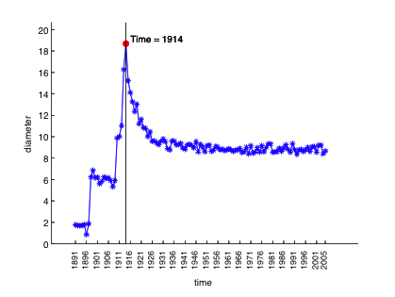
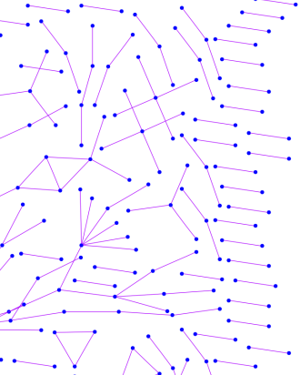

Observation 1: Gelling Point
Most real graphs display a gelling point, or burning off period
After gelling point, they exhibit typical behavior. This is marked by a spike in diameter.
IMDB
t=1914
Diameter
Time

Slide 17
Observation 2: NLCC behavior
Q2: How do NLCC’s emerge
and join with the GCC?
Do they continue to grow in size?
Do they shrink?
Stabilize?

Slide 18
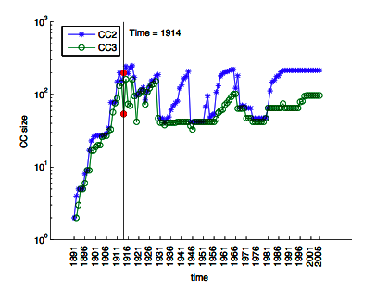
Observation 2: NLCC behavior
After the gelling point, the GCC takes off, but NLCC’s remain constant or oscillate.
IMDB
CC size
Time

Slide 19
Observation 3
Q3: How does the total weight
of the graph relate to the
number of edges?

Slide 20
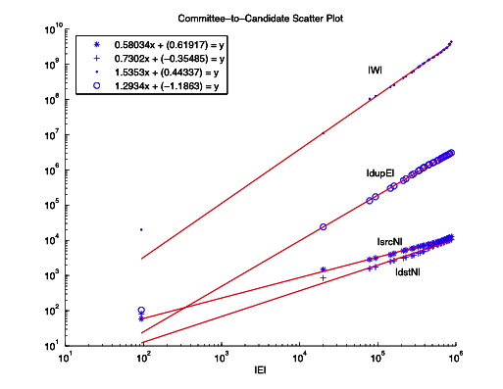
Observation 3: Fortification Effect
$ = # checks ?
Orgs-Candidates
2004
|$|
1980
|Checks|

Slide 21
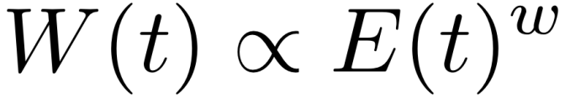
Observation 3: Fortification Effect
Weight additions follow a power law with respect to the number of edges:
W(t): total weight of graph at t
E(t): total edges of graph at t
w is PL exponent
1.01 < w < 1.5 = super-linear!
(more checks, even more $)
Orgs-Candidates
2004
|$|
1980
|Checks|

Slide 22
Observation 4 and 5
Q4: How do the weights
of nodes relate to degree?
Q5: Does this relation
change over time?

Slide 23
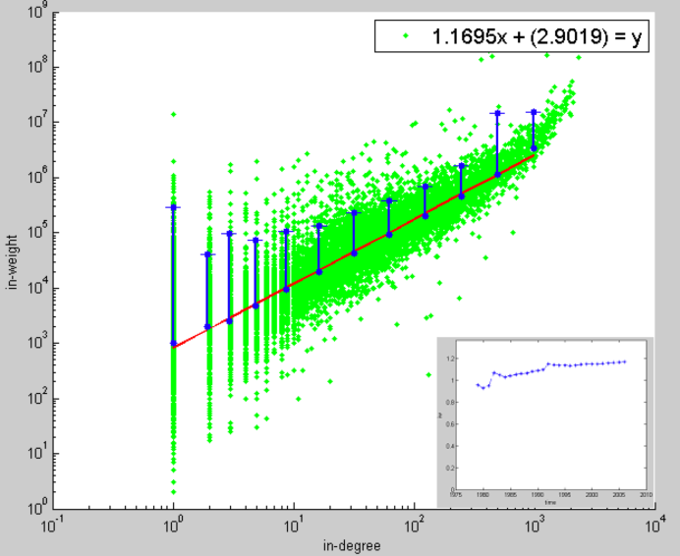
Observation 4: Snapshot Power Law
At any time, total incoming weight of a node is proportional to in degree with PL exponent, iw. 1.01 < iw < 1.26, super-linear
More donors, even more $
Orgs-Candidates
e.g. John Kerry,
$10M received,
from 1K donors
In-weights
($)
Edges (# donors)

Slide 24

Observation 5:Snapshot Power Law
For a given graph, this exponent is constant over time.
Orgs-Candidates
exponent
Time

Slide 25
Goals of model
a) Emergent, intuitive behavior
b) Shrinking diameter
c) Constant NLCC’s
d) Densification power law
e) Power-law degree distribution

Slide 26

Goals of model
a) Emergent, intuitive behavior
b) Shrinking diameter
c) Constant NLCC’s
d) Densification power law
e) Power-law degree distribution
= “Butterfly” Model

Slide 27
Butterfly model in action
A node joins a network, with own parameter.
n1
p_{step}
n3
n2
n8
“Curiosity”
n4
n5
n6
n7

Slide 28
Butterfly model in action
A node joins a network, with own parameter.
With (global) p_{host}, chooses a random host
n1
p_{host}
n3
“Cross-disciplinarity”
n2
n8
n4
n5
n6
n7
Notes:
Phost is the same for all nodes

Slide 29
Butterfly model in action
A node joins a network, with own parameters.
With (global) p_{host}, chooses a random host
With (global) p_{link}, creates link
n1
p_{link}
n3
“Friendliness”
n2
n8
n4
n5
n6
n7

Slide 30
Butterfly model in action
A node joins a network, with own parameters.
With (global) p_{host}, chooses a random host
With (global) p_{link}, creates link
With p_{step} travels to random neighbor
n1
n3
n2
n8
p_{step}
n4
n5
n6
n7

Slide 31
Butterfly model in action
A node joins a network, with own parameters.
With (global) p_{host}, chooses a random host
With (global) p_{link}, creates link
With p_{step} travels to random neighbor. Repeat.
n1
n3
n2
n8
p_{link}
n4
n5
n6
n7

Slide 32
Butterfly model in action
A node joins a network, with own parameters.
With (global) p_{host}, chooses a random host
With (global) p_{link}, creates link
With p_{step} travels to random neighbor. Repeat.
n1
n3
n2
n8
p_{step}
n4
n5
n6
n7

Slide 33
Butterfly model in action
Once there are no more “steps”, repeat “host” procedure:
With p_{host}, choose new host, possibly link, etc.
n1
n3
n2
n8
p_{host}
n4
n5
n6
n7

Slide 34
Butterfly model in action
Once there are no more “steps”, repeat “host” procedure:
With p_{host}, choose new host, possibly link, etc.
n1
n3
n2
n8
p_{host}
n4
n5
n6
n7

Slide 35
Butterfly model in action
Once there are no more “steps”, repeat “host” procedure:
With p_{host}, choose new host, possibly link, etc.
Until no more steps, and no more hosts.
n1
n3
n2
n8
n4
p_{link}
n5
n6
n7

Slide 36
Butterfly model in action
Once there are no more “steps”, repeat “host” procedure:
With p_{host}, choose new host, possibly link, etc.
Until no more steps, and no more hosts.
n1
n3
n2
n8
n4
p_{step}
n5
n6
n7

Slide 37
a) Emergent, intuitive behavior
Novelties of model:
Nodes link with probability
May choose host, but not link (start new component)
Incoming nodes are “social butterflies”
May have several hosts (merges components)
Some nodes are friendlier than others
p_{step} different for each node
This creates power-law degree distribution (theorem)

Slide 38
Validation of Butterfly
Chose following parameters:
p_{host}= 0.3
p_{link} = 0.5
p_{step} ~ U(0,1)
Ran 10 simulations
100,000 nodes per simulation

Slide 39
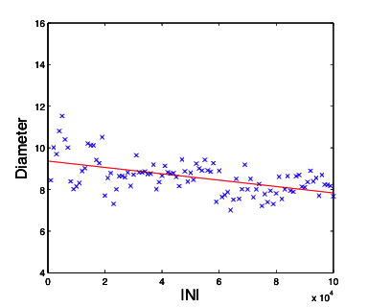
b) Shrinking diameter
Shrinking diameter
In model, gelling usually occurred around N=20,000
N=20,000
Diam-
eter
Nodes

Slide 40
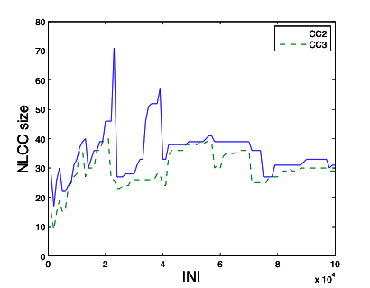
c) Oscillating NLCC’s
Constant / oscillating NLCC’s
N=20,000
NLCC
size
Nodes

Slide 41
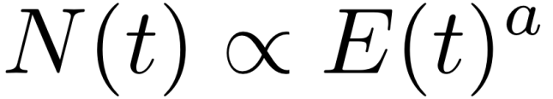
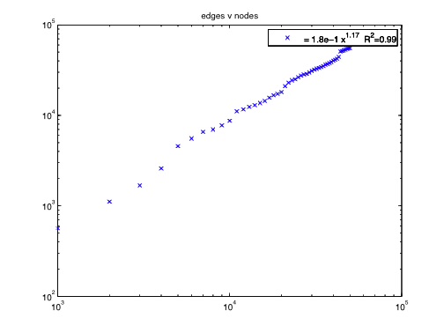
d) Densification power law
Densification:
Our datasets had a=(1.03, 1.7)
In [Leskovec+05-KDD], a= (1.1, 1.7)
Simulation produced a = (1.1,1.2)
Edges
N=20,000
Nodes

Slide 42
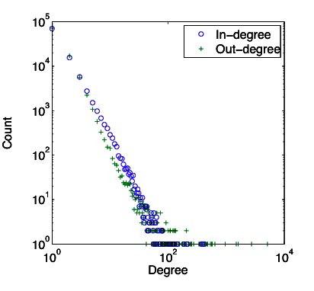
e) Power-law degree distribution
Power-law degree distribution
Exponents approx -2
Count
Degree

Slide 43
Summary
Studied several diverse public graphs
Measured at many timestamps
Unipartite and bipartite
Blogs, citations, real-world, network traffic
Largest was 6 million nodes, 10 million edges

Slide 44
Summary
Observations on unweighted graphs:
A1: The GCC emerges at the “gelling point”
A2: NLCC’s are of constant / oscillating size
Observations on weighted graphs:
A3: Total weight increases super-linearly with edges
A4: Node’s weights increase super-linearly with degree, power law exponent iw
A5: iw remains constant over time
A6: Intuitive, emergent generative “butterfly” model, that matches properties

