Slide 1
Scalable Distributed Reasoning Using MapReduce
Jacopo Urbani, Spyros Kotoulas,
Eyal Oren, and Frank van Harmelen
Department of Computer Science,
Vrije Universiteit Amsterdam,
The Netherlands
22 November 2012
SNU IDB Lab.
Hyesung Oh

Slide 2
Outline
Introduction
Related Work
What Is the MapReduce Framework?
Naive RDFS Reasoning with MapReduce
Efficient RDFS Reasoning with MapReduce
Experimental Results
Conclusion

Slide 3
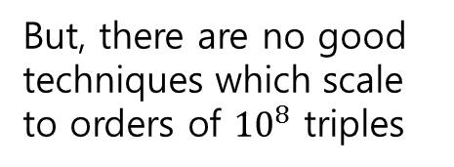
Introduction
The problem of scalable distributed reasoning
Centralised approach
Depends on H/W power
Only 1-Dimension
Moves
Many compute nodes
Parallel implementation
2-Dimensions
But, there are no good techniques which scale to orders of ${10}^{8}$ triples

Slide 4
Introduction
Technique for materialising the closure of an RDF graph
Distributed manner
Based on MapReduce
Use RDFS semantics
OWL Horst semantics (future work)
MapReduce framework for efficient large-scale Semantic Web reasoning

Slide 5
Outline
Introduction
Related Work
What Is the MapReduce Framework?
Naive RDFS Reasoning with MapReduce
Efficient RDFS Reasoning with MapReduce
Experimental Results
Conclusion

Slide 6
Related Work
The closure of an RDF graph using two passes on a single machine(Hogan et al.)
OWL Horst semantics
To allow efficient materialisation
To prevent “ontology hijacking”
Using MapReduce to answer SPARQL queries over large RDF graphs(Mika and Tummarello)
Graph-partitioning techniques improve reasoning over first-order logic knowledge bases.(MacCartney et al.)
Technique for parallel OWL inferencing through data partitioning (Soma and Prasanna)
For small datasets (1M triples)

Slide 7
Related Work
Technique based on data-partitioning in a self-organising P2P network(previous work)
Load-balanced auto-partitioning
Conventional reasoners
Locally executed
Data exchanged between the nodes
Several techniques based on deterministic rendezvous peers on top of distributed hashtables
Notes:
Rendezvous : 랑데부(만남, 약속)

Slide 8
Outline
Introduction
Related Work
What Is the MapReduce Framework?
Naive RDFS Reasoning with MapReduce
Efficient RDFS Reasoning with MapReduce
Experimental Results
Conclusion

Slide 9
What Is the MapReduce Framework?
MapReduce
Framework
parallel and distributed processing of batch jobs
On a large number of computer nodes
Job
Map
Reduce
Key/value pair

Slide 10
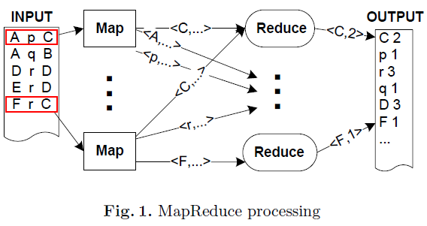
What Is the MapReduce Framework?
Counting term occurrences in RDF Ntriples files
Map
Input(key : line number, value : triple(s, p, o ))
Output(key : triple term, value : blank)
Reduce
Input(key : triple term, value : irrelevant values)
Output(key : triple term, value : count)
Skewed partitioning may slow down system’s speed
Notes:
Irrelevant : 무관한

Slide 11
Outline
Introduction
Related Work
What Is the MapReduce Framework?
Naive RDFS Reasoning with MapReduce
Efficient RDFS Reasoning with MapReduce
Experimental Results
Conclusion

Slide 12
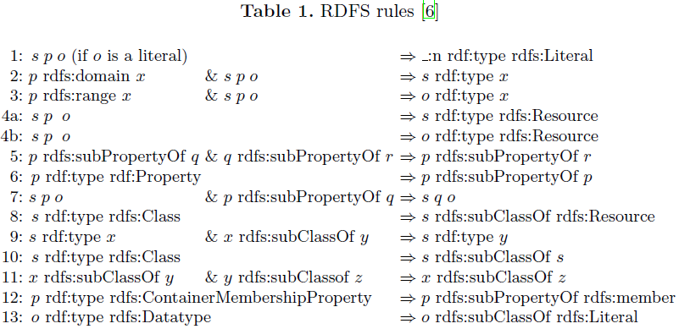
Naive RDFS Reasoning with MapReduce
RDFS rules

Slide 13
Naive RDFS Reasoning with MapReduce
The closure of an RDF input graph
RDFS semantics
Applying RDFS rules iteratively
Applying the RDFS
Performing a join over some terms
Ignore rules 1, 4a, 4b, 6, 8, 10, 12, 13(for brevity)
Rules with two antecedents are more challenging(-> join required)

Slide 14
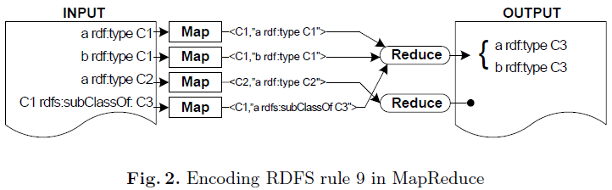
Naive RDFS Reasoning with MapReduce
Example rule 9 from Table 1
Map
Input(key : line number, value : triple)
Output
key : triple(object), value : triple // group (s rdf:type x) on x
key : triple(subject), value : triple // group (x rdfs:subClassOf y) on y
Reduce
Input(key : triple term(e.g. x), values : triples(e.g. s type x, x subClassOf y))
Output(key : null, value : triple(s, “rdf:type”, y))

Slide 15
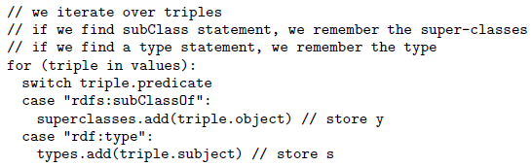
Naive RDFS Reasoning with MapReduce
Iteration process
x
rdfs:subClassOf
y
s
rdf:type
x
Find possible all s and y
s
rdf:type
y

Slide 16
Naive RDFS Reasoning with MapReduce
Complete RDFS Reasoning : The Need for Fixpoint Iteration
Need n map/reduce Iteration steps for all corresponding conclusions
Many rules are interrelated
Need to re-apply rules and chain map/reduce functions
Some fixpoint will be needed

Slide 17
Outline
Introduction
Related Work
What Is the MapReduce Framework?
Naive RDFS Reasoning with MapReduce
Efficient RDFS Reasoning with MapReduce
Experimental Results
Conclusion

Slide 18
Efficient RDFS Reasoning with MapReduce
Naive RDFS Reasoning is inefficient
Produces duplicate triples
Requires fixpoint iteration
Falcon dataset test result -> unique : duplicate = 1 : 50
Need more efficient approach
3 optimisations
decrease the number of jobs and time for closure computation

Slide 19
Efficient RDFS Reasoning with MapReduce
Loading Schema Triples in Memory
Schema triples << instance triples
e.g. rdfs:subClassOf triples << rdf:type triples
Instance triples(stream)
MapReduce:
Join operation
Schema triples(in-memory)

Slide 20
Efficient RDFS Reasoning with MapReduce
Data Grouping to Avoid Duplicates
e.g. rule 2: p rdfs:domain x & s p o => s rdf:type x
(s, rdf:type, x)
(s, rdf:type, x)
(s, rdf:type, x)
Map
(Join)
s p a
s p b
s p c
&
p rdfs:domain x
Reduce
(s, p)
(s, p)
(s, p)
Map
s p a
s p b
s p c
&
p rdfs:domain x
Reduce
(Join)
Join once with unique tuple
p rdfs:domain x

Slide 21
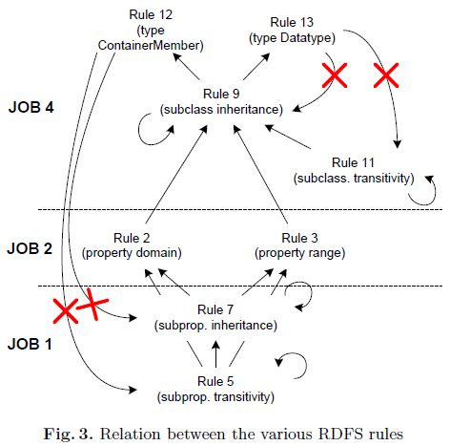
Efficient RDFS Reasoning with MapReduce
Ordering the Application of the RDFS Rules
Some rules may triggered by which other rule
So, categorise the rules based on their output and antecedents
Rule 12 and Rule 13 output X
rdfs:member, rdfs:Literal
both aren’t sub-classes or subproperties

Slide 22
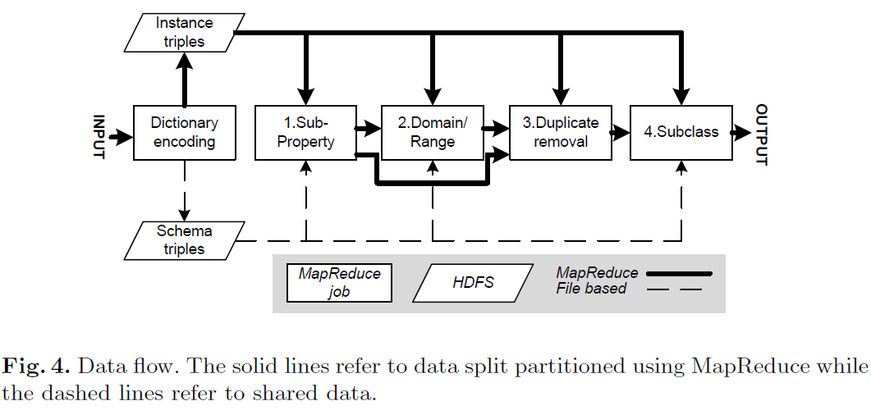
Efficient RDFS Reasoning with MapReduce
The Complete Picture

Slide 23
Efficient RDFS Reasoning with MapReduce
Distributed Dictionary Encoding in MapReduce
To reduce the physical size of the input data
Each triple term is rewritten into a unique identifier
Rewriting each term into 8-byte identifier
Encoding 865M triples takes about 1 hour on 32 nodes
Schema triples are extracted here

Slide 24
Efficient RDFS Reasoning with MapReduce
First Job: Apply Rules on Sub-Properties
Applies rules 5 & 7
5: p rdfs:subPropertyOf q & q rdfs:subPropertyOf r ⇒ p rdfs:subPropertyOf r
7: s p o & p rdfs:subPropertyOf q ⇒ s q o
Map
input(key : null, value : triple)
Output
Key : “1” + s + “-” + o, value : o // for rule 7
Key : “2” + s, value : o // for rule 5
Reduce
Input(key : flag + some triples terms, values : triples to be matched with the schema)
Output
Key : null, value : triple(s, superproperty, o) // doing rule 7
Key : null, value : triple(s, “rdfs:subPropertyOf”, superproperty) // doing rule 5

Slide 25
Efficient RDFS Reasoning with MapReduce
First Job: Apply Rules on Sub-Properties
INPUT
OUTPUT
p rdfs:subPropertyOf q
q rdfs:subPropertyOf r
s p o
p rdfs:subPropertyOf q
p rdfs:subPropertyOf r
s q o
Map
<2p, “q”>
Reduce
Map
Map
<1s-o, “p”>
Reduce
Map

Slide 26
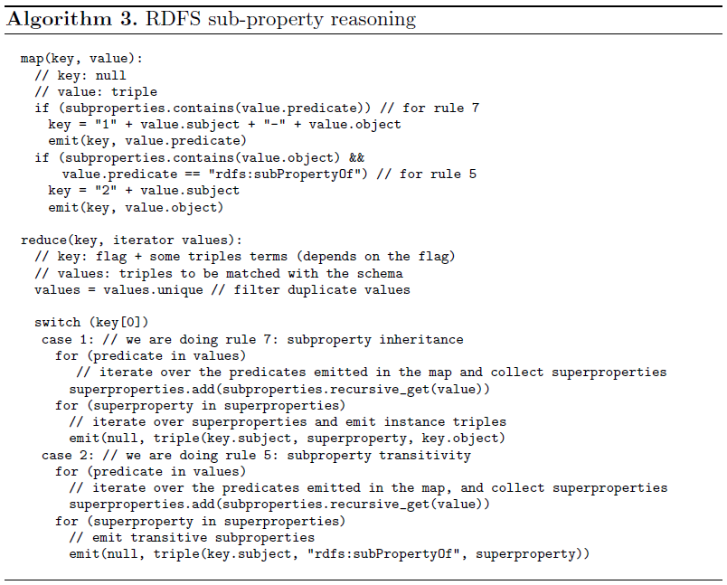
Efficient RDFS Reasoning with MapReduce

Slide 27
Efficient RDFS Reasoning with MapReduce
Second Job: Apply Rules on Domain and Range
Apply rules 2 & 3
2: p rdfs:domain x & s p o ⇒ s rdf:type x
3: p rdfs:range x & s p o ⇒ o rdf:type x
Map
Input(key : null, value : triple)
Output
key : s, value : p + “d” // for rule 2
Key : o, value : p + “r” // for rule 3
Reduce
Input(key : s, values : predicates to be matched with the schema)

Slide 28
Efficient RDFS Reasoning with MapReduce
Second Job: Apply Rules on Domain and Range
INPUT
OUTPUT
s p o
p rdfs:domain x
s’ p’ o’
p’ rdfs:range x’
s rdf:type x
o’ rdf:type x’
Map
<s, “pd”>
Reduce
Map
Map
<o’, “p’r”>
Reduce
Map

Slide 29
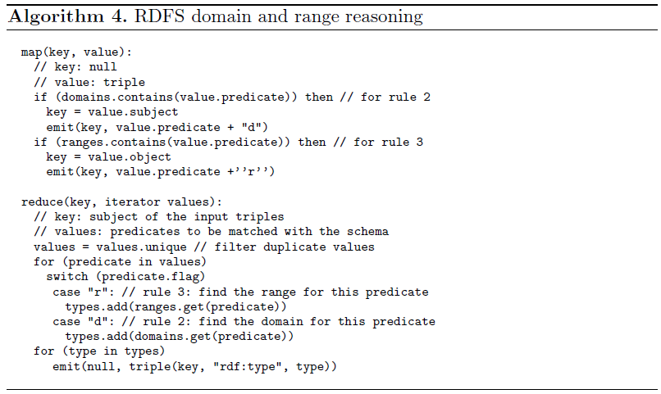
Efficient RDFS Reasoning with MapReduce

Slide 30
Efficient RDFS Reasoning with MapReduce
Third Job: Delete Duplicate Triples
Eliminates duplicates between the previous two jobs and the input data
Fourth Job: Apply Rules on Sub-Classes
Applies rules 9, 11, 12, and 13
9: s rdf:type x & x rdfs:subClassOf y ⇒ s rdf:type y
11: x rdfs:subClassOf y & y rdfs:subClassof z ⇒ x rdfs:subClassOf z
12: p rdf:type rdfs:ContainerMembershipProperty ⇒ p rdfs:subPropertyOf rdfs:member
13: o rdf:type rdfs:Datatype ⇒ o rdfs:subClassOf rdfs:Literal

Slide 31
Efficient RDFS Reasoning with MapReduce
Fourth Job: Apply Rules on Sub-Classes
Map
Input(key : source of triple, value : triple)
Output
Key : “0” + p, value : o // if predicate = “rdf:type”
Key : “1” + p, value : o // if predicate = “rdfs:subClassOf”
Reduce
Input(key : flag + s, values : list of classes)
Filter duplicate values
Recursively add superclasses
Output
Key : null, value : s, “rdf:type”, class // rdf:type
Key : null, value : s, “rdfs:subClassOf”, class // rdfs:subClassOf

Slide 32
Efficient RDFS Reasoning with MapReduce
Fourth Job: Apply Rules on Sub-Classes
INPUT
OUTPUT
x rdf:subClassOf y
y rdf:subClassOf z
s rdf:type x’
x’ rdfs:subClassOf y’
x rdfs:subClassOf z
s rdf:type y’
Map
<1s, “y”>
Reduce
Map
Map
<0s, “x’”>
Reduce
Map

Slide 33
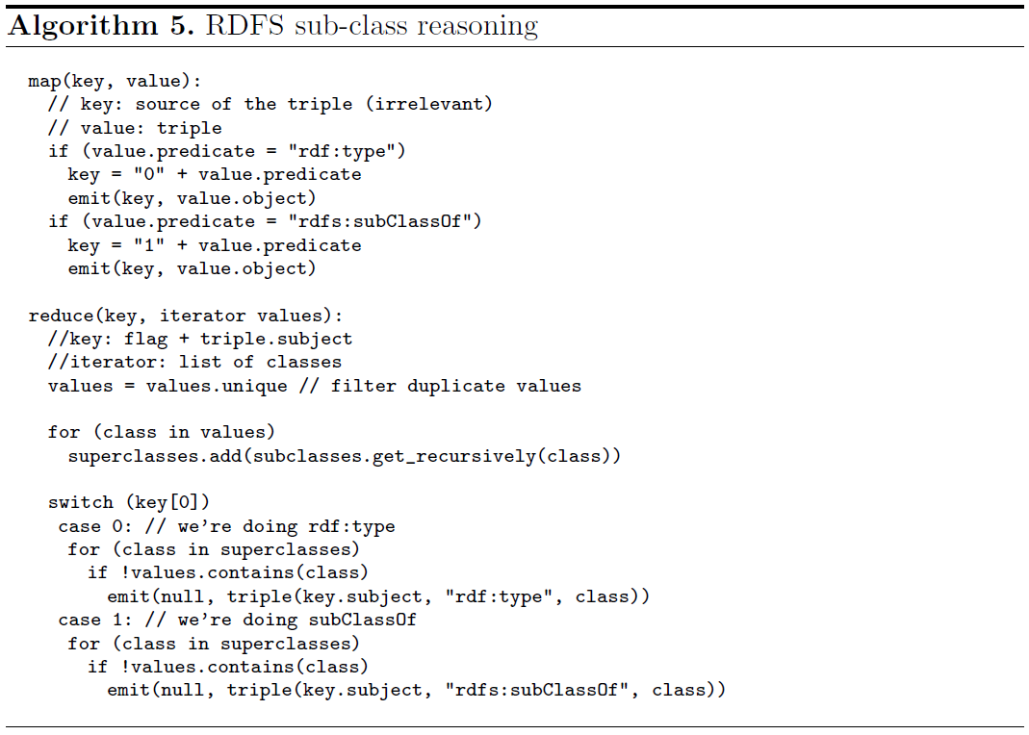
Efficient RDFS Reasoning with MapReduce

Slide 34
Outline
Introduction
Related Work
What Is the MapReduce Framework?
Naive RDFS Reasoning with MapReduce
Efficient RDFS Reasoning with MapReduce
Experimental Results
Conclusion

Slide 35
Experimental Results
Hadoop framework
An open-source Java implementation of MapReduce
Run and monitor MapReduce applications
Distributed file system
Job scheduling
Environment
DAS-3 distributed supercompeter
64 nodes with 4 cores and 4GB of main memory
Gigabit Ethernet as interconnect
Data : Billion Triple Challenge 2008

Slide 36
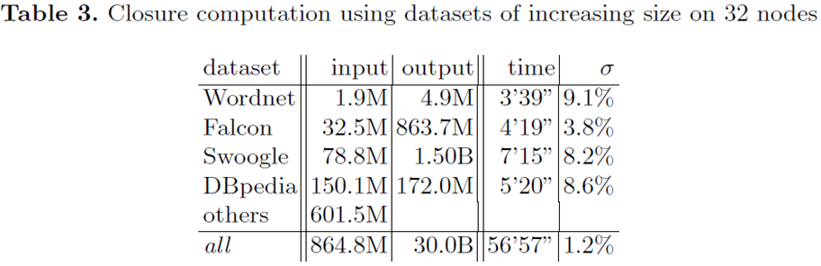
Experimental Results
Results for RDFS Reasoning
Total throughput 8.77 million/sec. for the output and 252.000 triples/sec. for the input
w/ dictionary encoding(1 hour), 4.27 million/sec. and 123.000 triples/sec

Slide 37
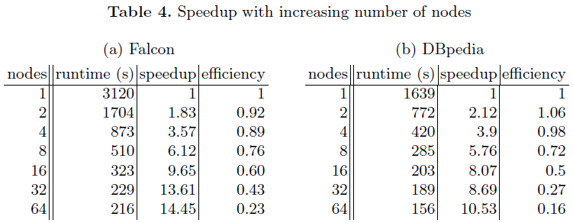
Experimental Results
Results for RDFS Reasoning(continue)

Slide 38
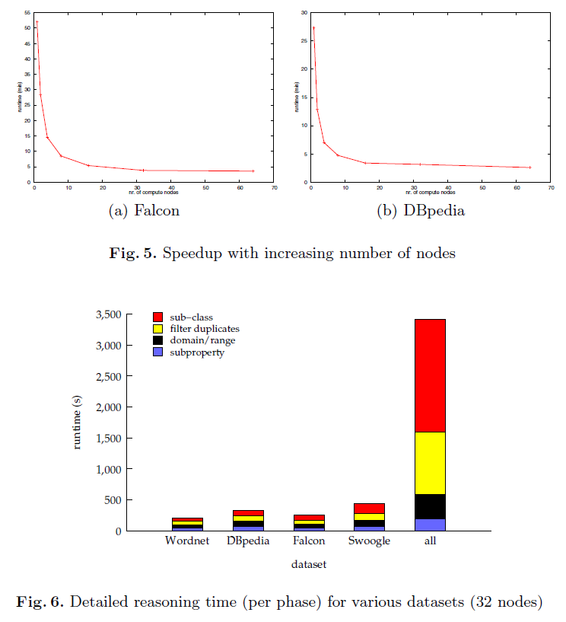
Experimental Results
Results for RDFS Reasoning(continue)

Slide 39
Experimental Results
Results for OWL Reasoning
OWL Horst Rules(more complex)
LUBM benchmark dataset(7M triples)
32 nodes, 3 hours => 13M triples
In comparison, RDFS closure 8.6M in 10 min
Falcon dataset(35M triples)
130 MapReduce jobs, 12 hours, 3.8B triples

Slide 40
Outline
Introduction
Related Work
What Is the MapReduce Framework?
Naive RDFS Reasoning with MapReduce
Efficient RDFS Reasoning with MapReduce
Experimental Results
Conclusion

Slide 41
Conclusion
MapReduce
Programming model for data processing on large clusters
Used in different contexts to process large collections of data
Semantic Web reasoning
Exploit the advantages of MapReduce
Outperforms any other published approach
Remaining challenge
Apply same techniques to OWL-Horst reasoning

