Slide 1
Chapter 3 – Data Exploration and Dimension Reduction
Data Mining for Business Intelligence
Shmueli, Patel & Bruce
© Galit Shmueli and Peter Bruce 2008

Slide 2
Exploring the data
Statistical summary of data: common metrics
  Average
  Median
  Minimum
  Maximum
  Standard deviation
  Counts & percentages

Slide 3
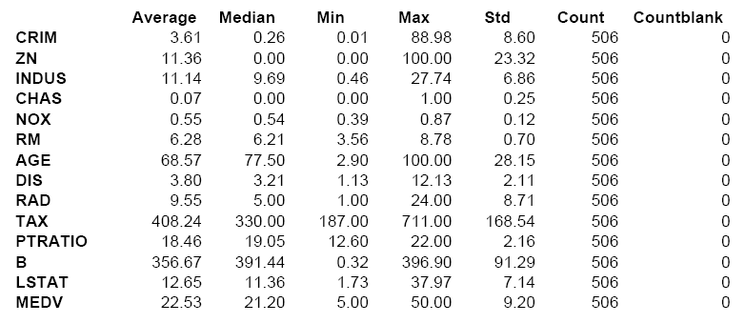
Summary Statistics – Boston Housing

Slide 4
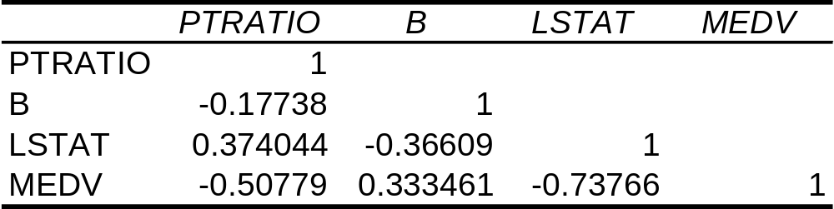
Correlations Between Pairs of Variables: Correlation Matrix from Excel

Slide 5
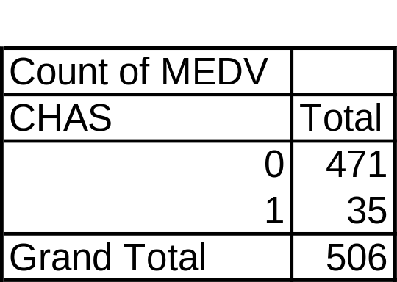
Summarize Using Pivot Tables
Counts & percentages are useful for summarizing categorical data
Boston Housing example:
471 neighborhoods border the Charles River (1)
35 neighborhoods do not (0)

Slide 6
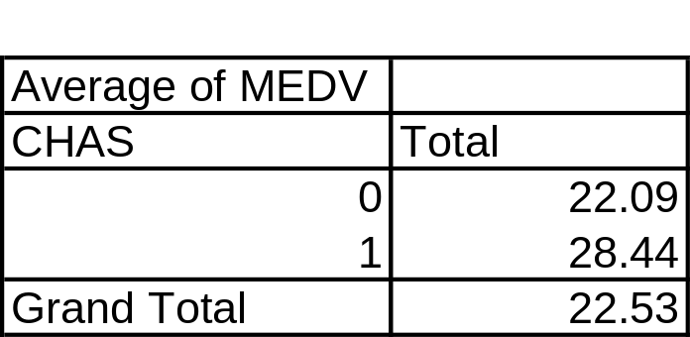
Pivot Tables - cont.
Averages are useful for summarizing grouped numerical data
In Boston Housing example: Compare average home values in neighborhoods that border Charles River (1) and those that do not (0)

Slide 7
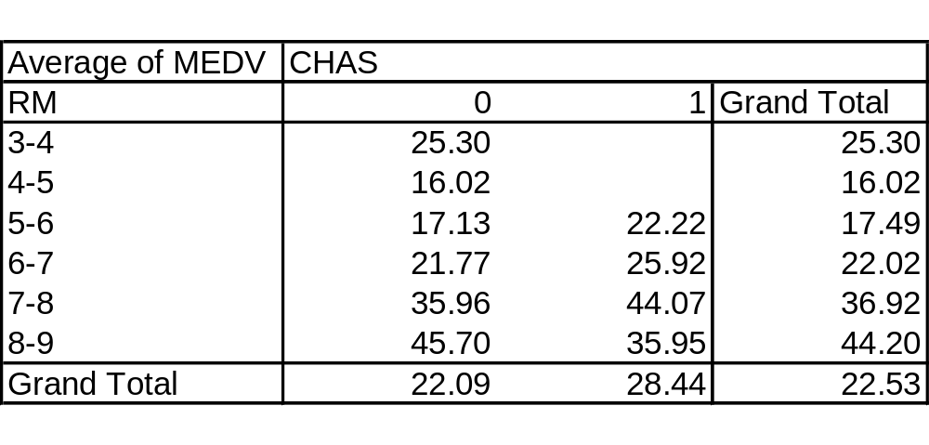

Pivot Tables, cont.
Group by multiple criteria:
By # rooms and location
E.g., neighborhoods on the Charles with 6-7 rooms have average house value of 25.92 ($000)

Slide 8
Graphs

Slide 9
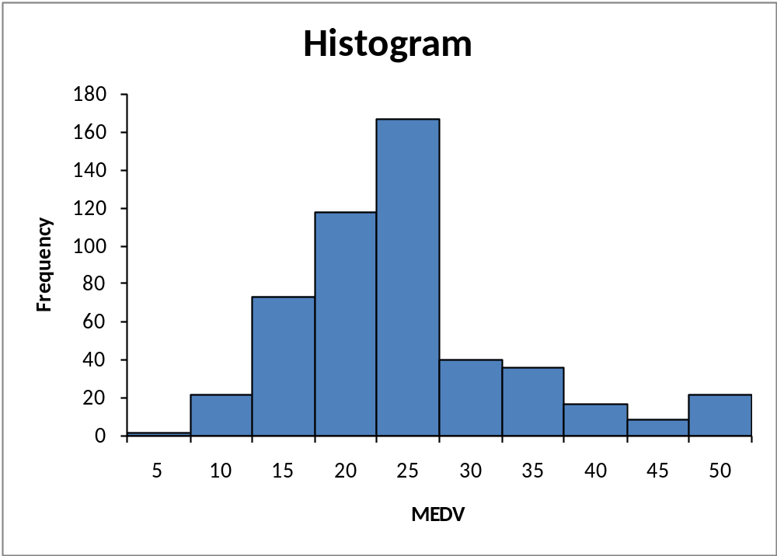
Histograms
Boston Housing example:
Histogram shows the distribution of the outcome variable (median house value)

Slide 10
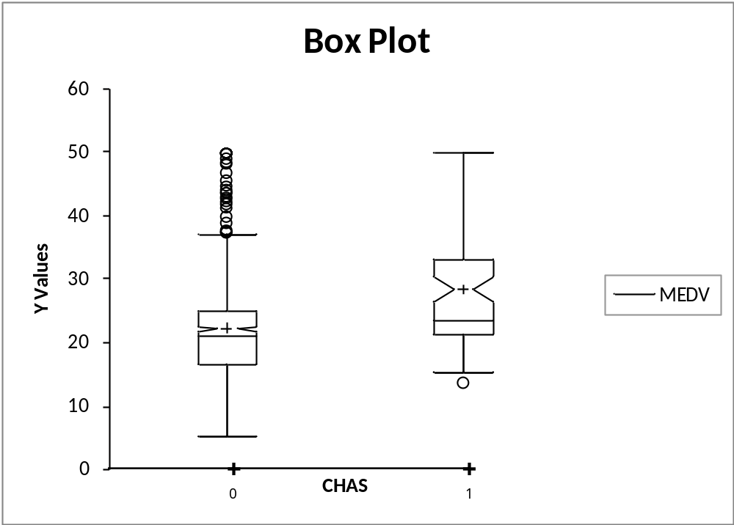
Boxplots
Side-by-side boxplots are useful for comparing subgroups
Boston Housing Example: Display distribution of outcome variable (MEDV) for neighborhoods on Charles (1) and not on Charles (0)

Slide 11
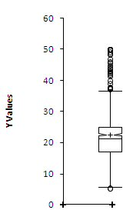
Box Plot
Top outliers defined as those above Q3+1.5(Q3-Q1).
“max” is the maximum of non-outliers
Analogous definitions for bottom outliers and for “min”
Details may differ across software
outliers
“max”
Quartile 3
mean
Median
Quartile 1
“min”
outlier

Slide 12
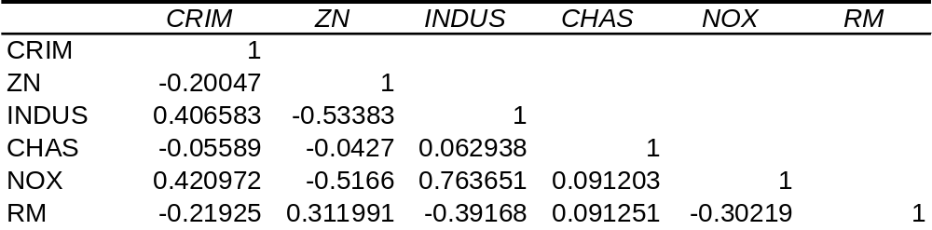
Correlation Analysis
Below: Correlation matrix for portion of Boston Housing data
Shows correlation between variable pairs

Slide 13
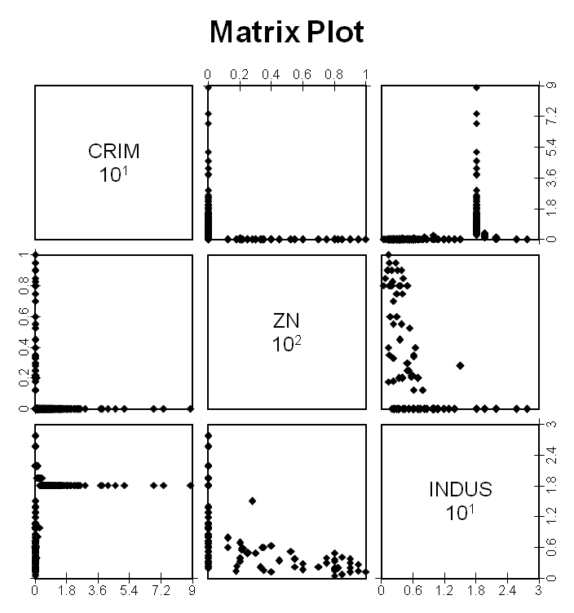
Matrix Plot
Shows scatterplots for variable pairs
Example: scatterplots for 3 Boston Housing variables

Slide 14
Reducing Categories
A single categorical variable with m categories is typically transformed into m-1 dummy variables
Each dummy variable takes the values 0 or 1
  0 = “no” for the category
  1 = “yes”
Problem: Can end up with too many variables
Solution: Reduce by combining categories that are close to each other
Use pivot tables to assess outcome variable sensitivity to the dummies
Exception: Naïve Bayes can handle categorical variables without transforming them into dummies

Slide 15
Principal Components Analysis
Goal: Reduce a set of numerical variables.
The idea: Remove the overlap of information between these variable. [“Information” is measured by the sum of the variances of the variables.]
Final product: a smaller number of numerical variables that contain most of the information

Slide 16
Principal Components Analysis
How does PCA do this?
Create new variables that are linear combinations of the original variables (i.e., they are weighted averages of the original variables).
These linear combinations are uncorrelated (no information overlap), and only a few of them contain most of the original information.
The new variables are called principal components.

Slide 17
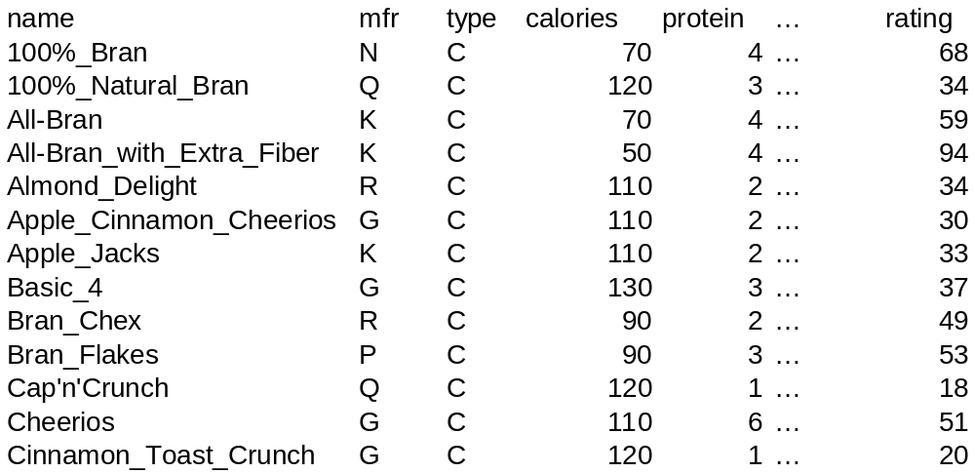
Example – Breakfast Cereals

Slide 18
Description of Variables
Name: name of cereal
mfr: manufacturer
type: cold or hot
calories: calories per serving
protein: grams
fat: g.
sodium: mg.
fiber: g.
carbo: g. complex carbohydrates
sugars: g.
potass: mg.
vitamins: % FDA rec
shelf: display shelf
weight: oz. 1 serving
cups: in one serving
rating: Consumer Reports

Slide 19
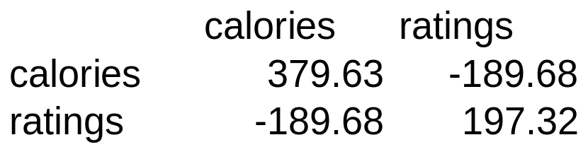
Consider calories & ratings
Total variance (=“information”) is sum of individual variances: 379.63 + 197.32
Calories accounts for 379.63/197.32 = 66%

Slide 20
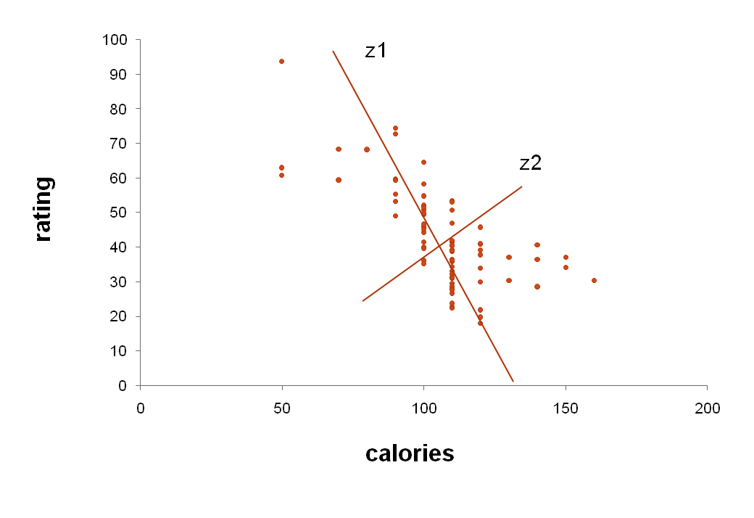
First & Second Principal Components
Z1 and Z2 are two linear combinations
Z1 has the highest variation (spread of values)
Z2 has the lowest variation

Slide 21
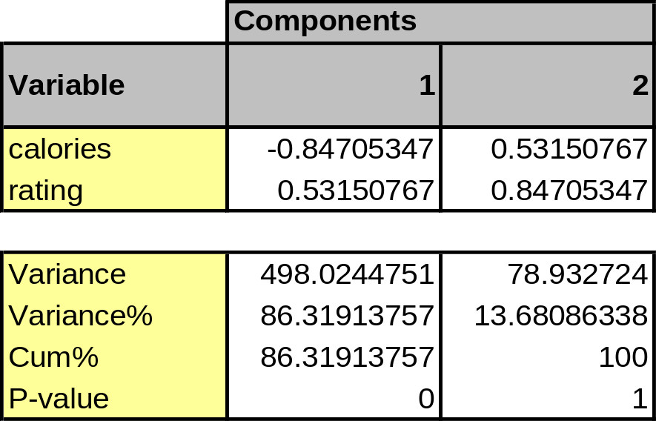
PCA output for these 2 variables
Top: weights to project original data onto z1 & z2
e.g. (-0.847, 0.532) are weights for z1
Bottom: reallocated variance for new variables
z1: 86% of total variance
z2: 14%

Slide 22
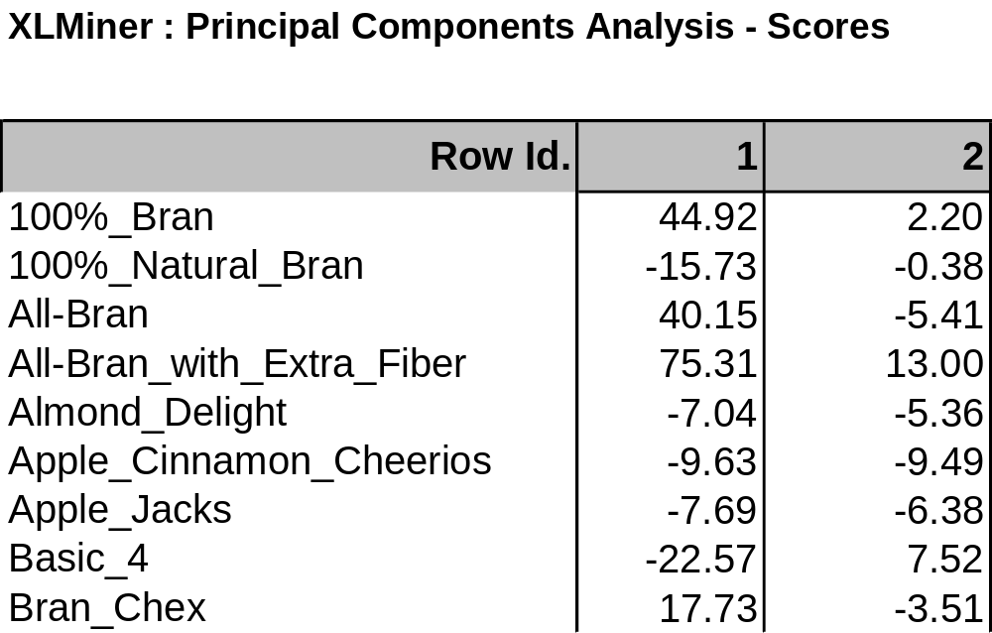
Principal Component Scores
Weights are used to compute the above scores
e.g., col. 1 scores are computed z1 scores using weights (-0.847, 0.532)

Slide 23
Properties of the resulting variables
New distribution of information:
New variances = 498 (for z1) and 79 (for z2)
Sum of variances = sum of variances for original variables calories and ratings
New variable z1 has most of the total variance, might be used as proxy for both calories and ratings
z1 and z2 have correlation of zero (no information overlap)

Slide 24
Generalization
X₁, X₂, X₃, … X_{p}, original p variables
Z₁, Z₂, Z₃, … Z_{p}, weighted averages of original variables
All pairs of Z variables have 0 correlation
Order Z’s by variance (z₁ largest, Z_{p} smallest)
Usually the first few Z variables contain most of the information, and so the rest can be dropped.

Slide 25
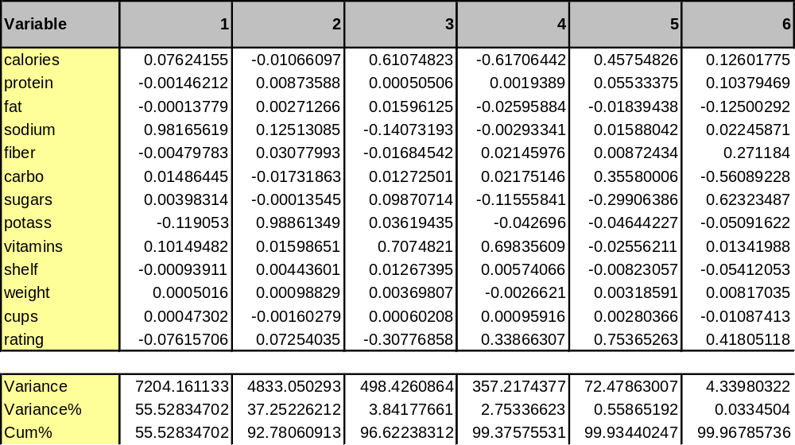
PCA on full data set
First 6 components shown
First 2 capture 93% of the total variation
Note: data differ slightly from text

Slide 26
Normalizing data
In these results, sodium dominates first PC
Just because of the way it is measured (mg), its scale is greater than almost all other variables
Hence its variance will be a dominant component of the total variance
Normalize each variable to remove scale effect
  Divide by std. deviation (may subtract mean first)
Normalization (= standardization) is usually performed in PCA; otherwise measurement units affect results
Note: In XLMiner, use correlation matrix option to use normalized variables

Slide 27
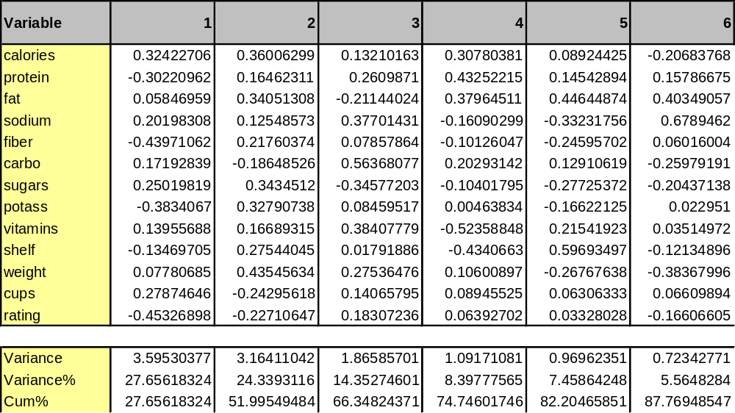
PCA using standardized variables
First component accounts for smaller part of variance
Need to use more components to capture same amount of information

Slide 28
PCA in Classification/Prediction
Apply PCA to training data
Decide how many PC’s to use
Use variable weights in those PC’s with validation/new data
This creates a new reduced set of predictors in validation/new data

Slide 29
Summary
Data summarization is an important for data exploration
Data summaries include numerical metrics (average, median, etc.) and graphical summaries
Data reduction is useful for compressing the information in the data into a smaller subset
Categorical variables can be reduced by combining similar categories
Principal components analysis transforms an original set of numerical data into a smaller set of weighted averages of the original data that contain most of the original information in less variables.

