Slide 1
Efficient Parallel Set-Similarity Joins Using MapReduce
Rares Vernica, Michael J. Carey, Chen Li
University of California, Irvine
SIGMOD 2010
September 22, 2011
Hyewon Kim

Slide 2
Outline
Introduction
Background
Parallel Set-Similarity Join
Evaluation
Conclusion

Slide 3

Introduction
There are many applications that require detecting similar pairs of records
Detecting near duplicate web-pages in web crawling
Plagiarism detection
Master data management
Recommendation based on user similarity
Table R
Table S
… | Name
… | Hyewonkim
… | John W. Smith
… | Tkkim
Name | …
John William Smith | …
Kskim | …
Twlee | …

Slide 4


Introduction
We have to deal with vast amounts of data that usually DO NOT fit in the main memory of one machine!
Challenging problem;
Data partitioning & redistribution for efficient query execution
Parallel algorithm

Slide 5
Outline
Introduction
Background
Set-similarity join
Set-similarity filtering
Join in MapReduce
Parallel Set-Similarity Join
Evaluation
Conclusion

Slide 6
Background Set-similarity join
Two files of records : R and S
A set-similarity function : sim
A similarity threshold : τ
Set-similarity join of R and S on R.a and S.a : Finding and combining all pairs of records from R and S where sim(R.a, S.a) ≥ τ
Table R
Table S
Tokenizing;
R.a = [ I, will, call, back]
S.a = [ I, will, call, you, soon]
Jaccard similarity function;
a
…
I will call back
…
a
…
I will call you soon
…
R.a : “I will call back”
S.a : “I will call you soon”

Slide 7
Background Set-Similarity Filtering
Effective Filters can decrease the number of candidate pairs whose similarity needs to be verified
Prefix Filtering
Similar strings need to share at least one common token in their prefixes
String
R : “I will call back”
S : “I will call you soon”
Tokenizing
[I, will, call, back]
[I, will, call, you, soon]
Sorting
[back, call, will, I]
[call, will, you, I, soon]
Global ordering ;
[back, call, will, you, I, soon]
Sort the tokens by a global ordering which is increasing order of document frequency

Slide 8
Background Prefix Filtering
Ref: Efficient Similarity Joins for Near Duplicate Detection by twlee
→ prefix length = |x| - t|x| + 1
Example: suppose J(x,y) >= 0.8
w = {D, E, F, G}
x = {C, D, E, F, G}
y = {B, C, D, E, G}
z = {A, B, C, F, G}
PPJoin: Positional filtering within prefix
PPJoin+: Positional filtering within suffix
4 – 0.8x4 + 1 = 1.2 → 1
5 – 0.8x5 + 1 = 2
Candidate Pairs <w,x> <x,y> <y,z>
Results <w,x>
Index construction algorithm

Slide 9
Background 2-Way Join in MapReduce
R(A,B) S(B,C)
Ref: Optimizing Joins in a Map-Reduce Environment by twlee
Input
Reduce input
R
Final output
A | B
a0 | b0
a1 | b1
a2 | b2
… | …
key | value
b0 | (a0, R)
b0 | (a1, R)
b0 | (c0, S)
… | …
A | B | C
a0 | b0 | c0
a0 | b0 | c1
a1 | b1 | c2
… | … | …
Map
Reduce
S
key | value
b1 | (a1, R)
b1 | (c2, S)
b2 | (a2, R)
… | …
B | C
b0 | c0
b0 | c1
b1 | c2
… | …

Slide 10
Outline
Introduction
Background
Parallel Set-Similarity Join
Self join
R-S join
Evaluation
Conclusion

Slide 11
Parallel Set-similarity Joins Overview
Making global ordering
Stage 1
Computes data statistics in order to generate good signatures
Stage 2
Map : extract the record ID & join attribute value from each record
Reducer : compute the similarity of the join-attribute values
Stage 3
Generates actual pairs of joined records
Computing similarity
Merging records
Ordering
RID pairs
Data
Stage 1
Stage 2
Stage 3
Join Result
Data
Data

Slide 12
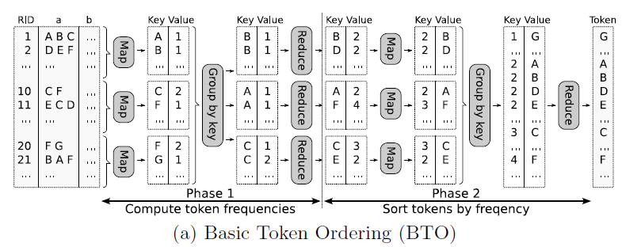
Parallel Set-similarity Joins Self Join - Stage 1 : Token Ordering
We produce a list of tokens that appear in the join-attribute value ordered increasingly by frequency
Basic Token Ordering (BTO)
2 MapReduce phases
Only 1 Reducer!
Combine function

Slide 13
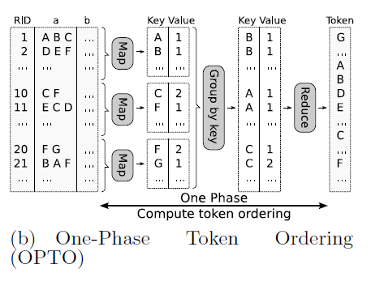
Parallel Set-similarity Joins Self Join - Stage 1 : Token Ordering
One Phase Token Ordering (OPTO)
Instead of using MapReduce to sort the tokens, we can explicitly sort the tokens in memory
Only 1 Reducer!
Combine function

Slide 14
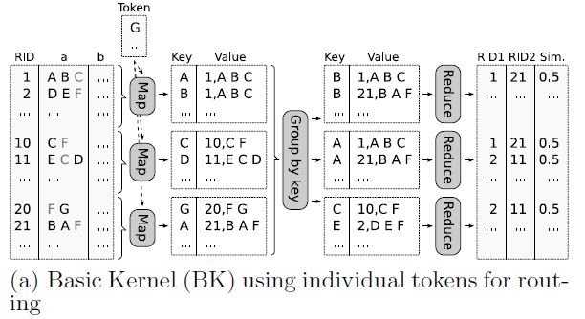
Parallel Set-similarity Joins Self Join - Stage 2 : RID-Pair Generation
Basic Kernel (BK) & Indexed Kernel (PK)
An initialization function loads the ordered tokens produced by stage 1
E 11, E C D
[D,E,C]
[D,E,C]
[G,F]
[G,F]
Tokenizes the join attribute &
reorders the tokens based on their frequencies
PK;
We use the PPJoin+ algorithm to index data, apply all the filters, and output the resulting pairs
Computes the prefix length &
Extracts the prefix tokens
Reducer applies the additional filters

Slide 15
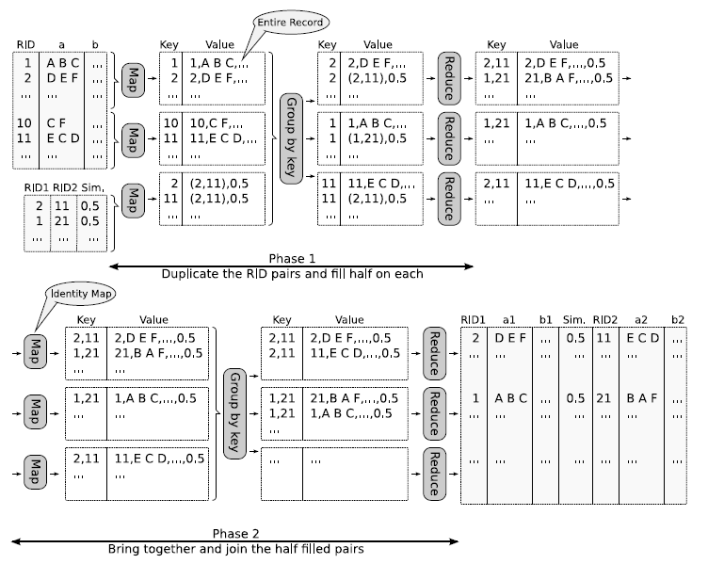
Parallel Set-similarity Joins Self Join - Stage 3 : Record Join
Basic Record Join (BRJ)
2 Map Reduce phases
Two pairs!

Slide 16
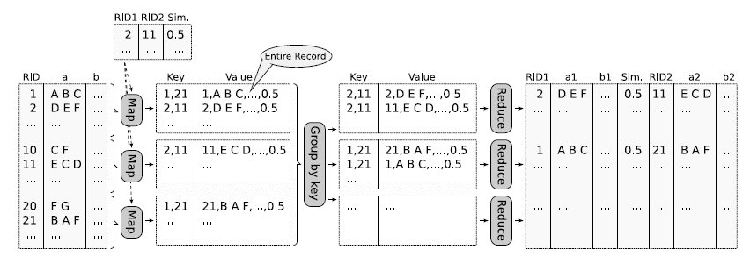
Parallel Set-similarity Joins Self Join - Stage 3 : Record Join
One-Phase Record Join (OPRJ)
We broadcast and load the RID pairs at each map function
Braodcast

Slide 17


Parallel Set-similarity Joins R-S Join
Stage 1 : Token Ordering
Stage 2 : Basic Kernel & Indexed Kernel
Mapper : extends the key of the (key, value) → include Relation tag
Reducer :
Table R
Phase 1;
We use the same algorithms as in the self-join case, on the relation with fewer records
Table S
Phase 2;
We discard the tokens that do not appear in the token list
a
…
…
a
…
…
. . .
…
Which one arrives first
Table R
Table S
Stream the records from the second relation
a
…
…
a
…
…
Indexed Kernel ;
Index the record

Slide 18
Parallel Set-similarity Joins R-S Join
Stage 3: Basic Record Join (BRJ)
Stage 3: One-Phase Record Join (OPRJ)
Map
Reduce
Map
Reduce
Tag their output with the relation name
Record + RID pairs
Identity Map
Build the record pairs using relation name
Map
Reduce
As many (key, value) pairs as the number of RID pairs containing the record’s RID
Build the record pairs using relation name

Slide 19
Outline
Introduction
Background
Parallel Set-Similarity Join
Evaluation
Conclusion

Slide 20
Evaluation
Cluster
10-node IBM x3650 , running Hadoop
Dataset
DBLP : 1.2M publications
CITESEERX : 1.3M publications
Increasing dataset sizes 5 to 25 times
Measure
Absolute running time
Speedup
Scaleup
REMIND!
STAGE 1;
BTO
OPTO
STAGE 2;
BK
PK
STAGE 3;
BRJ
OPRJ

Slide 21
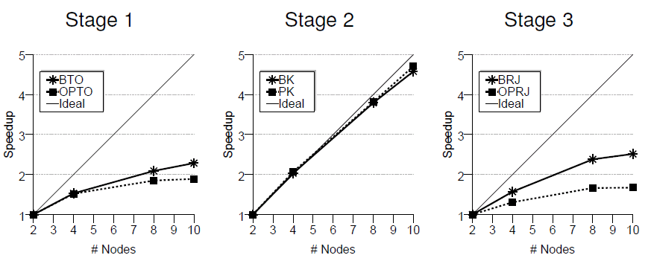
Evaluation Self-Join Performance
Speedup
Fixed dataset size and varied the cluster size
Limited Speedup;
More data was sent through the network
More data got merged and reduced
The final token ordering was produced by ONLY ONE REDUCER
Almost PERFECT Speedup
OPRJ;
The list of RID pairs was broadcast to all the maps where they must be loaded in memory and indexed

Slide 22
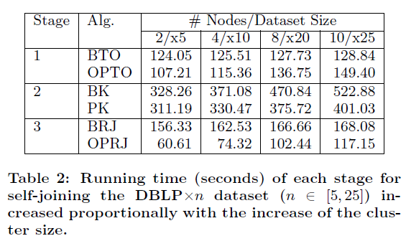
Evaluation Self-Join Performance
Scaleup
Increased the dataset size and the cluster size together by the same factor
Almost perfectly scaleup
1 reduce to aggregate the token counts
Quadratic increase
Almost perfectly scaleup
Because of INDEX!
List of RID pairs increased!

Slide 23
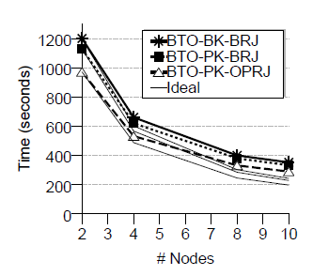
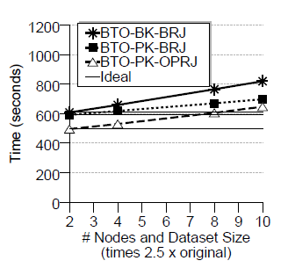
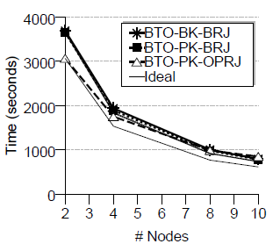
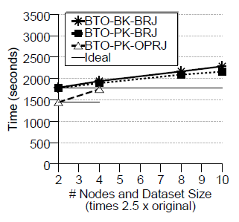
Evaluation Self-Join & R-S Join
Speedup
Scaleup
Self join
BTO-PK-BRJ is the BEST!
R-S join

Slide 24
Outline
Introduction
Background
Parallel Set-Similarity Join
Evaluation
Conclusion

Slide 25
Conclusion
Set-similarity join queries in parallel using the MapReduce
Three-stage approach
Balance workload and minimize replication
We show how our set-similarity self-join algorithms can be extended to answer set-similarity R-S join queries

Slide 26
Thank U!
Any question?

