Slide 1
Efficient Computing Deltas between RDF Models using RDFS Entailment Rules (working title)
IDB, SNU
Dong-Hyuk Im
2008.07.11

Slide 2
Contents
Introduction
Previous Works
Our Approach
Experimental Results

Slide 3
Introduction(1/2)
Ontology Evolution
  Ontologies change (real world is dynamic)
  Changes in the domain of interest
Modeling by
Described by
Domain
Model
Ontology
models
Describe

Slide 4
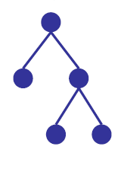



Introduction(2/2)
Change Detection in RDF
  RDF is used in a variety of area (knowledge domain)
  There are many updates in data on the web
    Generally, a changed part is relatively small
  Goal : “GNU Diff”
    Find the differences between two versions and inform the user about changes
conceptualization
What is change?
Real world
(Knowledge domain)
Add knowledge
Add relationship
Add …

Slide 5
Motivating Example (Ontology Evolution)
K
Person
subClassOf
Person
property
K’
Literal
type
TA
Student
Literal
Student
Transform K to K’
Jim
Jim
TA

Slide 6
Change Detection : Δe
K
K’
Person type class
Student type class
TA type class
Student subClassOf Person
TA subClassOf Person
Address type property
Address domain Student
Address range Literal
Jim type Student
Person type class
Student type class
TA type class
Student subClassOf Person
TA subClassOf Student
Address type property
Address domain Person
Address range Literal
Jim type Person
Δe (K – K’) = { Add(t) | t∈ K’ - K } ∪ { Del(t) | t∈ K – K’ }
Δe = {Del(TA subClassOf Person), Del(Address domain Student), Del(Jim type Student),
Add(TA subClassOf Student), Add(Address domain Person), Add(Jim type Person)}
*e : explicit

Slide 7
Change Detection : Δc
K
K’
Person type class
Student type class
TA type class
Student subClassOf Person
TA subClassOf Person
Address type property
Address domain Student
Address range Literal
Jim type Student
Person type class
Student type class
TA type class
Student subClassOf Person
TA subClassOf Student
Address type property
Address domain Person
Address range Literal
Jim type Person
Jim type Person
TA subClssOf Person
Address domain Student
Address domain TA
Δc (K – K’) = { Add(t) | t∈ C(K’) – C(K) } ∪ { Del(t) | t∈ C(K) – C(K’) }
Δc = {Del(Jim type Student), Add(TA subClassOf Student), Add(Address domain Person),
Add(Address domain TA)}
*c : closure

Slide 8
Change Detection : Δd
K
K’
Person type class
Student type class
TA type class
Student subClassOf Person
TA subClassOf Person
Address type property
Address domain Student
Address range Literal
Jim type Student
Person type class
Student type class
TA type class
Student subClassOf Person
TA subClassOf Student
Address type property
Address domain Person
Address range Literal
Jim type Person
Jim type Person
TA subClssOf Person
Address domain Student
Address domain TA
Δd (K – K’) = { Add(t) | t∈ K’ – C(K) } ∪ { Del(t) | t∈ K – C(K’) }
Δd = {Del(Jim type Student), Add(TA subClassOf Student), Add(Address domain Person)}
*d : dense

Slide 9
Problem Definition
Semantic Diff :
  Materialize the complete entailment
    (transitive closure)
  Perform a structural diff
  Enlighten the differences between two versions
Closure computation: (only class-hierarchy)
  perform inference (overhead)
 | Data Size | Triple | Inferred triple | Inference time
UniProt Taxonomy (2008/2/28) | 182MB | 2,637,046 | 7,111,072 | 257 (S)
Gene Ontology (2008/01) | 32MB | 409,671 | 376,807 | 11(S)

Slide 10
Related Works
On the Foundations of Computing Deltas between RDF models, ISWC 2007
  Various RDF comparison functions in conjunction with the semantics of the underlying change operations
SemVersion: A Versioning System for RDF and Ontologies, ESWC 2005
  Proposes two diff algorithm: structured-base, semantic-aware
Time-Space Trade-offs in Scaling up RDF Schema Reasoning, WISE workshop 2005
  RDF reasoning that only computes a small part of the implied statements
Inferencing and Truth Maintenance in RDF Schema, PSSS 2003
  Gives a detailed algorithm for truth maintenance for RDF(S)

Slide 11

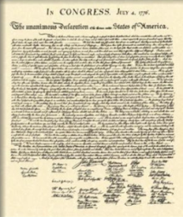
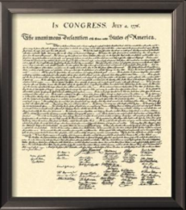
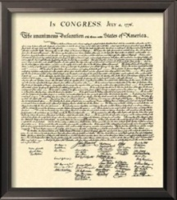

Previous Works vs Our Approach
Previous works
-Fatch File –
Insert : ~~~~
-------
-------
Delete: ~~~~~
--------
-----------
RDF Documents
inference
Parsing and
partitioning
Structural Diff
Diff result
Our Approach
-Fatch File –
Insert : ~~~~
-------
-------
Delete: ~~~~~
--------
-----------
inference
Structural Diff
Diff result

Slide 12
Our Approach : Delta_Closure
A
K
A
K’
Transform K to K’
C
D
B
C
B
B subClsssOf A
C subClassOf A
B subClsssOf C
C subClassOf A
D subClassOf A

Slide 13
Our Approach : Delta_Closure
B subClsssOf C
B subClsssOf A
May be inferred triple : apply entailment ruls
C subClsssOf A
C subClsssOf A
D subClsssOf A
No inference !!
Previous : if t ∉ K , check t ∈ C(K)
Our Approach : if t ∉ K ,
check t ∈ C(K) which satisfy only our conditions

Slide 14
Algorithm
Algorithm (Delta & Closure)
01: Input : S_{source} = Set of triples in source model
02: S_{target} = Set of triples in target model
03: L_{key} = List of keys (keys : all subject resource)
04: Output : Set of change operation Diff using entailment rules
05: DO {
06: For every key in L_{key}
07: Select all triples which satisfy the same subject in S_{source}
08: Select all triples which satisfy the same subject in S_{target}
09: For every possible triple pair (x, y), x∈ S_{source} , y∈ S_{target},
10: x’ = ApplyRule (x)
11: if (x’ == y)
12: else x ∪ Diff as deletion
13: y’ = ApplyRule (y)
14: if (y’ == x)
15: else y ∪ Diff as insertion
16: } While (L_{key} is not empty)

Slide 15
Inference Engine
Forward chaining
  Frequently used for load-time inference (materiallization)
  Increased load time and storage space
  Fast query response
Backward chaining
  Performs run-time inference
  Short load time
  Slow response time

Slide 16
RDF Inference Rule
RDFS entailment rules (subsumption & type)
  RDF Semantics
  Rule 7
  Rule 9
  Rule 5, 11
(A subPropertyOf B) ,(U A Y)
(U B Y)
(U subClassOf X) ,(V type U)
(V type X)
(U subPropertyV) ,(V subPropertyOf X)
(U subPropertyOf X)
(U subClassOf V) ,(V subClassOf X)
(U subClassOf X)

Slide 17
Applying Rules (Rule 11)
D
E
C
B
C
E
B
A
A
A subClassOf B
A subClassOf C
B subClassOf D
B subClassOf E
A subClassOf E
A subClassOf B
E subClassOf C
Check if triple may be inferred
A subClassOf C
A subClassOf E

Slide 18
Applying Rules (Rule 9)
B
C
B
C
a
A
A
a
A subClassOf B
A subClassOf C
a type A
A subClassOf B
A subClassOf C
a type C
a type A
a type C
(U subClassOf X) ,(V type U)
(V type X)
Check if triple may be inferred

Slide 19
Applying Rules (Rule 7)
B
C
B
C
A
A
A draw B
A draw C
A create B
A draw C
A draw B
A create B
(A subPropertyOf B) ,(U A Y)
(U B Y)

Slide 20
Experimental Setup (1/2)
Implemented in JAVA
  Based in the main memory representation of RDF graphs
Data Set
  Synthetic data set (RDF generator)
  Gene Ontology termDB (RDF)
    Only is-a relationship
  Uniprot taxonomy (RDF)
    Only is-a relationship

Slide 21
Experimental Setup (2/2)
Gene Ontology
 | G1 | G2 | G3 | G4 | G5 | G6 | G7 | G8
# of triple | 397720 | 404892 | 409671 | 413923 | 415488 | 418684 | 418927 | 420036
Inference | 599298 | 608336 | 614238 | 628964 | 631497 | 633409 | 634888 | 637292
Date(mm-yy) | Nov-07 | Dec-07 | Jan-08 | Feb-08 | Mar-08 | Apr-08 | May-08 | Jun-08
Size(MB) | 31 | 31 | 32 | 32 | 32 | 33 | 33 | 33
Uniprot Taxonomy
 | U1 | U2 | U3 | U4 | U5
# of triple | 2637046 | 2703674 | 2725324 | 2755810 | 2829621
inference | 8035785 | 8228086 | 8285704 | 8368233 | 8565134
Date(mm-yy) | Mar-08 | Apr-08 | Apr-08 | Jun-08 | Jul-08
Size(MB) | 187 | 192 | 193 | 195 | 201

Slide 22
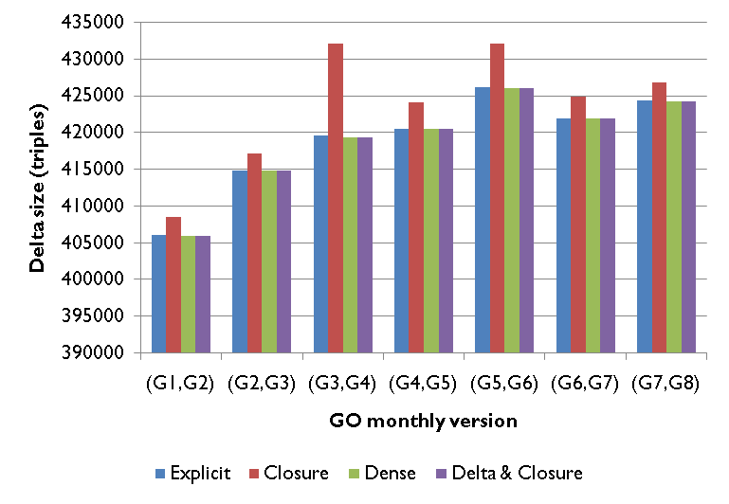
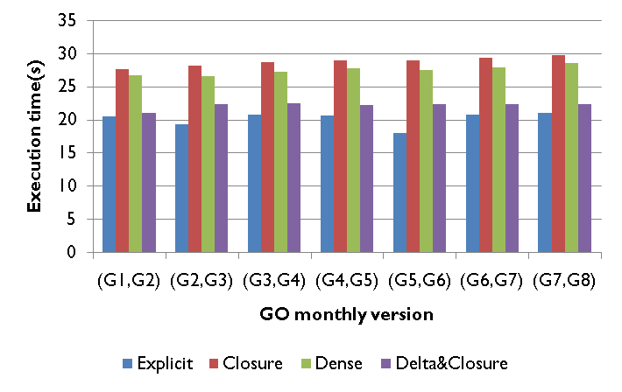
Experimental Result (1/2)
Delta Size
  : dense , delta&closure are smaller than explcit, closure
  : inferred triple is very small (is-a relationship)
Performance
  : explicit , delta&closure are faster than dense, closure

Slide 23
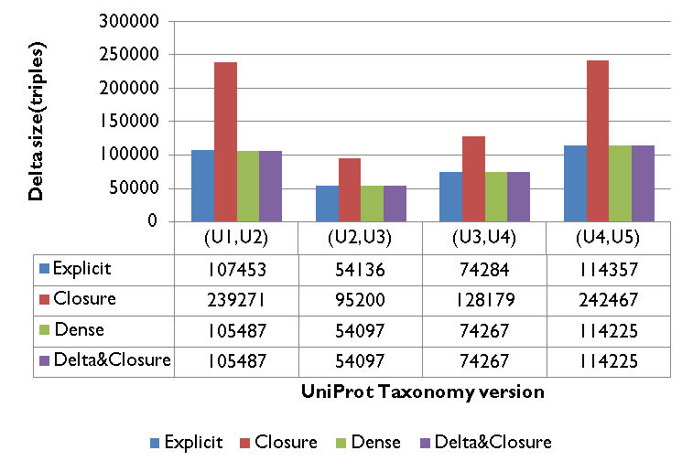
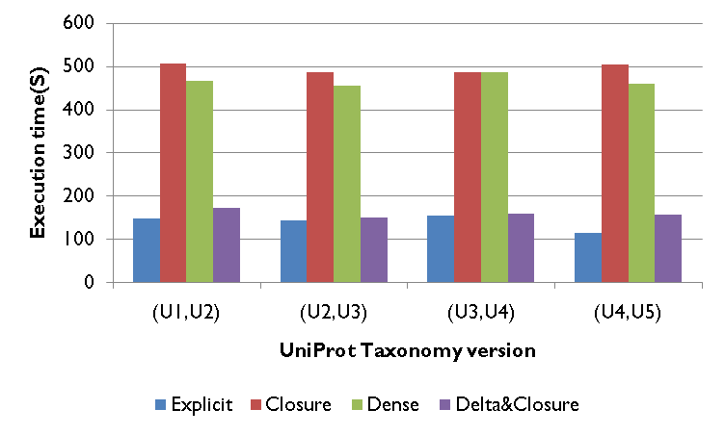
Experimental Result (2/2)
Delta Size
  : dense , delta&closure are smaller than explcit, closure
  : inferred triple is very small (is-a relationship)
  : closure is much bigger than explicit
Performance
  : explicit , delta&closure are faster than dense, closure

Slide 24
Conclusion
Semantic-aware Diff
  Using inference rules (RDFS schema)
  Δ Explicit, Δ Closure, Δ Dense&closure, Δ Dense
Our approach : Delta_closure
  Considering efficiency and correctness
  generates smaller than Δ Explicit and faster than Δ Dense

