Slide 1
Mining Interesting Link Formation Rules in Social Networks
Cane Wing-ki Leung, Ee-Peng Lim, David Lo and Jianshu Weng
School of Information Systems
Singapore Management University
2010 ACM Conference on Information and Knowledge Management (CIKM’10)
Presented by Kisung Kim
2012. 1. 13

Slide 2
Outline
Introduction
Related work
Link formation pattern & link formation rule
LFR-Miner
Experimental results
Conclusions and future work

Slide 3
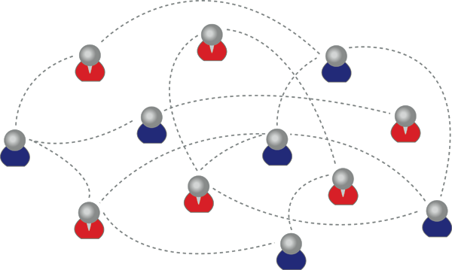
Introduction
Goal: examine how links are formed in social networks as a structural effect
What other connections between s and e may lead to link formation?
Mining interesting link formation rules in social networks

Slide 4
Introduction
Example: reciprocity effect
s: start node, e: end node of the new link
s
e
s
e
s
e
s
e
foe
foe
foe
foe

Slide 5
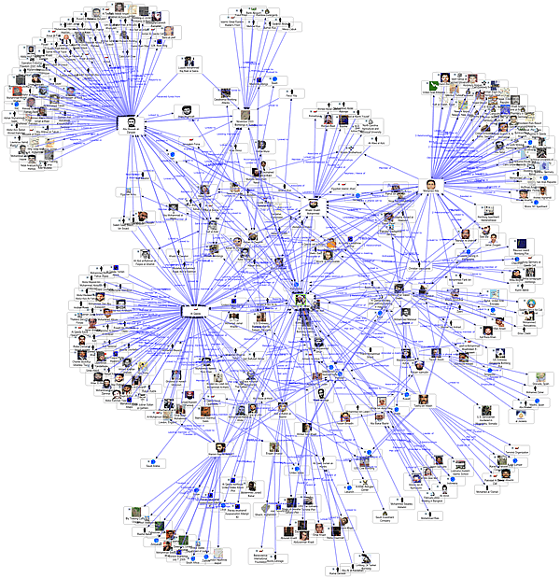





Introduction: Methodology
Social network
Directed, edge-labeled and time-stamped graph
Finding link formation rules
Modeling the link formation rule as a special graph pattern LF-Pattern
Mining link formation rules using the frequent subgraph mining
Subgraph
Mining
Understanding & Predicting dynamics of large and complex network
Frequent Link Formation Rules

Slide 6
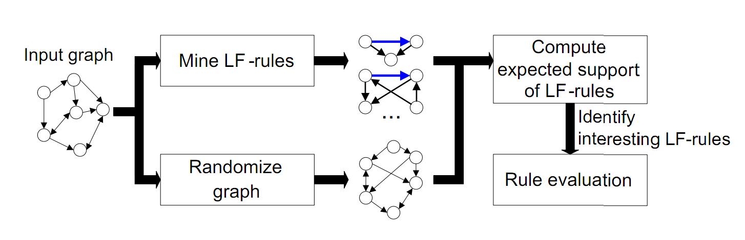
Overview
Mine LF-rules from a given social network
Apply randomization technique to the network, for estimating the expected support of LF-rules in a random graph
Evaluate interesting rules with higher-than-expected support

Slide 7
Related Work
Link and local structure analysis in social networks
M. Berlingerio et al., Mining graph evolution rules, PKDD¹, 2009
Mine frequent graph rules from a single, temporal graph
Do not consider link directions and labels
J. Leskovec et al., Signed networks in social media, CHI, 2010
Focus on sign prediction in signed triads
D. M. Romero and J. Kleinberg, The directed closure process in hybrid social-information networks, with an analysis of link formation on Twitter, ICWSM², 2010
Focus exclusively on directed closure
¹Practice of Knowledge Discovery in Databases
²International Conference on Weblogs and Social Media

Slide 8
Outline
Introduction
Related work
Link formation pattern & link formation rule
LFR-Miner
Experimental results
Conclusions and future work

Slide 9
Link Formation Pattern: LF-pattern
Structural constraints
s: start node, e: end node
Every intermediary must be connected both s and e in any direction
Focus patterns containing dyadic and triadic structures
Temporal constraints
Link (s,e) is formed after all other links in the same pattern
t=2
t=3
t=3
t=3
t=1
s
e
s
e
s
e
s
e
s
e
t=1
t=2
t=1
t=2
t=2
t=1
t=2
t=1
t=2
t=1
t=1
Intermediary

Slide 10
Link Formation Rule: LF-rule
LF-rule
Precondition: connections between s, e and intermediaries
Postcondition: link (s,e)
LF-rule
t=3
s
e
s
e
s
e
t=2
t=1
t=2
t=1
t=2
t=1
New link created
LF-pattern
Precondition (t=2)
Postcondition (t=3)

Slide 11
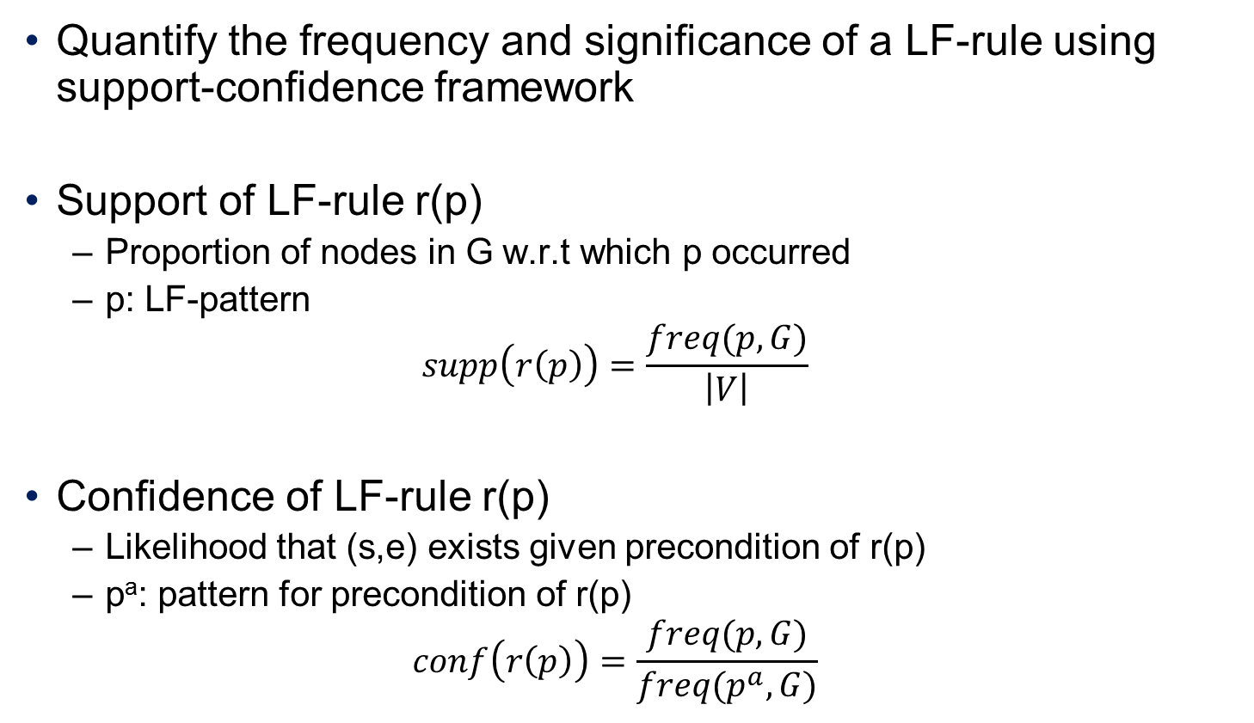
Link Formation Rule: LF-rule
Quantify the frequency and significance of a LF-rule using support-confidence framework
Support of LF-rule r(p)
Proportion of nodes in G w.r.t which p occurred
p: LF-pattern
$$supp\left(r\left(p\right)\right)=\frac{freq(p,G)}{\left|V\right|}$$
Confidence of LF-rule r(p)
Likelihood that (s,e) exists given precondition of r(p)
pª: pattern for precondition of r(p)
$$conf\left(r\left(p\right)\right)=\frac{freq(p,G)}{freq(p^{a},G)}$$

Slide 12

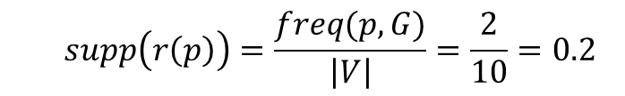
Link Formation Rule: LF-rule
We use ego-based occurrence as frequency freq(p, G)
The number of distinct nodes that acted as the start node of p
s
e
s
e
LF-pattern p
Precondition pattern pª
1
2
occurrence(p, G)=4
freq(p, G)=2
$$supp\left(r\left(p\right)\right)=\frac{freq(p,G)}{\left|V\right|}=\frac{2}{10}=0.2$$
t=2
t=1
$conf\left(r\left(p\right)\right)=\frac{freq(p,G)}{freq(p^{a},G)}$=$\frac{2}{3}=0.67$

Slide 13
Problem Definition
Given a directed, labeled, time-stamped graph, a support threshold, and a confidence threshold, mine LF-rules that satisfy the given support and confidence threshold
Support=0.1, Confidence=0.5
s
e
LF-rule1
LF-rule2
LF-rule3
t=2
t=1

Slide 14
Outline
Introduction
Related work
Link formation pattern & link formation rule
LFR-Miner
Experimental results
Conclusions and future work

Slide 15
Mining Link Formation Rules
Extend gSpan¹, a state-of-the-art subgraph mining algorithm
Subgraph mining
Extract all subgraphs whose support and confidence satisfy the given support threshold
Naïve approach for subgraph mining
Generate all possible subgraphs
Count the occurrence for each subgraph
Problem
Repeated discovery of the same graph
¹X.Yan and J. Han, gSpan: Graph-based substructure pattern mining, ICDM, 2002

Slide 16
gSpan
Problem: many duplicate graphs are generated
1-edge
a
b
c
2-edge
a
b
a
c
b
a
b
c
c
a
c
b
3-edge
a
b
c
a
b
c
a
b
c
a
b
c
a
b
c
a
b
c

Slide 17
gSpan
DFS code for a pattern
Transform a graph to an edge sequence
Apply DFS subscripting to all nodes to encode the traversal order in a DFS tree
Backward edges for a vertex must be appear just before its forward edges
Forward edge (in DFS tree)
Backward edge (not in DFS tree)
v0
v1
v2
v3
<(v0,v1), (v1,v2), (v2,v3), (v3,v1)>

Slide 18
gSpan
Every graph can be represented by a DFS code
We do not need to extend a DFS code into an incorrect DFS code ➔ the graph is redundant
Rightmost extension
A backward edge can only grow from the rightmost vertices of g to any vertices on the rightmost path
A forward edge can grow from vertices along the rightmost path
v0
Extension
v0
v0
v1
v1
New edge
v1
v2
v3
v2
v3
v2
v3
<(v0,v1), (v1,v2), (v1,v3)>
<(v0,v1), (v1,v2), (v1,v3), (v3,v2)>
<(v0,v1), (v1,v2), (v2,v3), (v3,v1)>
v0
v0
v0
v1
v1
v1
v2
v2
v3
v2
v3

Slide 19
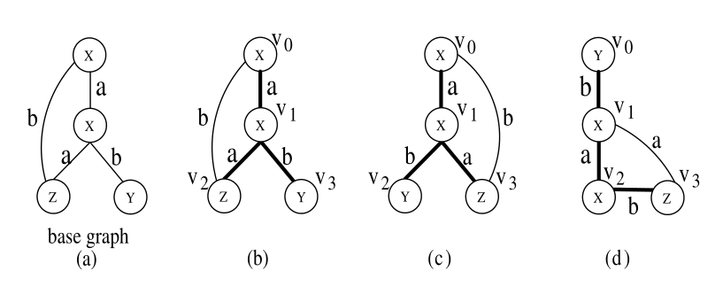
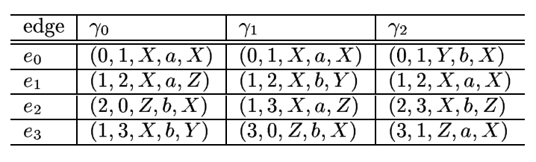
gSpan
A graph can have many DFS code representations
Minimum DFS code
Introduce ordering between edges and between sequences
A graph has a unique minimun DFS code
Edge: <i, j,l_{i}, l_{(i,j)}, l_{j}>
Minimum DFS code

Slide 20
gSpan
Prune subgraphs whose encoding is not the minimum DFS code
1-edge
a
b
c
2-edge
a
b
a
c
b
a
b
c
c
a
c
b
3-edge
a
b
c
a
c
b
b
c
a
Minimum DFS <a,b,c>
<a,c,b>
<b,c,a>

Slide 21
LFR-Miner
Extension of gSpan
Directed graph
Only interested in LF-patterns and intermediate patterns that can be grown into LF-patterns
Representation of LF-pattern
Ego-based occurrence
Temporal constraint on (s,e) link

Slide 22
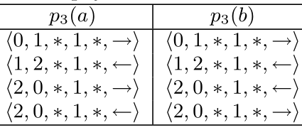
LFR-Miner
Directed graph
DFS edge with direction as a 6-tuple
Ego
Take s as v₀ and e as v₁
Time constraint
Consider edges with timestamps smaller than t(s,e)
Edge: <i, j,l_{i}, l_{(i,j)}, l_{j}, d(i,j)>
s
e
0
1
0
2
2
1
Pattern
DFS subscripting 1
DFS subscripting 2

Slide 23
LFR-Miner
Rightmost extension with pruning
Case 1) Every intermediary must be connected both s and e in any direction
Rightmost vertex
v0
v1
v2
Rightmost vertex
Cannot make valid LF-patter
by rightmost extension
➔ Pruning!

Slide 24
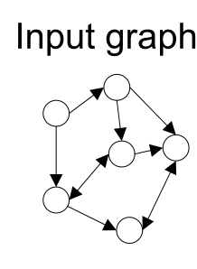
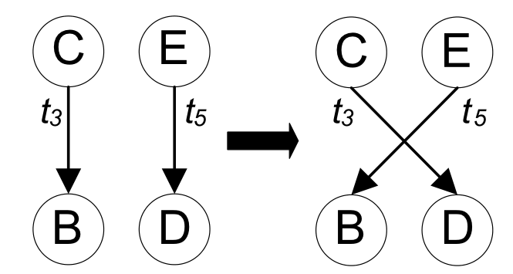
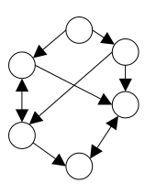
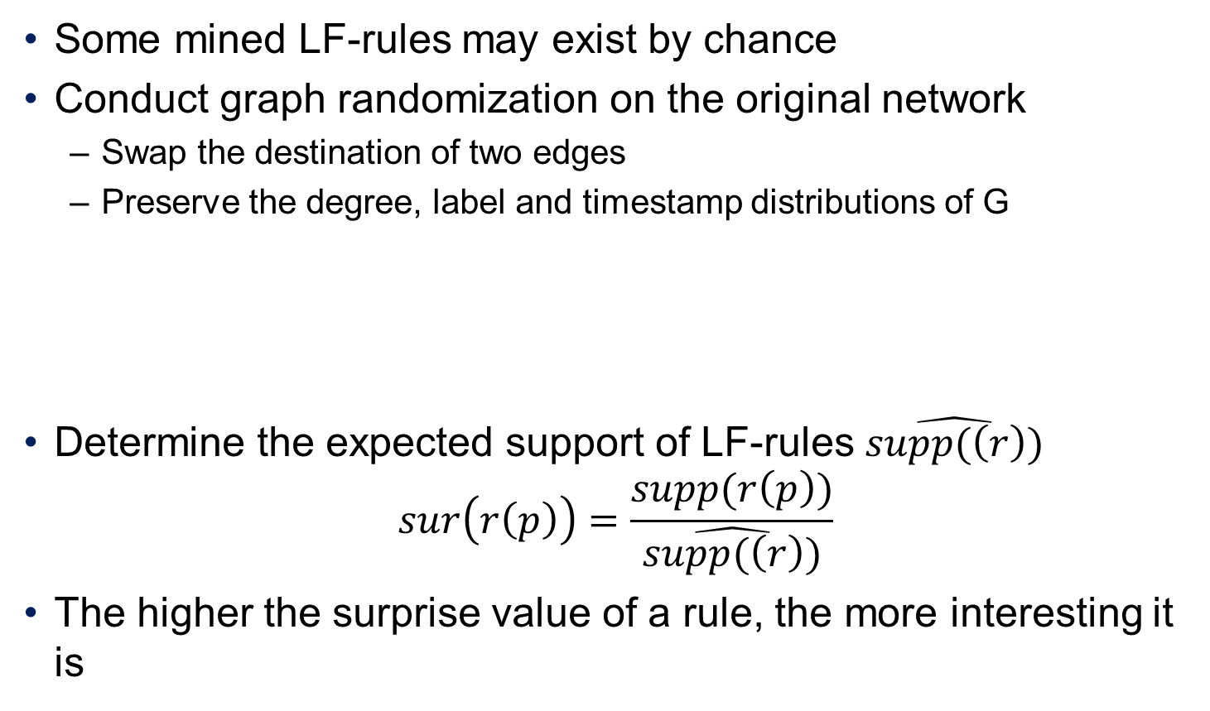
Expected Support of LF-rules
Some mined LF-rules may exist by chance
Conduct graph randomization on the original network
Swap the destination of two edges
Preserve the degree, label and timestamp distributions of G
Determine the expected support of LF-rules $\hat{supp(\left(r\right))}$
$$sur\left(r\left(p\right)\right)=\frac{supp(r\left(p\right))}{\hat{supp(\left(r\right))}}$$
The higher the surprise value of a rule, the more interesting it is
Randomized graph

Slide 25
Outline
Introduction
Related work
Link formation pattern & link formation rule
LFR-Miner
Experimental results
Conclusions and future work

Slide 26
Empirical Study: Datasets
Epinions: http://www.epinions.com/
Review site
myGamma: http://m.mygamma.com
Social networking
Common characteristics
Contain directed and time-stamped edges
Two edge labels: +ve (positive), -ve (negative)
Epinions: trust (+ve), distrust (-ve)
myGamma: friend (+ve), foe (-ve)
 | Epinions | myGamma
Nodes | 56,499 | 689,843
Edges: total | 496,627 | 9,156,575
+ve | 85.4% | 93.4%
-ve | 14.6% | 6.4%

Slide 27

Empirical Study: Epinion
Write reviews about a variety of topics
Consumer durables (such as cars and toasters)
Media objects (such as music and movies)
Colleges to vacation spots
Rate the reviews of other authors
Indicate trust or distrust for another user

Slide 28
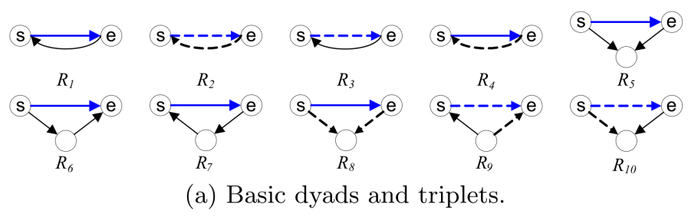
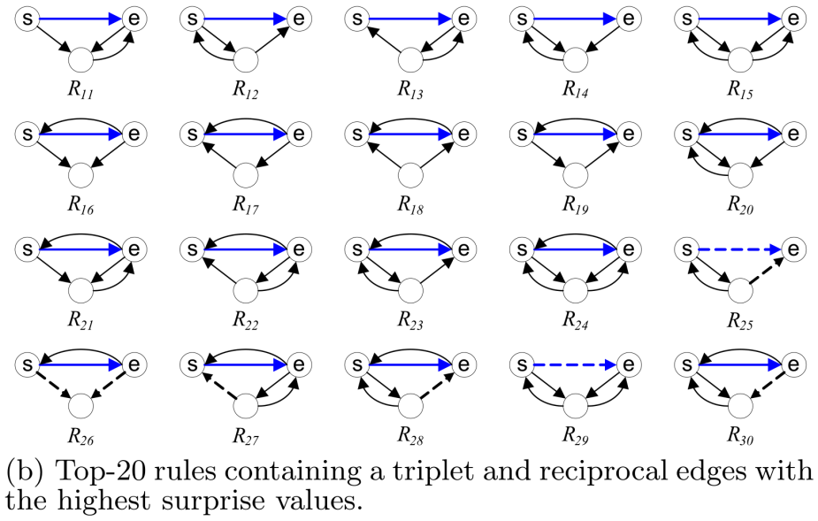
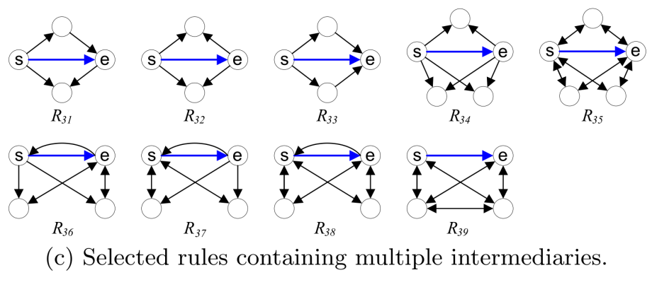
Analysis of Interesting LF-Rules
Analyze rules with surprise values above 1.1 (occurred 10% more than expected)

Slide 29
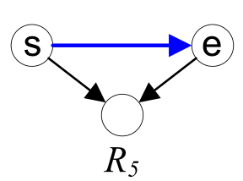
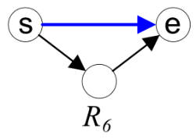
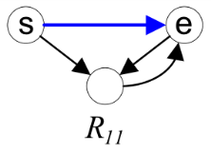
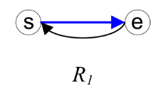
Analysis of Interesting LF-Rules
Observation 1
Two datasets share the same top-4 LF-rules in terms of support
R5 (common trustee) is the top in both lists
Considering support, surprise and confidence collectively, R1 is the most prevalent LF-rule
ID | supp(Rn) | conf(Rn) | sur(Rn) | Rank
R5 | 0.1499 | 0.2364 | 1.52 | 1
R6 | 0.1489 | 0.2439 | 1.51 | 2
R11 | 0.1259 | 0.2224 | 3.52 | 3
R1 | 0.1172 | 0.2234 | 7.76 | 4
ID | supp(Rn) | conf(Rn) | sur(Rn) | Rank
R5 | 0.2891 | 0.4322 | 1.29 | 1
R6 | 0.2838 | 0.431 | 1.27 | 2
R11 | 0.2542 | 0.3915 | 1.88 | 3
R1 | 0.2437 | 0.3198 | 20.06 | 4
Epinion
myGamma

Slide 30
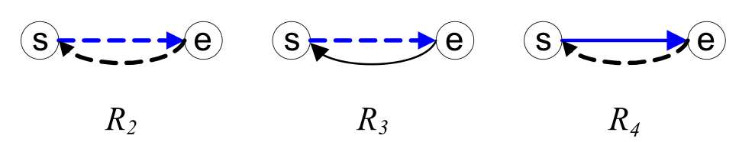
Analysis of Interesting LF-Rules
Observation 2
LF-rules containing –ve links are uncommon
Due to the skewed label distributions in the data
Although Epinions has a much larger proportion of –ve links, R2, R3 and R4 are frequent only in myGamma
“unwanted friendships” in my Gamma
Users block some other uses who try to establish friendships to them
R3 and R4 violate ‘structural balance’

Slide 31
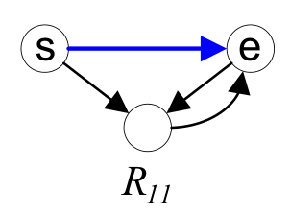
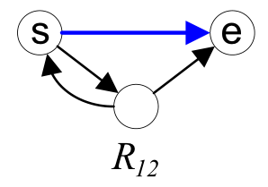
Analysis of Interesting LF-Rules
Observation 3
Mutual +ve links between s and intermediary are more important
ID | conf(Rn) | sur(Rn)
R11 | 0.2224 | 3.52
R12 | 0.3398 | 5.32
ID | conf(Rn) | sur(Rn)
R11 | 0.3915 | 1.88
R12 | 0.4715 | 13.65
Epinion
myGamma

Slide 32
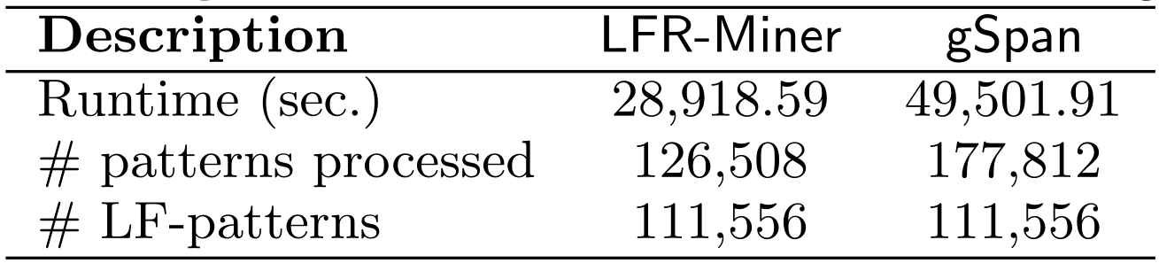
Empirical Study: Pruning Effect
Evaluate the reduction of computational efforts by the pruning and the completeness of LFR-Miner
Implemented LFR-Miner in C#
Executed on a Windows server machine with four 3.16홐 64-bit processors and 24GB of Ram
We achieved about 42% reduction in runtime and processed about 29% fewer patterns

Slide 33
Conclusions
Introduce the task of mining interesting LF-rules
Formalize the LF-patterns and LF-rules
Propose a frequent subgraph mining approach for our task
Apply graph randomization technique to identify interesting LF-rules
Report major observations from empirical study on two real-world datasets
Future work
Studying LF-rules with node labels such as users’ age groups and nationalities
Analyze the computational complexity of LFR-Miner

Slide 34
Discussions
Pros
Interesting topic
Merge the social network area with the data mining
Analysis on the mined graph results
Cons
Too small size mined graphs
Is it really practical to the link prediction?
The results are somewhat trivial
Subgraph mining on MapReduce looks promising

