Slide 1
Pathway Team
SNU, IDB Lab.
DongHyuk Im
DongHee Lee

Slide 2
Introduction
OASIS System
RDF storage, RDBMS
GO Annotation DB
(UniProt)
PubMed
Blast DB
GO annotation
Biomedical Literature
Sequence matching
KEGG pathway
PPI DB
Subcellular
Localization DB
Biological process
Molecular function
Cellular component

Slide 3
Pathway ?
Most chemical reaction mechanisms are translated from a compound(substrate) to a compound(product) by enzyme acting
Importance
  to comparison and analyze pathways in order to understand the process of creating compounds and the evolutive relevance between organisms
  Drug Discovery
enzyme
substrate
product
EC relation

Slide 4
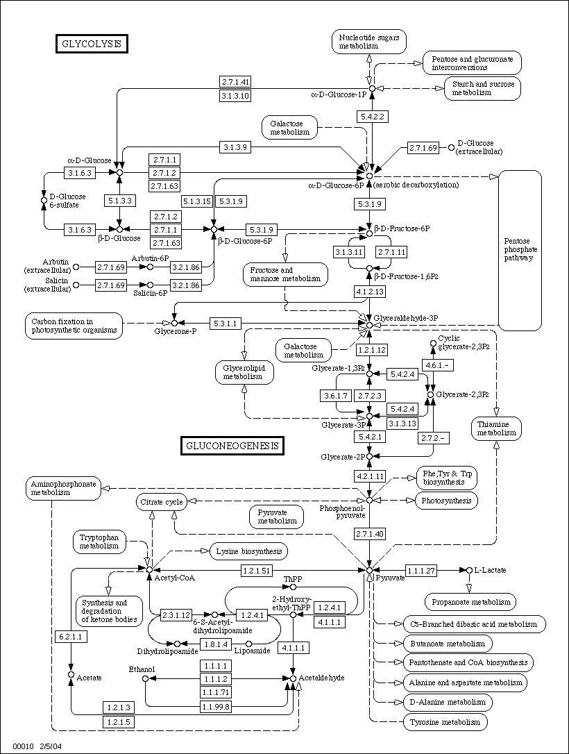
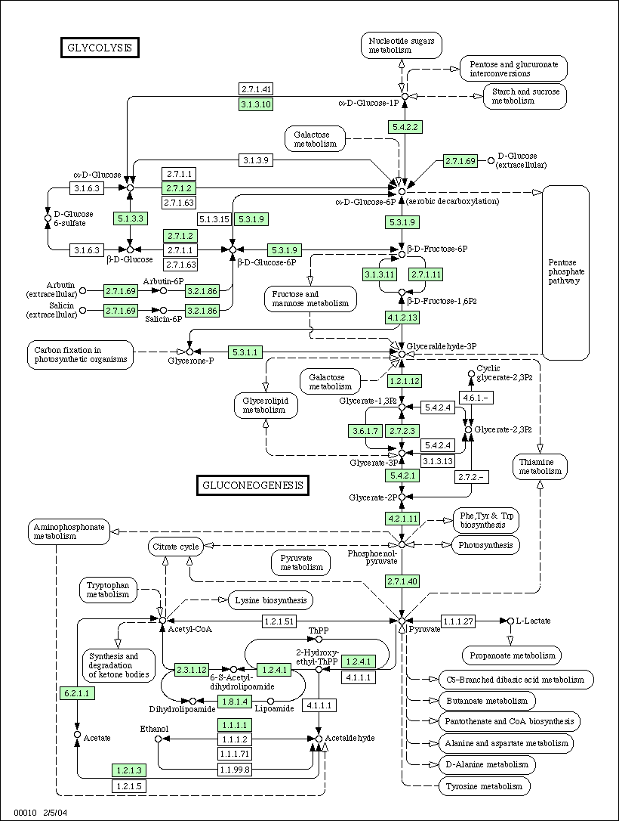
Pathway : Map
Map : *Glycolysis / Gluconeogenesis
Map : E. coli
* Glycolysis : 당분해

Slide 5

Our Approach : RDF based Pathway
Database
Database
User
User
Link-based
Integrated
Common format and integrated DB
will make data more accessible

Slide 6
System Architecture : R-Pathway
Pathway UI
Visualization
Query Processor
Processor for integrating
Pathway
GO
Enzyme

Slide 7

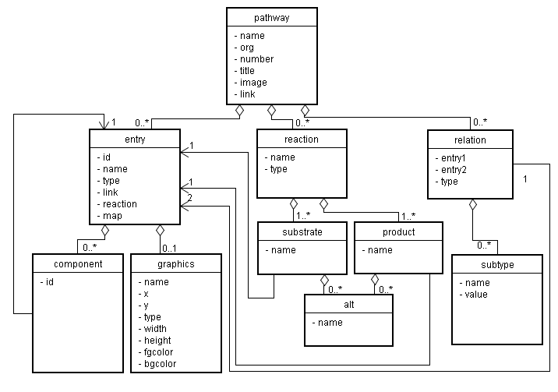
Pathway Data : KGML

Slide 8
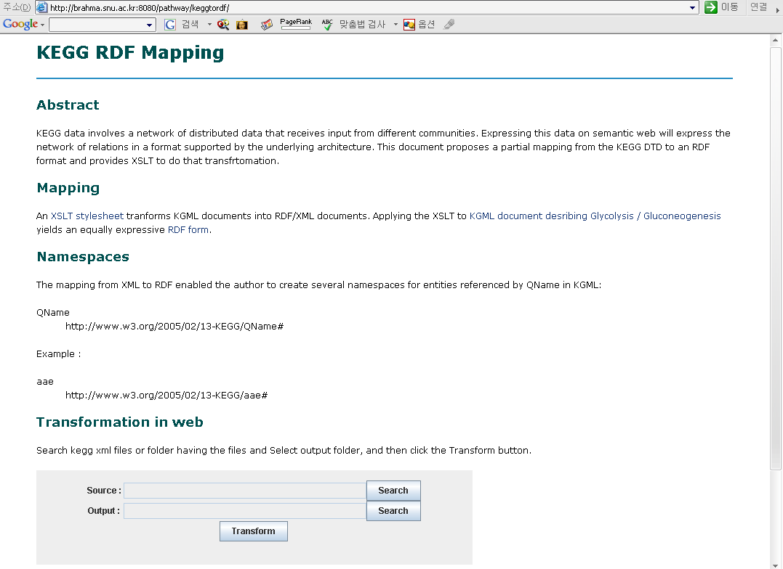
KGML RDF Mapping

Slide 9
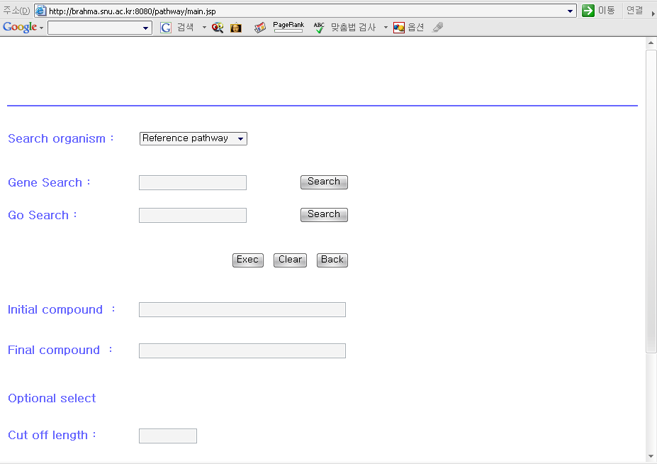
RDF based Pathway

Slide 10
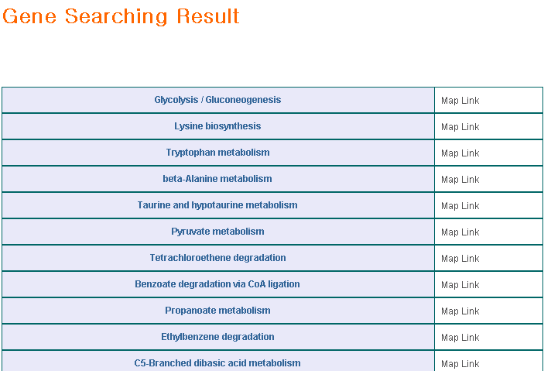
Gene Search

Slide 11
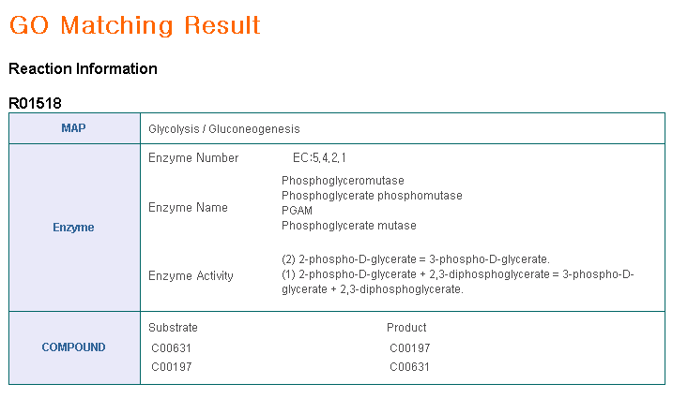
GO-to-Pathway
Search pathway using GO information

Slide 12
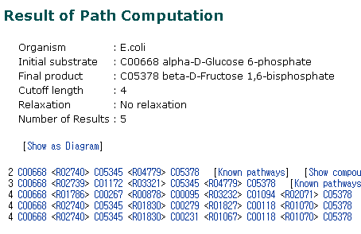
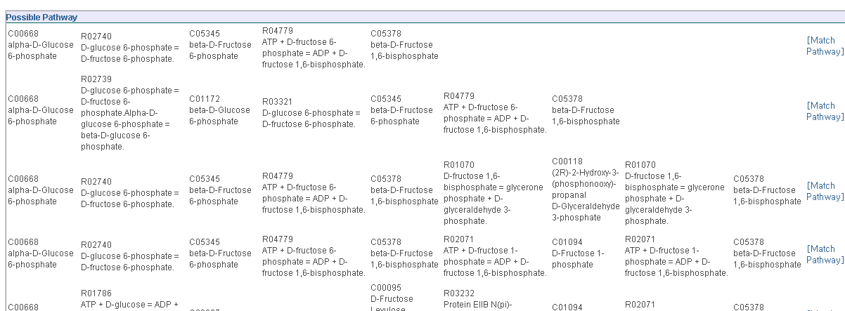
Comaparison to KEGG Pathway Prediction (1/2)
KEGG Pathway
Integrated Pathway
possible path
Show matching pathway

Slide 13
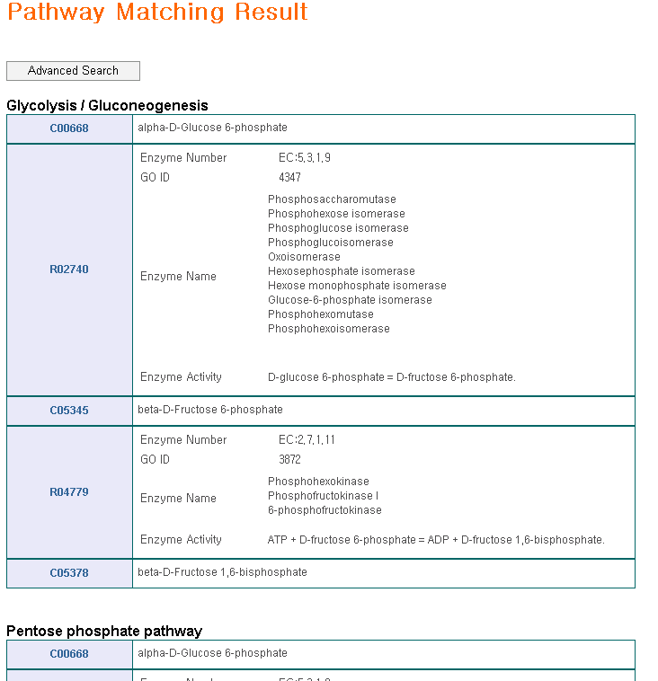
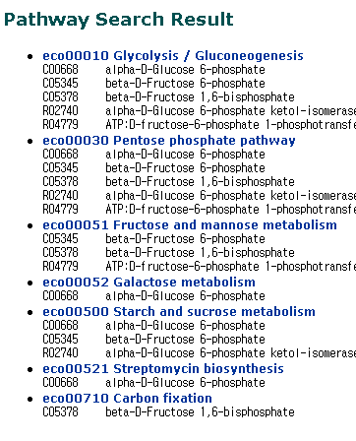
Comaparison to KEGG Pathway Prediction (2/2)
KEGG pathway
Integrated pathway
Our pathway can show the path results with integrated information in order

