Slide 1
Toward Scalable Keyword Search over Relational Data
Akanksha Baid, Ian Rae, Jiexing Li, AnHai Doan, and Jeffery Naughton
University of Wisconsin, Madison
VLDB 2010
September 29 2011
Presented by Somin Kim

Slide 2
Outline
Introduction
Current KWS Solutions
Keyword Search Using Forms
The Hybrid Approach
Experimental Evaluation
Conclusion

Slide 3
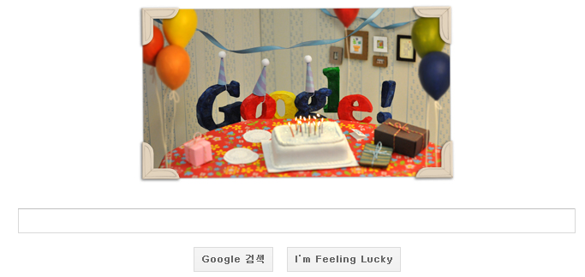
Introduction
Keyword Search?

Slide 4
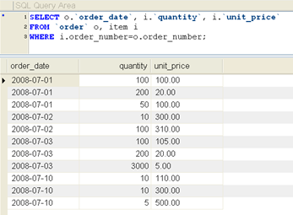
Introduction
Data Retrieval over Relational DBMS
Difficult for Untrained Users!

Slide 5

Introduction
Keyword Search over RDBMS

Slide 6
Introduction
Keyword Search on Documents vs on RDBMS
On Documents
Information unit : document
KWS queries can be answered by inspecting documents individually
On RDBMS
Information unit : record/tuple
KWS queries cannot be answered by inspecting records individually
Results have to be constructed by joining tuples
[1] Keyword Search over Relational Tables and Streams, ACM Transactions on Database Systems (TODS) 2009

Slide 7
Outline
Introduction
Current KWS Solutions
General Methodologies for Processing R-KWS
Performance Problems
Keyword Search Using Forms
The Hybrid Approach
Experimental Evaluation
Conclusion

Slide 8
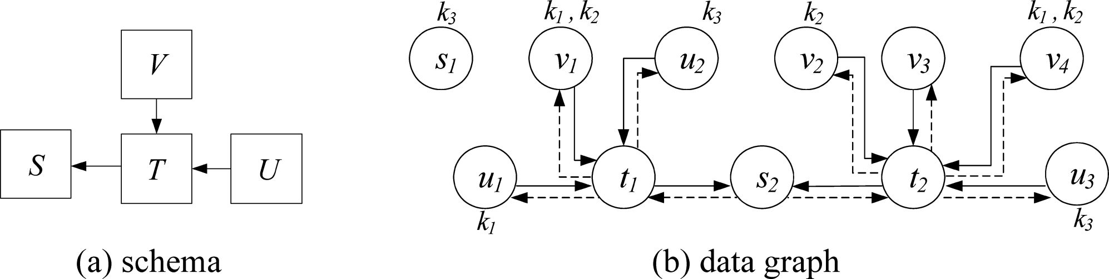

Current KWS Solutions General Methodologies for Processing R-KWS
1. Graph based R-KWS : BANKS
It maintains the data graph in main memory
It limits join conditions to foreign to primary key relationship
Results are retrieved by means of graph traversal
Keyword term
Tuple
Connects nodes/tuples
that can be joined
From the tuple containing a foreign key to its primary key partner
The opposite direction
[1] Keyword Search over Relational Tables and Streams, ACM Transactions on Database Systems (TODS) 2009

Slide 9
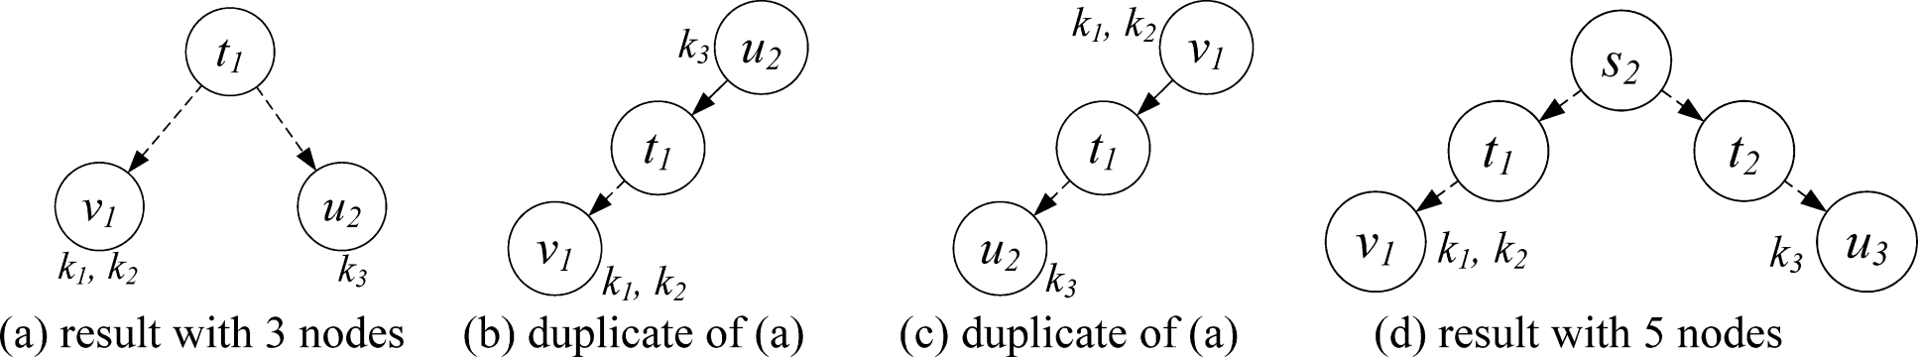
Current KWS Solutions General Methodologies for Processing R-KWS
1. Graph based R-KWS : BANKS (cont.)
The result of an R-KWS query q={k₁, … , k_{m}} is the set of trees in G
Edges (forward or backward) point from the root towards the leafs
Each leaf node contains at least one keyword in q
The nodes jointly covers all term of q
q = {k₁, k₂, k₃}
De-facto duplicates
[1] Keyword Search over Relational Tables and Streams, ACM Transactions on Database Systems (TODS) 2009

Slide 10
Current KWS Solutions General Methodologies for Processing R-KWS
2. Candidate-network based R-KWS : DISCOVER
It translates an R-KWS query into a series of SQL statement, executed directly on the underlying DBMS
Text indices over the data and the keywords are used to generate candidate networks(CNs)
The CNs are translated in to SQL queries
The CNs encodes a way to join relations
The corresponding queries are executed to obtain result tuples
Data graph remains conceptual and is never materialized
It limits join conditions to foreign to primary key relationship
[1] Keyword Search over Relational Tables and Streams, ACM Transactions on Database Systems (TODS) 2009

Slide 11
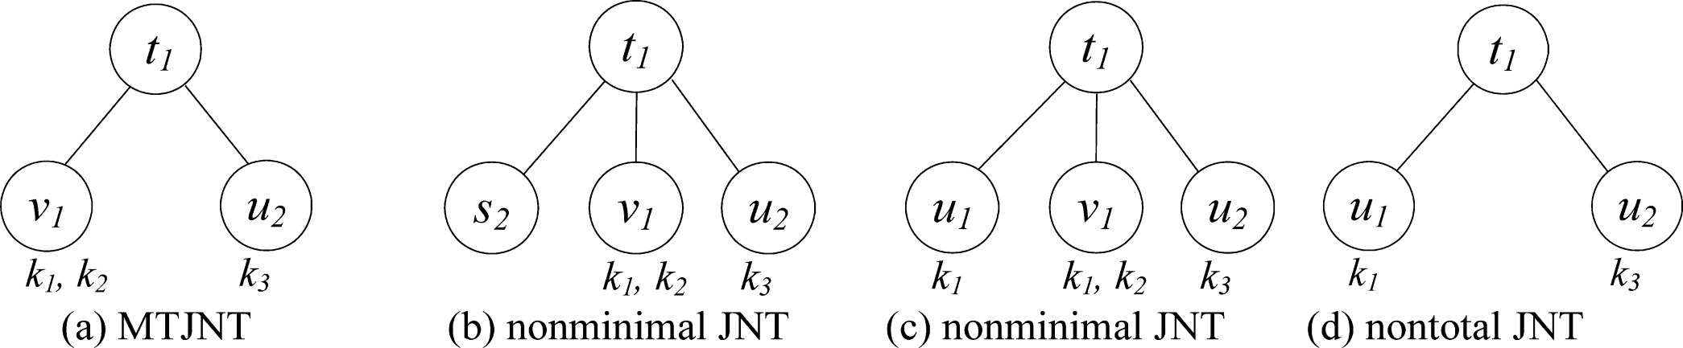
Current KWS Solutions General Methodologies for Processing R-KWS
2. Candidate-network based R-KWS: DISCOVER (cont.)
It evades the concept of trees through Join Networks of Tuples(JNT)
There are no distinct root node & leaf nodes
Terminal nodes : nodes with degree ≤ 1
Total JNT : iff it contains all keywords
Minimalism : iff every terminal node contains at least one unique keyword
Minimal Total JNT (MTJNT) : iff it is impossible to remove any node and find the remainder to be total
q = {k₁, k₂, k₃}
[1] Keyword Search over Relational Tables and Streams, ACM Transactions on Database Systems (TODS) 2009

Slide 12
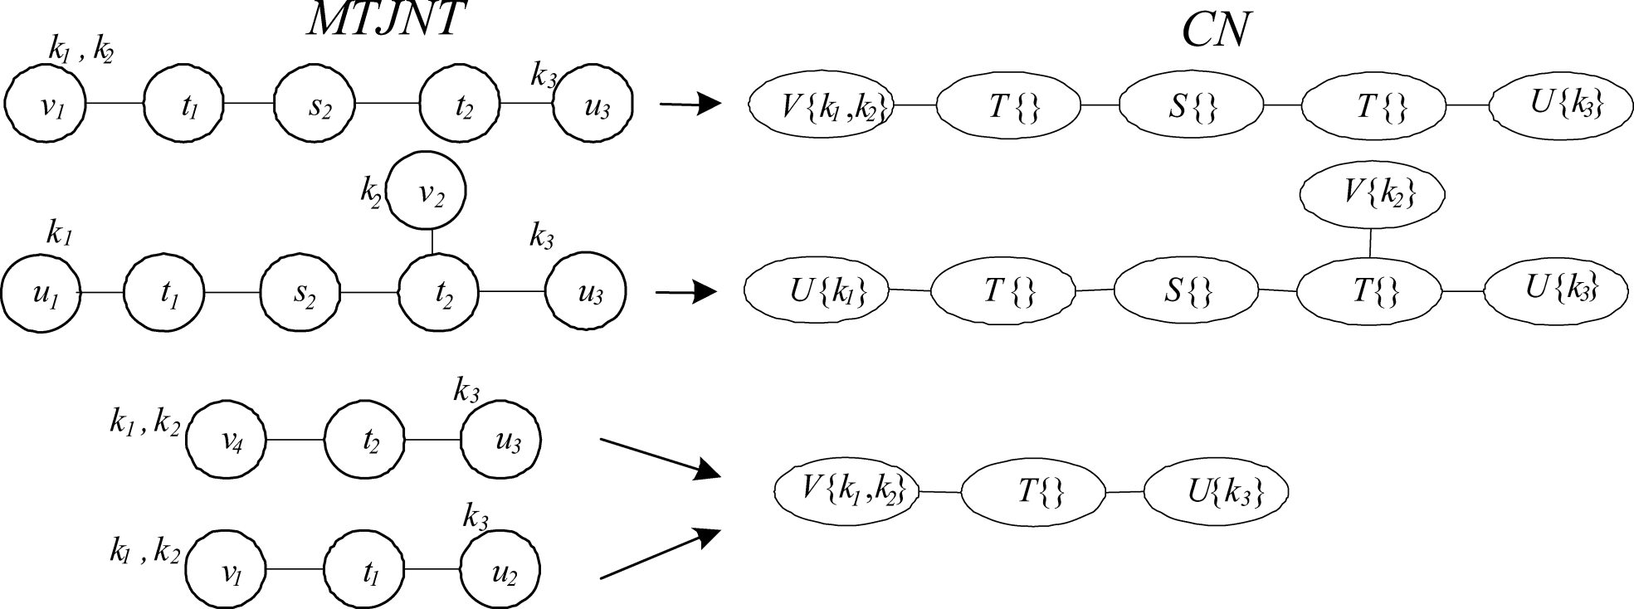
Current KWS Solutions General Methodologies for Processing R-KWS
2. Candidate-network based R-KWS : DISCOVER (cont.)
It’s query processing relies on CNs
An MTJNT projects to a unique CN
It is possible for multiple MTJNT to map to the same CN
[1] Keyword Search over Relational Tables and Streams, ACM Transactions on Database Systems (TODS) 2009

Slide 13
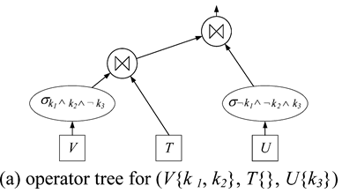

Current KWS Solutions General Methodologies for Processing R-KWS
2. Candidate-network based R-KWS : DISCOVER (cont.)
It answers a query by :
Generating all possible CNs
Converting CN to operator trees
Executing operator trees to produce results
[1] Keyword Search over Relational Tables and Streams, ACM Transactions on Database Systems (TODS) 2009

Slide 14
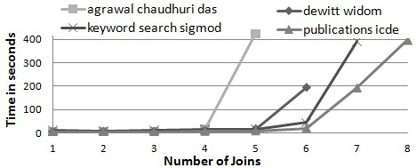

Current KWS Solutions Performance Problems
The run time performance of current R-KWS is unpredictable
The performance of KWS degenerates as the number of joins grows for four-keyword queries, issued over a CN based KWS system
As the number of allowed joins increases, the number of joining networks to be explored grows exponentially

Slide 15
Outline
Introduction
Current KWS Solutions
Keyword Search Using Forms
Overview of KWS-F
A Case for Combining KWS and KWS-F
The Hybrid Approach
Experimental Evaluation
Conclusion

Slide 16
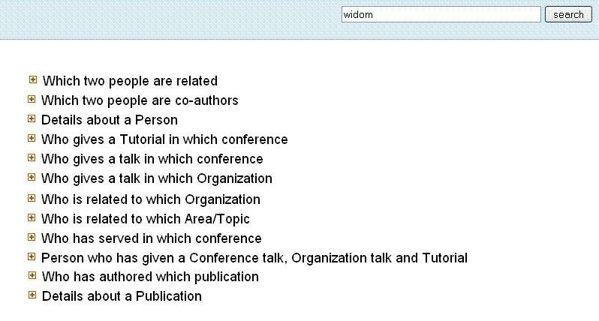
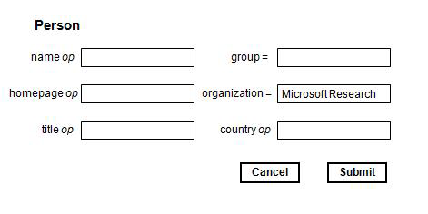
Keyword Search Using Forms Overview of KWS-F
KWS-F
How can we enable untrained users to pose complex SQL queries over a RDBMS, given that they do not know SQL?
1. Displays a set of forms
2. The user must examine the forms
3. The user select promising ones
4. Fill them out & submit them
5. Examine the results
[2] Combining Keyword Search and Forms for Ad Hoc Querying of Databases, SIGMOD ’09

Slide 17
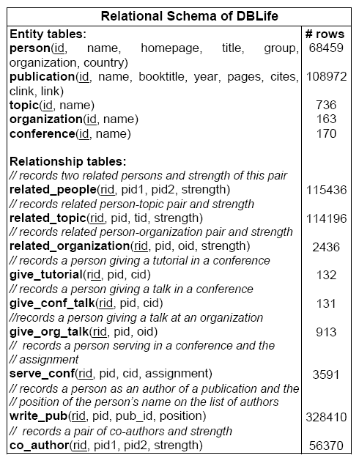
* DBLife
[2] Combining Keyword Search and Forms for Ad Hoc Querying of Databases, SIGMOD ’09
DBLife
A system that manages information for the database research community

Slide 18
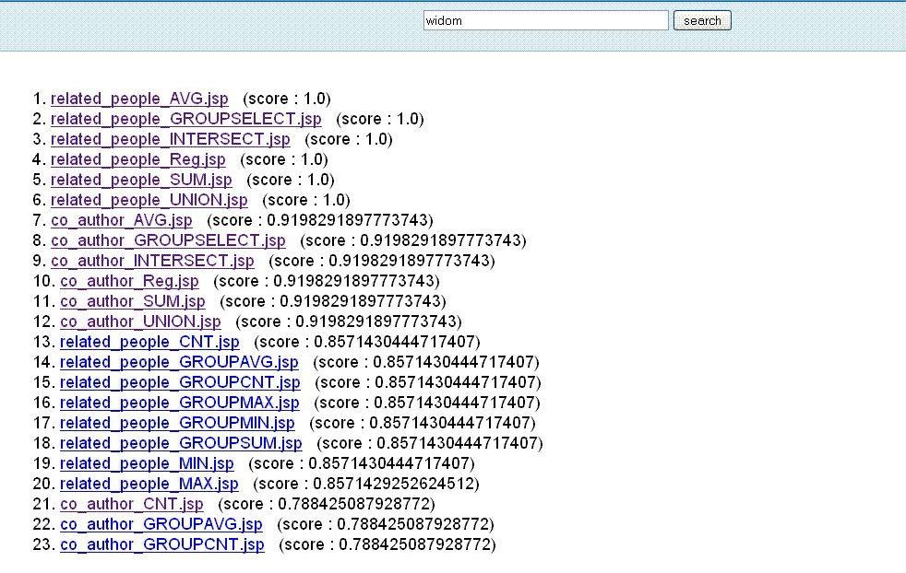
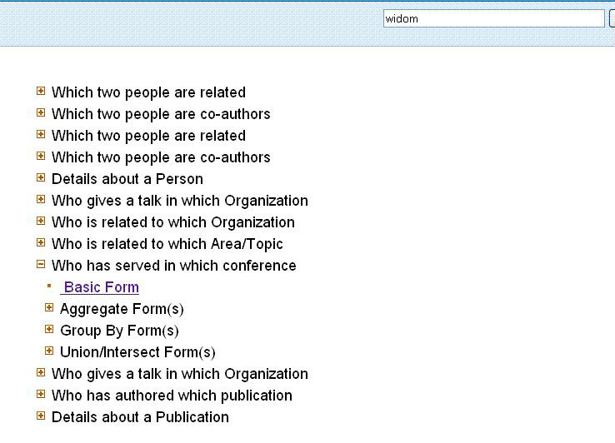
* DBLife
[2] Combining Keyword Search and Forms for Ad Hoc Querying of Databases, SIGMOD ’09

Slide 19
Keyword Search Using Forms Overview of KWS-F
The performance of KWS-F is predictable
KWS-F is suitable for hard queries despite this tedium
How about easy queries?
They can run very quickly
KWS is more appropriate where performance is not as important
KWS + KWS-F can be a solution!

Slide 20
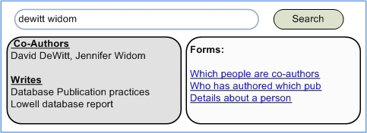
Keyword Search Using Forms A Case for Combining KWS and KWS-F
To achieve predictable performance and good coverage
KWS to handle easy queries, and KWS-F to handle hard queries
Impose a time limit on the KWS
When the time limit has been reached, a (possibly partial) result must be returned
Returns a set of forms to characterize the unexplored portion of the answer space

Slide 21
Keyword Search Using Forms A Case for Combining KWS and KWS-F
When ranking cannot help
Where a good ranking function does not exist
When many result tuples having the same score are returned
Forms offer a “guidance effect”
Form is a good transition from an unstructured query to the results of a structured query
When querying structured data, partially structured query interface if preferable

Slide 22
Outline
Introduction
Current KWS Solutions
Keyword Search Using Forms
The Hybrid Approach
Overview
KWS-F : Form Generation (Phase0)
KWS’ (Phase1)
KWS-F : Search (Phase2)
Minimizing Overlap (Phase3)
Experimental Evaluation
Conclusion

Slide 23
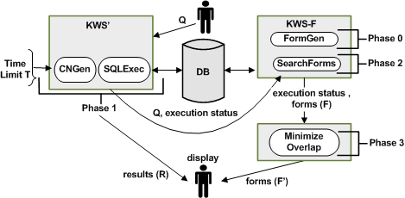
The Hybrid Approach Overview
Generating
a large set of forms offline
Executing query Q
to obtain
a ranked list of forms
Generating those CNs
and executing those SQL queries
that can be completed within time T
Eliminating from the ranked list of forms
which have been “covered” in phase1

Slide 24
The Hybrid Approach KWS-F : form generation (phase 0)
Previous approach
Generates forms combinatorially
Problems
The number of forms generated grows steadily
The set of generated forms contains many duplicates

Slide 25
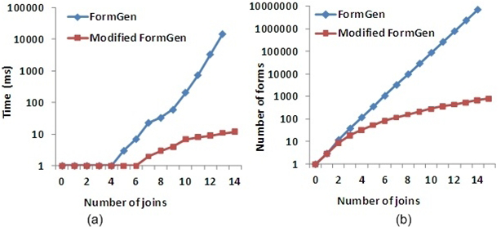
The Hybrid Approach KWS-F : form generation (phase 0)
Modified approach
Takes the maximum number of allowed joins and the schema graph as input
Generates all possible key-foreign key join sequences until the maximum number of joins is reached
29523
219

Slide 26
The Hybrid Approach KWS’ (phase 1)
How the time budget T needs to be divided between
CN generation
SQL query execution
Possible options
CN generation has terminated → start SQL query execution
CN generation can take up a large portion of the total query execution
Divide T into two parts
5:5? 6:4? 4:6?
Interleave CN generation and SQL query execution
Like most current KWS systems
It does not take query cost into account at all
A producer-consumer fashion
SQL queries are ordered and run based on their estimated execution cost

Slide 27
The Hybrid Approach KWS’ (phase 1)
Information passed to the next phase
S : a priority queue of SQL queries corresponding to a CN generated
When the system times out, S would be some SQL queries were generated, but not executed
G : a list of CN templates
The tables involved in a CN
R : the results of the executed queries
G
S
R

Slide 28
The Hybrid Approach KWS-F : search (phase 2)
Once KWS’ has terminated, the results R are displayed to the user
If KWS’ completes in the given time budget
No forms need to be displayed
If not?
We should allow the user to explore the search space that was not covered in Phase1

Slide 29
The Hybrid Approach KWS-F : search (phase 2)
Form terms
Terms that appear on a form, such as schema terms, SQL keywords, and natural-language descriptions
Two indexes
DataIndex : index on the data set
Takes in a term and returns a set of <tuple-id, table> pairs
FormIndex : index on the set of forms
Takes in a term and returns a set of form-ids
Query rewrite
For each q_{i}∈Q, if q_{i} is data term, we will add each table to the FormTerms
We also add q_{i} itself to FormTerms
We simple probe FormIndex with the terms in FormTerms
[2] Combining Keyword Search and Forms for Ad Hoc Querying of Databases, SIGMOD ’09

Slide 30
The Hybrid Approach KWS-F : search (phase 2)
Exmaple
Query : {Widom organization}
“Widom” is a data term
It may appear
Person&publication
Person&give_tutorial,
Person&related_organization …….
“Widom” is also a query term
“Organization” is a schema & query term
FormTerms
person, publication, give_tutorial, related_organization ……..
Widom
organization
[2] Combining Keyword Search and Forms for Ad Hoc Querying of Databases, SIGMOD ’09

Slide 31
The Hybrid Approach Minimising Overlap (phase 3)
Why overlap minimization is important?
We do not want to display redundant forms for simple queries
The screen is a limited resource
We cannot discard a form f
If a query corresponding to f is in the S
Can we discard a form f, if a query corresponding to f isn’t in S?
It may well be that KWS’ timed out before generating all the CNs

Slide 32
Outline
Introduction
Current KWS Solutions
Keyword Search Using Forms
The Hybrid Approach
Experimental Evaluation
Conclusion

Slide 33
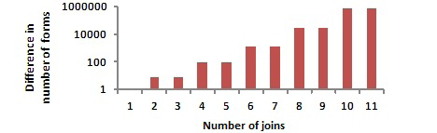
Experimental Evaluation
Evaluating the modified form generation algorithm
The number of duplicate forms that the modified form generation algorithm eliminates when compared to the previous approach
For the DBLife schema
The new approach generated 30-40% fewer forms than previous form generation algorithm

Slide 34
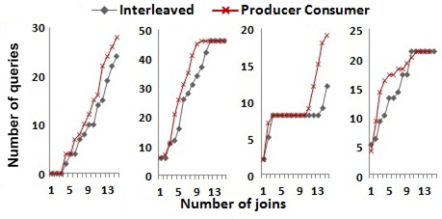
Experimental Evaluation
Evaluating KWS’
Interaction between CN generation and SQL query execution
We set time out T=15s
The producer-consumer based approach performs better than the interleaved approach
Because it takes SQL query execution cost into account

Slide 35
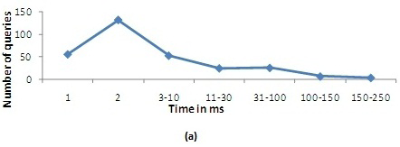
Experimental Evaluation
Evaluating KWS’ (cont.)
The distribution of the SQL queries generated in response to the keyword query “dewitt widom”
Most queries take under 2ms, while 3 queries take around 200ms
Taking SQL query execution cost into account can help increase the total number of SQL queries executed by the KWS’ sub-system

Slide 36
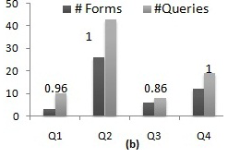
Experimental Evaluation
Evaluating the overlap minimization algorithm
The number of queries and forms eliminated by the hybrid system after overlap minimization
After overlap minimization, only 0~14% of duplicates are left

Slide 37
Conclusion
We explore techniques that allow keyword search over relational data that can guarantee a reasonable response time
KWS generate all the answers within some time bound
KWS-F search potential answers that KWS could not find in the specified time limit

Slide 38
References
[1] Keyword Search over Relational Tables and Streams, ACM Transactions on Database Systems (TODS) 2009.
[2] Combining Keyword Search and Forms for Ad Hoc Querying of Databases, SIGMOD ’09.
[3] DISCOVER : Keyword Search in Relational Databases, VLDB 2002.

