Slide 1

Session 9
Modeling the Static View
:The Class Diagram
Written by Thomas A. Pender
Published by Wiley Publishing, Inc.
October 12, 2011
Presented by So-min Kim

Slide 2
Contents
The Object Model
Elements of the Class Definition
Modeling an Attribute
Modeling an Operation
Modeling the Class Compartments
Creating Different View of a Class

Slide 3
The Object Model (1/5)
The Object Model
  Set of diagrams used to model objects, namely the Class and Object diagrams
  Often used as a synonym for Class diagram

Slide 4
The Object Model (2/5)
The Class Diagram
  It represents classes, their component parts, and the way in which classes of objects are related to one another
  Class : a definition for a type of object
  There are no real objects in a class, only descriptions of what a particular type of object looks like, what it can do, and what other objects it may be related to in some way

Slide 5
The Object Model (3/5)
The Class Diagram (cont.)
  The Class diagram includes :
    Attributes describe the appearance and knowledge of a class of objects
    Operations define the behavior that a class of objects can manifest
    Stereotypes help you understand this type of object in the context of other classes of objects with similar roles within the system’s design
    Properties provide a way to track the maintenance and status of the class definition
    Association is just a formal term for a type of relationship that this type of object may participate in. Associations may come in many variations, including simple, aggregate and composite, qualified, and reflexive
    Inheritance allows you to organize the class definitions to simplify and facilitate their implementation

Slide 6
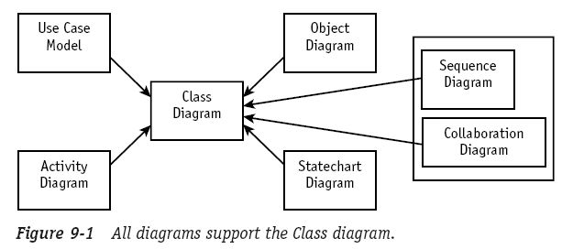
The Object Model (4/5)
The Class Diagram (cont.)
  However, the Class diagram is still limited in what it can show you
    It is a static view of the elements that make up the business or software
  We need other diagrams
    To model behavior and interactions over time
    To model the objects in motion

Slide 7
The Object Model (5/5)
The Object Diagram
  The class defines the rules; the objects express the facts
  The class defines what can be; the object describes what is
  (in Session 13)

Slide 8
Contents
The Object Model
Elements of the Class Definition
Modeling an Attribute
Modeling an Operation
Modeling the Class Compartments
Creating Different View of a Class

Slide 9
Elements of the Class Definition (1/1)
The class symbol
  Name compartment
    Uniquely defines a class (a type of object) within a package
  Attribute compartment
    Contains all the data definitions
  Operations compartment
    Contains a definition for each behavior supported by this type of object

Slide 10
Contents
The Object Model
Elements of the Class Definition
Modeling an Attribute
Modeling an Operation
Modeling the Class Compartments
Creating Different View of a Class

Slide 11
Modeling an Attribute (1/4)
An attribute describes a piece of information that an object owns or knows about itself
  To use that information, you must assign a name and then specify the kind of information, or data type
  In addition, each attribute may have rules constraining the values assigned to it

Slide 12
Modeling an Attribute (2/4)
Attribute visibility
  Specifying what other objects are allowed to see the attribute
  Public(+) : allows access to objects of all other classes
  Private(-) : limits access to within the class itself
  Protected(#) : allows access by subclasses
    In the case of generalizations (inheritance), subclasses must have access to the attributes and operations of the superclass
  Packages(~) : allows access to other objects in the same package

Slide 13
Modeling an Attribute (3/4)
  A common way of defining an attribute
      Visibility( +, -, #, ~ )
      Slash( / ) : derived values may be computed using other data and a set of rules
      Attribute name : required, must be unique within the class
      Data type : required
      Assignment operator and default value : optional
      Constraints
      Class level attribute : optional
visibility / attribute name : data type = default value { constraints }

Slide 14
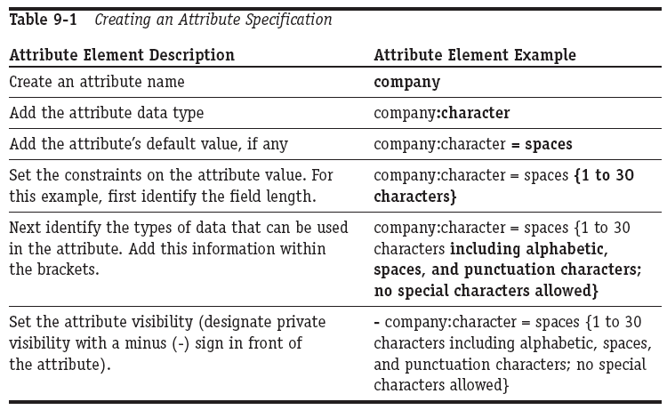
Modeling an Attribute (4/4)
  Creating an attribute specification

Slide 15
Contents
The Object Model
Elements of the Class Definition
Modeling an Attribute
Modeling an Operation
Modeling the Class Compartments
Creating Different View of a Class

Slide 16
Modeling an Operation (1/4)
Operation
  Behaviors of objects, things they can do and things that can be done to them
The UML distinguishes between operation and method
  Operation : the declaration of interface
  Method : the implementation of an operation

Slide 17
Modeling an Operation (2/4)
Elements of an operation specification
  Name
  Arguments
    Name, data type, constraints, and default
  Return
    An attribute data type
    You can specify the visibility of the operation

Slide 18
Modeling an Operation (3/4)
Notation of defining an operation
    Operation name : required
    Arguments/parameters
    Return data type : required for a return value, but return values are optional
    Visibility (+, -, #, ~ )
    Class level operation : optional
    Argument name : required for each parameter, but parameters are optional
    Argument data type : required for each parameter, but parameters are optional
    Constraints : optional
visibility operationName ( argname : datatype { constraints }, … ) :
return data type { constraints }

Slide 19
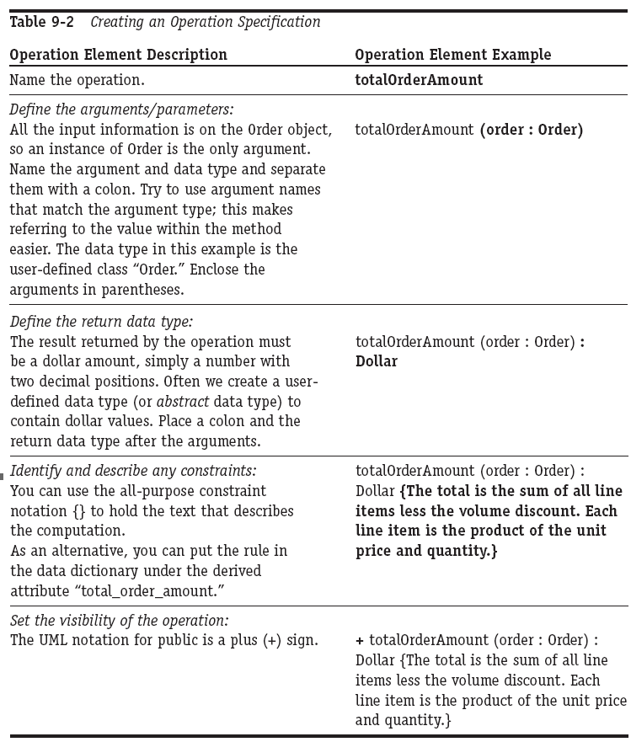
Modeling an Operation (4/4)
Creating an operation specification

Slide 20
Contents
The Object Model
Elements of the Class Definition
Modeling an Attribute
Modeling an Operation
Modeling the Class Compartments
Creating Different View of a Class

Slide 21
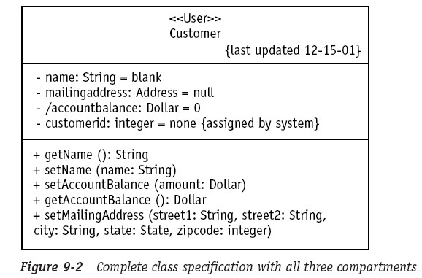
Modeling the Class Compartments (1/1)
The class symbol
Name compartment
Attribute compartment
Operation compartment

Slide 22
Contents
The Object Model
Elements of the Class Definition
Modeling an Attribute
Modeling an Operation
Modeling the Class Compartments
Creating Different View of a Class

Slide 23
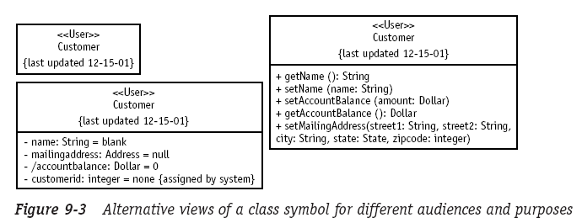
Creating Different View of a Class (1/1)
The completed class definition can be shown with all three compartments visible or as just the name compartment

Slide 24
The End

