Slide 1
Ready to Buy or Just Browsing? : Detecting Web Searcher Goals from Interaction Data
Qi Guo, Eugene Agichtein
Emory University, Emory University
SIGIR’ 10
July 13 2011
Presented by Somin Kim

Slide 2
Outline
Introduction
Background and Motivation
Search and User Model
Infrastructure, Features, and Algorithms
Experimental Results : Buying or Browsing?
Predicting Ad Clickthrough
Conclusions

Slide 3


Introduction(1/5)
An improved understanding of searcher needs and interests is crucial for search engine
To generate satisfactory search results
To improve search ranking, presentation and usability

Slide 4
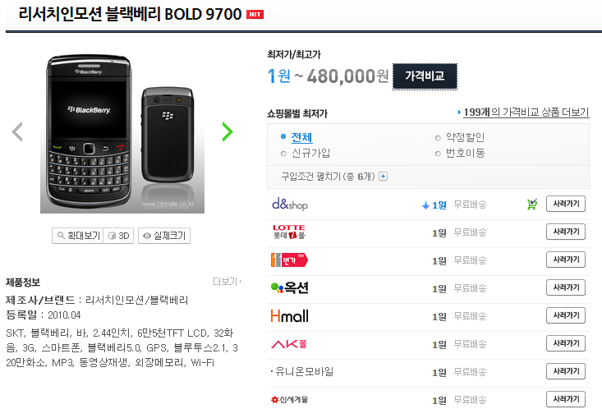
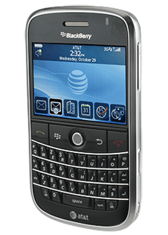
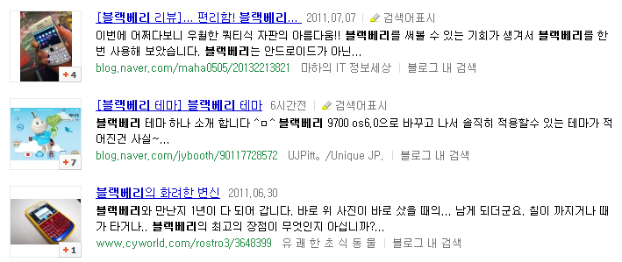
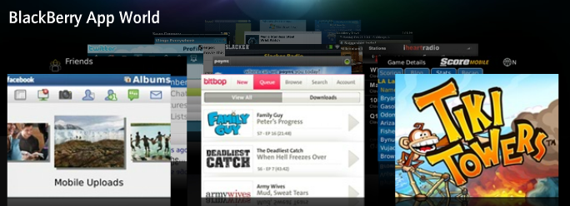
Introduction(2/5)
Problem : The same query may reflect different goals
“Blackberry”

Slide 5
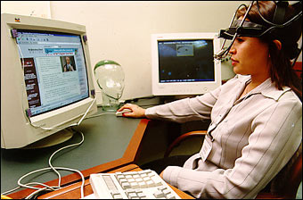
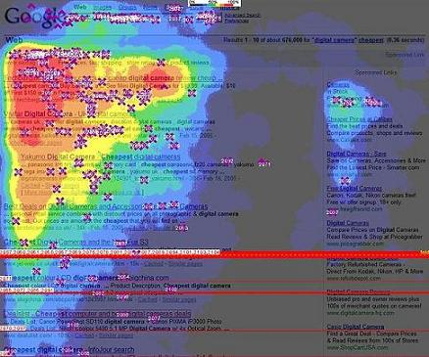
Introduction(3/5)
Previous studies have shown the effectiveness of eye tracking to identify user interests
Recent work has shown the existence of coordination between the searcher gaze position and mouse movement over the search results
Expensive equipment &
Limiting the applicability

Slide 6
Introduction(4/5)
We focus on two general types of commercial search intent
Research vs Purchase
These are broad classes of informational queries
Distinguishing between the two has significant practical applications

Slide 7
Introduction(5/5)
Contributions
A richer model of searcher intent, that incorporates searcher interactions
Empirical evidence that the predictions of the searcher’s goals correlate with empirical ad clickthrough rates
A large-scale experimental evaluation on predicting ad clickthrough

Slide 8
Outline
Introduction
Background and Motivation
Related work
Deconstructing Informational Searches
Application : Search Advertising
Search and User Model
Infrastructure, Features, and Algorithms
Experimental Results : Buying or Browsing?
Predicting Ad Clickthrough
Conclusions

Slide 9
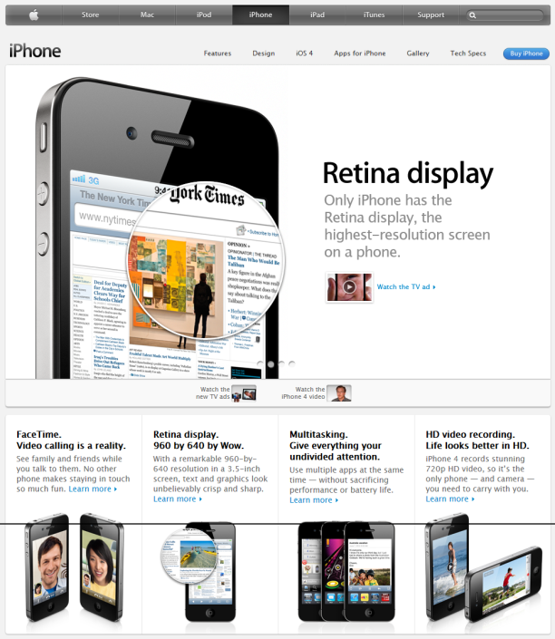
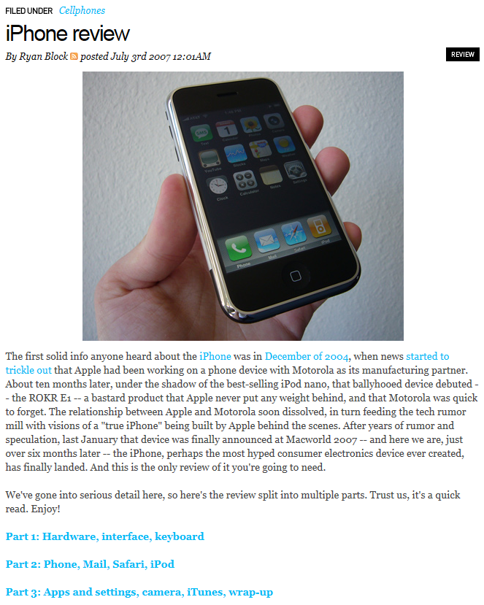
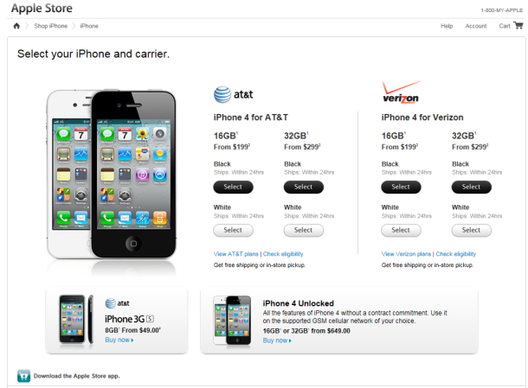
Background and Motivation(1/4) Related Work
A taxonomy of web searches
A. Broader. A taxonomy of web search. SIGIR Forum, 2002.
Navigational | Informational | Transactional
To reach particular site | To acquire some information | To perform some web-mediated activity

Slide 10
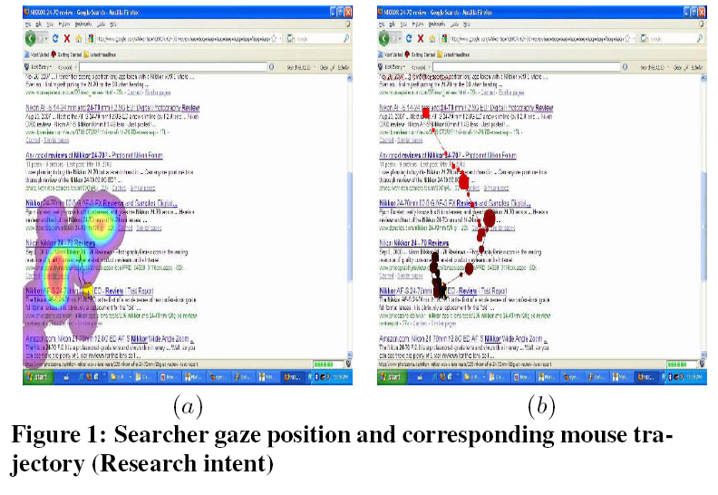
Background and Motivation(2/4) Related Work
Searcher behavior can help distinguish user intent
Using eye-mouse coordination patterns to understanding user behavior

Slide 11
Background and Motivation(3/4) Deconstructing Informational Searches
Informational query intent encapsulates many different types of important search tasks
It is difficult to identify specific kinds of informational intent
We focus on one important intersection of informational and commercial intent categories
Research vs Purchase
It is important to model the searcher’s immediate intent based on the context within a search session

Slide 12
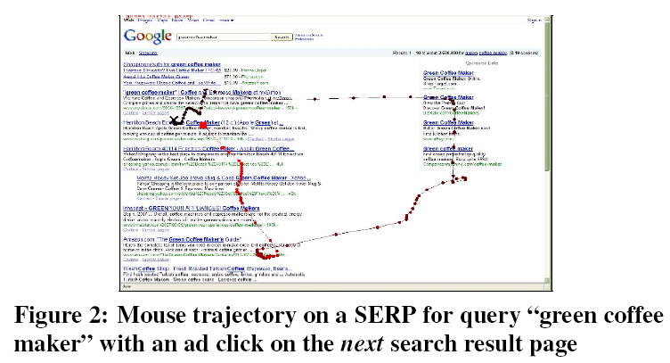
Background and Motivation(4/4) Application : Search Advertising
Search Advertising
Placing online advertisements on web page that show results from search engine queries
Contextualized user interaction models are required
If a search engine knows searcher intent, the next results returned can be more accurately targeted towards this user

Slide 13
Outline
Introduction
Background and Motivation
Search and User Model
Search Model : Tasks and Goals
User Model : Goal-driven Search
Infrastructure, Features, and Algorithms
Experimental Results : Buying or Browsing?
Predicting Ad Clickthrough
Conclusions

Slide 14
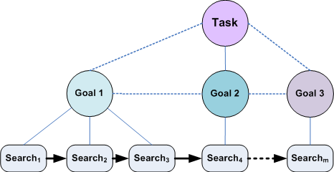
Search and User Model(1/3) Search Model : Tasks and Goals
User is attempting to accomplish an overall search task by solving specific search goals
It is natural to organize individual queries into overall tasks and immediate goals

Slide 15

Search and User Model(2/3) Search Model : Tasks and Goals
Search task
A consecutive sequence of queries that share at least one non-stopword term with any previous query within in the task
Users perform on average only two or three query reformulations before giving it up
The 30-minute sessions tend to be 6.77 searches long on average
Tasks tend to contain 2.71 searches on average

Slide 16
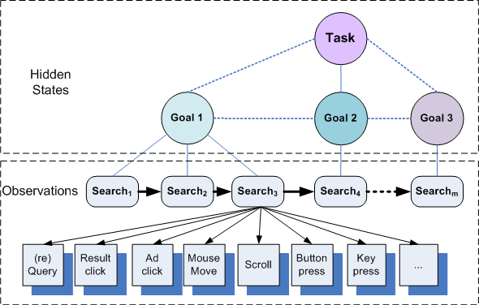
Search and User Model(3/3) User Model : Goal-driven Search
A user, while solving a search task, has a number of immediate goals
Hidden states representing user goals are not directly observable
Observable actions depend on the user’s current state can be observed

Slide 17
Outline
Introduction
Background and Motivation
Search and User Model
Infrastructure, Features, and Algorithms
Infrastructure
Features
Classifier implementation
Experimental Results : Buying or Browsing?
Predicting Ad Clickthrough
Conclusions

Slide 18
Infrastructure, Features, and Algorithms(1/4) Infrastructure
The user interaction data was captured by the LibX toolbar
150 public-use computers at the Emory University library
Users who have explicitly opted in to participate in our study
We are only modeling searcher behavior on a SERP(Search Engine Result Page) and do not consider the external result pages

Slide 19
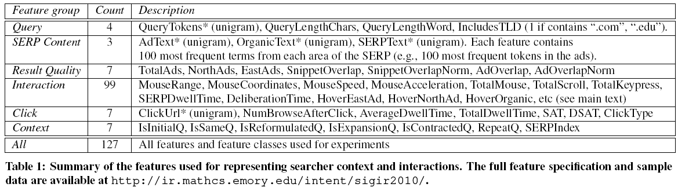
Infrastructure, Features, and Algorithms (2/4) Features
The types of interactions captured
Interaction
Mouse(global) : general statistics of the trajectory
Mouse(local) : 5 stages of SERP examination
Initial, early, middle, late and end

Slide 20
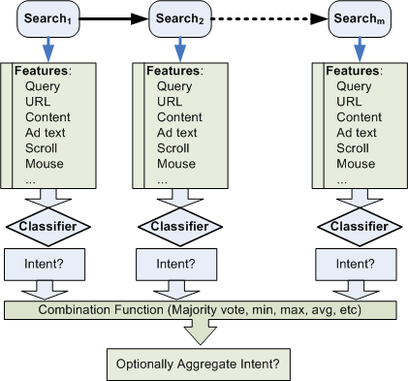
Infrastructure, Features, and Algorithms (3/4) Classifier Implementation
Our SVM classifier configuration

Slide 21
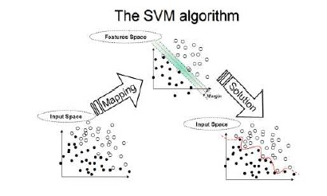
Infrastructure, Features, and Algorithms (4/4) Classifier Implementation
SVM (Support Vector Machine)
Perform classification by constructing an N-dimensional hyperplane that optimally seperates the data into two categories
CRF (Conditional Random Field)
Modeling sequences
Define a conditional probability over hidden state sequences given a particular observation sequence of searches

Slide 22
Outline
Introduction
Background and Motivation
Search and User Model
Infrastructure, Features, and Algorithms
Experimental Results : Buying or Browsing?
Search Task and Data Collection
Results
Ad Clickthrough on Real Search Data
Predicting Ad Clickthrough
Conclusions

Slide 23
Experimental Results : Buying or Browsing?(1/4) Search Task and Data Collection
Task
To detect, given a user’s behavior on a SERP, whether the query had research or purchase intent
Data Collection
10 subjects
who were graduate and undergraduate students and university staff
Asked to perform two search session
Research a product of interest to them for potential future research
Attempt to “buy” an item of immediate interest to them

Slide 24
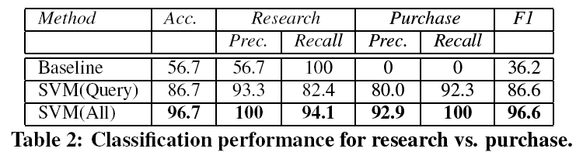
Experimental Results : Buying or Browsing?(2/4) Results
Whether the searcher had research or purchase intent
predicted independently of other searches in the session
The first 90% of searches for training, and the rest for testing
Classification performance
SVM(all) outperforms both baselines, resulting in accuracy of almost 97%

Slide 25
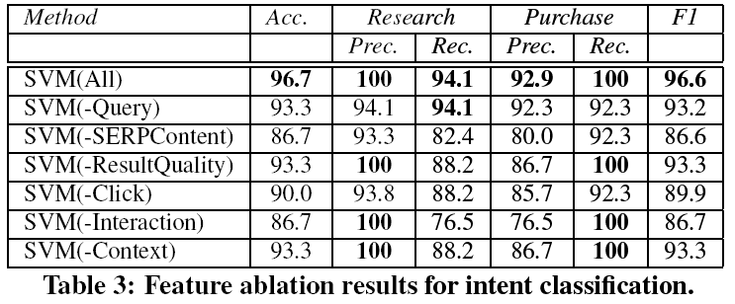
Experimental Results : Buying or Browsing?(3/4) Results
Identifying the most important features
SERPContent and Interaction features appear to be the most important
The SERPContent can help enrich the context of a query
The interaction provide additional clues about the searcher interest

Slide 26
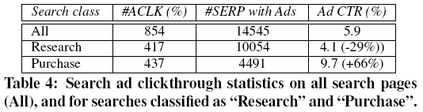
Experimental Results : Buying or Browsing?(4/4) Ad Clickthrough on Real Search Data
Comparing the ad clickthrough on the research to purchase classified by our model
Data
From mid-August through mid-December 2008, 440 opted-in users
6,476 search sessions, 16,693 search tasks and 45,212 searches
Results
The predicted purchase searches have substantially higher ad clickthrough rates

Slide 27
Outline
Introduction
Background and Motivation
Search and User Model
Infrastructure, Features, and Algorithms
Experimental Results : Buying or Browsing?
Predicting Ad Clickthrough
Problem statement and Classifier Configuration
Results and Discussion
Conclusions

Slide 28
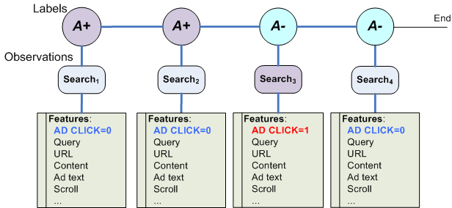
Predicting Ad Clickthrough(1/3) Problem Statement and Classifier Configuration
Problem statement
Given the first i searches in a search task S(s₁, … , s_{i}, …, s_{m}), and the searcher behavior on these first i SERPs, predict whether the searcher will click on an ad on the SERP within the current search task S, for any of the future searches s_{i+1}, s_{i+2}, …, s_{m}
Classifier Configuration
A+ : “Receptive”
A- : “Not Receptive”

Slide 29
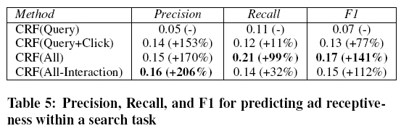
Predicting Ad Clickthrough(2/3) Results and Discussion
Results
CRF(Query+Click) outperforms CRF(Query) on the ad receptiveness prediction task
CRF(All) system further increases both precision and recall
CRF(All-Interaction) degrades the recall and F1, while precision is somewhat improved

Slide 30
Predicting Ad Clickthrough(3/3) Results and Discussion
Discussion
Potential limitations
User population is relatively homogeneous
Ad clickthrough is just one evaluation metric
Not using a mouse as a reading aid
Some user may not use a mouse to mark or focus their interest
Long difficult research sessions with ad clicks
User can click on ads because of the unsatisfactory organic results
Commercial purchase sessions without ad clicks
User may not click ad because of poor quality of search ads, or availability of more promising organic search results

Slide 31
Outline
Introduction
Background and Motivation
Search and User Model
Infrastructure, Features, and Algorithms
Experimental Results : Buying or Browsing?
Predicting Ad Clickthrough
Conclusions

Slide 32
Conclusion
Contributions
Predicting research vs purchase goal of the user provided insights about the feature group
We showed correlation of the predicted search intents with the ad click through rates of real users
We demonstrated the performance of our model for application of predicting future search ad clickthrough
Future work
Expanding our model to consider user interactions other than the search result pages
We plan to incorporate the user’s history to enable the personalization of intent inference

