Slide 1
UML Weekend Crash Course
Ch.11~20
Park, Hyoung-woo
SNU OOPSLA Lab.
Thomas A. Pender, Wiley
2004.8.15

Slide 2
Contents
Ch11 – The Class Diagram: Aggregation and Generalization
Ch12 – Applying the Class Diagram to the Case Study
Ch13 – Modeling the Static View: The Object Diagram
Ch14 – Modeling the Functional View: The Activity Diagram
Ch15 – Applying the Activity Diagram to the Case Study
Ch16 – Modeling the Dynamic View: The Sequence Diagram
Ch17 – Applying the Sequence Diagram to the Case Study
Ch18 – Modeling the Dynamic View: The Collaboration Diagram
Ch19 – Applying the Collaboration Diagram to the Case Study
Ch20 – Modeling the Dynamic View: The Statechart Diagram

Slide 3
Ch.11 (1/6)
The relationships among the concepts of association, aggregation, and composition
  Every aggregation relationship is a type of association.
  Every composition relationship is a form of aggregation

Slide 4
Ch.11 (2/6)
Elements of aggregation
aggregation relationship
constraint
{must have a
current contract}
Team
member
Player
0..1
9..9
assembly/aggregation
member
multiplicity

Slide 5
Ch.11 (3/6)
Elements of composition
composition relationship
Book
member
Chapter
1..1
1..*
assembly/aggregation
member
multiplicity

Slide 6
Ch.11 (4/6)
Difference between aggregation and composition
  Composition is used for aggregations where the life span of the part depends on the life span of the aggregate.
  ex) When the Team is disbanded, the players live on
  ➔ Aggregation relationship
  We can not think a chapter without a book
  ➔ Composition relationship

Slide 7
Ch.11 (5/6)
Difference between generalization and association
  Associations define the rules for how objects may relate to one another.
  Generalization relates classes together where each class contains a subset of the elements needed to define a type of object.

Slide 8
Ch.11 (6/6)
Elements of generalization
class
generalization relationship
Fruit
Fruit Type
Apple
Watermelon
Orange
Fruit Variety
discriminator
RedDelicious
GrannySmith

Slide 9
Contents
Ch11 – The Class Diagram: Aggregation and Generalization
Ch12 – Applying the Class Diagram to the Case Study
Ch13 – Modeling the Static View: The Object Diagram
Ch14 – Modeling the Functional View: The Activity Diagram
Ch15 – Applying the Activity Diagram to the Case Study
Ch16 – Modeling the Dynamic View: The Sequence Diagram
Ch17 – Applying the Sequence Diagram to the Case Study
Ch18 – Modeling the Dynamic View: The Collaboration Diagram
Ch19 – Applying the Collaboration Diagram to the Case Study
Ch20 – Modeling the Dynamic View: The Statechart Diagram

Slide 10
Ch.12 (1/5)
Problem statement: for the inventory control system
  “Our system is designed to inventory and ship uniquely identified products. These products may be purchased directly from vendors and resold as is, or we can package vendor products together to make our own custom product. Customers place orders for one or more items, but we acknowledge interested customers in the system whether they have purchased yet or not. Each item corresponds to a product. We identify each product using a unique serial number. The Customer may inquire on the status of his Orders using the order number.”

Slide 11
Ch.12 (2/5)
Class diagram: for the inventory control system
generates >
1..1
0..1
Customer
places >
Order
LineItem
ordernbr:int
1..1
1..*
1..1
1..1
1..*
serialnbr:String
0..1
1..1
Shipment
Product
Product
delivers >
0..*
1..1
0..*
VendorShipment
CustomerShipment
CustomProduct
VendorProduct
0..1
2..*

Slide 12
Ch.12 (3/5)
Elements of a Pattern Definition for Kitchen
Pattern Element | Element Example for Kitchen
A problem to solve | We need a place to store and prepare food.
The resources to solve it | We can use appliances, counters and cupboards, food, utensils, and so on.
The set of rules about how the resources could be used to solve the problem | The refrigerator stores perishable items prior to preparation, the oven is used to heat food, and so on.
Guidelines to know when the pattern works well and when it does not | It works well within the context of house. It does not work well outside the house (for example, while camping or picnicking).

Slide 13
Ch.12 (4/5)
Observer pattern example in a Class diagram
Observer
Pattern
observable
observer
Shipment
is observed by
Order
0..*
1..1

Slide 14
Ch.12 (5/5)
The State design pattern in a Class diagram using the Product example
State
Pattern
context
state
Product
delegates to
ProductState
0..*
1..1
Received
InStock
Held
Sold

Slide 15
Contents
Ch11 – The Class Diagram: Aggregation and Generalization
Ch12 – Applying the Class Diagram to the Case Study
Ch13 – Modeling the Static View: The Object Diagram
Ch14 – Modeling the Functional View: The Activity Diagram
Ch15 – Applying the Activity Diagram to the Case Study
Ch16 – Modeling the Dynamic View: The Sequence Diagram
Ch17 – Applying the Sequence Diagram to the Case Study
Ch18 – Modeling the Dynamic View: The Collaboration Diagram
Ch19 – Applying the Collaboration Diagram to the Case Study
Ch20 – Modeling the Dynamic View: The Statechart Diagram

Slide 16
Ch.13 (1/2)
Comparison of the Class and Object Diagrams
Class Diagram | Object Diagram
The class has three compartments: name, attribute, and operation. | The object has only two compartments: name and attribute.
The class name stands alone in the class name compartment. | The format for an object name is object-name, colon, class-name (1234:Order), with the entire expression underlined. You will encounter this notation in other diagrams that model objects rather than classes. Sometimes the object name is left off and only the colon and class-name are used. This is referred to as an anonymous object.
The class attribute compartment defines the properties of the attributes. | The object defines only the current value of each attribute for the test or example being modeled.
Operations are listed in the class. | Operations are not included in the object because they would be identical for every object of the same class.
The classes are connected with an association with a name, multiplicity, constraints, and roles. Classes represent a “classification” of objects, so it is necessary to specify how many may participate in the association. | The objects are connected with a link that has a name and no multiplicity. Objects represent single entities. All links are one-to-one, so multiplicity is irrelevant. Roles may be used on links.

Slide 17
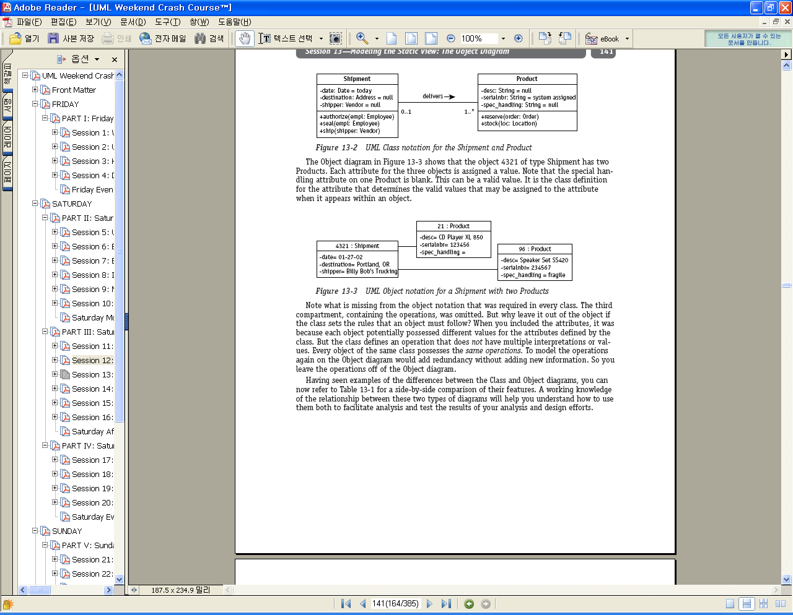
Ch.13 (2/2)
UML Class notation for the Shipment and Product
UML Object notation for a Shipment with two Products

Slide 18
Contents
Ch11 – The Class Diagram: Aggregation and Generalization
Ch12 – Applying the Class Diagram to the Case Study
Ch13 – Modeling the Static View: The Object Diagram
Ch14 – Modeling the Functional View: The Activity Diagram
Ch15 – Applying the Activity Diagram to the Case Study
Ch16 – Modeling the Dynamic View: The Sequence Diagram
Ch17 – Applying the Sequence Diagram to the Case Study
Ch18 – Modeling the Dynamic View: The Collaboration Diagram
Ch19 – Applying the Collaboration Diagram to the Case Study
Ch20 – Modeling the Dynamic View: The Statechart Diagram

Slide 19
Ch.14 (1/2)
Activity diagram notation(1/2)
decision
transition
guard condition
[sufficient
funds]
[insufficient
funds]
activity
Give the customer the money
Shake your finger at the customer

Slide 20
Ch.14 (2/2)
Activity diagram notation(2/2)
start
Merge point
[cancel]
cancelled
[proceed]
Fork
Synchronization
end
done

Slide 21
Contents
Ch11 – The Class Diagram: Aggregation and Generalization
Ch12 – Applying the Class Diagram to the Case Study
Ch13 – Modeling the Static View: The Object Diagram
Ch14 – Modeling the Functional View: The Activity Diagram
Ch15 – Applying the Activity Diagram to the Case Study
Ch16 – Modeling the Dynamic View: The Sequence Diagram
Ch17 – Applying the Sequence Diagram to the Case Study
Ch18 – Modeling the Dynamic View: The Collaboration Diagram
Ch19 – Applying the Collaboration Diagram to the Case Study
Ch20 – Modeling the Dynamic View: The Statechart Diagram

Slide 22
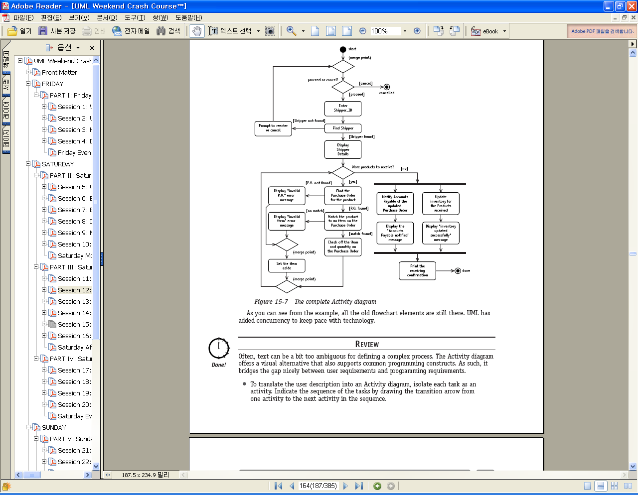
Ch.15 (1/2)
Activity diagram for Receive Product(1/2)

Slide 23
Ch.15 (2/2)
Activity diagram for Receive Product(2/2)

Slide 24
Contents
Ch11 – The Class Diagram: Aggregation and Generalization
Ch12 – Applying the Class Diagram to the Case Study
Ch13 – Modeling the Static View: The Object Diagram
Ch14 – Modeling the Functional View: The Activity Diagram
Ch15 – Applying the Activity Diagram to the Case Study
Ch16 – Modeling the Dynamic View: The Sequence Diagram
Ch17 – Applying the Sequence Diagram to the Case Study
Ch18 – Modeling the Dynamic View: The Collaboration Diagram
Ch19 – Applying the Collaboration Diagram to the Case Study
Ch20 – Modeling the Dynamic View: The Statechart Diagram

Slide 25
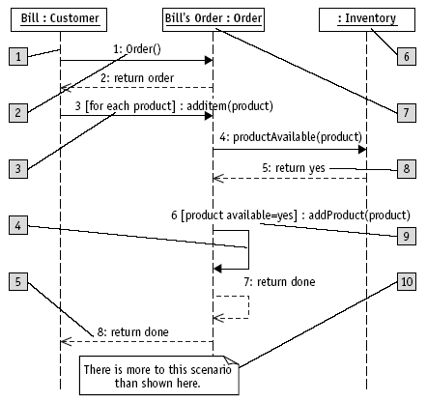
Ch.16 (1/2)
Elements of the Sequence diagram notation
Object lifeline
Anonymous object
Message/Stimulus
Object name
Iteration
Sequence number
Self-reference
Condition
Return
Basic comment

Slide 26
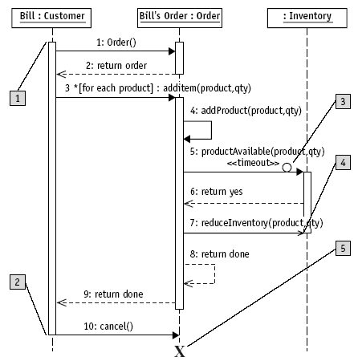
Ch.16 (2/2)
Extended elements of the Sequence diagram notation
Activation
Timeout event
Asynchronous
event
Object termination
Deactivation

Slide 27
Contents
Ch11 – The Class Diagram: Aggregation and Generalization
Ch12 – Applying the Class Diagram to the Case Study
Ch13 – Modeling the Static View: The Object Diagram
Ch14 – Modeling the Functional View: The Activity Diagram
Ch15 – Applying the Activity Diagram to the Case Study
Ch16 – Modeling the Dynamic View: The Sequence Diagram
Ch17 – Applying the Sequence Diagram to the Case Study
Ch18 – Modeling the Dynamic View: The Collaboration Diagram
Ch19 – Applying the Collaboration Diagram to the Case Study
Ch20 – Modeling the Dynamic View: The Statechart Diagram

Slide 28
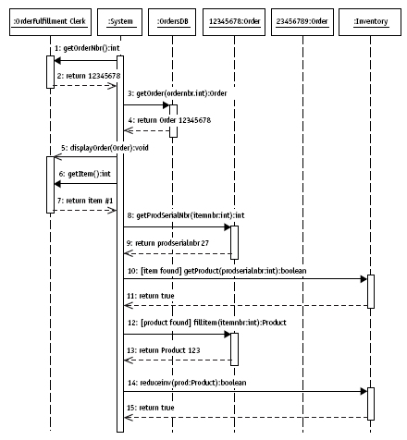
Ch.17 (1/4)
Sequence diagram of Fill Order Use Case (1/4)
(Scenario 1)

Slide 29
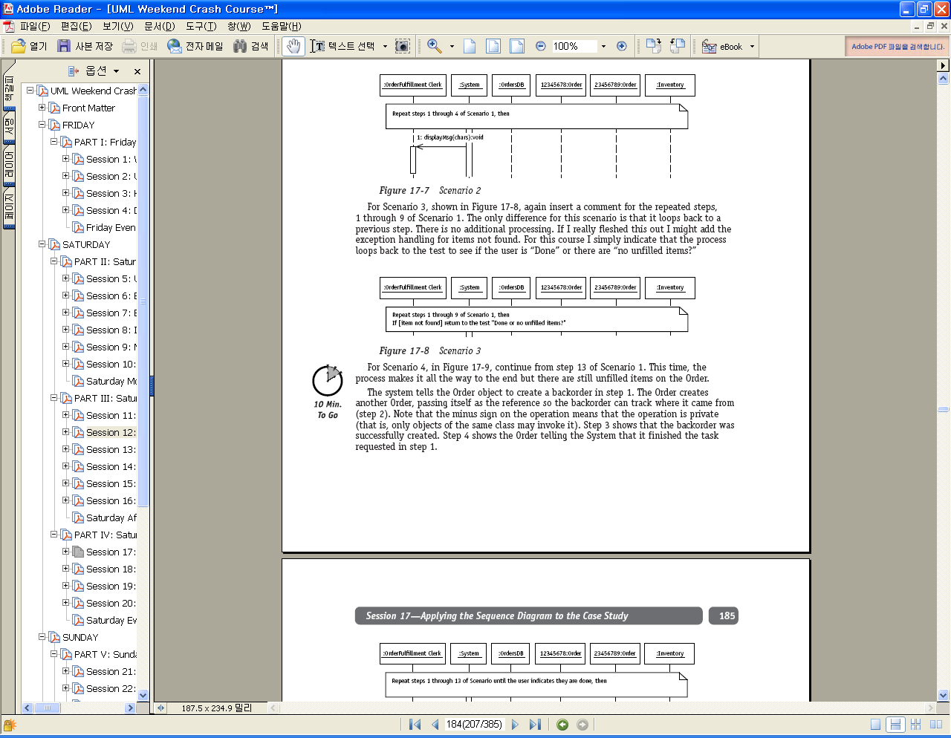
Ch.17 (2/4)
Sequence diagram of Fill Order Use Case (2/4)
(Scenario 2)

Slide 30
Ch.17 (3/4)
Sequence diagram of Fill Order Use Case (3/4)
(Scenario 3)

Slide 31
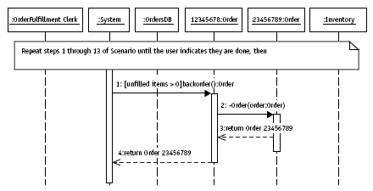
Ch.17 (4/4)
Sequence diagram of Fill Order Use Case (4/4)
(Scenario 4)

Slide 32
Contents
Ch11 – The Class Diagram: Aggregation and Generalization
Ch12 – Applying the Class Diagram to the Case Study
Ch13 – Modeling the Static View: The Object Diagram
Ch14 – Modeling the Functional View: The Activity Diagram
Ch15 – Applying the Activity Diagram to the Case Study
Ch16 – Modeling the Dynamic View: The Sequence Diagram
Ch17 – Applying the Sequence Diagram to the Case Study
Ch18 – Modeling the Dynamic View: The Collaboration Diagram
Ch19 – Applying the Collaboration Diagram to the Case Study
Ch20 – Modeling the Dynamic View: The Statechart Diagram

Slide 33
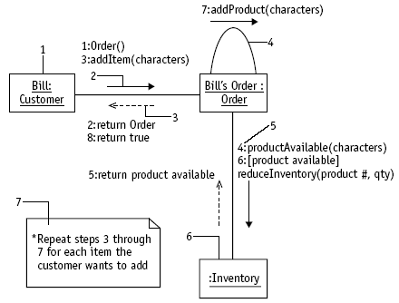
Ch.18 (1/2)
Collaboration diagram notation (1/2)
Synchronous event or procedure call
Self-reference
Object
Sequence number
Return
Comment
Anonymous object

Slide 34
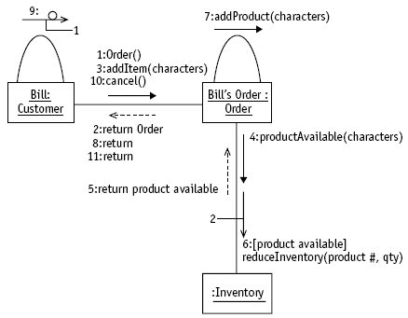
Ch.18 (2/2)
Collaboration diagram notation (2/2)
Timeout event
Asynchronous message

Slide 35
Contents
Ch11 – The Class Diagram: Aggregation and Generalization
Ch12 – Applying the Class Diagram to the Case Study
Ch13 – Modeling the Static View: The Object Diagram
Ch14 – Modeling the Functional View: The Activity Diagram
Ch15 – Applying the Activity Diagram to the Case Study
Ch16 – Modeling the Dynamic View: The Sequence Diagram
Ch17 – Applying the Sequence Diagram to the Case Study
Ch18 – Modeling the Dynamic View: The Collaboration Diagram
Ch19 – Applying the Collaboration Diagram to the Case Study
Ch20 – Modeling the Dynamic View: The Statechart Diagram

Slide 36
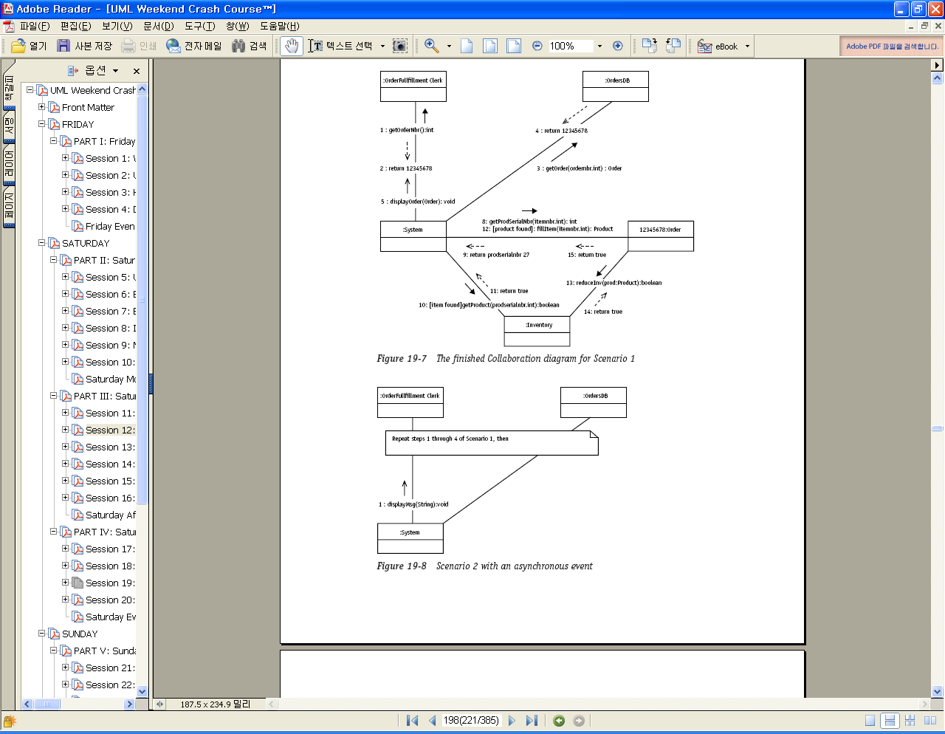
Ch.19 (1/4)
Collaboration diagram of Fill Order Use Case (1/4)
(Scenario 1)

Slide 37
Ch.19 (2/4)
Collaboration diagram of Fill Order Use Case (2/4)
(Scenario 2)

Slide 38
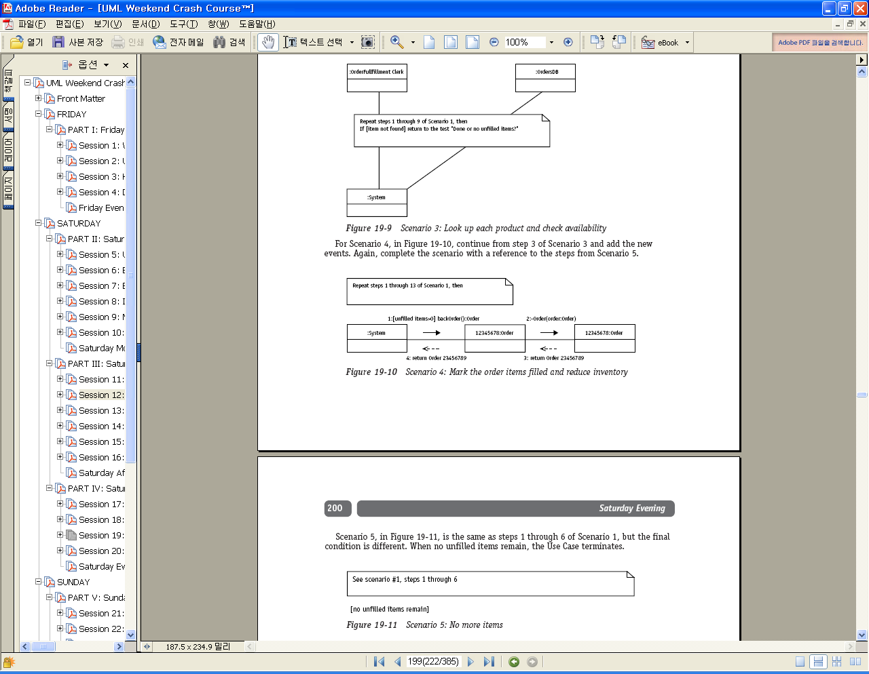
Ch.19 (3/4)
Collaboration diagram of Fill Order Use Case (3/4)
(Scenario 3)

Slide 39
Ch.19 (4/4)
Collaboration diagram of Fill Order Use Case (4/4)
(Scenario 4)

Slide 40
Contents
Ch11 – The Class Diagram: Aggregation and Generalization
Ch12 – Applying the Class Diagram to the Case Study
Ch13 – Modeling the Static View: The Object Diagram
Ch14 – Modeling the Functional View: The Activity Diagram
Ch15 – Applying the Activity Diagram to the Case Study
Ch16 – Modeling the Dynamic View: The Sequence Diagram
Ch17 – Applying the Sequence Diagram to the Case Study
Ch18 – Modeling the Dynamic View: The Collaboration Diagram
Ch19 – Applying the Collaboration Diagram to the Case Study
Ch20 – Modeling the Dynamic View: The Statechart Diagram

Slide 41
Ch.20
Elements of Statechart diagram
initial state
Prospect
event
action
order placed/addOrder(Order)
state name
Active
Do: generate monthly invoice
Do: generate monthly customer promotion
internal
transitions
…
Archived
final state

