Slide 1
The PageRank Citation Ranking: Bringing Order to the Web
Lawrence Page, Sergey Brin,
Rajeev Motwani, Terry Winograd
Stanford Digital Library Project Technologies 1998
5 July 2013
SNU IDB Lab.
Inhoe Lee
Notes:
세미나 발표를 맡은 이인회 입니다.
1981년 Communications of the ACM에 실린
Operating System Support for Database management 에 대하여 발표하겠습니다.

Slide 2
Outline
Introduction
Link Structure of the Web
PageRank
Simplified PageRank
Problem
Implementation
Testing on search engines
Application
Conclusion
Notes:
발표순서는 Intro
OS service의
Consider the following
BPM
FS
S/PM
과 Conclusions이 되겠습니다.

Slide 3
Introduction
Web is huge
The web pages are extremely diverse in terms of content, quality and structure
Problem:
How can the most relevant pages of the user's query be ranked at the top?
Answer:
Take advantage of the link structure of the Web to produce ranking of every web page known as PageRank
Notes:
웹은 매우 거대하며
content, quality 와 structure에 관하여 매우 다양합니다.
그렇기에
어떻게 User의 query에 가장 알맞은 page를 top에 놓을 수 있는가 하는 문제가 발생합니다.
여기서는 웹의 link structure를 이용하여 (웹 그래프를 기반으로) 웹 페이지를 ranking하는 방식인 page Ranking을 제안하였습니다.
Web의 link 구조를 살펴보면,

Slide 4
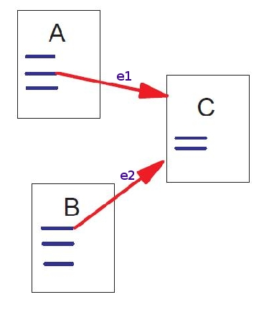
Link Structure of the Web
Forward links (outedges) Backlinks (inedges)
e1 and e2 are Backlinks of C
e1 is forward link of A
We can never know all the backlinks of a page, but we know all of its forward links (once we download it)
The more backlinks, the more important the page
Notes:
모든 page는 forward link와 back link를 가지고 있습니다.
그림을 보면 e1, e2는 C의 back link이고
E1은 A의 forward link인 것을 알 수 있습니다.
모든 back link를 알 수 는 없으나 모든 page를 다운로드 한 후에는 모든 forward link를 알 수 있기 때문에 back link도 알 수 있습니다.
학술인용에서 처럼 back link가 많으면 더 중요한 page가 될 수 있습니다.
한술 인용에서도 인용의 횟수를 세는 단순한 방법이 미래의 노벨상 수상자를 예측하는데 사용될 수 있습니다.
페이지 랭크는 더 정교한 방법을 제시합니다.
단순히 인용횟수가 일반적인 의미의 중요성과 일치하지 않는 경우가 많기 때문입니다. 예를 들어서, 어떤 페이지가 야후에 링크가 되어 있다면 그 페이지는 오직 하나의 back link밖에 없지만
그 링크는 매우 중요한 링크입니다.
이 야후 에 링크된 페이지는 다른 별볼일 없는 여러 곳에서 링크된 페이지보다 더 높은 순위를 가져야 합니다.

Slide 5
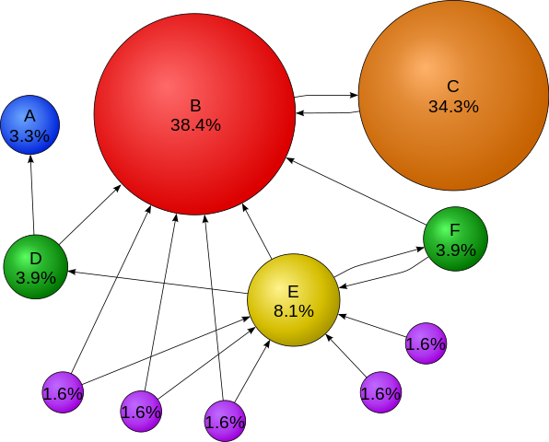
Link Structure of the Web
Notes:
이 그래프가 이해를 도울 수 있습니다.
C를 보면 back link가 B로부터 한 개만 있지만 Page Rank값이 굉장히 높은 것을 알 수 있습니다.

Slide 6
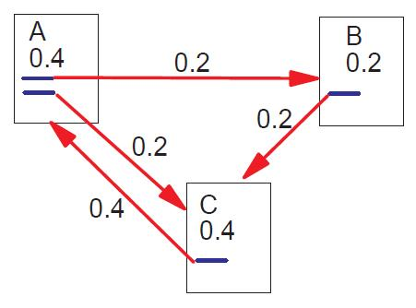
Simplified PageRank
Innovation: backlinks from high-rated pages are very important!
A page with N outlinks redistributes its rank to the N successor nodes
A page has high rank if the sum of the ranks of its backlinks is high

Slide 7
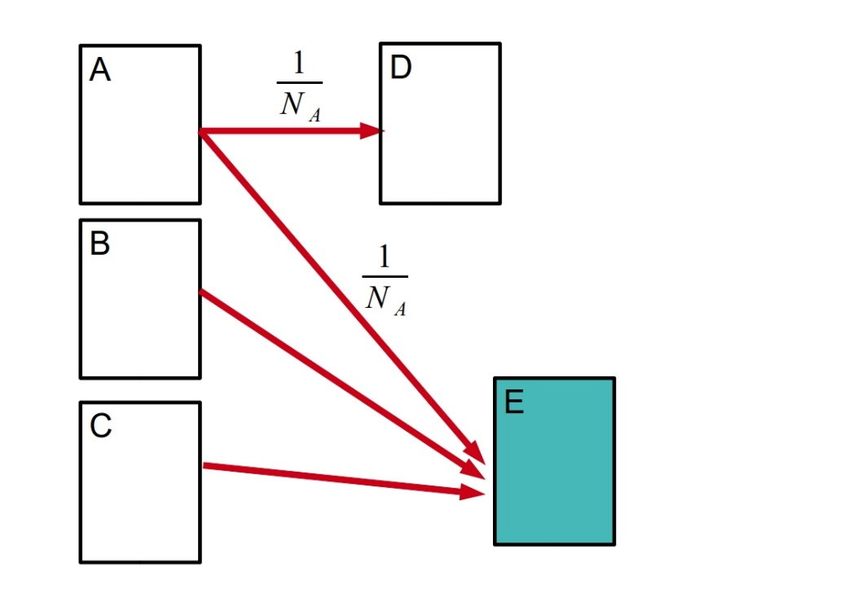
Simplified PageRank (equations)
v
u

Slide 8
Simplified PageRank (equations)

Slide 9
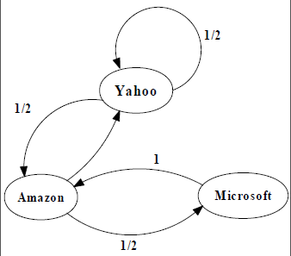
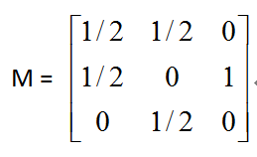
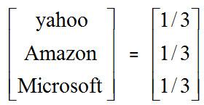
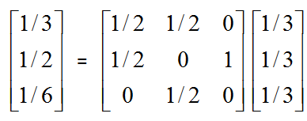
An example of Simplified PageRank
A
PageRank Calculation: first iteration

Slide 10
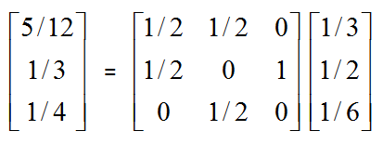
An example of Simplified PageRank
A
PageRank Calculation: second iteration

Slide 11
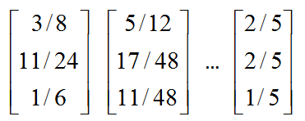
An example of Simplified PageRank
A
Convergence after some iterations

Slide 12
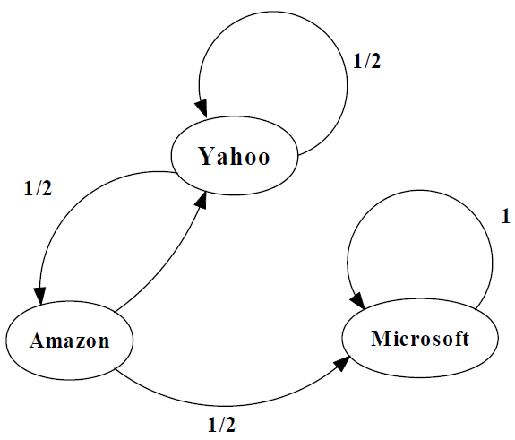
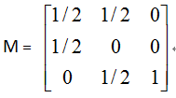
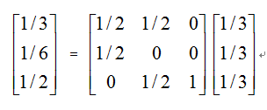
An example of the Problem
A

Slide 13
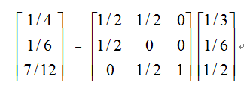
An example of the Problem
A

Slide 14
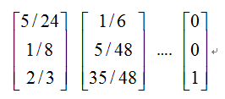
An example of the Problem
A

Slide 15
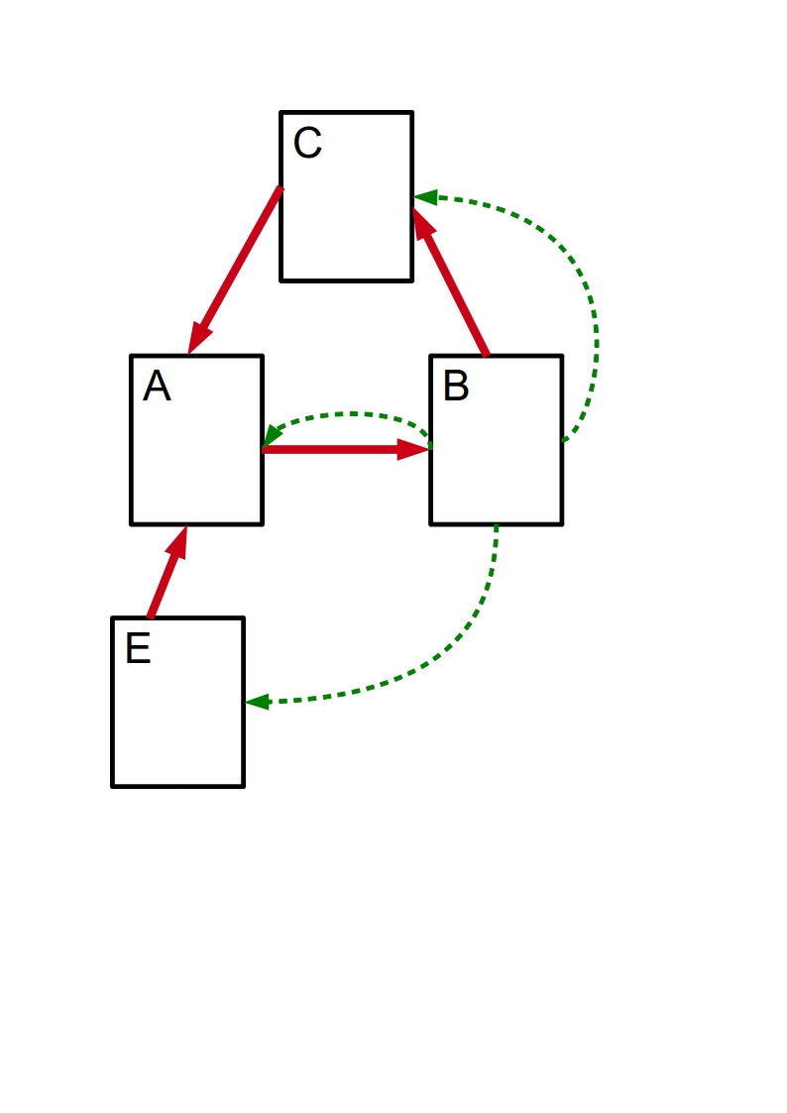
Problem 1 : Rank Sink
Problem:
A, B and C pages form a loop that accumulates rank (rank sink)
Solution:
Random Surfer Model
jump to a random page based on some distribution E (rank source)
Notes:
Radom surfer model
Keep clicking on successive links at random
It is unlikely that surfer will continue in the loop forever, the surfer will jump to some other page

Slide 16
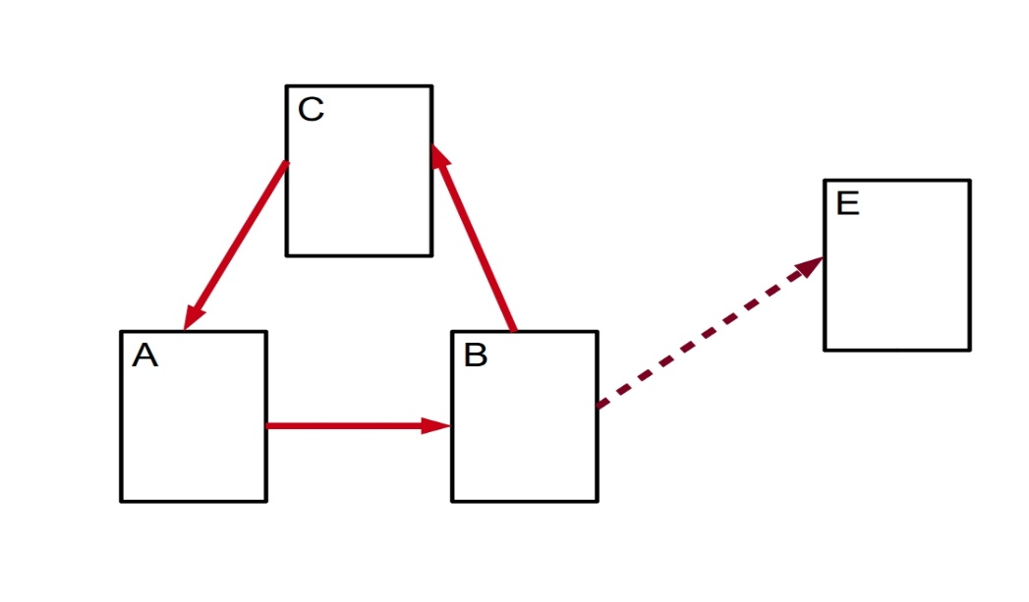
Problem 2 : Dangling Links
Dangling links:
links that point to any page with no outgoing links or
pages not downloaded yet
Problem : how to distribute their weight
Solution : they are removed from the system until all the PageRanks are calculated. Afterwards, they are added in without affecting things significantly

Slide 17
PageRank (equations)
E : distribution over pages
Democratic PageRank
uniform over all pages with
d: damping factor (usually equal to 0.85)
Pages with many related links end up with high rating
Personalized PageRank
default or user's home page
Notes:
D: ‘어떤 마구잡이로 웹서핑을 하는 사람이 그 페이지에 만족을 못하고 다른 페이지로 가는 링크를 클릭할 확률‘이다.

Slide 18
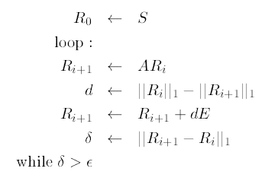
Computing PageRank
S: any vector over the web pages
Calculate the Ri+1 vector using Ri
Find the norm of the difference of 2 vectors
Loop until convergence

Slide 19
Quick overview
Have talked about:
Web as a graph
Why need page ranking
PageRank Algorithm
What's next?
Actual implementation
Testing on search engines
Applications
Web traffic estimation
Pagerank proxy

Slide 20
Implementation
Web crawler and indexer – 24 million pages, 75 million hyperlinks
Input: each link as unique ID in database
Method:
Sort by parent ID;
Remove dangling links;
Assign initial ranks;
Start iterating PageRank;
After convergence add back dangling links;
Recompute rankings.
Output: a rank for each link in the database
Notes:
24백만
75백만

Slide 21
Implementation - 2
Memory constraints
300 MB for ranks of 75 million URLs
Need both current ranks and previous ranks
Current ranks in memory
Previous ranks and matrix A on disk
Linear access to database, since it is sorted
Time span: 5 hours for 75 million URLs
Could converge faster if efficient initialization

Slide 22
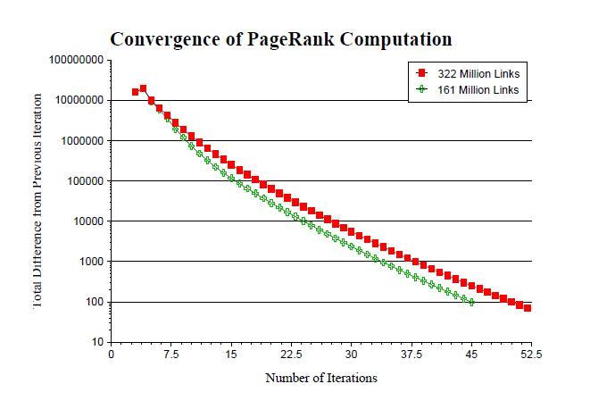
Convergence
Fast
Scales well
Because web is expander-like graph
Notes:
[Nielsen2005] - “Introduction to expander graphs”, M. A. Nielsen, 2005

Slide 23
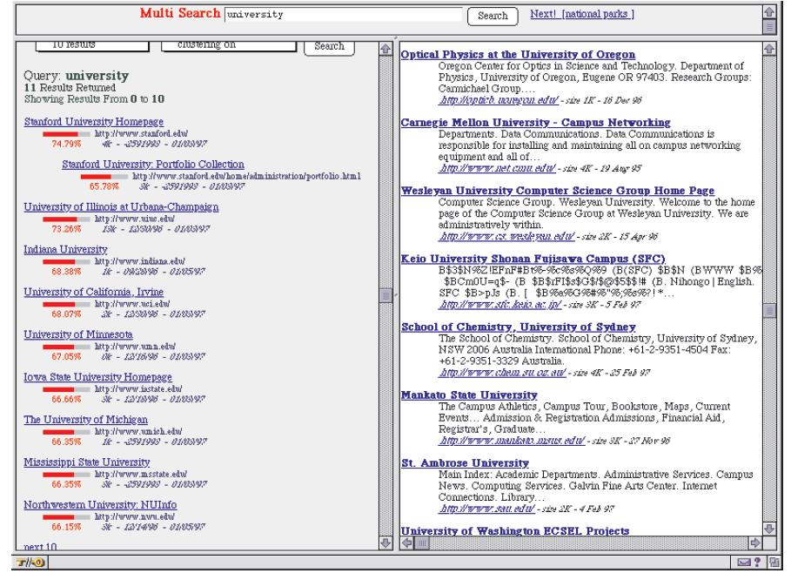
Testing on search engines – Title Search

Slide 24
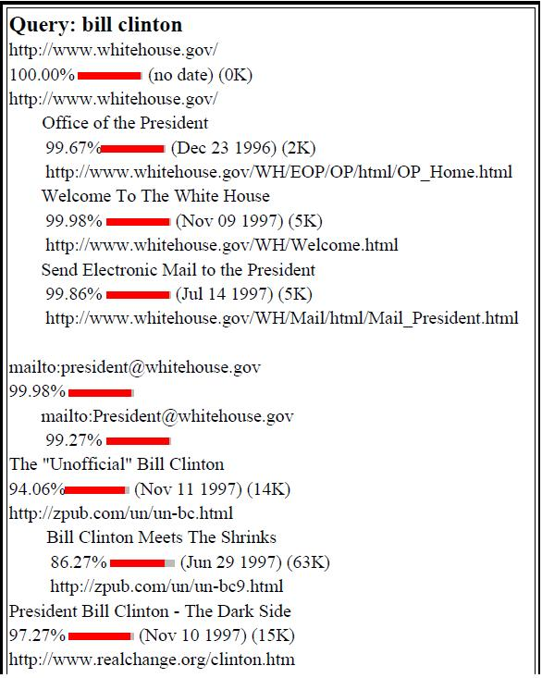
Testing on search engines - Google
Good quality pages
No broken links
Relevant results
Source: [Brin98]

Slide 25
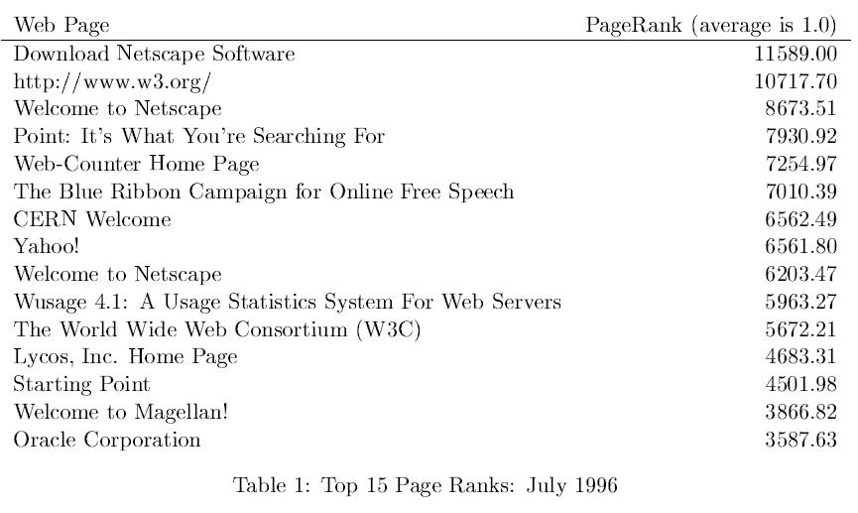
Testing on search engines

Slide 26
Applications- Web traffic & PageRank
Web traffic & PageRank
Some highly accessed web pages have low page rank because
People do not want to link to these pages from their own web pages (the example in their paper is pornographic sites…)
Some important backlinks are omitted
-> use usage data as a start vector for PageRank.
Notes:
PageRank가 실제 사용도와 어떻게 대응되는지 알아보기 위해서
프록시 캐쉬로부터 얻은 웹페이지의 접근 횟수를 페이지랭크와 비교해보았습니다.
흥미로운 트렌드는
케쉬데이터에서는 포르노그래프 사이트들이 높은 사용도를 보였음에도 이들의 페이지랭크 값은 대부분 낮았습니다.
사람들이 보고싶어 하지만 자신의 웹페이지에서는 언급하고 싶어 하지 않는게 어떤것인지 알 수 있었다고 하였습니다.
또한, 야후와 네스케이프의 경우 매우 높은 사용도를 갖지만 그것에 비해 페이지랭크는 낮은 경우가 있었습니다. 이것은
중요한 banklink가 누락되었기 때문인 것 같다고 하였습니다.

Slide 27
Applications – proxy
Annotates each link with its PageRank to help users decide which is more relevant
Useful because user receive information about link before they click
Other uses
Competition
Keep track of significant backlinks of competition has
Trustworthy
Directly cited from Stanford hompage

Slide 28
Conclusions
PageRank describes the behavior of an average web user
Fast computation even in 1998
Although famous, the paper is unclear about the actual computation of PageRank.
No statistical results for the tests
References:
[Brin98] - “The Anatomy of a Large-Scale Hypertextual Web Search Engine”, Sergey Brin, Lawrence Page, 1998
[Nielsen2005] - “Introduction to expander graphs”, M. A. Nielsen, 2005
Patent ?
Notes:
the patent is assigned to Stanford Universityand not to Google.
Google has exclusive license rights on the patent from Stanford University.
전용실시권
독점적·배타적으로 실시할 수 있는 권리
The university received 1.8 million shares of Google in exchange for use of the patent
the shares were sold in 2005 for $336 million (1억3천6백만달라)

Slide 29
PageRank Example
A= 1 2 3 4
1 0 0 0 0
2 1/3 0 0 0
3 1/3 1/2 0 1
4 1/3 1/2 1 0
Rank 1: URL 4 has PageRank value 0.4571875
Rank 2: URL 3 has PageRank value 0.4571875
Rank 3: URL 2 has PageRank value 0.048125000000000015
Rank 4: URL 1 has PageRank value 0.037500000000000006
1
3
2
4

Slide 30
Convergence Properties
Expander graph = graph where any (not too large) subset of nodes is linked to a larger neighboring subset;
The web is an expander-like graph!
PageRank <=> Random walk <=> Markov Chain.
For expander graphs: p' = A/d * p
Markov Chain with uniform distrib = stationary distribution converges exponentially quickly to uniform distribution
[Nielsen2005]
Rapidly mixing random walk = quick convergence to a limiting distribution on the set of nodes in the graph;
The PageRank of a node = the limiting probability that the random walk will be at that node after a sufficiently large time

