Slide 1
Stream Sampling for Frequency Cap Statistics
Edith Cohen
Google Research, CA, USA, Tel Aviv University, Israel
KDD’15
2016.2.12
Hyesung Oh(Some slides from author)
Notes:
Knowledge Discovery and Data Mining

Slide 2
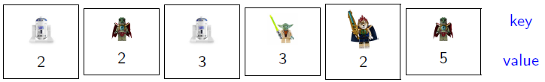
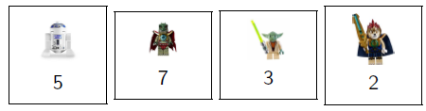
Data Model
Data elements ( x, w ) have a key x and a numeric value w > 0
Elements are streamed or distributed, no particular order / partition
“Unaggregated” : Multiple elements can have the same key
“Aggregated” : Elements have unique keys
Queries are typically specified over the aggregated view
element

Slide 3
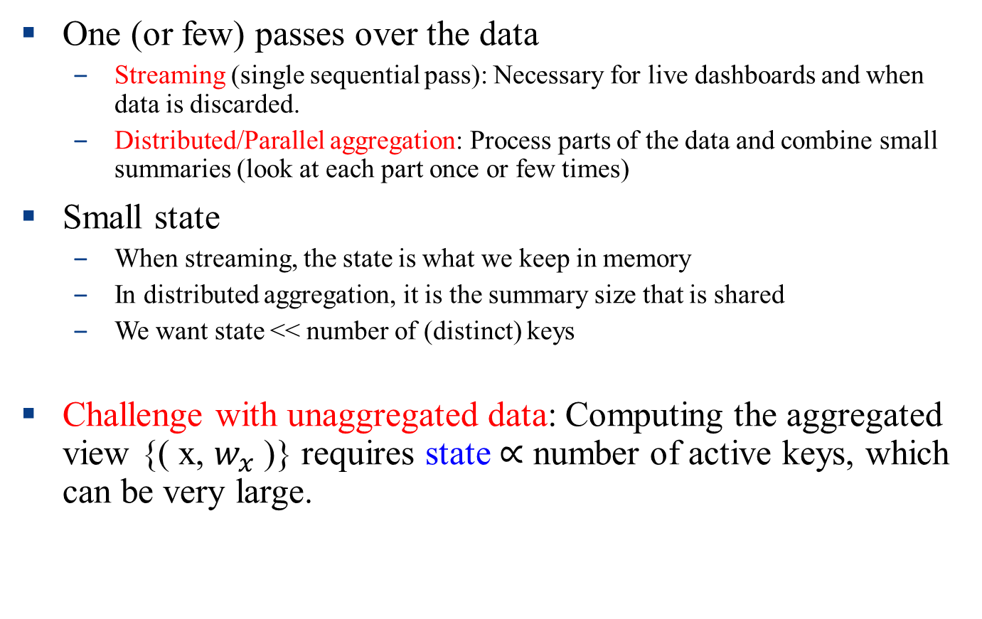
Scalable Computation
One (or few) passes over the data
Streaming (single sequential pass): Necessary for live dashboards and when data is discarded.
Distributed/Parallel aggregation: Process parts of the data and combine small summaries (look at each part once or few times)
Small state
When streaming, the state is what we keep in memory
In distributed aggregation, it is the summary size that is shared
We want state << number of (distinct) keys
Challenge with unaggregated data: Computing the aggregated view {( x, $w_{x}$ )} requires state $∝$ number of active keys, which can be very large.

Slide 4
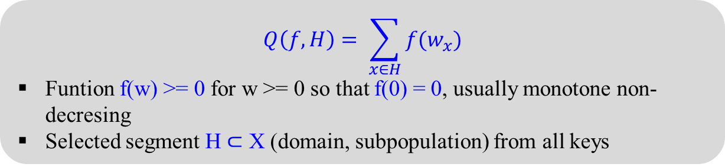
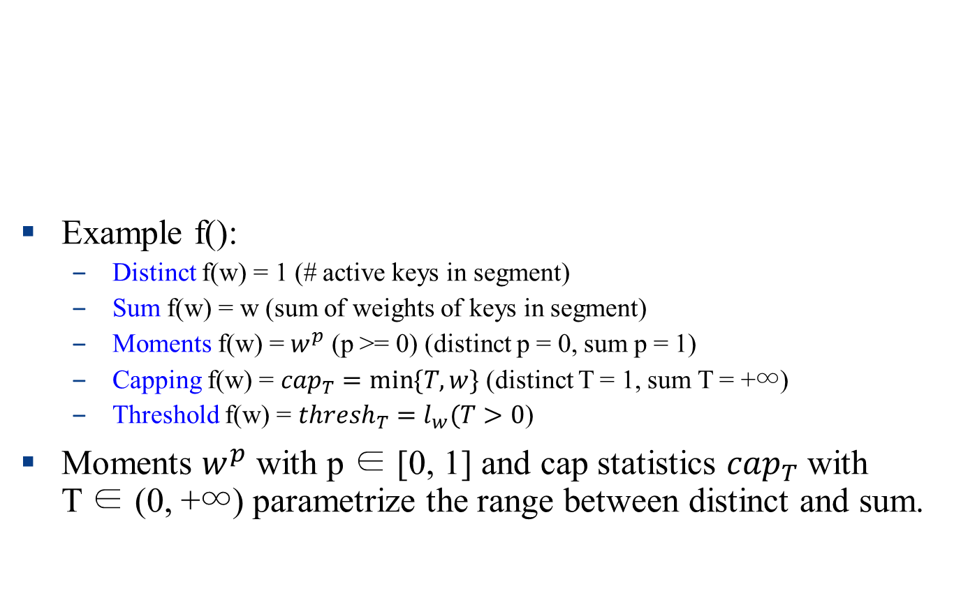
Frequency statistics
Example f():
Distinct f(w) = 1 (# active keys in segment)
Sum f(w) = w (sum of weights of keys in segment)
Moments f(w) = $w^{p}$ (p >= 0) (distinct p = 0, sum p = 1)
Capping f(w) = ${cap}_{T}=min⁡\{T,w\}$ (distinct T = 1, sum T = +∞)
Threshold f(w) = ${thresh}_{T}=l_{w}(T>0$)
Moments $w^{p}$ with p ∈ [0, 1] and cap statistics ${cap}_{T}$ with T ∈ (0, +∞) parametrize the range between distinct and sum.
$$Q\left(f, H\right)= \sum_{x∈H}{f(w_{x})}$$
Funtion f(w) >= 0 for w >= 0 so that f(0) = 0, usually monotone non-decresing
Selected segment H $⊂$ X (domain, subpopulation) from all keys

Slide 5
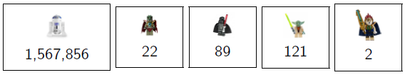
Use case for frequency capping: Online advertising
The first few impressions of the same ad per user are more effective than later ones (diminishing return).
A segment of users (based on geography, demographics, other)
Cap T on the number of impressions per user per time period.
Q: targeted segment: galactic-scale travelers cap: 5
Answer (number of qualifying impressions): 15
Q: targeted segment: non-human intelligent life cap: 3
Answer (number of qualifying impressions): 8

Slide 6
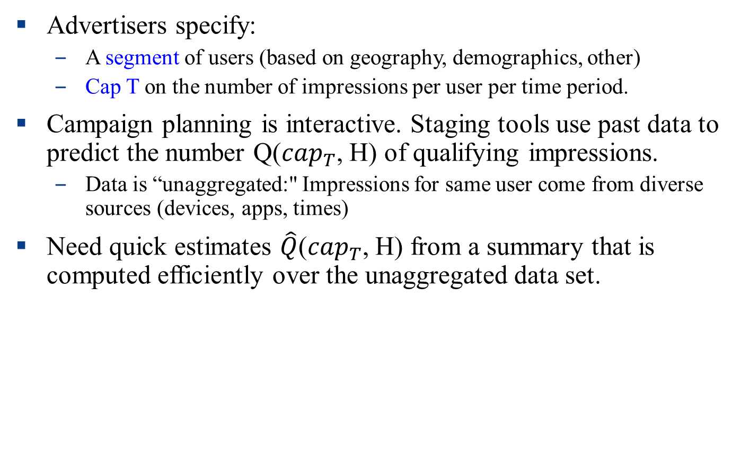
Use case for frequency capping: Online advertising
Advertisers specify:
A segment of users (based on geography, demographics, other)
Cap T on the number of impressions per user per time period.
Campaign planning is interactive. Staging tools use past data to predict the number Q(${cap}_{T}$, H) of qualifying impressions.
Data is “unaggregated:" Impressions for same user come from diverse sources (devices, apps, times)
Need quick estimates $\hat{Q}$(${cap}_{T}$, H) from a summary that is computed efficiently over the unaggregated data set.

Slide 7
Frequency statistics challenges
Multi-objective sample (un)aggregated data: For a set of functions F, compute a summary/sample from which we can estimate Q(f, H) for various f ∈ F, H ⊆ X.
Weighted sample unaggregated data: For a given f , compute a summary/sample from which we can estimate Q(f, H) for various H
Basic: estimate Q(f, H) for given f, H ⊆ X.
Goals: 1. Optimize tradeoffs of sample quality (statistical guarantees) and size. 2. Scalable computation.
Plan for this talk:
Aggregated data sets: Review the “gold standard" Sample size/ estimation quality tradeoffs. Multi-objective sampling scheme for all monotone (non-decreasing) f . [Coh15b]
Unaggregated data sets: How to sample effectively without aggregation for capping statistics (and more) [Coh15c]

Slide 8
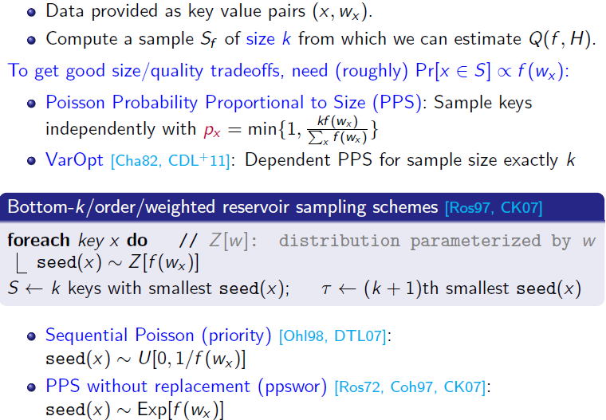
Aggregated data: Weighted sampling schemes

Slide 9
Toolbox for frequency functions on unaggregated streams
Deterministic algorithms: Misra Gries: [MG82] Space saving [MAEA05] for heavy hitters
Random linear projections (linear sketches): Project vector of key values to a vector with logarithmic dimension. JL transform [JL84] and stable distributions [Ind01] for frequency moments p ∈ [0, 2].
Sampling-based : Distinct Reservoir Sampling [Knu68] and MinHash sketches [FM85, Coh97] (distinct statistics), Sample and Hold [GM98, EV02, CDK+14] (sum statistics)
No previous solutions for general capping statistics.

Slide 10
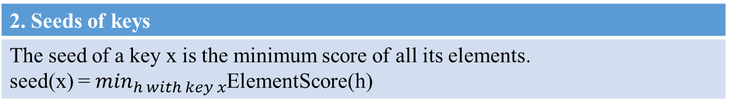
Sampling framework for unaggregated data
Unifies classic schemes for distinct or sum statistics, generalizes bottom-k
Properties of ElementScore: Distribution depends only on x and w. Can be dependent for same key, independent for different keys.
1. Scores of elements
Scheme is specified by a random mapping ElementScore(h) of elements h = (x, w) to a numeric score.
2. Seeds of keys
The seed of a key x is the minimum score of all its elements. seed(x) = $\min_{h with key x}$ElementScore(h)
3. Sample (S, τ )
S <- the k keys with smallest seed(x) (and their seed values) τ <- the (k + 1)st smallest seed value.

Slide 11
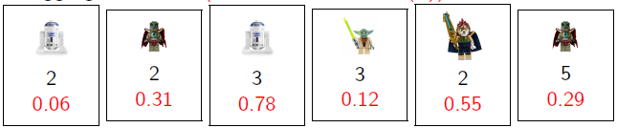
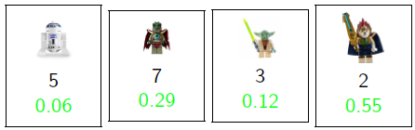
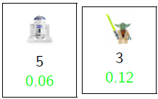

Sampling unaggregated data: Example
Unaggregated data: (with ElementScore(h))
The aggregated view:
with seed(x)
Sample of size k = 2: $τ$ = 0.29

Slide 12
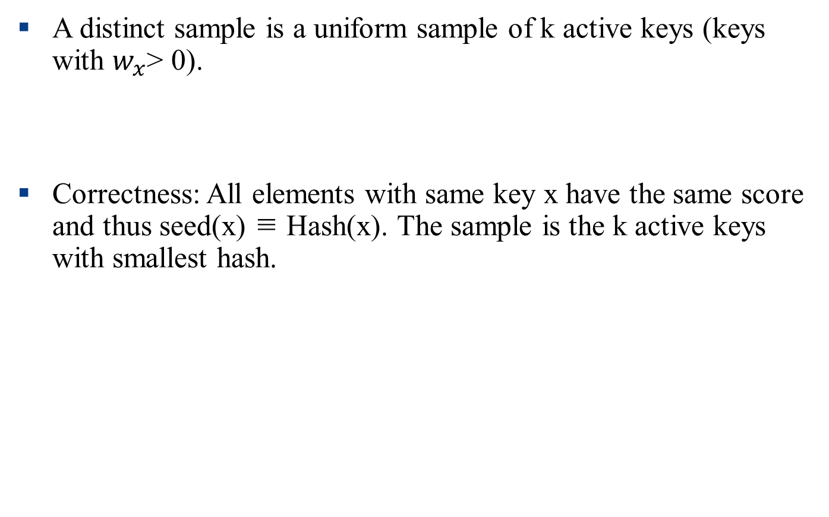
Distinct sampling, casted in our framework
A distinct sample is a uniform sample of k active keys (keys with $w_{x}$> 0).
Correctness: All elements with same key x have the same score and thus seed(x) ≡ Hash(x). The sample is the k active keys with smallest hash.
Scoring for distinct sampling
ElementScore(h) = Hash(x), for random hash Hash(x) ∼ U[0, 1]

Slide 13

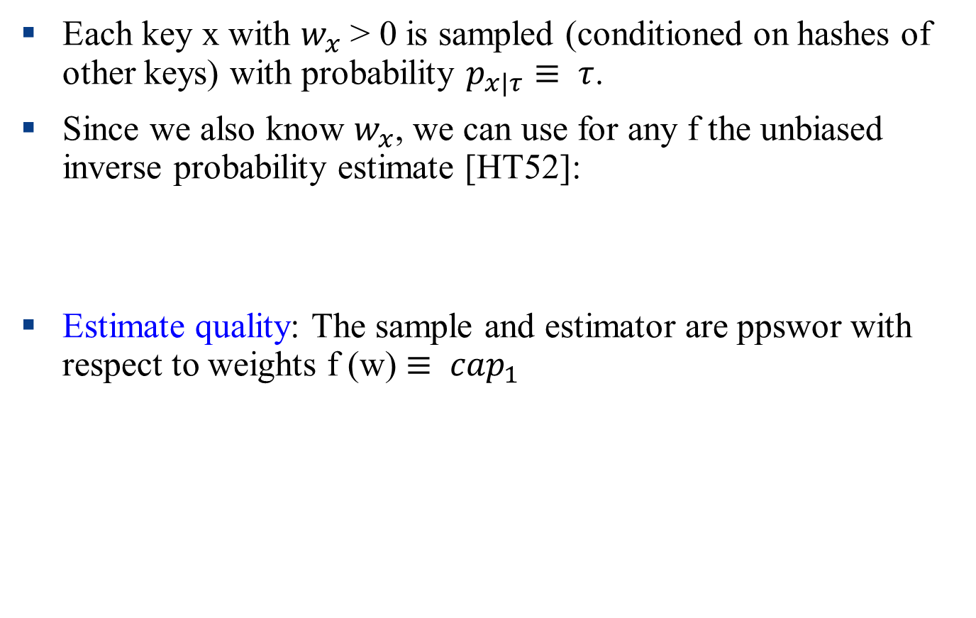
Estimation from a distinct sample
Each key x with $w_{x}$ > 0 is sampled (conditioned on hashes of other keys) with probability $p_{x|τ}≡ τ$.
Since we also know $w_{x}$, we can use for any f the unbiased inverse probability estimate [HT52]:
Estimate quality: The sample and estimator are ppswor with respect to weights f (w) $≡ {cap}_{1}$

Slide 14
Sampling for sum statistics
Sample and Hold (counting samples) [GM98, EV02]:
Can be used with a fixed-size sample k; Equivalent to ppswor [CDK+14];
Continuous version (element weights) [CCD11].
Sample and Hold casted in our framework:
The minimum of independent exponential random variables is an exponential random variable with a parameter that is the sum of their parameters. We get
If x ∈ S, increment $c_{x}$ . Otherwise, cache if rand() < τ .
Element scoring function
ElementScore(h=(x,w)) ∼ Exp[w]

Slide 15
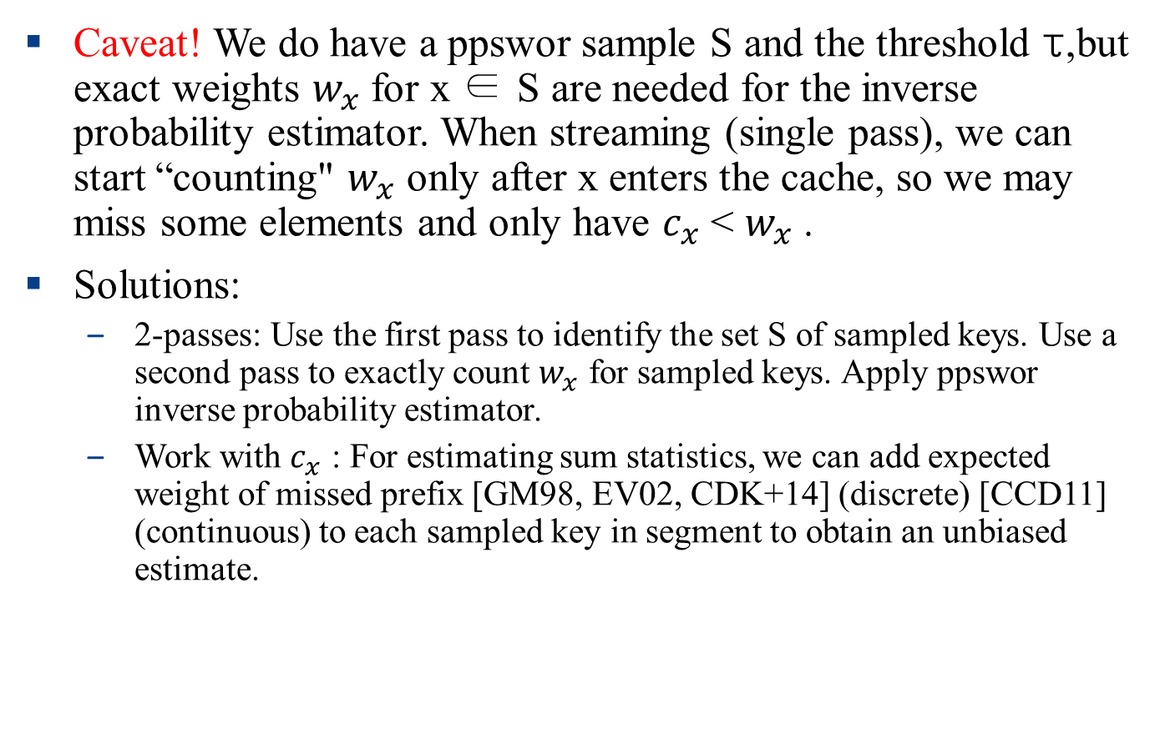
Unaggregated data: Estimating sum statistics from ppswor
Caveat! We do have a ppswor sample S and the threshold τ,but exact weights $w_{x}$ for x ∈ S are needed for the inverse probability estimator. When streaming (single pass), we can start “counting" $w_{x}$ only after x enters the cache, so we may miss some elements and only have $c_{x}$ < $w_{x}$ .
Solutions:
2-passes: Use the first pass to identify the set S of sampled keys. Use a second pass to exactly count $w_{x}$ for sampled keys. Apply ppswor inverse probability estimator.
Work with $c_{x}$ : For estimating sum statistics, we can add expected weight of missed prefix [GM98, EV02, CDK+14] (discrete) [CCD11] (continuous) to each sampled key in segment to obtain an unbiased estimate.

Slide 16
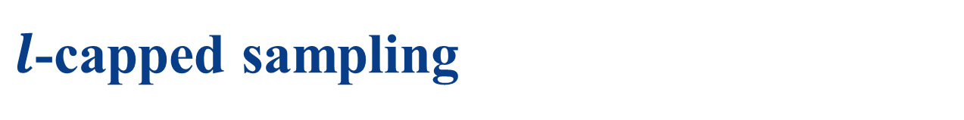
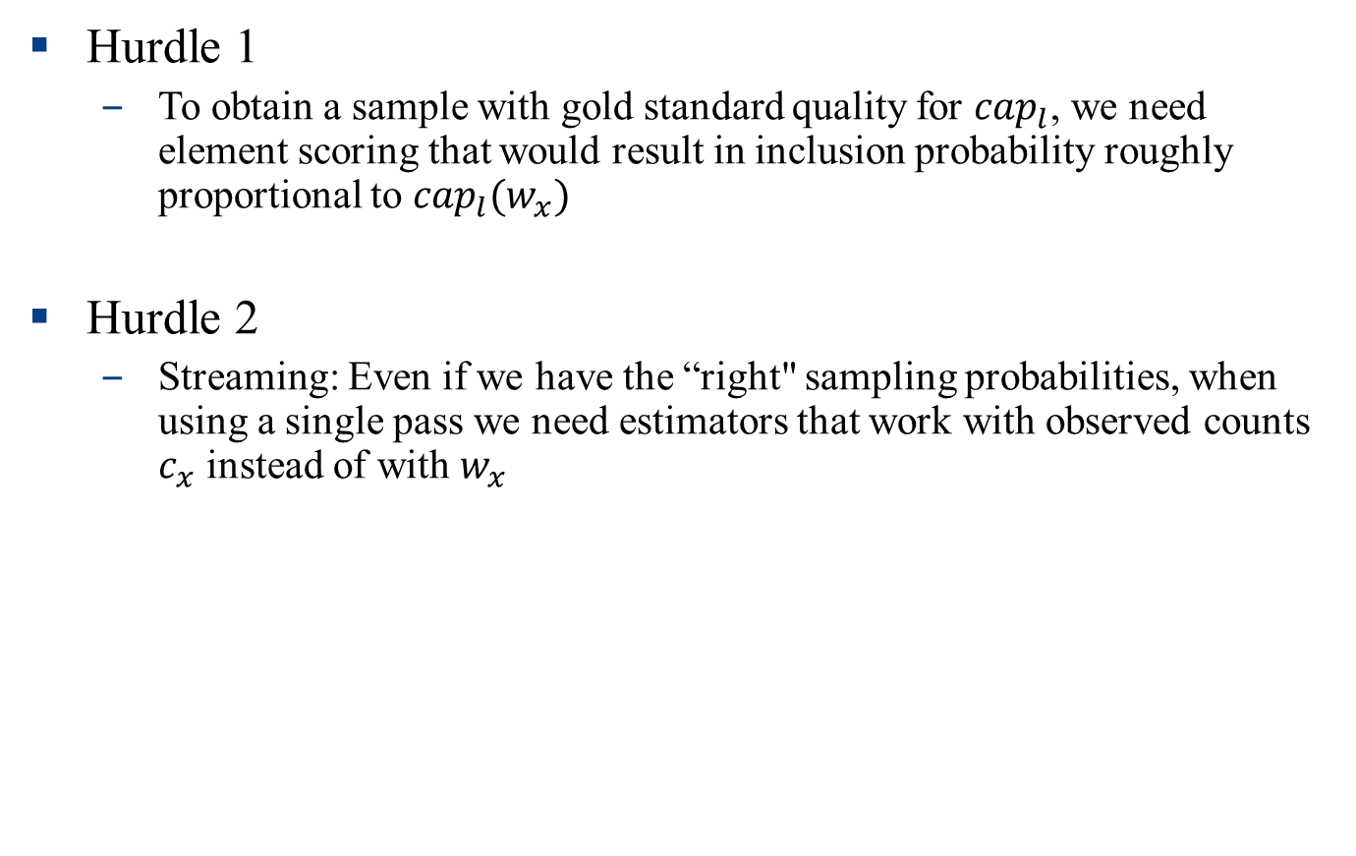
$l$-capped sampling
Hurdle 1
To obtain a sample with gold standard quality for ${cap}_{l}$, we need element scoring that would result in inclusion probability roughly proportional to ${cap}_{l}(w_{x})$
Hurdle 2
Streaming: Even if we have the “right" sampling probabilities, when using a single pass we need estimators that work with observed counts $c_{x}$ instead of with $w_{x}$

Slide 17
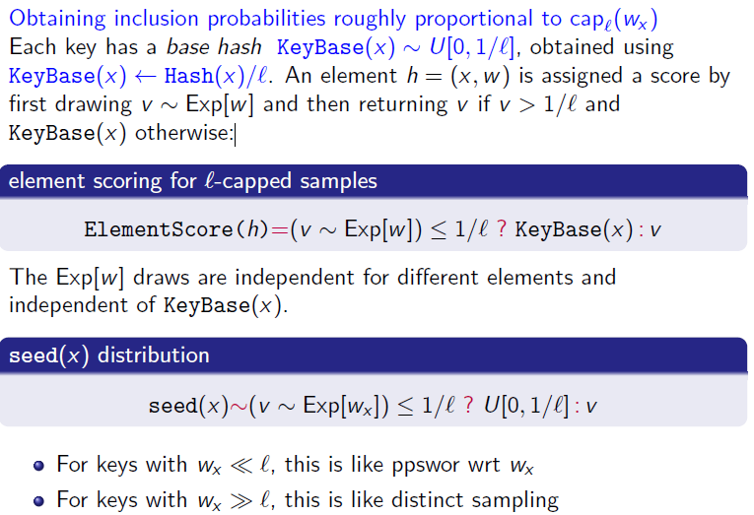
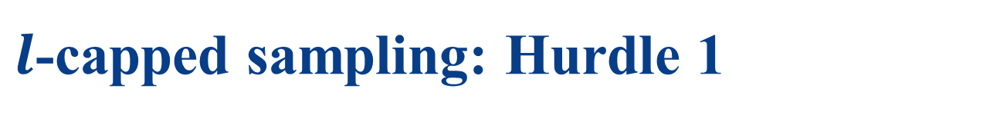
$l$-capped sampling: Hurdle 1

Slide 18
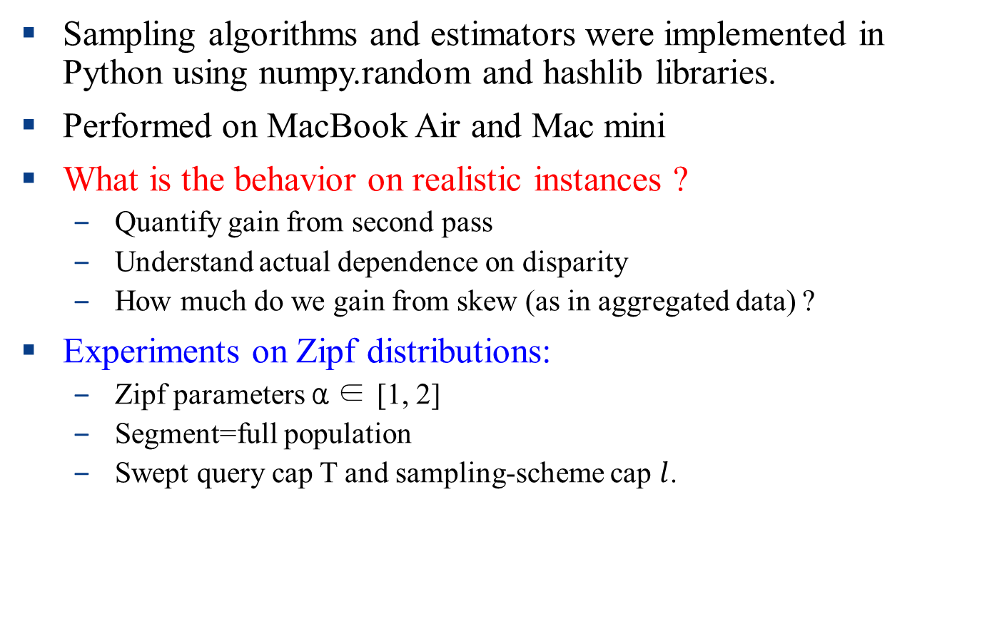
Simulations
Sampling algorithms and estimators were implemented in Python using numpy.random and hashlib libraries.
Performed on MacBook Air and Mac mini
What is the behavior on realistic instances ?
Quantify gain from second pass
Understand actual dependence on disparity
How much do we gain from skew (as in aggregated data) ?
Experiments on Zipf distributions:
Zipf parameters α ∈ [1, 2]
Segment=full population
Swept query cap T and sampling-scheme cap $l$.
Notes:
Disparity – 차이(불공평성)

Slide 19
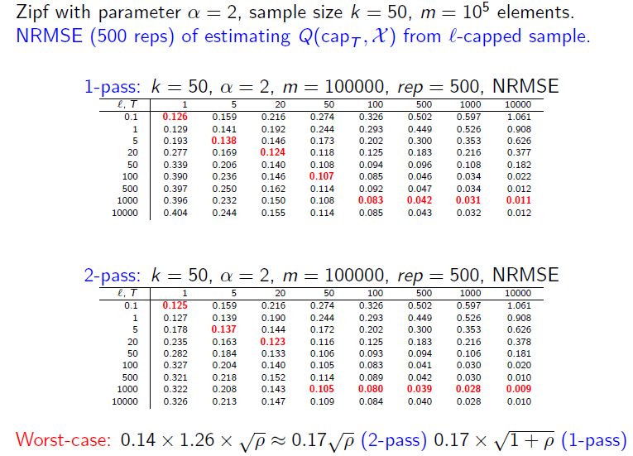

Simulation Results for $l$-capped samples

Slide 20
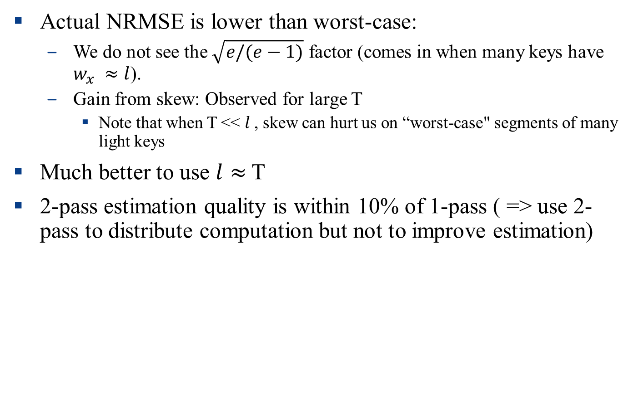
Observations from Simulations
Actual NRMSE is lower than worst-case:
We do not see the $\sqrt{e/(e−1)}$ factor (comes in when many keys have $w_{x} ≈l$).
Gain from skew: Observed for large T
Note that when T << $l$, skew can hurt us on “worst-case" segments of many light keys
Much better to use $l≈$ T
2-pass estimation quality is within 10% of 1-pass ( => use 2-pass to distribute computation but not to improve estimation)

Slide 21

Conclusion
Summary:
Aggregated data: Optimal multi-objective sampling scheme for all
monotone f
Unaggregated data: Sampling framework which unifies and extends
classic solutions for distinct and sum statistics.
First solution for mid-range ${cap}_{T}$ statistics, nearly matches aggregated gold standard.

