Slide 1
Characteristic Sets: Accurate Cardinality Estimation for RDF Queries with Multiple Joins
Thomas Neumann¹, Guido Moerkotte²
¹Technische Universitat Munchen
² Universitat Mannheim
ICDE 2011
Presented by Kisung Kim
2011. 7. 6

Slide 2
Outline
Introduction
The Challenge
Characteristic Sets
Evaluation
Conclusions

Slide 3
Introduction
Cardinality
The number of results(rows) of one operator
SQL
SELECT * FROM
T1 a, T2 b, T1 c
WHERE
a.c1 = b.c2 AND b.c1 = c.c1 AND
a.c2 < 100 AND c.c2 > 500
Execution Plan ---------------------------------------------------------- Plan hash value: 2438444873 ---------------------------------------------------------------------------- | Id | Operation | Name | Rows | Bytes | Cost (%CPU)| Time | ---------------------------------------------------------------------------- | 0 | SELECT STATEMENT | | 49 | 3822 | 10 (10)| 00:00:01 | |* 1 | HASH JOIN | | 49 | 3822 | 10 (10)| 00:00:01 | |* 2 | HASH JOIN | | 98 | 5096 | 7 (15)| 00:00:01 | |* 3 | TABLE ACCESS FULL| T1 | 98 | 2548 | 3 (0)| 00:00:01 | | 4 | TABLE ACCESS FULL| T2 | 999 | 25974 | 3 (0)| 00:00:01 | |* 5 | TABLE ACCESS FULL | T1 | 500 | 13000 | 3 (0)| 00:00:01 | ---------------------------------------------------------------------------- Predicate Information (identified by operation id): --------------------------------------------------- 1 - access("B"."C1"="C"."C1") 2 - access("A"."C1"="B"."C2") 3 - filter("A"."C2"<100) 5 - filter("C"."C2">500) Note ----- - dynamic sampling used for this statement (level=2)
HashJoin
HashJoin
T1 (C2>500)
T1 (C2<100)
T2

Slide 4
Introduction
Why cardinalities matter?
QC(query optimizer) make a choice based on cardinalities which making the execution plan of a query
Things for QC to decide
Type of operator
Join ordering
…

Slide 5
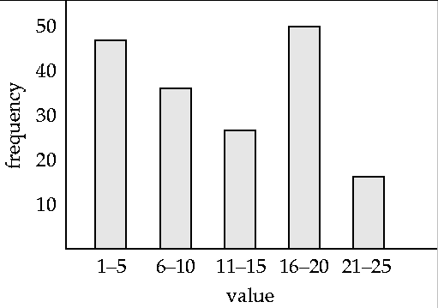
Introduction
Relational databases use various techniques to estimate cardinalities
Histograms
Dynamic sampling
How many rows have
C < 15?
C
Histogram

Slide 6
Introduction
Accurate cardinality estimates are also vital for a successful query optimization for RDF/SPARQL
Characteristic sets
A novel synopsis for RDF star joins
RDF star queries are quite common
?title
?author
title
author
?book
year
publisher
?year
?publisher

Slide 7
Related Work
Cardinality estimation
Y.E.Ioannidis, “The history of histograms”, VLDB 2003
Specialized histograms for RDF data
T.Neumann and G. Wiekum, “Scalable join processing on very large RDF graphs”, SIGMOD 2009
Still has issues in the presence of correlated predicates
Jena ARQ optimizer
M.Stoker, et al., “SPARQL basic graph pattern optimization using selectivity estimation”, WWW 2008
Use single attribute synopsis for individual patterns
Assume independence between tuple attributes
Graph summarization
A. Maduko, et al., “Graph summaries for subgraph frequency estimation”, ESWC 2008
Compute the frequency of subgraphs up to a given size

Slide 8
Correlation
sel(P=isCitizenOf)=10/100, sel(O=United_States)=10/100
Cardinality(<?S, isCitizenOf, United_States>) ?
100 triples
100 triples
<~~, ~~, United_States>
…
<person1, isCitizenOf, Canada>
<person2, isCitizenOf, United_States>
<person3, isCitizenOf, Japan>
…
<person10, isCitizenOf, England>
…
<~~, ~~, United_States>
…
<person1, isCitizenOf, United_States>
<person2, isCitizenOf, United_States>
<person3, isCitizenOf, United_States>
…
<person10, isCitizenOf, United_States>
…
Independence between P=isCitizenOF
and O=United_States
Correlation between P=isCitizenOF
and O=United_States
100 X 0.1 X 0.1 = 1
100 X 0.1 X 0.1 = 1 << 10

Slide 9
Challenge
Correlated predicates are not an exception but the rule
P=isCitizenOf and O=United_States are correlated
Nearly half of the triples with P=isCitizenOf has United_States as the object
(?a, <isCitizenOf>, <United_States>)
sel(P=isCitizenOf) sel(O=United_States) | 1.06*10⁻⁴ 6.41*10⁻⁴
sel(P=isCitizenOf˄O=United_States) | 4.86*10⁻⁵
sel(P=isCitizenOf) * sel(O=United_States) | 6.80*10⁻⁸

Slide 10
Challenge
RDF star query
?title
?author
title
author
?book
year
publisher
?year
?publisher
sel(P=title) X sel(P=year) X sel(P=author) X sel(P=publisher)
Most of RDF systems assume independence between predicates
➔ Vastly underestimate

Slide 11
Characteristic Sets
Set of predicates of an entity(resource)
title1
author1
title
author
title2
author2
book1
title
author
year
publisher
book2
year1
year
publisher1
year2
title3
author3
title
author
S_{C}(book1)={title, author, year, publisher}
book3
S_{C}(book2)={title, author, year}
author
year
S_{C}(book3)={title, author, year, publisher}
publisher
author3
year3
publisher3

Slide 12
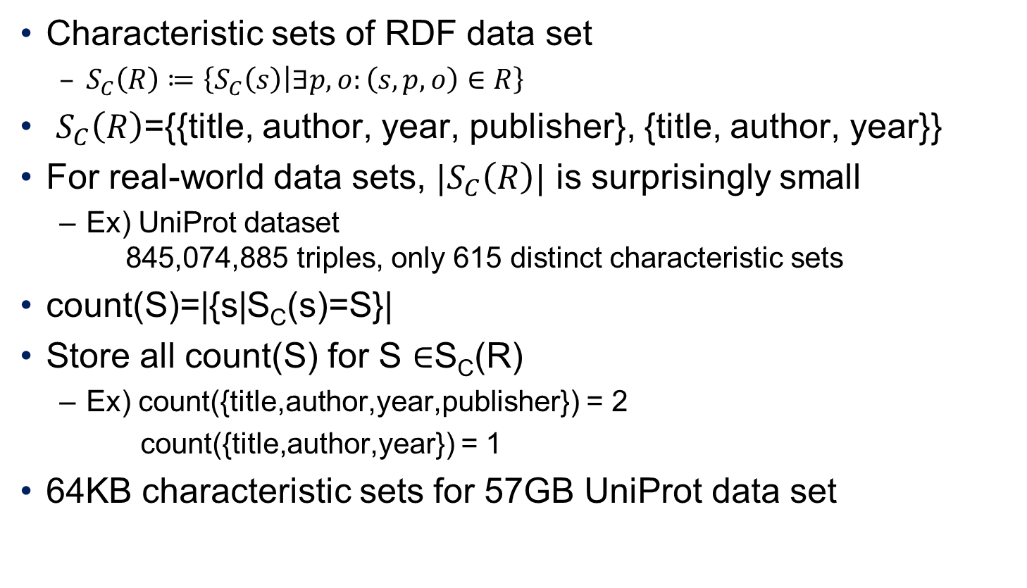
Characteristic Sets
Characteristic sets of RDF data set
$S_{C}\left(R\right)≔\left\{S_{C}\left(s\right) | ∃p,o:\left(s,p,o\right)∈R\right\}$
$S_{C}\left(R\right)$={{title, author, year, publisher}, {title, author, year}}
For real-world data sets, ${|S}_{C}\left(R\right)|$ is surprisingly small
Ex) UniProt dataset 845,074,885 triples, only 615 distinct characteristic sets
count(S)=|{s|S_{C}(s)=S}|
Store all count(S) for S $∈$S_{C}(R)
Ex) count({title,author,year,publisher}) = 2
count({title,author,year}) = 1
64KB characteristic sets for 57GB UniProt data set

Slide 13
Characteristic Sets
Query
count({title,author,year,publisher}) = 2
count({title,author,year}) = 1
?title
title
?book
year
Cardinality for ?book is 3
?year
Exact cardinality
S_{C}(?book)={title, year}

Slide 14
Occurrence Annotations
Query
count({title,author,year,publisher}) = 2
count({title,author,year}) = 1
?title
?author
title
author
?book
Estimated cardinality for ?book is 3
But real cardinality is 4
S_{C}(?book)={title, year}

Slide 15
Occurrence Annotations
title1
author1
author2
title2
title
author
title
author
book1
book2
year
publisher
year
year1
publisher1
year2
title3
author3
author
Result
book1
book2
book3
book3 (duplicate!)
title
book3
author
year
publisher
author3
year3
publisher3

Slide 16
Occurrence Annotations
count({title,author,year,publisher}) = 2, title:2, author:3, year:2, publisher:2
count({title,author,year}) = 1, title:1, author:1, year:1, publisher:1
Query
Result Cardinality
2 * 1 * 3/2 + 1* 1 * 1 = 3 + 1 = 4
?title
?author
title
author
?book
Each entity has 3/2 authors
Cardinality(distinct)
Each entity has 1 title
Not exact estimation

Slide 17
Queries with Bound Objects
First estimate the cardinality as if the objects were unbound
Then multiply with the selectivity of the objects
Query
Cardinality(?book) = Cardinality_unbound
X sel(O=The Tree and I|P=title)
X sel(O=R.Pecker|P=author)
The Tree and I
R.Pecker
title
author
?book
Assume there’re 1000 books with different titles and different authors
1000 X 1/1000 X 1/1000 = 10⁻⁶
Too Underestimated!

Slide 18
Queries with Bound Objects
Correlations between object values
Impossible to pre-compute the degree of correlation in full generality
Observations
Usually one predicate is extremely selective (similar to key)
The other predicates functionally follow from the selective one
Once the title of a book is fixed, restricting the authors has usually very little impact on the result cardinality

Slide 19
Queries with Bound Objects
Consider only the selectivity of the most selective value
Query
The Tree and I
R.Pecker
title
author
?book
Assume there’re 1000 books with different titles and different authors
1000 X 1/1000 X 1/1000 = 10⁻⁶
1000 X 1/1000 = 1

Slide 20
Evaluation
Compare with
Original RDF-3X estimator
Commercial database systems (DB A, DB B, DB C)
Stocker: Jena ARQ
Maduko: subgraph mining approach
Datasets
Yago
LibraryThing

Slide 21
Evaluation: Single Join Queries
Generate queries of the form (?S, p1, ?O1), (?S, p2, ?O2)
1,751 queries for YAGO
19,062,990 queries for LibraryThing
q-error: max(c/c’, c’/c) where c: correct cardinality and c’: the estimate
?S
p1
p2
?O1
?O2

Slide 22
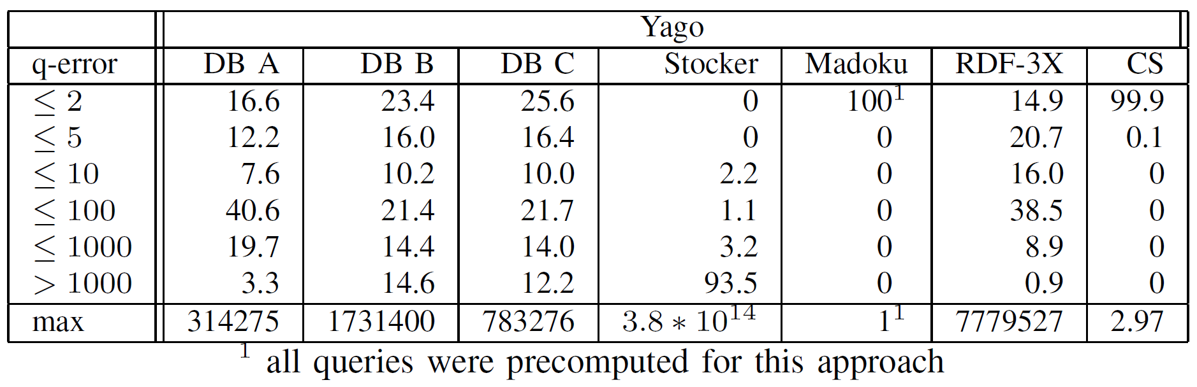
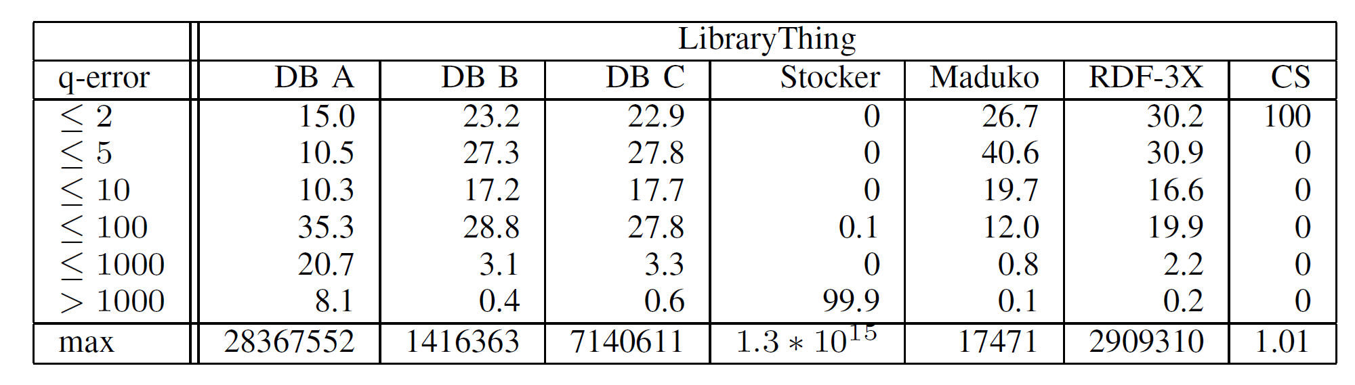
Evaluation: Single Join Queries
Commercial DBMSs, Stocker < Madoku, RDF-3X < CS

Slide 23
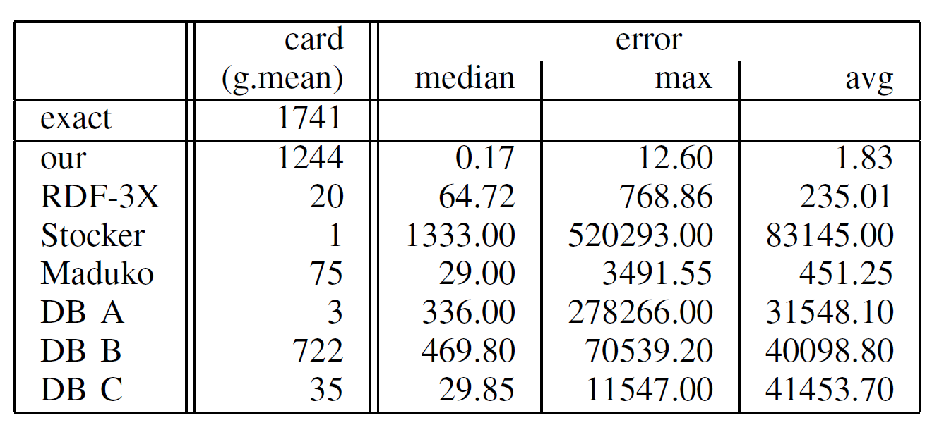
Evaluation: Complex Queries
Manually construct queries with up to 6 joins and including additional object constraints
CS perform very well with an average estimation error of 1.8
The other approaches tend to vastly underestimate
Cardinality Estimation Errors for YAGO Queries

Slide 24
Conclusions
Introduce a novel RDF synopsis called characteristic sets
The experiments have shown that CS greatly outperform both commercial database systems and other specialized RDF estimation techniques
CS gives positive impact on the runtime of execution plans

Slide 25
Thank You!
Any Questions or Comments?

