Slide 1
Personalized Tag Recommendation Using Social Influence
Jun Hu, Bing Wang, Yu Liu, and De-Yi Li
Journal of Computer Science and Technology, 27(3), 2012
29 Jan 2016
Hyewon Lim

Slide 2
Outline
Introduction
Data Collections
Measurement of User Influence in Social Network
Recommendation Framework
Evaluation
Conclusion

Slide 3

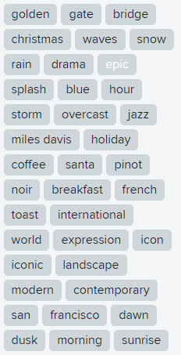
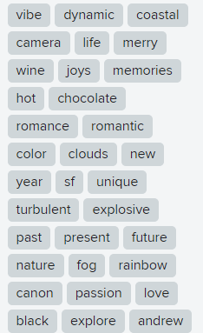
Introduction
Notes:
Bridging the semantic gap between human concepts

Slide 4
Introduction
Tag
Provide the semantic context through manual annotations
The same photo can be annotated by another user
It is possible to produce a different description
Need of tag recommendation
Users add very few tags or even none at all
Particular image is only tagged by a single user

Slide 5
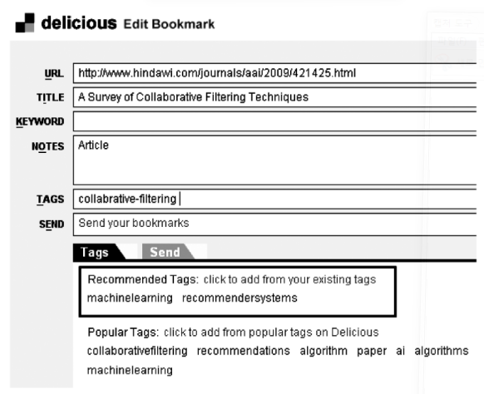

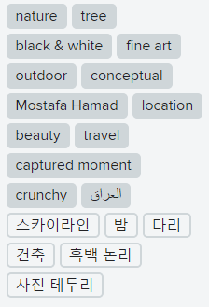
Introduction
Tag recommendation
Enriches the content information

Slide 6
Introduction
Topological potential in contacts network
Characterizes its ability of affecting other users
Tag history
Social contacts
Personalized tag recommendation
High co-occurrence
Global tag co-occurrence

Slide 7
Data Collections
Collect the users 3-hop away the seed user
The use of tag has local effect
Photos having at least two tags
Statistics | Numbers
Users | 258,869
Photos | 23,715,143
Tags | 5,046,975
Contact Relationships | 1,170,408

Slide 8
Outline
Introduction
Data Collections
Measurement of User Influence in Social Network
Recommendation Framework
Evaluation
Conclusion

Slide 9
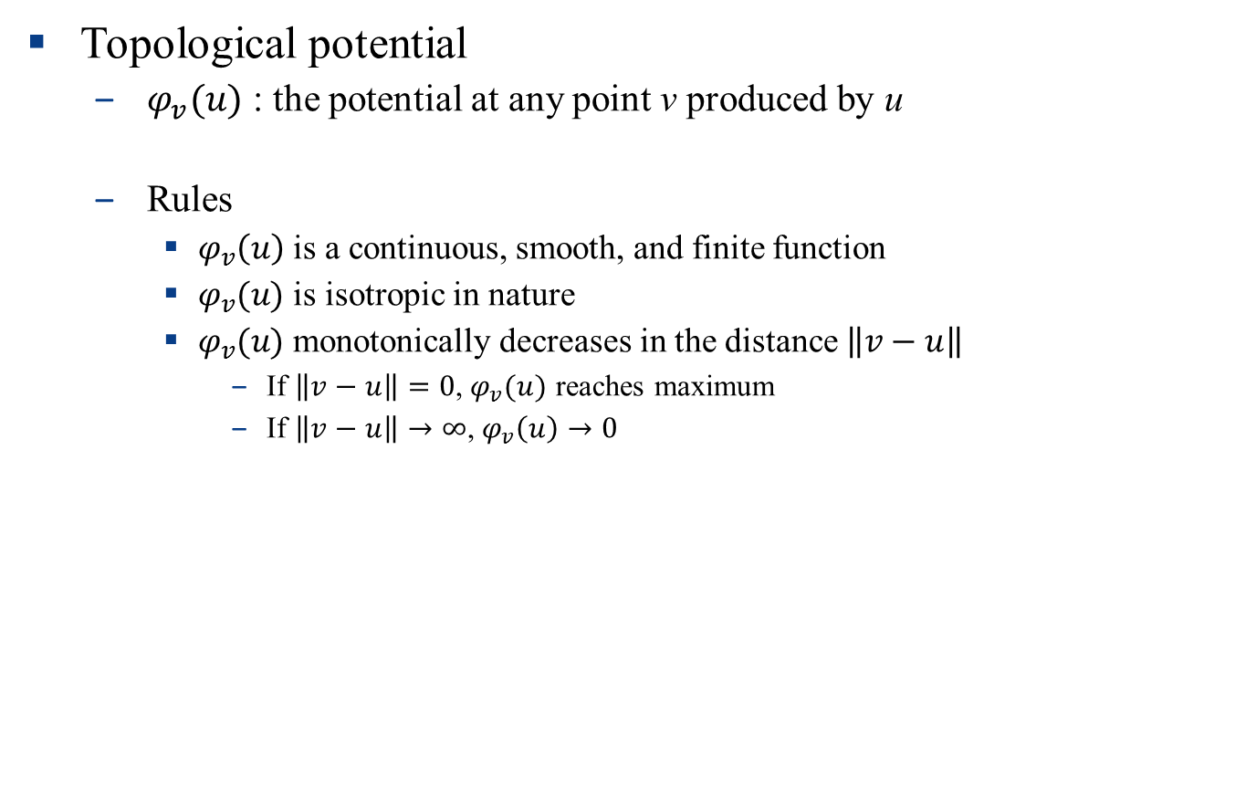
Measurement of User Influence in Social Network
Topological potential
$φ_{v}(u)$ : the potential at any point v produced by u
Rules
$φ_{v}\left(u\right)$ is a continuous, smooth, and finite function
$φ_{v}(u)$ is isotropic in nature
$φ_{v}(u)$ monotonically decreases in the distance $\left\|v−u\right\|$
If $\left\|v−u\right\|=0$, $φ_{v}(u)$ reaches maximum
If $\left\|v−u\right\|→∞$, $φ_{v}\left(u\right)→0$

Slide 10
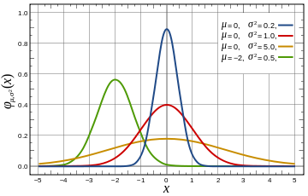
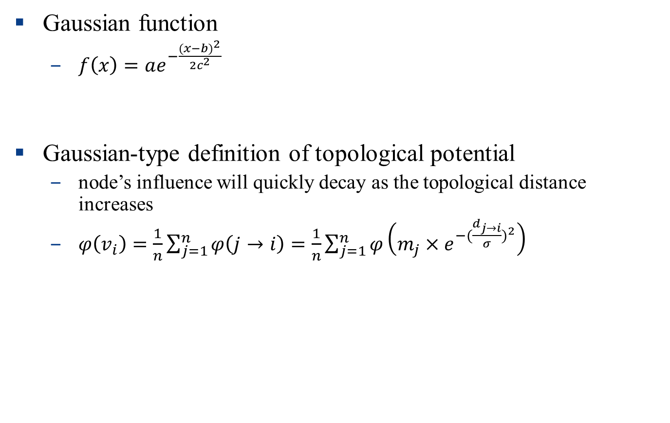
Measurement of User Influence in Social Network
Gaussian function
$f\left(x\right)=ae^{−\frac{{(x−b)}^{2}}{2c^{2}}}$
Gaussian-type definition of topological potential
node’s influence will quickly decay as the topological distance increases
$φ\left(v_{i}\right)=\frac{1}{n}\sum_{j=1}^{n}{φ\left(j→i\right)}=\frac{1}{n}\sum_{j=1}^{n}{φ\left(m_{j}×e^{−{(\frac{d_{j→i}}{σ})}^{2}}\right)}$
Distance between v_{i} and v_{j}
Influence range

Slide 11


Measurement of User Influence in Social Network
Optimizing the influence factor
Optimize $σ$ to make the topological potential of each node most different
When $σ$ = 0 or $σ→∞$, usually $σ>D$ (diameter),
→ no interaction among nodes
When $0<σ<D$,
→ Interaction among nodes and the node topological potential is much different

Slide 12
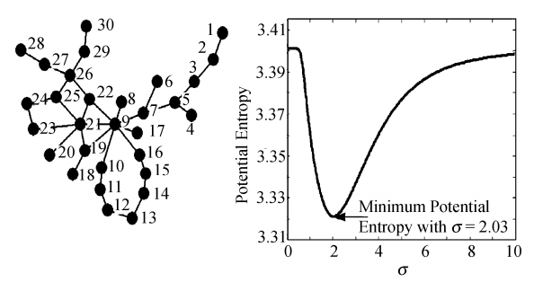
Measurement of User Influence in Social Network
Optimizing the influence factor (cont.)
Shannon’s entropy
A measure of uncertainty in an information system
불확실성이 높아질수록 정보의 양은 더 많아지고 엔트로피는 더 커진다

Slide 13
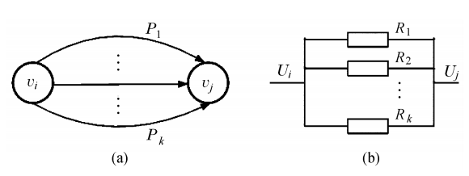


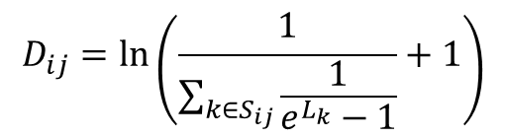

Measurement of User Influence in Social Network
Calculating the topological distance
$$\sum_{k∈S_{ij}}^{n}{\frac{1}{R_{k}}}=\frac{1}{R_{e}}$$
$$D_{ij}=\ln\left(\frac{1}{\sum_{k∈S_{ij}}{\frac{1}{e^{L_{k}}−1}}}+1\right)$$
$$R_{k}=f(L_{k})$$
$$f\left(x\right)=e^{x}−1$$

Slide 14
Outline
Introduction
Data Collections
Measurement of User Influence in Social Network
Recommendation Framework
Evaluation
Conclusion

Slide 15
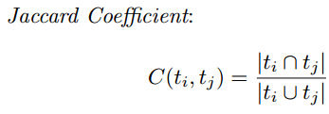
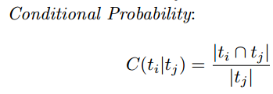
Recommendation Framework
Tag co-occurrence

Slide 16
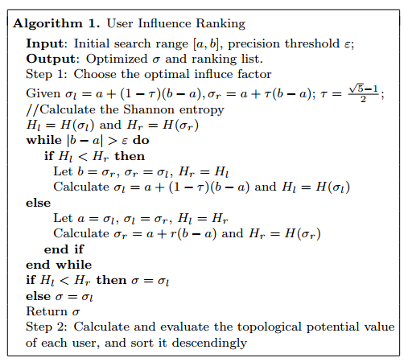





Recommendation Framework
Contacts with social influence
$$σ$$
a
b
$$σl$$
$$σr$$
$$σl$$
$$σr$$

Slide 17
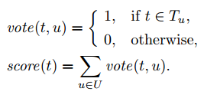

Recommendation Framework
Aggregation methods
Vote
Sum
Method 1
Method 2
Method 3
Method 1+2+3

Slide 18
Recommendation Framework
Combination of candidate recommendation tags from different approaches
Borda Count
A single-winner election method
Simple Combination
Recommendation list
Method 1
Method 3
Recommendation list
✓
✓
✓
✓
✓

Slide 19
Outline
Introduction
Data Collections
Measurement of User Influence in Social Network
Recommendation Framework
Evaluation
Conclusion

Slide 20
Evaluation
Evaluation metrics
Mean Reciprocal Rank (MRR)
Measures where in the ranking the first relevant tag is returned by system
Success at Rank k (S@k)
The probability of finding a good descriptive tag among the top k
Precision at Rank k (P@k)
The proportion of retrieved tags that are relevant

Slide 21
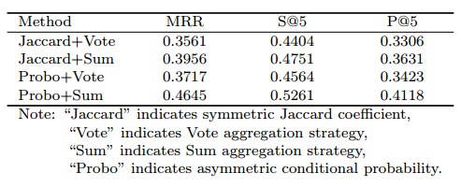
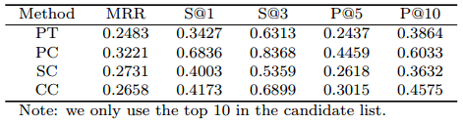
Evaluation
Evaluation results
Global tag co-occurrence
User tagging history & user social contacts
PT: the latest 10 tags
PC: user tag co-occurrence
SC: social contact based co-occurrence
CC: global co-occurrence
Not enough!

Slide 22
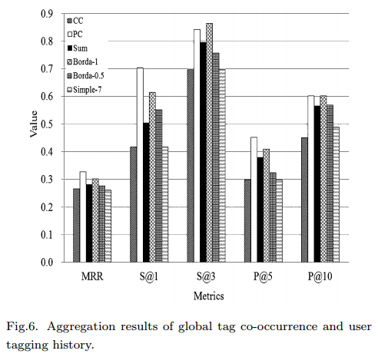
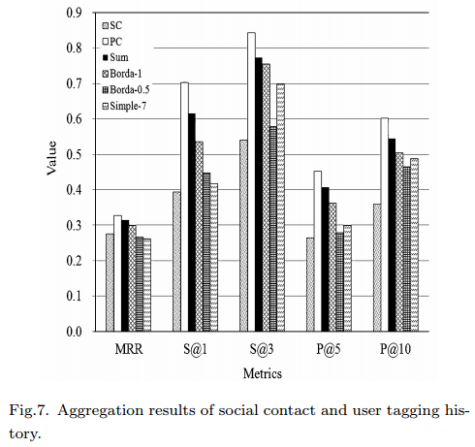
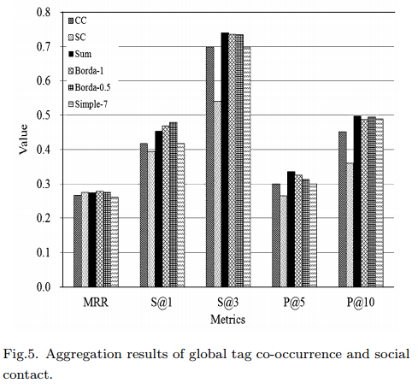
Evaluation
Evaluation results
Combination performance

Slide 23
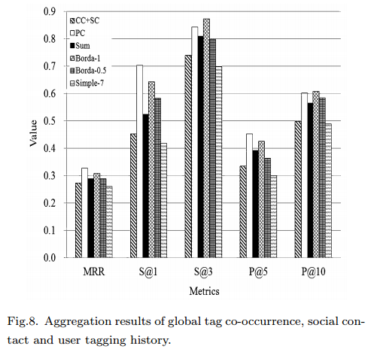
Evaluation
Evaluation results
Combination performance

Slide 24
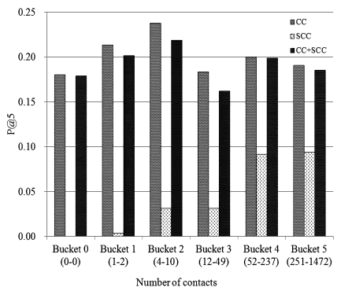
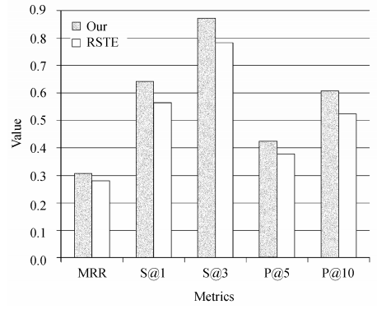
Evaluation
Comparison with other personalized methods
Adam et al.
Use all 1-hop contacts tagging information
Too many noises have been brought to the final tag list
RSTE (Ma et al.)
User-item matrix (α = 1) + trust-based system (α = 0)
The authors set α = 0 and use similarity to replace social trust

Slide 25
Conclusion
Personalized tag recommendation
User tagging history
Global tag co-occurrence
Measure user influence
Benefits for the cold start problem of tag recommendation

