Slide 1

Session 13
Modeling the Static View:
The Object Diagram
Written by Thomas A. Pender
Published by Wiley Publishing, Inc.
October 12, 2011
Presented by Hyewon Lim

Slide 2
Contents
Understanding the Object Diagram
Introducing Elements of the Object Diagram Notation
Comparing the Object Diagram and the Class Diagram Notations
Applying Object Diagrams to Test Class Diagrams

Slide 3
Understanding the Object Diagram (1/2)
Object diagram
  Primarily a tool for research and testing
  Can be used…
    to understand a problem by documenting examples from the problem domain
    During analysis and design to verify the accuracy of Class diagrams
Object diagram vs. Class diagram
  Object diagram models facts about specific entities
  Class diagram models the rules for types of entities

Slide 4



Understanding the Object Diagram (2/2)
From the Use Cases, you found scenarios
  Scenarios become the source for test cases to verify every behavior that your system needs to support
  Also the source for building the Object diagrams
vs.
Notes:
Compare the representation of the facts against the representation of the rules set forth in the Class diagram.
Adjust the Class diagram to address errors and missed requirement.

Slide 5
Contents
Understanding the Object Diagram
Introducing Elements of the Object Diagram Notation
Comparing the Object Diagram and the Class Diagram Notations
Applying Object Diagrams to Test Class Diagrams

Slide 6
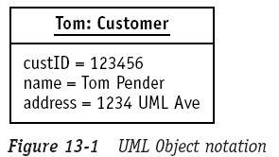
Introducing Elements of the Object Diagram Notation
Object notation
  name at the top of the box
    object name : class name (entire expression is underlined)
    : class name → anonymous object
  facts about the attributes at the bottom of the box
    Each attribute is named and assigned a value
      C.f., class contained no values
    A value of blank or null
      Distinguishes the condition of the object from other possibilities
Notes:
Class랑 비교.
Class는 value를 가지지 않는다. 왜냐, rule를 작성하는 것이기 때문.
Class는 Employee 객체가 이름을 가질 수 있는데, 그게 20자의 String 값이다, 라고 표현하지만, Object에서는 이름은 “Tom Pender”라고 값을 할당해버림.

Slide 7
Contents
Understanding the Object Diagram
Introducing Elements of the Object Diagram Notation
Comparing the Object Diagram and the Class Diagram Notations
Applying Object Diagrams to Test Class Diagrams

Slide 8
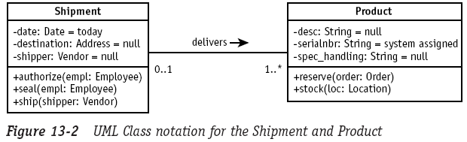
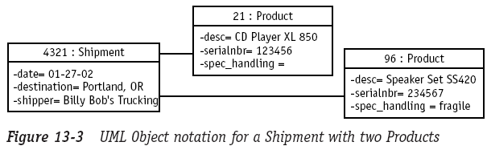
Comparing the Object Diagram and the Class Diagram Notations (1/3)
Class diagram
Object diagram
Notes:
Class diagram은 각각의 object type을 정의하기 위해 사용되는 attribute들과 각각의 object type이 지원해야만 하는 기능들을 정의함.
Object diagram을 설명하자면, Shipment 타입의 객체 4321은 두개의 Product를 가지고 있고 각각 3개의 attribute를 지님.
그런데 Product 21의 속성 중 spec_handling의 값이 blank 상태로 표기되는데, 앞에서 설명했듯이 이 또한 valid한 값임.
이런 값의 유효성을 결정하는 것은 속성에 대한 클래스 정의이다!!!

Slide 9
Comparing the Object Diagram and the Class Diagram Notations (2/3)
The class definition for the attribute
  determines the valid values that may be assigned to the attribute when it appears within an object
The operation compartment was omitted
  Every object of the same class possesses the same operations
  C.f., attribute
    Each object potentially possessed different values for the attributes defined by the class

Slide 10
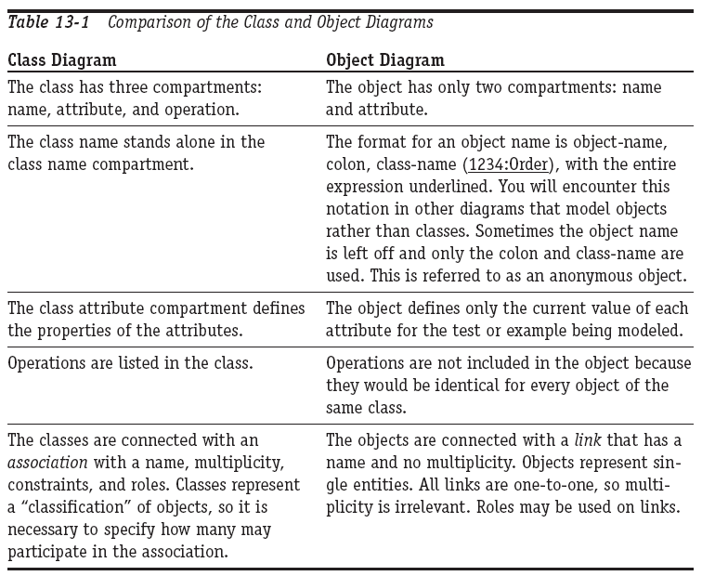
Comparing the Object Diagram and the Class Diagram Notations (3/3)
Comparison of the Class and Object diagrams

Slide 11
Contents
Understanding the Object Diagram
Introducing Elements of the Object Diagram Notation
Comparing the Object Diagram and the Class Diagram Notations
Applying Object Diagrams to Test Class Diagrams

Slide 12

Applying Object Diagrams to Test Class Diagrams (1/7)
We need to use additional diagrams to test the Class diagram
Perfect!

Slide 13
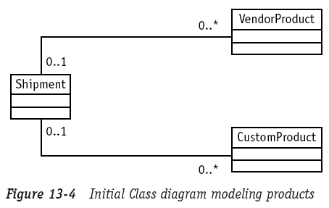
Applying Object Diagrams to Test Class Diagrams (2/7)
Test my diagram with an Object diagram

Slide 14
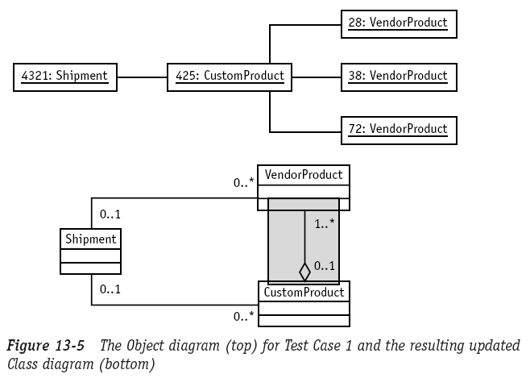
Applying Object Diagrams to Test Class Diagrams (3/7)
Test case 1
  A CustomProduct is created by assembling VendorProducts

Slide 15
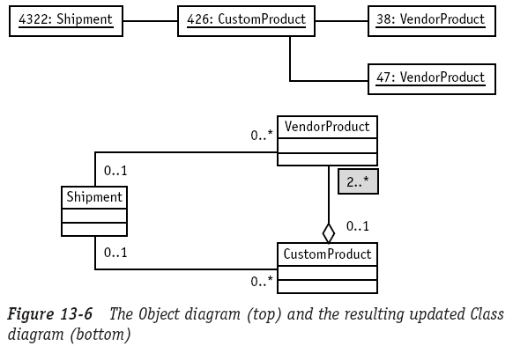
Applying Object Diagrams to Test Class Diagrams (4/7)
Test case 2
  What is the minimum number of objects that make up a CustomProduct configuration?
    At least two VendorProducts
    Otherwise, there is no way to distinguish a CP from a VP

Slide 16
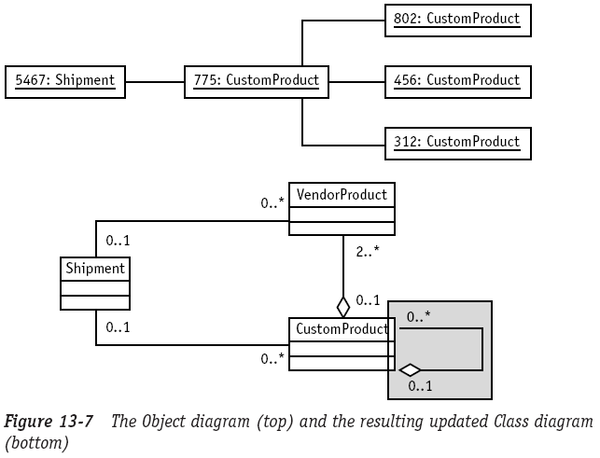
Applying Object Diagrams to Test Class Diagrams (5/7)
Test case 3
  Is there evidence that a CustomProduct may be configured into another CustomProduct?
Notes:
CustomProduct로 다시 CustomProduct를 만드는 경우가 있는가?
-> 예를 들면 VendorProducts 다섯개로 component stereo system을 만들었는데 (이건 CustomProduct),
이게 다시 home entertainment center의 일부로 구성되는 경우.
Test case 3에서 이런걸 표현해준 것.

Slide 17
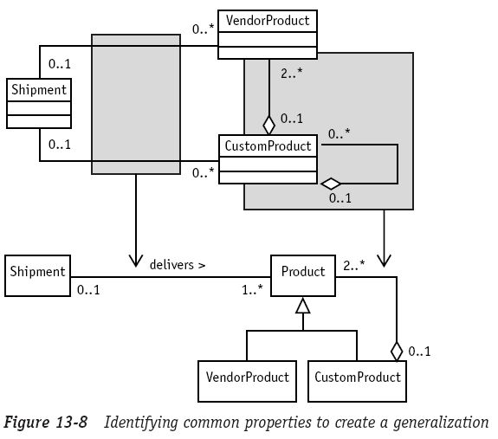
Applying Object Diagrams to Test Class Diagrams (6/7)
Test case 4
  Are there any common characteristics among the objects used to configure CustomProduct?
Composite
design pattern
Notes:
VenderProduct와 CustomProduct는 CustomProduct의 일부라고 볼 수 있다!!! 따라서 Generalization 해줌.
Generalization을 위한 새 class를 정의함. 새로 생성된 P와 VP, CP의 관계(association)는 CP와 VP 둘 중 어떤 Product type이라도 CP를 구성할 수 있음을 나타냄.
또한 Shipment와 VP, CP와의 관계도 generalization할 수 있으므로 single association으로 표현. 둘 중 어떤 Product type이라도 Shipment가 가능함을 나타냄.

Slide 18
Applying Object Diagrams to Test Class Diagrams (7/7)
Use the Object diagram
  An as-needed basis to model specific example or test cases
Compare the representation of the facts against the representation of the rules set forth in the Class diagram
  Adjust the Class diagram to address errors and missed requirement

Slide 19
The End

