Slide 1
Chapter 7: Relational Database Design

Slide 2
Database System Concepts
Chapter 1: Introduction
Part 1: Relational databases
  Chapter 2: Relational Model
  Chapter 3: SQL
  Chapter 4: Advanced SQL
  Chapter 5: Other Relational Languages
Part 2: Database Design
  Chapter 6: Database Design and the E-R Model
  Chapter 7: Relational Database Design
  Chapter 8: Application Design and Development
Part 3: Object-based databases and XML
  Chapter 9: Object-Based Databases
  Chapter 10: XML
Part 4: Data storage and querying
  Chapter 11: Storage and File Structure
  Chapter 12: Indexing and Hashing
  Chapter 13: Query Processing
  Chapter 14: Query Optimization
Part 5: Transaction management
  Chapter 15: Transactions
  Chapter 16: Concurrency control
  Chapter 17: Recovery System
Part 6: Data Mining and Information Retrieval
  Chapter 18: Data Analysis and Mining
  Chapter 19: Information Retreival
Part 7: Database system architecture
  Chapter 20: Database-System Architecture
  Chapter 21: Parallel Databases
  Chapter 22: Distributed Databases
Part 8: Other topics
  Chapter 23: Advanced Application Development
  Chapter 24: Advanced Data Types and New Applications
  Chapter 25: Advanced Transaction Processing
Part 9: Case studies
  Chapter 26: PostgreSQL
  Chapter 27: Oracle
  Chapter 28: IBM DB2
  Chapter 29: Microsoft SQL Server
Online Appendices
  Appendix A: Network Model
  Appendix B: Hierarchical Model
  Appendix C: Advanced Relational Database Model

Slide 3
Part 2: Database Design
(Chapters 6 through 8).
Chapter 6: Database Design and the E-R Model
  provides an overview of the database-design process, with major emphasis on database design using the entity-relationship data model. UML class-diagram notation is also covered in this chapter.
Chapter 7: Relational Database Design
  introduces the theory of relational-database design. The theory of functional dependencies and normalization is covered, with emphasis on the motivation and intuitive understanding of each normal form. Instructors may chose to use only this initial coverage in Sections 7.1 through 7.3 without loss of continuity.
Chapter 8: Application Design and Development
  emphasizes the construction of database applications with Web-based used interfaces. In addition, the chapter covers application security.

Slide 4
Chapter 7: Relational Database Design
7.1 Features of Good Relational Design
7.2 Atomic Domains and First Normal Form
7.3 Decomposition Using Functional Dependencies
7.4 Functional Dependency Theory
7.5 Algorithms for Functional Dependencies
7.6 Decomposition Using Multivalued Dependencies
7.7 More Normal Form
7.8 Database-Design Process
7.9 Modeling Temporal Data
7.10 Summary

Slide 5
The Banking Schema
branch = (branch_name, branch_city, assets)
customer = (customer_id, customer_name, customer_street, customer_city)
loan = (loan_number, amount)
account = (account_number, balance)
employee = (employee_id. employee_name, telephone_number, start_date)
dependent_name = (employee_id, dname)
account_branch = (account_number, branch_name)
loan_branch = (loan_number, branch_name)
borrower = (customer_id, loan_number)
depositor = (customer_id, account_number)
cust_banker = (customer_id, employee_id, type)
works_for = (worker_employee_id, manager_employee_id)
payment = (loan_number, payment_number, payment_date, payment_amount)
savings_account = (account_number, interest_rate)
checking_account = (account_number, overdraft_amount)

Slide 6
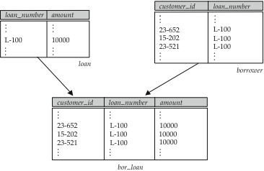
Combine Schemas?
Suppose we combine borrow and loan to get
  bor_loan = (customer_id, loan_number, amount )
Result is possible repetition of information (L-100 in example below)
M TO M

Slide 7
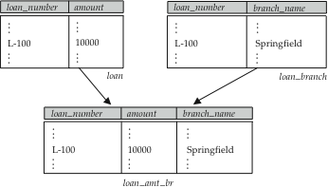
A Combined Schema Without Repetition
Consider combining loan_branch and loan
  loan_amt_br = (loan_number, amount, branch_name)
No repetition (as suggested by example below)

Slide 8
What About Smaller Schemas?
Suppose we had started with bor_loan in the slide 7.6.
  How would we know to split up (decompose) it into borrower and loan?
Write a rule “if there were a schema (loan_number, amount), then loan_number would be a candidate key”
  Denote as a functional dependency: loan_number → amount
In bor_loan, because loan_number is not a candidate key, the amount of a loan may have to be repeated.
  This indicates the need to decompose bor_loan.
However, not all decompositions are good.
Suppose we decompose employee into
employee1 = (employee_id, employee_name)
employee2 = (employee_name, telephone_number, start_date)
The next slide shows how we lose information
  we cannot reconstruct the original employee relation
  and so, this is a lossy decomposition!

Slide 9
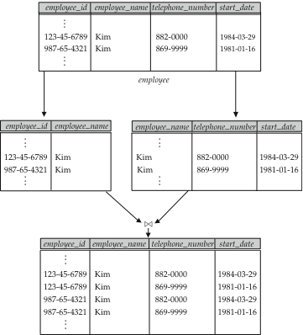
A Lossy Decomposition
employee1
employee2

Slide 10
Chapter 7: Relational Database Design
7.1 Features of Good Relational Design
7.2 Atomic Domains and First Normal Form
7.3 Decomposition Using Functional Dependencies
7.4 Functional Dependency Theory
7.5 Algorithms for Functional Dependencies
7.6 Decomposition Using Multivalued Dependencies
7.7 More Normal Form
7.8 Database-Design Process
7.9 Modeling Temporal Data
7.10 Summary

Slide 11
First Normal Form
Domain is atomic if its elements are considered to be indivisible units
  Examples of non-atomic domains:
    Set of names, composite attributes
    Identification numbers like CS101 that can be broken up into parts
A relational schema R is in first normal form if the domains of all attributes of R are atomic
Non-atomic values complicate storage and encourage redundant (repeated) storage of data
  Example: Set of accounts stored with each customer, and set of owners stored with each account
  We assume all relations are in first normal form (and revisit this in Chapter 9)

Slide 12
First Normal Form (Cont’d)
Atomicity is actually a property of how the elements of the domain are used.
  Example: Strings would normally be considered indivisible
  Suppose that students are given roll numbers which are strings of the form CS0012 or EE1127
  If the first two characters are extracted to find the department, the domain of roll numbers is not atomic.
  Doing so is a bad idea: leads to encoding of information in application program rather than in the database.

Slide 13
Chapter 7: Relational Database Design
7.1 Features of Good Relational Design
7.2 Atomic Domains and First Normal Form
7.3 Decomposition Using Functional Dependencies
7.4 Functional Dependency Theory
7.5 Algorithms for Functional Dependencies
7.6 Decomposition Using Multivalued Dependencies
7.7 More Normal Form
7.8 Database-Design Process
7.9 Modeling Temporal Data
7.10 Summary

Slide 14
Goal — Devise a Theory for the Following
Decide whether a particular relation R is in “good” form.
In the case that a relation R is not in “good” form, decompose it into a set of relations {R₁, R₂, ..., R_{n}} such that
  each relation is in good form
  the decomposition is a lossless-join decomposition
Our theory is based on:
  functional dependencies
  multivalued dependencies

Slide 15
Functional Dependencies
Constraints on the set of legal relations.
Require that the value for a certain set of attributes determines uniquely the value for another set of attributes.
A functional dependency is a generalization of the notion of a key.
Provide the theoretical basis for good decomposition

Slide 16
Functional Dependencies (Cont.)
Let R be a relation schema
α ⊆ R and β ⊆ R
The functional dependency α → β holds on R if and only if
for any legal relations r(R), whenever any two tuples t₁ and t₂ of r agree on the attributes α, they also agree on the attributes β. That is,
t₁[α] = t₂ [α] ⇒ t₁[β ] = t₂ [β ]
Example: Consider r(A,B ) with the following instance of r.
On this instance, A → B does NOT hold, but B → A does hold.
4
1 5
3 7

Slide 17
Functional Dependencies (Cont.)
K is a superkey for relation schema R if and only if K → R
K is a candidate key for R if and only if
  K → R, and
  for no α ⊂ K, α → R
Functional dependencies allow us to express constraints that cannot be expressed using superkeys.
Consider the schema:
bor_loan = (customer_id, loan_number, amount ).
Super key: customer_id, loan_number
So, customer_id, loan_number → customer_id, loan_number, amount
Additionally we expect this FD to hold: loan_number → amount
but would not expect the following to hold: amount → customer_name

Slide 18
Use of Functional Dependencies
We use functional dependencies to:
  test relations to see if they are legal under a given set of functional dependencies.
    If a relation r is legal under a set F of functional dependencies, we say that r satisfies F.
  specify constraints on the set of legal relations
    We say that F holds on R if all legal relations on R satisfy the set of functional dependencies F.
Note: A specific instance of a relation schema may satisfy a functional dependency even if the functional dependency does not hold on all legal instances.
  For example, a specific instance of loan may, by chance, satisfy
  amount → customer_name.

Slide 19
Functional Dependencies (Cont.)
A functional dependency is trivial if it is satisfied by all instances of a relation
  Example:
    customer_name, loan_number → customer_name
    customer_name → customer_name
  In general, α → β is trivial if β ⊆ α
Under the trivial FDs, any instance of a relation is legal

Slide 20
Closure of a Set of Functional Dependencies
Given a set F set of functional dependencies, there are certain other functional dependencies that are logically implied by F.
  For example: If A → B and B → C, then we can infer that A → C
The set of all functional dependencies logically implied by F is the closure of F.
We denote the closure of F by F⁺.
F⁺ is a superset of F.

Slide 21
Boyce-Codd Normal Form
A relation schema R is in BCNF with respect to a set F of functional dependencies if for all functional dependencies in F⁺ of the form
α → β
where α ⊆ R and β ⊆ R, at least one of the following holds:
α  → β is trivial (i.e., β ⊆ α)
α is a superkey for R
** Example schema not in BCNF:
bor_loan = ( customer_id, loan_number, amount )
because loan_number → amount holds on bor_loan but loan_number is not a superkey

Slide 22
Decomposing a Schema into BCNF
Suppose we have a schema R and a non-trivial dependency α →β causes a violation of BCNF.
We decompose R into two relation schemas:
  (α U β )
  ( R - ( β - α ) )
In our example, bor_loan = ( customer_id, loan_number, amount )
  α = loan_number
  β = amount
  and bor_loan is replaced by two relation schemas
  (α U β ) = ( loan_number, amount )
  ( R - ( β - α ) ) = ( customer_id, loan_number )
Of course, we are only interested in lossless join decomposition!

Slide 23
BCNF and Dependency Preservation
Constraints, including functional dependencies, are costly to check in practice unless they pertain to only one relation
In order to ensure that all functional dependencies hold in a decomposition
  It is sufficient to test only those dependencies on each individual relation of a decomposition
  If so, the decomposition is dependency preserving.
But, It is not always possible to achieve a decomposition having properties of both BCNF and dependency preservation
Therefore, we consider a weaker normal form, known as third normal form.

Slide 24
Third Normal Form
A relation schema R is in third normal form (3NF) if for all:
α → β in F⁺
at least one of the following holds:
  α → β is trivial (i.e., β ∈ α)
  α is a superkey for R
  Each attribute A in β – α is contained in a candidate key for R.
  (NOTE: each attribute may be in a different candidate key)
If a relation R is in BCNF, then R is in 3NF
  Since in BCNF one of the first two conditions above must hold
Third condition is a minimal relaxation of BCNF to ensure dependency preservation (will see why later).

Slide 25
Goals of Normalization
Let R be a relation scheme with a set F of functional dependencies.
Decide whether a relation scheme R is in “good” form (such as 3NF, BCNF).
In the case that a relation scheme R is not in “good” form, decompose it into a set of relation scheme {R₁, R₂, ..., R_{n}} such that
  each relation scheme is in good form
  the decomposition is a lossless-join decomposition
  Preferably, the decomposition should be dependency preserving.

Slide 26
How good is BCNF?
There are database schemas in BCNF that do not seem to be sufficiently normalized
Consider a database
classes (course, teacher, book )
such that (c, t, b) ∈ classes means that t is qualified to teach c, and b is a required textbook for c
The database is supposed to list for each course the set of teachers any one of which can be the course’s instructor, and the set of books, all of which are required for the course (no matter who teaches it).

Slide 27
How good is BCNF? (Cont.)
course
teacher
book
database
database
database
database
database
database
operating systems
operating systems
operating systems
operating systems
Avi
Avi
Hank
Hank
Sudarshan
Sudarshan
Avi
Avi
Pete
Pete
DB Concepts
Ullman Book
DB Concepts
Ullman Book
DB Concepts
Ullman Book
OS Concepts
Stallings Book
OS Concepts
Stallings Book
classes
There are no non-trivial functional dependencies and therefore the relation is in BCNF
Insertion anomalies – i.e., if Marilyn is a new teacher that can teach database, two tuples need to be inserted
(database, Marilyn, DB Concepts)
(database, Marilyn, Ullman Book)
Update anomalies – If Hank quits the univeristy and HJK is hired instead,…….

Slide 28
How good is BCNF? (Cont.)
Therefore, it is better to decompose classes into:
course
teacher
database
database
database
operating systems
operating systems
Avi
Hank
Sudarshan
Avi
Pete
teaches
course
book
database
database
operating systems
operating systems
DB Concepts
Ullman Book
OS Concepts
Stalling Book
text
This suggests the need for higher normal forms, such as Fourth Normal Form (4NF), which we shall see later.

Slide 29
Chapter 7: Relational Database Design
7.1 Features of Good Relational Design
7.2 Atomic Domains and First Normal Form
7.3 Decomposition Using Functional Dependencies
7.4 Functional Dependency Theory
7.5 Algorithms for Functional Dependencies
7.6 Decomposition Using Multivalued Dependencies
7.7 More Normal Form
7.8 Database-Design Process
7.9 Modeling Temporal Data
7.10 Summary

Slide 30
Functional-Dependency Theory
We now consider the formal theory that tells us which functional dependencies are implied logically by a given set of functional dependencies.
We then develop algorithms to generate lossless decompositions into BCNF and 3NF
We then develop algorithms to test if a decomposition is dependency-preserving

Slide 31
Closure of a Set of Functional Dependencies
Given a set F set of functional dependencies, there are certain other functional dependencies that are logically implied by F.
  For example: If A → B and B → C, then we can infer that A → C
The set of all functional dependencies logically implied by F is the closure of F.
We denote the closure of F by F⁺.
We can find all of F⁺ by applying Armstrong’s Axioms:
  if β ⊆ α, then α → β (reflexivity)
  if α → β, then γ α → γ β (augmentation)
  if α → β, and β → γ, then α → γ (transitivity)
These rules are
  sound (generate only functional dependencies that actually hold) and
  complete (generate all functional dependencies that hold).

Slide 32
Example
R = (A, B, C, G, H, I)
F = { A → B
A → C
CG → H
CG → I
B → H}
some members of F⁺
  A → H
    by transitivity from A → B and B → H
  AG → I
    by augmenting A → C with G, to get AG → CG
    and then transitivity with CG → I
  CG → HI
    by augmenting CG → I to infer CG → CGI,
    and augmenting of CG → H to infer CGI → HI,
    and then transitivity

Slide 33
Procedure for Computing F⁺
To compute the closure of a set of functional dependencies F:
F ⁺ = F
repeat
for each functional dependency f in F⁺
apply reflexivity and augmentation rules on f
add the resulting functional dependencies to F ⁺
for each pair of functional dependencies f₁and f₂ in F ⁺
if f₁ and f₂ can be combined using transitivity
then add the resulting functional dependency to F ⁺
until F ⁺ does not change any further
NOTE: We shall see an alternative procedure for this task later

Slide 34
Closure of Functional Dependencies (Cont.)
We can further simplify manual computation of F⁺ by using the following additional rules.
  If α → β holds and α → γ holds, then α → β γ holds (union)
  If α → β γ holds, then α → β holds and α → γ holds (decomposition)
  If α → β holds and γ β → δ holds, then α γ → δ holds (pseudotransitivity)
  The above rules can be inferred from Armstrong’s axioms.

Slide 35
Closure of Attribute Sets
Given a set of attributes α, define the closure of α under F (denoted by α⁺ ) as the set of attributes that are functionally determined by α under F
Algorithm to compute α⁺ , the closure of α under F
result := α;
while (changes to result) do
for each β → γ in F do
begin
if β ⊆ result then result := result ∪ γ
end

Slide 36
Example of Attribute Set Closure
R = (A, B, C, G, H, I)
F = {A → B
A → C
CG → H
CG → I
B → H}
(AG)⁺
  1. result = AG
  2. result = ABCG (A → C and A → B)
  3. result = ABCGH (CG → H and CG ⊆ AGBC)
  4. result = ABCGHI (CG → I and CG ⊆ AGBCH)
Is AG a candidate key?
  Is AG a super key?
    Does AG → R? means Is (AG)⁺ ⊇ R ?
  Is any subset of AG a superkey?
    Does A → R? means Is (A)⁺ ⊇ R ?
    Does G → R? means Is (G)⁺ ⊇ R ?

Slide 37
Uses of Attribute Closure
There are several uses of the attribute closure algorithm:
Testing for superkey:
  To test if α is a superkey, we compute α^{+,} and check if α⁺ contains all attributes of R.
Testing functional dependencies
  To check if a functional dependency α → β holds (or, in other words, is in F⁺), just check if β ⊆ α⁺.
  That is, we compute α⁺ by using attribute closure, and then check if it contains β.
  Is a simple and cheap test, and very useful
Computing closure of F
  For each γ ⊆ R, we find the closure γ⁺, and for each S ⊆ γ⁺, we output a functional dependency γ → S.
  Still exponential

Slide 38
Canonical Cover
Sets of functional dependencies may have redundant dependencies that can be inferred from the others
  For example: A → C is redundant in: {A → B, B → C}
  Parts of a functional dependency may be redundant
    E.g.: on RHS: {A → B, B → C, A → CD} can be simplified to
    {A → B, B → C, A → D}
    E.g.: on LHS: {A → B, B → C, AC → D} can be simplified to
    {A → B, B → C, A → D}
Intuitively, a canonical cover of F is a “minimal” set of functional dependencies equivalent to F, having no redundant dependencies or redundant parts of dependencies

Slide 39
Extraneous Attributes
Consider a set F of functional dependencies and the functional dependency α → β in F.
  Attribute A is extraneous in α if A ∈ α
  and F logically implies (F – {α → β}) ∪ {(α – A) → β}.
  Attribute A is extraneous in β if A ∈ β
  and the set of functional dependencies
  (F – {α → β}) ∪ {α →(β – A)} logically implies F.
Note: implication in the opposite direction is trivial in each of the cases above, since a “stronger” functional dependency always implies a weaker one
Example: Given F = {A → C, AB → C }
  B is extraneous in AB → C because {A → C, AB → C} logically implies A → C (I.e. the result of dropping B from AB → C).
Example: Given F = {A → C, AB → CD}
  C is extraneous in AB → CD since AB → C can be inferred even after deleting C
    We can get AB → CD with {A → C, AB → D} because A → C implies AB → C

Slide 40
Testing if an Attribute is Extraneous
Consider a set F of functional dependencies and the functional dependency α → β in F.
To test if attribute A ∈ α is extraneous in α
  compute ({α} – A)⁺ using the dependencies in F
  check that ({α} – A)⁺ contains A; if it does, A is extraneous
To test if attribute A ∈ β is extraneous in β
  compute α⁺ using only the dependencies in
  F’ = (F – {α → β}) ∪ {α →(β – A)},
  check that α⁺ contains A; if it does, A is extraneous

Slide 41
Canonical Cover
A canonical cover for F is a set of dependencies F_{c} such that
  F logically implies all dependencies in F_{c,} and
  F_{c} logically implies all dependencies in F, and
  No functional dependency in F_{c} contains an extraneous attribute, and
  Each left side of functional dependency in F_{c} is unique.
To compute a canonical cover for F:
repeat
Use the union rule to replace any dependencies in F
α₁ → β₁ and α₁ → β₂ with α₁ → β₁ β₂
Find a functional dependency α → β with an
extraneous attribute either in α or in β
If an extraneous attribute is found, delete it from α → β
until F does not change
Note: Union rule may become applicable after some extraneous attributes have been deleted, so it has to be re-applied

Slide 42
Computing a Canonical Cover
R = (A, B, C)
F = {A → BC
B → C
A → B
AB → C}
Combine A → BC and A → B into A → BC
  Set is now {A → BC, B → C, AB → C}
A is extraneous in AB → C
  Check if the result of deleting A from AB → C is implied by the other dependencies
    Yes: in fact, B → C is already present!
  Set is now {A → BC, B → C}
C is extraneous in A → BC
  Check if A → C is logically implied by A → B and the other dependencies
    Yes: using transitivity on A → B and B → C.
      Can use attribute closure of A in more complex cases
The canonical cover is: A → B
B → C

Slide 43
Lossless-join Decomposition
For the case of R = (R₁, R₂), we require that for all possible relations r on schema R
r = ∏_{R1} (r ) ∏_{R2} (r )
A decomposition of R into R₁ and R₂ is lossless join if and only if at least one of the following dependencies is in F⁺:
  R₁ ∩ R₂ → R₁
  R₁ ∩ R₂ → R₂

Slide 44

Example
R = (A, B, C)
F = {A → B, B → C)
  Can be decomposed in two different ways
R₁ = (A, B), R₂ = (B, C)
  Lossless-join decomposition:
  R₁ ∩ R₂ = {B} and B → BC
  Dependency preserving
R₁ = (A, B), R₂ = (A, C)
  Lossless-join decomposition:
  R₁ ∩ R₂ = {A} and A → AB
  Not dependency preserving
  (cannot check B → C without computing R₁ R₂)

Slide 45
Dependency Preservation
Let F_{i} be the set of dependencies F ⁺ that include only attributes in R_{i}.
    A decomposition is dependency preserving, if
    (F₁ ∪ F₂ ∪ … ∪ F_{n} )⁺ = F ⁺
    If it is not, then checking updates for violation of functional dependencies may require computing joins, which is expensive.

Slide 46
Testing for Dependency Preservation
To check if a dependency α → β is preserved in a decomposition of R into R₁, R₂, …, R_{n} we apply the following test (with attribute closure done with respect to F)
  result = α
  while (changes to result) do
  for each R_{i} in the decomposition
  t = (result ∩ R_{i})⁺ ∩ R_{i}
  result = result ∪ t
  If result contains all attributes in β, then the functional dependency
  α → β is preserved.
We apply the test on all dependencies in F to check if a decomposition is dependency preserving
This procedure takes polynomial time, instead of the exponential time required to compute F⁺ and (F₁ ∪ F₂ ∪ … ∪ F_{n})⁺

Slide 47
Example
R = (A, B, C )
F = {A → B
B → C}
Key = {A}
R is not in BCNF
Then, Do decomposition R₁ = (A, B), R₂ = (B, C)
  R₁ and R₂ in BCNF
  Lossless-join decomposition
  Dependency preserving

Slide 48
Chapter 7: Relational Database Design
7.1 Features of Good Relational Design
7.2 Atomic Domains and First Normal Form
7.3 Decomposition Using Functional Dependencies
7.4 Functional Dependency Theory
7.5 Algorithms for Functional Dependencies
7.6 Decomposition Using Multivalued Dependencies
7.7 More Normal Form
7.8 Database-Design Process
7.9 Modeling Temporal Data
7.10 Summary

Slide 49
Testing for BCNF
To check if any non-trivial dependency α →β in F+ causes a violation of BCNF
  1. compute α⁺ (the attribute closure of α), and
  2. verify that α⁺ includes all attributes of R, that is, α⁺ is a superkey of R.
Simplified test: To check if a relation schema R is in BCNF, it suffices to check only the dependencies in the given set F for violation of BCNF, rather than checking all dependencies in F⁺.
  If none of the dependencies in F causes a violation of BCNF, then none of the dependencies in F⁺ will cause a violation of BCNF either.
However, using only F is incorrect when testing a relation in a decomposition of R
  Consider R = (A, B, C, D, E), with F = { A → B, BC → D}
    Decompose R into R₁ = (A,B) and R₂ = (A,C,D, E)
    Neither of the dependencies in F contain only attributes from
    (A,C,D,E) so we might be mislead into thinking R₂ satisfies BCNF.
    In fact, dependency AC → D in F⁺ shows R₂ is not in BCNF.

Slide 50
Testing Decomposition for BCNF
To check if a relation R_{i} in a decomposition of R is in BCNF,
  Either test R_{i} for BCNF with respect to the restriction of F to R_{i} (that is, all FDs in F⁺ that contain only attributes from R_{i})
  or use the original set of dependencies F that hold on R, but with the following test:
      for every set of attributes α ⊆ R_{i}, check that α⁺ (the attribute closure of α) either includes no attribute of R_{i}- α, or includes all attributes of R_{i}.
    If the condition is violated by some α → β in F, the dependency
    α → (α⁺ - α ) ∩ R_{i}
    can be shown to hold on R_{i}, and R_{i} violates BCNF.
    We use above dependency to decompose R_{i}
Testing BCNF is Exponential Time

Slide 51
BCNF Decomposition Algorithm
result := {R };
done := false;
compute F ⁺;
while (not done) do
if (there is a schema R_{i} in result that is not in BCNF)
then begin
let α  → β be a nontrivial functional dependency that holds on R_{i}
such that α  → R_{i} is not in F ⁺,
and α ∩ β = ∅;
result := (result – R_{i} ) ∪ (R_{i} – β) ∪ (α, β ) ;
end
else done := true;
Note: ** Each R_{i} is in BCNF, and decomposition has lossless-join property.
** Generating BCNF Decomposition is Exponential Algorithm

Slide 52
Example of BCNF Decomposition
R = (A, B, C )
F = {A → B, B → C}
Key = {A}
R is not in BCNF (B → C, but B is not superkey)
Decomposition
  R₁ = (B, C)
  R₂ = (A, B)

Slide 53
Example of BCNF Decomposition
Original relation R and functional dependency F
R = (branch_name, branch_city, assets, customer_name, loan_number, amount)
F = {branch_name → assets branch_city, loan_number → amount branch_name}
Key = {loan_number, customer_name}
Decomposition of R
  R₁ = (branch_name, branch_city, assets )
  R₂ = (branch_name, customer_name, loan_number, amount )
    R₃ = (branch_name, loan_number, amount )
    R₄ = (customer_name, loan_number )
Final decomposition
R₁, R₃, R₄

Slide 54
BCNF and Dependency Preservation
It is not always possible to get a BCNF decomposition that is dependency preserving
Example
R = (J, K, L )
F = {JK → L, L → K }
Two candidate keys = JK and JL
R is not in BCNF
Any decomposition of R will fail to preserve
JK → L
This implies that testing for JK → L requires a join

Slide 55
Third Normal Form: Motivation
There are some situations where
  BCNF is not dependency preserving, and
  efficient checking for FD violation on updates is important
Solution: define a weaker normal form, called Third Normal Form (3NF)
  Allows some redundancy (with resultant problems; we will see examples later)
  But functional dependencies can be checked on individual relations without computing a join.
  There is always a lossless-join, dependency-preserving decomposition into 3NF.

Slide 56
3NF Example
Relation R:
  R = (J, K, L )
  F = {JK → L, L → K }
  Two candidate keys: JK and JL
  R is in 3NF because every FD satisfies the constraint
  JK → L JK is a superkey
  L → K K is contained in a candidate key

Slide 57
Redundancy in 3NF
There could be some redundancy in this 3NF schema
Example of problems due to redundancy in 3NF
  R = (J, K, L)
  F = {JK → L, L → K }
J
L
K
j₁
j₂
j₃
null
l₁
l₁
l₁
l₂
k₁
k₁
k₁
k₂
The above relation instance is 3NF and legal under F. But ….
  repetition of information (e.g., the relationship l₁, k₁)
  need to use null values (e.g., to represent the relationship
  l₂, k₂ where there is no corresponding value for J).

Slide 58
Testing for 3NF
Optimization: Need to check only FDs in F, need not check all FDs in F⁺.
Use attribute closure to check for each dependency α → β, if α is a superkey.
If α is not a superkey, we have to verify if each attribute in β is contained in a candidate key of R
  this test is rather more expensive, since it involve finding candidate keys
So, Testing for 3NF has been shown to be NP-hard
Interestingly, decomposition into third normal form (described shortly) can be done in polynomial time

Slide 59
3NF Decomposition Algorithm
Let F_{c} be a canonical cover for F;
i := 0;
for each functional dependency α → β in F_{c} do
if none of the schemas R_{j}, 1 ≤ j ≤ i contains α β
then begin
i := i + 1;
R_{i} := α β
end
if none of the schemas R_{j}, 1 ≤ j ≤ i contains a candidate key for R
then begin
i := i + 1;
R_{i} := any candidate key for R;
end
return (R₁, R₂, ..., R_{i})
** Generating 3NF decomposition is Polynomial Time

Slide 60
3NF Decomposition Algorithm (Cont.)
Above algorithm ensures:
  each relation schema R_{i} is in 3NF
  decomposition is dependency preserving and lossless-join
  Proof of correctness is at end of this file (click here)

Slide 61
3NF Example
Relation schema:
  cust_banker_branch = (customer_id, employee_id, branch_name, type )
f1: customer_id, employee_id → branch_name, type
f2: employee_id → branch_name
The for loop generates:
R1 ➔ (customer_id, employee_id, branch_name, type )
It then generates
R2 ➔ (employee_id, branch_name)
but ignore R2 because R2 is a subset of R1
  R1 contains candidate key of cust_banker_branch
  So, R1 is the only 3NF decomposition and f1 & f2 are preserved
Note that R1 is not BCNF
  If we apply BCNF algorthim ➔ (employee_id, branch_name), (employee_id, customer_id, type)
  But f1 is not preserved

Slide 62
Comparison of BCNF and 3NF
It is always possible to decompose a relation into a set of relations that are in 3NF such that:
  Always lossless join property and always dependency preservation property
  the 3NF decomposition algorithm is based on canonical cover, so polynomial
It is always possible to decompose a relation into a set of relations that are in BCNF such that:
  Always lossless join property and not always dependency preservation property
  the BCNF decomposition algorithm is based on F closure, so exponential

Slide 63
Design Goals
Goal for a relational database design is:
  BCNF.
  Lossless join.
  Dependency preservation.
If we cannot achieve this, we accept one of
  Lack of dependency preservation
  Redundancy due to use of 3NF
Interestingly, SQL does not provide a direct way of specifying functional dependencies other than superkeys.
Can specify FDs using assertions, but they are expensive to test
Even if we had a dependency preserving decomposition, using SQL we would not be able to efficiently test a functional dependency whose left hand side is not a key.
학부는 여기까지!

Slide 64
Chapter 7: Relational Database Design
7.1 Features of Good Relational Design
7.2 Atomic Domains and First Normal Form
7.3 Decomposition Using Functional Dependencies
7.4 Functional Dependency Theory
7.5 Algorithms for Functional Dependencies
7.6 Decomposition Using Multivalued Dependencies
7.7 More Normal Form
7.8 Database-Design Process
7.9 Modeling Temporal Data
7.10 Summary

Slide 65
Multivalued Dependencies (MVDs)
Let R be a relation schema and let α ⊆ R and β ⊆ R. The multivalued dependency
α →→ β
holds on R if in any legal relation r(R), for all pairs for tuples t₁ and t₂ in r such that t₁[α] = t₂ [α], there exist tuples t₃ and t₄ in r such that:
t₁[α] = t₂ [α] = t₃ [α] = t₄ [α]
t₃[β] = t₁ [β]
t₃[R – β] = t₂[R – β]
t₄ [β] = t₂[β]
t₄[R – β] = t₁[R – β]

Slide 66
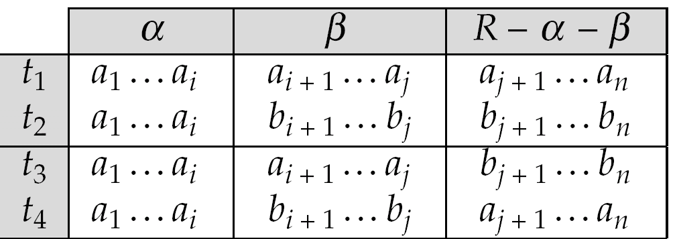
MVD (Cont.)
Tabular representation of α →→ β

Slide 67
Example
Let R be a relation schema with a set of attributes that are partitioned into 3 nonempty subsets.
Y, Z, W
We say that Y →→ Z (Y multidetermines Z )
if and only if for all possible relations r (R )
< y₁, z₁, w₁ > ∈ r and < y₂, z₂, w₂ > ∈ r
then
< y₁, z₁, w₂ > ∈ r and < y₂, z₂, w₁ > ∈ r
Note that since the behavior of Z and W are identical it follows that
Y →→ Z if Y →→ W

Slide 68
Example (Cont.)
In our example:
course →→ teacher
course →→ book
The above formal definition is supposed to formalize the notion that given a particular value of Y (course) it has associated with it a set of values of Z (teacher) and a set of values of W (book), and these two sets are in some sense independent of each other.
Note:
  If Y → Z then Y →→ Z
  Indeed we have (in above notation) Z₁ = Z₂
  The claim follows.

Slide 69
Use of Multivalued Dependencies
We use multivalued dependencies in two ways:
  1. To test relations to determine whether they are legal under a given set of functional and multivalued dependencies
  2. To specify constraints on the set of legal relations. We shall thus concern ourselves only with relations that satisfy a given set of functional and multivalued dependencies.
If a relation r fails to satisfy a given multivalued dependency, we can construct a relations r′ that does satisfy the multivalued dependency by adding tuples to r.

Slide 70
Theory of MVDs
From the definition of multivalued dependency, we can derive the following rule:
  If α → β, then α →→ β
That is, every functional dependency is also a multivalued dependency
The closure D⁺ of D is the set of all functional and multivalued dependencies logically implied by D.
  We can compute D⁺ from D, using the formal definitions of functional dependencies and multivalued dependencies.
  We can manage with such reasoning for very simple multivalued dependencies, which seem to be most common in practice
  For complex dependencies, it is better to reason about sets of dependencies using a system of inference rules (see Appendix C).

Slide 71
Fourth Normal Form
A relation schema R is in 4NF with respect to a set D of functional and multivalued dependencies if for all multivalued dependencies in D⁺ of the form α →→ β, where α ⊆ R and β ⊆ R, at least one of the following hold:
  α →→ β is trivial (i.e., β ⊆ α or α ∪ β = R)
  α is a superkey for schema R
If a relation is in 4NF it is in BCNF

Slide 72
Restriction of Multivalued Dependencies
The restriction of D to R_{i} is the set D_{i} consisting of
  All functional dependencies in D⁺ that include only attributes of R_{i}
  All multivalued dependencies of the form
    α →→ (β ∩ R_{i})
  where α ⊆ R_{i} and α →→ β is in D⁺

Slide 73
4NF Decomposition Algorithm
result: = {R};
done := false;
compute D⁺;
Let D_{i} denote the restriction of D⁺ to R_{i}
while (not done)
if (there is a schema R_{i} in result that is not in 4NF) then
begin
let α →→ β be a nontrivial multivalued dependency that holds
on R_{i} such that α → R_{i} is not in D_{i}, and α∩β=φ;
result := (result - R_{i}) ∪ (R_{i} - β) ∪ (α, β);
end
else done:= true;
Note: each R_{i} is in 4NF, and decomposition is lossless-join

Slide 74
Example
R =(A, B, C, G, H, I)
F ={ A →→ B
B →→ HI
CG →→ H }
R is not in 4NF since A →→ B and A is not a superkey for R
Decomposition
a) R₁ = (A, B) (R₁ is in 4NF)
b) R₂ = (A, C, G, H, I) (R₂ is not in 4NF)
c) R₃ = (C, G, H) (R₃ is in 4NF)
d) R₄ = (A, C, G, I) (R₄ is not in 4NF)
Since A →→ B and B →→ HI, A →→ HI, A →→ I
e) R₅ = (A, I) (R₅ is in 4NF)
f)R₆ = (A, C, G) (R₆ is in 4NF)

Slide 75
Chapter 7: Relational Database Design
7.1 Features of Good Relational Design
7.2 Atomic Domains and First Normal Form
7.3 Decomposition Using Functional Dependencies
7.4 Functional Dependency Theory
7.5 Algorithms for Functional Dependencies
7.6 Decomposition Using Multivalued Dependencies
7.7 More Normal Form
7.8 Database-Design Process
7.9 Modeling Temporal Data
7.10 Summary

Slide 76
Further Normal Forms
Join dependencies generalize multivalued dependencies
  lead to project-join normal form (PJNF) (also called fifth normal form)
A class of even more general constraints, leads to a normal form called domain-key normal form.
Problem with these generalized constraints: are hard to reason with, and no set of sound and complete set of inference rules exists.
Hence rarely used

Slide 77
Chapter 7: Relational Database Design
7.1 Features of Good Relational Design
7.2 Atomic Domains and First Normal Form
7.3 Decomposition Using Functional Dependencies
7.4 Functional Dependency Theory
7.5 Algorithms for Functional Dependencies
7.6 Decomposition Using Multivalued Dependencies
7.7 More Normal Form
7.8 Database-Design Process
7.9 Modeling Temporal Data
7.10 Summary

Slide 78
Overall Database Design Process
We have assumed schema R is given
  R could have been generated when converting E-R diagram to a set of tables.
  R could have been a single relation containing all attributes that are of interest (called universal relation).
  Normalization breaks R into smaller relations.
  R could have been the result of some ad hoc design of relations, which we then test/convert to normal form.

Slide 79
ER Model and Normalization
When an E-R diagram is carefully designed, identifying all entities correctly, the tables generated from the E-R diagram should not need further normalization.
However, in a real (imperfect) design, there can be functional dependencies from non-key attributes of an entity to other attributes of the entity
  Example: an employee entity with attributes department_number and department_address, and a functional dependency department_number → department_address
  Good design would have made department an entity
Functional dependencies from non-key attributes of a relationship set possible, but rare --- most relationships are binary

Slide 80
Denormalization for Performance
May want to use non-normalized schema for performance
For example, displaying customer_name along with account_number and balance requires join of account with depositor
Alternative 1: Use denormalized relation containing attributes of account as well as depositor with all above attributes
  faster lookup
  extra space and extra execution time for updates
  extra coding work for programmer and possibility of error in extra code
Alternative 2: use a materialized view defined as
account depositor
  Benefits and drawbacks same as above, except no extra coding work for programmer and avoids possible errors

Slide 81
Other Design Issues
Some aspects of database design are not caught by normalization
Examples of bad database design, to be avoided:
Instead of earnings (company_id, year, amount ), use
  earnings_2000, earnings_2001, earnings_2002, etc., all on the schema (company_id, earnings).
    Above are in BCNF, but make querying across years difficult and needs new table each year
  company_year(company_id, earnings_2000, earnings_2001,
  earnings_2002)
    Also in BCNF, but also makes querying across years difficult and requires new attribute each year.
    Is an example of a crosstab, where values for one attribute become column names
    Used in spreadsheets, and in data analysis tools

Slide 82
Chapter 7: Relational Database Design
7.1 Features of Good Relational Design
7.2 Atomic Domains and First Normal Form
7.3 Decomposition Using Functional Dependencies
7.4 Functional Dependency Theory
7.5 Algorithms for Functional Dependencies
7.6 Decomposition Using Multivalued Dependencies
7.7 More Normal Form
7.8 Database-Design Process
7.9 Modeling Temporal Data
7.10 Summary

Slide 83
Modeling Temporal Data
Temporal data have an association time interval during which the data are valid.
A snapshot is the value of the data at a particular point in time.
Adding a temporal component results in functional dependencies like
customer_id → customer_street, customer_city
not to hold, because the address varies over time
A temporal functional dependency holds on schema R if the corresponding functional dependency holds on all snapshots for all legal instances r (R )

Slide 84
Chapter 7: Relational Database Design
7.1 Features of Good Relational Design
7.2 Atomic Domains and First Normal Form
7.3 Decomposition Using Functional Dependencies
7.4 Functional Dependency Theory
7.5 Algorithms for Functional Dependencies
7.6 Decomposition Using Multivalued Dependencies
7.7 More Normal Form
7.8 Database-Design Process
7.9 Modeling Temporal Data
7.10 Summary

Slide 85
Ch 7: Summary (1)
We showed pitfalls in database design, and how to systematically design a database schema that avoids the pitfalls.
  The pitfalls included repeated information and inability to represent some information.
We introduced the concept of functional dependencies and showed how to reason with functional dependencies.
  We laid special emphasis on what dependencies are logically implied by a set of dependencies.
  We also defined the notion of a canonical cover, which is a minimal set of functional dependencies equivalent to a given set of functional dependencies.
We introduced the concept of decomposition, and showed that decompositions must be lossless-join decompositions, and should preferably be dependency preserving.

Slide 86
Ch 7: Summary (2)
If the decomposition is dependency preserving, given a database update, all functional dependencies can be verifiable from individual relations, without computing a join of relations in the decomposition.
We then presented Boyce-Codd Normal Form(BCNF); relations in BCNF are free from the pitfalls outlined earlier.
  We outlined an algorithm for decomposing relations into BCNF.
  There are relations for which there is no dependency preserving BCNF decomposition.
We used the canonical covers to decompose a relation into 3NF, which is a small relaxation of the BCNF condition.
  Relations in 3NF may have some redundancy, but there is always a dependency-preserving decomposition into 3NF.

Slide 87
Ch 7: Summary (3)
We presented the notion of multivalued dependencies, which specify constraints that cannot be specified with functional dependencies alone.
  We defined fourth normal form (4NF) with multivalued dependencies.
  Section C.1.1 of the appendix gives details on reasoning about multivalued dependencies.
Other normal forms, such as PJNF and DKNF, eliminate more subtle forms of redundancy.
  However, these are hard to work with and are rarely used.
  Appendix C gives detail on these normal forms.
In reviewing the issue in the this chapter, note that the reason we could define rigorous approaches to relational-database design is that the relational data advantages of the relational model compared with the other data models that we have studied.

Slide 88
Ch 7: Bibliographical Notes (1)
The first discussion of relational-database design theory appeared in an early paper by Codd [1970]. In that paper, Codd also introduced functional dependencies, and first, second, and third normal forms.
Armstrong’s axioms were introduced in Armstrong [1974].
Ullman [1988] is an easily accessible source of proofs of soundness and completeness of Armstrong’s axioms.
Ullman [1988] also provides an algorithm for testing for lossless-join decomposition for general (nonbinary) decompositions, and many other algorithms, theorems, and proofs concerning dependency theory.
Maier [1983] discusses the theory of functional dependencies.
Graham et al. [1986] discusses formal aspects of the concept of a legal relation.
BCNF was introduced in Codd [1972].
The desirability of BCNF is discussed in Bernstein et al. [1980a].
A polynomial-time algorithm for BCNF decomposition appears in Tsou and Fischer [1982], and can also be found in Ullman [1988].

Slide 89
Ch 7: Bibliographical Notes (2)
Biskup et al. [1979] gives the algorithm we used to find a lossless-join dependency-preserving decomposition into 3NF.
Fundamental results on the lossless-join property appear in Aho et al. [1979a].
Multivalued dependencies are discussed in Zaniolo [1976].
Beeri et al. [1977] gives a set of axioms for multivalued dependencies, and proves that the authors axioms are sound and complete. Our axiomatization is based on theirs.
The notions of 4NF, PJNF, and DKNF are from Fagin [1977], Fagin [1979], and Fagin [1981], respectively.
Maier [1983] presents the design theory of relational databases in detail.
Ullman [1988] and Abiteboul et al. [1995] present a more theoretic coverage of many of the dependencies and normal forms presented here.
See the bibliographical notes of Appendix C for further references to literature on normalization.

Slide 90
Chapter 7: Relational Database Design
Features of Good Relational Design
Atomic Domains and First Normal Form
Decomposition Using Functional Dependencies
Functional Dependency Theory
Algorithms for Functional Dependencies
Decomposition Using Multivalued Dependencies
More Normal Form
Database-Design Process
Modeling Temporal Data
Summary

Slide 91
End of Chapter

Slide 92
Proof of Correctness of 3NF Decomposition Algorithm

Slide 93
Correctness of 3NF Decomposition Algorithm
3NF decomposition algorithm is dependency preserving (since there is a relation for every FD in F_{c})
Decomposition is lossless
  A candidate key (C ) is in one of the relations R_{i} in decomposition
  Closure of candidate key under F_{c} must contain all attributes in R.
  Follow the steps of attribute closure algorithm to show there is only one tuple in the join result for each tuple in R_{i}

Slide 94
Correctness of 3NF Decomposition Algorithm (Cont’d.)
Claim: if a relation R_{i} is in the decomposition generated by the
above algorithm, then R_{i} satisfies 3NF.
Let R_{i} be generated from the dependency α → β
Let γ → B be any non-trivial functional dependency on R_{i}. (We need only consider FDs whose right-hand side is a single attribute.)
Now, B can be in either β or α but not in both. Consider each case separately.

Slide 95
Correctness of 3NF Decomposition (Cont’d.)
Case 1: If B in β:
  If γ is a superkey, the 2nd condition of 3NF is satisfied
  Otherwise α must contain some attribute not in γ
  Since γ → B is in F⁺ it must be derivable from F_{c}, by using attribute closure on γ.
  Attribute closure not have used α →β. If it had been used, α must be contained in the attribute closure of γ, which is not possible, since we assumed γ is not a superkey.
  Now, using α→ (β- {B}) and γ → B, we can derive α →B
  (since γ ⊆ α β, and B ∉ γ since γ → B is non-trivial)
  Then, B is extraneous in the right-hand side of α →β; which is not possible since α →β is in F_{c}.
  Thus, if B is in β then γ must be a superkey, and the second condition of 3NF must be satisfied.

Slide 96
Correctness of 3NF Decomposition (Cont’d.)
Case 2: B is in α.
  Since α is a candidate key, the third alternative in the definition of 3NF is trivially satisfied.
  In fact, we cannot show that γ is a superkey.
  This shows exactly why the third alternative is present in the definition of 3NF.
Q.E.D.

Slide 97
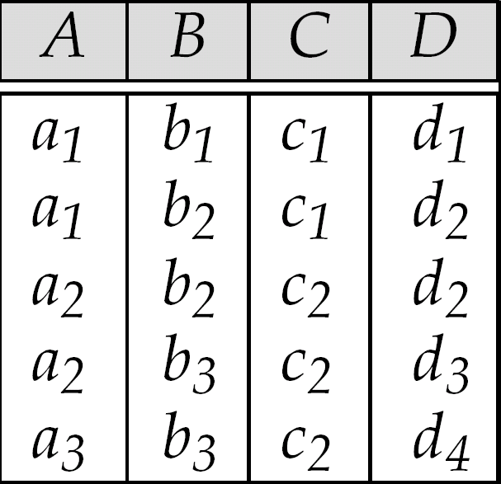
Figure 7.5: Sample Relation r

Slide 98
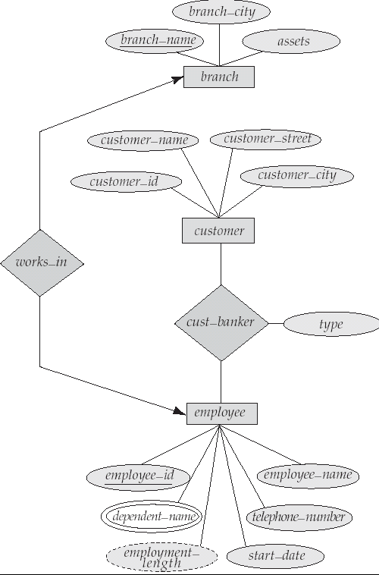
Figure 7.6

Slide 99
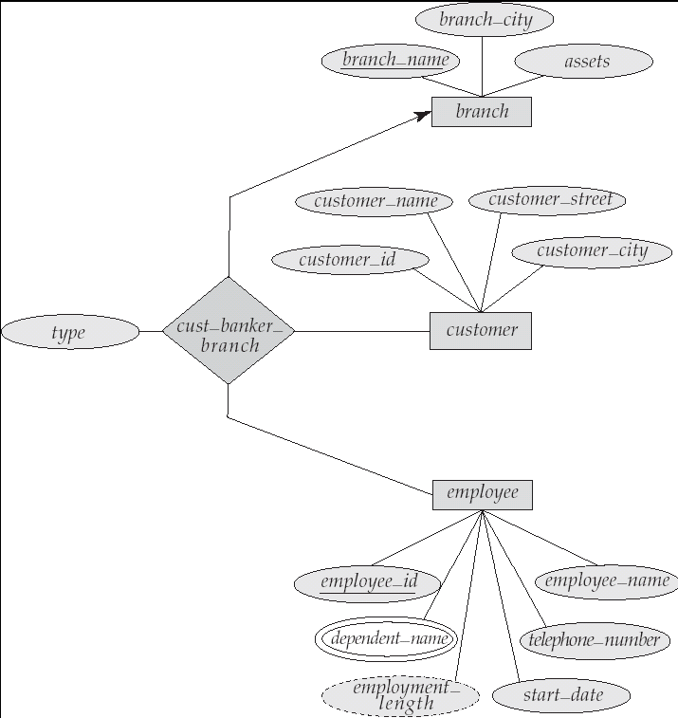
Figure 7.7

Slide 100
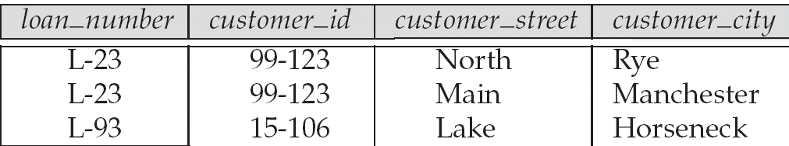
Figure 7.15: An Example of
Redundancy in a BCNF Relation

Slide 101
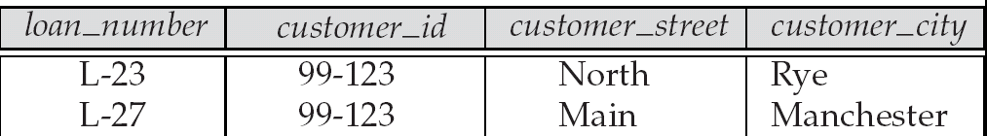
Figure 7.16: An Illegal R₂ Relation

Slide 102
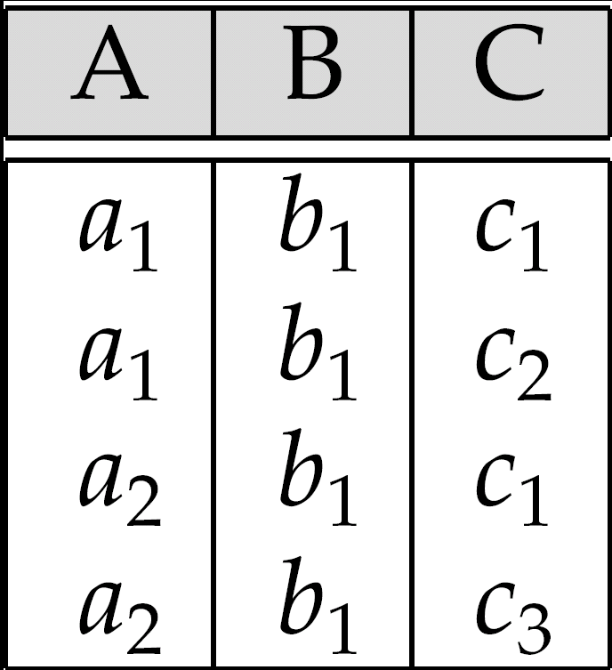
Figure 7.18: Relation of Practice Exercise 7.2

