Slide 1
Large-Scale SMS Messages Mining Based on Map-Reduce
Tian XIA
Renmin University of China
2008 IEEE (International Symposium on Computational Intelligence and Design)
11 January 2012
Hyewon Kim

Slide 2
Outline
Introduction
Mining Approach
Results
Conclusion
Discussion

Slide 3



Introduction
Finding out the popular SMS messages in a short period of time is very useful!
POPULAR SMS messages!
OLAP-based mining

Slide 4
Outline
Introduction
Mining Approach
Mining Task
Data pre-processing
Popular SMS messages extracting
Merging similar messages semantically
Results
Conclusion
Discussion

Slide 5

Mining Approach (1/9) Mining Task
Finding out the popular SMS messages in a short period of time
Every popular message must be send or forward many times among many users
Every popular message’s content size should not be too small
Different popular messages with the same meaning should be merged as one
What is a ‘POPULAR’ message?

Slide 6



Mining Approach (2/9) Data pre-processing
We normalize the SMS messages and remove unnecessary SMS messages in the data pre-processing phase
Decoding
Combining
Restoring the messages which are split by gateway and scattered in raw files
Filtering
SMPN (Sender’s mobile phone number) | RMPN (Receiver’s mobile phone number) | Send Time | Length | Encoded Content
응
Short SMPN
(broadcasting)
From blacklist
Short content

Slide 7
Mining Approach (3/9) Data pre-processing
MR-1: Pre-processing
MAP
<key, value>
Decoding
Filtering
<SMPN, SMS>
<1, [29555417, 55051222, 20120110111630, 2, 응응]>
<1, [29555417, 55051222, 20120110111630, 2, ##########]>
<2, [40596547, 55051222, 20120107154045, 4, 어디야?]>
<40596547, [40596547, 55051222, 20120107154045, 4, 어디야?]>
<2, [40596547, 55051222, 20120107154045, 4, 어디야?]>
<2, [40596547, 55051222, 20120107154045, 4, @@@@@@@@@@]>
<3, [55051222, 42466003, 20120108134535, 6, 엄마카드로머]>
<55051222, [55051222, 42466003, 20120108134535, 6, 엄마카드로머]>
<3, [55051222, 42466003, 20120108134535, 6, 엄마카드로머]>
<3, [55051222, 42466003, 20120108134535, 6, $$$$$$$$$$]>
<4, [55051222, 42466003, 20120108134536, 6, 리잘라도돼?]>
<55051222, [55051222, 42466003, 20120108134536, 6, 리잘라도돼?]>
<4, [55051222, 42466003, 20120108134536, 6, 리잘라도돼?]>
<4, [55051222, 42466003, 20120108134536, 5, %%%%%%%%%%]>
Reduce
<SMPN, SMS>
Combining
<SMPN, SMSList>
<40596547, [40596547, 55051222, 20120107154045, 4, 어디야?]>
<40596547, [40596547, 55051222, 20120107154045, 4, 어디야?]>
<55051222, [55051222, 42466003, 20120108134535, 6, 엄마카드로머]>
<55051222, [55051222, 42466003, 20120108134535, 12, 엄마카드로머리잘라도돼?]
<55051222, [55051222, 42466003, 20120108134536, 6, 리잘라도돼?]>

Slide 8
Mining Approach (4/9) Popular SMS messages extracting
We need to transform the <key, value> pairs
We use the refined content as the new key instead of using the full text content
ONLY Chinese sentence
Named entities are removed
Special characters are removed
The new content size should be smaller than 15
<SMPN, SMSList>
<Content, SenderList>

Slide 9
Mining Approach (5/9) Popular SMS messages extracting
MR-2: Making refined contents as a new key
MAP
<SMPN, SMS>
Removing
Resizing
<Content, SMS>
<29555417, [29555417, 55051222, 20120110111630, 15, 누나언제집에와?]>
<29555417, [29555417, 55051222, 20120110111630, 15, 누나언제집에와?]>
<누나언제집에와?, [29555417, 55051222, 20120110111630, 15, 누나언제집에와?]>
<55051222, [55051222, 55666777, 20120107154045, 10, 강남에서만나자]>
<55051222, [55051222, 55666777, 20120107154045, 10, 강남에서만나자]>
< 강남에서만나자, [55051222, 55666777, 20120107154045, 10, 강남에서만나자]>
<55666777, [55666777, 26808160, 20120108134535, 12, 전달:강남에서만나자]>
<55666777, [55666777, 26808160, 20120108134535, 12, 강남에서만나자]>
<강남에서만나자, [55666777, 26808160, 20120108134535, 12, 강남에서만나자]>
<26808160, [26808160, 99721223, 20120109151526, 14, 전달:전달:강남에서만나자]>
<26808160, [26808160, 99721223, 20120109151526, 14, 강남에서만나자]>
<강남에서만나자, [26808160, 99721223, 20120109151526, 14, 강남에서만나자]>
Reduce
<Content, SMS>
Merging
<Content, SenderList>
<누나언제집에와?, [29555417, 누나언제집에와?]>
<누나언제집에와?, [29555417, 누나언제집에와?]>
< 강남에서만나자, [55051222, 강남에서만나자]>
< 강남에서만나자, [[55051222, 강남에서만나자],
<강남에서만나자, [55666777, 전달:강남에서만나자]>
[55666777, 전달:강남에서만나자],
<강남에서만나자, [26808160, 전달:전달:강남에서만나자]>
[26808160, 전달:전달:강남에서만나자]>

Slide 10
Mining Approach (6/9) Popular SMS messages extracting
MR-3: Finding out popular messages
MAP
<Content, SenderList>
Counting
<Content, SenderList>
≥ threshold φ
<누나언제집에와?, [29555417, 누나언제집에와?]>
< 강남에서만나자, [[55051222, 강남에서만나자], [55666777, 전달:강남에서만나자], [26808160, 전달:전달:강남에서만나자]]>
3
Reduce
<Content, SenderList>

Slide 11


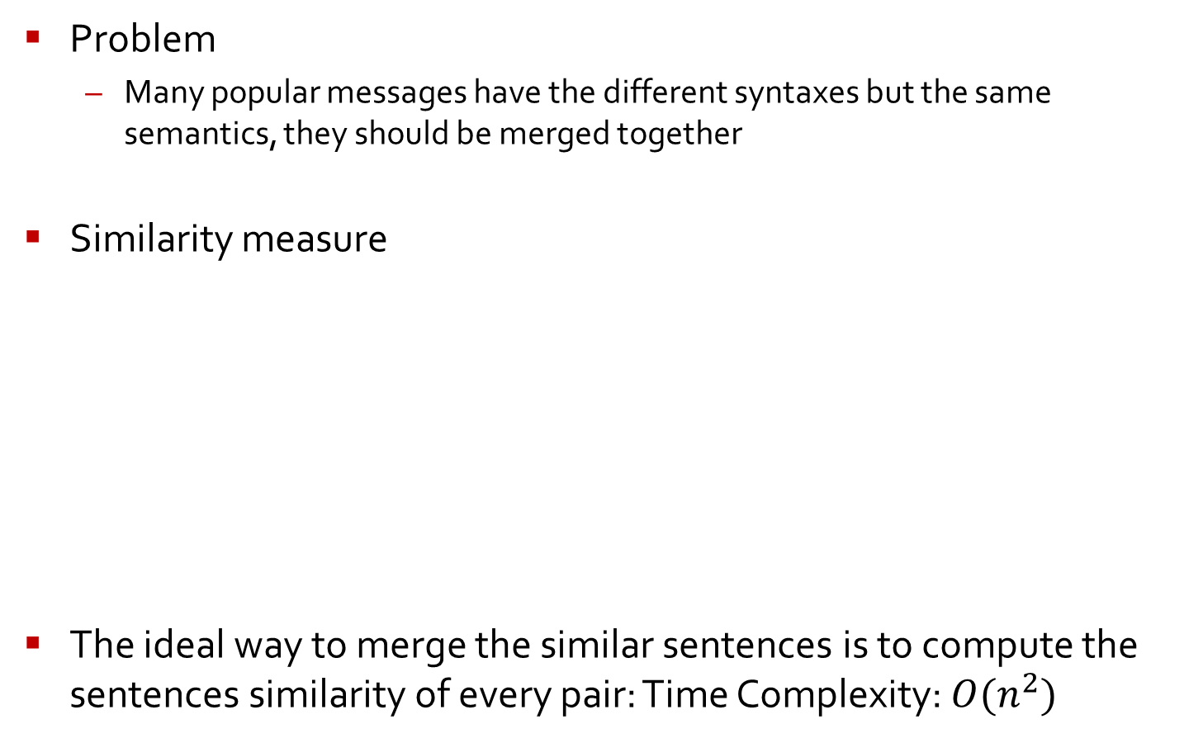
Mining Approach (7/9) Merging similar messages semantically
Problem
Many popular messages have the different syntaxes but the same semantics, they should be merged together
Similarity measure
The ideal way to merge the similar sentences is to compute the sentences similarity of every pair: Time Complexity: $O(n^{2})$
Sentence $S_{i}$: {$w_{i1}$, $w_{i2}$, $w_{i3}$, $w_{i4}$, … , $w_{im}$}
Sentence $S_{j}$: {$w_{j1}$, $w_{j2}$, $w_{j3}$, $w_{j4}$, … , $w_{jn}$}

Slide 12










Mining Approach (8/9) Merging similar messages semantically
Forward Merging and K-Neighbor Checking (FMKC)
Time Complexity: $O(n)$
L = ($S_{1}$, $S_{2}$, … , $S_{n}$) is a sorted list of n sentences
k
$$S_{1}$$
$$S_{2}$$
$$S_{3}$$
$$S_{4}$$
$$S_{5}$$
…
$$S_{n}$$
$$S_{i}$$
$$S_{j}$$
$$S_{j}$$
Calculate the similarity Θ
If similarity Θ is higher than threshold

Slide 13
Mining Approach (9/9) Merging similar messages semantically
MR-4: Merging similar messages
We divide the popular messages into several groups by the two-character length prefix in a Map function
All these groups can be processed in parallel to save the processing time
MAP
Reduce

Slide 14
Outline
Introduction
Mining Approach
Results
Conclusion
Discussion

Slide 15


Results (1/3)
Results for different φ in MR-3
Hadoop 0.13.1
2 processors and 2G RAM
42285.8M raw files
7 nodes
 | φ = 5 | φ = 10 | φ = 20
DCPM (the different count of popular messages) | 299,016 | 225,015 | 128,794
SCPM (the sending count of popular messages) | 54,239,289 | 53,283,689 | 52,389,732

Slide 16
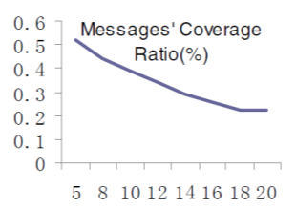
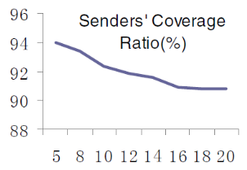
Results (2/3)
Coverage ratio for different φ
MR-1, MR-2 and MR-3 can mining the popular messages in parallel and efficiently
The top 128,794 messages (0.22% of total valid messages) even cover the 90.78% of all valid sending counts

Slide 17
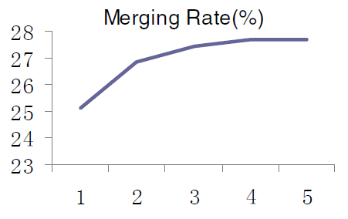
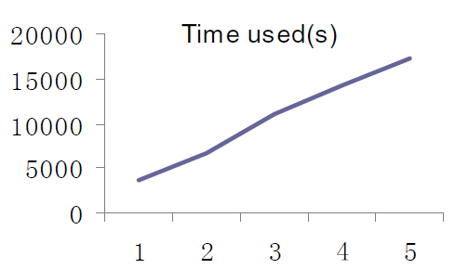
Results (3/3)
Merging results for different k
The merging rate increases very slow when the k increased, while the processing time increases very significantly

Slide 18
Outline
Introduction
Mining Approach
Results
Conclusion
Discussion

Slide 19
Conclusion
We aimed to extract the popular SMS messages in a short period of time based on MapReduce framework
Experimental results show that our approach can find the popular messages out at reasonable cost

Slide 20
Outline
Introduction
Mining Approach
Results
Conclusion
Discussion

Slide 21
Discussion
Strong point
A topic relevant to social data mining using mapreduce
Description of the algorithms in detail
It presents a roughly outline of the mining using mapreduce
Weak point
Poor English
Insufficient experiments to show its performance
SMS messages don’t be a measure to represent public opinion any more

Slide 22
谢谢

