Slide 1
A New Suffix Tree Similarity Measure for Document Clustering
Hung Chim, Xiaotie Deng
City University of Hong Kong
WWW 2007
Session: Similarity Search
Internet Database Lab., SNU
Hyewon Lim
April 11, 2008

Slide 2
Contents
Introduction
Related Work
A New Suffix Tree Similarity Measure
A Practical Approach
Evaluation
Conclusions and Future Work

Slide 3
Introduction (1/3)
BBS, Weblog and Wiki
  Computer have no understanding of the content and meaning of the submitted information data.
  Assessing and classifying the information data
    Relied on the manual work of a few experienced people
    Grows of a community → manual work become heavier
Document clustering algorithms
  Group document together based on their similarities.
The objective our work
  Develop a document clustering algorithm to categorize the Web documents in an online community.

Slide 4
Introduction (2/3)
VSD model
  Very widely used
  Represent any document as a feature vector of the words
  The similarity between two documents is computed with similarity measures.
  Sequence order of words is seldom considered
STC algorithm
  A linear time clustering algorithm
    Based on identifying phrases that are common to groups of documents.
  Lacks an efficient similarity measure

Slide 5
Introduction (3/3)
We focused our work on how to combine the advantages of two document models in document clustering.
The new suffix tree similarity measure
  Combination of the word’s sequence order consideration of suffix tree model and the term weighting scheme of VSD model

Slide 6
Contents
Introduction
Related Work
A New Suffix Tree Similarity Measure
A Practical Approach
Evaluation
Conclusions and Future Work

Slide 7
Related Work (1/2)
The method used for document clustering
  1. Agglomerative Hierarchical Clustering Algorithm
    Most commonly used algorithm among the numerous document clustering algorithm.
    Can often generate a high quality clustering result with a tradeoff of a higher computing complexity.
  2. VSD model
    Words or characters are considered to be atomic elements.
    Clustering methods based on VSD model mostly make use of single word term analysis of document data set.

Slide 8
Related Work (2/2)
The method used for document clustering
  3. Suffix tree document model
    Considers a document to be a set of suffix substrings
    Common prefixes of the suffix substrings are selected as phrases to label the edges of a suffix tree.
    STC algorithm
      Developed based on this model
      Works well in clustering Web document snippets

Slide 9
Contents
Introduction
Related Work
A New Suffix Tree Similarity Measure
A Practical Approach
Evaluation
Conclusions and Future Work

Slide 10
A New Suffix Tree Similarity Measure
- Suffix Tree Document Model and STC Algo. (1/4)
Document model
  A concept that describes how a set of meaningful features in extracted from a document.
Suffix tree document model
  A document d=w₁w₂…w_{m} as a string consisting of words w_{i}, not characters (i=1,2,…,m)
  Suffix tree of document d is a compact trie containing all suffixes of document d.

Slide 11
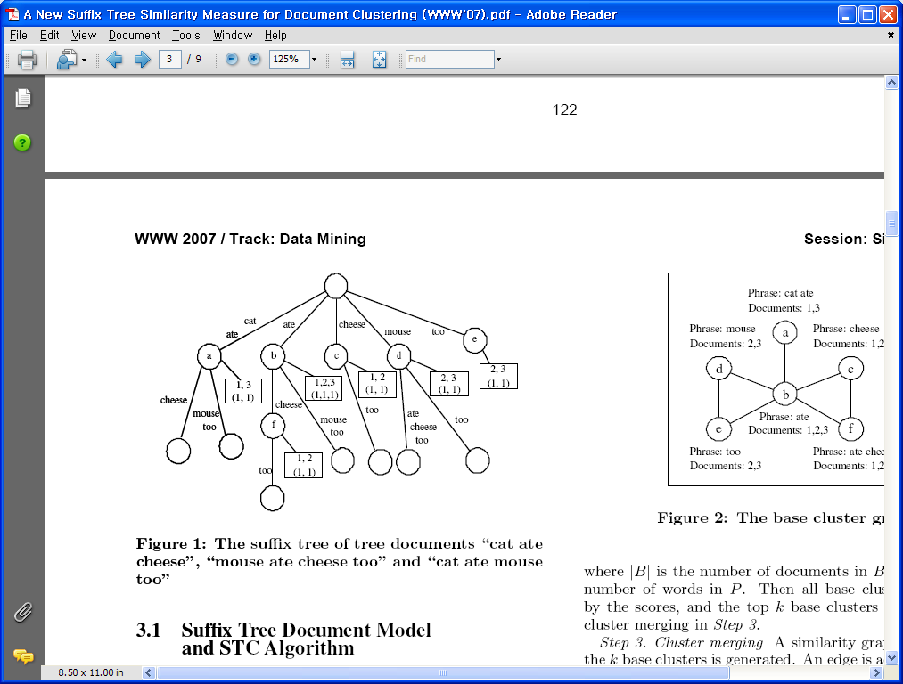
A New Suffix Tree Similarity Measure
- Suffix Tree Document Model and STC Algo. (2/4)

Slide 12
A New Suffix Tree Similarity Measure
- Suffix Tree Document Model and STC Algo. (3/4)
The original STC algorithm
  Developed based on the suffix tree document model.
  Three logical steps:
    1. the common suffix tree generating
      A suffix tree S for all suffixes of each document in D = {d₁,d₂, …, d_{N}} is constructed.
    2. base cluster selecting
      s(B) = |B|· f(|P|)
      All base clusters are sorted by the scores, and the top k base clusters are selected for cluster merging.
    3. cluster merging
      A similarity graph consisting of the k base clusters is generated.

Slide 13
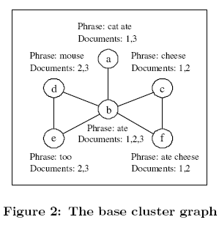
A New Suffix Tree Similarity Measure
- Suffix Tree Document Model and STC Algo. (4/4)

Slide 14
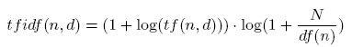
A New Suffix Tree Similarity Measure
- The New Suffix Tree Similarity Measure (1/2)
Mapping all nodes n of the common suffix tree to a M dimensional space of VSD model,
  D = {w(1,d), w(2,d), …, w(M, d)}
  df(n): the number of the different documents that have traversed node n
  tf(n, d): total traversed times of document d through node n
  w(n, d): weight of node n

Slide 15
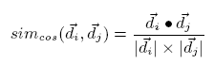
A New Suffix Tree Similarity Measure
- The New Suffix Tree Similarity Measure (2/2)
After obtaining the term weights of all nodes,
  apply traditional similarity measures like the cosine similarity to compute the similarity of two documents.

Slide 16
A New Suffix Tree Similarity Measure
- A Closer Look to Suffix Tree Doc Model (1/3)
In suffix tree document model,
  Document is considered as a string consisting of words, not characters.
  O(m²) times
    The naïve, straightforward method to build a suffix tree for a document of m words
  Ukkonen’s paper
    Time complexity of building a suffix tree: O(m)
    Makes it possible to build a large incremental suffix tree online

Slide 17
A New Suffix Tree Similarity Measure
- A Closer Look to Suffix Tree Doc Model (3/3)
Stopword
  Use a standard Stopwards List and Porter stemming algorithm to preprocess the document to get “clean” doc.
  Words appearing in the stoplist, or that appear in too few or too many documents receives a score of zero in computing the score s(B) of a base cluster.
  “stopnode”
    Same idea of stopwords in the suffix tree similarity measure computation
    Threadhold idf_{thd} of idf is given to identify whether a node is a stopnode.

Slide 18
Contents
Introduction
Related Work
A New Suffix Tree Similarity Measure
A Practical Approach
Evaluation
Conclusions and Future Work

Slide 19
A Practical Approach: Web Document Clustering In online Forum Communities (1/5)
Web document clustering algorithm has three logical steps:
  Document preparing
  Document clustering
  Cluster topic summary generating

Slide 20
A Practical Approach: Web Document Clustering In online Forum Communities (2/5)
Document Preparing
  Content of a topic thread in a forum consists of a topic post and the reply posts.
    Each post is saved as a tuple
  To prepare a text document with respect to a topic thread,
    Access the tuples from DB table directly
    Combine all posts of the same thread into a single document
    Before adding a post into the doc, a doc “cleaning” procedure is executed
    After cleaning, the posts containing at least 3 distinct words are selected for document merging.

Slide 21
A Practical Approach: Web Document Clustering In online Forum Communities (3/5)
Document Clustering
  Each thread document is fetched from the corresponding table, and inserted into a suffix tree.
  The tf and df of each node have been calculated during constructing the suffix tree.
  The pairwise similarity of two documents can be computed with cosine similarity measure.

Slide 22
A Practical Approach: Web Document Clustering In online Forum Communities (4/5)
Cluster Topic Summary Generating (1/2)
  Topic summary generating concerns two important information retrieval work:
    1) ranking the documents in a cluster by a quality score
    2) extracting common phrases as the topic summary of the corresponding cluster

Slide 23
A Practical Approach: Web Document Clustering In online Forum Communities (5/5)
Cluster Topic Summary Generating (2/2)
  Evaluating quality of cluster and its documents is still a challenging research
    The Web documents of a forum system can provide some additional human assessments for the document quality evaluation
    3 statistical scores provided in our forum system, view clicks, reply posts and recommend clicks.
      q(d) = |d|· v· r· c
    All documents in the same cluster are sorted by their quality scores.

Slide 24
Contents
Introduction
Related Work
A New Suffix Tree Similarity Measure
A Practical Approach
Evaluation
Conclusions and Future Work

Slide 25
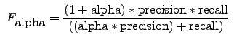
Evaluation (1/2)
F-Measure
  Commonly used in evaluating the effectiveness of clustering and classification algorithms.
  The weighted harmonic mean of precision and recall.
  Formula of F-measure:

Slide 26
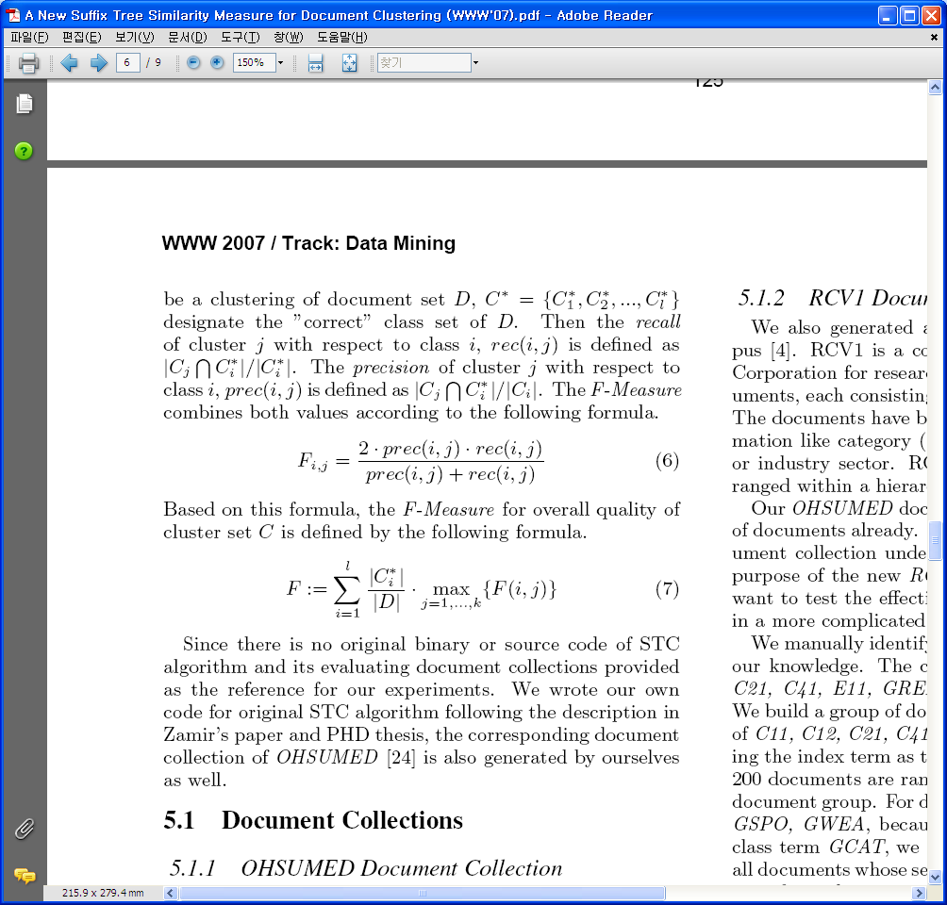
Evaluation (2/2)
F-Measure
  It combines the precision and recall idea from IR:
  The F-Measure for overall quality of cluster set C:
rec(i, j) = |C_{j} ∩C_{i}*|/|C_{i}*|
prec(i, j) = |C_{j} ∩C_{i}*|/|C_{i}|
C: a clustering of document set D
C*: the “correct” class set of D

Slide 27
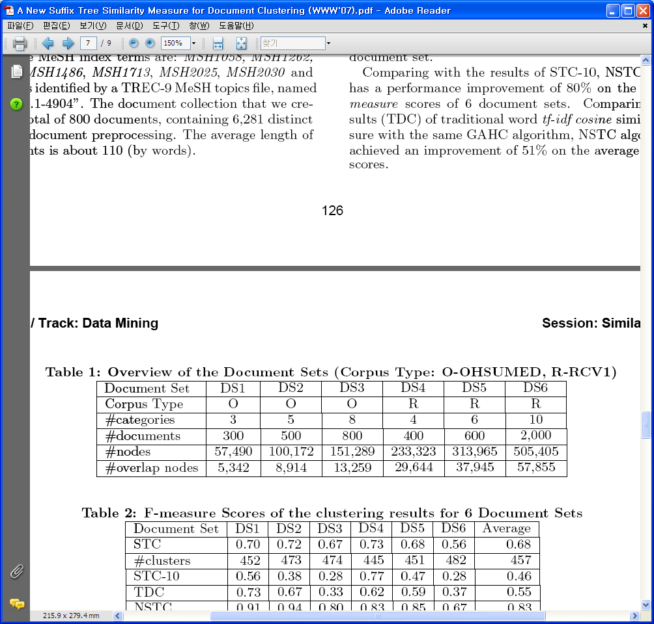
Evaluation
- Results and Discussion (1/5)
We constructed document sets from OHSUMED and RCV1 document collections

Slide 28
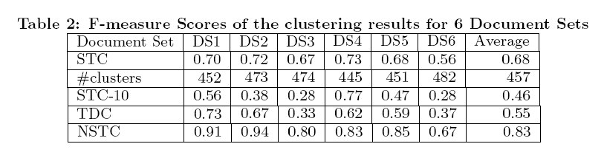
Evaluation
- Results and Discussion (2/5)
  NSTC: results of the new suffix tree similarity measure
  TDC: results of traditional word tf-idf cosine similarity measure
  STC: results of all clusters generated by STC algorithm
  STC-10: results of the top 10 clusters generated by orginal STC algorithm

Slide 29
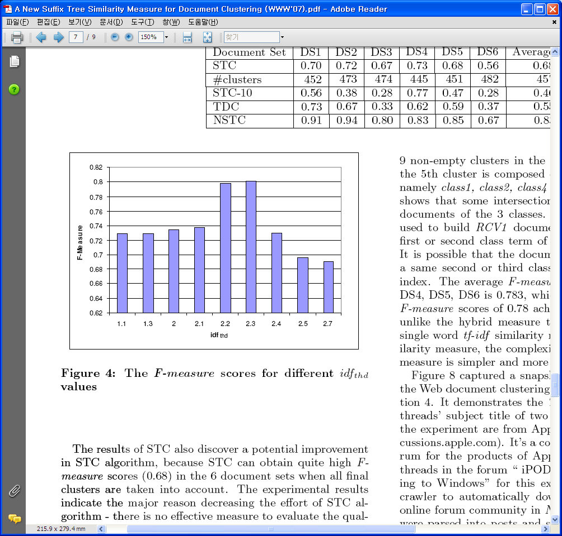
Evaluation
- Results and Discussion (3/5)
  Result from DS3 document set

Slide 30
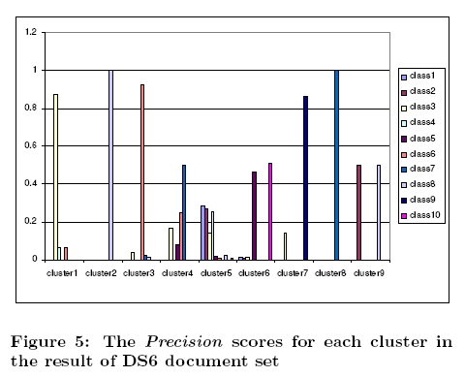
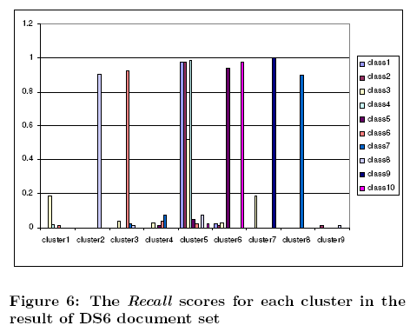
Evaluation
- Results and Discussion (4/5)

Slide 31
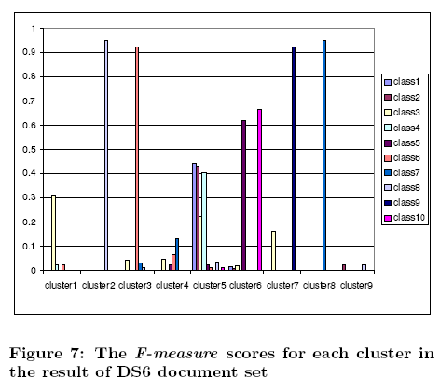
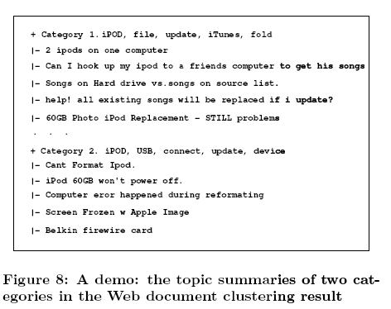
Evaluation
- Results and Discussion (5/5)

Slide 32
Contents
Introduction
Related Work
A New Suffix Tree Similarity Measure
A Practical Approach
Evaluation
Conclusions and Future Work

Slide 33
Conclusions and Future Work (1/2)
  VSD model and suffix tree model
    Two models are used in two isolated ways:
      Almost all clustering algorithms based on VSD model
        ignore the occurring position of words in the document
        the different semantic meanings of a word in different sentences are unavoidably discarded
      Suffix tree document model
        Keeps all sequential characteristics of the sentences for each document
        Phrases consisting of one or more words are used to designate the similarity of two documents.
        Original STC algorithms cannot provide an effective evaluation method to assess the quality of clusters.

Slide 34
Conclusions and Future Work (2/2)
  New suffix tree similarity measure
    Connect both two document models.
      Mapping all nodes in the common suffix tree into a M dimensional space of VSD model
      The advantages of two document models are smoothly inherited in the new similarity measure.
  The new similarity measure is suitable to not only hierarchical clustering algorithm but also most traditional clustering algorithms based on VSD model.
  Future Work
    More performance evaluation comparisons for these clustering algorithms with the new similarity measure.

