Slide 1
MapReduce: Simplified Data Processing on Large Clusters
Jeffrey Dean and Sanjay Ghemawat
Google, Inc
OSDI 2004
August 10, 2011
Hyewon Kim

Slide 2
Outline
Introduction
Programming model
Implementation
Refinements
Performance

Slide 3




Introduction (1/3)
We should process large amounts of raw data!
Issues;
Parallelization the computation
Distribution the data
Handle failures

Slide 4


Introduction (2/3)
MapReduce
Map function
processes a key/value pairs to generate a set of intermediate key/value pairs
Reduce function
merges all intermediate values associated with the same intermediate key
Library
Parallelization
Fault-tolerance
Data distribution
Load balancing
……
map
reduce

Slide 5





Introduction (3/3)
It has been used across a wide range of domains within Google
large-scale machine learning
large-scale graph computation
clustering
Extraction of data used to produce reports

Slide 6
Outline
Introduction
Programming model
Implementation
Refinements
Performance

Slide 7
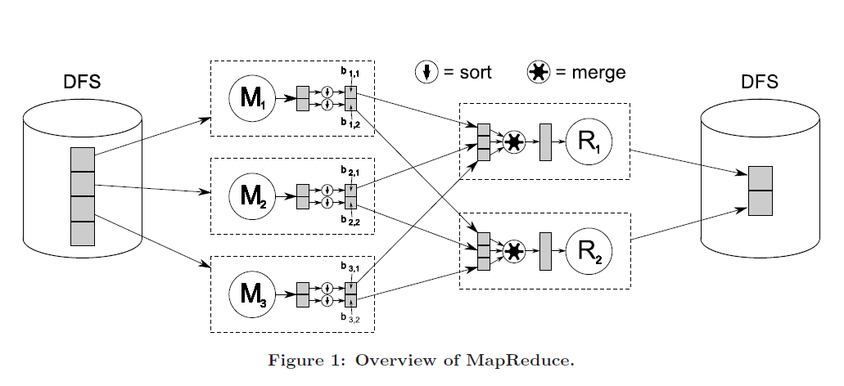
Programming model (1/2)

Slide 8
Programming model (2/2) Example
Find the maximum global temperature recorded in each year
The raw NCDC Data
1950051507004...9999999N9+00001+
1949032412004...0500001N9+01111+
1950051512004...9999999N9+00221+
1950051518004...9999999N9-00111+
1949032418004...0500001N9+00781+
map
reduce
input
shuffle
output
(0, 1950051507004...9999999N9+00001+)
(1, 1949032412004...0500001N9+01111+)
(2., 1950051512004...9999999N9+00221+)
(1950, 0)
(1949, 111)
(1950, 22)
(1949, 111)
(1949, 111)
(1949, <78, 111>)
(1949, 111)
(1950, 22)
(1950, 0)
(1950, 0)
(1950, 22)
(3, 1950051518004...9999999N9-00111+)
(4, 1949032418004...0500001N9+00781+)
(1950, -11)
(1949, 78)
(1949, 78)
(1949, 78)
(1950, <0, 22, -11>)
(1950, <0, 22>)
(1950,-11)
(1950,-11)

Slide 9
Outline
Introduction
Programming model
Implementation
Refinements
Performance

Slide 10


Implementation (1/7) Execution overview
Input
Split the input files into M pieces of typically 16 MB to 64MB per piece
Start up many copies of the program on a cluster of machines
M Splits
16~64MB
The master assigns each worker a map task or a reduce task
M map tasks & R reduce tasks
master
Map
Map
Map
worker
worker
worker
Reduce
Reduce
worker
worker

Slide 11

Implementation (2/7) Locality
Network bandwidth is a relatively scare resource
Input data is stored on the local disks of the machines that make up our cluster
GFS stores several copies of each block on different machines
Input
M Splits
16~64MB
Map

Slide 12


Implementation (3/7) Execution overview
Input
Map
parsing
(key, value)
M Splits
16~64MB
Map function
(key, value)
master
intermediate(key, value)
Map
Map
Map
Buffer
intermediate(key, value)
worker
worker
worker
Periodically!
Local disk
Reduce
Reduce
Location and Size
worker
worker
R partitions

Slide 13
Implementation (4/7) Master Data Structures
The master is the conduit
The location of intermediate file regions is propagated from map to reduce
State and Identity
(idle | in-progress | completed)
Map task is completed!
Map
worker
The information is pushed to workers that have in-progress reduce tasks
master
Locations and sizes of the R intermediate file
Reduce
worker

Slide 14



Implementation (5/7) Execution overview
Input
Reduce
1. Reduce tasks is notified by the master about intermediate data location
M Splits
16~64MB
2. Read the buffered data from the local disks of the map workers
3. Sort the intermediate data by it keys → all occurrences of the same key are grouped
Location and Size
Location and Size
master
Merged intermediate (key, value)
Map
Map
Map
Reduce function
worker
worker
worker
intermediate(key, value)
Using RPC !
Reduce
Reduce
Final output file
In GFS
(global file system)
worker
worker

Slide 15
Implementation (6/7) Fault Tolerance
Master Failure
Master writes periodic checkpoints
If master tasks dies
A new copy can be started from the last check pointed state
Worker Failure
Master pings every worker periodically
MapReduce is resilient to large-scale worker failures
master
Map
Idle
- In-progress
- Completed!
Reduce
Idle
- In-progress
- Completed!
Re-excute!
DON’T re-excute!
worker
worker
Idle
- In-progress
Idle
- In-progress
Idle
Idle

Slide 16

Implementation (7/7) Backup Tasks
Straggler
Takes an unusually long time to complete one of the last few tasks
Master schedules backup executions of the remaining in-progress tasks
backup
Straggler
The task is marked as completed whenever either the primary or the backup execution completes

Slide 17
Outline
Introduction
Programming model
Implementation
Refinements
Performance

Slide 18
Refinements
Although the basic functionality provided by Map and Reduce functions is sufficient for most needs we have found a few extensions useful
Partitioning Function
Ordering Guarantees
Combiner Function
Input and Output Types
Side-effects
Skipping Bad Records
Local Execution
Status Information
Counters

Slide 19
Refinements Partitioning Function
Data gets partitioned across reduce tasks using a partitioning function on the intermediate key
Default partitioning function
Hash(key) mod R
R: The number of reduce tasks
map
reduce
input
shuffle
output
(0, 1950051507004...9999999N9+00001+)
(1, 1949032412004...0500001N9+01111+)
(2., 1950051512004...9999999N9+00221+)
(1950, 0)
(1949, 111)
(1950, 22)
(1949, 111)
(1949, 111)
(1949, <78, 111>)
(1949, 111)
(1950, 22)
(1950, 0)
(1950, 0)
(1950, 22)
(3, 1950051518004...9999999N9-00111+)
(4, 1949032418004...0500001N9+00781+)
(1950, -11)
(1949, 78)
(1949, 78)
(1949, 78)
(1950, <0, 22, -11>)
(1950, <0, 22>)
(1950,-11)
(1950,-11)

Slide 20
Refinements Combiner Function
Significant repetition in the intermediate keys
Combine once in map task for saving network bandwidth
Typically the same as reduce function, but output is an intermediate file
Combiner function
map
reduce
input
shuffle
output
(0, 1950051507004...9999999N9+00001+)
(1, 1949032412004...0500001N9+01111+)
(2., 1950051512004...9999999N9+00221+)
(1950, 0)
(1949, 111)
(1950, 22)
(1949, 111)
(1949, 111)
(1949, <78, 111>)
(1949, 111)
(1950, 22)
(1950, 0)
(1950, 0)
(1950, 22)
(1950, 22)
(3, 1950051518004...9999999N9-00111+)
(4, 1949032418004...0500001N9+00781+)
(1950, -11)
(1949, 78)
(1950, <22, -11>)
(1949, 78)
(1949, 78)
(1950, <0, 22, -11>)
(1950, <0, 22>)
(1950,-11)
(1950,-11)

Slide 21
Refinements Skipping Bad Records
Ignore certain records that make tasks crash due to bugs
Install a signal handler to catch segmentation violations and bus errors
If user code generates a signal, the handler sends a “last gasp” packet to master
The master indicates that the record should be skipped when it is re-executed

Slide 22
Outline
Introduction
Programming model
Implementation
Refinements
Performance

Slide 23

Performance (1/2)
Sort program
Sorts ${10}^{10}$ 100-byte records
Map function
Extracts a 10-byte sorting key from a text line
Emits the key and the original text line as the intermediate key/value pair
Reduce function
Built-in Identity function
Output key/value pair is the unchanged intermediate key/value pair
3 different methods of execution
Normal execution
No backup tasks
200 tasks killed
100-byte : value
input
10-byte : key

Slide 24
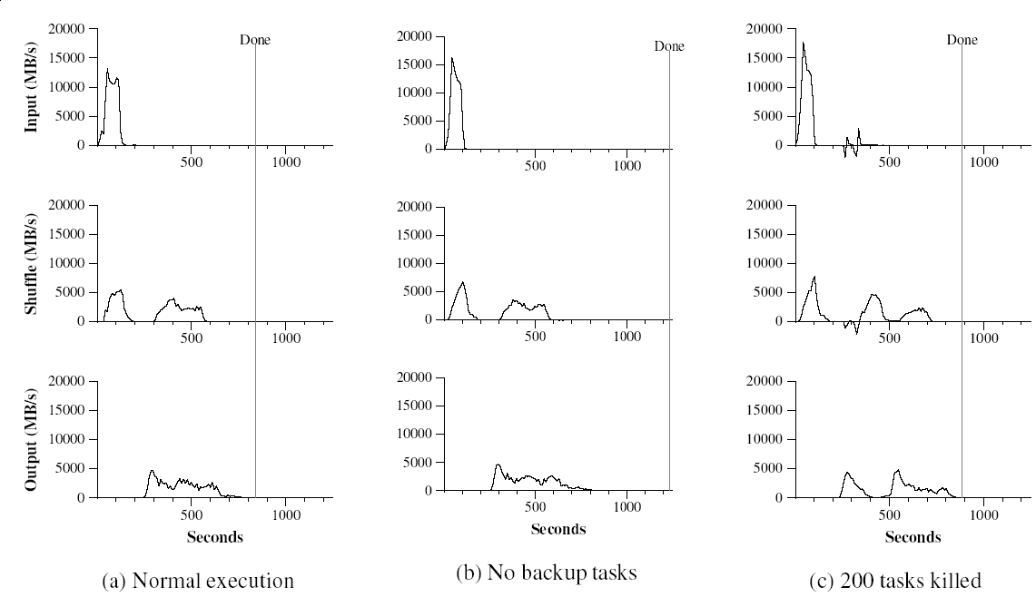
Performance (2/2)
Input rate > shuffle rate > output rate
Locality optimization
Worker death
Write two copies
Long tail
891 seconds
1283 seconds
933 seconds

Slide 25
Thank U!
Any question?

