Slide 1
An Information-Theoretic Definition of Similarity
In Proc. 15th International Conf. on Machine Learning, 1998
Dekang Lin
Department of Computer Science
University of Manitoba
Winnipeg, Manitoba, Canada R3T 2N2
SNU IDB Lab.
Chung-soo Jang
JAN 18, 2008

Slide 2
Content
Introduction
Definition of Similarity
In different domains, similarity
  Similarity between Ordinal Values
  Feature Vectors
  Word Similarity
  Semantic Similarity in a Taxonomy
Comparison between Different Similarity Measures
Conclusion

Slide 3
Introduction (1)
Similarity
  Fundamental concept.
  Many measures have been proposed.
    Information content [Resnik, 1995b]
    Mutual information [Hindle, 1990]
    Dice coefficient [Frakes and Baeza-Yates, 1992]
    Cosine coefficient [Frakes and Baeza-Yates, 1992]
    Distance-based measurements [Lee et al., 1989; Rada et al., 1989]
    Feature contrast model [Tversky, 1977]

Slide 4
Introduction (2)
Previous similarity measure’s problem
  Tied to a particular application or a particular domain
    The Distance-based measure of concept similarity
      The domain is represented in a network.
    The Dice and cosine coefficients
      The object is represented as numerical feature vectors
  Not explicitly stated underlying assumptions
    Based on empirical results, comparisons and evaluations
    Impossible to make theoretical arguments.

Slide 5
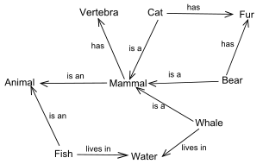
Introduction (3)
This paper’s goal
  A formal definition of the concept of similarity
    Universality
      Information theoretic terms on probabilistic model
      Integrated with many kinds of knowledge representation
        First order logic
        Semantic networks
      Applied to many different domains (previous domains)
    Theoretical Justification
      Not directly defined formula.
      Derived from reasonable assumption

Slide 6
Content
Introduction
Definition of Similarity
In different domains, similarity
  Similarity between Ordinal Values
  Feature Vectors
  Word Similarity
  Semantic Similarity in a Taxonomy
Comparison between Different Similarity Measures
Conclusion

Slide 7
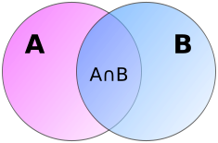
Definition of Similarity (1)
First, Clarifing our intuitions about similarity
  Intuition 1
    The similarity between A and B is related to their commonality. The more commonality they share, the more similar they are.
  Intuition 2
    The similarity between A and B is related to the differences between them.
    The more differences they have, the less similar they are.
  Intuition 3
    The maximum similarity between A and B is reached when A and B are identical, no matter how much commonality they share.

Slide 8
Definition of Similarity (2)
Our goal
  To arrive at a definition of similarity that captures the above intuitions
  A set of additional assumptions about similarity for it
  A definition of a similarity measure derived from those assumptions.

Slide 9
Definition of Similarity (3)
Assumption 1
  A measure of commonality
  I(Common (A, B))
    Common
      A proposition that states the commonalities between A and B
    I(s)
      The amount of information content in a s
      - log P(s)

Slide 10
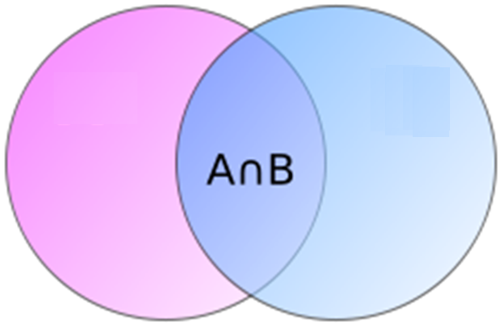
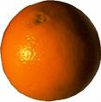
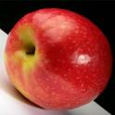
Definition of Similarity (4)
Assumption 1
  I(common(Orange, Apple))= - log P(Orange and Apple)

Slide 11
Definition of Similarity (5)
Assumption 2
  A measure of difference
  I(description (A, B))-I(common(A, B))

Slide 12
Definition of Similarity (6)
Assumption 3
  The similarity between A and B may be formalized by a function, sim(A, B)
    sim(A, B)=f(I(common(A, B), I(description(A, B)))
    The domain of f(x, y) – {(x, y)|x≥0, y›0, y≥x}

Slide 13
Definition of Similarity (7)
Assumption 4
  The similarity between a pair of identical Objects is 1
  I(common(A, B))=I(description(A, B))
  The function f(x,y)’s property: ∀x › 0, f(x, x)=1

Slide 14
Definition of Similarity (8)
Assumption 5
  When there is no commonality between A and B, their similarity is 0
  ∀y>0, f(0, y)=0
“depth-first search”
“leather sofa”
“rectangle”
“interest rate”

Slide 15
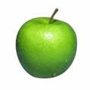
Definition of Similarity (9)
Assumption 6
  Suppose two objects A and B can be viewed from two independent perspectives.
  How to calculate similarity?
Shape
?
Shape
Taste
Taste
Color
Color

Slide 16
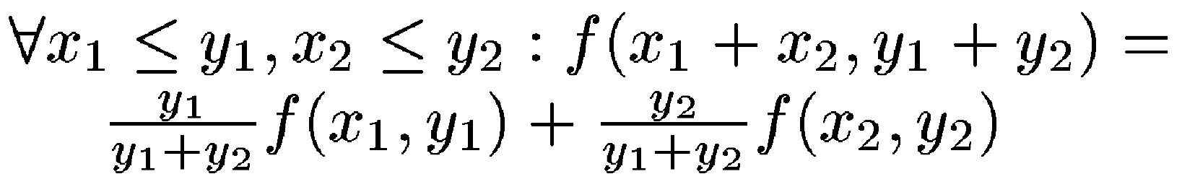
Definition of Similarity (10)
Assumption 6
  The overall similarity
  A weighted average of their similarities computed from different perspectives.
  The weights are the amounts of information in the descriptions.

Slide 17
Content
Introduction
Definition of Similarity
In different domains, similarity
  Similarity between Ordinal Values
  Feature Vectors
  Word Similarity
  Semantic Similarity in a Taxonomy
Comparison between Different Similarity Measures
Conclusion

Slide 18
Similarity between Ordinal Values (1)
Ordinal values for describing many features
  Quality {“excellent”, “good”, “average”, “bad”, “awful”}
Non existence of a measure for the similarity between two ordinal values
Application of our definition

Slide 19

Similarity between Ordinal Values (2)

Slide 20
Similarity between Ordinal Values (3)
sim(excellent, good)=2xlogP(excellent∨good) =0.72
logP(excellent)+logP(good)
sim(good, average)=2xlogP(good∨average) =0.34
logP(good)+logP(average)
sim(excellent, average)=2xlogP(excellent∨average) = 0.23
logP(excellent)+logP(average)
sim(good, bad)= 2xlogP(good∨bad) = 0.11
logP(good)+logP(bad)

Slide 21
Content
Introduction
Definition of Similarity
In different domains, similarity
  Similarity between Ordinal Values
  Feature Vectors
  Word Similarity
  Semantic Similarity in a Taxonomy
Comparison between Different Similarity Measures
Conclusion

Slide 22
Feature Vectors
Feature vectors
  Forms of knowledge representation
  Especially in case based reasoning
    [Aha et al., 1991; Stanfill andWaltz, 1986] and machine learning.
Our definition of similarity
  A more principled approach
  Demonstrated in the following case study

Slide 23
String Similarity-A case study (1)
The task of retrieving from a word list the words that are derived from the same root as a given word.
Given the word “eloquently”, Retrieving the other related words such as “ineloquent”, “ineloquently”, “eloquent”, and “eloquence”.
A similarity measure between two strings and rank the words in the word list

Slide 24
String Similarity-A case study (2)
Three measures
  Simedit= 1
  1+editDist(x,y)
  Simtri(x,y)= 1
  1+|tri(x)|+|tri(y)|-2x|tri(x)∧tri(y)|
    ex) tri(eloquent)={elo, loq, oqu, que, ent}
  Sim(x,y)= 2*∑t∈tri(x)^tri(y)logP(t)
  ∑t∈tri(x)logP(t) +∑t∈tri(y)logP(t)

Slide 25
String Similarity-A case study (3)
[Top-10 Most Similar Words to “grandiloquent”]
Rank | simedit | simtri | sim
1 | Grandiloquently 1/3 | Grandiloquently ½ | Grandiloquently 0.92
2 | Grandiloquence 1/4 | Grandiloquence ¼ | Grandiloquence 0.89
3 | Magniloquent 1/6 | Eloquent 1/8 | Eloquent 0.61
4 | Grandient 1/6 | Grand 1/9 | Magniloquent 0.59
5 | Grandaunt 1/7 | Grande 1/10 | Ineloquent 0.55
6 | Gradients 1/7 | Rand 1/10 | Eloquently 0.55
7 | Grandiose 1/7 | Magniloquent 1/10 | Ineloquently 0.50
8 | Diluent 1/7 | Ineloquent 1/10 | Magniloquence 0.50
9 | Ineloquent 1/8 | Grands 1/10 | Eloquence 0.50
10 | Grandson 1/8 | Eloquently1/10 | Ventriloquy 0.42
Text Retrieval Conference [Harman, 1993]

Slide 26
String Similarity-A case study (4)
[Evaluation of String Similarity Measures]
Root | Meaning | |Wroot| | 11-point average precisions
 |  |  | simedit | simtri | Sim
Agog | Leader, leading, bring | 23 | 37% | 40% | 70%
Cardi | Heart | 56 | 18% | 21% | 47%
Circum | Around, surrounding | 58 | 24% | 19% | 68%
Gress | To step, to walk, to go | 84 | 22% | 31% | 52%
loqu | To speak | 39 | 19% | 20% | 57%

Slide 27
Content
Introduction
Definition of Similarity
In different domains, similarity
  Similarity between Ordinal Values
  Feature Vectors
  Word Similarity
  Semantic Similarity in a Taxonomy
Comparison between Different Similarity Measures
Conclusion

Slide 28
Word Similarity (1)
How to measure similarities between words according to their distribution in a text corpus
  To extract dependency triples from the text corpus
  A dependency triple
    a head, a dependency type and a modifier.
    “I have a brown dog”
      (have subj I), (have obj dog), (dog adj-mod brown),
      (dog det a)

Slide 29
Word Similarity (2)
How to measure similarities between words according to their distribution in a text corpus
  To extract dependency triples from the text corpus
  A dependency triple
    a head, a dependency type and a modifier.
    “I have a brown dog”
      (have subj I), (have obj dog), (dog adj-mod brown),
      (dog det a)

Slide 30
Word Similarity (3)
[Features of “duty” and “sanction”]
Features | duty | sanction | I(fi)
f1: subj-of(include) | X | X | 3.15
f2: obj-of(assume) | X |  | 5.43
f3: obj-of(avert) | X | X | 5.88
f4: obj-of(ease) |  | X | 4.99
f5: obj-of(impose) | X | X | 4.97
f6: adj-mod(fiduciary) | X |  | 7.76
f7: adj-mod(punitive) | X | X | 7.10
f8: adj-mod(economic) |  | X | 3.70

Slide 31
Word Similarity (4)
Sim(w1, w2)=2*I(F(w1)^F(w2))
I(F(w1))+I(F(w2))
2*I({f1, f3, f5, f7}) =0.66
I({f1,f2,f3,f5.f6,f7})+I({f1, f3, f4, f5, f7,f8})
22-million-word corpus consisting of Wall Street Journal and San Jose Mercury
A principle-based broad-coverage parser, called PRINCIPAR [Lin, 1993; Lin, 1994]

Slide 32
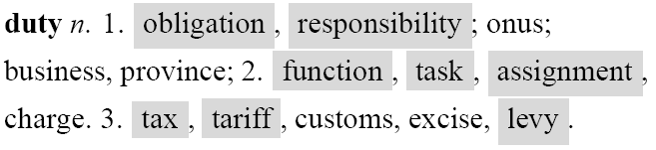
Word Similarity (5)
The words with similarity to “duty” greater than 0.04
The entry for “duty” in the Random House Thesaurus [Stein and Flexner, 1984].
responsibility, position, sanction, tariff, obligation, fee, post, job, role, tax, enalty, condition, function, assignment, power, expense, task, deadline, training, work, standard, ban, restriction, authority, commitment, award, liability, equirement, staff, membership, limit, pledge, right, chore, mission, care, title, capability, patrol, fine, faith, seat, levy, violation, load, salary, attitude, bonus, schedule, instruction, rank, purpose, personnel, worth, jurisdiction, presidency, exercise.

Slide 33
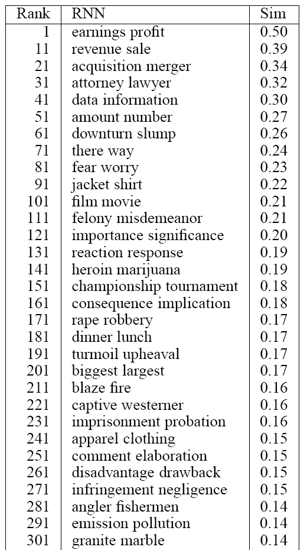
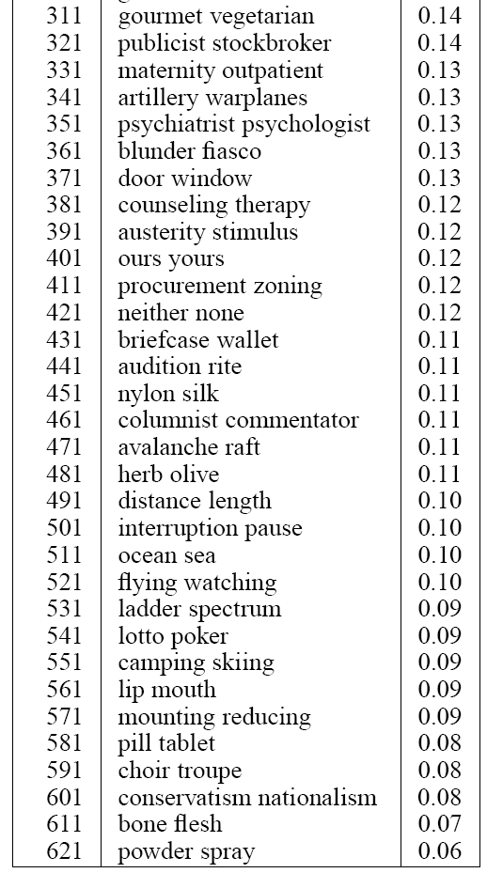
Word Similarity (6)
Respective Nearest Neighbors
  622 pairs of RNNs among the 5230 nouns

Slide 34
Content
Introduction
Definition of Similarity
In different domains, similarity
  Similarity between Ordinal Values
  Feature Vectors
  Word Similarity
  Semantic Similarity in a Taxonomy
Comparison between Different Similarity Measures
Conclusion

Slide 35
Semantic Similarity in a Taxonomy (1)
Similarity between two concepts in a taxonomy such as the WordNet [Miller, 1990] or CYC upper ontology
Not about similarity of two classes, C and C`, themselves
  “rivers and ditches are similar”,
    Not comparing the set of rivers with the set of ditches.
    Comparing a generic river and a generic ditch.

Slide 36
Semantic Similarity in a Taxonomy (2)
Assume that taxonomy is a tree
  If x1 ∈ C and x2 ∈ C2
  The commonality between x1 and x2
    x1∈C0 ^ x2∈C0
    C0: The most specific class that subsumes both C1 and C2
    Sim(X1, X2)= 2*logP(C0)
    logP(C1)+logP(C2)

Slide 37
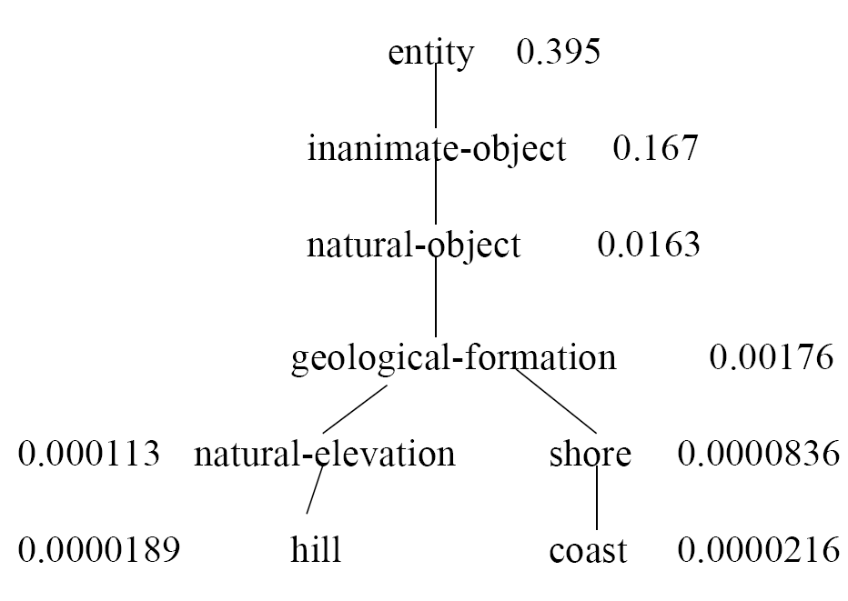
Semantic Similarity in a Taxonomy (3)
Sim(Hill, Coast)=2*logP(Gelogical-Formation) =0.59
logP(Hill)+logP(Coast)
[A Fragment of WordNet]

Slide 38
Semantic Similarity in a Taxonomy (4)
Other measurements between two concpets
  Distance based similarity [Resnik 1995b]
    SimResnik(A, B)=1/2(I (common(A, B)))
    SimResnik(Hill, Coast)=-logP(Geological-Formation)
  Wu and Palmer [Wu and Palmer, 1994]
    simWu&Palmer(A, B)= 2*N3
    N1+N2+2*N3
    N1, N2: The number of IS-A links from A and B to specific
    common superclass C
    N3: The number of IS-A links from C and the root

Slide 39
Semantic Similarity in a Taxonomy (5)
Other measurements between two concpets
  Wu and Palmer [Wu and Palmer, 1994]
    Ex) The most specific superclass of Hill and Coast
    N1=2, N2=2, N3=3
    simWu&Palmer(Hill, Coast)=0.6

Slide 40
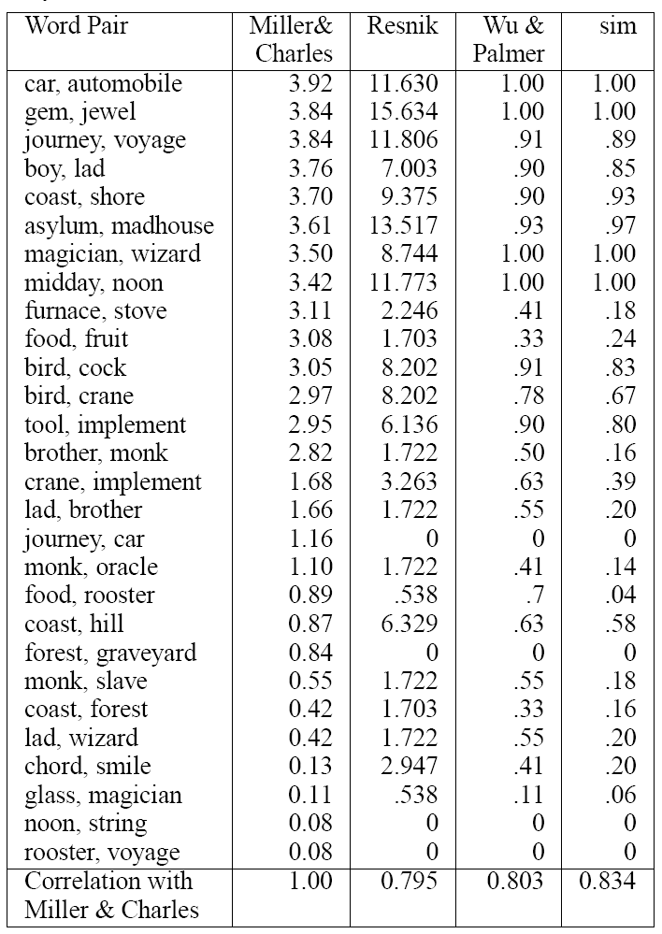
Semantic Similarity in a Taxonomy (6)
[Results of Comparison between Semantic Similarity Measures]

Slide 41
Content
Introduction
Definition of Similarity
In different domains, similarity
  Similarity between Ordinal Values
  Feature Vectors
  Word Similarity
  Semantic Similarity in a Taxonomy
Comparison between Different Similarity Measures
Conclusion

Slide 42
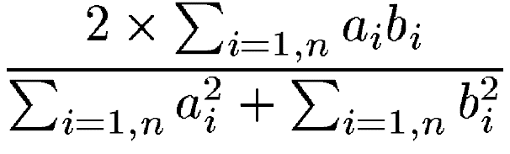
Comparison between Different Similarity Measures (1)
Other measures for comparison
  Wu&Palmer, Rensic, Dice, similarity metric based a distance
    Dice coefficient
      Two nemeric vectors (a1, a2, a3, …, an), (b1, b2, b3, …, bn)
      Simdice(A, B)=
    Simdist
      Simdist(A, B)= 1
      1+dist(A, B)

Slide 43
Comparison between Different Similarity Measures (2)
Property | Similarity Measures: WP: sim Wu&Palmer R: sim Rensik Dice: sim dice
 | sim | WP | R | Dice | simdist
Increase with commonality | yes | yes | yes | yes | no
Decrease with difference | yes | yes | no | Yes | yes
Triangle inequality | no | no | no | No | yes
Assumption 6 | yes | yes | no | Yes | no
Max value=1 | yes | yes | no | yes | yes
Semantic similarity | yes | Yes | Yes | no | yes
Word similarity | yes | no | no | yes | yes
Ordinal similarity | yes | no | no | no | no

Slide 44
Comparison between Different Similarity Measures (3)
Commonality and Difference
  Most similarity measures increase with commonality and decrease with difference
  simdist only decreases with difference
  simResnik only takes commonality into account.

Slide 45

Comparison between Different Similarity Measures (4)
Triangle Inequality
  Distance metric: dist(A, C) ≤ dist(A, B) + dist(B, C)
  Counter-intuitive situation:
A
B
C
Counter-example of Triangle Inequality

Slide 46
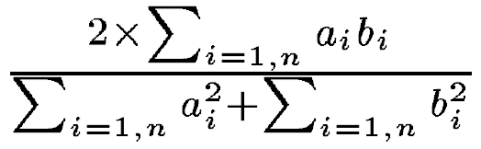
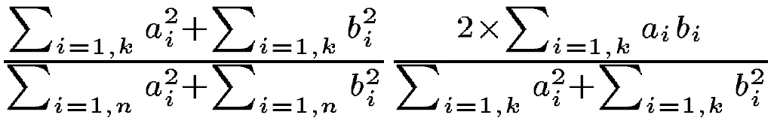
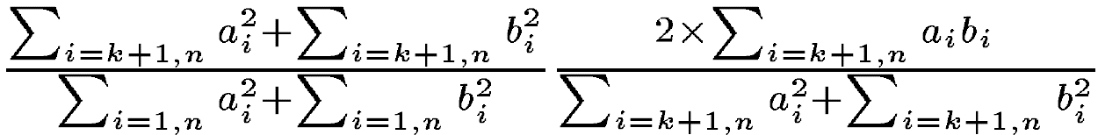
Comparison between Different Similarity Measures (5)
Assumption 6
  simWu&Palmer , simdice
  The first k features and the rest n-k features
    simdice =
    =
    +

Slide 47
Comparison between Different Similarity Measures (6)
Maximum Similarity Values
  The maximum similarity of most similarity measure: 1
  Exception: simResnik : no upper bound

Slide 48
Comparison between Different Similarity Measures (7)
Application Domain
  In this paper’s similarity measure
    Be applied in all the domains listed, including the similarity of ordinal values,
  the other similarity measures
    Not applicable.

Slide 49
Content
Introduction
Definition of Similarity
In different domains, similarity
  Similarity between Ordinal Values
  Feature Vectors
  Word Similarity
  Semantic Similarity in a Taxonomy
Comparison between Different Similarity Measures
Conclusion

Slide 50
Conclusion
A universal definition of similarity in terms of information theory.
The universality’s demonstration by applications in different domains

