Slide 1
A Survey of Approaches to Automatic Schema Matching (VLDB Journal, 2001)
November 7, 2008
IDB Lab. @ SNU
Presented by Kangpyo Lee

Slide 2
Contents
Introduction
Application Domains
The Match Operator
Architecture for Generic Match
Classification of Schema Matching Approaches
Schema-level Matchers
Instance-level Approaches
Combining Different Matchers
Sample Approaches from the Literature
Conclusion

Slide 3
Introduction
Operation Match
  Takes two schemas as input
  Produces a mapping between elements of the two schemas that correspond semantically to each other
Manual Matching
  Tedious, time-consuming, error-prone, and expensive
  The level of effort is at least linear in the # of matches to be performed
Automated Matching
  Faster and less labor-intensive

Slide 4
Application Domains [1/2]
1. Schema integration
  Investigated since the early 1980s
  Given a set of independently developed schemas, construct a global view
  A variation is to integrate an independently developed schema with a given conceptual schema ⇒ OASIS
2. Data warehouse
  Became popular in the 1990s
  A decision support database extracted from a set of data sources
  The match operation is useful for designing transformations from the source format to the warehouse format

Slide 5
Application Domains [2/2]
3. E-commerce
  Message translation
    Translating between different message format
    Translating between different message schemas
  Semantic Web
    Mapping messages between autonomous agents or matching declarative mediator definitions ⇒ OASIS
4. Semantic query processing
  Run-time analysis of schemas
    A user specifies the output of a query (e.g., SELECT), and the system figures out how to produce that output (e.g., by determining the FROM & WHERE)
    The system must give a qualification (e.g., WHERE) that gives the semantics of the mappings

Slide 6
The Match Operator [1/5]
Schema
  A set of elements connected by some structure
Mapping
  A set of mapping elements
  Certain elements of schema S1 are mapped to certain elements in S2
Mapping expression
  Specifies how the S1 and S2 elements are related
  Directional or non-directional
  Use simple relations over scalars (e.g., =, <), functions (e.g., addition, concatenation), ER-style relationships (e.g., is-a, part-of), set-oriented relationships (e.g., overlaps, contains), etc.
Match result
  The match operation outputs a mapping between two schemas

Slide 7

The Match Operator [2/5]
The criteria used to match the elements are based on heuristics
  Not easily captured in a precise mathematical way
  The practical, though mathematically unsatisfying, goal of producing a mapping
Similarity relation,
  Over the power sets of S1 and S2
  A mapping that does not include mapping expressions

Slide 8
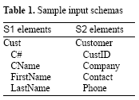
The Match Operator [3/5]
Examples for a mapping between S1 and S2
  Cust.C# = Customer.CustID
  Cust.CName = Customer.Company
  Concatenate(Cust.FirstName, Cust.LastName) = Customer.Contact
  Cust.C# = Customer.CustID
  Cust.CName = Customer.Company
  {Cust.FirstName, Cust.LastName} = Customer.Contact

Slide 9
The Match Operator [4/5]
Match vs. Join
  Both are binary operations that determine pairs of corresponding elements from their input operand
  Match operates on metadata (schema elements) and Join on data (rows of table)
  Match is more complex than Join
    Join
      Each element in the Join result combines only one element of the first with one matching element of the second input
      Join semantics is specified by a single comparison expression (e.g., = for natural join) that must hold for all matching input elements
    Match
      An element in a match result can relate multiple elements from both inputs
      Each element in a match result may have a different mapping expression
    ⇒ The semantics of Match is less restricted than that of Join and is more difficult to capture in a consistent way

Slide 10
The Match Operator [5/5]
OuterMatch (vs. OuterJoin)
  A right (or left) OuterMatch ensures that every element pf S2 (or S1) is referenced by the mapping
  A full OuterMatch ensures every element of both S1 and S1 are referenced by the mapping
  By ensuring that every element of a schema S is referenced in the mapping returned by Match, the mapping can be more easily composed with other mappings that refer to S

Slide 11
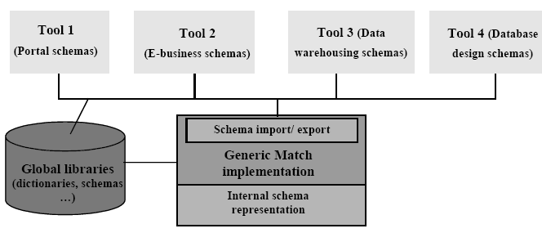
Architecture for Generic Match
A high-level architecture for a generic, customizable implementation of Match
  A semantic-preserving importer
    Translates input schemas from their native representation into the internal representation
  An exporter
    Translates mappings produced by the generic implementation of Match from the internal representation into the representation required by each tool
※ The implementation of Match only determines match candidates
  The user can accept, reject, or change it

Slide 12
Classification of Schema Matching Approaches [1/2]
Match Algorithms (or Matchers)
  The realization of individual matchers
    Instance vs. schema
    Element vs. structure matching
    Language vs. constraint
    Matching cardinality
    Auxiliary information
  The combination of individual matchers
    Hybrid matcher or composite matcher

Slide 13
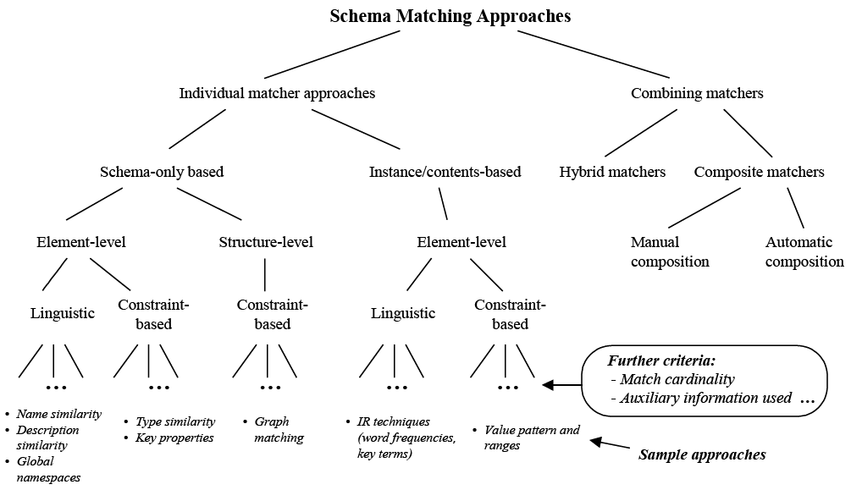
Classification of Schema Matching Approaches [2/2]

Slide 14
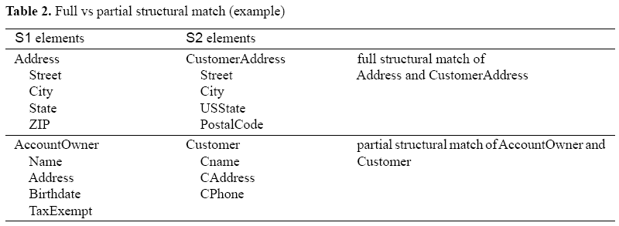
Schema-level Matchers [1/14]
Only consider schema information, not instance data
The available information includes the usual properties of schema elements
  Name, description, data type, relationship type, constraints, and schema structure
For each match candidate, it is customary to estimate the degree of similarity by a normalized numeric value in the range 0-1

Slide 15
Schema-level Matchers [2/14]
1. Match Granularity
Element-level matching
  Determines the matching elements in the second input schema for each element of the first schema
  In the simplest case, only elements at the finest level of granularity are considered ⇒ atomic level
  in Tab. 2, Address.ZIP = CustomerAddress.PostalCode
Structure-level matching
  Refers to matching combinations of elements that appear together in a structure
  Full structural match vs. partial structural match
    The need for partial matches arises because subschemas of different domains are being compared
    In Tab. 2, AccountOwner may come from a finance database while Customer comes from a sales database

Slide 16

Schema-level Matchers [3/14]
1. Match Granularity (cont’d)
Considering known equivalence patterns in a library
  E.g., relating two structures in an is-a hierarchy to a single structure
Element-level matching may also be applied to coarser grained, higher (non-atomic) level elements
  E.g., file records, entities, classes, relational tables, & XML elements
  Ignoring the substructure and components
  In Tab. 2, Address = CustomerAddress
Element-level matching can be implemented by algorithms similar to relational join processing such as nested-loop join
  Comparing each S1 element with each S2 element

Slide 17
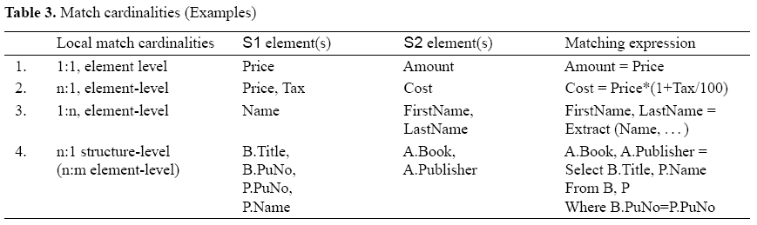
Schema-level Matchers [4/14]
2. Match Cardinality
An S1 (or S2) element can participate in zero, one, or many mapping elements of the match result
  1:1, 1:n, n:1, and n:m

Slide 18
Schema-level Matchers [5/14]
2. Match Cardinality (cont’d)
Matching element with respect to
  Different mapping elements: global cardinality
  Individual mapping elements: local cardinality
There may be different match cardinalities at the instance level instead of the schema level
  In row 4 of Tab. 3
Most existing approaches map each element of one schema to the element of the other schema with highest similarity
  ⇒ Local 1:1 matches & global 1:1 or 1:n mappings
  More work is needed on local and global n:1 and n:m mappings

Slide 19
Schema-level Matchers [6/14]
3. Linguistic Approaches
Use names & texts to find semantically similar schema elements
Name matching
  Equality of names
  Equality of canonical name representations after stemming & other preprocessing
    E.g. CName → customer name, EmpNo → employee number
  Equality of synonyms
    E.g. Car → automobile, make → brand
  Equality of hypernyms*
    E.g. book is-a publication & article is-a publication imply book → publication, article → publication, & book → article
  Similarity of names based on common substrings, edit distance, pronunciation, soundex
    E.g. representedBy → representative, ShipTo → Ship2
  User-provided name matches
    E.g. reportsTo → manager, issue → bug

Slide 20
Schema-level Matchers [7/14]
3. Linguistic Approaches (cont’d)
Name matching (cont’d)
  Exploiting synonyms & hypernyms
    Requires the use of the thesauri & dictionaries
      General natural language dictionaries
      Domain- or enterprise-specific dictionaries & is-a taxonomies
    Requires a substantial effort to be built up in a consistent way
  Homonyms
    A name matcher can reduce the # of wrong match candidates by exploiting mismatch information supplied by users or dictionaries
      Context information
  Name-based matching is possible for elements at different levels of granularity or cardinality

Slide 21
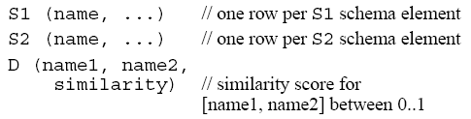
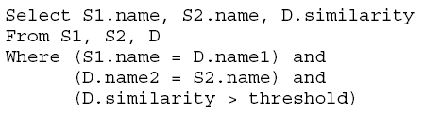
Schema-level Matchers [8/14]
3. Linguistic Approaches (cont’d)
Name matching (cont’d)
  Dictionary D
  Generation of a list of all match candidates
    This assumes that D contains all relevant pairs of the transitive closure over similar names

Slide 22

Schema-level Matchers [9/14]
4. Description Matching
Comments
  Schemas often contain comments in natural language to express the intended semantics of schema elements
  Linguistic analysis of comments to determine the similarity
    Extracting keywords from the description
      Used for synonym comparison
    Using natural language understanding technologies
      To look for semantically equivalent expressions

Slide 23
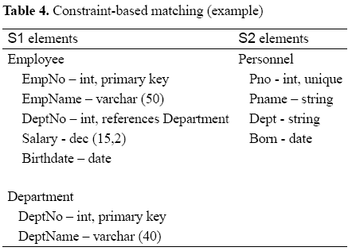
Schema-level Matchers [10/14]
5. Constraint-based Approaches
Constraints
  If two input schemas contain constraint information, it can be used by a matcher to determine the similarity
    Equivalence of data types & domains, of key characteristics (e.g., unique, primary, foreign), of relationship cardinality (e.g., 1:1 relationships), or of is-a relationships
    Equivalent data types & constraint
    names (e.g., string = varchar,
    primary key = unique) can be
    provided by a special synonym
    table

Slide 24
Schema-level Matchers [11/14]
5. Constraint-based Approaches (cont’d)
Imperfect but helpful
  The use of constraint information alone often leads to imperfect n:m matches
  Still, it helps to limit the # of match candidates and may be combined with other matchers (e.g., name matchers)
Structural information
  Can be interpreted as constraints
    Intra-schema references (e.g., foreign keys), adjacency-related information (e.g., part-of- relationships)
  Tells us which elements belong to the same higher-level schema element, transitively through multi-level structures
  Top-down algorithm vs. bottom-up algorithm

Slide 25
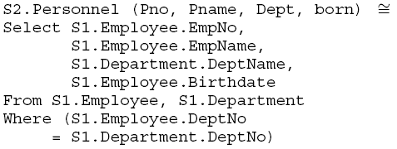
Schema-level Matchers [12/14]
5. Constraint-based Approaches (cont’d)
Structural Information (cont’d)
  Observing that
    Components of S2.Personnel match components of both S1.Employee & S1.Department
    S1.Employee & S1.Department are interconnected by foreign key DeptNo in Employee referencing Department
  The n:m SQL-like match mapping
    Some inferencing was needed to know that the join should be added

Slide 26
Schema-level Matchers [13/14]
6. Reusing schema & mapping information
Schema & mapping Information
  The reuse of common schema components & previously determined mappings
  Reuse-oriented approaches are promising since schemas often are very similar to each other & to previously matched schemas
    E.g., in E-commerce, substructures often repeat within different message formats (e.g., address fields & name fields)
The reuse of not only globally defined names but also entire schema fragments
  Including data types, keys, & constraints
  Defined & maintained in a schema library

Slide 27
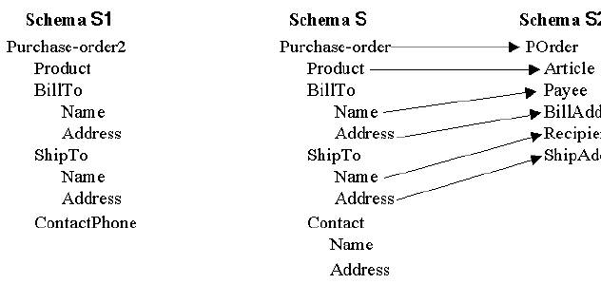

Schema-level Matchers [14/14]
6. Reusing schema & mapping information
The reuse of existing mappings
  Previously determined element-level matches
  Entire structures, which is useful
    When matching different but similar schemas to the same destination schema
    When integrating new sources into a data warehouse or digital library

Slide 28
Instance-level Approaches [1/2]
Instance-level matching can be valuable
  When useful schema information is limited
  When uncovering incorrect interpretations of schema information
Especially applicable to
  A linguistic characterization based on information retrieval techniques for text elements
    E.g., extracting keywords and themes based on the relative frequencies of words
  A constraint-based characterization for more structured data such as numerical & string elements
    E.g., numerical value ranges & averages or character patterns

Slide 29
Instance-level Approaches [2/2]
Main benefit of evaluating instances
  A precise characterization of the actual contents of schema elements
    To enhance schema level matchers
    To perform instance-level matching on its own
      The per-instance match results need to be merged and abstracted to the schema level
      To generate a ranked list of match candidates

Slide 30
Combining Different Matchers [1/2]
A matcher that combines several approaches is likely to achieve many good match candidates
Two Ways
  Hybrid matchers
    Integrates multiple matching criteria
  Composite matchers
    Combine the results of independently executed matchers
Hybrid Matchers
  Directly combine several matching approaches to determine match candidates
    Based on multiple criteria or information sources
  Reduces the # of passes over the schema
  Better match candidates + better performance
  Combine structure- with element-level matching
    Using one algorithm to generate a partial mapping & the other to complete the mapping

Slide 31
Combining Different Matchers [2/2]
Composite Matchers
  Combine the results of several independently executed matchers
  More flexible
    Allows a selection from a repertoire of modular matchers based on application domain or schema language
    Allows a flexible ordering of matchers
Selection of matchers & determining their execution order & the combination of independently determined match results
  Automatically by the implementation of Match itself or its clients
  Manually by a human user
  But, user interaction is necessary in any case
    The implementation of Match can only determine match candidates which a user can accept, reject or change

Slide 32
Sample Approaches from the Literature
Prototype Schema Matchers
  SemInt (Northwestern Univ.)
  LSD (Univ. ofWashington)
  SKAT (Stanford Univ.)
  TransScm (Tel Aviv Univ.)
  DIKE (Univ. of Reggio Calabria, Univ. of Calabria)
  ARTEMIS (Univ. of Milano, Univ. of Brescia) & MOMIS (Univ. of Modena and Reggio Emilia)
  Cupid (Microsoft Research)
Related Prototypes
  Clio (IBM Almaden and Univ. of Toronto)
  Similarity flooding (Stanford Univ. and Univ. of Leipzig)
  Delta (MITRE)
  Tess (Univ. of Massachusetts, Amherst)
  Tree matching (NYU)

Slide 33
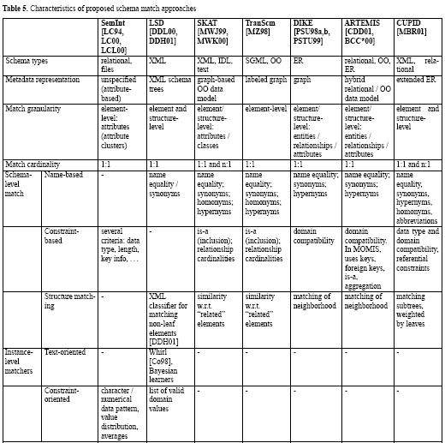

Slide 34
Conclusion
Past Work on Schema Matching
  Has mostly been done in the context of a particular application domain
  The problem is so fundamental
    A need to treat it as an independent problem
Future Work
  On the relative performance & accuracy of different approaches

