Slide 1
Flickr Tag Recommendation based on
Collective Knowledge
Borkur Sigurbjornsson, Roelof van Zwol
Yahoo! Research
WWW 2008
Hyunwoo Kim
SNU IDB Lab.
August 27, 2008

Slide 2
Contents
Introduction
Related Work
Tag Behavior in Flickr
Tag Recommendation Strategies
Evaluation
Conclusion

Slide 3
Introduction [1/4]
Tagging
  Action of adding keywords to objects
Tags
  Meaningful descriptors of the objects
  To organize and index contents
  Useful with multimedia objects
    – little or no textual context

Slide 4
Introduction [2/4]
Users are willing to provide semantic context through manual annotations
User annotate their photos to make them better accessible to the general public
Same photo would be annotated by another user it is possible that a different description is produced

Slide 5
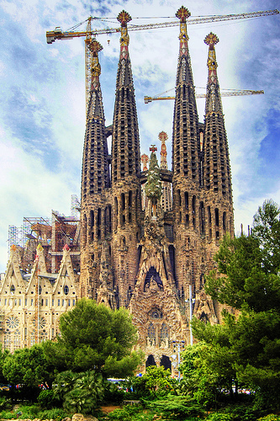
Introduction [3/4]
La Sagrada Familia
Barcelona
Gaudi
Spain
Catalunya
Arcitecture
Church

Slide 6
Introduction [4/4]
How can we assist users in the tagging phase?
Two contributions
  1. Analyze how users tag photos and what information is contained in the tagging
  2. Evaluate tag recommendation strategies using global co-occurrence

Slide 7
Contents
Introduction
Related Work
Tag Behavior in Flickr
Tag Recommendation Strategies
Evaluation
Conclusion

Slide 8
Related Work [1/2]
Tags are useful to give improved access to photo collection using temporal information
  Visualizing Tags Over Time, WWW2006
Usefulness of tagging information depends on the motivation of users
  Why We Tag, SIGCHI2007

Slide 9
Related Work [2/2]
Various methods exist semi-automatically annotate photographs
  Matching Words and Pictures, JMLR2003
  Real-time Computerized Annotation of Pictures, MC2006
Adding semantic labels to Flickr tags
  Towards Automatic Extraction of Event and Place Semantics from Flickr Tags, SIGIR2007

Slide 10
Contents
Introduction
Related Work
Tag Behavior in Flickr
Tag Recommendation Strategies
Evaluation
Conclusion

Slide 11
Tag Behavior in Flickr [1/7]
How do users tag?
What are they tagging?
Why do people tag?
  - Users are highly driven by social incentives

Slide 12
Tag Behavior in Flickr [2/7]
Flickr Photo Collection
Flickr contains hundreds of millions of photos
More than 8.5 million users
12,000 photos served per second
2 million photos uploaded per day

Slide 13
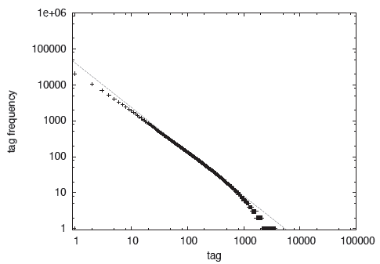
Tag Behavior in Flickr [3/7]
General Tag Characteristics
How users tag their photos
3.7 million unique tags

Slide 14
Tag Behavior in Flickr [4/7]
General Tag Characteristics
Top 5 most frequent tags
  2005, 2006, wedding, party, and 2004
The infrequent tags
  Ambrose tompkins, ambient vector
  15.7 million tags occur only once
  Highly specific tags will only be useful in exceptional cases
3.7 million unique tags

Slide 15
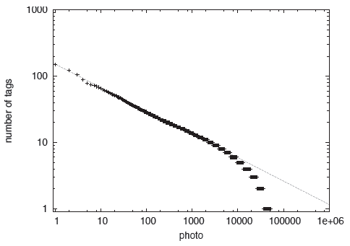
Tag Behavior in Flickr [5/7]
General Tag Characteristics
Less than 3 tagged photos covers 64% of all
Tag recommendation to be useful

Slide 16
Tag Behavior in Flickr [6/7]
Tag Categorization
What are users tagging?
Mapping Flickr tags onto WordNet
ex) London
According to WordNet, London belongs to
noun.person and noun.location

Slide 17
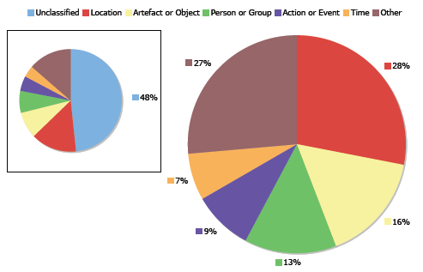
Tag Behavior in Flickr [7/7]
Tag Categorization
Not only visual contents, also broader context
  ex) location, time, actions

Slide 18
Contents
Introduction
Related Work
Tag Behavior in Flickr
Tag Recommendation Strategies
Evaluation
Conclusion

Slide 19
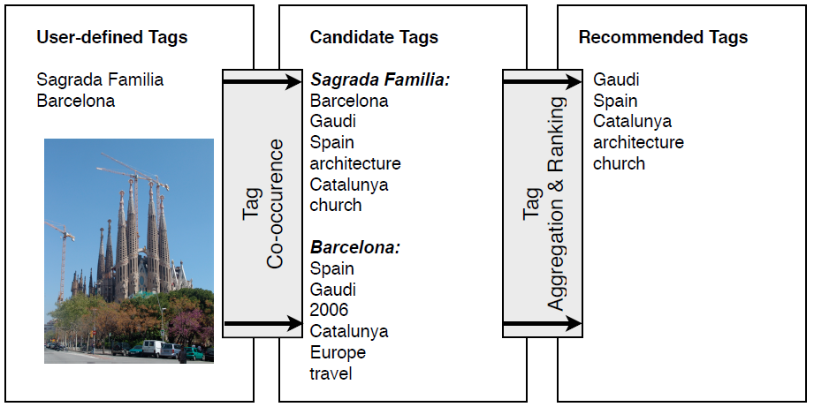
Tag Recommendation Strategies [1/8]
Tag Recommendation System

Slide 20
Tag Recommendation Strategies [2/8]
Tag Co-occurrence
Method to calculate co-occurrence coefficients between of two tags
The co-occurrence between two tags
  : the number of photos where both tags are used

Slide 21


Tag Recommendation Strategies [3/8]
Tag Co-occurrence
Symmetric measures
Asymmetric measures

Slide 22
Tag Recommendation Strategies [4/8]
Tag Co-occurrence
The difference between symmetric and asymmetric
ex) Eiffel Tower
  Symmetric method:
  Tour Eiffel, Eiffel, Seine, La Tour Eiffel, Paris
  Asymmetric method:
  Paris, France, Tour Eiffel, Eiffel, Europe
Asymmetric tag co-occurrence provides more suitable diversity of candidate tags

Slide 23
Tag Recommendation Strategies [5/8]
Tag Aggregation and Promotion
Tag aggregation step is needed to merge the list into a single ranking
Two aggregation methods
  Voting
    - It doesn’t take the co-occurrence values
  Summing
    - It takes the co-occurrence values to produce final ranking

Slide 24



Tag Recommendation Strategies [6/8]
Tag Aggregation and Promotion
Voting
Summing

Slide 25
Tag Recommendation Strategies [7/8]
Tag Aggregation and Promotion
Promotion
  The head and the tail of the power law is not good tags for recommendation
Stability-promotion
Descriptiveness-promotion
Rank-promotion

Slide 26




Tag Recommendation Strategies [8/8]
Tag Aggregation and Promotion

Slide 27
Contents
Introduction
Related Work
Tag Behavior in Flickr
Tag Recommendation Strategies
Evaluation
Conclusion

Slide 28
Evaluation [1/3]
Evaluation metrics
  Mean Reciprocal Rank (MRR)
  : the ability to return a relevant tag at the top ranking
  Success at rank k (S@k)
  : the probability of finding a good descriptive tag among the top k recommended tags
  Precision at rank k (P@k)
  : the proportion of retrieved tags that is relevant

Slide 29
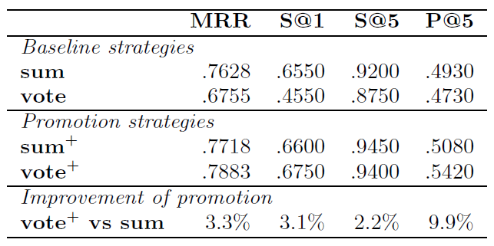
Evaluation [2/3]

Slide 30
Evaluation [3/3]
The recommended tags contain useful additions to the user-defined tags
Promotion function has a positive effect on the performance in general
Best strategy has a stable performance over different classes of photos
System is particularly good at recommending locations, artifacts, and objects

Slide 31
Contents
Introduction
Related Work
Tag Behavior in Flickr
Tag Recommendation Strategies
Evaluation
Conclusion

Slide 32
Conclusion [1/2]
Tag behavior in Flickr
  Mid section of power law contained the most interesting candidates for tag recommendation
  The majority of the photos is being annotated with only a few tags
  Users annotate where their photos are taken, who or what is on the photo, and when the photo was taken

Slide 33
Conclusion [2/2]
Extending Flickr photo annotations
  Collective knowledge
  Tag aggregation strategies are effective
  Promotion function is an effective way to incorporate the ranking of tags
  Best strategy shows to be a very stable approach for different types of tag-classes

