Slide 1
RDFSync: efficient remote synchronization of RDF models
Giovanni Tummarello, Christian Mobidoni, Reto Bachmann-Gmur, Orri Erling
ISWC/ASWC 2007

Slide 2
Contents
Introduction and definitions
The minimum self contained graph theory
MSG based graph decomposition and merging
Experimental results
Conclusion

Slide 3
Introduction
Remote synchronization of data file
  A procedure by which local information is updated over a network in order to made identical with a remote one
The rsync algorithm
  Efficiently synchronize remote binary files
  The changes will be significantly lower in size
update
f_new
f_old
request
Server
Client

Slide 4
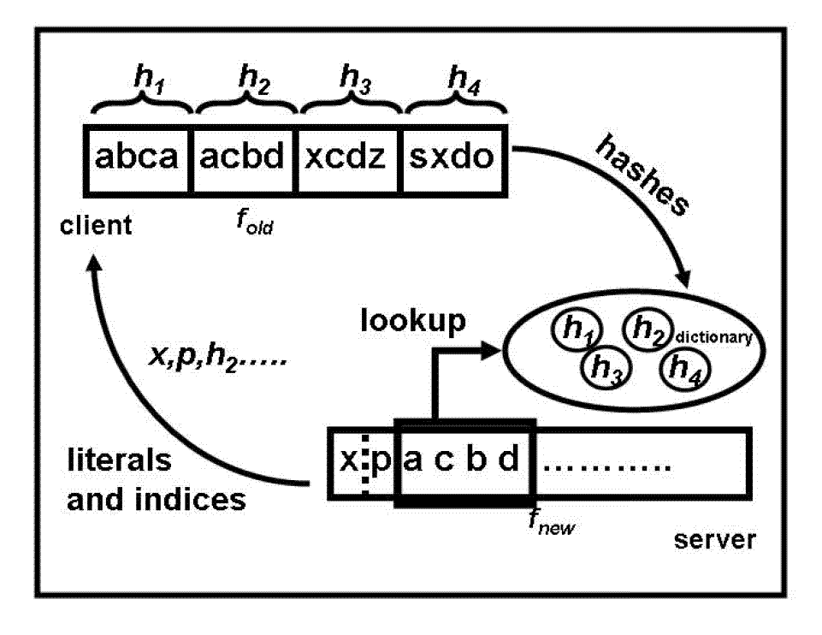
The rsync algorithm
encoded file
f_new
f_old
hashes
Server
Client
- clients splits f_old into blocks of size b
- compute a hash value for each block and send to
server
- server stores received hashes in dictionary
- server transmits f_new to client, but replaces
any b-byte window that hashes to value
in dictionary by reference

Slide 5
Motivation
RDF models cannot be efficiently synchronized by the rsync or similar algorithms (due to RDF semantics)
  Serializing the graph into a deterministic, canonical way, by ordering the triples in lexicographical order
  The results of a simple rsync synchronization will be shown to be still unsatisfactory
    When graphs contain blank nodes

Slide 6
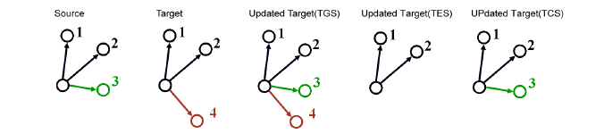
Different Kinds of Synchronization
To be equal to the merge of both graphs (Target Growth Sync, TGS)
To delete information that is not known by the source (Target Erase Sync, TES)
To be equal to the source (Target Change Sync, TCS)

Slide 7
RDF Semantics
The definition of merge and equals are strictly derived from RDF Semantics
  B-node IDs will not be preserved
  Sync is not required to transfer redundant information that might be contained in the graphs
    Only lean versions of two graph
  Serialization format idiosyncrasies (RDF/XML comments) are ignored

Slide 8
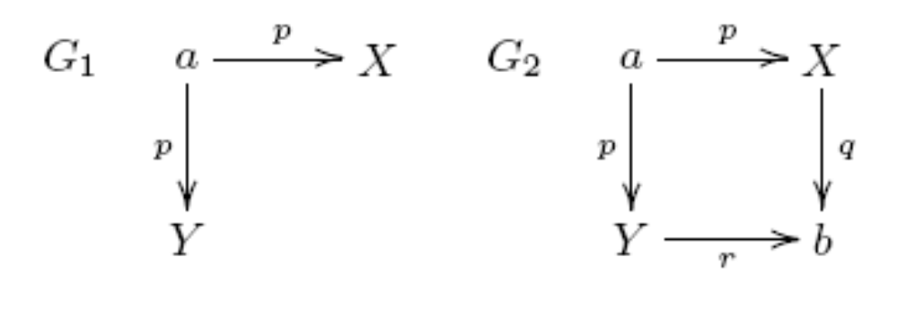
Lean Graph*
Def: A graph G is lean if there is no map µ such that µ(G) is a proper subgraph of G
Ex) N, X, Y …. To denote blank nodes and a,b,c,… for URI and literals
G₁ : not lean
G₂ : lean (there is no proper map of G₂ into itself)
*From PODS 2004: Foundation of Semantic Web Databases

Slide 9
Minimum Self-contained Graph
MSG (Def). Given an RDF statement s and a graph G, the Minimum Self-contained Graph (MSG) containing that statement, written MSG(s,G), is the set of RDF statements comprised of the following:
  The statement in question
  Recursively, for all the blank nodes involved by statements included in the description so far, the MSG of all the statements involving such blank nodes
Important Properties:
  Each RDF Graph can be decomposed in a canonical set of MSGs
  Each MSG has a unique (blank-node agnostic) hash sum

Slide 10
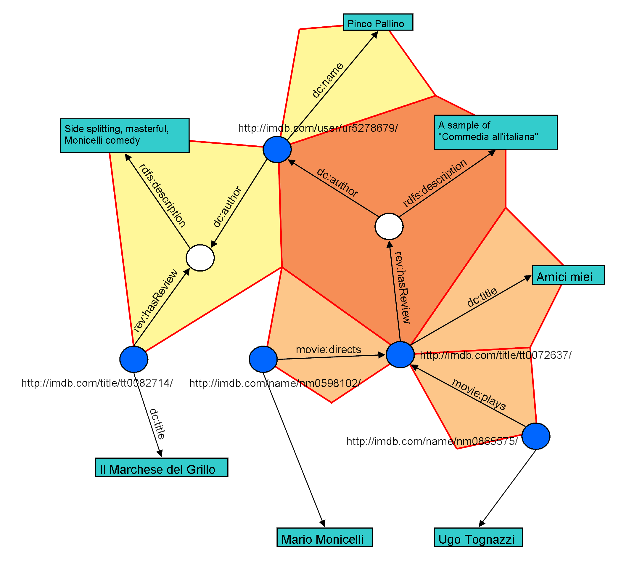
Example : MSG
Graph ID list = [MSG ID 1 , MSG ID 2, ..]

Slide 11
Canonical Serialization of MSGs and MSG’s hash
Provide a sort of digest or hash value of the graph
1) obtain a canonical string representing the MSG
2) hash it to an appropriate number of bits to reasonably avoid collisions
    This hash acts as an unique identifier for the MSG
U_{i} = serialize(s_{i}, p_{i}, o_{i})
Digest = hash(concate(sort(u₁,u₂,…,u_{n})))

Slide 12
Canonical Serialization and RDF graphs Synchronization
Graph can be decomposed into a set of MSGs
  Canonically represented by the ordered list of the identifiers(hashes) of its composing MSGs
Synchronization is performed in 2 steps
  A diff between the source and the target ordered lists of MSGs is performed
  Such diff indicates which MSGs have to be requested from the other side and which should be deleted in the local model

Slide 13
Perform the diff
The diff
  Between the source and the target ordered list of MSGs
  Two procedures can be employed
    To directly transfer the list
    To create a copy of the remote list, using the standard rsync, from the local list
The latter approach
  Highly efficient in case of small differences between two lists
  rsync is optimized for differences which result in shifting of data block within the file

Slide 14
In Case of MSGs Hashes Lists(1/2)
Big changes result in a great amount of hashes to be inserted in random position of the list
  Almost all the file to be transferred (overhead of the rsync operation) : calculating hashes of file sections. Transferring and comparing them)

Slide 15
In Case of MSGs Hashes Lists(2/2)
Once the two lists are available
  The list of MSGs to be requested from the remote model (in case of a TCS or TGS sync)
    Be sent to the remote host which complies to the request
  The list of MSGs to be deleted in the local model (in case of TCS and TES sync)

Slide 16
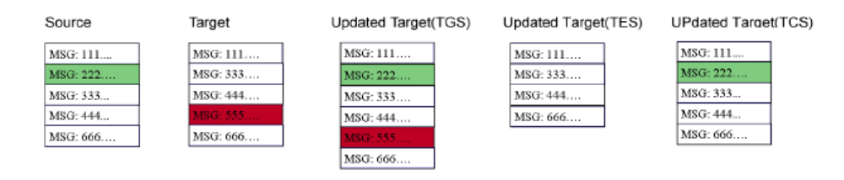
RDFSync in Different Modes

Slide 17
Experimental Results(1/2)
Show the performance of the algorithm in three cases:
  Labled SyntGraph no bnodes
    Syntherically generated graph (ground triples: 8000 triples, 8000MSGs) , 1.07MB in size
    Comparable with any other made completely of ground triples such as DBPedia dataset
  Labled SyntGraph bnodes
    The graph is 1.3MB in size and has 9000 triples in 7800 MSGs
    With a moderate number of blank nodes (approximately 600)
  Labled DBWorld Graph
    This graph is 2.1 MB and contains approximately 1300 triples in 5000MSGs
    Comparable with that on others with similar characteristics (e.g. DBLP dump in RDF)

Slide 18
Experimental Results(2/2)
The algorithm that we compare are:
  RDFSync Full list
    By graph decomposition we produce a list of 64 bits MSG hashes
    This is entirely copied on the other side and then the missing ones are requested
  RDFSync rsync
    The list of hashes, created as above, is synchronized itself with rsync
    The missing MSGs are then copied
  rsync
    rsync is applied on a lexicographically sorted list triples(Ntriples)

Slide 19
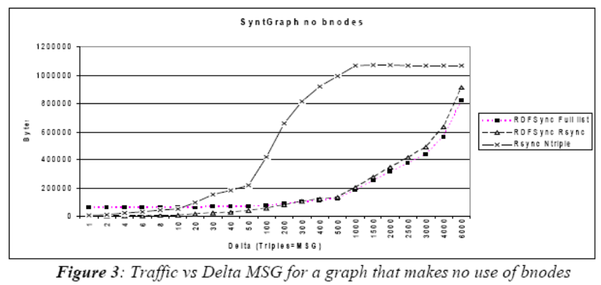
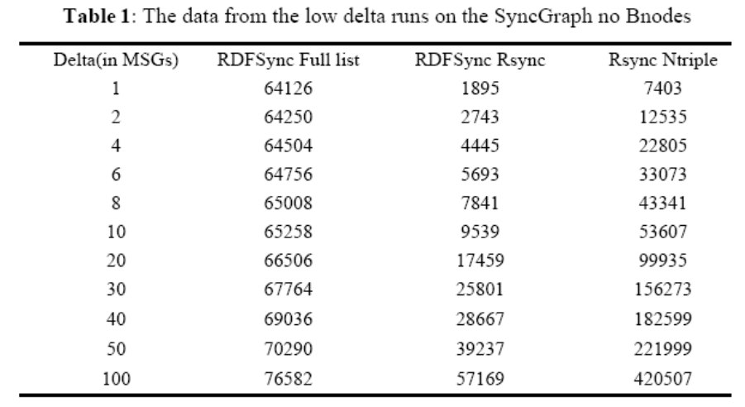
Performance(1/3)
Proposed algorithm gives very high bandwidth saving as opposed to the alternative rsync Ntriple

Slide 20
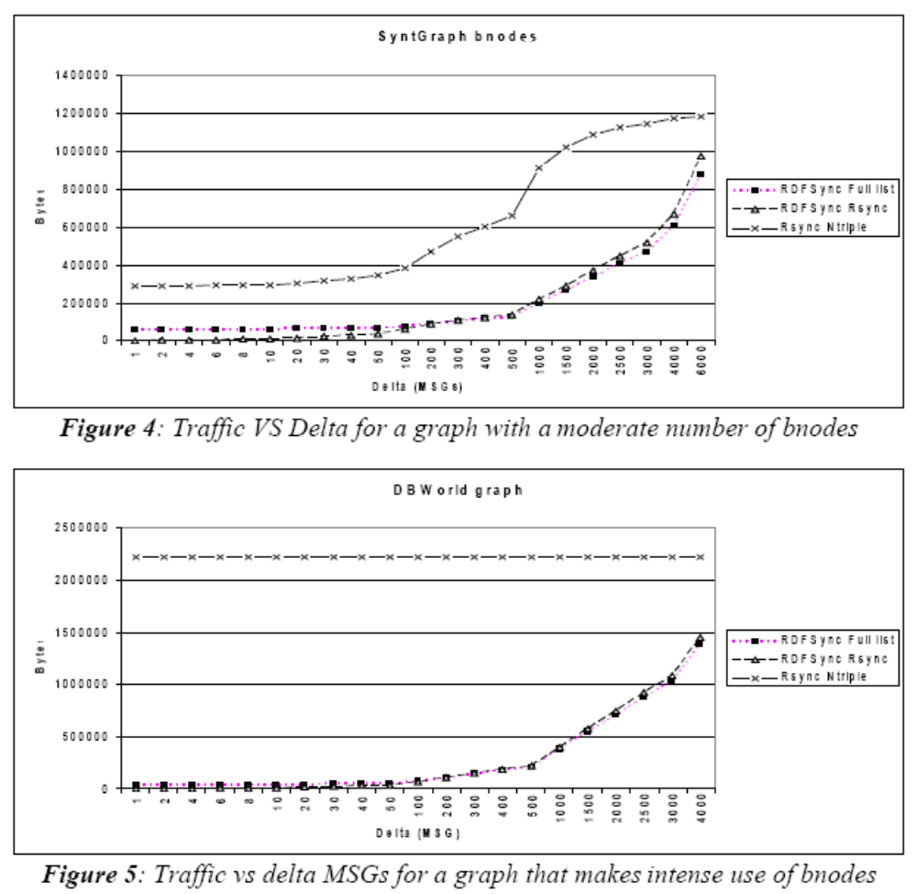
Performance(2/3)

Slide 21
Performance(3/3)
When bnodes are used
  The difference is as much as the entire graph size(DBWorld)
  With the blank nodes IDs (random generated)
Performance are dramatically different
  When small number of blank nodes are used (SyntGraph bnodes)
The different for small updates is huge
  As much as 150 to 1 for single delta MSG (1.8 k on the RDFSync algorithm vs 290k of rsync)

Slide 22
Conclusion
We described a methodology to perform an efficient synchronization of RDF models called RDFSync
RDFSync:
  Based on RDF Semantics only
  General purpose tool independent of the application domain and independent of the used ontologies
Experimental results show that the algorithm provides very significant saving on network traffic compared to a simple rsync on a ordered list of triples

