Slide 1
RDFScape: Semantic Web meets Systems Biology
Andrea Splendiani
BMC Bioinformatics, 2008
Hyewon Lim
SNU IDB Lab.
July 25th, 2008

Slide 2
Contents
Background
Methods
Results
Discussion
Conclusions

Slide 3
Background (1/4)
The role of ontologies in the Life Sciences domain has increased in recent years.
Ontologies are necessary for the annotation and the interpretation of large datasets
For the integration of heterogeneous information
For the creation of common languages
Gene Ontology: an example of the usefulness of ontologies

Slide 4
Background (2/4)
The development of ontologies has been driven
The need of a wide-coverage annotation of the entities of their domain
Result: a large shared terminology
Current research
Focusing on clear and formal definition of entities, relations and their properties.

Slide 5
Background (3/4)
Ontology development in the Life Sciences
Increasingly adopting the Semantic Web in particular through the OWL language

Slide 6
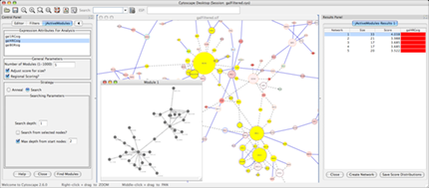
Background (4/4)
Motivation
The lack of a common platform
Disconnection between tools and methodologies
Cytoscape
Offers an interactive visual environment to explore biological networks.

Slide 7
Methods
RDFScape is implemented as a Cytoscape plugin.
RDFScape organizes data structures and inference in a peculiar way.
RDFScape maintains a connection between the data structure of the network in Cytoscape and the knowledge-base.
This link is based on different interfaces
Depending which interfaces are supported by the knowledge library in use.

Slide 8
Methods - Requirements
RDFScape is a Java based cross platform project.
Its requirements are equivalent to the fore-mentioned software.
Cytoscape (at least v2.4)
Jena (at least v2.5)
Pellet (at least v1.5)

Slide 9
Results
A number of interesting synergies result.
Ontologies can be treated as graphs within Cytoscape
hence visualized taking advantage of its interactive features.
Ontologies can be used to annotate
Hence query elements in networks representing biological entities and experimental data.
Herein ontologies are not just seen as a set of annotations, but as a knowledge-base.

Slide 10
Results - Ontology query and navigation (1/5)
RDFScape provides a system for visualizing and querying ontologies represented in OWL within Cytoscape.
A set of features improves the readability of this visualization of ontologies as networks.
Node shapes, colors can be associated to attributes.
It is possible to select which resources should be visible, based on their namespaces.

Slide 11
Results - Ontology query and navigation (2/5)
Networks represented in Cytoscape can be populated in several ways.
through the use of queries
through an interacting browsing system
through the visual definition of graph patterns

Slide 12
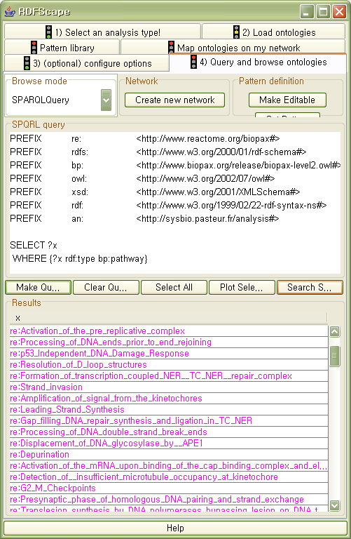
Results - Ontology query and navigation (3/5)
1. through the use of queries
The plugin presents the user with a choice of panels to perform queries.

Slide 13
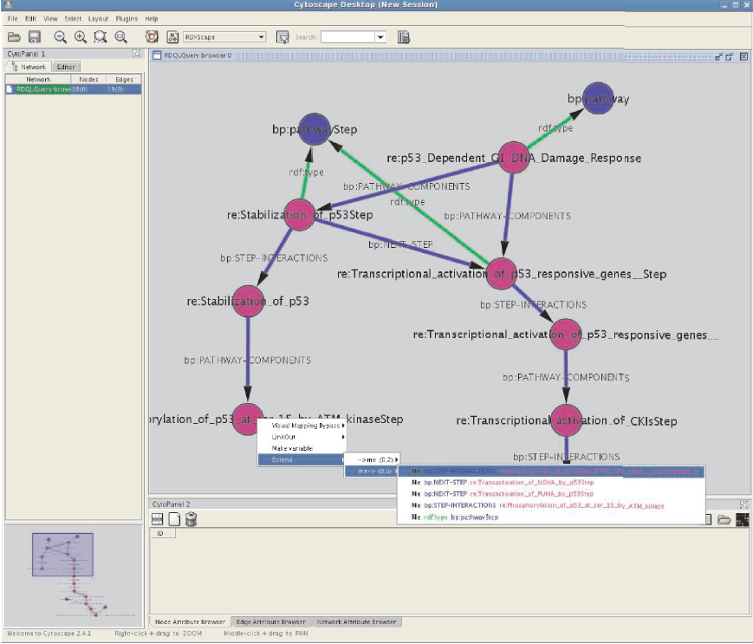
Results - Ontology query and navigation (4/5)
2. through an interacting browsing system

Slide 14
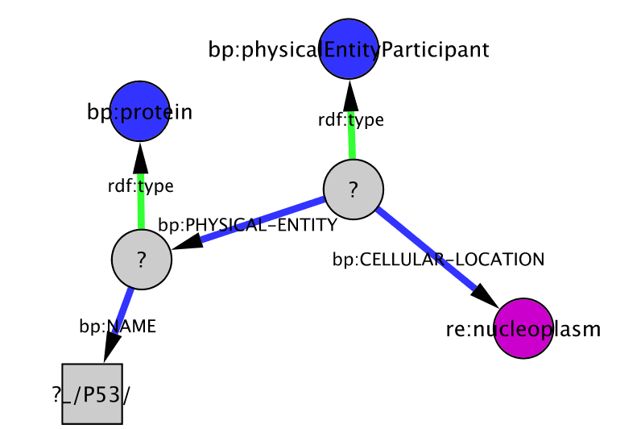
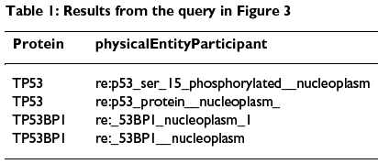
Results - Ontology query and navigation (5/5)
3. through the visual queries
All the elements of type protein whose name contains P53 and that are active in the extracellular region.

Slide 15
Results - Support for inference on ontologies (1/2)
Two distinct ways of the inference procedure
1. some options are available to perform a subset of all inferences proper to the OWL/RDF semantics.
tradeoff between the amount of deduction computable the execution time.
2. a set of rules specified by the user is processed for the production of additional statements.

Slide 16
Results - Support for inference on ontologies (2/2)
Two facts for the use of reasoning in RDFScape
1. custom inference rules can be saved in libraries and applied at run time.
2. additional logic to interpret ontologies can be provided in two ways.
Via the aforementioned inference rules or via additional ontologies to be added to the knowledge-base.
These two ways overlap in their expressiveness but none of them is exhaustive.

Slide 17
Results - An example (1/3)
“Visualize a set of pathways as an interaction network.”
Consider a subset of Pathway Commons
In particular a subset of Reactome represented in BioPAX
This provides classes and relations for the description of biological pathways.
Catalysis
Control
Interaction
“subclassOf” relation,

Slide 18
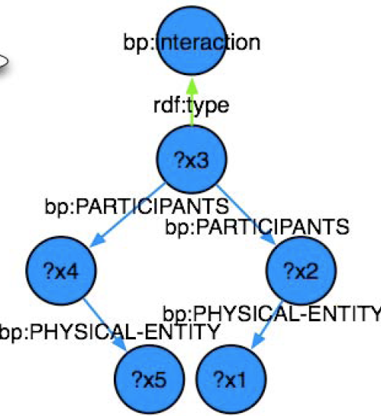
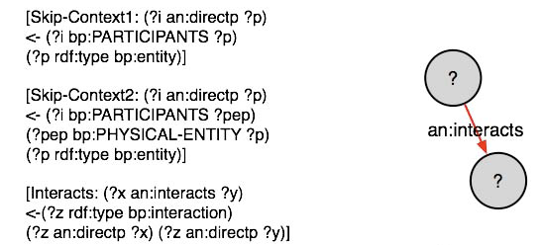
Results - An example (2/3)

Slide 19
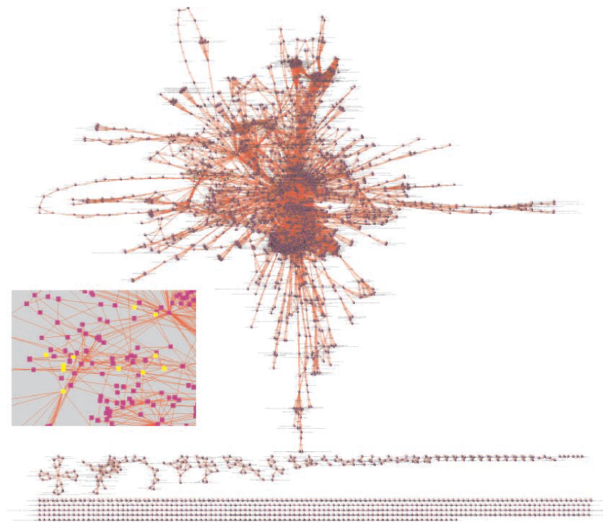
Results - An example (3/3)
Abstraction of Reactome Homo sapiens pathways as an interaction network.

Slide 20
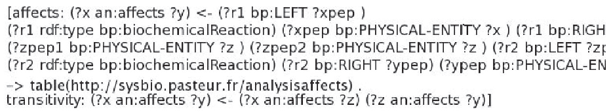
Results - Towards reasoning on pathways (1/2)
How inference can be used on pathways to answer specific queries.
“Find all genes whose expression is directly or indirectly affected by a given compound.”
Consider a related simpler query:
“Find all compounds whose expression is directly or indirectly affected by a given compound.”
It allows to define easily a meaning for “affects”
Focusing on biochemical reactions.

Slide 21
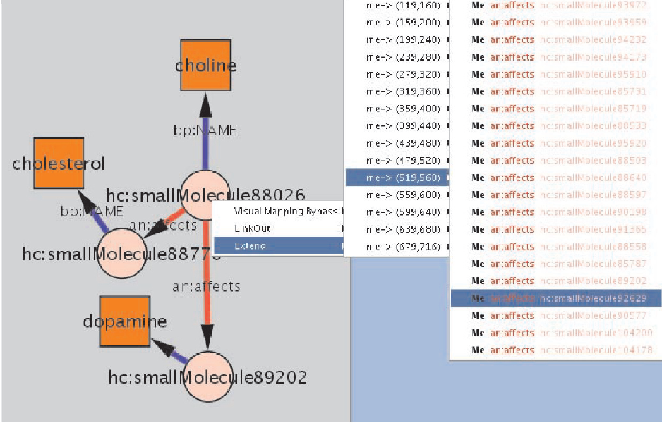
Results - Towards reasoning on pathways (2/2)
An example of interactive browsing of the HumanCyc ontology following this new property.

Slide 22
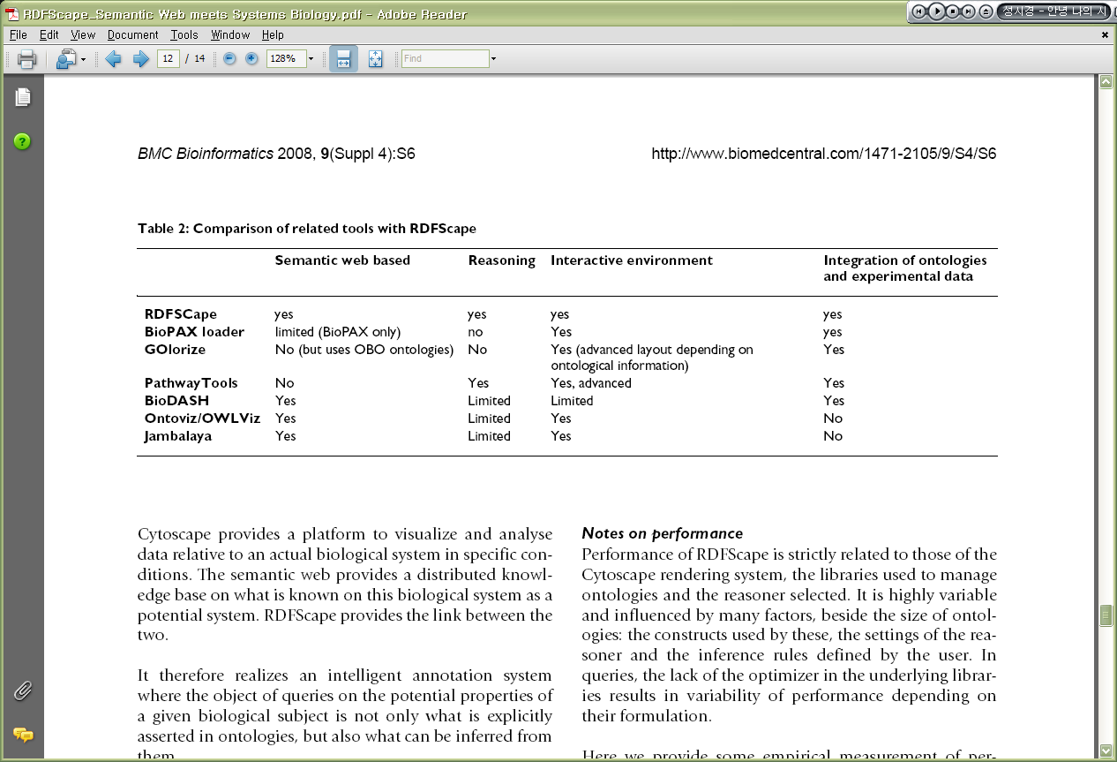
Discussion (1/2)
RDFScape fills a gap in the availability of tools that rely on ontologies for biological data analysis.
A comparison between RDFScape and other related tools
⇒ RDFScape presents a unique combination of features.

Slide 23
Discussion (2/2)
Cytoscape
Provides a platform to visualize and analyze data relative to an actual biological system in specific conditions.
RDFScape
Provides the link between the two.
It realize an intelligent annotation system.
Semantic Web
Provides a distributed knowledge base on what is known on this biological system as a potential system.

Slide 24
Discussion - Notes on performance
Related to
The Cytoscape rendering system
The libraries used to manage ontologies
The reasoner selected
Settings of the reasoner, the inference rules defined by the user
Wrong settings of the inference process
easily result in unacceptable reasoning & answering times
make exceed the memory capacity of an average workstation.

Slide 25
Conclusions (1/2)
RDFScape
A plugin for Cytoscape
Enables it to use ontologies represented in the semantic frameworks
Possible to query and visualize
the information explicitly asserted in ontologies and what can be inferred from them
Enables new queries functionalities in Cytoscape like SPARQL queries, visual queries or interactive browsing of ontologies

Slide 26
Conclusions (2/2)
Introduction of reasoning in a platform oriented to biological data analysis
fills a gap in the availability of semantic web tools in the Life Sciences area.
Future development
Target the link between ontologies and experimental data.

