Slide 1
Change Detection in Ontologies Using DAG Comparison
Johann Eder
University of Vienna, Dep. Of Knowledge and Business Engineering
Karl Wiggisser
Klagenfurt University, Dep. of Informatics-Systems
iDB Lab., SNU
Junseok Yang
2008-11-27

Slide 2
Introduction
Real
World
Domain
Given two versions of an ontology, we want to derive which is a series of change operations
Assumption
Every semantic change has to be represented by a structural change
Graph based approach for change detection between two versions of an ontology based on structural comparisons
Ontology

Slide 3
Related Work
Our approach is designed to find changes in two versions of the same ontology
There are more intended to find the semantic overlapping of two or more different independently developed ontologies,
Graph matching and graph comparison
Existing algorithms have some shortcomings which make them either completely unusable for our purpose or at least very hard to adapt to our problem

Slide 4
Ontology Graphs and Graph Operations [1/3]
An ontology can be seen as a graph where the concepts are represented by nodes and semantic relations between concepts by edges
Assume the ontology graph to be a rooted directed acyclic graph (RDAG)
Node
Name
Attributes
Slots
Edge
(parent, child), type

Slide 5
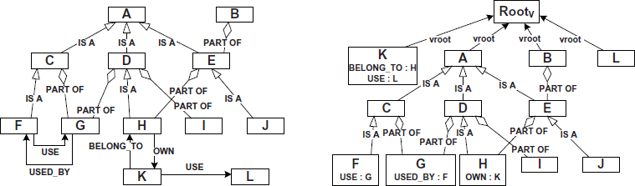
Ontology Graphs and Graph Operations [2/3]
Common ontological relations like generalization (IS-A) or aggregation (PART-OF) typically build up a DAG
Slots represents cyclic edges

Slide 6
Ontology Graphs and Graph Operations [3/3]
Operations
InsertNode(name, attributes, slots, parents)
DeleteNode(node)
InsertEdge(parent, child, type)
DeleteEdge(parent, child)
InsertSlot(node, slot)
DeleteSlot(node, slot)
UpdateNode(node, attributes)
RenameNode(node, name)
ChangeEdgeType(parent, child, type)

Slide 7
The Comparison Algorithm [1/11] Node Matching
similar(x, y)
x.name = y.name
compare(x, y)
Compares all attributes of x and y, returns 0~1
commonSlotsRatio(x, y)
commonSlots(x, y) / maxSlots(x, y), returns 0~1
commonLeavesRatio(x, y)
commonLeaves(x, y) / maxLeaves(x, y), returns 0~1
Same name && returned value > threshold == true

Slide 8
The Comparison Algorithm [2/11] Longest Common Subsequence
LCS(A, B, equal)
A and B are sequence of objects of the same type
equal(a, b): Decides the equality of the objects a and b and returns either true or false
Use this LCS-function to efficiently compare sequences of graph nodes during node matching

Slide 9
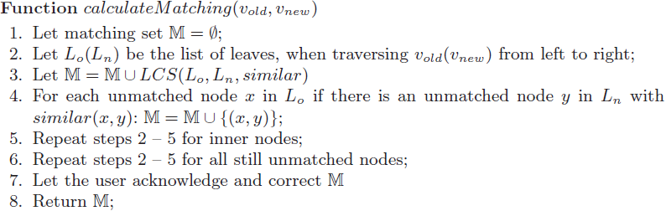
The Comparison Algorithm [3/11] Matching Algorithm
Sort the nodes’ children alphabetically by their name
and then
Matching order does not guarantee the best matching, i.e. the matching with the minimum differences

Slide 10
The Comparison Algorithm [4/11] Renaming Detection
Try to find pairs of nodes, which differ in their names but are so similar with respect to their attributes and structure
Consider node pairs under matched parents as possible renamings

Slide 11
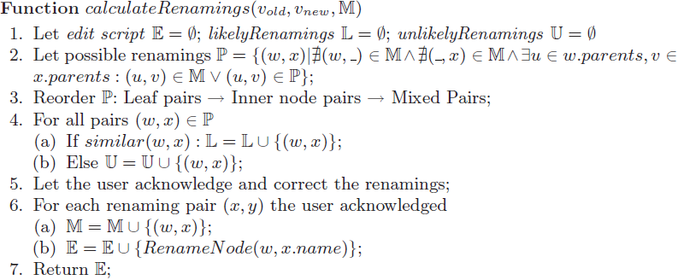
The Comparison Algorithm [5/11] Renaming Detection
For each acknowledged renaming (w, x), a RenameNode(w, x.name) operation is appended to the edit script and immediately applied on v_{old}

Slide 12
The Comparison Algorithm [6/11] Comparing Two DAGs
Partner of a node x
The node y to which x is matched
Insert Phase
Let x be the current node when traversing v_{new} in topological order
InsertNode(x.name, x.attributes, x.slots, Z)
Z
partner
Y
x
inserted
v_{old}
v_{new}

Slide 13
The Comparison Algorithm [7/11] Comparing Two DAGs
Update Phase
w: partner of x
If the attribute of x and w differ, UpdateNode(w, x.attributes)
Slot Changing Phase
For every slot s_{n} contained in x but not in w, InsertSlot(w, s_{n})
For every slot s_{o} contained in w but not in x, DeleteSlot(w, s_{o})

Slide 14
The Comparison Algorithm [8/11] Comparing Two DAGs
Edge Changing Phase
Check whether every node in Y has a partner in V and vice versa, and whether all edges are of the correct edge type
InsertEdge(y.partner, w, e.type)
DeleteEdge(v, w)
ChangeEdgeType(v, w, e_{n}.type)
V
Y
v
y
v
x
partner
v_{old}
v_{new}

Slide 15
The Comparison Algorithm [9/11] Comparing Two DAGs
Delete Phase
Let w be the current node when traversing v_{old} in post-order
If w is not matched, it has been deleted, DeleteNode(w)

Slide 16
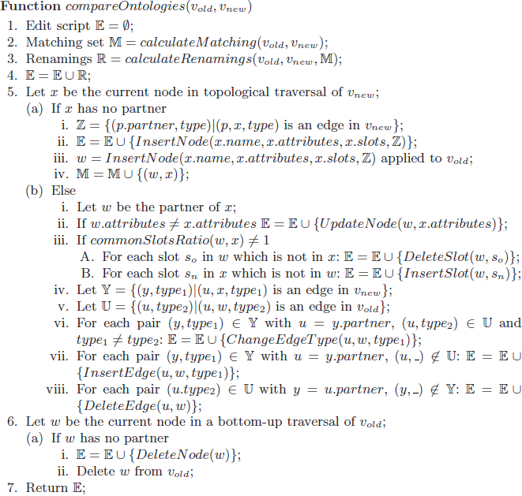
The Comparison Algorithm [10/11] Comparing Two DAGs

Slide 17
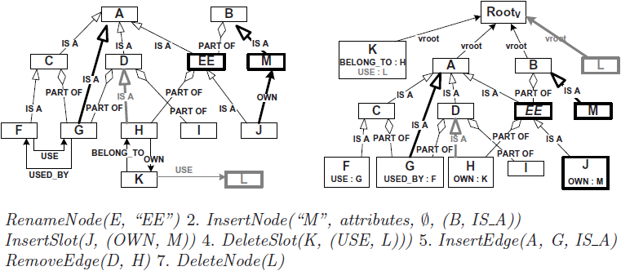
The Comparison Algorithm [11/11] Example

Slide 18
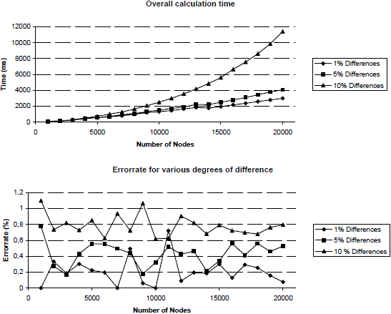
Implementation and Evaluation
Random DAG
Up to seven levels
At most three parents
One (p = 0.7)
Two (p = 0.15)
Three (p = 0.15)
About a quarter of the created nodes get up to file slots

Slide 19
Thank you!

