Slide 1
RCFile: A fast and space-efficient data placement structure in MapReduce-based warehouse systems
Yongqiang He#$, Rubao Lee%, Yin Huai%, Zheng Shao#, Namit Jain#, Xiaodong Zhang%, Zhiwei Xu$
# Facebook Data Infrastructure Team, % The Ohio State University,
$ Institute of Computing Technology, Chinese Academy of Sciences
ICDE 2011
November 3, 2011
Hyewon Kim

Slide 2
Outline
Introduction
Existing data placement structure
RCFile
Experiments
Conclusion

Slide 3





Introduction (1/2)
We need to analyze big data!
To understand quickly the dynamics of user behavior trends and user needs
MapReduce based warehouse systems
HIVE in facebook & PIG in yahoo

Slide 4
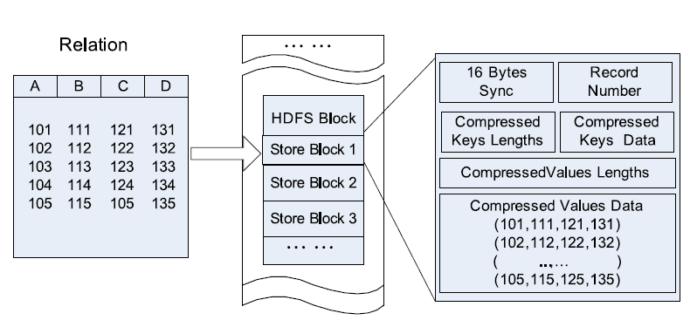
Introduction (2/2)
Data Placement Structure is important!
Row-store structure Column-store structure
101 111 121 131
102 112 122 132
101
102
103
104
105
111
112
113
114
115
121
122
123
124
125
131
132
133
134
135
BLOCK 1
103 113 123 133
114 124 134
115 125 135
BLOCK 1
BLOCK 2
BLOCK 3
BLOCK 4
BLOCK 2
Find an efficient data placement structure !
Four critical
requirements
1. Fast data loading
2. Fast query processing
3. Highly efficient storage space utilization
4. Strong adaptivity to highly dynamic workload patterns

Slide 5
Outline
Introduction
Existing data placement structure
Row-store
Column-store
RCFile
Experiments
Conclusion

Slide 6
Existing data placement structure (1/3) Horizontal Row-store
Advantage
Fast data loading
Strong adaptive ability to dynamic workload
Weaknesses
CANNOT provide fast query processing
NOT easy for row-store to achieve a high data compression ratio

Slide 7
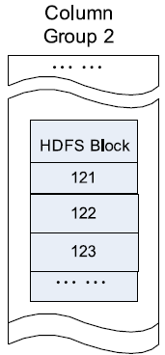
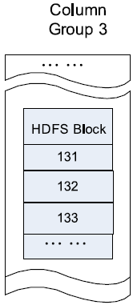
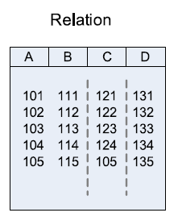
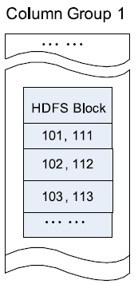
Existing data placement structure (2/3) Vertical Column-store
Advantage
CAN avoid reading unnecessary columns during a query execution
CAN easily achieve a high compression ratio
Weaknesses
CANNOT provide fast query processing in Hadoop-based systems due to high overhead of a tuple reconstruction
Column-group
Column-store

Slide 8
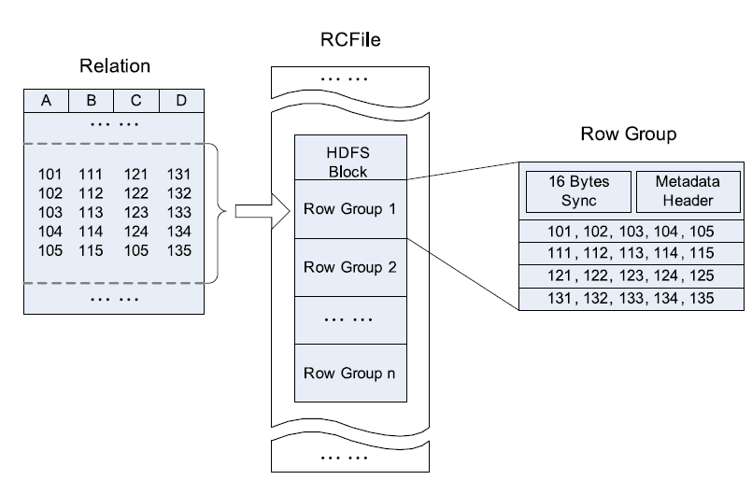
Existing data placement structure (3/3) RCFile (Record Columnar File)
Merits of the row-store
Merits of the column-store
RCFile
Horizontally partitioned into multiple row groups
Each row group is vertically partitioned so that each column is stored independently
Lazy decompression
Flexible row group size

Slide 9
Outline
Introduction
Existing data placement structure
RCFile
Data layout
Compression
Lazy decompression
Row group size
Experiments
Conclusion

Slide 10
RCFile (1/4) Data layout
All row groups have the same size
Sync marker is used to separate two continuous row groups
Metadata header stores the information items
First horizontally partition
Then vertically-partition
Data in the same row are located in the same node, thus it has low cost of tuple reconstruction
Can exploit a column-wise data compression and skip unnecessary column reads

Slide 11
RCFile (2/4) Compression
In each row group, the metadata header section and the table data section are compressed independently
RLE(Run Length Encoding)
Each column is independently compressed with the heavy-weight Gzip compression algorithm.
Lazy decompression

Slide 12
RCFile (3/4) Lazy decompression
It only reads the metadata header and the needed columns in the row group for a given query
SELECT c1 FROM tbl WHERE c4=1
Main memory
`
Row group
Metadata header is always decompressed in memory until RCFile processes the next row group
Metadata Header
Sync |  | Metadata Header
1 | 2 |  | 3 | 4 | 5
11 | 12 |  | 13 | 14 | 15
21 | 22 |  | 23 | 24 | 25
1 | 0 |  | 0 | 1 | 1
Metadata Header
C1
1 2 3 4 5
C2
1 0 0 1 1
C3
1 0 0 1 1
C4
Lazy decompression ;
A column will not be decompressed in memory until RCFile has determined that the data in the column will be really useful for query execution

Slide 13
RCFile (4/4) Row group size
Compression Efficiency
A large row group size can have better data compression efficiency
Query execution time
A large row group size may hurt the data read performance
Users should choose the row group size to consider both the storage space and query execution requirements
Large row group
Small row group
Sync |  | Metadata Header
1 | 2 |  | 3 | 4 | 5 | 6
11 | 12 |  | 13 | 14 | 15 | 16
21 | 22 |  | 23 | 24 | 25 | 26
1 | 0 |  | 0 | 0 | 0 | 0
Sync |  | Metadata Header
1 | 2 |  | 3 | 4 | 5 | 6
11 | 12 |  | 13 | 14 | 15 | 16
21 | 22 |  | 23 | 24 | 25 | 26
1 | 0 |  | 0 | 0 | 0 | 0
C1
C1
C2
C2
C3
C3
C4
C4
Row group 1
Row group 2
Row group 3
SELECT c1, c2, c3 FROM tbl WHERE c4=1
Useful row group!
Useless row group!

Slide 14
Outline
Introduction
Existing data placement structure
RCFile
Experiments
Conclusion

Slide 15



Experiments (1/6)
RCFile vs Other structures
Data storage space
Data loading time
Query execution time
RCFile with different row group sizes
Intel Xeon CPU with 8 cores
32GB Main memory
12 1TB disks
Benchmark proposed by Pavlo et al.
RCFile
40 nodes

Slide 16
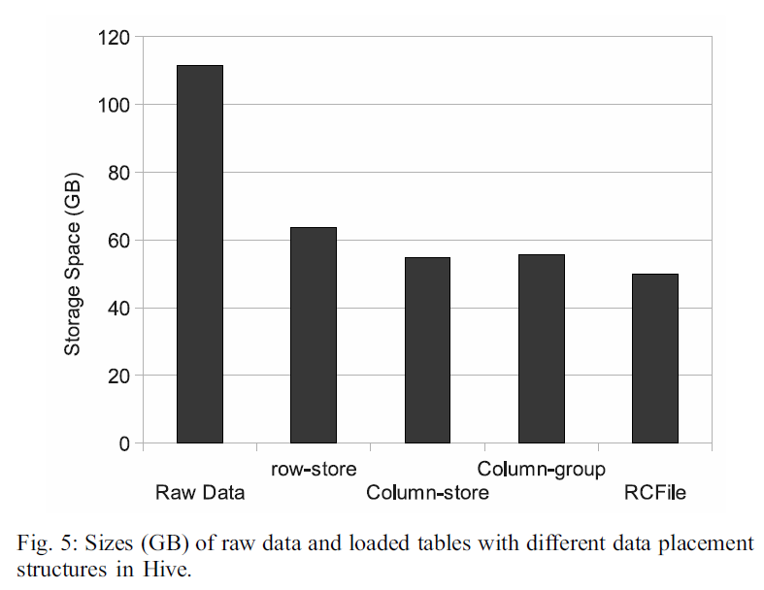
Experiments (2/6) RCFile vs Other structures
Data storage space
During loading, data is compressed by the Gzip algorithm for each structure
WORST!!
Because of mixed data domains
BEST!!
RCFile uses TWO section to store the real column data and the metadata
; It CAN compress the two sections independently
Zebra stores column metadata and real column data together
;It CANNOT compress them separately
Zebra library

Slide 17
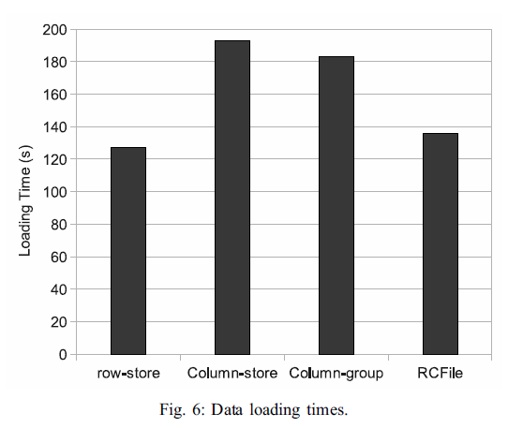
Experiments (3/6) RCFile vs Other structures
Data loading time
The time required by loading the raw data into the data warehouse
BEST!!
It has the minimum overhead to re-organize records in the raw text file
WORST!!
Each record will be written to multiple HDFS blocks for different columns Multiple blocks are not in the same cluster node!
Small overhead of RCFIle
; It needs to re-organize records inside each row group

Slide 18
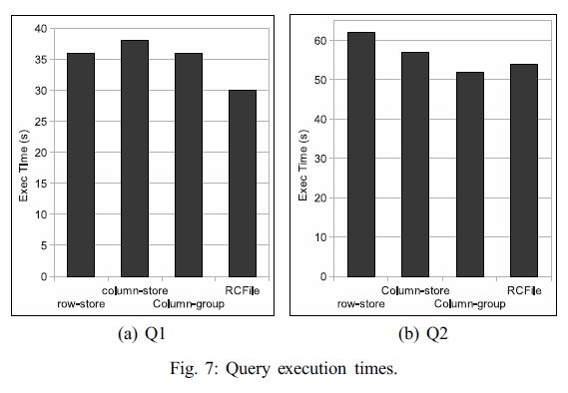
Experiments (4/6) RCFile vs Other structures
Query execution time
Lazy decompression technique in RCFile can accelerate the query execution with a low query selectivity
5%
Q1.
SELECT pagerank, pageurl FROM RANKING
WHERE pagerank > 400 ;
95%
Q2.
SELECT pagerank, pageurl FROM RANKING
WHERE pagerank < 400 ;
The high selectivity of this query makes lazy decompression useless

Slide 19
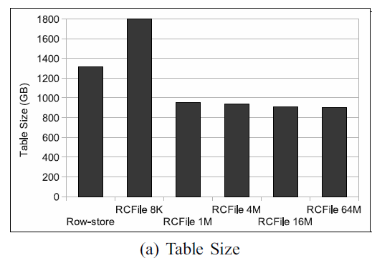
Experiments (5/6) RCFile with Different Row Group Sizes
How the row group size can affect data storage space?
When increasing the row group size,
RCFile can significantly decrease storage space compared with row-store
After a threshold,
Increasing row group size would not help improve data compression efficiency significantly
A small 8KB row group size
;RCFile needs more storage space than row-store

Slide 20
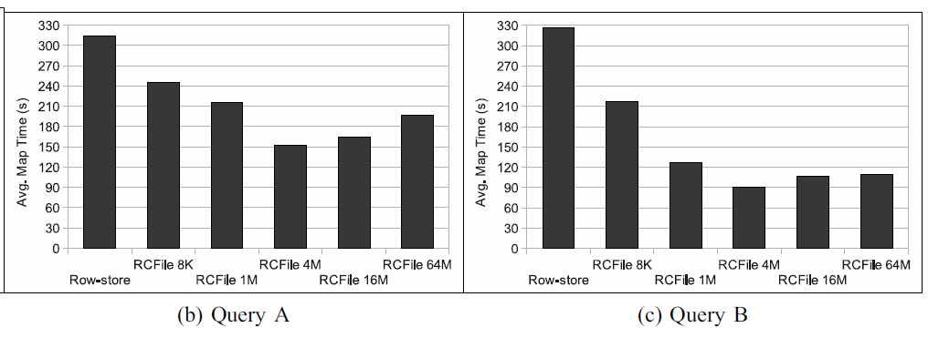
Experiments (6/6) RCFile with Different Row Group Sizes
How the row group size can affect query execution time?
RCFile can significantly outperform row-store
Large row group size ?
CANNOT gain further I/O space advantage
Has more overhead to manage a large row group
CAN decrease the advantage of lazy decompression
BEST!!
It can reduce the amount of disk accesses and thus accelerate query execution

Slide 21
Outline
Introduction
Existing data placement structure
RCFile
Experiments
Conclusion

Slide 22
Conclusion
RCFile is a new big data placement structure
It satisfies the four requirements
Fast data loading
Fast query processing
Highly efficient storage space utilization
Strong adaptivity to highly dynamic
RCFile has been chosen in Facebook data warehouse system as the default option

Slide 23
Thank U!
Any question?

