Slide 1
Estimating R3F Triple Filtering Effects
Kisung Kim
IDB Lab.
2012-2-24
kskim@idb.snu.ac.kr

Slide 2
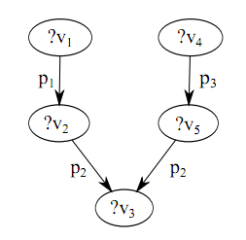
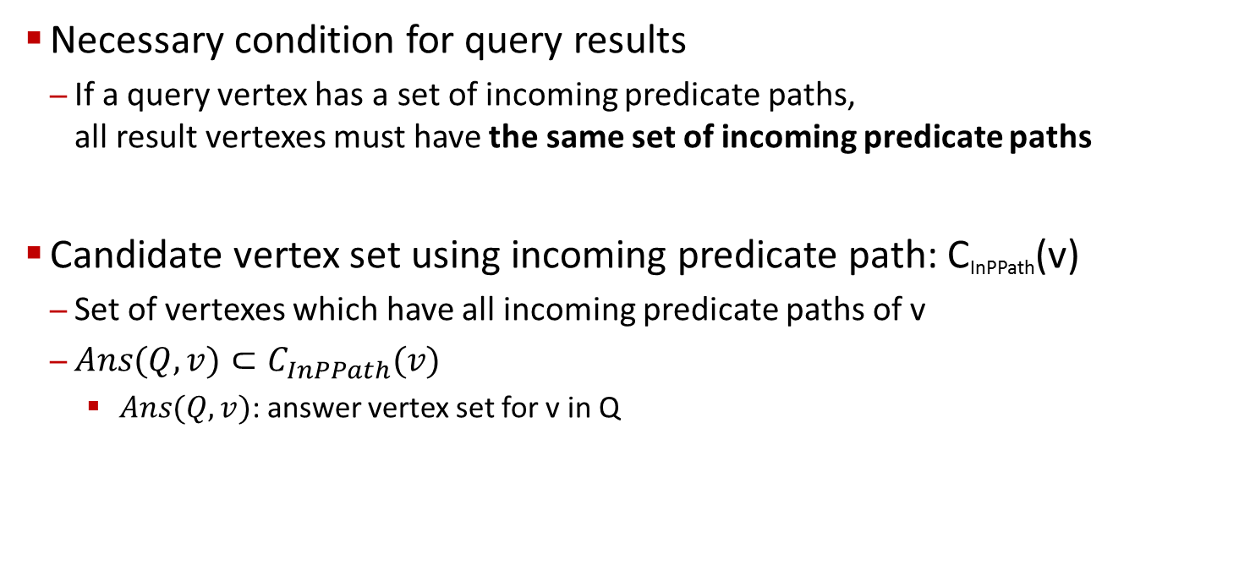
R3F Overview
Necessary condition for query results
If a query vertex has a set of incoming predicate paths, all result vertexes must have the same set of incoming predicate paths
Candidate vertex set using incoming predicate path: C_{InPPath}(v)
Set of vertexes which have all incoming predicate paths of v
$Ans(Q,v)⊂C_{InPPath}(v)$
$Ans(Q,v)$: answer vertex set for v in Q
Incoming Predicate Paths of ?v₃
r₁
r₂
p₁
p₃
r₃
r₄
<p₁, p₂>
<p₃, p₂>
p₂
p₂
r₅
Query
Result

Slide 3
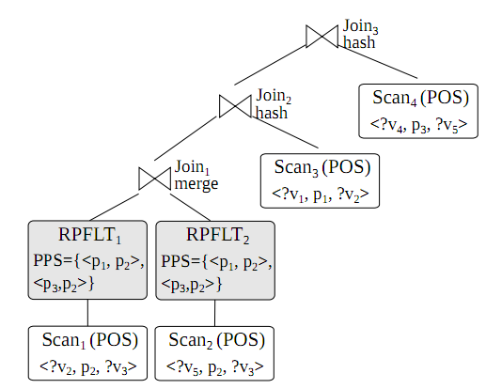
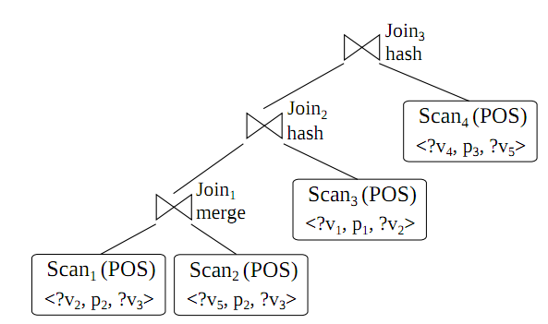
R3F Overview
RP-index provides C_{InPPath}(v)
Filtering operators filter input triples using C_{InPPath}(v)
RP-index
<p₁, p₂>
<p₃, p₂>
C_{InPPath}(?v₃)

Slide 4
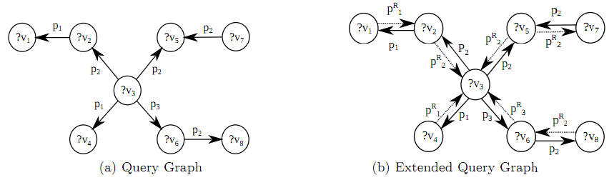
R3F Overview
We cannot use the triple filtering for a query vertex with no incoming predicate path
Supplement RDF database and SPARQL queries with the reverse predicates
InPPath(?v3) = {<p₂^{R}>, <p₂,p₂^{R}>,
<p₁^{R},p₂^{R}>, <p₁^{R}> <p₃^{R}>,
<p₂^{R}, p₃^{R}> }
InPPath(?v3) = { }

Slide 5
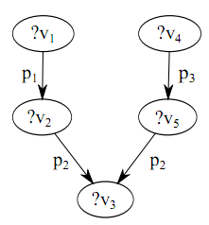
RPFLT Operator
Conduct triple filtering for one scan operator
PPS (Predicate Path Set)
Contain predicate paths assigned by query compiler
RPFLT uses assigned Vlists as its filter data

Slide 6
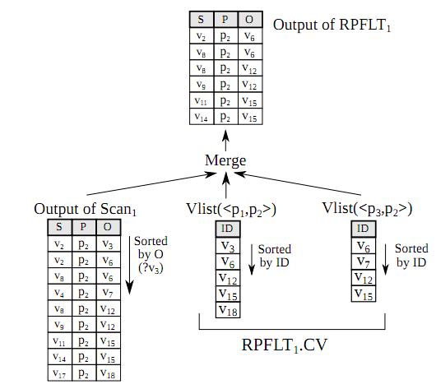
RPFLT Operator
RPFLT.CV
Candidate vertex set
Intersection of all associated Lists
Triple filtering
Filter out triples whose sortkey column value is not in RPFLT.CV
Use merging process
Input triples and Vlists are all sorted

Slide 7
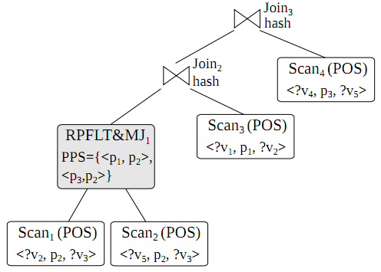
RPFLT&MJ Operator
Redundant reading of filter data in RPFLT
Conduct the triple filtering for all child operators and join operation

Slide 8
Estimation of Filtering Effects
<HashJoin 4.29045 43689974
<RPFLT_M 0 28498659 ⬅ (28498707)
VLIST[2]<100000000,15> 5987174
VLIST[2]<16,15> 5783852
<IndexScan 199993 199993
PredicateSubjectObject
"http://idb.snu.ac.kr#headOf" (12)
>
<IndexScan 1.70086e+06 1700475
PredicateObjectSubject
"http://www.w3.org/1999/02/22-rdf-syntax-ns#type" (0)
"http://idb.snu.ac.kr#FullProfessor" (28)
>
<IndexScan 4.10246e+07 40527001
PredicateObjectSubject
"http://idb.snu.ac.kr#advisor" (15)
>
<IndexScan 1.43574e+08 138035505
PredicateObjectSubject
"http://idb.snu.ac.kr#publicationAuthor" (16)
>
>
<RPFLT_M 0 2530814 ⬅ (62978102)
VLIST[2]<100000000,100000015> 41024602
VLIST[2]<100000012,100000015> 1628717
VLIST[2]<16,100000015> 41024602
<IndexScan 2.5192e+07 25161050
PredicateObjectSubject
"http://www.w3.org/1999/02/22-rdf-syntax-ns#type" (0)
"http://idb.snu.ac.kr#GraduateStudent" (2014)
>
<IndexScan 1.43574e+08 140324211
PredicateObjectSubject
"http://idb.snu.ac.kr#publicationAuthor" (16)
>
>
>
HashJoin
RPFLT_M
RPFLT_M
Index
Scan
Index
Scan
Index
Scan
Index
Scan
Index
Scan
Index
Scan
Useless application of filters
Non-optimal join ordering
LUBM Q3

Slide 9
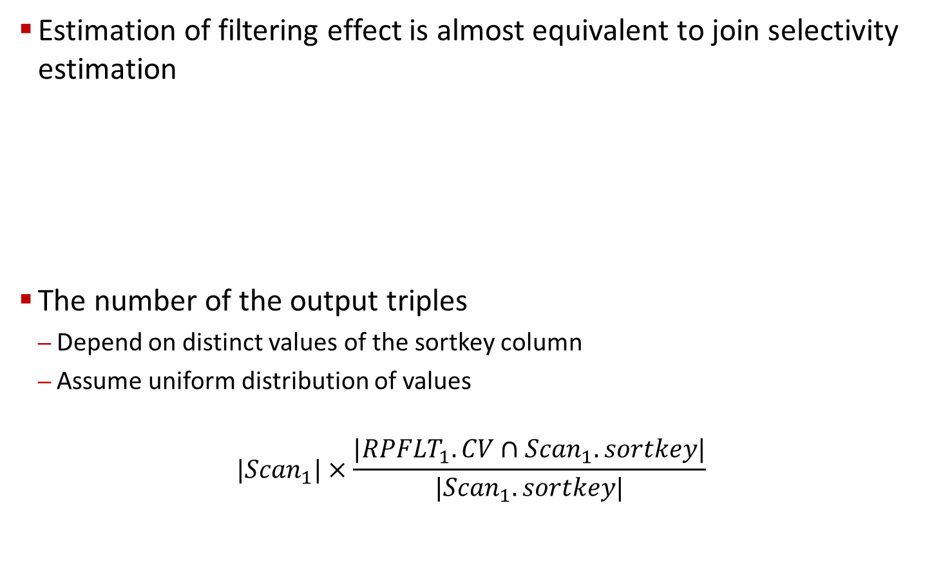
Estimation of Filtering Effects
Estimation of filtering effect is almost equivalent to join selectivity estimation
The number of the output triples
Depend on distinct values of the sortkey column
Assume uniform distribution of values
$$|{Scan}_{1}|×\frac{|{RPFLT}_{1}.CV∩{Scan}_{1}.sortkey|}{|{Scan}_{1}.sortkey|}$$
?
p₃
RPFLT₁
PPS={<p₃, p₂>}
p₁
p₂
Scan₁(POS)
<v₁, p₁, v₂>
How can we obtain this?

Slide 10
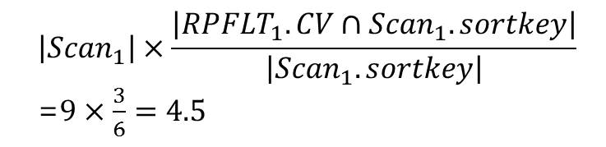
Estimation of Filtering Effects
RPFLT.CV
Candidate vertex set
Intersection of all associated Lists
Triple filtering
Filter out triples whose sortkey column value is not in RPFLT.CV
$$\left|{Scan}_{1}\right|×\frac{\left|{RPFLT}_{1}.CV∩{Scan}_{1}.sortkey\right|}{\left|{Scan}_{1}.sortkey\right|}$$
=$9×\frac{3}{6}=4.5$
v₆, v₁₂, v₁₅
v₃, v₆, v₇, v₁₂, v₁₅, v₁₈

Slide 11
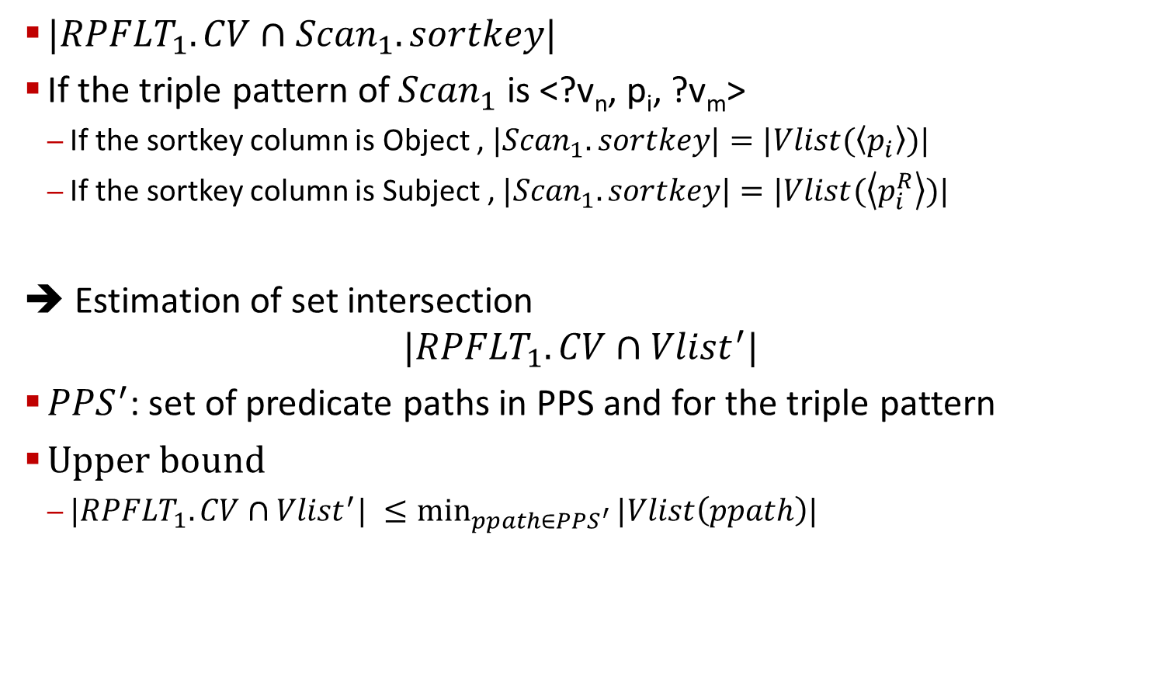
Estimation of Filtering Effects
$|{RPFLT}_{1}.CV∩{Scan}_{1}.sortkey|$
If the triple pattern of ${Scan}_{1}$ is <?v_{n}, p_{i}, ?v_{m}>
If the sortkey column is Object , ${|Scan}_{1}.sortkey|=|Vlist(\left\langle p_{i}\right\rangle )|$
If the sortkey column is Subject , ${|Scan}_{1}.sortkey|=|Vlist(\left\langle p_{i}^{R}\right\rangle )|$
➔ Estimation of set intersection
$$|{RPFLT}_{1}.CV∩{Vlist}^{′}|$$
${PPS}^{′}$: set of predicate paths in PPS and for the triple pattern
Upper bound
$\underset{ppath∈{PPS}^{′}}{|{RPFLT}_{1}.CV∩{Vlist}^{′}| ≤min}{|Vlist\left(ppath\right)|}$

Slide 12

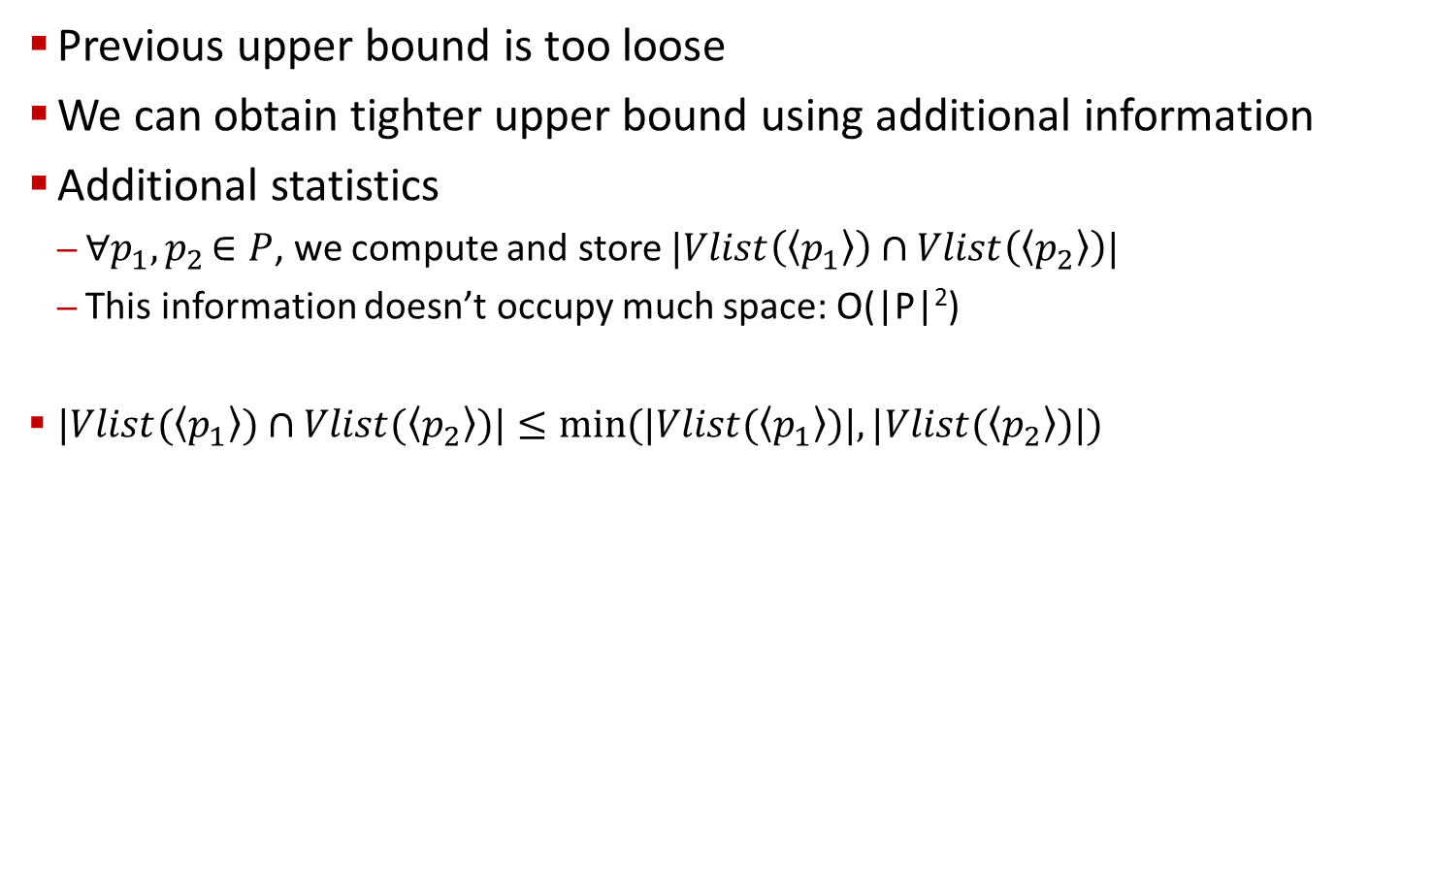
Estimation of Filtering Effects
Previous upper bound is too loose
We can obtain tighter upper bound using additional information
Additional statistics
$∀p_{1}{,p}_{2}∈P$, we compute and store $|Vlist\left(\left\langle p_{1}\right\rangle \right)∩Vlist\left(\left\langle p_{2}\right\rangle \right)|$
This information doesn’t occupy much space: O(|P|²)
$|Vlist(\left\langle p_{1}\right\rangle )∩Vlist(\left\langle p_{2}\right\rangle )|≤min⁡(|Vlist(\left\langle p_{1}\right\rangle )|, |Vlist(\left\langle p_{2}\right\rangle )|)$
p₁
p₂
p₁
p₂
$$1≤min⁡(2,2)$$

Slide 13

Estimation of Filtering Effects
Example
p₁
p₂
p₁
p₂
p₁
p₂
p₂
p₁
p₂
p₂
$\left|Vlist\left(\left\langle p_{1}\right\rangle \right)∩Vlist\left(\left\langle p_{1},p_{2}\right\rangle \right)∩Vlist\left(\left\langle p_{2},p_{2}\right\rangle \right)\right|$=1
$$\min\left(\left|Vlist\left(\left\langle p_{1}\right\rangle \right)\right|,\left|Vlist\left(\left\langle p_{1},p_{2}\right\rangle \right)\right|,\left|Vlist\left(\left\langle p_{2},p_{2}\right\rangle \right)\right|\right)=\min\left(2,2,2\right)=2$$
$$\min\left(\left|Vlist\left(\left\langle p_{1}\right\rangle \right)∩Vlist\left(\left\langle p_{2}\right\rangle \right)\right|,|Vlist(⟨p_{2}⟩)∩Vlist(⟨p_{2}⟩)|\right)=\min\left(1,3\right)=1$$

Slide 14
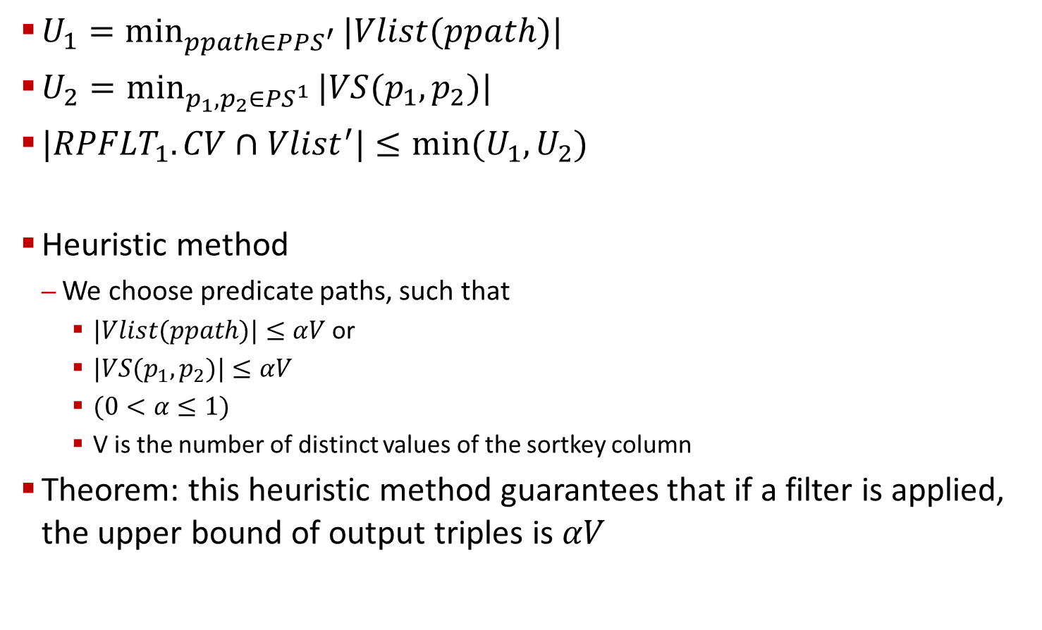
Estimation of Filtering Effects
$U_{1}=\min_{ppath∈{PPS}^{′}}{|Vlist(ppath)|}$
$U_{2}=\min_{p_{1},p_{2}∈{PS}^{1}}{|VS(p_{1},p_{2})|}$
$|{RPFLT}_{1}.CV∩{Vlist}^{′}|≤min⁡(U_{1},U_{2})$
Heuristic method
We choose predicate paths, such that
$|Vlist(ppath)|≤αV$ or
$|VS(p_{1},p_{2})|≤αV$
$(0<α≤1)$
V is the number of distinct values of the sortkey column
Theorem: this heuristic method guarantees that if a filter is applied, the upper bound of output triples is 𝛼𝑉

Slide 15
Thank You Any Question?

