Slide 1
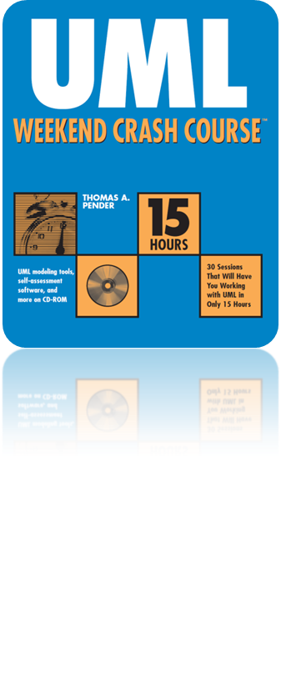
Session 8
Identifying the Use Case Scenarios
Written by Thomas A. Pender
Published by Wiley Publishing, Inc.
October 12, 2011
Presented by So-min Kim

Slide 2
Contents
Describing Use Case Scenarios
  Why you should care about Use Case scenarios
  How to find Use Case scenarios
  Finding Use Case scenarios for the case study
  The Continuing Refinement & Expansion of the UML
  Applying Use Case scenarios

Slide 3
Describing Use Case Scenarios (1/12)
Scenario
  Each possible outcome of an attempt to accomplish a Use Case goal
  A single logical path through a Use Case
  An instance of a Use Case in that a scenario is one realization, or execution
Use Case & Scenario
  A Use Case defines what could happen
  A scenario defines what does happen under a given set of conditions

Slide 4
Describing Use Case Scenarios (2/12)
Why you should care about Use Case scenarios
  Scenario break down the narrative explanation to provide a detailed examination of every possible outcome of the Use Case
    Why each outcome happens
    How the system is supposed to respond

Slide 5
Describing Use Case Scenarios (3/12)
How to find Use Case scenarios
  Follow each unique series of activities and decisions from the beginning of the Use Case to a single end point
  The scenarios should account for every possible way that a Use Case could execute
  Reading a narrative and following every possible path ( Difficult! )
  Activity Diagram
    Provides a visual evaluation of the Use Case narrative
      It isn’t necessary to use an Active diagram
      It can be very helpful, especially for complex Use Cases
    Activity diagram quickly reveal dead-end segments and incomplete paths

Slide 6
Describing Use Case Scenarios (4/12)
How to find Use Case scenarios (cont.)
  Find scenario using Activity diagram
    Follow the path of the successful scenario first
    Trace the steps until you come to a decision, represented by a diamond.
    Select one of the possible paths leading out of the diamond, preferably the path that leads to the successful completion of the scenario (the first scenario)
      Continue to trace the steps
      Continue the process until you reach an end point
    Now return to the top and retrace the first scenario to the first branching point
    Start the second scenario at the branch, but follow a different path leading out of the decision
      Continue tracing the steps as before
      If you loop back to a place you have already been, then stop
    Repeat the process until you have traced a path through every segment of the diagram.

Slide 7
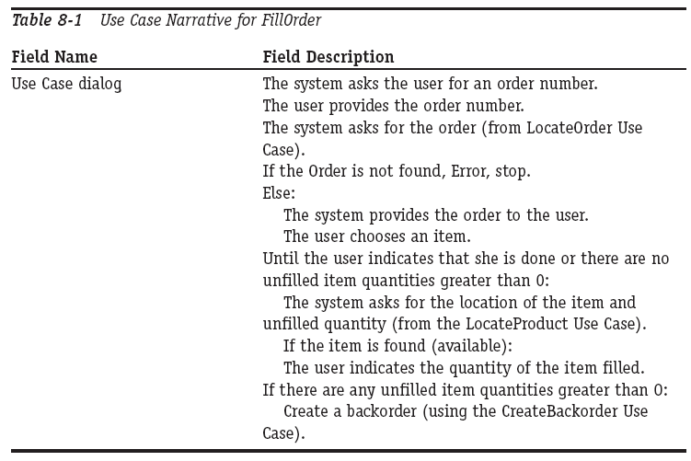
Describing Use Case Scenarios (5/12)
Finding Use Case scenarios for the case study

Slide 8
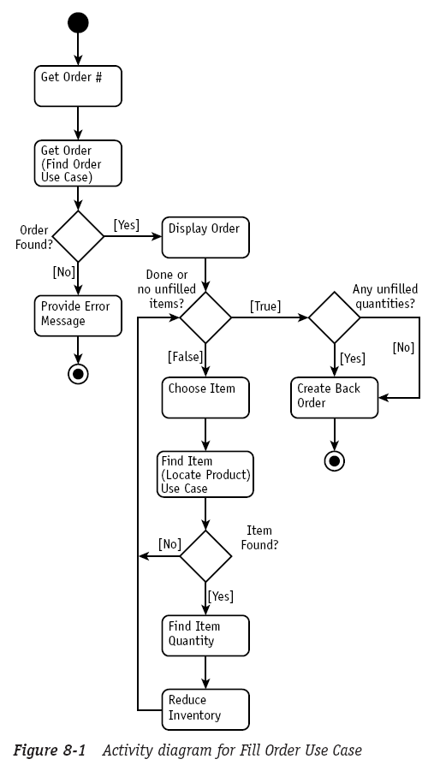
Describing Use Case Scenarios (6/12)
Finding Use Case scenarios for the case study (cont.)

Slide 9
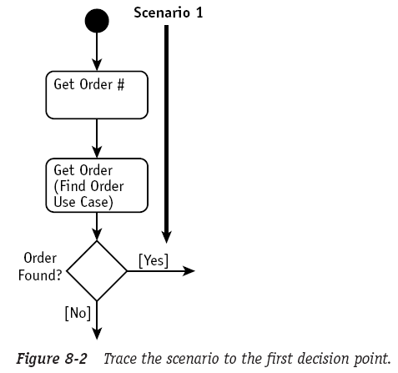
Describing Use Case Scenarios (7/12)
Finding Use Case scenarios for the case study (cont.)

Slide 10
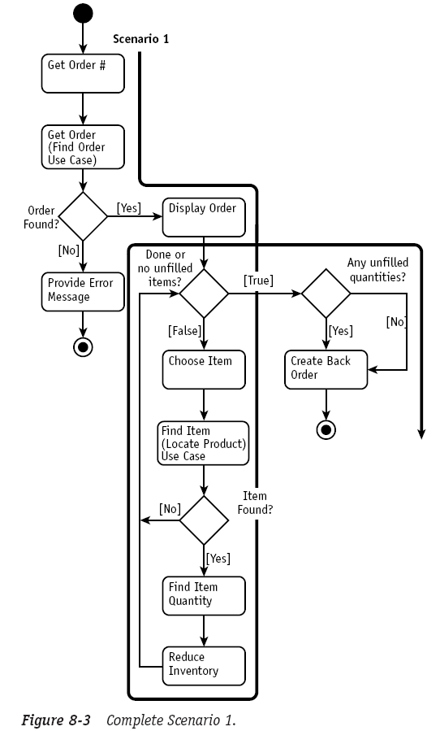
Describing Use Case Scenarios (8/12)
Finding Use Case scenarios for the case study (cont.)

Slide 11
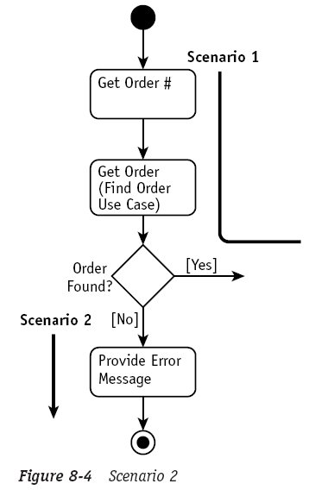
Describing Use Case Scenarios (9/12)
Finding Use Case scenarios for the case study (cont.)

Slide 12
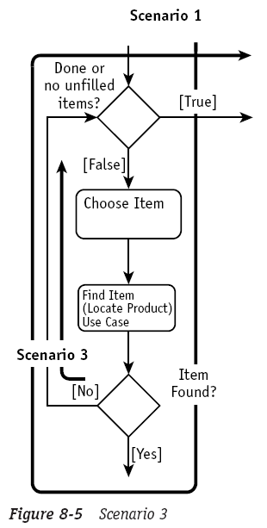
Describing Use Case Scenarios (10/12)
Finding Use Case scenarios for the case study (cont.)

Slide 13
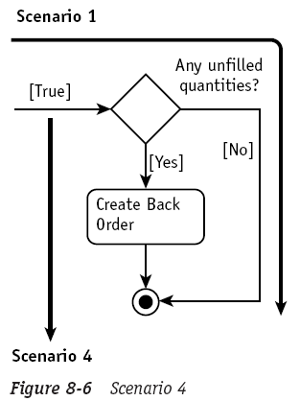
Describing Use Case Scenarios (11/12)
Finding Use Case scenarios for the case study (cont.)

Slide 14
Describing Use Case Scenarios (12/12)
Applying Use Case scenarios
  Using the Activity diagram, you can visually identify each path
  The result of completing the description of all the scenarios should be a reasonably complete test plan for each Use Case
    We have only modeled the system at the Use Case level
    The test plan we have so far is really only acceptance-level
      Not full system or integration testing
  They may also be used to test the results of subsequent analysis and design efforts

Slide 15
The End

