Slide 1
I4E: Interactive Investigation of Iterative Information Extraction
Anish Das Sarma, Yahoo Research CA, USA
Alpa Jain, Yahoo Research CA, USA
Divesh Srivastava, AT&T Labs-Research NJ, USA
SIGMOD 2010
Sep 22, 2011
Heegook Jun

Slide 2
Outline
Introduction
Iterative Information Extraction
Explain, Diagnose and Repair
Chaining EDR Operations
Experimental Evaluation
Conclusion

Slide 3
Introduction
Knowledge-driven tasks
Question answering, opinion mining, trend analysis..
Significant interest in automatically extracting structured information from text documents such as newspaper articles, email, etc
Examples of real-life extraction systems
Gate1, DBLife2, DIPRE, KnowItAll, Rapier, Snowball

Slide 4

Structured data from structured DB
Select Name, Job ..
DB
<Tom, Actor>
ID | Name | Job
111 | Tom | Actor
222 | Joe | Singer

Slide 5


Structured data from unstructured text documents
Get Name, Job ..
<Tom, Actor>
“…Top gun, movie starring Tom Cruise …”

Slide 6
Iterative Information Extraction System (IIE)
IIE
Output
<동방신기, 윤호>
<Idol Group, member>
<쥬얼리, 서인영 >
Learn pattern
<소녀시대, 써니>

Slide 7
Iterative Information Extraction System (IIE)
Wrong Output
IIE
<동방신기, 윤호>
<Idol Group, member>
<쥬얼리, 서인영 >
Learn pattern
<소녀시대, 써니>
“소녀시대가 코엑스에서 영화 써니 단체관람을…”
<who, movie>

Slide 8
Interactive Investigation System of IIE
I4E
Wrong Output
IIE
Output
III. Repair
<Idol Group, member>
I. Explain
II. Diagnose

Slide 9
Introduction
Iterative Information Extraction
A commonly used information extraction technique for largescale information extraction
Naturally, in most real-world extraction applications, it is not feasible to know apriori all possible contexts in which tuples of a relation may occur, thus, necessitating an iterative process

Slide 10
Introduction
Output from an information extraction system may contain unexpected, and potentially incorrect data
We focus on the problem of building an interactive investigation tool for iterative information extraction (14E)
14E is able to provide guidance by showing influential tuples and patterns, and thus make recommendations to aid the repair process
It supports the three phases of investigation
Explain, diagnose, and repair

Slide 11
Outline
Introduction
Iterative Information Extraction
Explain, Diagnose and Repair
Chaining EDR Operations
Experimental Evaluation
Conclusion

Slide 12
Iterative Information Extraction
The primary goal of information extraction systems is to obtain a set of tuples of a pre-defined relation, from a set of unstructured text documents.
Extraction patterns capture common ways of representing tuples of the target relation in a natural-language form
IIE systems follow a working hypothesis that tuples from a relation tend to occur in similar contexts.
Naturally, in most real-world extraction applications, it is no feasible to know apriori all possible contexts in which tuples of a relation may occur, thus, necessitating an iterative process.

Slide 13
Iterative Information Extraction
Discover patterns
Discover tuples
Seed tuples
Append to seed tuples
Prune tuples
Prune patterns

Slide 14
IIE 1: Discover patterns ‘P_{p}(t)’
For each tuple t, we denote by P_{p}(t) the set of patterns produced using t; similarly, for each pattern p, we denote by T_{g}(p) the set of tuples that generated pattern p.
EXAMPLE: relation actor <Movie, actor>
Discover patterns
Seed tuples
<Top Gun, Tom Cruise>
<Movie>, movie starring <Actor>
Top Gun, movie starring Tom Cruise.

Slide 15
IIE 1: Discover patterns ‘P_{p}(t)’
For each tuple t, we denote by P_{p}(t) the set of patterns produced using t; similarly, for each pattern p, we denote by T_{g}(p) the set of tuples that generated pattern p.
EXAMPLE: relation actor <Movie, actor>
Discover patterns
Seed tuples
<Top Gun, Tom Cruise>
<Movie>, movie starring <Actor>

Slide 16
IIE 1: Discover patterns ‘P_{p}(t)’
For each tuple t, we denote by P_{p}(t) the set of patterns produced using t; similarly, for each pattern p, we denote by T_{g}(p) the set of tuples that generated pattern p.
EXAMPLE: relation actor <Movie, actor>
Discover patterns
<Movie>, movie starring <Actor>
<Star Wars, Alec Guiness>
P_{p}(t)
T_{g}(p)
Star Wars, movie starring Alec Guiness

Slide 17
IIE 2: Discover tuples ‘T_{p}(p)’
Apply the current set of patterns on each document in D and obtain a set T’ of new tuples. For each tuple t, we denote by P_{g}(t) the set of patterns that generated t; similarly, for each pattern p, we denote by T_{p}(p) the set of tuples produced by p.
EXAMPLE: relation actor <Movie, actor>
T’
Discover patterns
Discover tuples
<Movie>, movie starring <Actor>
<Movie>, films starring <Actor>
P_{p}(t)
T_{g}(p)
P_{g}(t)
T_{p}(p)
<Troy, Brad Pitt>
Troy, films starring Brad Pitt
<Star Wars, Alec Guiness>
Star Wars, films starring Alec Guiness

Slide 18
Iterative Information Extraction
Discover patterns
Discover tuples
Seed tuples
Append to seed tuples
Prune tuples
Prune patterns

Slide 19
IIE 3: Prune patterns
Information extraction is a noisy process and oftentimes, we may learn unreliable patterns that can, in turn, produce erroneous tuples.
Confidence score: S_{p}(p) = F_{p}(T_{g}(p), T_{p}(p), s_{p})
Discover patterns
F_{p}(p₁) = 1
P_{p}(t)
F_{p}(p₂) = 0.6
Threshold
Ƭp = 0.5
F_{p}(p₃) = 0.8
F_{p}(p₄) = 0.2

Slide 20
IIE 4: Prune tuples
Discovered tuples are also assigned a confidence score.
Confidence score: S_{t}(t) = F_{t}(P_{g}(t), s_{t})
Discover tuples
F_{p}(t₁) = 1
T_{p}(p)
F_{p}(t₂) = 0.7
Threshold
Ƭt = 0.6
F_{p}(t₃) = 0.3
F_{p}(t₄) = 0.8

Slide 21
Iterative Information Extraction
Discover patterns
Discover tuples
Seed tuples
Append to seed tuples
Prune tuples
Prune patterns

Slide 22
Iterative Information Extraction
Bipartite Graph!
<Movie>, movie starring <Actor>
<Star Wars, Alec Guiness>
P_{p}(t)
T_{g}(p)
Star Wars, films starring Alec Guiness
<Movie>, films starring <Actor>
<Troy, Brad Pitt>
P_{g}(t)
T_{p}(p)

Slide 23
Enhanced Bipartite Graph (EBG)
I. Explain
II. Diagnose
III. Repair
F_{p}(p1) = 0.7
F_{t}(t1)
F_{p}(p2) = 0.5
F_{t}(t2)
Threshold
Ƭp = 0.6
F_{t}(t3)
Threshold
Ƭp = 0.4
F_{t}(t4)

Slide 24
Characterizing IIE: EBG
To capture the necessary tracing information in an IIE
so as to allow users and developers to effectively carry out post-extraction investigations
Given an iteration I_{i}, we focus on the set of tuples and patterns that were retained at the end of iteration I_{i} ³. To characterize iteration I_{i} (and all other iterations), we define an enhanced bipartite graph (EBG):

Slide 25
Characterizing IIE: EBG
DEFINITION [EBG]
An enhanced bipartite graph (EBG) G = (P, T, E₁, E₂) is a directed bipartite graph consisting of two classes of nodes
the set P of patterns’ nodes (“p” nodes)
the set T of tuples’ nodes (“t” nodes)
a set of directed edges E = E₁∪E₂, where E₁ ⊆ P x T and E₂ ⊆ T x P
An edge (p, t) ∈ E₁ (denoted p → t) connects a p node to a t node, and depicts that tuple t was generated by applying pattern p
an edge (t, p) ∈ E₂ (denoted t → p) connects a t node to a p node and depicts that pattern p was generated using tuple t.
Multiple edges may originate from or reach to a node.

Slide 26
Characterizing IIE: EBG
1. If p ∉ P, add a node p to P. If t ∉ T add a node for t to T.
2. Introduce into E₁ an edge (p, t), from p to a tuple t, if t was produced using p.
3. Annotate each edge p → t ∈ E1 with the score of t obtained from p applied to the document from which t was derived.
4. Introduce into E2 an edge (t, p), from t to a pattern p if p was produced using t.
5. Annotate each edge t → p with the score of p obtained from t applied to d.

Slide 27
Outline
Introduction
Iterative Information Extraction
Explain, Diagnose and Repair
Chaining EDR Operations
Experimental Evaluation
Conclusion

Slide 28

I. Explaining Extraction Output
Intuitively, given a set of tuples, explanation traverses its lineage backward, and so we are interested in building the history for each tuple.
I4E
IIE
Output
III. Repair
<Group, member>
I. Explain
II.Diagnose

Slide 29
I. Explaining Extraction Output: E1
E1 Given a tuple t, determine the set P_{g}(t) of patterns that generated t, i.e., contributed to increasing t’s score?
p1
t1
p2
t2
p3
p4

Slide 30
I. Explaining Extraction Output: E2
E2 Given a tuple t, which pattern contributed to t the most? That is, dropping which pattern would reduce the score of t the most?
S(p1, context₁₁) = 0.7
F_{p}(p1)
F_{t}(t1)
S(p2, o₂₁) = 0.3
F_{p}(p2)
S(p3, o₃₁) = 0.5
F_{p}(p3)

Slide 31
I. Explaining Extraction Output: E3
E3 Given a tuple t, which was the first iteration that discovered t?
There are two ways to solve it
Iteration 1
Iteration 2
Iteration 3
p1
t
p1
t
p1
t
p2
p2
p2
p3
p3
p3

Slide 32
I. Explaining Extraction Output: E3
E3 Given a tuple t, which was the first iteration that discovered t?
There are two ways to solve it
Iteration 1
p1
t1
Iteration 2
p2
Iteration 3
p3

Slide 33
I. Explaining Extraction Output: E4
E4 Determine the most influential patterns in the entire IIE result
(a) I_{t}(p), using the number of result tuples p produced, i.e, |T_{p}(p)|
(b) I_{o}(p), using the number of tuples only p produced
(c) I_{s}(p), using the total score contribution of p aggregated over all tuples.
Roughly, E4 aims to answer E1 and E2 for the entire batch of tuples in the result.
Set of K most influential patterns based on each of the three measures of impact.

Slide 34
I. Explaining Extraction Output: E4
(a) I_{t}(p), using the number of result tuples p produced
I_{t}(p) = |T_{p}(p)|
p1
t1
t2
p2
t3
t4

Slide 35
I. Explaining Extraction Output: E4
(b) I_{o}(p), using the number of tuples only p produced
p1
t1
t2
p2
t3
p3
t4

Slide 36
I. Explaining Extraction Output: E4
(c) I_{s}(p), using the total score contribution of p aggregated over all tuples.
S(p1, o₁₁) = 0.2
Total 0.7
p1
t1
S(p1, o₁₂) = 0.5
t2
Total 1.2
p2
S(p1, o₂₂) = 0.4
S(p1, o₂₃) = 0.4
t3
S(p1, o₂₄) = 0.4
t4

Slide 37
I. Explaining Extraction Output: Chaining Explanations
We consider complex (multi-step) investigations by interleaving the fundamental operations
We study two examples of chained explanations, obtained by extending E1 and E4. First consider the following extension of one-step E1

Slide 38
I. Explaining Extraction Output: E5
E5 Given a tuple t, find all patterns that (directly or indirectly) contributed to t.
p1
t1
t2
p2
t3
p3
t4

Slide 39



Interactive Investigation of IIE
I4E
Output
IIE
I. Explain
II. Diagnose
III. Repair
NP-Complete
Reduction!
These solution would be NP problem
↓
Need Approximation Algorithm
Vertex Cover Problem

Slide 40
II. Diagnosing the Extraction output
Intuitively, diagnosis performs a “forward pass” to determine all extraction results that were affected by specific pattern(s) or threshold(s).
I4E
IIE
Output
III. Repair
<Group, member>
I. Explain
II.Diagnose

Slide 41
II. Diagnosing the Extraction output: D1
D1 Given a pattern p, determine the set T_{p}(p) of tuples produced by p.
p1
t1
t2
p2
t3
t4

Slide 42
II. Diagnosing the Extraction output: D2
D2 Given a pattern p, determine all tuples that would get eliminated if p is removed.
p1
t1
t2
p2
t3
t4

Slide 43
II. Diagnosing the Extraction output: D3, D4
D3 Given a pattern p, which was the first iteration that discovered p?
D4 Find a set of K most influential tuples, i.e., find the set of K tuples that are contributed to by the largest number of patterns.
However, here we are only interested in finding K tuples and not ranking all tuples
the total number of tuples is likely to be large and ideally, we would like to present users with a small set of tuples to obtain feedback on whether these tuples are correct.

Slide 44
II. Diagnosing the Extraction output: Chaining Diagnosis
We consider the following extension of D2
D5 Given a pattern p, find all tuples that would get deleted if p were removed.
If a pattern is deleted, all tuples generated from it are deleted, which in turn may cause several other tuples and patterns to be deleted.

Slide 45
III. Repairing the Extraction Output
R1 One or more patterns are deleted.
R2 The score of one or more patterns is modified. (Setting the score of a pattern to 0 is equivalent to deleting it.)
R3 Some thresholds on tuples or patterns are modified.
R4 Each of a (small) set of tuples has been annotated (by a user) as correct or incorrect.
We would like to modify the IIE so that the users annotations are respected, i.e., revise the scores of other tuples and patterns to reflect the users annotations.

Slide 46
III. Repairing the Extraction Output
S(p1, o₁₁) = 0.2
p1
t1
Threshold
Ƭp = 0.5
S(p1, o₁₂) = 0.5
Threshold
Ƭt = 0.6
t2
p2
S(p1, o₂₂) = 0.4
S(p1, o₂₃) = 0.4
t3
S(p1, o₂₄) = 0.4
t4

Slide 47
III. Repairing the Extraction Output: Chaining Repair
We consider repairing the score of all affected tuples when a pattern’s score is modified, an extension of R2
R5 When the score of a pattern p is modified, repair the scores of all extracted tuples.
One option for solving R5 would be to repeatedly solve R2: determine the modified scores for the set of tuples directly contributed to by p, then modify scores of patterns based on the modified tuples, and so on.

Slide 48
Outline
Introduction
Iterative Information Extraction
Explain, Diagnose and Repair
Chaining EDR Operations
Experimental Evaluation
Conclusion

Slide 49
Experimental Evaluation
Experimental Settings
Effectiveness of 14E algorithms
Overhead of 14E (space & time)
Overhead vs. Coverage Tradeoff

Slide 50
Experimental Settings
Data sources: We used a collection of 500 million web pages crawled by Yahoo! search engine crawl.
Iterative information extraction method: 10 iterations
1 | actors: | <movie, actor>
2 | books: | <book, authori>
3 | directors: | <movie, directors>
4 | mayor: | <U.S. city, mayor>
5 | sen-party: | <senator, affiliated party>
6 | sen-state: | <senator, state>

Slide 51
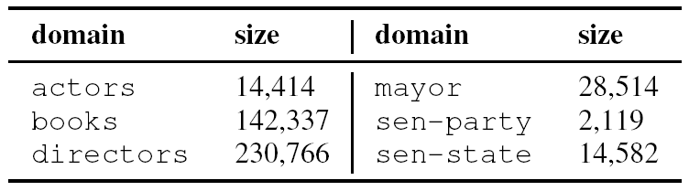
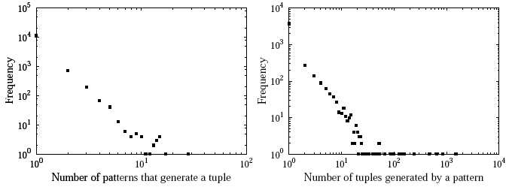
Experimental Settings
Size of the relations in our experiments
Actors relation:
(a) # of patterns generating a tuple (b) # of tuples generated by a pattern

Slide 52
Effectiveness of 14E algorithms
To examine the utility of the proposed I4E algorithms, we recruited a human annotator to prototype a repair scenario. Based on the IIE output, for a relation, we carried out two experiments: (1) patterns-based repair and (2) tuples-based repair.
Generated in IIE
Diagnose in I4E

Slide 53
Effectiveness of 14E algorithms
To examine the utility of the proposed I4E algorithms, we recruited a human annotator to prototype a repair scenario. Based on the IIE output, for a relation, we carried out two experiments: (1) patterns-based repair and (2) tuples-based repair.
Generated in IIE
Diagnose in I4E
Notes:
IIE가 찾은 모든 pattern을 가지고 Tuples 생성해내는 건 너무 시간 걸리고 비싸.
반면 I4E는 얼마나 Effective한지 보이는 실험을 함
Top K pattern을 시험 대상자에게 줘서 Correct/Wrong 평가하게 함. 그 결과를 Threshold등에 적용한 후 생성된 Tuples의 개수를 그래프로 그린 것
P-Inf 는 패턴 영향력으로 Top K Allign
P-Scr 은 패턴 신뢰점수로 (다른 논문 것)
P-Rnd 는 패턴 랜덤 (비교를 위한 평균치)
그 결과 14E가 제안한 게 효과적, 효율적인 결과를 보이더라.

Slide 54
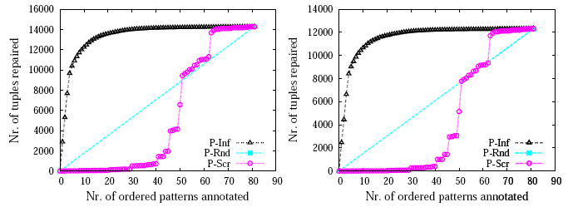
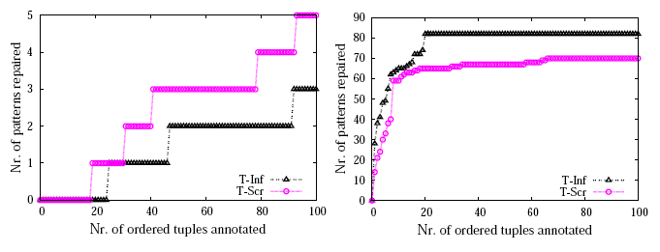
Effectiveness of 14E algorithms
Gains when annotated pattern is (a) correct and (b) wrong for the actors relation
Gains when annotated tuple is (a) correct and (b) wrong for the actors relation
Notes:
P-Scr의 그래프가 올라가는 때는 P-Inf에서 상위 Top-K에 있는 Pattern에 속한 pattern과 동일한 Pattern을 제시한 경우 Tuple이 빠르게 올라가더라

Slide 55
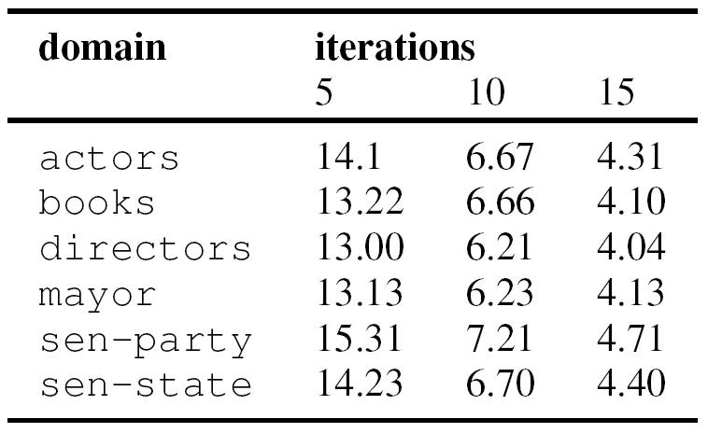
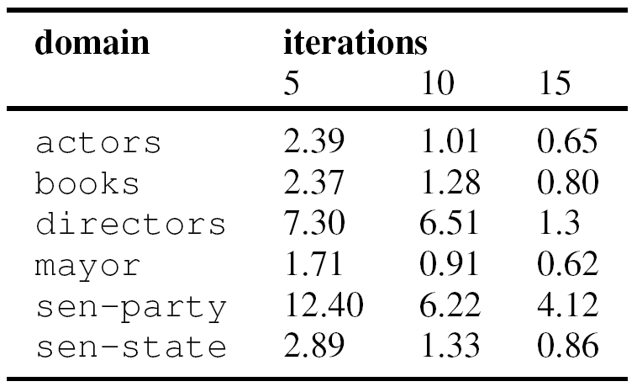
Overhead of 14E (space & time)
Space overhead
Time overhead
Relative increase (%) in space introduced by EBG for various relations and iterations for score recomputation.
Relative increase (%) in time introduced by EBG for various relations and iterations for score recomputation.

Slide 56
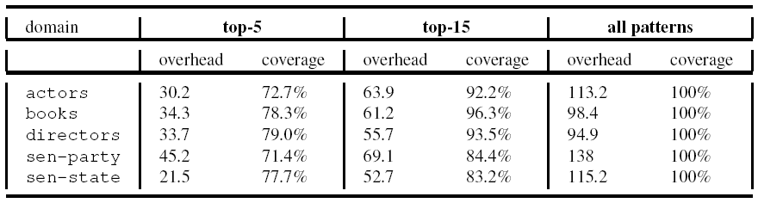
Overhead vs. Coverage Tradeoff
Tradeoff between
(1) correct-influence coverage and
(2) space overhead, for top-K patterns

Slide 57
Outline
Introduction
Iterative Information Extraction
Explain, Diagnose and Repair
Chaining EDR Operations
Experimental Evaluation
Conclusion

Slide 58
Conclusion
There are multiple benefits of building an investigation tool for IIE
Giving users useful insight into the extraction result
It helps in explaining to the user and system developer, the output from running an IIE over a collection of documents
It can help in diagnosing an IIE system
It can lead to repairing the IIE system by fixing patterns and thresholds, thus improving the IIE result

Slide 59
Contribution
Representing iterative IE
It captures sufficient information to carry out complex investigation operations, yet is simple and sufficient enough to scale to large-scale extraction scenarios such as the Web
Explain, diagnose, and repair operations
We present a set of fundamental queries that users may be interested in, for each stage of explain, diagnose, and repair. We give efficient algorithms for answering these questions
Chaining operations
Experimental evaluation

Slide 60
Future Work
Extending our approach to other (non-iterative) extraction systems is an important next step
Perform post-extraction investigation
by-product of our work is the process of extraction can be optimized
Incorporating textual context as a first-class component of I4E and further developing the theory of chaining
Applying graph-compression techniques on EBG

Slide 61
Thank You!
Any Questions or Comments?

