Slide 1
Improving Recommendation based on Implicit Trust Relationships from Tags
Hyunwoo Kim and Hyoung-Joo Kim
Seoul National University, Korea
CNSI 2012

Slide 2
Outline
Introduction
Our Approach
Evaluation
Conclusion

Slide 3


Introduction
Recommender systems
Collaborative filtering
User input
Recommendation
Similar users
item
item
item

Slide 4
Introduction
User similarity in collaborative filtering
User-item rating matrix
Similarity measures
Jaccard similarity coefficient
Cosine similarity
Pearson correlation coefficient
Items
1
2
3
4
5
6
7
8
9
10
User 1
 | 4 |  | 3 |  | 5
 | 4 |  | 3 |  |  | 4
 |  |  | 1 |  | 1 |  | 5
User 2
User 3
Rating matrix

Slide 5
Introduction
Sparsity problem of collaborative filtering
High sparsity, no overlap*
Serious weakness of collaborative filtering**
Trust data relieve the sparsity problem
Items
 |  | 3 |  |  | 5
 |  |  |  |  |  |  |  |  | 3
 |  |  |  | 4 |  |  |  | 2
… … … …
… … … …
Users
… … … …
* Massa and Avesani, “Trust-aware Recommender Systems”, RecSys 2007
** Bhuiyan et al., “Developing Trust Networks based on User Tagging Information for Recommendation Making”, WISE 2010

Slide 6
Introduction
Definition of trust*
“A subjective expectation an agent has about another’s future behavior based on the history of their encounters”
Trust
Subjective and personal
Asymmetric
Propagation
Dynamic
A
B
* Mui et al. “A computational model of trust and reputation” HICSS 2002

Slide 7
Introduction
Difference between user similarity and trust relationship
USER SIMILARITY
No direction, symmetric
TRUST RELATIONSHIP
Asymmetric relationship, propagation

Slide 8

Introduction
No explicit trust relationship in recommender systems
Extracting trust relationships from tagged items and tags
Tagging information
Trust relationships

Slide 9

Introduction
Tagging
A user annotates an item with tags
Basic building block <user, item, tag>
Tagged items
Similar preferences and interests
Tags
Similar point of view on items
Eliciting implicit trust relationships using Kullback-Liebler divergence*
Tags: MacBook Air, Apple, Cool
* Kullback and Leibler, “On Information and Sufficiency”, The Annals of Mathematical Statistics 1951

Slide 10
Outline
Introduction
Our Approach
Evaluation
Conclusion

Slide 11
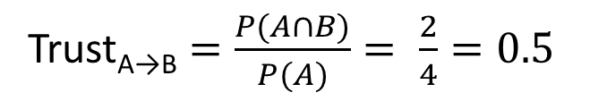
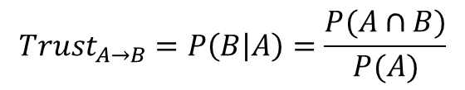
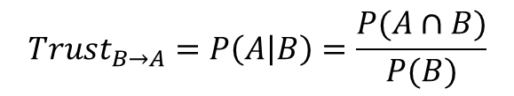

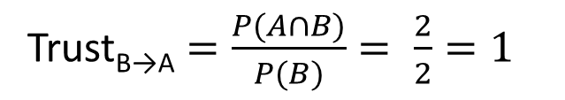
Our Approach
Naïve approach
A distinction between symmetric and asymmetric relationships
Conditional probability between two users
A
B
1
2
3
4
⊃
2
3
Jaccrad similarity coefficient $=\frac{P(A∩B)}{P(A∪B)}= \frac{2}{4}=0.5$
$${Trust}_{A→B}=P\left(B | A\right)=\frac{P(A∩B)}{P(A)}$$
$${Trust}_{B→A}=P\left(A | B\right)=\frac{P(A∩B)}{P(B)}$$
Trust_{A→B} $=\frac{P(A∩B)}{P(A)}= \frac{2}{4}=0.5$
Trust_{B→A} $=\frac{P(A∩B)}{P(B)}= \frac{2}{2}=1$

Slide 12
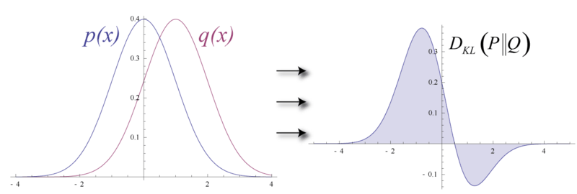

Our Approach
Kullback-Leibler divergence*
Asymmetric measure of the difference between two probability distributions
* Kullback and Leibler, “On Information and Sufficiency”, Annals of Mathematical Statistics 1951

Slide 13

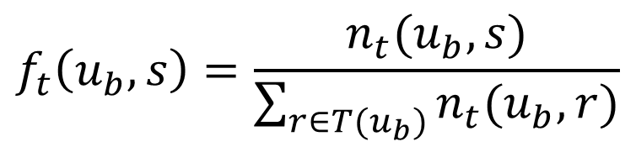
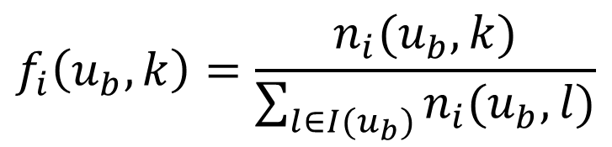

Our Approach
Kullback-Leibler divergence based method
KL divergence of tagged items and tags
Considering the weight of tagged items and tags
$$n_{i}\left(u_{b}, l\right)$$
: user u_{b}’s distribution of tagged item l
$$n_{t}\left(u_{b}, r\right)$$
: user u_{b}’s distribution of tag r
f_{i}(u_{b}, k) and f_{t}(u_{b}, s) are probability mass function
$$f_{i}\left(u_{b}, k\right)=\frac{n_{i}(u_{b},k)}{\sum_{l∈I(u_{b})}{n_{i}(u_{b}, l)}}$$
$$f_{t}\left(u_{b}, s\right)=\frac{n_{t}(u_{b},s)}{\sum_{r∈T(u_{b})}{n_{t}(u_{b}, r)}}$$
Normalization

Slide 14
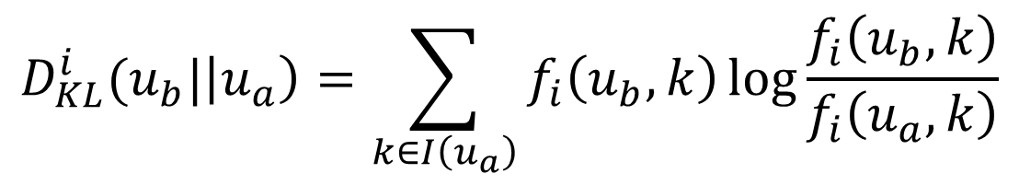
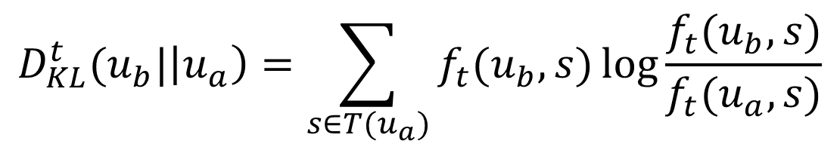
Our Approach
Kullback-Leibler divergence based method
Trust relationship from user a to user b over tagged items
$$D_{KL}^{i}(u_{b}|\left|u_{a}\right)=\sum_{k∈I\left(u_{a}\right)}{f_{i}\left(u_{b}, k\right)\log{\frac{f_{i}\left(u_{b}, k\right)}{f_{i}\left(u_{a}, k\right)}}}$$
Trust relationship from user a to user b over tags
$$D_{KL}^{t}(u_{b}|\left|u_{a}\right)=\sum_{s∈T(u_{a})}{f_{t}(u_{b},s)\log{\frac{f_{t}(u_{b}, s)}{f_{t}(u_{a}, s)}}}$$

Slide 15
Introduction
Recommender System
Trust based approach
User input
trust
trust
trust
Recommendation
Trustful users
item
item
item

Slide 16
Outline
Introduction
Related Work
Our Approach
Evaluation
Conclusion

Slide 17

Evaluation
Dataset
Last.fm (www.last.fm)
Music website
Tagging information
User-Artist-Tag
Evaluation measures
Precision, recall, and F-measure
Naïve approach vs. proposed approach
Collaborative filtering vs. proposed approach

Slide 18
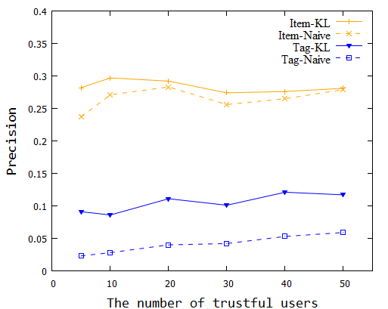
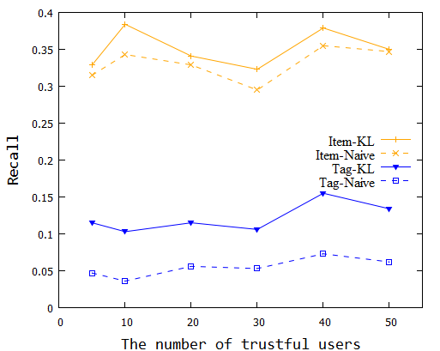
Evaluation
Extracting trust relationships
Naïve approach: conditional probability
Proposed approach: KL divergence
KL-divergence-based recommender system outperforms naïve approach
Tagged item-based recommender system outperforms tag-based one

Slide 19
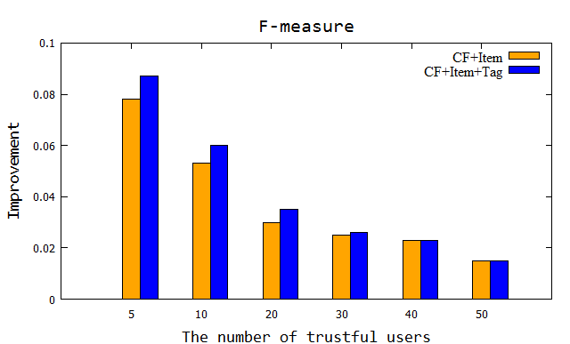
Evaluation
Compared to traditional collaborative filtering
Improvement of CF + tagged item
Improvement of CF + tagged item + tag
Trust relationships from tagged items and tags improve recommendation performance
Trust relationships alleviate sparsity problem effectively

Slide 20
Outline
Introduction
Related Work
Our Approach
Evaluation
Conclusion

Slide 21
Conclusion
We propose a recommender system based on implicit trust relationships from tags
Implicit trust relationships improve recommendation performance
Future work
A hybrid approach
Tag abstraction

Slide 22
Thank You

