Slide 1
Information Extraction: A Survey
Jan 6, 2012
Heegook Jun

Slide 2
Outline
Introduction
Information Extraction (IE)
IE System
Paper Overview
Related Work
Method & Contribution
Conclusion
Comparative Analysis
Consideration

Slide 3
Information Extraction
The goal of information extraction is to transform text into a structured format and reducing the information in a document to a tabular structure
Domain-specific information from free text
Searching and structuring
Filtering of irrelevant information

Slide 4
IR vs IE
IE is different from the more mature technology of information retrieval (IR)
IR retrieves relevant documents from collections
Probability theory and statistics have influenced
IE extracts relevant information from documents
Rule-based systems in computational linguistics and natural language processing

Slide 5
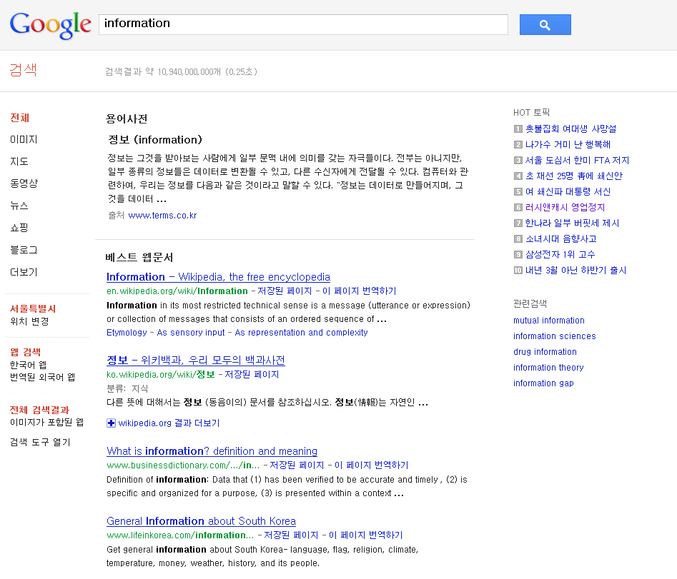
Information Retrieval

Slide 6


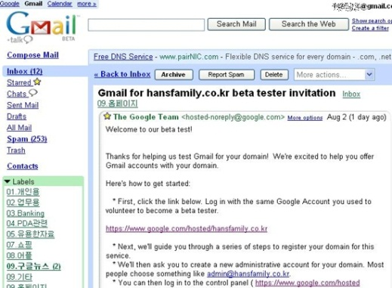
Information Extraction
<Name, Job>
Name | Job
Tom | Actor
Joe | Singer
Kim | Teacher
… | …

Slide 7
RDBMS
Query language
Name | Job
Tom | Actor
Joe | Singer
Kim | Teacher
… | …
Name | Job
Tom | Actor
Joe | Singer
Kim | Teacher
… | …
Structured Data
(Table, Domain, Schema,..)

Slide 8
Study Issues
INPUT
Unstructured Data
(Natural Language)
Processing

Slide 9
Web Based IE
Wrapper System
Program specific to that source which extracts the requested information and returns the result
Pattern Recognition System
Wrapper Induction System
Method for automatic wrapper generation

Slide 10
Wrapper Induction System
seed data
Web Pages
Simple input
Paper [1]
Wrapper
Induction
System
Wrapper
GUI
Supervised
Extracted Data
Paper [2]

Slide 11
Paper Overview
[1] | I4E: Interactive Investigation of Iterative Information Extraction | SIGMOD 2010
[2] | Automatic Rule Refinement for Information Extraction | VLDB 2010
[3] | Exploiting Content Redundancy for Web Information Extraction | VLDB 2010

Slide 12
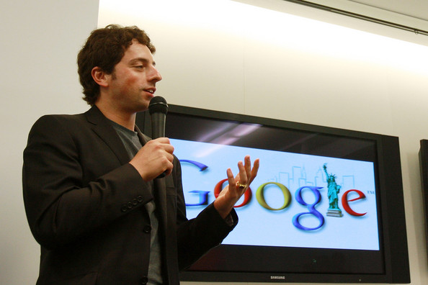
Related Work: DIPRE
DIPRE(Dual Iterative Pattern Expansion)
Sergey Brin, WebDB, 1998
It exploits this redundancy and inherent structure in the collection to extract the target relation with minimal training from a user

Slide 13

Related Work: DIPRE
seed data
Wrapper
Induction
System
Wrapper
Simple input
Seed Tuple
Context
Org | Location
MICROSOFT | REDMOND
…Computer servers at the Redmond-based Microsoft
…
president of Eastern’s flight attendants union, the past practice of Eastern’s parent, Houston-based Texas Air Co., has involved ultimatums to unions to accept the carrier’s terms..
…
Armonk-based IBM, currently
….
Construct Pattern
<String1> | -based | <String2>

Slide 14
Related Work: DIPRE
Web Pages
seed data
Wrapper
Induction
System
Wrapper
Simple input
Extracted Data
Pattern
Context
<String1> | -based | <String2>
…Computer servers at the Redmond-based Microsoft
…
president of Eastern’s flight attendants union, the past practice of Eastern’s parent, Houston-based Texas Air Co., has involved ultimatums to unions to accept the carrier’s terms..
…
Armonk-based IBM, currently
….
Result Table
Org | Location
MICROSOFT TEXAS AIR IBM | REDMOND HOUSTON ARMONK

Slide 15
Related Work: Snowball
E. Agichtein et al. ACM DL, 2000
Snowball introduces a strategy for evaluating the quality of the patterns and the tuples that are generated in each iteration of the extraction process
Snowball pattern uses vectors associating weights with terms
 |  | Pattern
Left | Tag1 | Middle | Tag2 | Right
{<the, 0.2>} | Org | { <-, 0.5>, <based, 0.5> } | Location | { }
<String1> | -based | <String2>

Slide 16
DIPRE vs. Snowball
(a) (b)
(a) Recall (b) Precision of DIPRE, Snowball as a function of the number of iterations

Slide 17

Paper [1]
I4E: Interactive Investigation of Iterative IE
Anish Das Sarma et al. In SIGMOD, 2010 [1]
Management of IE System
To reduce uncertainty in Information Extraction
I4E
Web Pages
Pattern
Tuples
IE
Extracted Data

Slide 18
Paper [1]
Explain
Keep track of what you’ve extracted and integrated
Why is a data item (not) present in the result?
Diagnose
What would happen if an operator was modified?
What is the impact of modifying input data (pattern)?
Repair
Fix the IE execution when you have feedback on output
Suggest potential problems automatically, to guide debugging

Slide 19
Enhanced Bipartite Graph (EBG)
I. Explain
II. Diagnose
III. Repair
Pattern
Tuple
p1 (0.7)
t1
p2 (0.5)
t2
t3
Threshold
Ƭp = 0.6
Threshold
Ƭp = 0.4
t4

Slide 20
Paper Overview
[1] | I4E: Interactive Investigation of Iterative Information Extraction | SIGMOD 2010
[2] | Automatic Rule Refinement for Information Extraction | VLDB 2010
[3] | Exploiting Content Redundancy for Web Information Extraction | VLDB 2010

Slide 21
Wrapper Induction System
seed data
Web Pages
Simple input
Paper [1]
Wrapper
Induction
System
Wrapper
GUI
Supervised
Extracted Data
Paper [2]

Slide 22
Related Work: SystemT
Declarative IE system based on an algebraic framework, to address both expressivity and performance issues
Web Pages
JAVA
XML
…
“AQL”
Based on SQL
GUI
Wrapper
Induction
System
Wrapper
Supervised
Extracted Data

Slide 23
Paper [2]
Automatic Rule Refinement for Information Extraction.
Bin Liu et al. In VLDB, 2010
This system automatically identifies candidate rule changes that would eliminate the false positives.

Slide 24
Paper [2]
AQL Input query (Like SQL)
R1: create view Phone as
Regex(‘d{3}-\d{4}’, Document, text);
R2: create view FirstNameCand as
Dictionary(‘first_names.dict’, Document, text);
R3: create view FirstName as
select * from FirstNameCand F
where Not(ContainsDict(‘street_suffix.dict’,
RightContextTok(F.match,1)));
…

Slide 25
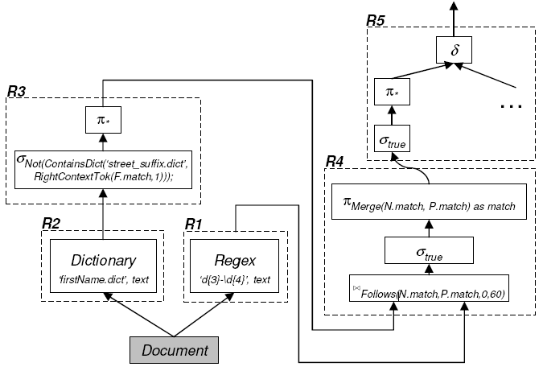
Paper [2]
This system presents canonical representation of rules

Slide 26
Paper Overview
[1] | I4E: Interactive Investigation of Iterative Information Extraction | SIGMOD 2010
[2] | Automatic Rule Refinement for Information Extraction | VLDB 2010
[3] | Exploiting Content Redundancy for Web Information Extraction | VLDB 2010

Slide 27

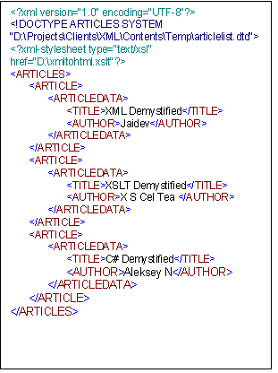
Data Structure
Unstructured Text
Semistructured Text
Structured Text
Astro Teller is the CEO and co-founder of BodyMedia. Astro holds a Ph.D. in Artificial Intelligence from Carnegie Mellon University, where he was inducted as a national Hertz fellow. His M.S. in symbolic and heuristic computation and B.S. in computer science are from Stanford University.
Paper [1, 2]
Paper [3]

Slide 28
Paper [3]
Exploiting Content Redundancy for Web IE
Pankaj Gulhane et al. In VLDB, 2010.
Exploit content redundancy by using extractions from one site to identify attribute values in the pages of overlapping entities in a different site
Reuse identified structure to extract attribute values from the remaining pages of the site

Slide 29
Paper [3]
Context
Seed Tuple
Beijing Bites
120 Lexington Ave
(between 28th and 29th St)
New York, NY 10016
Name | Address
Beijing Bites | 120 Lexington Avenue New York, NY 10016
Nearest Transit:
120 Lexington Avenue
New York, NY
Related Restaurants:
China Club
China Grill

Slide 30
Paper [3]
Context
Seed Tuple
Beijing Bites
120 Lexington Ave
(between 28th and 29th St)
New York, NY 10016
Name | Address
Beijing Bites | 120 Lexington Avenue New York, NY 10016
Nearest Transit:
120 Lexington Avenue
New York, NY
Related Restaurants:
China Club
China Grill

Slide 31
Paper [3]
Context
Seed Tuple
Beijing Bites
120 Lexington Ave
(between 28th and 29th St)
New York, NY 10016
Name | Address
Beijing Bites | 120 Lexington Avenue New York, NY 10016
Nearest Transit:
120 Lexington Avenue
New York, NY
Related Restaurants:
China Club
China Grill

Slide 32
Paper [3]
Context
Seed Tuple
Beijing Bites
120 Lexington Ave
(between 28th and 29th St)
New York, NY 10016
Name | Address
Beijing Bites | 120 Lexington Avenue New York, NY 10016
Nearest Transit:
120 Lexington Avenue
New York, NY
Related Restaurants:
China Club
China Grill

Slide 33
Paper [3]
Context
Seed Tuple
Beijing Bites
120 Lexington Ave
(between 28th and 29th St)
New York, NY 10016
Name | Address
Beijing Bites | 120 Lexington Avenue New York, NY 10016
Nearest Transit:
120 Lexington Avenue
New York, NY
Related Restaurants:
China Club
China Grill
Pattern
<Name> | <Address1> | Ignore “( * )“ | <Address2>

Slide 34
Conclusion
Information extraction can be performed on structured, semistructured and unstructured text
Unstructured text techniques from natural language processing are often used
Wrapper System is used for Web Based IE
Management of extraction systems are starting to appear

Slide 35
Comparative Analysis
Paper [1] | Paper [2] | Paper [3]
Web based IE | Web based IE | Web based IE
Unstructured text | Unstructured text | Semistructured text
Minimize manual work | Maximize user’s need | Minimize manual work
Simple input | Intuitive SQL like query | Simple input
Management System | Management System
Bipartite Graph Data Structure | Provenance Graph Data Structure

Slide 36
Consideration
Primary Goal is to extract right information
IE System based on Machine Learning
To handle natural language
They provide additional DB concepts
Data Lineage (Data Provenance)
For Managing IE System
Notes:
이전 논문과 달리 이 세 논 문 VLDB, SIGMOD에 채택된 이유
정성적 접근
테크닉: IE에 자료구조를 두어 전략적으로 Managing
(cf: Phantom phenomenon을 상위 차원 끌어올려 Index해결)

