Slide 1

Tag Research - Bibliography
IDB LAB ⊃
WEB 2.0 team ∋
Chung-soo Jang

Slide 2
Contents
  Tag Tutorial
  Technical Map
  Bibliography
    Tag’s effects
    Measures related to tag
    Top-k query
    Similarity search
    Evaluation method
  Introduction
  Motivation
  My Approach
  Schedule

Slide 3
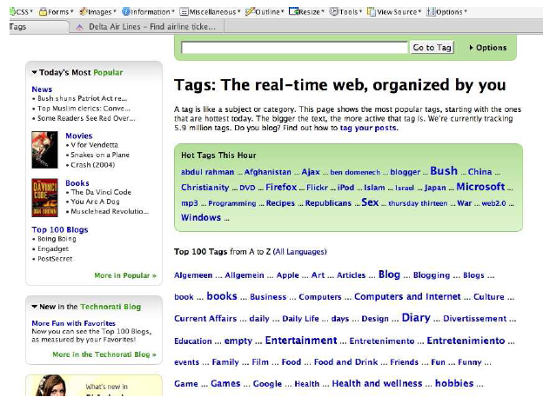
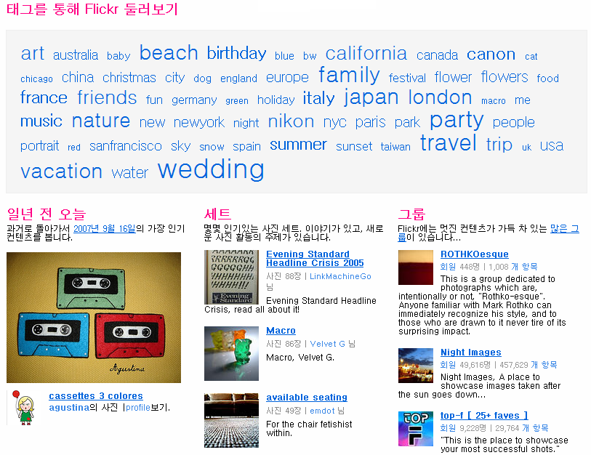
What is Tag?
  Tag
    A short word used to represent post
    Label easy to use and intuitive
    Popular annotation method

Slide 4




Objectives of Tag Research
To understand the effectiveness of tag
Utilizing tag’s properties
Toward more better knowledge management

Slide 5
Contents
  Tag Tutorial
  Technical Research Map
  Bibliography
    Tag’s effects
    Measures related to tag
    Top-k query
    Similarity search
    Evaluation method
  Introduction
  Motivation
  My Approach
  Schedule

Slide 6
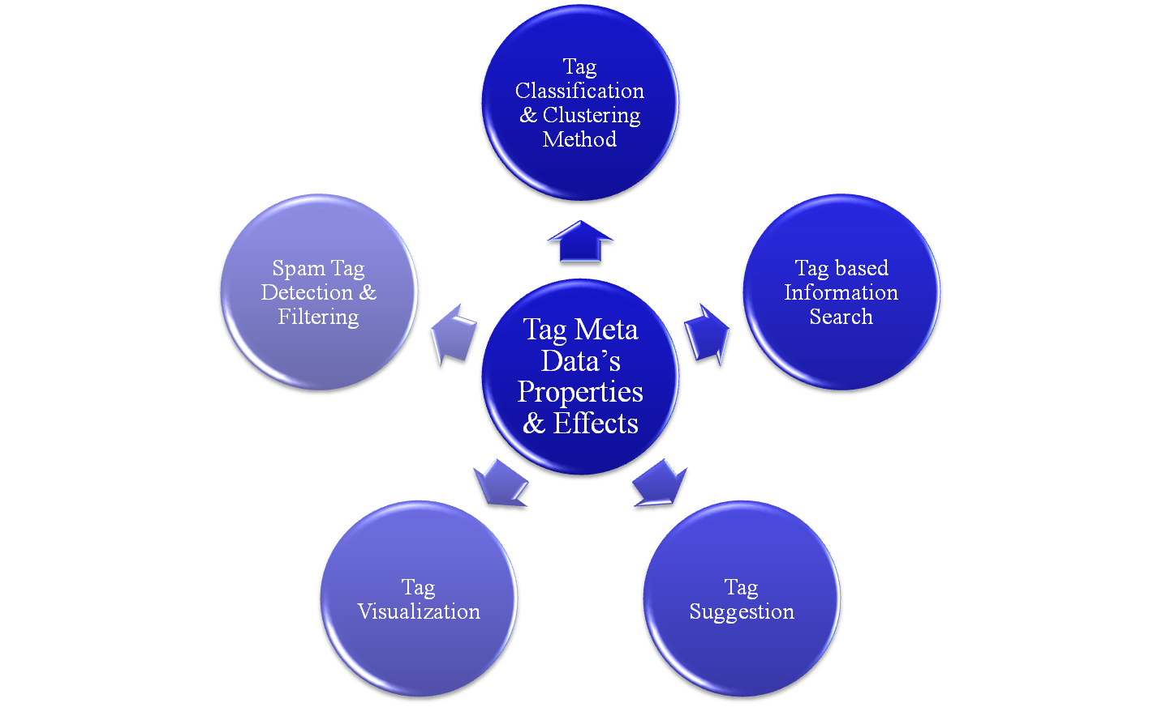
Technical Research Map (1/4)

Slide 7
Technical Research Map (2/4)
  Tag Meta Data’s Properties & Effects
    Usage patterns of collaborative tagging systems, Journal of Information Science 2006
  Tag Classification and Tag Clustering Method
    Improved Annotation of the Blogosphere via Autotagging and Hierarchcal Clustering, WWW 2006
    Tag-based Social Interest Discovery, WWW 2008
  Tag based Information Search
    Optimizing Web Search Using Social Annotations, WWW 2006
    Can Social Bookmarking Enhance Search in the Web?, JCDL 2007
    Can Social Bookmarking Improve Web Search?, WSDM 2008
Notes:
그 동안 읽었던 My reading list입니다.

Slide 8
Technical Research Map (3/4)
  Tag based Information Search
    Information Retrieval in Folksonomies: Search and Ranking, ESWC(European Semantic Web) 2006
    Efficient Network-Aware Search in Collaborative Tagging Sites, VLDB 2008
    Efficient Top-k Querying over Social – Tagging Neworks, SIGIR 2008
  Tag Suggestion
    Towards the semantic web: Collaborative tag suggestions, WWW 2006
    Autotag: collaborative approach to automated tag assignment for weblog posts, WWW 2006
    Social Tag Prediction, SIGIR 2008

Slide 9
Technical Research Map (4/4)
  Spam Tag Detection & Filtering
    Combating Spam in Tagging Systems, AIRWeb 2007
    Collaborative Blog Spam Filtering Using Adaptive Percolation Search, WWW 2006
  Tag Visualization
    Visualizing Tags over Time, WWW 2006
    Tag-Cloud Drawing: Algorithms for Cloud Visualization, WWW 2007
    Seeking Stable Clusters in the Blogosphere, VLDB 2007
    Topigraphy: Visualization for Large-scale Tag Clouds, WWW 2008
    Ad-Hoc Aggregations of Ranked Lists in the Presence of Hierarchies, SIGMOD 2008

Slide 10
My Research Focus
Tag based Information Search
  Efficient search for tag annotated document
    Similarity problem
    Top-k ranking problem
  Tag Visualization
  Tag cloud visualization improvement
    Tag cloud evolution
      Time interval query processing
    Tag cloud visualization in limited space
      Zoom operation support: tag packing, unpacking
In this time, at first, I’ll treat this
Notes:
아쉽지만 tag visualization은 다음 기회에…..

Slide 11
Contents
  Tag Tutorial
  Technical Map
  Bibliography
    Tag’s effects
    Measures related to tag
    Top-k query
    Similarity search
    Evaluation method
  Introduction
  Motivation
  My Approach
  Schedule
Notes:
Tag based Information Search를 개선하기 위한 것이 제 목적이고
관련된 리딩 페이퍼들을 중요한 것들만 나열했습니다.

Slide 12
Improved Annotation of the Blogosphere via Autotagging and Hierarchcal Clustering (1/3)
  Authors, Organization, Journal, Year
    Christopher H.Brooks, …
    Computer science department ,university of sanfrancisco
    ACM WWW 2006
  Objectives
    Popular Tag data but a few research about tag’s effects
      What tasks are tags useful for?
      Do tags help as an information retrieval mechanism?
    This survey describes tag’s characteristics and answers above questions

Slide 13
Improved Annotation of the Blogosphere via Autotagging and Hierarchcal Clustering (2/3)
  Results of Survey
    Three clear uses
      Individual organization, Shared annotation of articles into category, Shared annotation as an aid to searching
    Representational Power
      Opposite, more general/speciﬁc, synonym
    Tags as an Information Retrieval Mechanism
      All articles that share a tag are assigned to a tag cluster
        Articles with the same tag are somewhat similar
        Tagging seems most effective at grouping articles into broad topical bins.
        Not very effective as a mechanism for locating particular articles

Slide 14
Improved Annotation of the Blogosphere via Autotagging and Hierarchcal Clustering (3/3)
  Conclusion
    Tags are very attractive due to their simplicity and ease of use.
    Limited representational power makes them most useful for grouping into large categories.
    By themselves, tags do not seem very effective as a search mechanism.
    Tags can be grouped using clustering techniques, which indicates that relationships can be induced automatically.

Slide 15
Tag-based Social Interest Discovery (1/3)
  Authors, Organization, Journal, Year
    Xin Li, Lei Guo, Yihong Zhao
    Yahoo! Inc
    ACM WWW, 2008
  Motivation
    Through key observation of tag, exploiting the human judgment contained in tags to discover social interests

Slide 16
Tag-based Social Interest Discovery (2/3)
Key observation of tag
Approach
Topic discovery
  Frequently used multiple tags
  Key: (user, URL), Item: (tags)
  Hot topics: {food, recipes}, {apple, …}, … (support: 30)
Clustering
Rich and large
High level abstraction than keyword
For each URL, much smaller than unique keywords
Stable vocabulary
More concise and closer to the user’s understanding
Good candidate for social interest discovery
for all topic T ⋲ T do T.user ← ∅ ; T.url ← ∅ ; end for for all post P ⋲ P do for all topic T of P do T.user←T.user⊔{P.user} T.url←T.url⊔{P.url} end for end for
T2
T1
users
users
users
users
users
users
users
T4
users
T3

Slide 17
Tag-based Social Interest Discovery (3/3)
  Conclusion
    This paper proposed a tag-based social interest discovery approach
    Through some experiments, the authors justified that user-generated tags are effective to represent user interests
    They implemented a system to discovery common interest topics in social networks such as del.icio.us

Slide 18
Can Social Bookmarking Enhance Search in the Web? (1/3)
  Authors, Organization, Journal, Year
    Satoshi Nakamura, Katsumi Tanaka, …
    Department of Social Informatics, Kyoto University
    ACM JCDL 2007
  Motivation
    The previous search method’s limitations in social bookmarking
    The emergent of social bookmarking → a potential for improving search.
      SBRank: The popularity of a Web page = number of users voting for the page
    Authors analyzed the potential of a new web search
      Comparative analysis between PageRank and SBRank
      Support of complex queries (temporal search, sentimental search)

Slide 19
Can Social Bookmarking Enhance Search in the Web? (2/3)
  Analytical study
    Social bookmarking sites has a high number of pages with low PageRank
      56.1% of URLs have PageRank value equal to 0
      Finding these pages using conventional search engines is relatively difficult → SBRank as good candidate
    Temporal Analysis
      67% of pages reached their peak popularity levels in the first 10 days
      PageRank is not effective in terms of fresh information retrieval
    Sentimental Analysis
      Tags contain sentiments → Sentimental-aware search
        scary, funny, stupid etc.

Slide 20
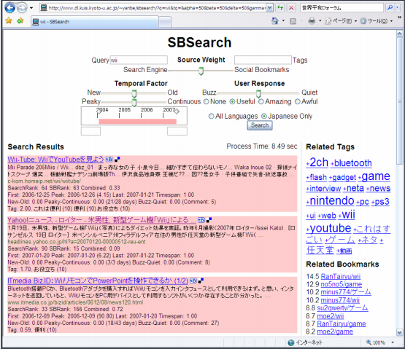
Can Social Bookmarking Enhance Search in the Web? (3/3)
  Result
    Authors implemented the prototype search systems and demonstrate its search capabilities
    The best method: Hybrid method
      SBRank+PageRank in social bookmarking
      Page quality measure can be improved thanks to incorporation
      More precise relevance estimation
      Feasible temporal-aware queries (← timestamp of tag data)
      Sentimental-aware queries

Slide 21
Can Social Improve Web Search? (1/3)
  Authors, Organization, Journal, Year
    Paul Heymann, Hector Garcia-Molina, …
    Department of computer science, standford university
    ACM WSDM, 2008
  Aim of survey
    To quantify the size of user-generated tag data source
    To determine the potential impact tag data may have on improving web search

Slide 22
Can Social Improve Web Search? (2/3)
  Analysis of tag data’s effects
Positive factors
Negative factors
About URLs
del.icio.us user post interesting pages that are actively updated or have been recently created
As a small data source for new web pages and to help crawl ordering
Disproportionately common in search results compared to their coverage
About URLs
The number of posts per day is relatively small
The number of total posts is relatively small (⬄ the web as a whole)
About tags
A substantial proportion of tags are obvious in context, and many tagged pages would be discovered by a search engine
Domain are often highly correlated with particular tags and vice versa. ( For classification, it may be more efficient to train librarians to label domains than to ask users to tag pages )
About tags
del.icio.us may be able to help with queries where tags overlap with query terms
On the whole accurate

Slide 23
Can Social Improve Web Search? (3/3)
  Discussion & Summary
    Social book marking’s properties as a data source
      Positive
        Actively updated
        Prominent in search results
        Given tag, tag improves the crawl ordering of search engine
      Negative
        Small amounts of data on the scale of the web
        → Not enough to impact the crawl ordering of search engine
        The tags are often determined by context
        → Not more useful than a full text search
        Many tags are determined by domain of the URL

Slide 24
Contents
  Tag Tutorial
  Technical Map
  Bibliography
    Tag’s effects
    Measures related to tag
    Top-k query
    Similarity search
    Evaluation method
  Introduction
  Motivation
  My Approach
  Schedule

Slide 25
SimRank: A Measure of Structural-Context Similarity(1/3)
  Authors, Organization, Journal&Conference, Year
    Jennifer Widom, Glen Jeh
    Standford University
    ACM SIGKDD, 2002
  Motivation
    Many domains need approaches that exploits the object-to-object relationships for similarity calculation
    The authors present an algorithm to compute similarity scores based on the structural context in which they appear

Slide 26






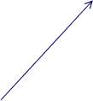






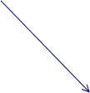


SimRank: A Measure of Structural-Context Similarity (2/3)
  Approach
    SimRank
  [G]
    Iterative fixed point algorithm
    Intuition: Similar objects are related to similar objects
    For A≠B,
    For c≠d,
    if (A=B), s(A,B)=1, and if(c=d), s(c,d)=1
    Required Space
    Running Time
Sugar
A
frosting
B
eggs
2
flour
  [G ]
{sugar, frosting}
0.619
{sugar, eggs}
{A, A}
0.619
1
{sugar, flour}
0.437
{A, B}
{frosting, frosting}
0.547
1
{frosting, eggs}
{B, B}
0.619
1
{frosting, flour}
0.619
{eggs, eggs}
1
0.619
{eggs, flour}

Slide 27
SimRank: A Measure of Structural-Context Similarity (3/3)
  Results
    Experiments on two representative data sets.
    Results confirm the applicability of the algorithm in these domains, showing significant improvement over simpler co-citation measures.

Slide 28
Optimizing Web Search Using Social Annotations (1/3)
  Authors, Organization, Journal&Conference, Year
    Shenghua Bao, etc.
    Shanghai JiaoTong University, IBM China Research Lab
    ACM WWW, 2007
  Motivation
    The authors studied the problem of utilizing social annotations for better web search result
    It optimized web search by using social annotation from the following two aspects

Slide 29
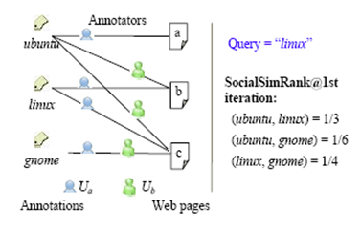
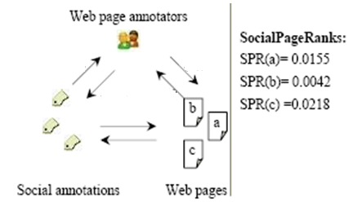



Optimizing Web Search Using Social Annotations (2/3)
  Approach & Implementation
  Similarity Ranking
  Static Ranking
  Annotation
    Good summary of web page
    New metadata for the similarity
  SocialSimRank(SSR)
  The amount of annotation
    Popularity
    Quality
  SocialPageRank(SPR)

Slide 30
Optimizing Web Search Using Social Annotations (3/3)
  Results
    The novel problem of integrating social annotations into web search
    Tag’s effects as good summary and good indicator of the quality of web pages
    Both SPR and SSR could benefit web search significantly
      Term matching utilizing SSR improves the performance of web search
      In environment given tags, SPR is better than PageRank

Slide 31
Information Retrieval in Folksonomies: Search and Ranking (1/3)
  Authors, Organization, Journal&Conference, Year
    Andreas Hothos, Christoph Schmitz, …
    Department of Mathematics and Computer Science, University of Kassel
    The European Semantic Web Conference 2006
  Motivation
    The research question is how to provide suitable ranking mechanism exploiting folksonomy structure
    This paper proposes a formal model for folksnomies
    The authors present a new algorithm, called FolkRank
Notes:
In social resource sharing systems, the resources are displayed by order of date.
But a more sophisticated notion of relevance – which could be used for ranking- is still missing
In such systems, Folksonomy has been considered as approaches to overcome knowledge acquisition
The research question is how to provide suitable ranking mechanism exploiting folksonomy structure
This paper proposes a formal model for folksnomies
The authors present a new algorithm, called FolkRank

Slide 32
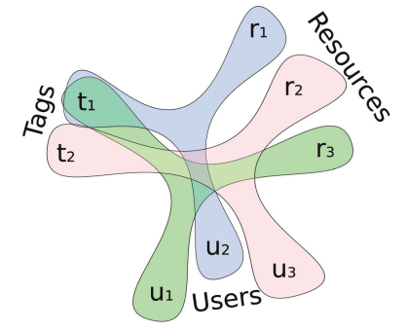
Information Retrieval in Folksonomies: Search and Ranking (2/3)
  Approach & Implementation
    Formal Model for Folksonomy & FolkRank
    The basic notion: A resource which is tagged with important tags by important users becomes important. The same holds, symmetrically, for tags and users.
0.9
0.1
0.2
0.8
0.2
0.1
0.3
0.6
0.8
Random surfer
0.2
Tag
Resource
User

Slide 33
Information Retrieval in Folksonomies: Search and Ranking (3/3)
  Results
    Empirical user evaluation
      FolkRank yields a set of related users and resources for a given tag.

Slide 34
Contents
  Tag Tutorial
  Technical Map
  Bibliography
    Tag’s effects
    Measures related to tag
    Top-k query
    Similarity search
    Evaluation method
  Introduction
  Motivation
  My Approach
  Schedule

Slide 35
Optimal aggregation algorithms for middleware (1/3)
  Authors, Organization, Journal&Conference, Year
    Ronald Fagin, Amnon Lotem, and Moni Naor
    IBM Almaden Research Center, University Maryand-Colleage Park, Weizmann Institute of Science Israel
    Journal of Computer and System Sciences, 2003
  Motivation
    In multimedia database or distributed database, an object R has m attributes and someone wants to find k objects whose overall scores are the highest
    Fagin proposed optimal method to process data in this context

Slide 36
Optimal aggregation algorithms for middleware (2/3)
  ΤΑ Algorithm
Ln: sorted array in descending order
τ=t(x1, x2, x3)
  t: monotone aggregation function
Random access and sequential access are allowed
Naive
  Full scan
TA
  No full scan
  Stop condition t(D)≥τ
    Stop when the grade of the last object in Y is equal or larger than the threshold value
L1
L2
L3
n
j
c
e
x
h
u
k
p
x1
x2
x3

Slide 37
Optimal aggregation algorithms for middleware (3/3)
  Results
    TA is instance optimal
    Advantages: The number of object accessed is minimized

Slide 38







Efficient Network-Aware Search in Collaborative Tagging Sites (1/4)
  Authors, Organization, Journal&Conference,Year
    Sihem Amer Yahia, Michael Benedikt, …
    Yahoo! Research, Oxford University, Columbia University, University of British Columbia
    ACM VLDB, 2008
  Motivation
    Given a query Q issued by a seeker u, we wish to efficiently determine the top k items, i.e., the k items with highest over-all score.
    Query is a set of tags
      Q = {t1,t2,…,tn}
    For a seeker u, a tag t, and a item i
      score(i,u,t) =
      f( | Network(u) ∧
      {v, s.t. Tagged(v,i,t)} |)
    score(i,u,Q) = g(score(i,u,t1),
    score(i,u,t2),…, score(i,u, tn))
shopping
shopping
Jane
Ann
Notes:
When some people want to know the most hot item(event, chatter, …) between their friends, tags can play a important role.
We need a system that enables us to find common hot issues between friends, effectively
This paper introduces such system

Slide 39
Efficient Network-Aware Search in Collaborative Tagging Sites (2/4)
  Approach
  Naïve solution: Exact
  Score Upper-Bounds (GUB)
  Standard Top-k Processing: Fagin style TA algorithm
  Strong: fast processing time
  Weak: high space overhead
  1 list per tag
  Strong: low space overhead
  Weak: slow processing time
tag = shoes
tag = shopping
Global Upper-Bound (GUB): 1 list per tag
item
score
item
score
item
score
item
score
item
taggers
upper-bound
i1
30
i5
99
i1
73
i5
53
Miguel,…
i8
29
i2
80
i2
65
i9
36
i1
73
i4
27
i8
78
i3
62
i2
30
i2
Kath, …
65
i2
25
i7
75
i4
40
i6
15
i3
Sam, …
62
i3
23
i1
72
i5
39
i5
14
i5
Miguel, …
53
i6
20
i6
63
i6
18
i8
10
i4
Peter, …
40
i7
15
i4
60
i7
16
i7
10
i9
Jane, …
36
i9
13
i3
50
i8
16
i3
5
i6
Mary, …
18
seeker Jane
seeker Ann
seeker Jane
seeker Ann
i7
Miguel, …
16
i8
Kath, …
16
both seekers

Slide 40
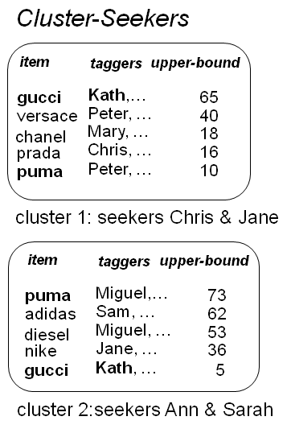
Efficient Network-Aware Search in Collaborative Tagging Sites (3/4)
  Approach
  Cluster - Seekers
  Cluster - Tagger
item
taggers
UB
item
taggers
UB
prada
…
5
nike
…
4
louis v
…
4
diesel
…
3
puma
…
4
reebok
…
2
gucci
…
3
item
taggers
UB
puma
…
3
gucci
…
3
adidas
…
2
diesel
…
1

Slide 41
Efficient Network-Aware Search in Collaborative Tagging Sites (4/4)
  Result
    Space: GUB> Cluster Taggers > Cluster Seeker > Naïve
    Time: Naïve>Cluster Seeker >Cluster tagger>GUB
  Contribution
    Formalize the problem of Network-Aware Search
    Adapt known top-k algorithms to Network-Aware Search, by using score upper-bounds
    Refine score upper-bounds based on the user’s network and tagging behavior

Slide 42
Contents
  Tag Tutorial
  Technical Map
  Bibliography
    Tag’s effects
    Measures related to tag
    Top-k query
    Similarity search
    Evaluation method
  Introduction
  Motivation
  Schedule

Slide 43
Approximate Nearest Neighbors:
Towards Removing the Curse of Dimensionality (1/3)
  Authors, Organization, Journal&Conference,Year
    Piotr Indyk, Rajeev Motwani, …
    Department of Computer Science Stanford University
    ACM VLDB, 2008
  Motivation
    The nearest neighbor problem
      Given a set of n points P={p1, ..., pn} in metrix space, preprocess P so as to efficiently answer queries which require finding the point in P closest to a query point q ∈X
    Despite decades of effort, the current solutions are far from satisfactory
    The authors provided the algorithm that improves the results
    Its key ingredient is the notion of locality-sensitive hashing

Slide 44
Approximate Nearest Neighbors:
Towards Removing the Curse of Dimensionality (2/3)
Approach
(r, cr, p1, p2)-sensitive
Applying LSH
If D(q, p) < r, then Pr[h(q)=h(p)] >= p1
If D(q, p) > cr, then Pr[h(q)=h(p)] <= p2
Basic idea: closer objects have higer collision probability
W: slot size
h(x): hash function
r
cr
W
W
W
Slot 1
Slot 2
Slot 3

Slide 45
Approximate Nearest Neighbors: Towards Removing the Curse of Dimensionality (3/3)
  Result
    Experimental results indicate that our first algorithm offers orders of magnitude improvement on running times over real data sets
    This paper gives applications to several domains

Slide 46
Contents
  Tag Tutorial
  Technical Map
  Bibliography
    Tag’s effects
    Measures related to tag
    Top-k query
    Similarity search
    Evaluation method
  Introduction
  Motivation
  Schedule

Slide 47
Evaluating Strategies for Similarity Search on the Web (1/3)
  Authors, Organization, Journal&Conference,Year
    Taher H. Haveliwala, Aristides Gionis, Dan Klein, Piotr Indyk
    Laboratory of Computer Science Cambridge MIT, Computer Science Department Stanford University
    ACM WWW, 2002
  Motivation
    Given a small number of similarity search strategies, one might imagine comparing their relative quality with user feedback
    However user studies can have significant cost (time, resources)
    In this situation, it is extremely desirable to automate strategy comparisons and parameter selection
    Authors developed an automated evaluation methodology

Slide 48
Evaluating Strategies for Similarity Search on the Web (2/3)
  Proposed Methodology
Directory vs. Strategy
Comparing two orderings
  Open Directory → Similarity judgements
  (directory, query) → Similarity Ordering
Computers
query
Computers
Software
ODP
xxx.sss.com
www.afd.com
www.ooo.co.kr
www.sdfs.com
Strategy θ(i)
x
x

Slide 49
Evaluating Strategies for Similarity Search on the Web (3/3)
  Conclusion
    The authors proposed a automated evaluating strategy
    It compare similarity ordering by parameter setting
    This paper’s method is nice and fair

Slide 50
Contents
  Tag Tutorial
  Technical Map
  Bibliography
    Tag’s effects
    Measures related to tag
    Top-k query
    Similarity search
  Introduction
  Motivation
  Schedule

Slide 51




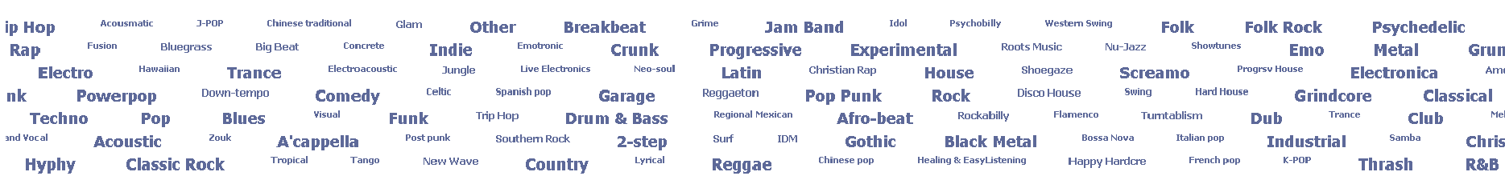
Introduction
The popularity of collaborative tagging site
  Many tag data
  Incredible growth speed
  Various users
An important tag data as meta data
Requirements of tag data management
Notes:
최근 web2.0기술의 출현과 함께 del.icio.us, CiteULike, Flickr, Snapfish, YouTube 같은 collaborative tagging site들이 인기를 끌고 있다. 다양한 배경의 유저들이 collaborative tagging site들에서, 믿을 수 없는 속도로 annotation을 달고 있으며, 다양하고 많은 양의 tag data들을 생산하고 있다. 특별히, tag data들은 컨텐츠 관리와 정보검색 분야에 있어 유용한 메타 데이터로서 여겨지고 있다. 웹 리소스의 분류와 웹 검색 향상에서 tag 데이터의 효과를 분석한 기존 연구들이 메타 데이터로서 tag data의 역할을 말해주고 있으며 이들 연구들은 대중에 의해 수렴된 지식으로서, tag data가 인터넷 검색 처리에서 social behavior들의 통합에 대한 가능성을 제시해주고 있다. 이에 본 논문에서는 분류와 검색에 있어 유용한 메타데이터인 tag를 이용해, 정보검색에서 k개의 유사한 item(문서, 웹페이지, 주석된 사진, 기타 웹 리소스)을 검색하는 방법을 제시하고자 한다.

Slide 52
Contents
  Tag Tutorial
  Technical Map
  Bibliography
    Tag’s effects
    Measures related to tag
    Top-k query
    Evaluation method
  Introduction
  Motivation
  Schedule

Slide 53
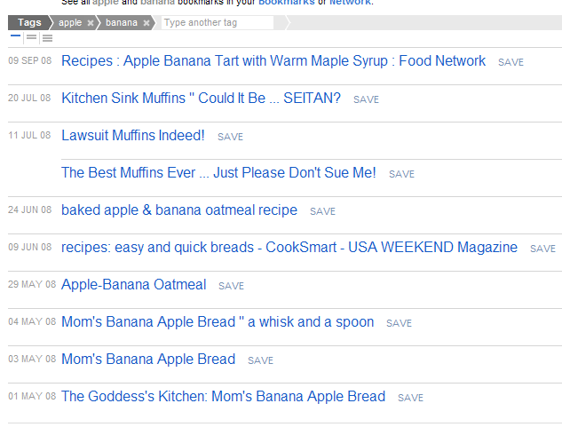
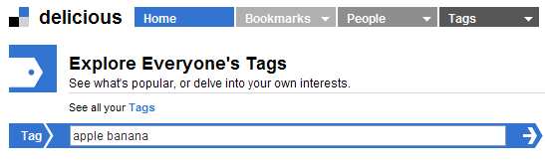
Motivation (1/5)
Limited search support of existing tagging systems
  Usually ordered by date (flickr, delicious, citeUlike, etc.)
  Needs about notion of ‘relevance’
    Ranking
      Short text snippet: ranking schemes such as TF/IDF are not feasible
      Good popularity measures are needed
    Similarity
      Naïve simple tag-term matching is not feasible
      Good similarity measures are needed
    In previous works, good measures were recommended

Slide 54
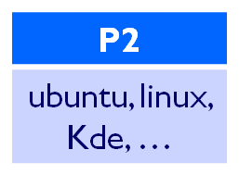
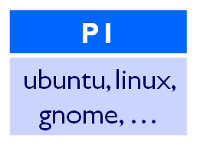
Motivation (2/5)
Web similarity search
  Given a query Web page q, return Web pages that are “similar” q
  Possible scenario of similarity search
{ Query}
www. moneycentral.com
www.pathfinder.com/money
www.moneyworld.co.kr
…
{ Answer}
What are items related “linux”?
When it was known that item P1 is similar to item P2, what are other items similar to P1?
→ Similarity search should find answers about above question

Slide 55
Motivation (3/5)
Web similarity search
  Two major issues
    Choose the strategy Θ → focus of previous works
      It best captures the notion of Web-page “similarity”
      Several similarity measures have been known.
    Scaling up the chosen strategy to repository of millions of pages → My focus

Slide 56
Motivation (4/5)
Problem of scaling up similarity search
Problem of term selection
Example of similarity search
For similarity search, # of accesses to inverted index equals to inverted index equals # of terms in the query page
Many of these terms could have huge postings list in the inverted index
Inverted index lookup is not manageable
ipod
Fruit
Apple
…
…
…
Mac
d1 | d2 | … | d8 | d9
d8 | d9 | … | d28 | d34
d6 | d9 | … | d16 | d79
D4 | d23 | … | d54 | d77

Slide 57
Motivation (5/5)
Existing Problem solutions
  Naïve approach
    The problem of scaling up
    Many merge operations about inverted index
  LSH method
    A known best solution
    But, still term selection problem
      Hash function dependent
Set A:
{mouse, dog}
Signature = dog
Sim(A,B)
Round 1:
ordering = [cat, dog,
mouse, banana]
Set B:
{cat, mouse}
Signature = cat

Slide 58
Contents
  Tag Tutorial
  Technical Map
  Bibliography
    Tag’s effects
    Measures related to tag
    Top-k query
    Evaluation method
  Introduction
  Motivation
  My Approach
  Schedule

Slide 59
My Approach (1/3)
Strategy 1: Exploiting tag metadata as term selection candidate
Given tag: Fruit, Apple, …
Term-term similarity
  Progressive tag expansion
Term-Doc similarity
Clustering by MaxSim
  Cluster skipping
Adaption to TA
Document filtering (by Michael)
  Tag Expansion
ipod
Fruit
Apple
…
…
…
Mac
d1 | d2 | … | d8 | d9
Apple
d8 | d9 | … | d28 | d34
MaxSim
d6 | d9 | … | d16 | d79
D 1
Tag {apple, fruit, …}
D4 | d23 | … | d54 | d77
sorted as term-doc similarity

Slide 60
My Approach (2/3)
Strategy 2: Using tag clustering
Given tag: Fruit, Apple, …
Clustering documents in document list with tags
  Finding cluster is hard
Term-cluster similarity
  Cluster skipping
Adaption to TA
ipod
Fruit
Apple
…
…
…
Mac
d1 | d2 | … | d8 | d9
d8 | d9 | … | d28 | d34
d6 | d9 | … | d16 | d79
D4 | d23 | … | d54 | d77
sorted as term-cluster centronoid

Slide 61
My Approach (3/3)
Evaluating strategy
  Which tag adaption strategy is best?
  Evaluation ingredients
    Dimension
    Retrieval time
    Precision
    Space

Slide 62
Contents
  Tag Tutorial
  Technical Map
  Bibliography
    Tag’s effects
    Measures related to tag
    Top-k query
    Evaluation method
  Introduction
  Motivation
  My Approach
  Schedule

Slide 63
Schedule
~ next week
  Strengthening my approach
  Cluster skipping, threshhold value definition
~ October 1 week
  Term-term, term-doc similarity calculation
  Data collection for experiment
~ October 3 week
  LSH implementation, adapted-TA algorithm implementation, Experiment
~ November 30th
  Writing paper

